Slide 1

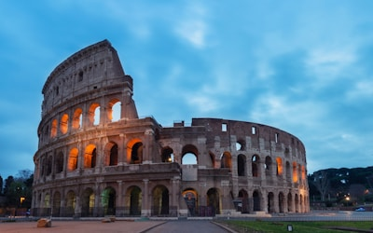
WanderWorld
Travel Website Project
Name: (Irsa Hareem, Eman Saeed, Muhammad Faiq Shah)
Roll No: (2600008,2600010,249563)
Subject: ICT Lab - Front end Website Development

Slide 2
Explore The World
With WanderWorld
Discover breathtaking destinations, plan your dream trips, and create unforgettable memories
Your journey starts here - explore, dream, and travel smarter.

Slide 3

Introduction
WanderWorld is a modern travel website designed to help users explore destinations around the world easily.
It provides travel inspiration, destination details, and contact options in a simple and user-friendly interface.
The goal of this project is to create a visually attractive and easy-to-use travel platform.
Problem Statement
Overloaded with information
Difficult to navigate
Not visually engaging

Slide 4
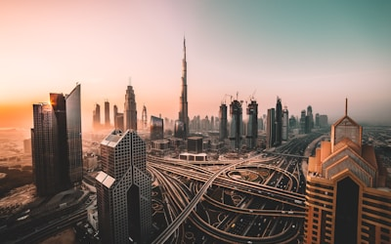
Project Objective
To create a simple and attractive travel website
To provide easy navigation between pages
To display popular travel destinations
To improve user experience through clean UI design
Features of Website
Home Page with hero section
Travel information cards
Popular destinations list
Simple navigation system

Slide 5
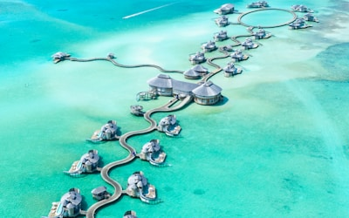
Pages Description
Home Page:
Hero section with tagline
“Why Travel With Us” feature cards
Destinations Page:
List of popular travel destinations
Images, descriptions, and pricing
Contact Page:
Contact form (Name, Email, Message)
Company contact details

Slide 6

Design Concept (UI/UX)
Clean and minimal layout
Large visuals for engagement
Simple navigation system
Card-based UI for destinations
User-friendly structure

Slide 7

Conclusion
WanderWorld is a simple but effective travel website project that demonstrates web development fundamentals using HTML, CSS, and JavaScript.
It focuses on user experience, clean design, and easy navigation, making it a strong foundation for a real-world travel platform.
Thank You!
Does anyone have any questions?

