Slide 1
Multigrate
Single-Cell Multi-Omic Data Integration
Paper
Lotfollahi M., Litinetskaya A. & Theis F.J.
Venue
ICML Workshop on Computational Biology, 2021
Presented by
Faiqa Zarar | Pukhraj Tahir
Repository
github.com/FaiqaZarar/multigrate-multiomics

Slide 2
What is Multigrate?
Definition
Multigrate is an unsupervised deep generative model — a multi-view variational autoencoder — that learns a unified low-dimensional representation of cells from multiple biological measurement types simultaneously, while correcting for technical batch effects and handling missing modality data in a principled mathematical way.
Why is this needed?
The Challenge
Multi-omic technologies generate rich datasets but combining heterogeneous measurement types is non-trivial due to batch effects, incomplete data, and differing feature spaces.
Prior Methods
Existing methods are constrained to specific technology pairings, rely on linear models, or require complete measurements — all of which fail on real-world datasets.
Multigrate's Contribution
A single unified framework simultaneously addressing batch correction, missing modality handling, and arbitrary modality pairing within one principled generative model.

Slide 3
Single-Cell Multi-Omic Modalities
The three measurement types Multigrate integrates
RNA-seq — Transcriptomic Profiling
Quantifies mRNA abundance across the genome at single-cell resolution. Provides a snapshot of gene expression activity — which genes are actively transcribed. The most widely used single-cell modality.
Preprocessing: normalise to 10,000 counts per cell, log1p transform, select top 4,000 HVGs per batch.
CITE-seq — RNA + Surface Protein
Simultaneously captures transcriptomic profiles and surface protein abundance via DNA-tagged antibodies (ADT), enabling co-profiling of two orthogonal biological layers in the same cells.
Preprocessing: Centred Log-Ratio (CLR) normalisation on protein counts removes compositional bias.
ATAC-seq — Chromatin Accessibility
Measures genome-wide chromatin accessibility, identifying open regulatory DNA regions. Combined with RNA-seq, enables joint analysis of gene regulatory activity and expression outcomes.
Preprocessing: binarise accessibility peaks, log-normalise. MSE reconstruction loss applied.

Slide 4
Core Technical Challenges
Why naive combination approaches fail
I
Batch Effects
Example:
Systematic technical variation from differences in laboratory protocols, sequencing platforms, and reagents. These artefacts distort biological signals and prevent meaningful cross-study comparisons.
A CD4+ T cell from Site A and Site B will occupy different latent space regions despite being biologically identical.
II
Missing Modalities
Example:
Not all cells have complete multi-omic measurements. Methods requiring complete paired data across all modalities must discard the majority of available cells — sometimes 70–80% of observations.
15,000 cells with 75% paired and 25% RNA-only: a naive method discards 3,750 cells.
III
Non-Overlapping Feature Spaces
Example:
Different labs measure different gene panels, protein panels, or genomic regions. Rigid feature alignment is impossible when feature spaces differ — the typical real-world scenario.
One study measures 134 ADT proteins; another measures 14 different proteins — no direct alignment.

Slide 5
Related Work — Existing Methods and Limitations
Method
Approach
Non-
linear
Missing
Data
Any
Modal.
Batch
Corr.
MOFA+
Linear factor model — matrix factorisation generalisation of PCA
No
No
No
No
Seurat v4
Weighted nearest-neighbour graph, separate per-modality reduction
Part
No
No
Yes
totalVI
Probabilistic VAE — architecturally specific to CITE-seq only
Yes
No
No
Yes
scVI
VAE for single-modality RNA-seq — cannot handle multiple data types
Yes
No
No
Yes
Multigrate
Multi-view VAE with PoE — any modality, missing data by design
Yes
Yes
Yes
Yes
Multigrate is the only method satisfying all four desiderata simultaneously within a principled generative framework.

Slide 6
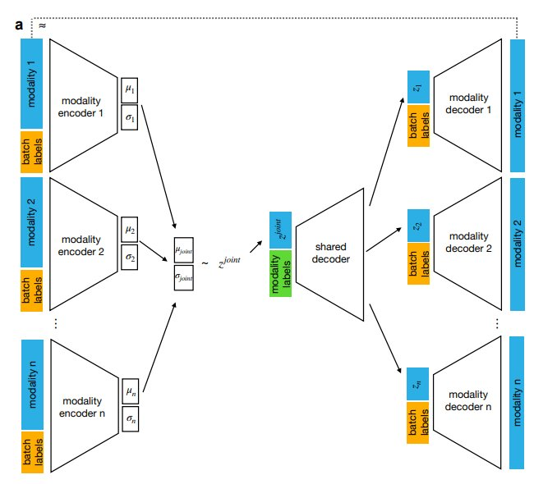
Multigrate Architecture
Multi-view VAE with Product of Experts fusion
Modality Encoders {f_i}
Each modality has a dedicated encoder mapping input X_i and batch label S_i to a Gaussian posterior q(Z_i | X_i, S_i) = N(mu_i, sigma_i).
Product of Experts Fusion
Individual Gaussian posteriors are combined multiplicatively. Missing modalities contribute the prior — no gradient flows through absent data.
Shared + Modality Decoders
Z_joint passes through a shared decoder, then per-modality decoders: negative binomial for RNA; MSE for ADT and ATAC.
Figure 1a (Lotfollahi et al., 2021)
MMD Regularisation
Max Mean Discrepancy loss between joint latent distributions of dataset pairs enforces distribution alignment in the latent space.

Slide 7
Product of Experts — Mathematical Formulation
Joint Posterior
q(Z_joint | X, S) = PROD_i q(Z_i | X_i, S_i) where q(Z_i|X_i,S_i) = N(0,I) if modality i absent
Precision-Weighted Parameter Estimation
mu_joint =
( mu_0/s_0 + SUM_i m_i*mu_i/s_i )
------------------------
( 1/s_0 + SUM_i m_i/s_i )
sigma_joint =
1
------------------------
( 1/s_0 + SUM_i m_i/s_i )
m_i = 1 if modality present, 0 if absent | Prior: N(0, I)
Precision-weighted
Missing data by construction
Closed-form solution
Modalities with lower variance (higher precision) contribute proportionally more to the joint estimate.
Absent modalities contribute only the prior — no information added, no special code required.
Both mu_joint and sigma_joint have exact analytical expressions — no approximate inference needed.

Slide 8
Training Objective — Reconstruction Loss
L_multigrate = SUM_i L_AE(phi,theta,X_i,S_i,alpha,eta) + beta * SUM_{i<j} L_MMD(Z_i,Z_j)
L_AE = alpha * E[log p(X|Z_joint,S)] - eta * KL(q(Z_joint|X,S) || p(Z_joint|S))
RNA (count data)
Negative Binomial likelihood models the overdispersion inherent in scRNA-seq count data. More appropriate than Gaussian or Poisson for integer sequencing counts.
ADT proteins
Mean Squared Error on CLR-normalised protein values. CLR converts compositional counts to continuous values well-suited to MSE optimisation.
ATAC peaks
MSE on binarised log-normalised chromatin accessibility peaks. Binarisation converts continuous accessibility scores to binary open/closed indicators.
KL divergence
Regularises the posterior towards a standard normal prior N(0,I). Controls the reconstruction vs latent space smoothness trade-off. Weight controlled by eta.

Slide 9
Training Objective — MMD Batch Correction Loss
L_MMD = beta * SUM_{i<j} [ k(Z_i,Z_i) + k(Z_j,Z_j) - 2*k(Z_i,Z_j) ] k(x,x') = SUM_l exp(gamma_l * ||x-x'||^2)
Distribution alignment
Directly minimises the statistical distance between the joint latent distributions of different datasets, operating at the population level rather than per-sample.
Multi-scale RBF kernel
Uses Gaussian kernels at multiple bandwidth scales gamma_l for robust MMD estimation. Provides unbiased estimates across different distribution shapes.
Pairwise application
Applied to all pairwise dataset combinations in each training batch. Hyperparameter beta controls the strength of batch alignment relative to reconstruction fidelity.
Complementary to encoder
Provides distribution-level correction beyond per-sample encoder conditioning. The two mechanisms act at different granularities for more robust batch removal.

Slide 10
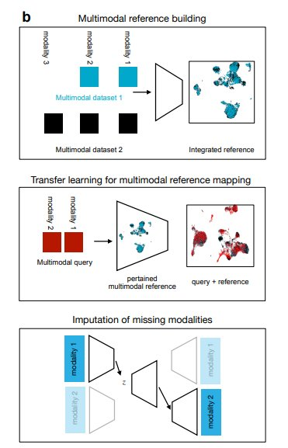
Three Applications of Multigrate
Application I
Multimodal Reference Atlas Construction
Multiple multi-omic datasets from different studies are jointly integrated into a single harmonised reference latent space, capturing shared biological variation while removing technical confounders.
Application II
Query-to-Reference Mapping (scArches)
Novel datasets are mapped onto a pre-trained reference by fine-tuning only new batch-specific weights while preserving reference structure. Enables rapid atlas extension without full retraining.
Application III
Missing Modality Imputation
The trained decoder reconstructs unobserved modalities for cells with partial measurements. Accuracy evaluated via Pearson correlation between imputed and held-out ground-truth values.
Figure 1b (Lotfollahi et al., 2021)

Slide 11
Experiment I — Integration: Experimental Design
Objective: Integrate paired CITE-seq measurements across 4 collection sites, demonstrating batch correction while preserving cell-type-level biological structure.
Dataset
Preprocessing & Model
Source
NeurIPS 2021 CITE-seq BMMCs (GEO: GSE194122)
RNA
Full size
90,261 cells (subsampled to 20,000)
Normalise to 10,000 counts | log1p transform | 4,000 HVGs per batch | Loss: Negative Binomial
RNA
13,953 genes → 4,000 HVGs per batch
ADT
ADT
134 surface proteins
CLR normalisation (removes compositional bias) | Loss: MSE
Batches
4 collection sites
Model Config
losses = ['nb','mse'] | KL weight = 0.1 | 200 epochs, lr=1e-3, batch size=256

Slide 12
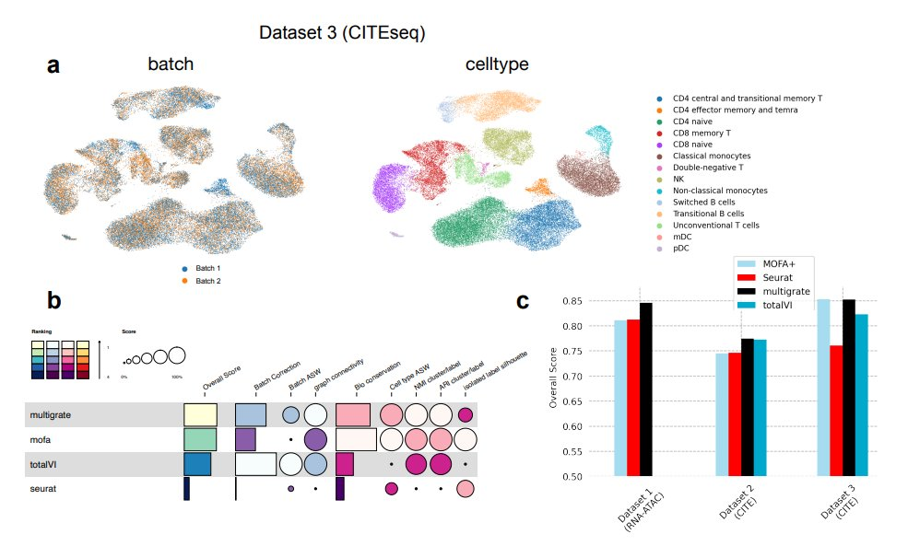
Experiment I — Paper Results (Figure 2)
Figure 2 (Lotfollahi et al., 2021) — (a) UMAP by batch and cell type | (b) Per-metric benchmark scores | (c) Overall ranking across three datasets
Batch effects corrected
Biological structure preserved
Ranked #1 across 3 datasets

Slide 13
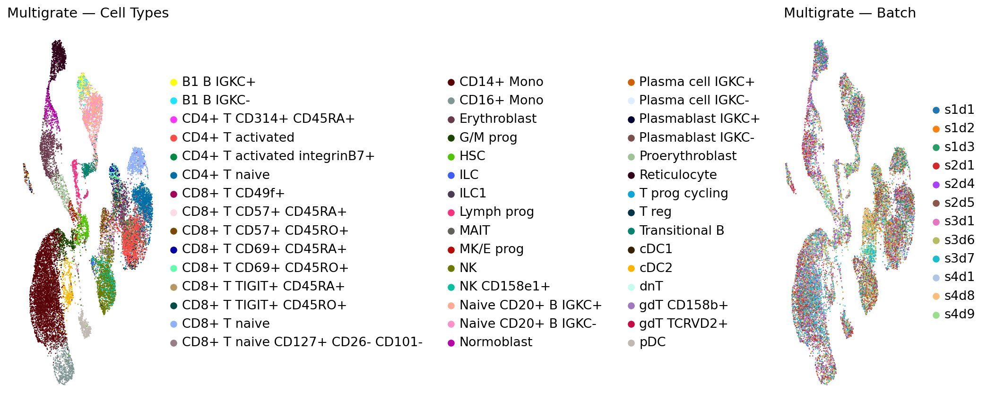
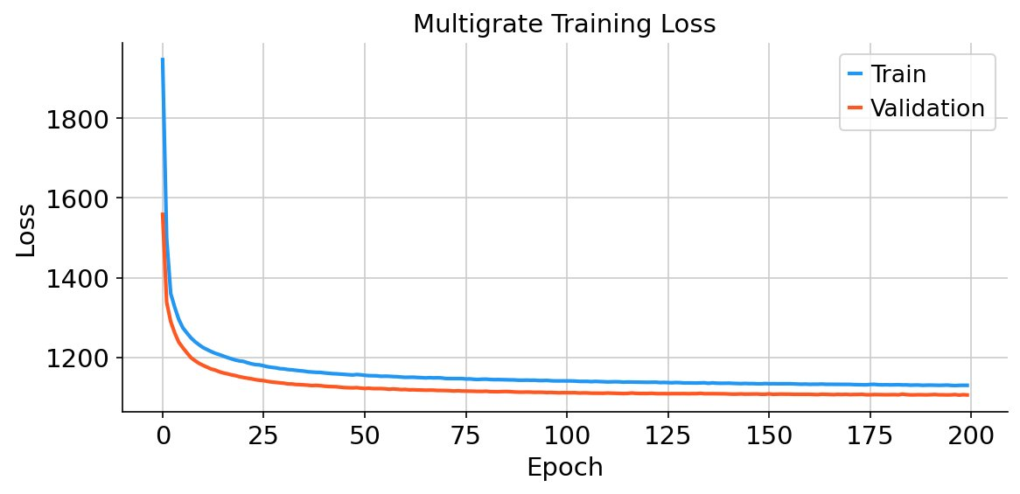
Experiment I — Reproduction Results
NeurIPS 2021 dataset, 20,000 cells, 200 epochs, T4 GPU
Training / validation loss
ARI > 0.5
NMI > 0.5
cluster ↔
cell type
mutual
info
UMAP coloured by cell type (left) and collection site / batch (right)
Cells from all 4 sites intermix within biologically coherent clusters, confirming successful batch correction. Training and validation loss curves converge smoothly, indicating stable optimisation without overfitting.

Slide 14
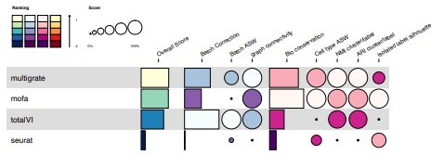
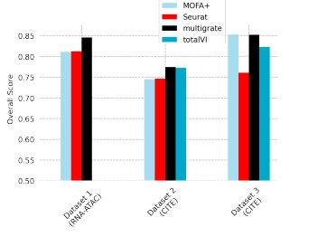
Integration Quality Metrics
Evaluation framework — Luecken et al., Nature Methods 2022
Biology
ARI
Agreement between unsupervised clusters and true cell type labels.
Biology
NMI
Mutual information between cluster assignments and reference labels.
Biology
ASW cell type
Intra-cluster cohesion and inter-cluster separation in latent space.
Batch
ASW batch
Lower is better — batch labels should not be predictable from latent space.
Combined
Overall Score
Final = 0.6 × Biology Conservation + 0.4 × Batch Correction.
Fig 2b: Score heatmap | Fig 2c: Overall score bar chart — Multigrate (black) consistently highest

Slide 15
Experiment II — Imputation: Experimental Design
Objective: Evaluate whether Multigrate can accurately predict held-out protein measurements for RNA-only cells using the RNA-protein relationship learned from paired observations.
15,000 cells — NeurIPS 2021 CITE-seq BMMCs | RNA + 134 surface proteins measured per cell
Training Set — 75%
11,250 cells
RNA available | ADT available
Both modalities used in training
Evaluation Set — 25%
3,750 cells
RNA available | ADT withheld
Model predicts — compare with ground truth
Metric: Pearson correlation between imputed and true CLR-normalised ADT values, per protein, averaged across all 134.
Baselines: totalVI (Gayoso et al., 2021) and Seurat v4 (Hao et al., 2021), both with default parameters.

Slide 16
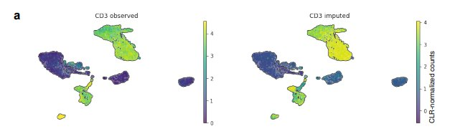
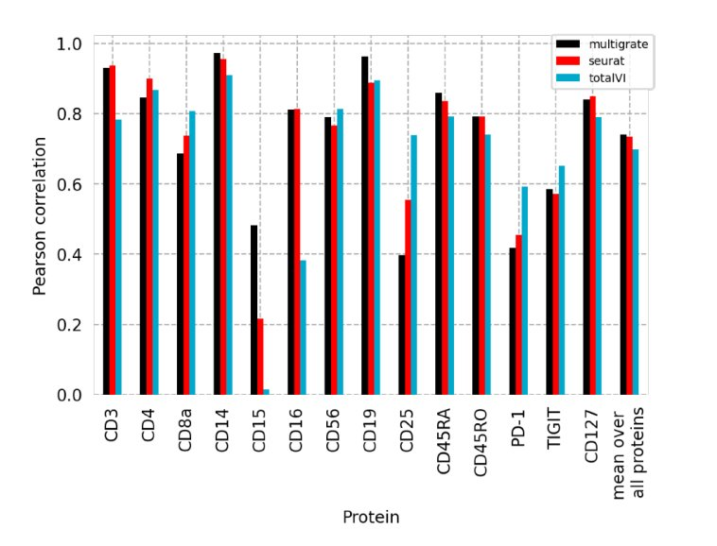
Experiment II — Paper Results (Figure 4)
~0.80
Mean Pearson r (paper, 14 proteins)
Comparison vs Baselines
Method
r
Multigrate
~0.80
Figure 4a: CD3 protein — ground truth (left) vs imputed (right). Pearson r ≈ 0.94.
totalVI
~0.78
Seurat v4
~0.77
Multigrate marginally outperforms totalVI — a method specialised for this exact task — demonstrating the generality of the PoE framework.
Figure 4b: Per-protein Pearson r — Multigrate (black), Seurat v4 (red), totalVI (blue)

Slide 17
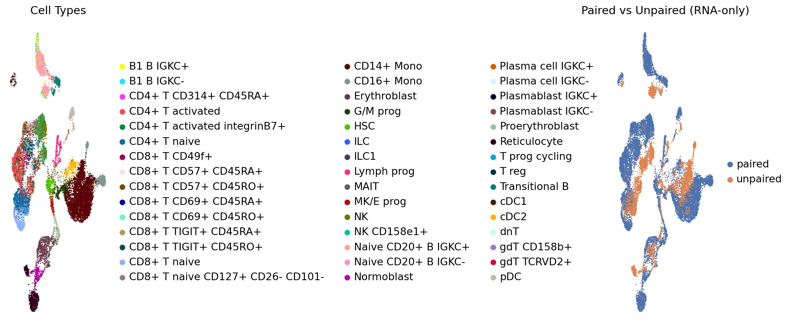
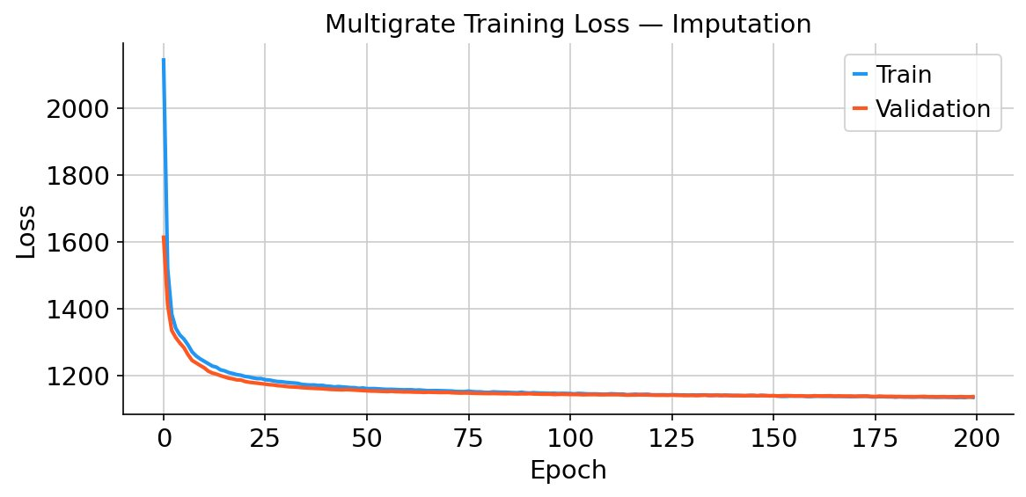
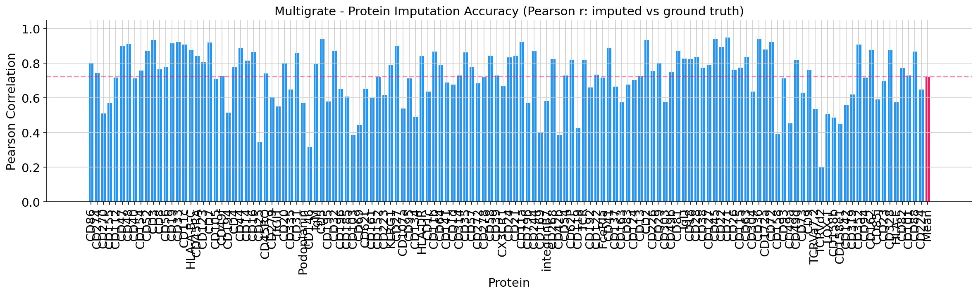
Experiment II — Reproduction Results
Extended to 134-protein panel (vs 14 in paper)
Training loss
0.72
0.94
UMAP: cell types (left) — RNA-only cells (orange, right) correctly placed within cell-type clusters
Mean r
134 prot.
Best (CD3)
Per-protein Pearson r (134 proteins). Pink reference line = mean r = 0.72.

Slide 18
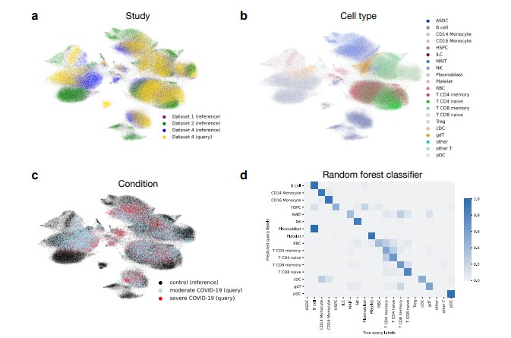
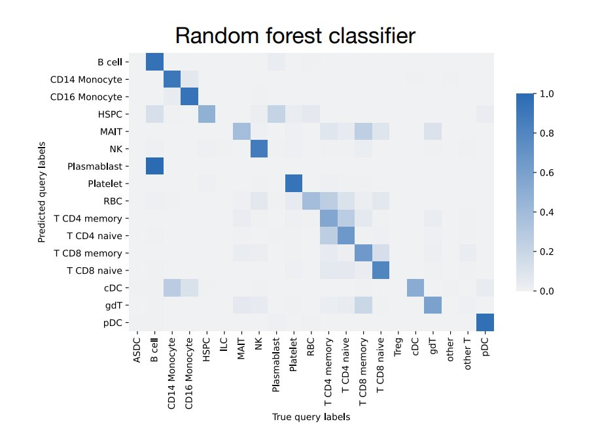
Experiment III — Query-to-Reference Mapping (scArches)
I
Build healthy reference atlas
Train on 160,000 cells (RNA+ADT+ATAC) across 3 datasets.
II
Add query batch weights
Extend model with new batch vectors. All reference weights frozen.
III
Fine-tune in 2–5 minutes
Only new batch weights updated. Reference structure preserved.
Figure 3a-c: Reference (healthy) + COVID-19 query cells integrated across studies, cell types, and conditions
IV
Transfer cell type labels
Random forest classifier on reference latent space → 79% accuracy.
Figure 3d: Confusion matrix — predicted vs true cell types — 79% overall accuracy
79% accuracy | 2–5 min vs hours for full retraining

Slide 19
Summary of Results Across All Three Experiments
Experiment I
Integration
Experiment II
Imputation
Experiment III
Query Mapping
#1
Outperforms
r=0.80
r=0.72
79%
2–5 min
overall rank
across 3 datasets
MOFA+, Seurat
and totalVI
mean Pearson r
(paper, 14 prot.)
our result
134 proteins
cell type
accuracy
fine-tuning
vs hours
Highest combined biology conservation and batch correction score across all three benchmark datasets. Consistent across CITE-seq and ATAC+RNA modality pairings.
Marginally outperforms totalVI — architecturally specialised for CITE-seq imputation — demonstrating the generality of the PoE framework.
COVID-19 patient cells correctly mapped to the healthy reference. Cell type labels transfer with 79% accuracy via a random forest classifier.

Slide 20
Reproducibility — Our GitHub Repository
github.com/FaiqaZarar/multigrate-multiomics
Experiment I Notebook
01_paired_integration/paired_integration.ipynb — complete Colab notebook: data download, preprocessing, model training, UMAP generation, ARI/NMI metrics.
Experiment II Notebook
02_protein_imputation/protein_imputation.ipynb — complete Colab notebook: 75/25 split, training, imputation inference, per-protein Pearson correlation barplot.
All Paper Figures
figures/ directory contains all original paper figures (Fig 1–4) for in-line README rendering. Extracted directly from the published PDF.
Experiment III Documentation
03_query_to_reference/ contains full methodology with executable code, paper figures, and transparent explanation of computational constraints.
Presentation
slides/ directory contains this presentation

Slide 21
Conclusion
Key Contributions
Limitations & Future Work
A unified generative framework applicable to any combination of multi-omic modalities without architectural modification
Cycle-consistency loss
Enforcing RNA→protein→RNA consistency expected to improve imputation accuracy on difficult proteins.
Product of Experts fusion handles missing modalities by mathematical construction — no imputation heuristics required
Learnable modality embeddings
Replace one-hot labels with trainable modality vectors to decompose modality-specific variance.
MMD regularisation provides distribution-level batch correction complementing per-sample encoder conditioning
Spatial transcriptomics
scArches integration enables reference atlas extension in minutes — supporting scalable clinical applications
Extension to spatial + RNA + protein trimodal data is a natural application of the PoE framework.
Competitive or superior performance versus task-specific methods across all three evaluation tasks
Million-cell scalability
Online learning and mini-batch PoE fusion for datasets exceeding GPU memory capacity.

Slide 22
Thank You
Questions & Discussion
Paper:
Lotfollahi et al. (2021) — arxiv.org/abs/2108.05218
Official Code:
github.com/theislab/multigrate
Our Repository:
github.com/FaiqaZarar/multigrate-multiomics
Repro Code:
github.com/theislab/multigrate_reproducibility

