Slide 1
Web & Mobile App Development
Lecture # 1

Slide 2

What is Computer?
A computer is a machine that can store and process information.
It’s a device that accepts information (in the form of digitalized data) and manipulates it for some result based on a program, software, or sequence of instructions on how the data is to be processed.

Slide 3
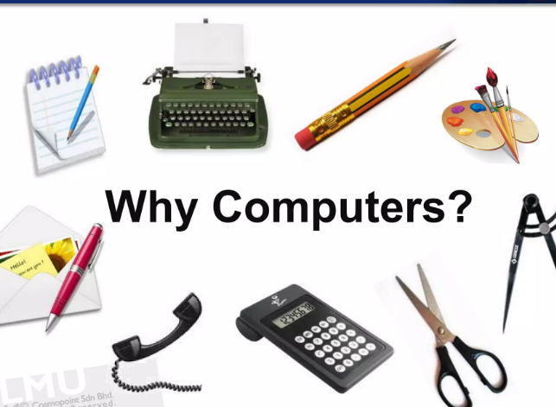
Why Computers?
The computer was invented in order to automate mathematical calculations that were previously completed by people.
“Automation” of everything is the main cause behind invention of computers.

Slide 4
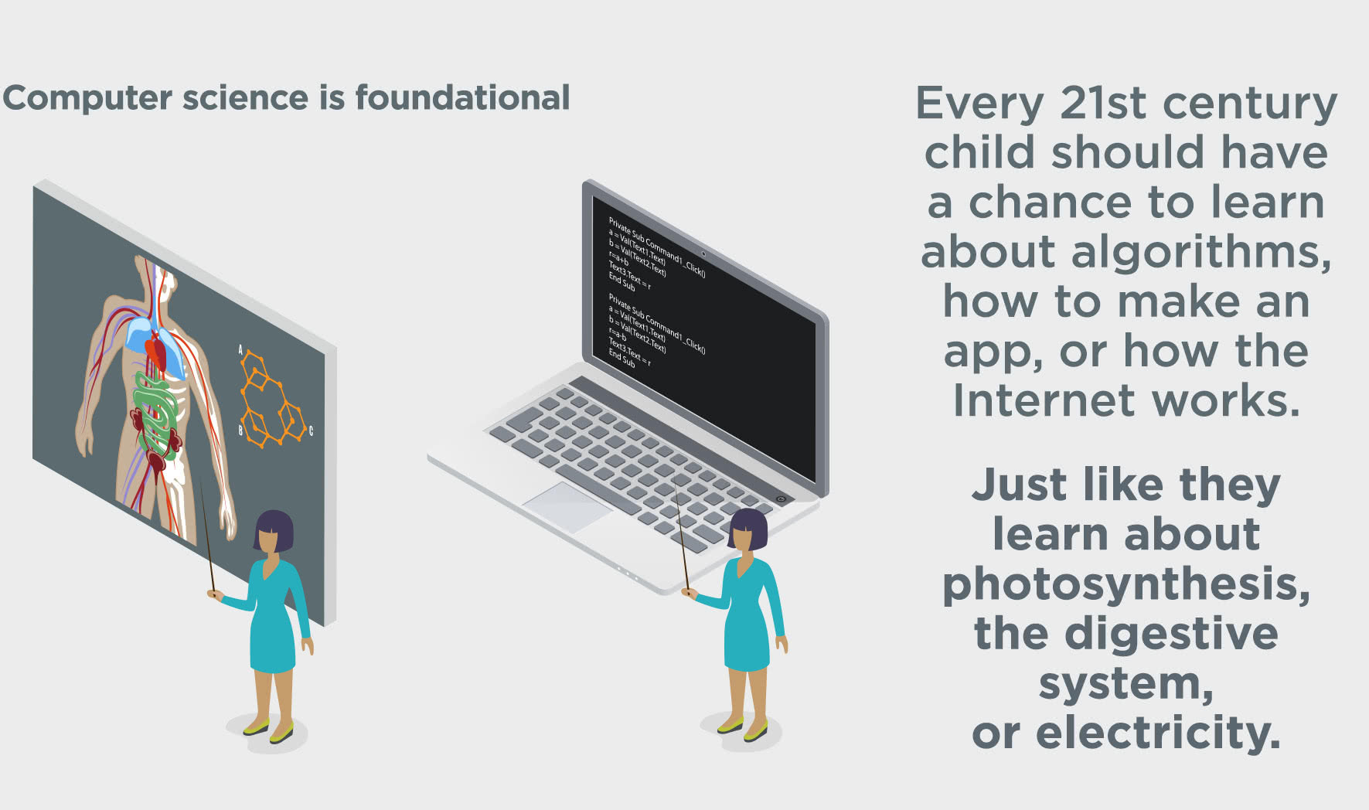

Slide 5
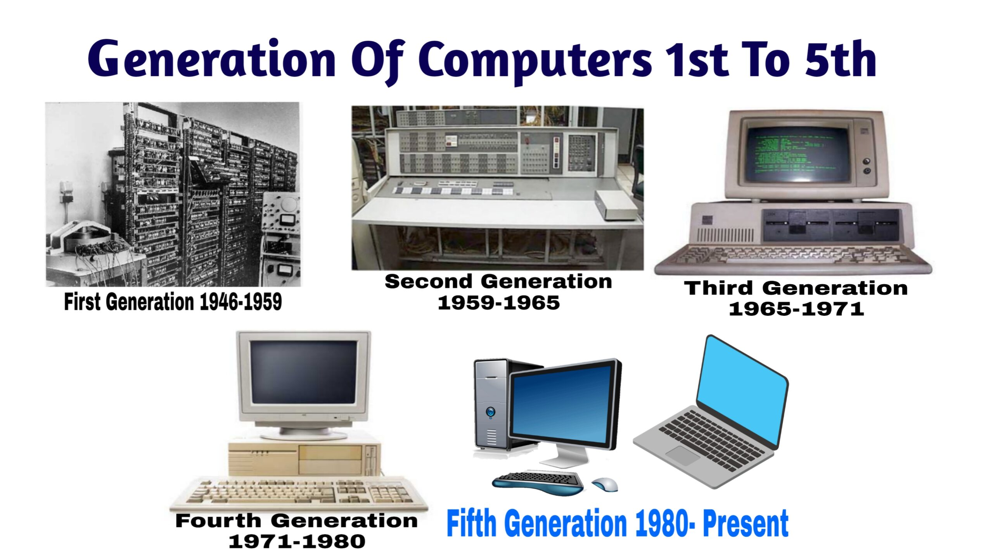

Slide 6
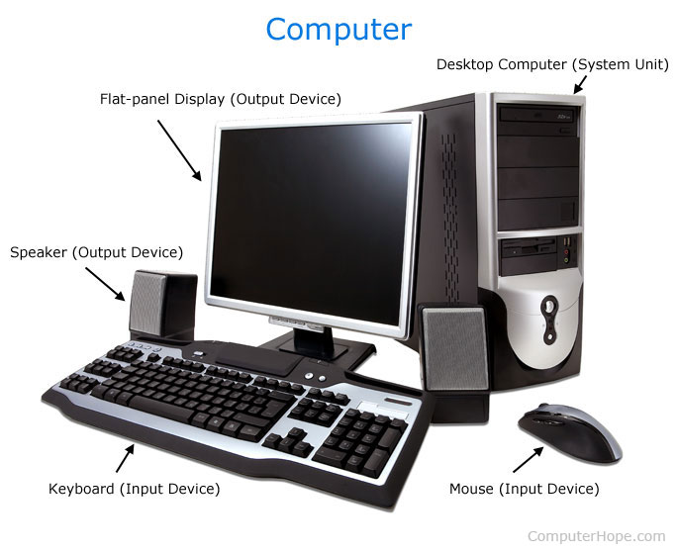
Parts of Computer

Slide 7

Input and Output
An input device is connected to a computer that sends out data into the computer, while an output device is connected to a computer that receives incoming data.
A keyboard or computer mouse is an input device for a computer, while monitors and printers are output devices.

Slide 8

Hardware and Software
Hardware is any element of a computer that's physical. This includes things like monitors, keyboards, and also the insides of devices, like microchips and hard drives. Software is anything that tells hardware what to do and how to do it, including computer programs and apps on your phone.

Slide 9
Hardware Example
Processor
Memory Devices (USB/Hard drive)
Monitor
Printer
Keyboard
Mouse
Central Processing Unit (CPU).

Slide 10
Types of Software
System Software
Application Software

Slide 11
System Software
System software is a type of computer program that is designed to run a computer's hardware and application programs.
Examples of system software include operating systems (OS) like macOS, Linux, Android and Microsoft Windows.

Slide 12
Application Software
Application software is a type of computer program that performs a specific personal, educational, and business function.

Slide 13
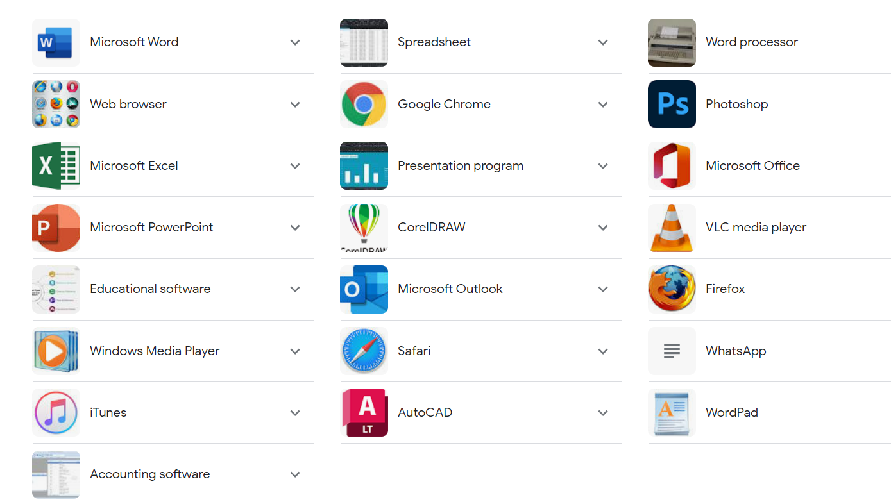

Slide 14

What is a Program?
A program is a set of instructions that a computer follows in order to perform a particular task.

Slide 15
What is a Programming Language?
A programming language is a vocabulary and set of grammatical rules for instructing a computer or computing device to perform specific tasks.
A programming language is a way for programmers (developers) to communicate with computers.

Slide 16
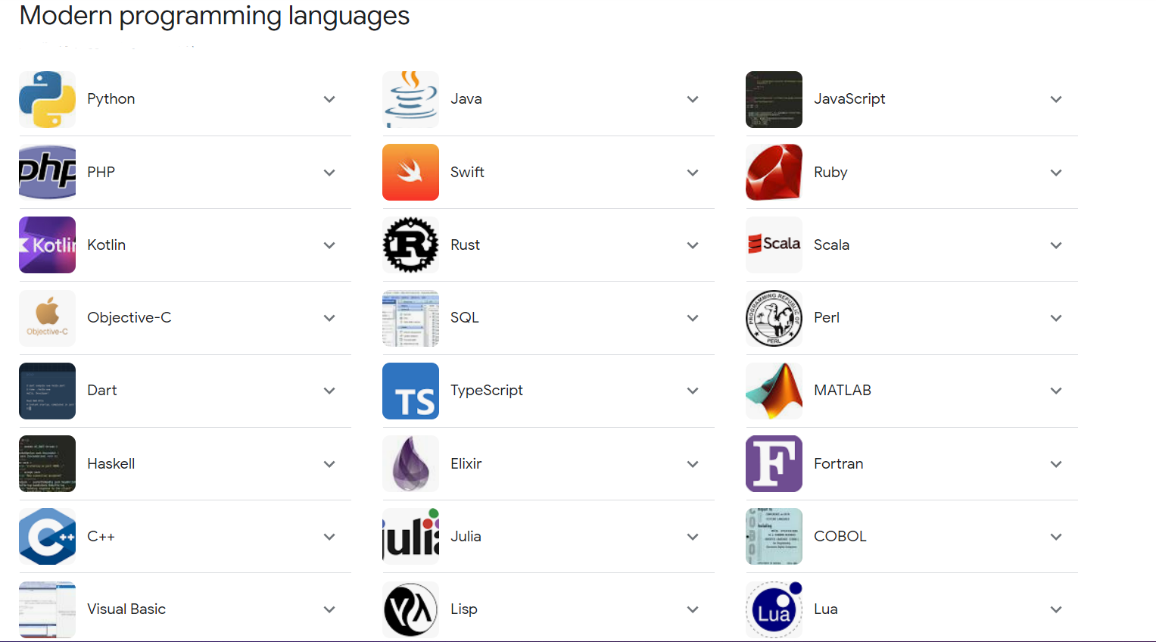

Slide 17
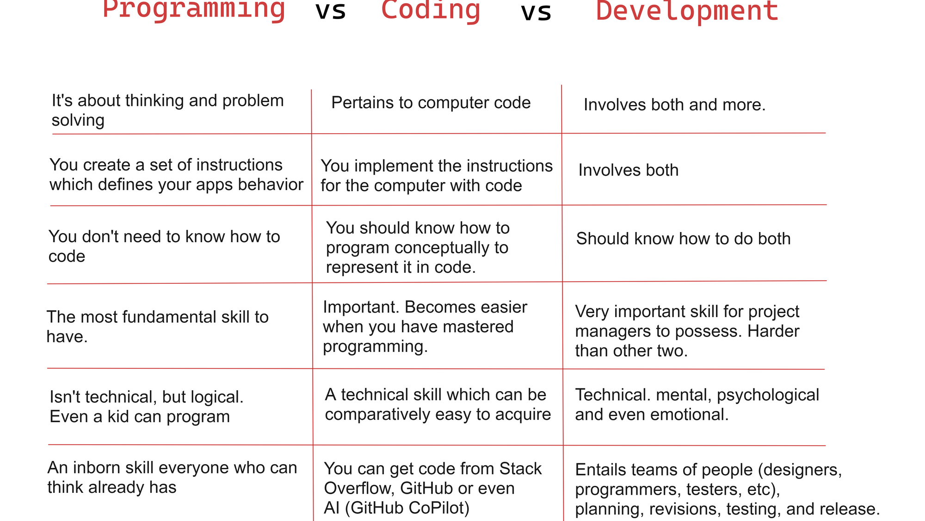

Slide 18
Where to write Code?
An editor lets you write computer code. They range from simple, like a basic text editor, to advanced software, such as Adobe Dreamweaver, Eclipse, JDeveloper, or Microsoft Visual Studio Code.

Slide 19
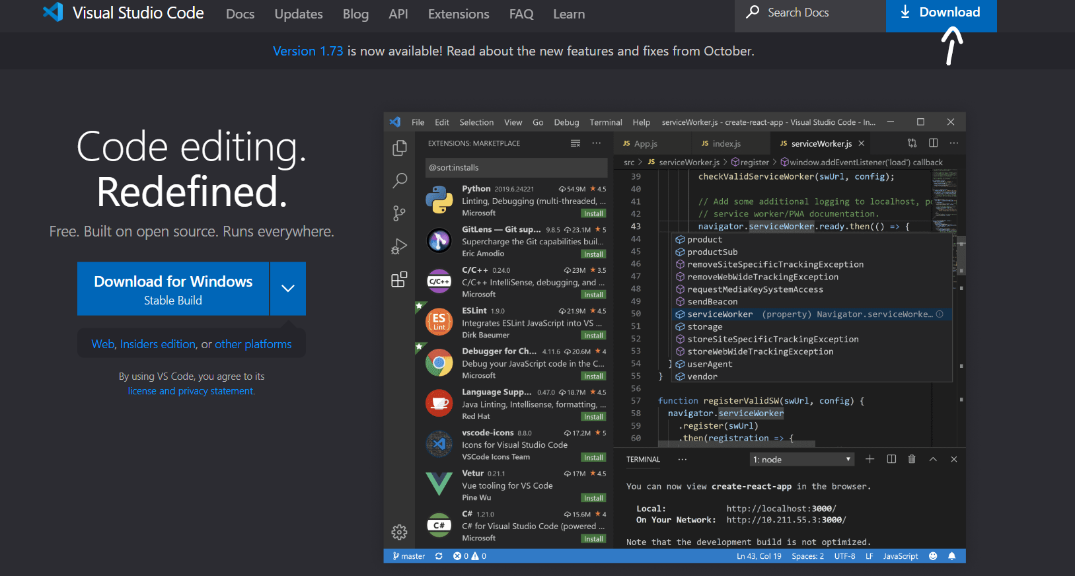
VS Code Installation
https://code.visualstudio.com

Slide 20
Main Shortcut Keys
Copy
Copy: Ctrl + C.
Cut
Cut: Ctrl + X.
Paste
Paste: Ctrl + V.
Select
Select All: Ctrl + A

Slide 21
Explore
Application Software (MS Office etc.)
Browsers (Chrome, Firefox, Opera, Safari)
Files and Folders
Search Engine (Google, Yahoo)

Slide 22
