Slide 1

Web and Mobile App Development
Lecture # 2

Slide 2
Websites
Websites were originally developed for information sharing.

Slide 3
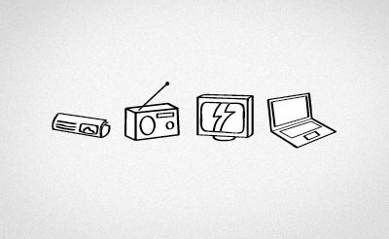
Notes:
Information sharing, 1-1 > website 1-* > digital newspaper > cost effective > fast

Slide 4
First Website
Tim Berners-Lee, a British scientist, invented the World Wide Web (WWW) in 1989, while working at CERN. The Web was originally conceived and developed to meet the demand for automated information-sharing between scientists in universities and institutes around the world.
info.cern.ch

Slide 5
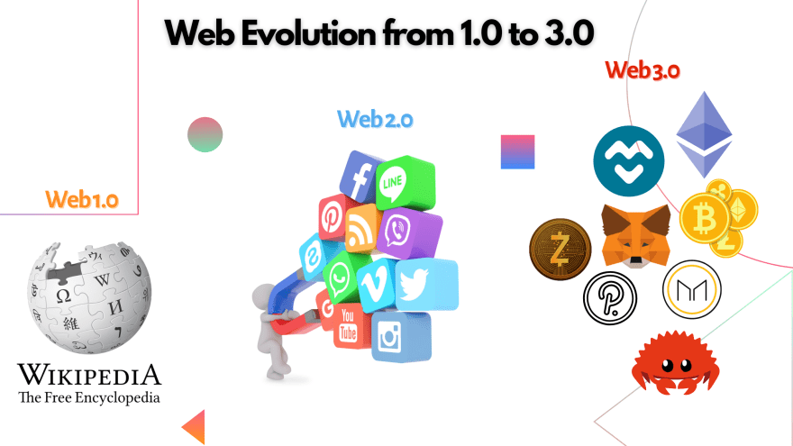

Slide 6
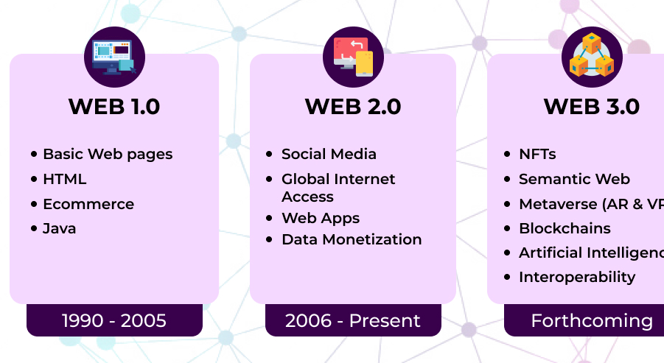

Slide 7
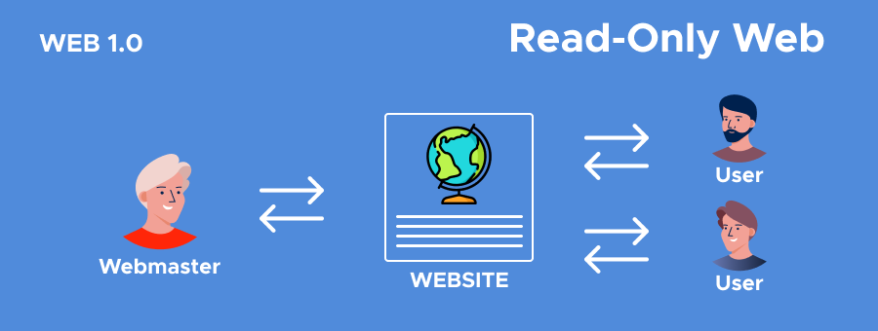

Slide 8
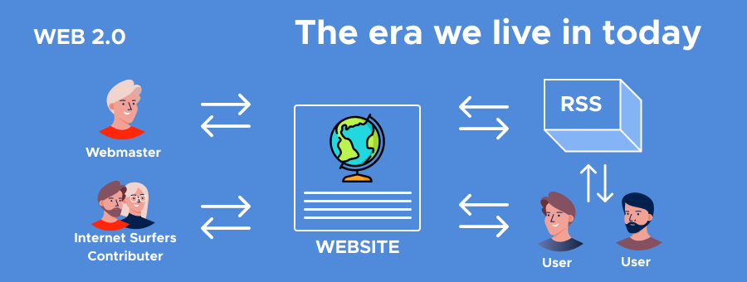

Slide 9
Web 3.0
Web 3.0 is not dependent or lead by any human.
It is entirely working on defined piece of code called “Smart Contracts”

Slide 10
Types of Website
Static
Dynamic

Slide 11
Static Website
Fixed Data & Design
Developer Dependent (User can’t make changes on own)
Same content for longest time.
Doesn’t use database
No Server
Fast loading
Design part of a Website is usually Static

Slide 12
Static Website – Skills Required
HTML
CSS
JS
Bootstrap

Slide 13
Example of Static Site
Portfolios
Resumes

Slide 14
Dynamic Website
Enables changing in Data
Can have unique content on every visit.

Slide 15
Dynamic Websites
Dynamic websites have 2 parts:
User-Facing > Website
Client Handled > Control Panel / Admin Panel
Notes:
Dynamic websites aren’t dependent on developers and user can add/remove/update content.

Slide 16
Dynamic Website - Skills Required
Dynamic Websites requires Database and Server Connection.
Hence, you need to have grip on DBs like MongoDb, MySQL, Postgresql, Firebase.
Server like, Nodejs, PHP, Python, Java, .net.

Slide 17
Frontend & Backend

Slide 18
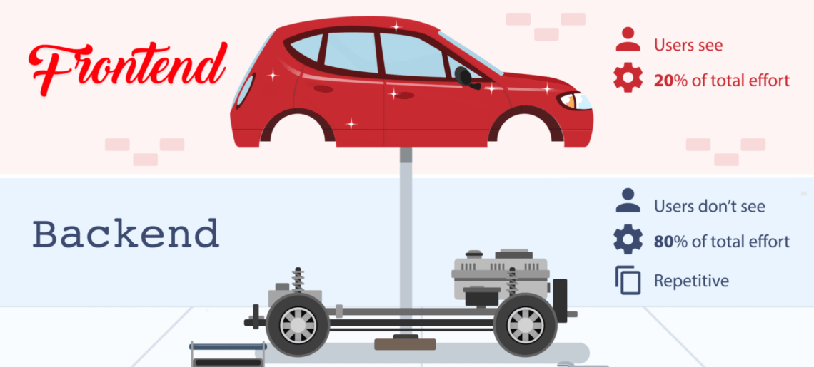

Slide 19
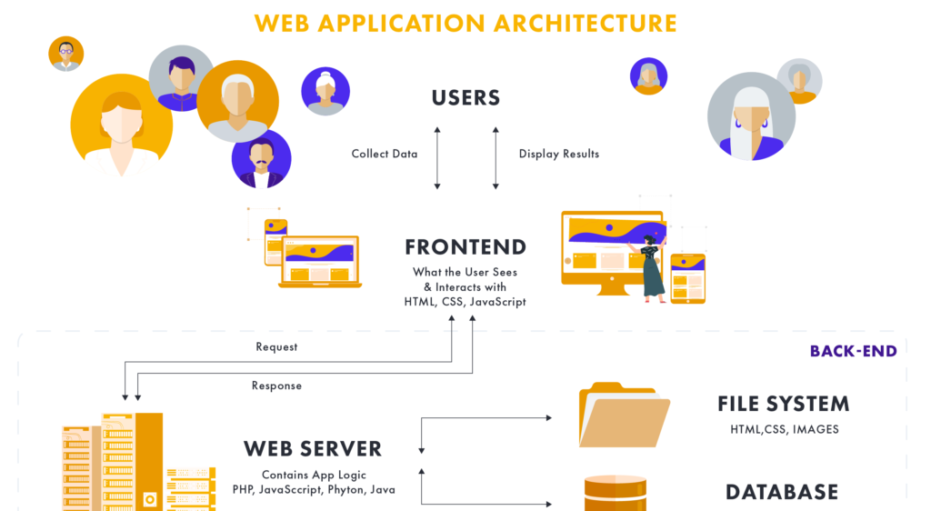

Slide 20
Frontend
Front-end development is the process of building components that interact with users. Examples are the user interface, buttons, user-entered data, and user experience (UX) features.
Notes:
View products

Slide 21
Backend
The back-end, also called the server-side, consists of the server which provides data on request, the application that channels it, and the database which organizes the information
Notes:
Search for products

Slide 22
Database
Databases support good data access because: Large volumes of data can be stored in one place. Multiple users can read and modify the data at the same time. Databases are searchable and sortable, so the data you need can be found quick and easily.

Slide 23
Web Categories

Slide 24
Web Categories
Blogs. (medium.com)
Business/Corporate Websites. (techloset.com)
NGO /Non-Profit Websites. (saylaniwelfareuk.com)
E-Commerce Websites. (khaadi.com)
Multi-vendor Websites. (daraz.pk)
Educational Websites. (lms.uaf.edu.pk)
Entertainment Website. (Netflix.com)
Portfolio Website.
Social Media Websites.(Facebook.com)

