Slide 1

SPEECH
RECOGNITION
GROUP MEMBERS:
FAIQ ASLAM(19P-0082)
UMAIR AZAD(19P-0030)

Slide 2
INTRODUCTION:
Speech recognition is the process of converting spoken words into text.It is a technology that enables computers to understand and interpret human speech.

Slide 3
WHY FOR URDU?
Urdu is the national language of Pakistan and it is widely spoken in South Asia and the Middle East.

Slide 4
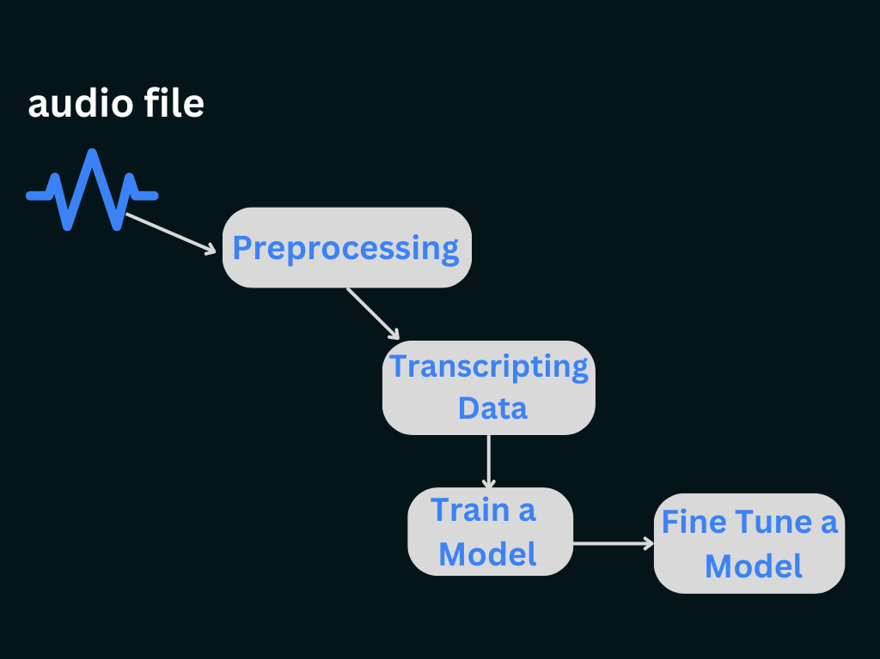
METHODOLOGY:

Slide 5
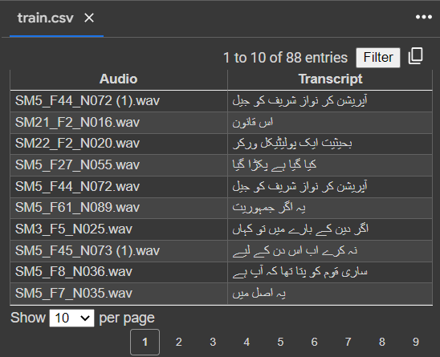
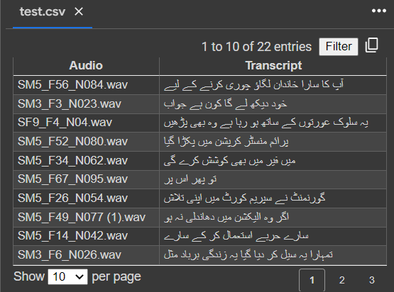
OUTPUT:

Slide 6
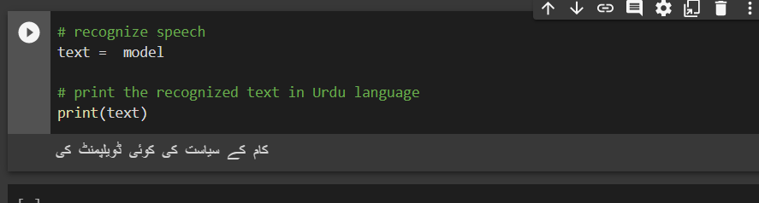

Slide 7
CODE

Slide 8
THANKS!!

