Slide 1






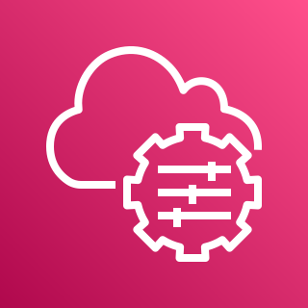


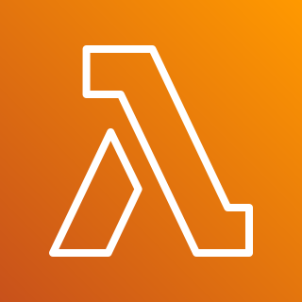

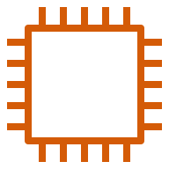


AWS Cloud
VPC
Internet gateway
Availability Zone 1
Availability Zone 2
Availability Zone 3
Availability Zone 4
Public subnet
Public subnet
Public subnet
Public subnet
CloudWatch
NAT GW
NAT GW
NAT GW
NAT GW
SSM
ALB
ALB
ALB
ALB
JSON-RPC
Private subnet
Private subnet
Private subnet
Private subnet
Lambda Function
EC2
Polygon Edge
Polygon Edge
Polygon Edge
Polygon Edge
S3
Parameter Store
Notes:
Network Layout

Slide 2





AWS Cloud
VPC
Private subnet
3
4
5
Upload genesis.json to S3
2
Run initialization function
Fetch keys from Parameter Store
Generate genesis.json
1
Receive API call from Polygon Edge node
Lambda Function
Notes:
Lambda function – generation of genesis block

Slide 3
AWS Cloud
VPC
Private subnet
EC2
2
3
4
5
Make API call to Lambda function notifying that the keys are stored
Fetch genesis.json from S3
Fetch keys from PS
Store genesis.js on the local file system
Parameter Store
1
Store keys in Parameter Store
Start polygon-edge service
7
Create polygon-edge service
6
Notes:
Validator Node Initialization Stage

