Slide 1
University of Asia Pacific
Department of Computer Science & Engineering
Data Structures and Algorithms I
2nd Year 1st Semester

Slide 2
Books
1. “Introduction to Algorithms” by Thomas H. Coremen, Charles E. Leiserson,
Ronald L. Rivest and Clifford Stein, Prentice-Hall ,2nd Edition, ISBN - 81 -
203-2141-3.
2. “Data Structures” by Schaum’s Series.
2. “Data Structures and Algorithm Analysis in C by Mark Allen Weiss, Addison Wesly,
ISBN 81-7808-167-9.
3. “Fundamentals of Computer Algorithms” by Ellis Horowitz, Sartaj Sahni and
Sanguthevar Rajasekaran, Galgotia, ISBN -81-7515-257-5.
4. “Theory & Problems of Data Structures” by Seymour Lipschutz, McGraw-Hill,
ISBN 0-07-038001-5.
5. “Data Structures & Algorithms in JAVA by Robert Lafore, Techmedia,
ISBN 81-7635-186-5.

Slide 3
Introduction to Data Structures
Data Structures
The logical or mathematical model of a particular organization of data is called a data
structure.
Types of Data Structure
1. Linear Data Structure
Example: Arrays, Linked Lists, Stacks, Queues
2. Nonlinear Data Structure
Example: Trees, Graphs
A
Array
A
B
C
D
E
F
Tree
B
C
D
E
F
Figure 1: Linear and nonlinear structures

Slide 4
Data Structures
Linear Data Structures
Non- linear Data Structures
Static Data Structure
Dynamic Data Structures
Tree
Graph
Array
Stack
Queue
Linked List
Figure 2: Classifications of Data Structures

Slide 5
Choice of Data Structures
The choice of data structures depends on two considerations:
It must be rich enough in structure to mirror the actual relationships of data in the real world.
The structure should be simple enough that one can effectively process data when necessary.
10
10
20
30
40
20
30
50
60
70
40
50
60
70
80
Figure 3: Array with 8 items
Figure 4: Tree with 8 nodes

Slide 6
Data Structure Operations
Traversing: Accessing each record exactly once so that certain items in the record may be processed.
2. Searching: Finding the location of the record with a given key value.
3. Inserting: Adding a new record to the structure.
4. Deleting: Removing a record from the structure.
5. Sorting: Arranging the records in some logical order.
6. Merging: Combing the records in two different sorted files into a single sorted file.

Slide 7
Algorithms
It is a well-defined set of instructions used to solve a particular problem.
Example 1:
Write an algorithm for finding the location of the largest element of an array Data.
Largest-Item (Data, N, Loc)
1. set k:=1, Loc:=1 and Max:=Data[1]
2. while k<=N repeat steps 3, 4
3. If Max < Data[k] then Set Loc:=k and Max:=Data[k]
4. Set k:=k+1
5. write: Max and Loc
6. exit

Slide 8
Properties of algorithms
Input from a specified set: The data that will be transformed by the algorithm to create the output
Output from a specified set: result of the computation,
Definiteness of every step in the computation,
Finiteness of the number of calculation steps,
Effectiveness of each calculation step

Slide 9
Algorithm Vs. Program
Algorithm | Program
An Algorithm is an abstract concept Example: Start Initialize a variable ‘result’ to 1. Read the input number ‘n’ Repeat the following until ‘n’ becomes 0 a. Multiply ‘result’ by ‘n’ b. Decrement ‘n’ by 1. v. Print the value of ‘result’ as factorial. vi. Stop | A Program is a concrete implementation of the algorithm Example: int factorial(int n) { int result =1; while (n>0) { result *=n; n--; } return result; }
2. An algorithm can be written in any language. | 2. A program must be written using a programming language only.

Slide 10

Algorithm Vs. Program
Algorithm | Program
3. An Algorithm is developed during the design phase. | 3. A Program is developed during the implementation phase.

Slide 11
Algorithm Vs. Program
Algorithm | Program
4. An Algorithm does not depend on the hardware and operating system. | 4. A Program depends on them.
5. An algorithm is always analyzed. | 5. A program is tested.

Slide 12
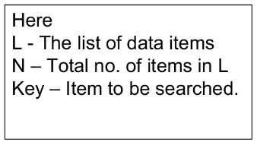
Algorithm Example 2
Linear Search: A linear search is a technique for finding a particular value in a unsorted or sorted list. Search each item of list using key value, one at a time, until finding the item from the list.
Algorithm: Linear-Search (L, N, Key)
Set k := 1 and Loc := 0
Repeat Steps 3 and 4 while k <= N
If Key = L[k], then Set Loc := k, print: Loc and exit.
Set k := k+1
If Loc = 0 then Write: Item is not in List
Exit

Slide 13
Example of Linear Search
List : 10, 6, 222, 44, 55, 77, 24
Key: 55
Steps:
6 222 44 55 77 24 K=1
10 222 44 55 77 24 K=2
10 6 44 55 77 24 K=3
10 6 222 55 77 24 K=4
10 6 222 44 77 24 K=5
So, Item 55 is in position 5.
55
10
55
6
55
222
55
44
55
55

Slide 14
Algorithm example 3
Binary Search:
List of items should be sorted.
It uses the divide-and-conquer technique.
The elements of the list are not necessarily all unique. If one searches for a value that occurs multiple times in the list, the index returned by the binary search will be of the first-encountered equal element.
Compare the given Key value with the element in the middle of the list. It tells which half of the list contains the Item. Then compare Key with the element in the middle of the correct half to determine which quarter of the list contains Item. Continue the process until finding Item in the list.

Slide 15
Algorithm: Binary-Search (L, N, Key)
Set Loc := 0, Beg := 1, End :=N and Mid := (Beg + End)/2
Repeat steps 3 to 6 while Beg <= End
If Key < L[Mid], then Set End := Mid – 1
Else if Key>L[Mid] then Set Beg := Mid + 1
Else if Key = List[Mid] then Loc:= Mid, print: Loc and exit.
Set Mid := (Beg + End)/2
If Loc = 0 Write: Item is not in List.
Exit.
Here
L - The list of data items
N – Total no. of items in L
Key – Item to be searched.

Slide 16
Example of Binary Search
List : 6, 10, 20, 30, 55, 75, 190
Key: 55
Steps:
6 10 20 55 75 190 Beg=1, End=7,Mid=4
6 10 20 30 55 190 Beg=5, End=7,Mid=6
6 10 20 30 75 190 Beg=5, End=5,Mid=5
[Item Found]
So, Item 55 is in position 5.
55
30
55
75
55
55

Slide 17
Complexity of Algorithms
The complexity of an algorithm M is the function f(n) which gives the running time and/or storage space requirement of the algorithm in terms of the size n of the input data.
Two types of complexity
1. Time Complexity
2. Space Complexity

Slide 18
Complexity
In general, we are not so much interested in the time and space complexity for small inputs.
For example, let us assume two algorithms A and B that solve the same class of problems.
The time complexity of A is 5,000n, the one for B is 1.1^n for an input with n elements.
For n = 10, A requires 50,000 steps, but B only 3, so B seems to be superior to A.
For n = 1000, however, A requires 5,000,000 steps, while B requires 2.5x1041 steps.

Slide 19
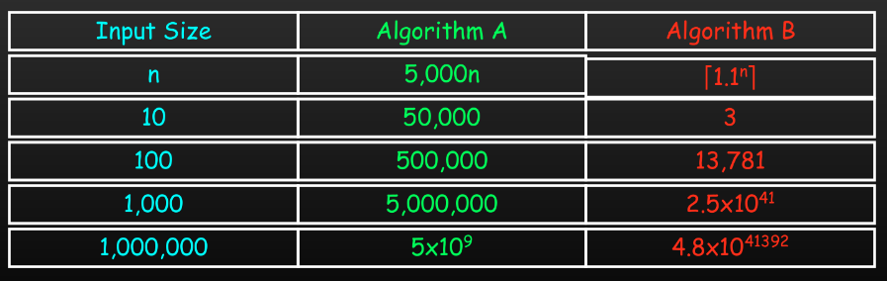
Complexity
Comparison: time complexity of algorithms A and B
This means that algorithm B cannot be used for large inputs, while algorithm A is still feasible.
So what is important is the growth of the complexity functions.
The growth of time and space complexity with increasing input size n is a suitable measure for the comparison of algorithms.

Slide 20
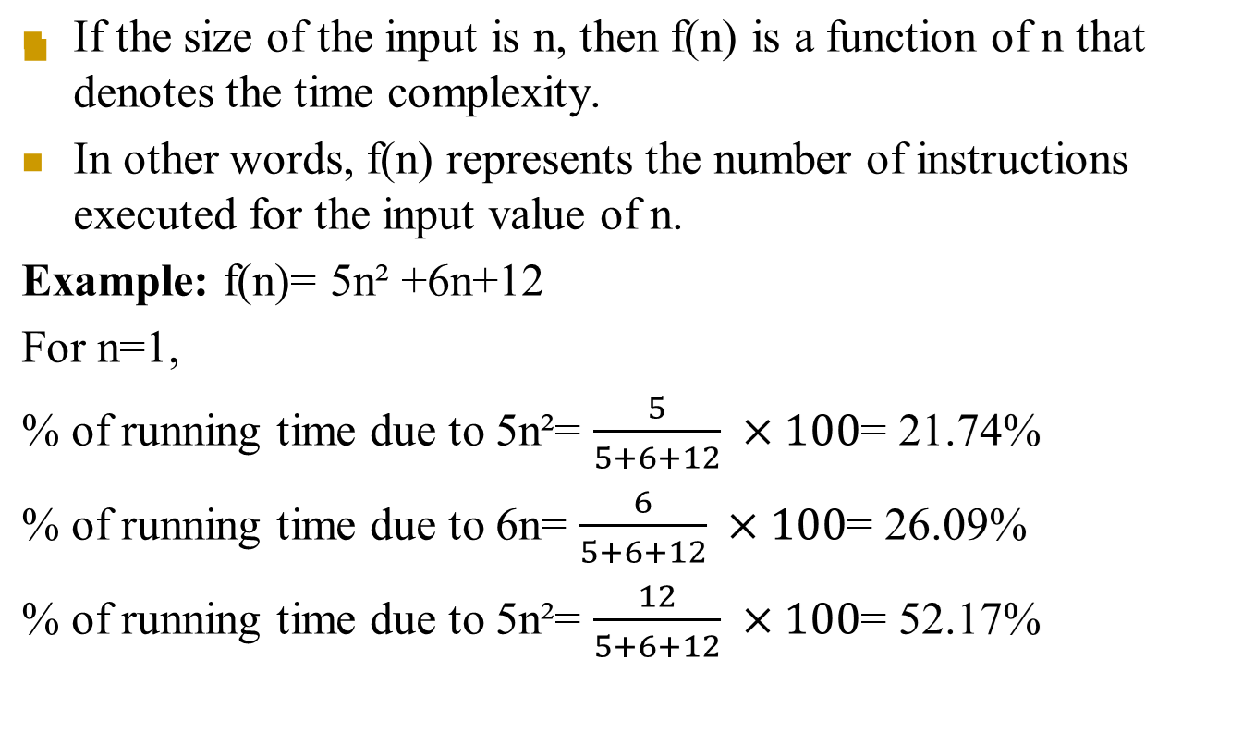
Time complexity
12

Slide 21
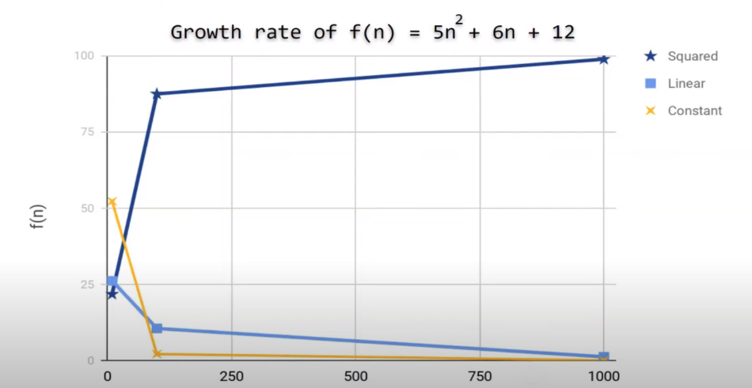
f(n)= 5n² +6n+12
n | 5n² | 6n | 12
1 | 21.74% | 26.09 | 52.17%
10 | 87.41% | 10.49% | 2.09%
100 | 98.79% | 1.19% | 0.02%
1000 | 99.88% | 0.12% | 0.0002%

Slide 22
Importance of growth rate
Linear Search | Binary Search
100 items 100 comparisons (100 ms) | 100 items 7 comparisons (7 ms)
1 billion items 1 billion comparisons (1000000000 ms) = 1000000000 / (24*60*60*1000) ≈ 11.574 days | 1 billion items 30 comparisons (30 ms)

Slide 23
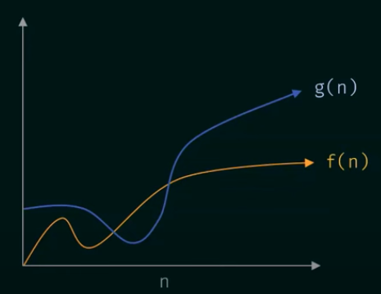
Asymptotic Notation
These notations are used to describe the running time or space requirement of an algorithm.
1. 0-notation- for the upper bound running time
2. Ω-notation- for the lower bound running time
3. Θ-notation - for the average bound running time

Slide 24
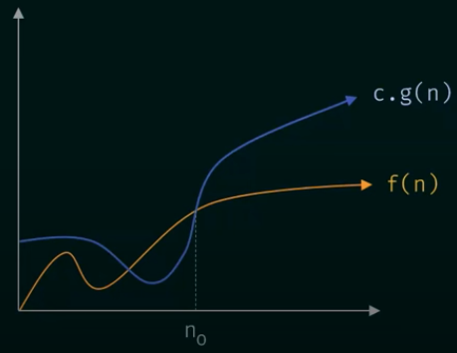
0-notation
- A function f(n)=0(g(n)) if there are positive constants c and n₀ such that
f(n) <= c.g(n) for all n>= n₀.
- When f(n)=0(g(n)), it is guaranteed that f(n) grows at a rate no faster than g(n).
So g(n) is an upper bound on f(n).

Slide 25
Calculating 0-notation
Example 1:
Assume that f(n)= 5n+50 and g(n) = n. Is f(n)=O(g(n))?
Assuming c = 6
So we can say that,
5n+50 = O(n)
for c=6 and n≥ 50
 | 5n+50 | 6n
n=10 | 100 | 60
n= 20 | 150 | 120
n=50 | 300 | 300
n=51 | 305 | 306

Slide 26
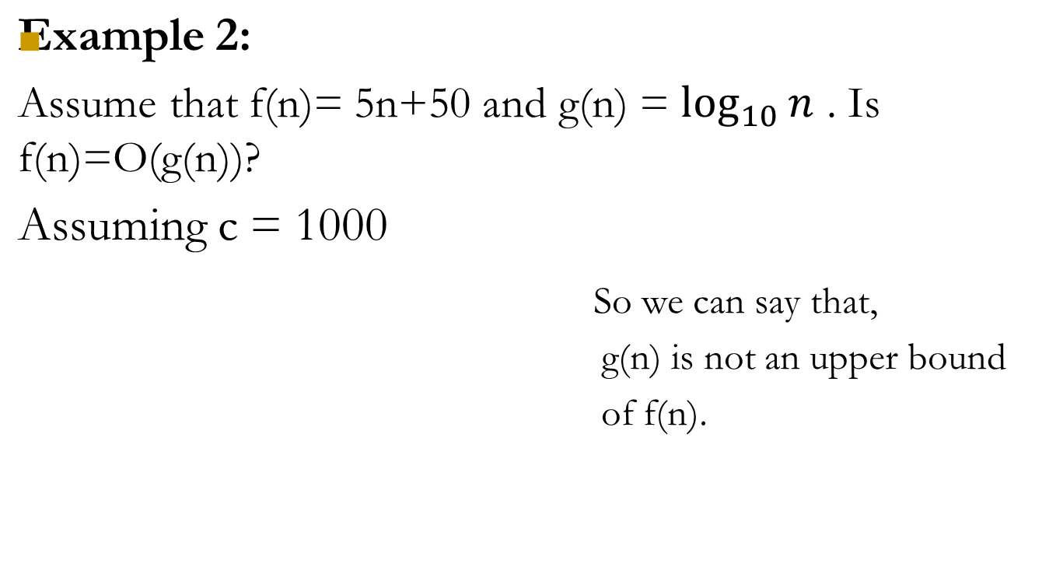
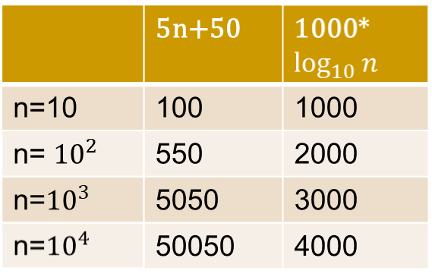
Calculating 0-notation

Slide 27
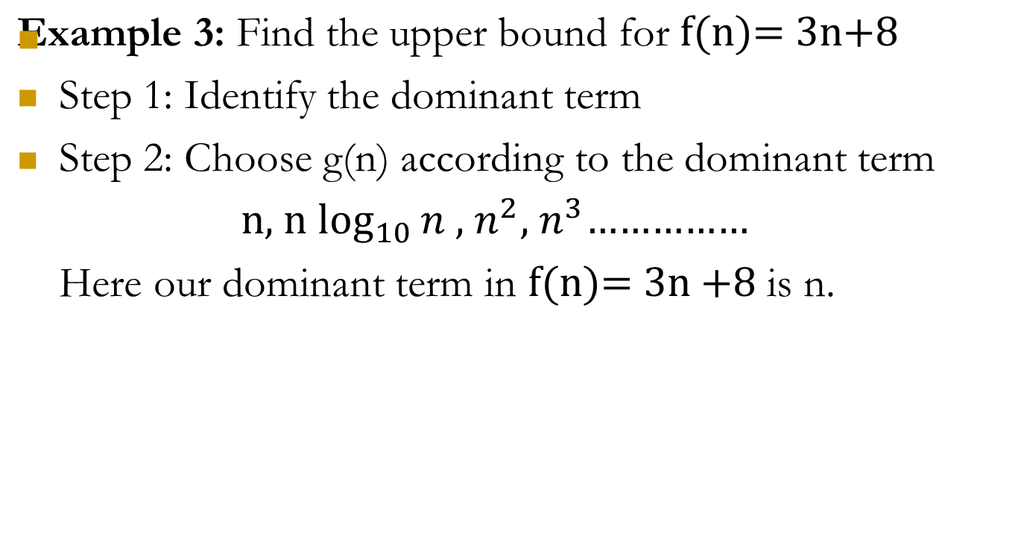
How to find g(n)?

Slide 28
Steps to calculate c and n₀
Step 3: Apply the Big O notation.
According to the definition of Big O Notation:
f(n)=O(g(n)) iff f(n) <= c.g(n) for all n>= n₀. where c and n₀ are positive constants.
Assuming c =4,
We can say that,
3n+8 = O(n)
for c=4 and n≥ 8
 | 3n+8 | 4n
n=7 | 29 | 28
n=8 | 32 | 32
n= 10 | 38 | 40
n= 100 | 308 | 400

Slide 29
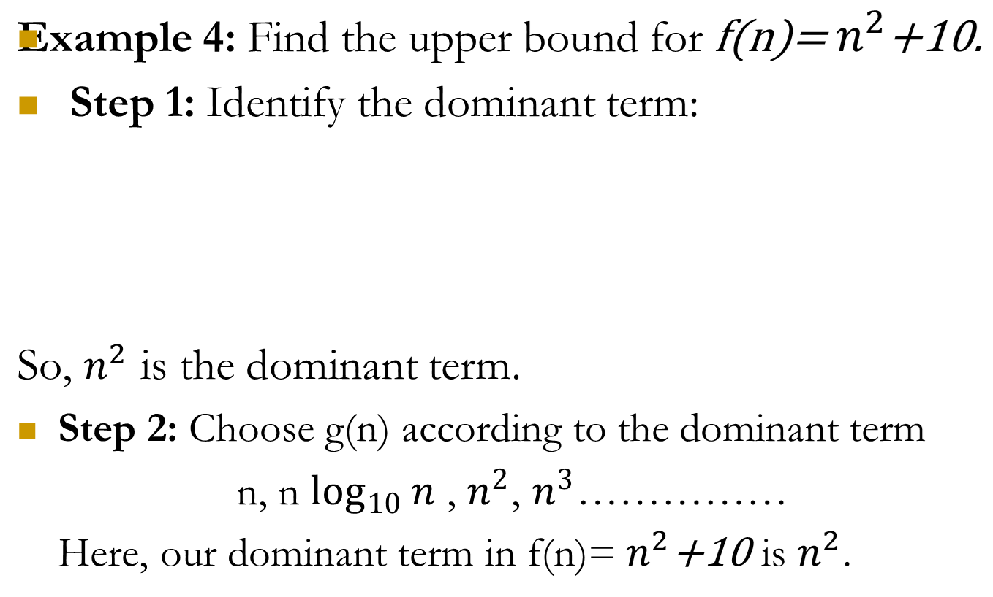
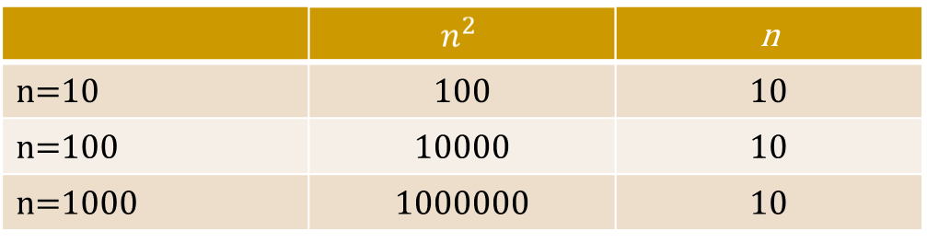
Calculating 0-notation

Slide 30
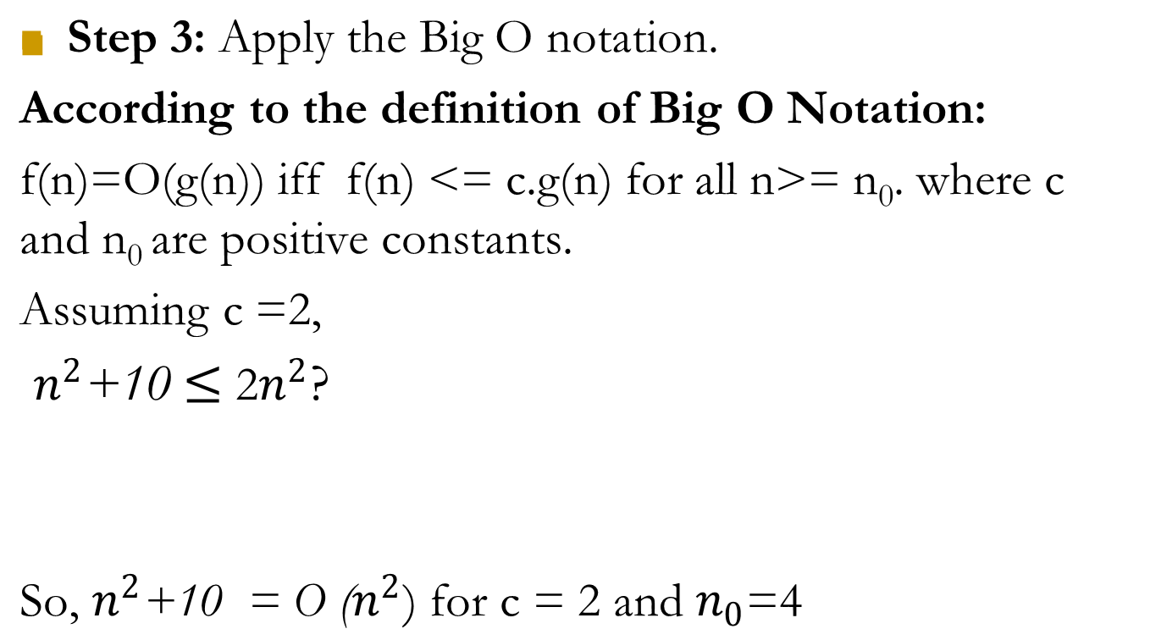
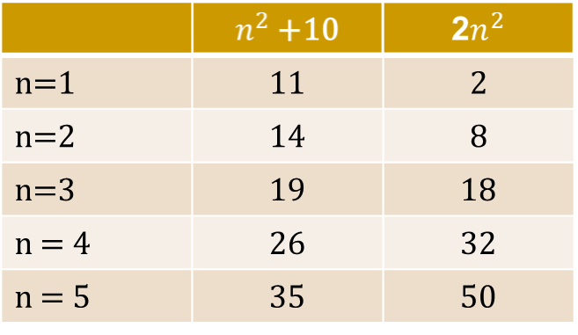

Calculating 0-notation

Slide 31
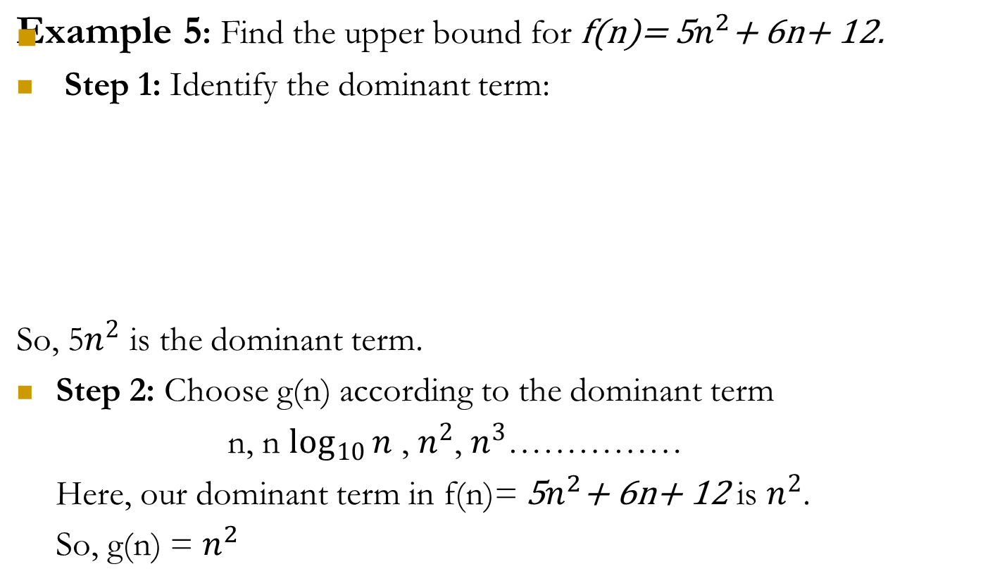
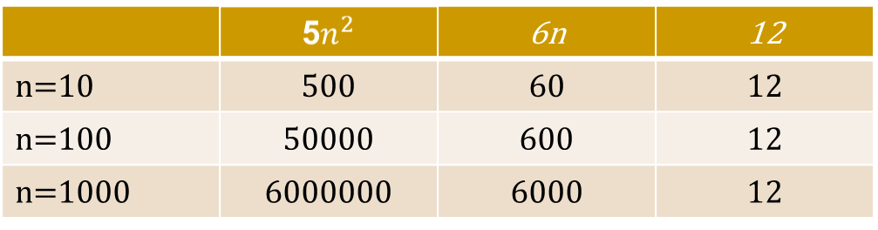
Calculating 0-notation

Slide 32
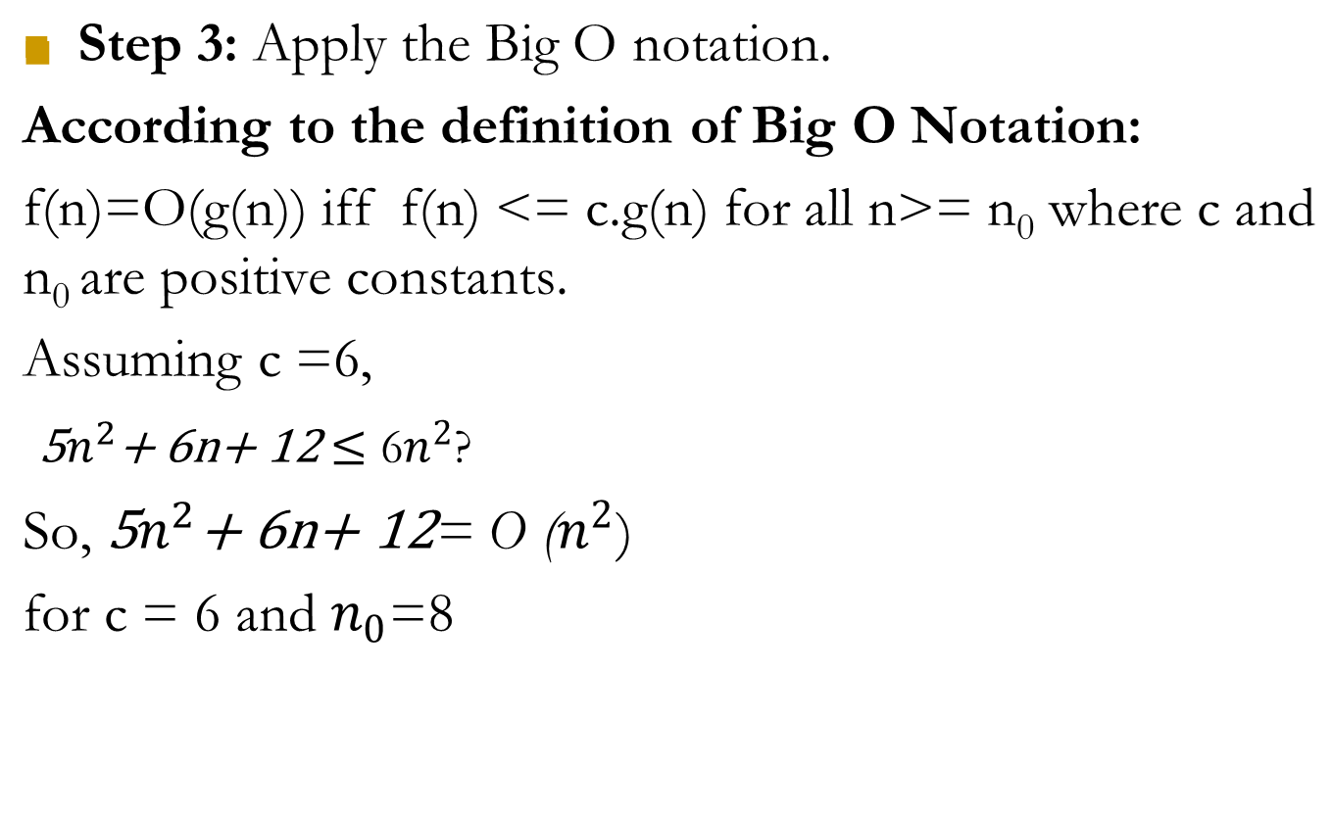
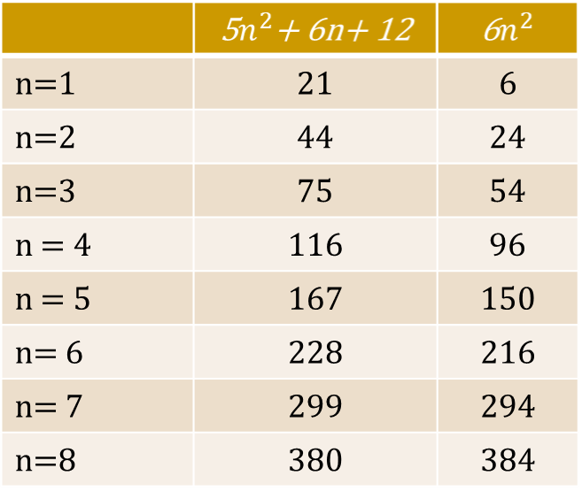

Calculating 0-notation

Slide 33
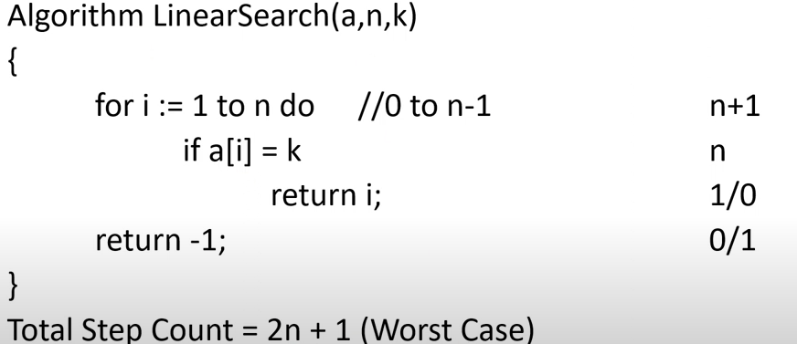
Time Complexity of Linear Search
Total Step Count = 2n+1 (Worst Case)

Slide 34
Ω-notation
- A function f(n) = Ω(g(n)) if there are positive constant c and n₀ such that c.g(n)<=f(n) for all n>= n₀.
- When f(n) = Ω(g(n)), it is guaranteed that f(n) grows at a rate faster than g(n).
So g(n) is a lower bound on f(n).
Example:
(a) f(n) = 3n+2
Here f(n) > n for n>=1
So, f(n) = Ω(n).
(b) f(n) = 3n²+2
Here f(n) > 3n² for n>=1
So, f(n) = Ω(n²).

Slide 35
3. Θ-notation
- A function f(n)= Θ(g(n)) if there are positive constants c₁, c₂ and n₀ such that
0<=c₁.g(n)<=f(n)<=c₂.g(n) for all n>= n₀.
- The Θ-notation asymptotically bounds a function from above and below.
Example:
(a) f(n) = 3n+2
Here, f(n) = 0(n) and f(n)= Ω(n).
So, f(n) = Θ(n)
(b) f(n) = 3n²+2
Here, f(n) = 0(n) and f(n) = Ω(n).
So, f(n) = Θ(n²)

Slide 36
4. o-notation
The function f(n) = o(g(n)) if and only if lim_{n->∞} = 0.
Example: Suppose f(n) = 3n+2
Let g(n)=n².
lim_{n->∞} = lim_{n->∞} = 0.
So, 3n+2 = o(n²).
5. ω-notation
The function f(n) = ω(g(n)) if and only if lim_{n->∞} = ∞.
Example: Suppose f(n) = 3n²+2
Let g(n)=n.
lim_{n->∞} = lim_{n->∞} = 0.
So, 3n²+2 = ω(n).
f(n)
g(n)
f(n)
g(n)
3n+2
n²
f(n)
g(n)
g(n)
f(n)
n
3n²+2

Slide 37
Some rules related to asymptotic notation
Rule-1
If f_{a}(n) = 0(g_{a}(n)) and f_{b}(n) = 0((g_{b}(n)) then
(a) f_{a}(n)+f_{b}(n) = max(0(g_{a}(n)),0(g_{b}(n))
(b) f_{a}(n) * f_{b}(n) = 0(g_{a}(n) * g_{b}(n))
Rule-2
If f(n) is a polynomial of degree k, then f(n) = Θ(n^{k}).
Rule-3
Log^{k}n = 0(n) for any constant.

Slide 38
Typical Growth Rates
Function | Name
c | Constant
logn | Logarithmic
log²n | Log-squared
n | Linear
nlogn
n² | Quadratic
n³ | Cubic
2^{n} | Exponential

Slide 39
Thank You!

