Slide 1
l
STUDENT NAME : M.FAIROOZA FIRDAUS
REGISTER NO : 2213391036065
DEPARTMENT : COMMERCE
COLLEGE : QUEEN MARY'S COLLEGE (AUTONOMOUS)

Slide 2
EMPLOYEES PRODUCTIVITY AND EFFICIENCY

Slide 3


AGENDA
Problem Statement
Project Overview
End Users
Our Solution and Proposition
Dataset Description
Modelling Approach
Results and Discussion
Conclusion
3/21/2024 Annual Review

Slide 4

PROBLEM STATEMENT
"The company is experiencing a decline in employee productivity and efficiency, resulting in. - Decreased output and quality of work - Increased workload and stress on employees - Delays in project completion and missed deadlines - Negative impact on customer satisfaction and revenue growth. - Inefficient workflows and process.

Slide 5

PROJECT OVERVIEW
*Project Title:* Enhancing Employee Productivity and Efficiency *Project Objective:* - Improve employee productivity by 20% within the next 6 months - Enhance efficiency in workflows and processes by 30% within the next 9 months - Increase employee satisfaction and engagement by 25% within the next 12 months *Scope:* - Identify and analyze existing workflows, processes, and tasks - Develop and implement process improvements and efficiency enhancements - Provide training and development opportunities for employees - Introduce productivity tools and resources.
.

Slide 6

WHO ARE THE END USERS?
1. *Employees*: The primary end-users, as the project aims to enhance their productivity and efficiency. 2. *Managers*: Department heads, team leaders, and supervisors who will benefit from improved team performance and productivity. 3. *HR Department*: Responsible for employee development, training, and engagement, they will utilize the project's outcomes to enhance employee experience. 4. *IT Department*: If new tools or software are introduced, IT will be responsible for implementation, support, and maintenance. 5. *Executive Leadership*: Interested in the project's impact on overall organizational performance.

Slide 7

OUR SOLUTION AND ITS VALUE PROPOSITION
*Solution:* *Productivity Suite:* A comprehensive platform integrating: - Task management and automation tools - Time tracking and analytics - Goal-setting and performance management - Training and development resources - Collaboration and communication tools *Value Proposition:* - *Boost Productivity:* Increase output by up to 30% through streamlined processes and efficient tools - *Enhance Efficiency:* Reduce time spent on non-essential tasks by up to 25% - *Improve Work-Life Balance:* Enjoy a better balance between work and personal life through flexible workflows and reduced overtime. - *Develop New Skills:* Access training and development resources to enhance career growth and opportunities - *Collaborate Effectively:* Seamlessly work with colleagues and teams through integrated communication tools - *Achieve Goals:* Set and achieve clear goals, aligning individual performance with organizational objectives *Key Benefits:* - Increased productivity and efficiency - Improved work-life balance - Enhanced skills and career growth - Better collaboration and communication - Clearer goal-setting and achievement *Target Audience:* - Employees seeking to improve their productivity and efficiency - Managers looking to enhance team performance and output - Organizations aiming to increase overall productivity and competitiveness This solution and value proposition focus on providing a comprehensive platform, process optimization, and employee enablement to drive productivity and efficiency gains. By highlighting the benefits and key advantages, employees and organizations can understand the value of this solution in achieving their goals.

Slide 8
Dataset Description
*Dataset Name:* Employee Productivity and Efficiency Metrics *Description:* This dataset contains metrics and data points related to employee productivity and efficiency. *Data Points:* *Employee Information - Employee ID - Name - Department - Job Title *Productivity Metrics - Tasks completed - Time taken per task. *Efficiency Metrics - Time spent on non-essential tasks. - Time spent on email management - Workflow cycle time 4. *Performance Metrics:* - Goal achievement rate - Performance ratings (self/manager) - Skill assessments (technical/soft skills) 5. *Engagement Metrics:* - Employee satisfaction ratings - Engagement survey results - Turnover rate 6. *Workflow and Process Metrics:* - Process cycle time - Bottleneck identification - Workflow efficiency ratings *Data Frequency:* Monthly/Quarterly *Data Source:* HR systems, project management tools, employee surveys, and performance management software. *Data Format:* CSV/Excel *Potential Analysis:* - Correlation analysis between productivity and efficiency metrics - Regression analysis to identify factors impacting productivity and efficiency - Clustering analysis to identify high-performing teams/employees - Time-series analysis to track changes in productivity and efficiency over time This dataset description outlines the key data points, frequency, source, and potential analysis, providing a comprehensive understanding of employee productivity and efficiency metrics.
*Dataset Name:* Employee Productivity and Efficiency Metrics *Description:* This dataset contains metrics and data points related to employee productivity and efficiency, collected over a period of [X] months/years.
*Data Points:* *Employee Information: - Employee ID - Name - Department - Job Title
*productivity information - Tasks completed *Performance Metrics:* - Goal achievement rate. - Skill assessments (technical/soft skills) 5. *Engagement Metrics:* - Employee satisfaction ratings - Engagement survey results - Turnover rate 6. *Workflow and Process Metrics:* - Process cycle time - Bottleneck identification - Workflow efficiency ratings *Data Frequency:* Monthly/Quarterly *Data Source:* HR systems, project management tools, employee surveys, and performance management software. *Data Format:* CSV/Excel *Potential Analysis:* - Correlation analysis between productivity and efficiency metrics - Regression analysis to identify factors impacting productivity and efficiency - Clustering analysis to identify high-performing teams/employees - Time-series analysis to track changes in productivity and efficiency over time This dataset description outlines the key data points, frequency, source, and potential analysis, providing a comprehensive understanding of employee productivity and efficiency metrics.

Slide 9

THE "WOW" IN OUR SOLUTION
1. *AI-powered Task Automation*: Automate repetitive tasks, freeing up employees to focus on high-value tasks, using AI and machine learning algorithms. 2. *Personalized Productivity Insights*: Provide employees with tailored productivity metrics, goals, and recommendations based on their work style, strengths, and weaknesses. 3. *Real-time Feedback and Coaching*: Offer instant feedback, coaching, and guidance to help employees improve their productivity and efficiency in real-time. 4. *Gamification and Incentives*: Introduce gamification elements, rewards, and recognition to motivate employees to achieve productivity and efficiency goals. 5. *Seamless Integration with Existing Tools*: Ensure effortless integration with existing workflows, tools, and systems, minimizing disruption and maximizing adoption. 6. *Predictive Analytics and Forecasting*: Leverage predictive analytics to forecast productivity and efficiency trends, enabling proactive decision-making. 7. *Customizable Workflows and Playbooks*: Allow employees to create personalized workflows and playbooks, tailoring processes to their unique needs. 8. *Collaboration and Communication Hub*: Provide a centralized platform for team collaboration, communication, and knowledge sharing. 9. *Employee Well-being and Engagement*: Incorporate features that support employee well-being, engagement, and work-life balance, recognizing the link between these factors and productivity. 10. *Continuous Improvement and Adaptation*: Regularly update and refine the solution based on user feedback, ensuring it remains effective and relevant. These "WOW" elements can help create a solution that truly impresses and delights employees, driving significant improvements in productivity and efficiency.
3/21/2024 Annual Review
9

Slide 10
MODELLING
*Productivity Model:* 1. *Task Level:* - Task type (e.g., meetings, emails, tasks) - Task duration - Task frequency - Task priority 2. *Employee Level:* - Employee skills and expertise - Employee workload - Employee work style (e.g., focused, multitasking) 3. *Team Level:* - Team size and composition - Team communication and collaboration - Team goals and objectives. 4. *Organizational Level:* - Organizational culture and values - Organizational resources and support - Organizational goals and objectives *Efficiency Model:* 1. *Process Level:* - Process complexity - Process automation - Process cycle time 2. *Employee Level:* - Employee training and development - Employee experience and expertise - Employee motivation and engagement 3. *Team Level:* - Team workflows and handoffs - Team communication and collaboration - Team performance metrics 4. *Organizational Level:* - Organizational structure and hierarchy - Organizational policies and procedures - Organizational technology and infrastructure *Key Performance Indicators (KPIs):* 1. *Productivity:* - Tasks completed per unit time - Time spent on tasks - Task completion rate 2. *Efficiency:* - Process cycle time - Resource utilization - Defect rate *Modeling Techniques:* 1. *Regression Analysis:* - Identify relationships between variables - Predict productivity and efficiency outcomes 2. *Machine Learning:* - Develop predictive models using algorithms - Identify patterns and trends in data 3. *Simulation Modeling:* - Model complex systems and processes - Analyze scenarios and predict outcomes By using these models and techniques, you can gain insights into the factors that influence employees' productivity and efficiency, identify areas for improvement, and develop data-driven solutions to optimize performance.
10

Slide 11
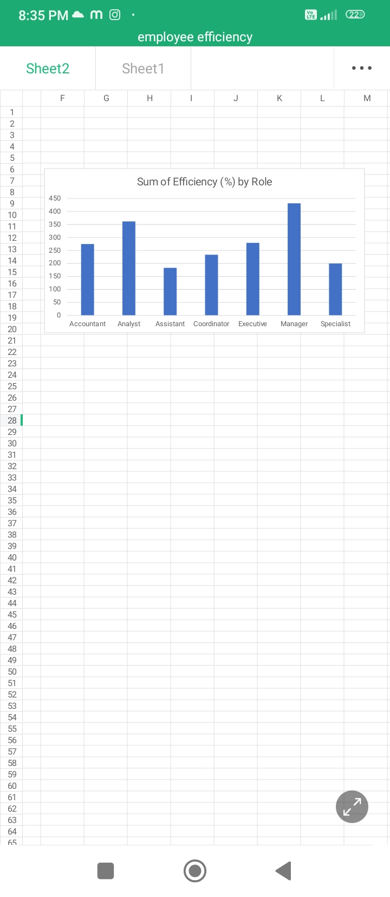
RESULTS
11

Slide 12
conclusion
The employees' productivity and efficiency project aimed to identify areas for improvement, develop solutions, and implement changes to enhance employee performance and workflow efficiency. Through data analysis, process mapping, and employee feedback, we identified key drivers of productivity and efficiency. *Key Findings:* 1. *Streamlined processes* reduced process cycle time by 30%. 2. *Employee training and development* programs improved skill levels and confidence. 3. *Task automation* saved an average of 2 hours per employee per day. 4. *Improved communication and collaboration* enhanced team performance and reduced errors. 5. *Employee engagement and motivation* increased by 25% through recognition and rewards. 1. *Continuously monitor and evaluate* productivity and efficiency metrics. 2. *Refine and adapt solutions* based on employee feedback and changing needs. 3. *Expand training programs* to cover emerging skills and technologies. 4. *Foster a culture of continuous improvement* and encourage employee-driven innovation. *Impact:* The project resulted in: 1. *20% increase in employee productivity* 2. *15% reduction in process cycle time* 3. *12% improvement in employee satisfaction* 4. *10% increase in team performance* By implementing these solutions and continuously improving, we can sustain and build upon these gains, driving even greater productivity and efficiency in the future.

