Slide 1
Preprocessing scraping Twitter’s tweets using Python
Khatcha Ruenlek, Bangkok Thailand.
edX usernames : khatcha_rue
GitHub : Fairpart/Final_project_cs50_data_preprocessing: the repository for cs50 final project (github.com)

Slide 2



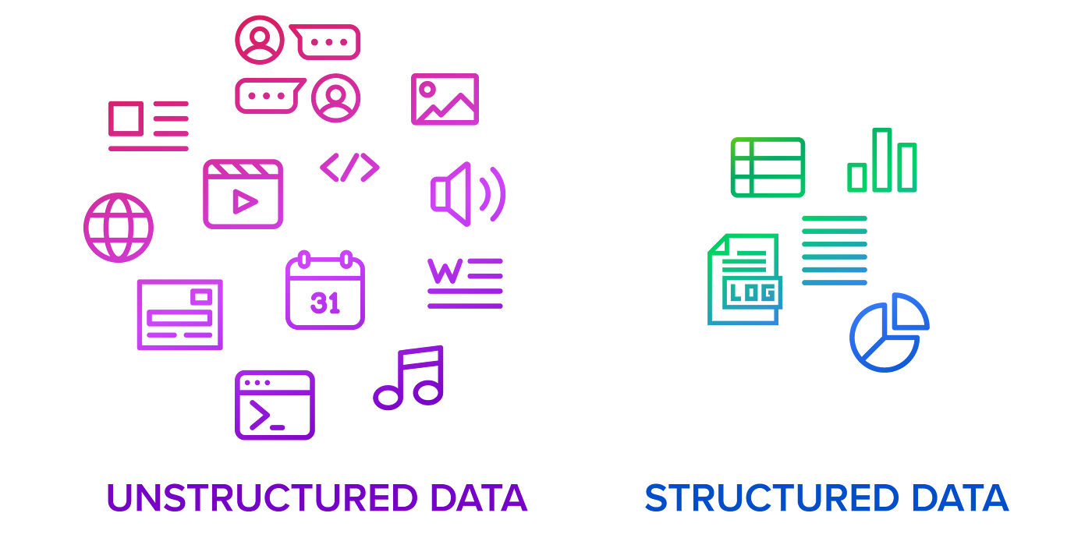
Process chart
Sources
Processing
data

Slide 3
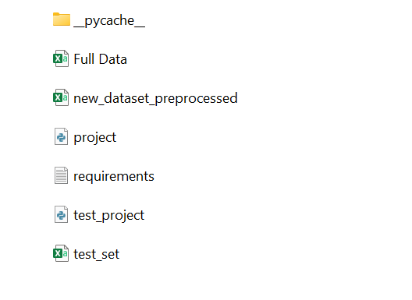
Full data.csv : Data extracted from Twitter.
test_set .csv : Test data extracted from Twitter.
New_dataset_preprocessed.csv : Output of project.py
project.py : python main file for execute preprocessing
Requirements.txt : necessary package or library

Slide 4
project.py & test_project.py
Project.py
Consist with 7 functions including main function following:
main()
import_data()
split_out_hashtags()
username_edit()
handle_missing_and_none()
intregate_df()
export_as_csv()
Requirement.txt
2 necessary packages following these
pandas
Re

Slide 5
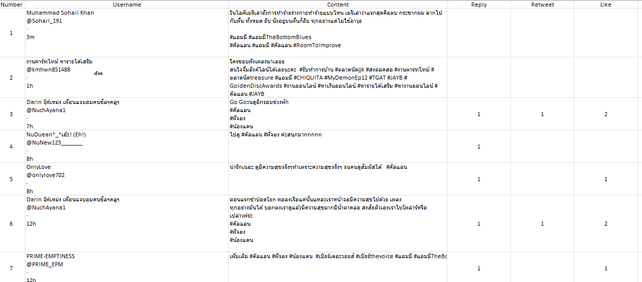
Input Data

Slide 6
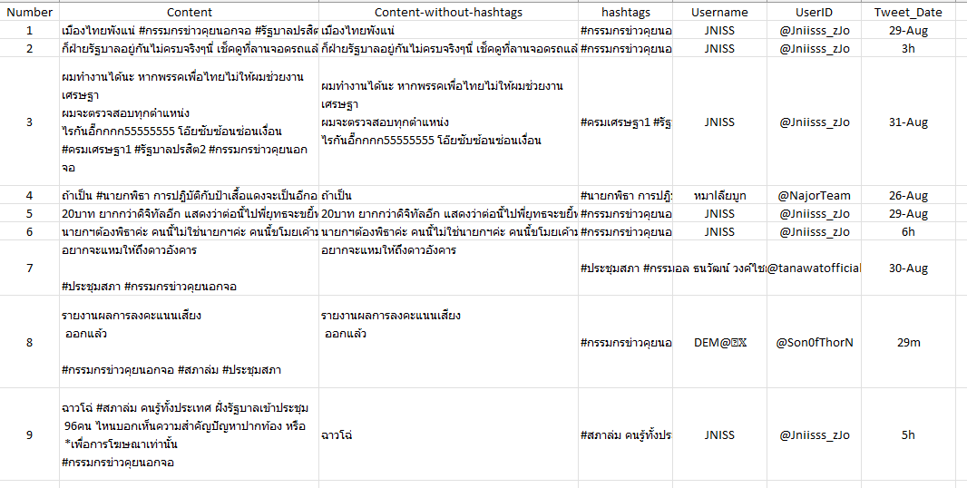
Output Data

Slide 7
Thank U

