Slide 1

FRC LabVIEW Software Overview
Joe Hershberger
Staff Software Engineer
National Instruments

Slide 2
Agenda
Robot Framework
Basic
Advanced
Debugging
Palette Overview
Gyro
Analog Trigger
Digital Input
Encoder
Robot Drive
PID Control
Common Questions
Questions?
Notes:
LabVIEW palette – initial view is restricted for new users. In order to switch to the full palette set – use Switch Palette Set… in the tools menu. You get the standard LabVIEW palettes as well as 2 palettes that are specific to the FRC competition. FIRST Vision and WPI Robotics Library. The FIRST Vision palette will be mainly discussed in a later session. This session will focus primarily on the WPI Robotics Library. In addition to standard LabVIEW, we have also included the PID toolkit in the FRC installation. We will cover PID basics in the sessions as well.
All of the functions in the palettes have additional help associated with them. If you have Context Help open (Ctrl-H) you can get a brief description of a palette or function with the option to access more detailed help.

Slide 3
Robot Framework - Basic
Frameworks handle switching between modes for you
Select Basic when creating your cRIO Robot Project
Robot Main.vi allows users to drop Tele-Op code into designated areas directly
Provided Autonomous VI is spawned off by framework code
Basic framework implements 2-wheel, Jaguar, arcade drive by default

Slide 4
Robot Framework - Advanced
Select Advanced when creating your cRIO Robot Project
Users should not have a need to modify Robot Main.vi
Users modify the VIs in the “Team Code” folder in the framework project
Basic framework implements 2-wheel, Jaguar, arcade drive by default

Slide 5
Debugging
Execution Highlighting
Probes
Breakpoints
Stepping
Vision Probes
Dashboard
Error Display.vi
Dialog
File
Dashboard
Serial Console
Notes:
Dependencies -> vi.lib - > NI_FPGA_Interface.lvlib -> Error Management -> Error Display.vi
C:\Program Files\National Instruments\LabVIEW 8.5\vi.lib\Robotics Library\NIFPGAInterface\ErrorManagement\ErrorDisplay.vi

Slide 6
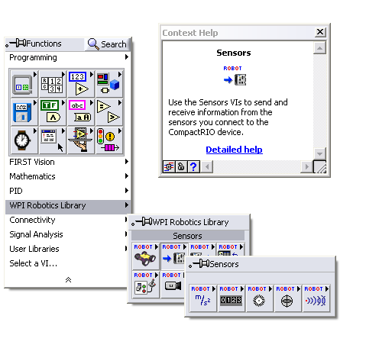
Overview
LabVIEW palette sets
FRC specific palettes
FIRST Vision
WPI Robotics Library
PID Toolkit palette
Context Help
Notes:
LabVIEW palette – initial view is restricted for new users. In order to switch to the full palette set – use Switch Palette Set… in the tools menu. You get the standard LabVIEW palettes as well as 2 palettes that are specific to the FRC competition. FIRST Vision and WPI Robotics Library. The FIRST Vision palette will be mainly discussed in a later session. This session will focus primarily on the WPI Robotics Library. In addition to standard LabVIEW, we have also included the PID toolkit in the FRC installation. We will cover PID basics in the sessions as well.
All of the functions in the palettes have additional help associated with them. If you have Context Help open (Ctrl-H) you can get a brief description of a palette or function with the option to access more detailed help.

Slide 7
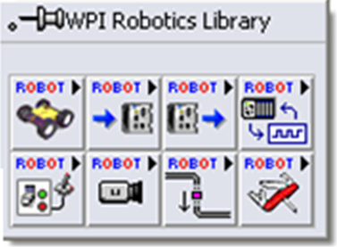
WPI Robotics Library Overview
Interfaces with cRIO, sensors & actuators
Basic functionality matches C/C++ version
Contains multiple palettes
Robot Drive
Sensors
Actuators
IO
Driver Station
Camera
Communications
Utilities
Notes:
WPI is used to interface with various devices including the cRIO, sensors, actuators, the camera, the driver station etc…
The functionality will match what is available in the C/C++ version of WPI Lib, but because of language differences, the actual implementation may differ.
Talk about the different palettes in a greater detail:

Slide 8
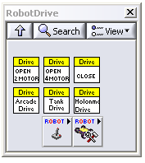
Robot Drive
Higher level options for 2 and 4 wheel drive
Arcade
Tank
Holonomic
Use by opening references to motor controllers (specifying Jaguar or Victor) and then passing to drive mechanism
Joystick Palette
Advanced Palette for direct
control of motors using PWM
channel
Notes:
Robot Drive – This palette gives you APIs for driving the robot. There are higher level options for 2 and 4 wheel driving, tank, arcade, holonomic etc… You use these by specifying 2 or 4 wheel drive and opening a reference for those motors (specifying type). Then you can pass the reference into your desired drive mechanism. Later in this presentation we will take a more in-depth look at how to use the RobotDrive API.
This palette also contains subpalettes for getting information from up to 4 joysticks (via the DS) and controlling the motor controllers directly using the PWM channel.
Note that there are existing examples for how to use the arcade drive, tank drive, motor control, getting joystick values, and do custom motor scaling.

Slide 9
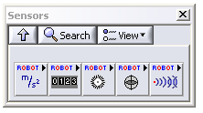
Sensors
Contains Subpalettes:
Accelerometer
Counter
Encoder
Gyro
Ultrasonic
Notes:
Sensors palette – This palette contains built in sensor support for different sensors. Accelerometer, Counter, Encoder, Gyro, and Ultrasonic. Later in this presentation we will take a more in depth look at two of the more commonly used sensors: the Gyro and Encoder.
All of the APIs in the palette work on the same paradigm. Open a reference to the sensor that you would like to use, read one or more values from the sensor then close the reference. Some of the sensors, like Counter and Encoder, will additionally need to be started/stopped/reset in order to take readings.
Note that there are examples for all of these APIs except ultrasonic.

Slide 10
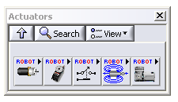
Actuators
Contains Subpalettes:
Motor Control
Servo
Relay
Solenoid
Compressor
Notes:
Actuators palette – This palette contains built in support for different actuators. Motor Controllers, Servos, Relay, Solenoid, and Compressor.
All of the APIs in the palette work on the same paradigm as the sensor palettes. Open a reference to the actuator that you would like to use, set one or more values then close the reference to the actuator. In some cases, you can get a value from the actuator as well as setting it.
This may be a good time to talk about how the processor the compressor is spun off. Also, about how you have to feed the watchdog or shut it off in order to use an actuator.
Note that there are examples for all of these APIs.

Slide 11
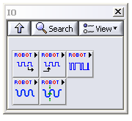
IO
Contains Subpalettes:
Digital Input
Digital Output
PWM
Analog Channel
Analog Trigger
Notes:
IO palette – This palette contains lower level access to the digital and analog modules. All of these Input/Output palettes have very simple Open, Get/Set, Close interfaces.
You may want to note here how you do not expect people to be using the PWM API directly with all the stuff that is already provided to them in the Robot Drive palette.
There are also more advanced analog functions in this palette for using accumulators, doing averaging, and analog triggering.
Note that there are examples for all of these APIs.

Slide 12
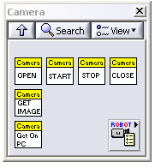
Camera
Contains :
Functions:
Open, Close
Start, Stop
Get Image
Get Image from Controller
Subpalette:
Camera Properties
Notes:
Camera Palette: Note that this palette is only for interfacing with the camera and getting images. It doesn’t have any functions on it for image processing. You can find those functions in the FIRST Vision palette.
You use most of the functions on this palette to Open and Close references to the camera, Start and Stop the camera from acquiring images and to actually obtain the images from the camera. There is one function, that is used from the host computer rather than on the cRIO Controller: Get Image from Controller. You can use this function on the PC side in order to obtain images from the cRIO.
There is also a subpalette for setting properties on the camera.
We have included a variety of vision examples that use the APIs in the palette in order to obtain images.

Slide 13
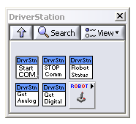
Driver Station
Contains :
Functions:
Start Communication
Stop Communication
Set Robot Status
Get Analog Data
Get Digital Data
Subpalette:
Joystick API subpalette
Notes:
Driver Station Palette: Contains various functions for communicating with the driver station. You can start and stop communication (this should be handled for you in the starter framework), set the user data that will be sent back to the computer, and get the digital and analog values from devices that are connected to the driver station.
There is also a link to the joystick subpalette to get information from up to 4 joysticks that are connected to the driver station.

Slide 14
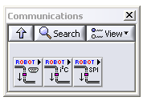
Communications
Contains Subpalettes:
Serial
I2C
SPI
Notes:
Communications palette: This palette contains APIs for Serial, I2C, and SPI interfaces.

Slide 15
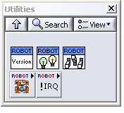
Utilities
Contains :
Functions:
FRC FPGA Version
FRC LEDs
FRC ReadSwitch
Subpalettes:
Watchdog
Interrupts
Notes:
Utilties palette: This palette contains functions for getting/setting information on the cRIO such as the FPGA version number, the state of the LEDs on the front of the cRIO and the user switch on the cRIO.
There are also subpalettes for the User Watchdog and Interrupts. Discuss these as much as you think the audience needs to hear.

Slide 16
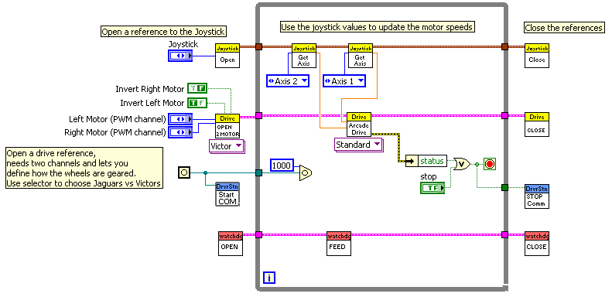
Robot Drive Example

Slide 17
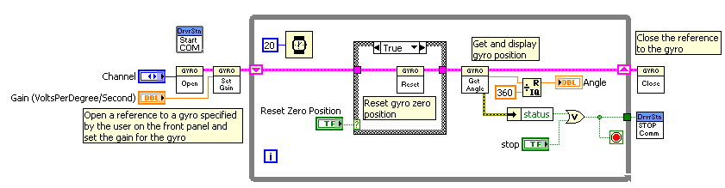
Gyro Example

Slide 18
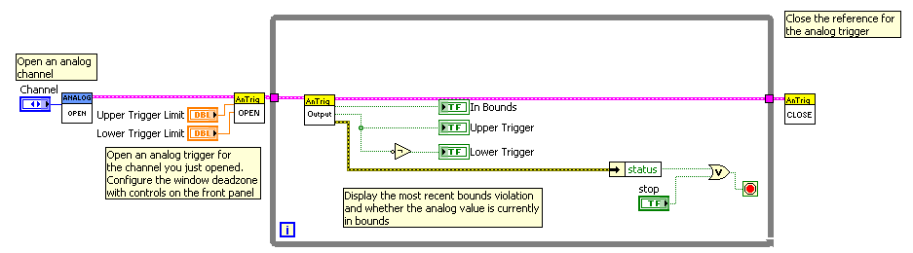
Analog Trigger Example

Slide 19
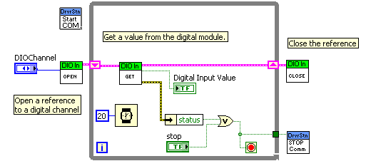
Digital Input Example

Slide 20
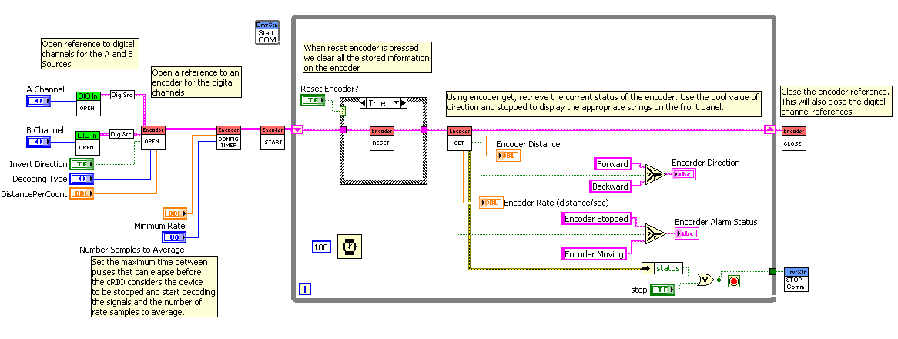
Encoder Example

Slide 21
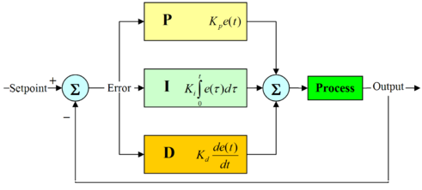
PID Control
Control Loop Feedback Algorithm
Uses 3 parameters:
Proportional Value
Integral Value
Derivative Value

Slide 22
Proportional Value
Determines reaction based on what the current error is
Integral Value
Determines reaction based on what the sum of the recent errors is
Derivative Value
Determines reaction based on the rate of how the error has been changing

Slide 23

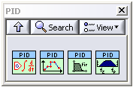
PID Control
Varying the multiplier constants for PID (Kp, Ki, Kd) for a specific system is called tuning
PID toolkit in LabVIEW provides functions for implementing a PID control loop

Slide 24
Common Questions
What is the difference between running and deploying?
How can I build an application to deploy?
Why do I keep losing the startup application on my cRIO?
Will software updates continue to be provided?
Why won’t any of my actuators work?
Why doesn’t my counter/encoder work?
Why do I measure zero battery voltage?
Why doesn’t my servo work?

Slide 25
Questions?

