Slide 1
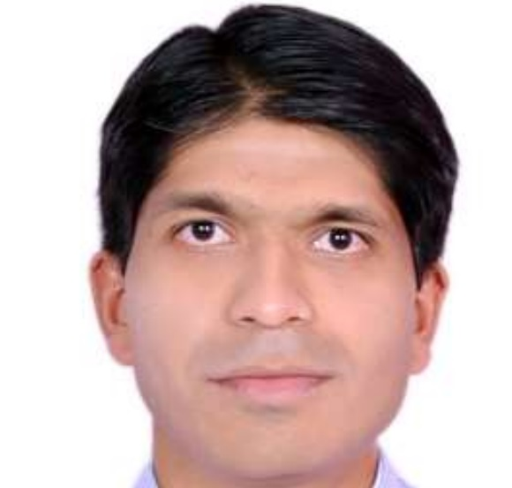
Vinayak Anvekar
Professional Experience
Vinayak is a Full Stack Developer with 8+ years of experience in Web Design, development applications. Artifacts developed include technologies, from Angular, React with Android Studio, Spring Boot/Cloud, Core Java/J2EE, Typescript/JavaScript.
Expertise in Angular with Bootstrap/Material integration with Micro-Front-End functionality.
Proficient in SPA design for Android + Web , utilizing Capacitor / Cordova interaction with relational / cloud databases.
Good Understanding of Several Frameworks from Story Book , NGRX to even the SASS base CSS design
Practical experience in integration of payment gateway such a PayPal, Stripe.
Worked in KYC and Onboarding Workflow using Angular with Android Activities for SCAN , Location detect service from Google Play Services
Articulated docker based Angular and Testing Based environments that deliver high-quality Test Workflows within deadlines.
Designed Java based JAXRS REST API schema for multipart form and document upload , WSDL along with WADL design.
Tools & Technology:
Angular , React , Ng nix, Mongodb , REDUX , Node JS, Spring Cloud , Spring Batch, Spring Security, Microservices, Mongo DB, MySQL ,AWS, Jenkins, JIRA, GIT, Maven, Bitbucket, SonarQube, Figma , Cypress, DOCKER , Google Play Services.
Full Stack Developer
Email :vanvekar@deloitte.com Phone: 7588230462
Qualifications
B.C.A : IMCC University
M.C.A: IMCC University
Key Engagements
Primary Skill
Worked with Ingram Reseller (B2B Portal ) as WCS and Full stack Developer.
Involved in integrating Social Authenticating using Google / Facebook, Design ,develop and consume web services.
Achieved the re-use of Angular WEB code with Capacitor and Cordova for Mobile Apps.
Rigorous Web UI / Android Layout design, suitable for deployment over NPM different client engagement apps.
Actively participating in the Knowledge Based improvements and POC’s for SPA for WEB/Android.
Provided Kubernetes support for the project deployed in the production using Kibana/ Dynatrace.
Worked with AIG Insurance Company in US for marketing of insurance and assurance products.
Generated a Feedback Workflow for Customer’s to provide theirs views on Insurance products the enrolled for.
Data model design ,user upload using AWS Cognito , AWS Aurora DB story planning and implementation
Analyze transaction based , resume where you begin feedback system integrated with Workday.
Done complex API design using Page Reference , Constraint Layout etc.
Developed RESTful APIs and backend services for authentication over SSL , cloud-based DB like MongoDB.
Mentor Junior team member and prepared technical documentation.
Angular React, Node JS , Bootstrap ,Material Design
Java Spring Boot Microservices, WSDL,WADL, JBoss Drools
Testing: Cypress, Jasmine Mockito
Git, VS-Code, IntelliJ IDEA, Eclipse
Agile/Scrum Methodologies

