Slide 1

AnGULAR

Slide 2
Introduction to company
The company founded in March, 2000. Mr PD Mundra and Mr Anjan Malik are the founder of this organisation.
The Company headquarter is in Mumbai, India. There are around 10000 employees working under this organisation.
eClerx is an Indian IT consulting and outsourcing multinational company

Slide 3
Various Department
Digital – eClerx Digital is the trusted partner of choice to the world’s largest global brands for creative production, eCommerce / web operations, and analytics & insights services
Financial Markets - For financial organizations across the world, eClerx Markets, offers consulting, technological innovation, and process management
Customer Operations - eClerx improves customer experience and operational efficiencies by leveraging deep domain knowledge, advanced automation, and data analytics.

Slide 4
My profile
Frontend developer in Angular: - Front-end web development is the practice of converting data to a graphical interface, through the use of HTML, CSS, and TypeScript, so that users can view and interact with that data. Angular so that users can view and interact with that data.
Front End Developers are computer programmers who specialize in website design. Front End Developer duties include determining the structure and design of web pages, striking a balance between functional and aesthetic design and ensuring web design is optimized for smartphones

Slide 5
What is Angular?
Angular is a TypeScript-based open-source front-end web framework mainly maintained by Google and by a community of individuals and corporations to address many of the challenges encountered in developing single-page applications.
Angular is a platform and framework for building client application in HTML and TypeScript. Angular is written in TypeScript. It implements core and optional functionalities as a set of TypeScript libraries that we import into our app.
It aims to simplify both the development and the testing of such applications by providing a framework for client-side model–view–controller (MVC) and model–view–viewmodel (MVVM) architectures, along with components commonly used in rich Internet applications.

Slide 6
My Project- Car Management
Cars project is the project that is made by me in the internship in my organisation.
This project is made by angular only. In this project there is json file which act as backend server for the project so this project is the full project in which frontend and backend both are available but the backend is without any server and any backend languages.
Car management system where we can find the details of the car and we also can edit, add, delete car dynamically. We can find the car which has highest price, most used car, most efficient car, oldest car, new car amongst all the cars.

Slide 7
Tools and Languages used
Visual Studio Code
Vs Code is a source-code editor developed by Microsoft for Windows, Linux and macOS. It includes support for debugging, embedded Git control and GitHub, syntax highlighting, intelligent code completion, snippets, and code refactoring.
It is highly customizable, allowing users to change the theme, keyboard shortcuts, preferences, and install extensions that add additional functionality
It also has integrated terminal so no need to open command prompt.

Slide 8
Tools and Languages used
Angular CLI
The Angular CLI is a command-line interface tool that you use to initialize, develop, scaffold, and maintain Angular applications. You can use the tool directly in a command shell, or indirectly through an interactive UI such as Angular Console.
The ng new command creates an Angular workspace folder and generates a new app skeleton. A workspace can contain multiple apps and libraries. The initial app created by the ng new command is at the top level of the workspace. When you generate an additional app or library in a workspace, it goes into a projects/ subfolder.

Slide 9
Why Angular?
Angular was ranked the second most used technology after Node. js in the 2018 Stack Overflow survey.
This frontend tool is equipped with robust components to help developers write readable, maintainable, Component-based architecture and easy-to-use code.
Support by Google.

Slide 10
Tools and Languages used
HTML
Hypertext Markup Language (HTML) is the standard markup language for documents designed to be displayed in a web browser. It can be assisted by technologies such as Cascading Style Sheets (CSS) and scripting languages such as JavaScript.
HTML elements are the building blocks of HTML pages. With HTML constructs, images and other objects such as interactive forms may be embedded into the rendered page. HTML provides a means to create structured documents by denoting structural semantics for text such as headings, paragraphs, lists, links, quotes and other items.

Slide 11
Tools and Languages used
CSS
Cascading Style Sheets (CSS) is a style sheet language used for describing the presentation of a document written in a markup language like HTML
CSS is designed to enable the separation of presentation and content, including layout, colors, and fonts.

Slide 12
Tools and Languages used
Bootstrap
Bootstrap is a free and open-source CSS framework directed at responsive, mobile-first front-end web development. It contains CSS- and (optionally) JavaScript-based design templates for typography, forms, buttons, navigation and other interface components.
Bootstrap is a web framework that focuses on simplifying the development of informative web pages The primary purpose of adding it to a web project is to apply Bootstrap's choices of color, size, font and layout to that project

Slide 13
Components in projects
Components define views, which are sets of screen elements that angular can choose among and modify according to program logic and data.
We define a component’s app logic, what it does to support the view, inside the class. The class interacts with the view through API of properties and methods.
The @Component decorator identifies the class immediately below it as a component class and specifies its metadata. The metadata for a component tells angular where to get the major building blocks that needs to create and present the component and its view.

Slide 14
Components in projects
There are four components Cars, Dashboard, Report and cars-add.
Cars component in which we can add edit delete any car and it will instantly render into the database and all the data get updated instantly.
Report component is where we can find the details of the cars.
Cars-add component help us to add cars dynamically in our project.
Dashboard component is the component which is shown to the user very first.

Slide 15
services in projects
Angular services are singleton objects which get instantiated only once during the lifetime of an application. They contain methods that maintain data throughout the life of an application, i.e. data does not get refreshed and is available all the time
The main objective of a service is to organize and share business logic, models, or data and functions with different components of an Angular application.
The separation of concerns is the main reason why Angular services came into existence. An Angular service is a stateless object and provides some very useful functions. These functions can be invoked from any component of Angular, like Controllers, Directives, etc. This helps in dividing the web application into small, different logical units which can be reused

Slide 16
services in projects
In this project there is one service that is car-service in which functions are there by which we can dynamically update our database files, add car, delete car, edit car.
In the service we use HttpClient module by which we are calling http functions to get and post the data into the json file.

Slide 17
Class in projects
Modal
Modals are the folder in which ng class is there which provide structure to our form and as well as to our json file in that format our data is storing in json file.
All the characteristics that a car should have all are define in this class.

Slide 18
Routing
The Angular Router enables navigation from one view to the next as users perform application tasks.
The browser is a familiar model of application navigation:
Enter a URL in the address bar and the browser navigates to a corresponding page.
Click links on the page and the browser navigates to a new page.
Click the browser's back and forward buttons and the browser navigates backward and forward through the history of pages you've seen

Slide 19
Module
Module
app.module.ts file provide essentials packages and modules that is necessary to our project.
When we create any component, any server or any package we install all the files and packages are added here.
Module.ts file is the root file all the files are linked with this file.

Slide 20
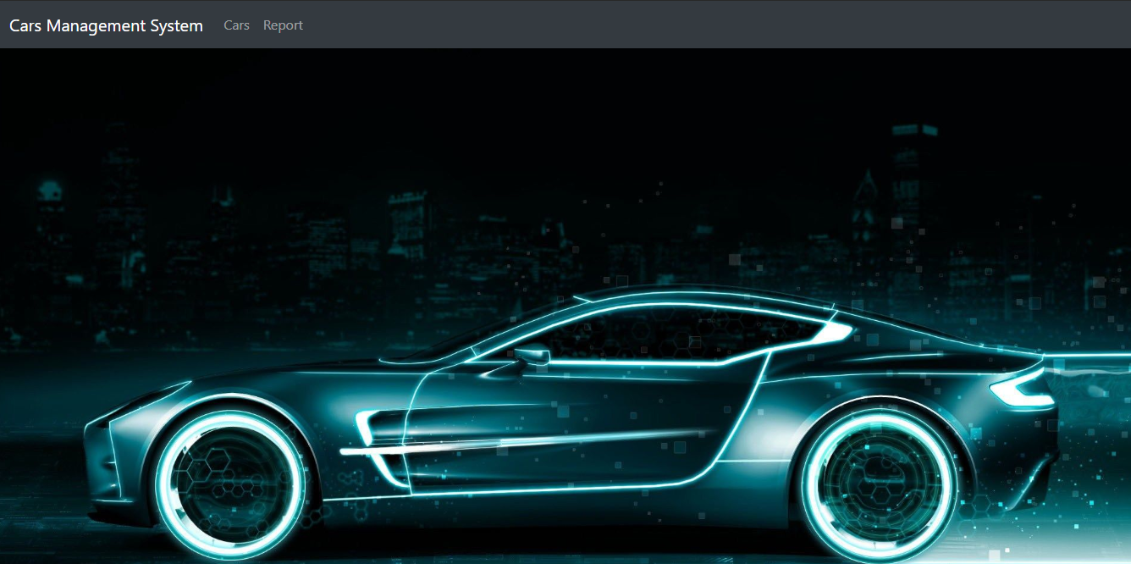
Output Screenshots

Slide 21
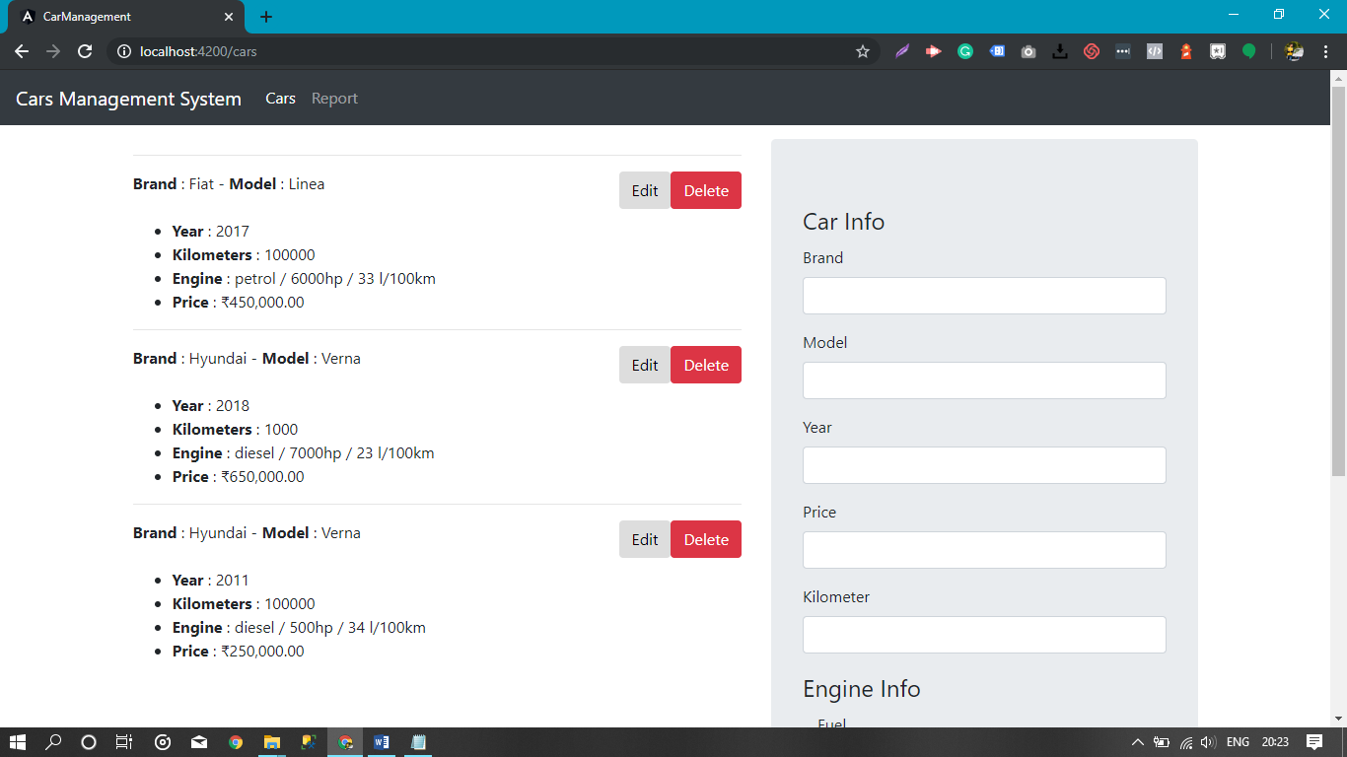
Output Screenshots

Slide 22
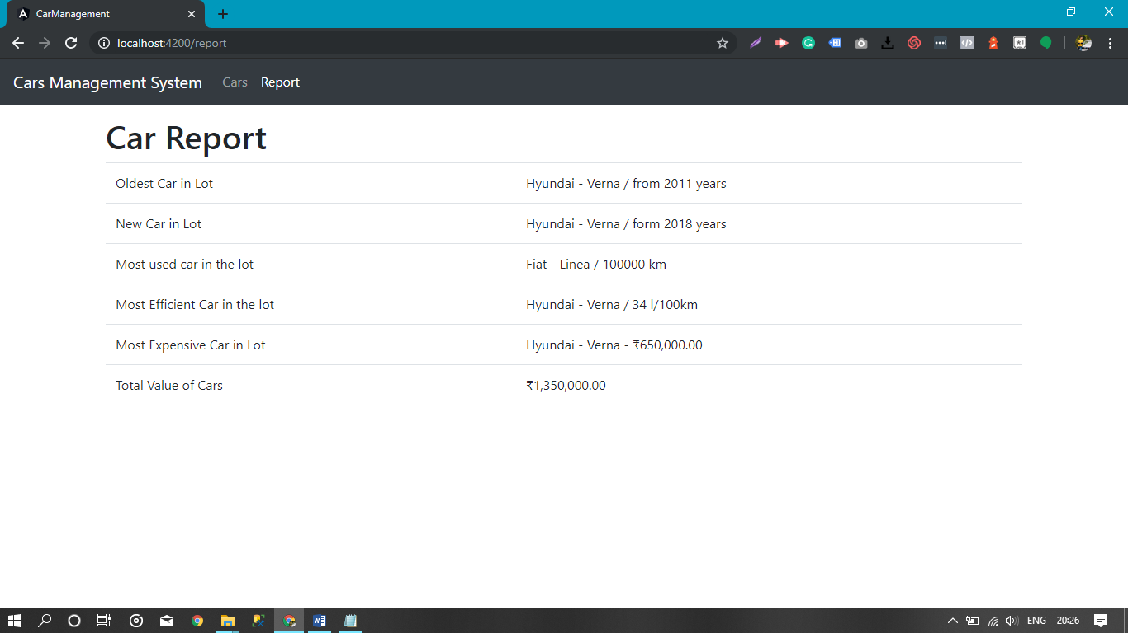
Output Screenshots

Slide 23


