Slide 1
TEAM ARIA PRESENTS

Slide 2
Digital
Assimilation and
Virtual
Assistant

Slide 3
Created By:
Faisal Manzer
Prakash Mishra
Anant Garg
Mohammad Ahmad

Slide 4
Problems faced during disaster management:
Generally, we are unable to rescue people swiftly and
speedily because of simple reasons like:-
Unavailability of data in organised manner.
Transportation and detection of the medical conditions
of patients is a cause of major concern.
Hospitals also get affected and patients with serious
ailments being immobile and dependant become a cause of
major concern.
Communication channels, electricity and other basic
amenities also get affected.
These all things eventually prove fatal for already sensitive sick
people.

Slide 5
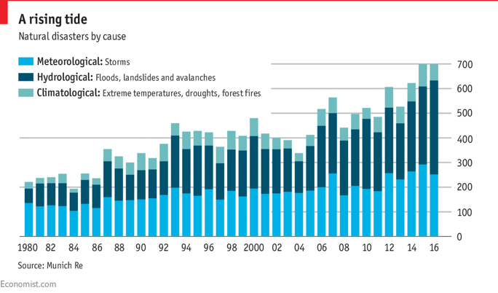
Over a span of time there has been a considerable rise in disasters all over the world,
be it man-made or natural. Every year natural disasters kill around 90,000 people
and affect close to 160 million people worldwide. In the last 17 years, India alone has
faced more than 300 natural disasters which include drought, earthquake, epidemics,
extreme temperature, floods, landslides and storms.

Slide 6
Things needed to be exercised during different disaster rescue operations:
Scene safety (self and casualties)
Effective strategy
Accurate triage
Selective clinical management
Transport resource maximisation
Appropriate patient distribution
DAVA helps in solving all these issues single handedly and very efficiently.

Slide 7


DAVA
1 critical patients
4 Vacancy
10 critical patients
3 patients
10 Vacancy
7 Vacancy

Slide 8
Tasks performed by DAVA
Collect data of all the patients admitted in the hospitals of the affected areas.
This data includes their personal details along with guardian details and most importantly the medical condition of the patient.
Collect data of all the affected hospitals and nearby unaffected hospitals and other health care centres.
This data comprises of their complete postal address along with their geographical coordinates for air borne rescue ops. It also contains info about the number of patients present along with the number of patients with critical health condition and the accommodation capacity of the hospital.
It then automatically calculates and presents the most feasible unaffected hospital where the patients from the nearby affected hospital can be transported. Thus saving precious time and money during the rescue ops which are otherwise wasted in manually formulating rescue techniques.
An added advantage of this website is that all the tracking ops are done in real time.

Slide 9
Conclusion
Thus, DAVA takes up all the manual work done by various operators in control room and hands over the result with maximum efficiency and ease thereby saving precious time during the disaster rescue and also large money.
Most importantly it works to save hundreds of critical lives which could otherwise be lost due to slow and faulty manual processing.

Slide 10
Future ventures of DAVA:
Implementation boundaries will be increased and DAVA will be available to serve other affected masses also.
It will auto generate a complete route map with strategies to be followed by rescue teams who go to ground zero for rescue operations.
It will also be able to identify suitable public and private structures which can accomodate large number of people.
THANK YOU

