Slide 1
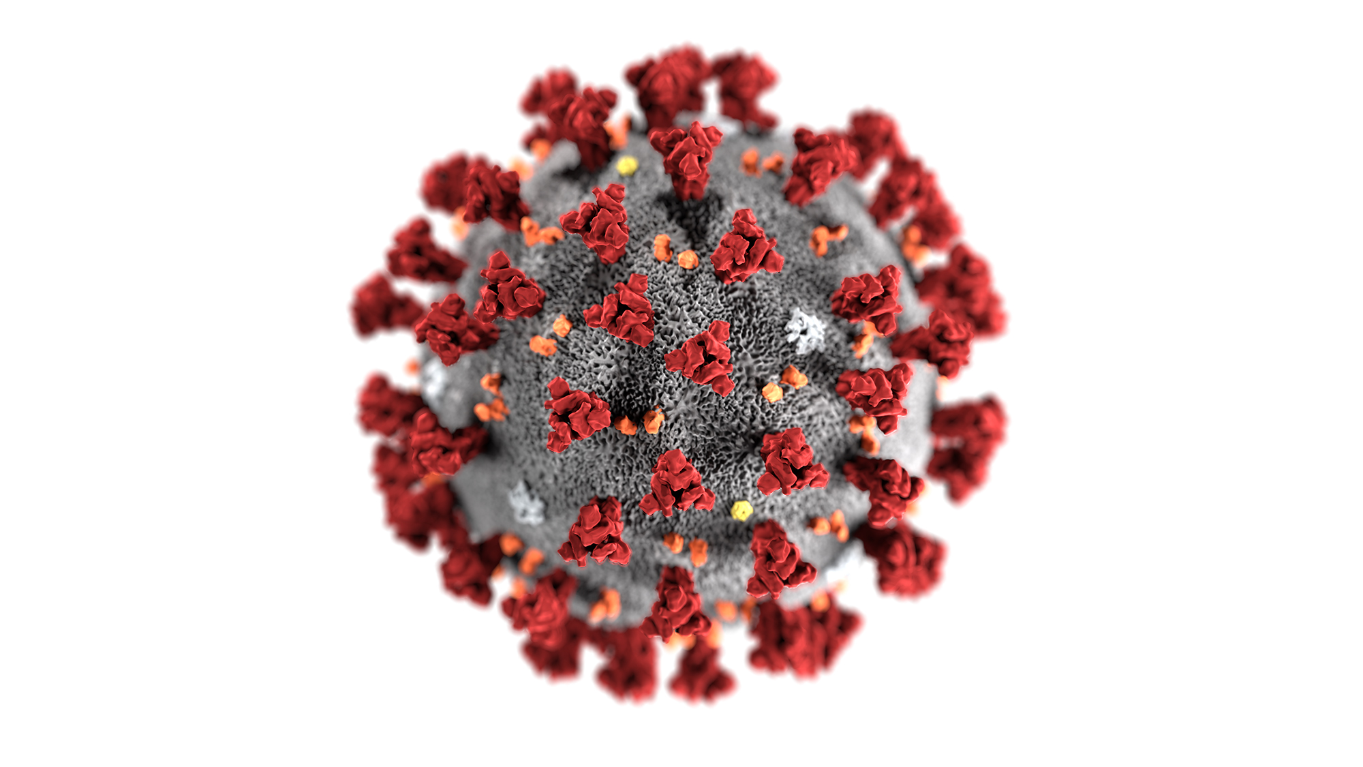
YOURNAME Community Support Group Process Flow & Standard Operating Procedures
Volunteer Coordinator: Name1 Surname1
Training Volunteer Coordinator: Name2 Surname2
Request Coordinator: Name3 Surname3
Deputy Request Coordinator: Name4 Surname4

Slide 2
Volunteer Coordinator:
Name1 Surname1
Request Coordinator:
Name3 Surname3
External Company Liaison:
Name5 Surname5
Training Volunteer Coordinator:
Name2 Surname2
Deputy Request Coordinator:
Name4 Surname4
All Group Volunteers
All Community Requests
All contacts outside YOURGROUPNAME
Organizational Chart

Slide 3
Volunteer Process Flow
Volunteer Coordinator: NAME1 SURNAME1
Training Volunteer Coordinator: NAME2 SURNAME2
Volunteer initiates contact offering to help
(if they contact NAME4
they passes them to NAME2)
NAME2 verbally confirms volunteer understands Information sheet, particularly sanitation procedures and updating Command team on their health status
Volunteer is available to execute task(s)
Healthy, no known contact with COVID-19 positive individuals
Minimum two week quarantine, NAME2/NAME1 checks on volunteer (as requested by volunteer). Contact is made at end of quarantine by NAME2 to assess health
NAME1/NAME2
Populates all columns on Volunteers
tab
NAME2/NAME1 emails new volunteer the Volunteer Information sheet then schedules a five minute call on procedures with NAME1
No
Possible contact with COVID-19 positive cases, ill, immuno-compromised, or in risky age category
Age Under 18yrs
Yes
Seek Parental
Approval

Slide 4
Building resident initiates contact with NAME3/NAME4 requesting assistance (if they contact NAME2, he passes them to NAME4)
NAME3/NAME4 assign healthy volunteer to request based on their availability in Volunteers tab. Call to confirm availability and provide ‘5W’s (who, what, where, when, why) and ‘how’ task is to be performed to the volunteer. Have volunteer reach out to requester to confirm they will fulfill tasking.
Follow up with requester and volunteer to ensure request completed
NAME3/NAME4
Notify rest of Command team if there is a serious incident or recommendation to better the SOPs
Serious Incident?
Urgent/Life threatening?
No
Populates all columns on Requests Tab
NAME1/NAME2 notifies Building Management
Yes
NAME3/NAME4(or whoever receives first call) executes themselves, if unable, contact NAME2/NAME1 to execute. If no Command member available immediately, then send to a volunteer. Populate columns on Requests Tab after incident
Check ‘Task Completed’ box next to request to close out
Request Process Flow
Request Coordinator: NAME3 SURNAME3
Deputy Request Coordinator: NAME4 SURNAME4

Slide 5
Designation of Other Responsibilities
Request Coordinator: NAME3 SURNAME3
Deputy Request Coordinator: NAME4 SURNAME4
Action: | Individual(s) Responsible:
Populating ‘At-Risk Population’ Tab | NAME3 SURNAME3 / NAME4 SURNAME4
Checking on ‘At-Risk Population’ (as needed) | NAME2 SURNAME2
Liaising with external contacts and updating tab and Command members as necessary | NAME5 SURNAME5 OR ANOTHER TEAM MEMBER
Updating Command team of COVID-19 health alerts | NAME2 SURNAME2
Updating/changing SOP | Command team
Notifying Skyline Management of new COVID-19 incidents or incidents within building | NAME1 SURNAME1 / NAME2 SURNAME2
Posting Flyers/Notices in public areas (community bulletin near postal boxes, Lobby, and electronic screen) for residents | NAME3 SURNAME3
Follow through on taskings for group and ensure execution | NAME1 SURNAME1

