Slide 1
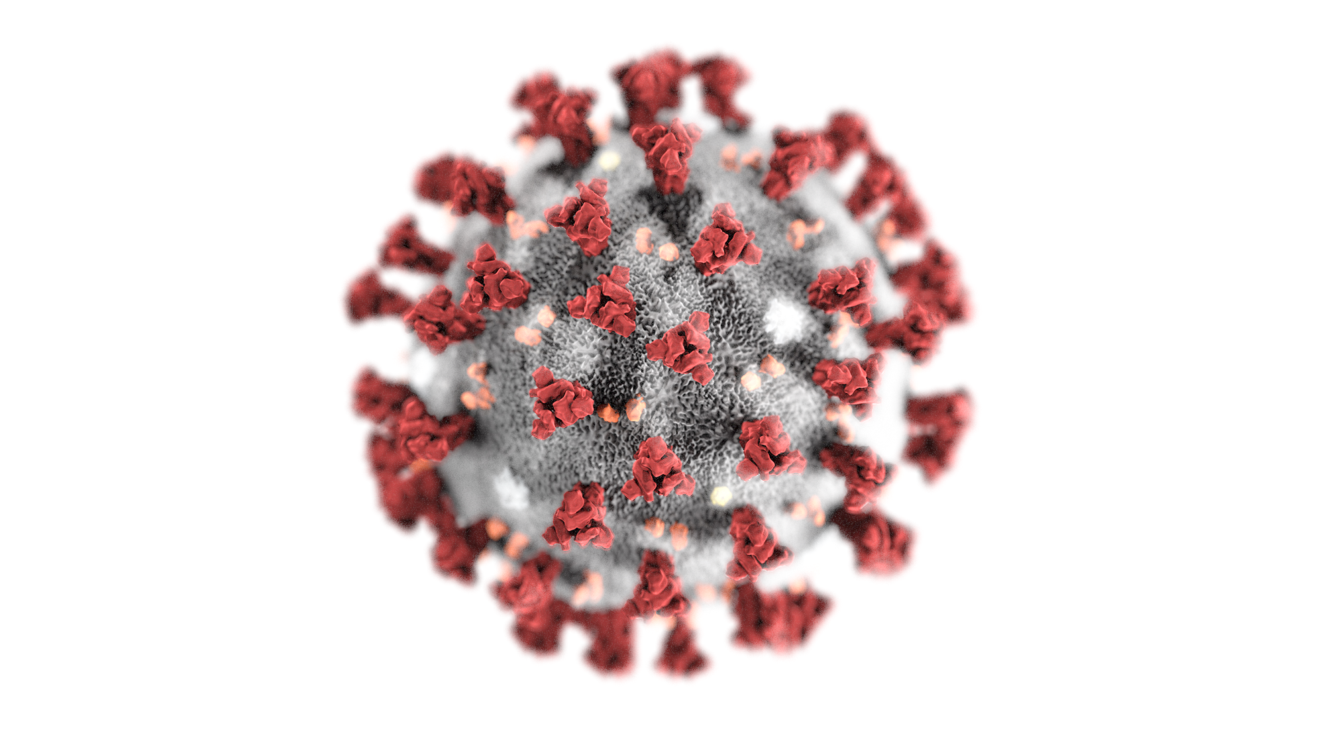
Name
Name
Email(s)
Address
Email(s)
Address
Four Person Team
Phone(s)
Phone(s)
At Risk Individuals
Volunteers
Maintain Google Docs Master Spreadsheet with contact info
Coordination Group connecting At Risk Persons with Onboarded Community Volunteers
Command Center

