Slide 1


TECH-AQUARIST
CMR COLLEGE OF ENGINEERING & TECHNOLOGY
(Autonomous)
Kandlakoya, Medchal, HYDERABAD
CENTRE FOR ENGINEERING EDUCATION RESEARCH
REVIEW-II
SOCIAL INNOVATION IN PRACTICE (A400507)
IV SEMESTER A.Y 2023-24
Student Team Details
Vignesh - 22H51A0408
Vignan -22H51A0429
Lasya -22H51A0431
Faisal -22H51A0442
Anuhya -22H51A0443
Faculty Mentors
B. Suresh Ram, HOD CEER
B.Balakrishna , Asst. Professor
, Asst. Professor
Tech-Aquarist CMR College of Engineering & Technology

Slide 2

CONTENT
Problem Statement
Existing Solutions
Proposed Solution
Components required
Block Diagram
Flow Chart
Working Principle of all components used/Software modules
Working of the Business model
Results and Discussions
References

Slide 3

PROBLEM STATEMENT
To Maintain Aquarium, One of the most important aspects of keeping your fish healthy is ensuring you have the proper feeding system and right filtration system for their needs. Due to the hectic nature of human life or whenever fish owner is away from home, they find themselves unable to consistently provide proper feeding and filtration for their aquariums. This neglect leads to significant disadvantages, foremost among them being the compromised health and well-being of the fish.
Tech-Aquarist CMR College of Engineering & Technology

Slide 4
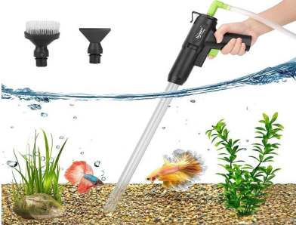
EXISTING SOLUTIONS
Gravel Vacuum Cleaners Function:
Remove debris, waste, and uneaten food from the substrate.
Types:
Manual Gravel Vacuums: Operate by creating a siphon; the user manually pumps to start the water flow.
Electric Gravel Vacuums: Use a battery or electric pump to suck debris from the substrate into a collection container or directly out of the tank.
Tech-Aquarist CMR College of Engineering & Technology

Slide 5
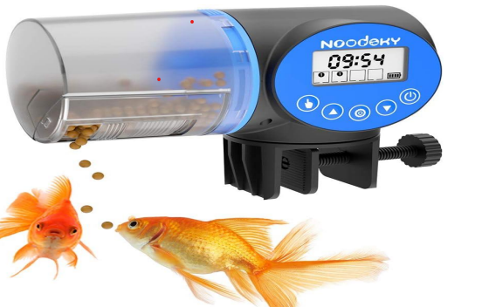
EXISTING SOLUTIONS
2) Fish Feeders: Ensure consistent feeding and reduce the risk of overfeeding, which can lead to excess waste.
Types:
• Battery-Powered Feeders: Dispense a pre-set amount of food at scheduled times.
• Programmable Feeders: Allow for customizable feeding schedules and portions.
Tech-Aquarist CMR College of Engineering & Technology

Slide 6
GAPS IN EXISTING SOLUTIONS
All the existing solutions have many disadvantages. The following are the gaps we found in those existing solutions:
May not adapt well to varying fish behavior or environmental conditions.
Cost-effectiveness
Sensor accuracy
No Time setting

Slide 7
PROPOSED SOLUTION
Aquariums can be beautiful, but they also need to be well-maintained. Part of this involves cleaning the tank and adding water changes as required. The most common way to do this is through an aquarium canister filter. Effective fish feeding within aquarium environments is essential for proper health and growth of fishes. With the emergence of technologies including Internet of Things, we have emerged automatic fish feeding within IoT-based .
Communicate
Iterate
Tech-Aquarist CMR College of Engineering & Technology

Slide 8
COMPONENTS REQUIRED
HARDWARE REQUIRED :-
1 X ESP8266 NODEMCU
1 X Servo Motor
1 X 5V 2A USB Wall Adapter
1 X Micro USB Charging Cable
1 X Airtight Food Container (4L)
1 X Hose Connectors
1 X Siphon Pump
1 X Power Head (1000L/H)
SOFTWARE REQUIRED :-
Arduino IDE
BLYNK
Tech-Aquarist CMR College of Engineering & Technology

Slide 9
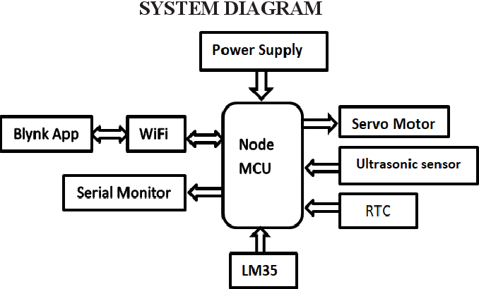
BLOCK DIAGRAM(FEEDER)
Tech-Aquarist CMR College of Engineering & Technology

Slide 10
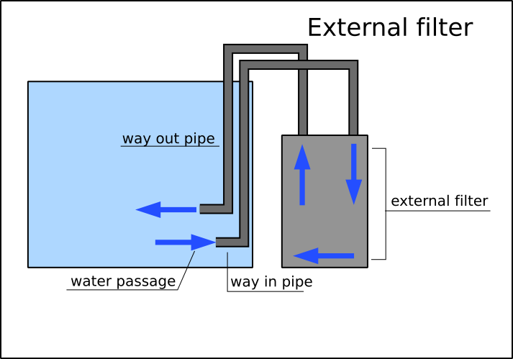
BLOCK DIAGRAM(FILTER)

Slide 11
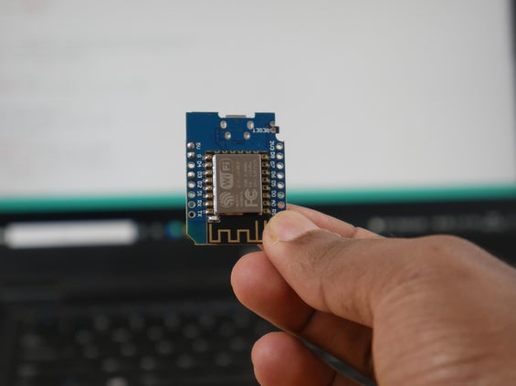
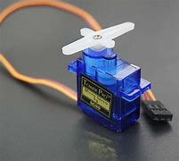
WORKING PRINCIPLE OF ALL COMPONENTS
ESP8266 NODEMCU
There is a wide variety of development boards with the ESP8266 chip. We actually need a board with an optimum size that can be easily reprogrammable and powered from an external source.
SERVO MOTOR
A continuous rotation servo looks like a regular hobby servo. While a regular servo motor only turns over a narrow range, with precise control over position, a continuous rotation servo has a shaft that spins continuously, with control over its speed and direction. They can easily drive from the microcontroller itself, not needing an external power supply.
Tech-Aquarist CMR College of Engineering & Technology

Slide 12
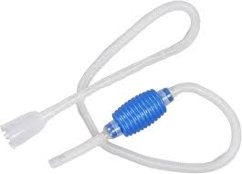
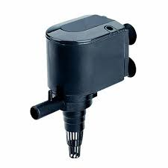
WORKING PRINCIPLE OF ALL COMPONENTS
SIPHON PUMP
Using the siphon like a vacuum cleaner, gently go over the gravel at the bottom of the tank and turn it over so that it sucks up loose debris. If gravel sticks in the end of the tube you can pinch or bend the flexible end to reduce the suction and gently tap it against the side so that the stones fall out.
POWER HEAD
They help to keep detritus and other tank matter from settling on the bottom of the tank. Powerhead circulation permits the majority of these particulates to be circulated or suspended, allowing them to be filtered out by a mechanical filter.
Tech-Aquarist CMR College of Engineering & Technology

Slide 13
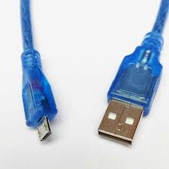
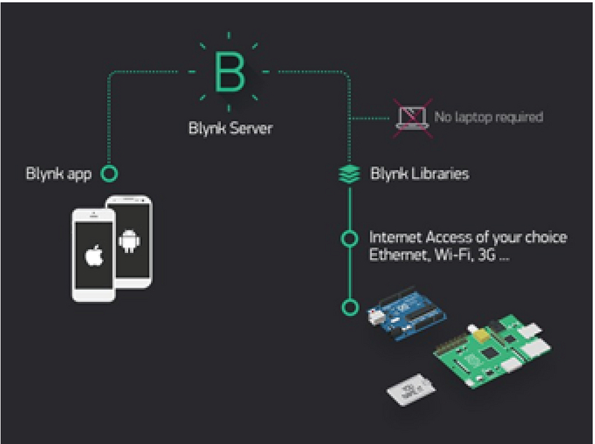
WORKING PRINCIPLE OF ALL COMPONENTS
Micro USB Charging Cable
Micro USB cable allows you to connect your NodeMCU to your computer for programming. It also supplies power to the device. The NodeMCU only works with specific cables. Some USB cables are 'charging only', and have only 2 wires inside, meaning they can only provide power and can't transfer data.
BLYNK
Blynk is an IoT platform for iOS or Android smartphones that is used to control Arduino, Raspberry Pi and NodeMCU via the Internet. This application is used to create a graphical interface or human machine interface (HMI) by compiling and providing the appropriate address on the available widgets.
Tech-Aquarist CMR College of Engineering & Technology

Slide 14
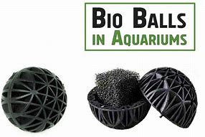
WORKING PRINCIPLE OF ALL COMPONENTS
BIO BALLS
Bio balls are small, usually plastic, biodegradable spheres covered in numerous tiny ridges and pores. Their core purpose is to provide a substantial surface area for beneficial bacteria to thrive, facilitating the efficient decomposition of harmful organic matter within the aquarium. This natural process of biomineralization and biosorption, with the help of these microbes, contributes significantly to maintaining a clean and healthy environment for the aquatic residents
Tech-Aquarist CMR College of Engineering & Technology

Slide 15
WORKING OF THE MODEL/FRONTEND DEMONSTRATION
A fish feeder with an ESP8266 and a servo motor typically works like this:
The ESP8266 microcontroller is programmed to connect to your Wi-Fi network and listen for commands or triggers. You can set up a schedule or trigger remotely via an app or web interface using the ESP8266. When triggered, the ESP8266 sends a signal to the servo motor to rotate a certain angle, releasing the fish food into the tank. The system is powered either by a battery or a power adapter, ensuring continuous operation. Overall, it's a combination of programming, remote control, and mechanical movement to automate the process of feeding fish.
Tech-Aquarist CMR College of Engineering & Technology

Slide 16
WORKING PRINCIPLE
A fish feeder with an ESP8266 and a servo motor typically works like this: The ESP8266 microcontroller is programmed to connect to your Wi-Fi network and listen for commands or triggers. You can set up a schedule or trigger remotely via an app or web interface using the ESP8266. When triggered, the ESP8266 sends a signal to the servo motor to rotate a certain angle, releasing the fish food into the tank. The system is powered either by a battery or a power adapter, ensuring continuous operation. Overall, it's a combination of programming, remote control, and mechanical movement to automate the process of feeding fish
Tech-Aquarist CMR College of Engineering & Technology

Slide 17
WORKING PRINCIPLE
DIY Canister Filter typically Works like this:
A DIY canister filter with a sponge and pump works by using the pump to draw water into the canister, where it passes through layers of sponge or other filter media. The sponge acts as a mechanical filter, trapping debris and particles from the water. Beneficial bacteria colonize the sponge, providing biological filtration by breaking down harmful ammonia and nitrites into less toxic nitrates. The filtered water is then returned to the aquarium, creating a cleaner and healthier environment for fish and other aquatic life. Regular maintenance, such as cleaning the sponge and replacing filter media, is essential to keep the filter running efficiently
Tech-Aquarist CMR College of Engineering & Technology

Slide 18
RESULTS AND DISCUSSIONS
In conclusion, the DIY canister filter utilizing sponge and a pump is an effective and budget-friendly solution for maintaining a clean and healthy aquarium environment. Regular maintenance and monitoring are essential to ensure optimal performance and longevity of the filter system. Overall, this DIY project offers a customizable and accessible option for aquarium enthusiasts seeking reliable filtration solutions.
The ESP8266-based feeder machine, integrated with blink, offers a seamless and innovative solution for pet feeding needs. Leveraging the ESP8266's capabilities for Wi-Fi connectivity and the blink platform for remote monitoring and control, pet owners can easily schedule and adjust feeding times from anywhere with internet access. With proper setup, testing, and integration with blink, the feeder machine provides an accessible and efficient solution for enhancing pet care and well-being."
Immersive Automatic Water Heater CMR College of Engineering & Technology

Slide 19
REFERENCES
https://aquariumscience.org/index.php/8-3-2-do-it-yourself-canisters/
https://www.pinterest.com/craig_dorrell/diy-canister-filters/
https://courseware.cutm.ac.in/wp-content/uploads/2020/06/Session-6-2.pdf
https://www.amazon.in/gp/bestsellers/pet-supplies/4771356031
https://www.researchgate.net/publication/342624403_AUTOMATIC_FISH_FEEDING_AND_MONITORING_SYSTEM_FOR_AQUARIUM_USING_555_TIMERS
Tech-Aquarist CMR College of Engineering & Technology

Slide 20
THANK YOU

