Slide 1
EMPLOYEE RETENTION PREDICTION

Slide 2

Predicting Job Change for Data Scientists
This presentation explores a machine learning approach for predicting employee retention, specifically focused on data scientists. We'll delve into the project's overview, data exploration, preprocessing, model training, and the valuable insights derived from this analysis.
By MD. Faisal Alam

Slide 3
Methodology: Workflow
1. Exploratory Data Analysis (EDA)
2. Data Preprocessing
3. Model Training and Evaluation
4. Insights and Conclusion

Slide 4
Project Overview
Objective
The primary objective is to predict whether a data scientist is likely to seek a job change. This prediction can be used to understand employee retention patterns and implement strategies to retain valuable talent.
Why Machine Learning
Machine learning provides the ability to analyze large datasets, identify patterns, and build predictive models. Its capabilities in pattern recognition and predictive modeling make it an ideal tool for employee retention prediction.

Slide 5

Exploratory Data Analysis (EDA) Exploratory Data Analysis (EDA)
Dataset Overview
The first step involved analyzing the dataset to understand its structure, data types, missing values, and basic statistics. This provided a foundational understanding of the data.
Key Visualizations
Visualizations helped to reveal relationships and patterns within the data. For example, we visualized the relationship between experience and job change likelihood and the impact of salary and age on job change probability.

Slide 6

Feature Scaling Continuous variables were normalized to a common scale to ensure consistent model performance and prevent bias introduced by differing scales.
Data Preprocessing
Handle Missing Values
Missing values were addressed by either filling them with appropriate values or dropping the entire row, depending on the nature of the missing data.
Categorical Encoding
Categorical variables were converted to numeric values using suitable encoding methods, such as one-hot encoding, to make the data suitable for model training.

Slide 7

Model Selection and Training
Logistic Regression
Logistic regression is a commonly used model for binary classification problems. It predicts the probability of an event occurring, in this case, the likelihood of a job change.
Random Forest Classifier
Random forest is a powerful ensemble method that combines multiple decision trees to make predictions. It is known for its robust performance and ability to handle high-dimensional data.

Slide 8
Model Selection and Training
Models Used:
Logistic Regression
Random Forest Classifier
Evaluation Metrics:
Accuracy Score
Confusion Matrix
ROC-AUC Score
Best Model:
Random Forest (based on evaluation metrics).

Slide 9
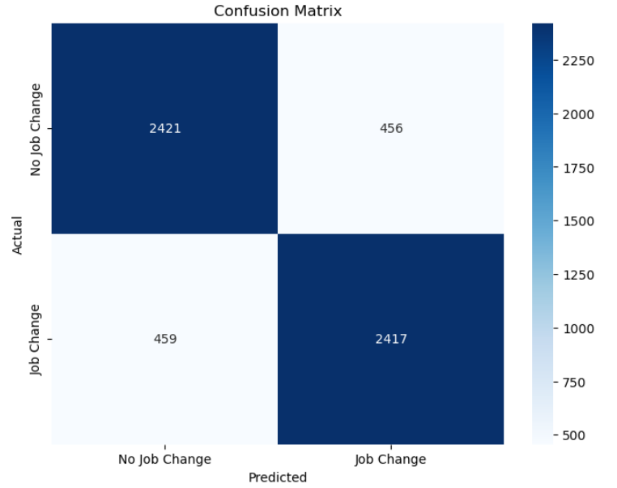
Slide: Confusion Matrix
Explanation:
True Negatives (No Job Change predicted correctly): 2421
False Positives (Job Change predicted incorrectly): 459
False Negatives (No Job Change predicted incorrectly): 455
True Positives (Job Change predicted correctly): 2421
The heatmap shows the counts, with color intensity indicating the count.

Slide 10
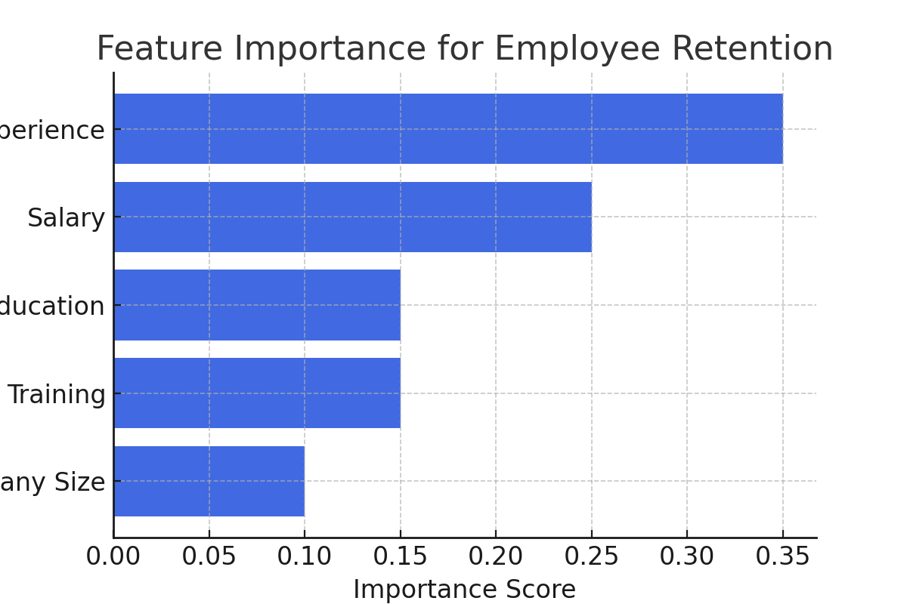
Feature Importance Visualization

Slide 11
Machine Learning Model Comparison
Dataset Information:
Total Data Points: 15,326
Features Used: 12
Positive Cases: 3,825
Negative Cases: 11,501

Slide 12
Models & Performance:
Model | Accuracy | ROC-AUC | Confusion Matrix
Logistic Regression | 77.27% | 77.35% | TP: 268, TN: 2693, FP: 187, FN: 684
XGBoost | 78.44% | 79.27% | TP: 478, TN: 2528, FP: 352, FN: 474
LightGBM | 79.25% | 80.28% | TP: 562, TN: 2475, FP: 405, FN: 390
✅ Best Model: LightGBM 📈 Highest Accuracy & ROC-AUC Score

Slide 13
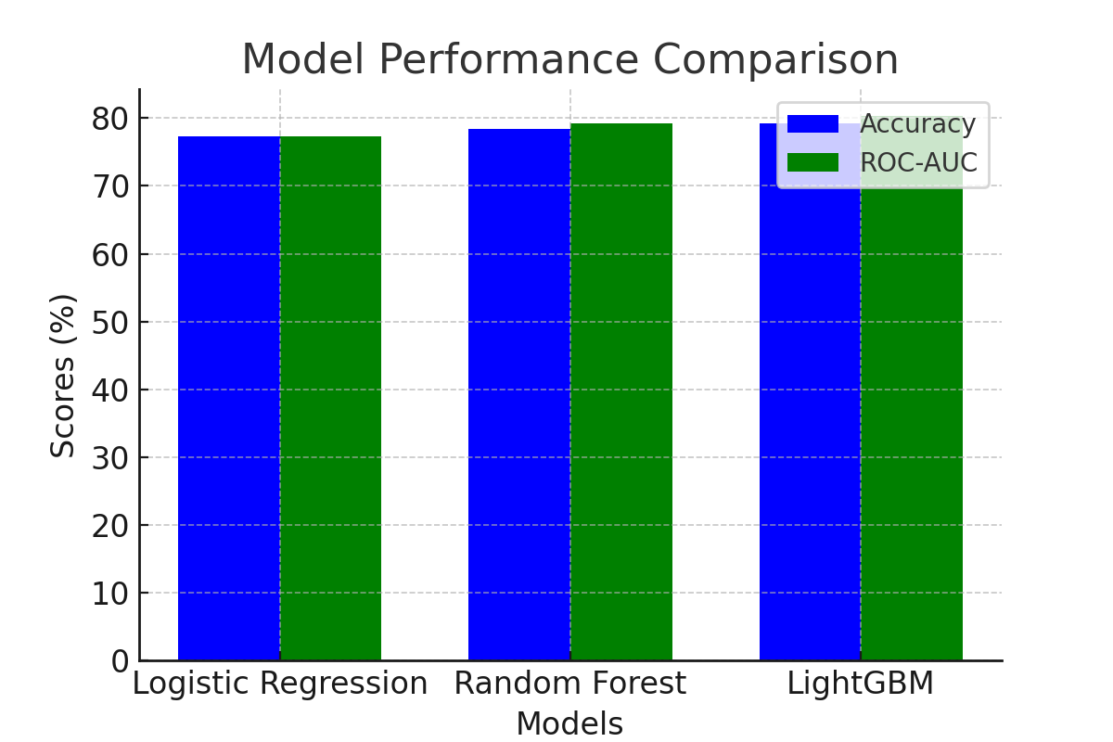
Model Performance Comparison

Slide 14
Business Impact & Future Scope
📌 Key Business Takeaways:
- Companies can focus on improving salary structures
- Employee training programs can enhance retention
- Better career growth opportunities reduce job switching
🚀 Future Scope:
- Adding psychological factors like job satisfaction
- Analyzing impact of company policies on retention

Slide 15
Insights and Conclusion
Key Findings:
• Features like experience, salary, and age significantly affect job change probability.
• Random Forest outperformed Logistic Regression in prediction accuracy.
Business Impact:
Helps organizations proactively manage employee retention.
Future Scope:
Incorporate additional features like company policies or job satisfaction.

Slide 16
Thank You!

