Slide 1
OPERATING SYSTEMS PROJECT
Linux File System Explorer
A graphical Linux file management system using C and system calls
Environment: WSL Ubuntu 24.04 · Team members and student IDs: add confirmed names and IDs
Notes:
Introduce the project as a graphical file management system that makes Linux filesystem operations visible through a simple interface. Confirm the team names and student IDs before presenting.

Slide 2






FOUNDATIONS
From POSIX APIs to Linux operations
The explorer translates user actions into standard filesystem operations.
System calls
File handling
User-space to kernel boundary for filesystem work.
open(), read(), write(), close()
Directories
Descriptors
Create, open, read, and remove directories.
Integer handles for open resources.
Metadata
API boundary
Size, permissions, and modification time via stat().
POSIX library interfaces may wrap or standardize access; not every function is a direct system call.
APIs: open(), read(), write(), close(), unlink(), stat(), opendir(), readdir(), mkdir(), rmdir()
Notes:
Clarify the distinction between the kernel boundary and POSIX library interfaces. The named functions describe the project’s operating vocabulary, while the exact implementation path should be confirmed against source code.

Slide 3
ARCHITECTURE
The interface reaches the Linux filesystem through a C bridge
Technology stack
C, Linux/POSIX APIs, GCC, WSL Ubuntu 24.04, React, Node.js/Express, HTML, CSS, JavaScript
User — Interacts with the graphical file explorer.
1
React frontend — Sends an operation request.
2
Node.js / Express — Routes the request to the C Explorer Bridge.
3
C Explorer Bridge — Runs existing C file operations through Linux/POSIX APIs.
4
Linux kernel / filesystem — Applies the operation to the real filesystem.
5
Notes:
Read the architecture from top to bottom. The bridge is the handoff point between the web application and the existing C operations. The final effect is applied by Linux to the filesystem.

Slide 4
FEATURE MAP
Features map directly to OS concepts
Demonstrated functionality is separated from concepts discussed theoretically. Confirm any implementation-specific function before presenting it as shipped.
Feature | OS concept | Representative API
Directory listing | Directory traversal | opendir(), readdir()
File creation | File handling / descriptors | open()
Folder creation | Directory management | mkdir()
Read file contents | File I/O | open(), read(), close()
Rename / delete | Filesystem mutation | Confirm exact C function in implementation
Search | Traversal and metadata | readdir(), stat() as applicable
Edit and save | Write path | write() if implemented
Notes:
Use the table to distinguish what the interface demonstrates from what the operating-system model explains. Avoid claiming that rename, delete, search, or edit-and-save are shipped until the C implementation is confirmed.

Slide 5
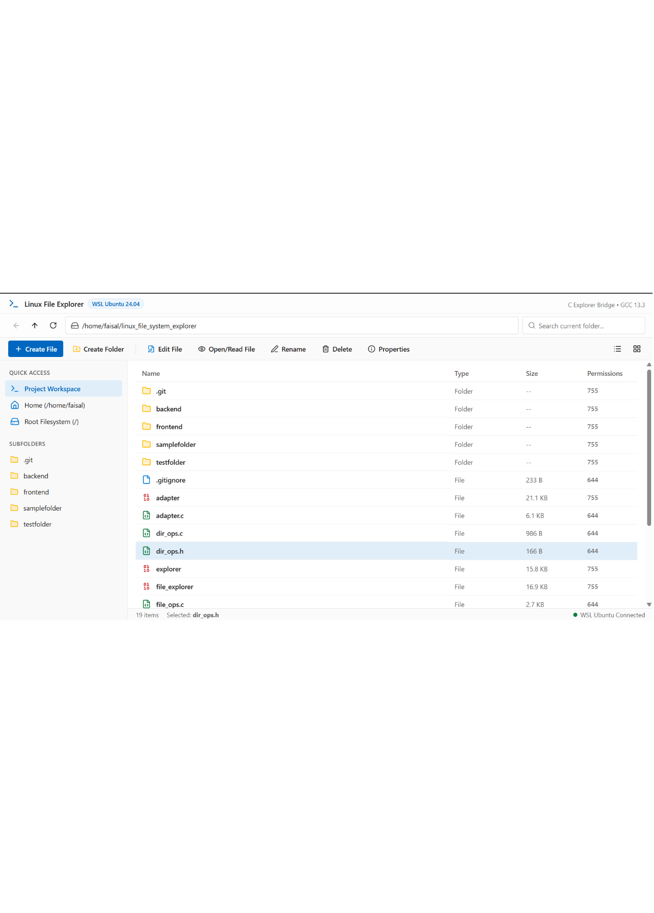
LIVE WORKFLOW
The GUI changes the real Linux filesystem
Open the explorer and inspect the current directory
Navigate into a folder
Create a file or directory
Open and read a file
Edit and save, if implemented
Rename or delete a selected item
int fd = open(path, O_RDONLY);
read(fd, buffer, size);
close(fd);
Illustrative C path for reading a file; verify exact arguments and source implementation.
Supplied frontend evidence
Notes:
Use the supplied screenshot as the evidence of the frontend. Walk through the workflow in order, then explain that the code snippet is illustrative and must be checked against the project source before being described as the exact implementation.

Slide 6

TAKEAWAY
Low-level Linux operations become visible, testable, and accessible.
A simple graphical interface makes systems concepts tangible.
Filesystem structure · directory traversal · metadata
User-space / kernel-space interaction · C systems programming
Frontend and backend integration
Thank You · Q&A
Notes:
Close by connecting the layers: filesystem structure, kernel interaction, POSIX APIs, C programming, and web integration. The project makes those relationships observable through one working interface.

