Slide 1
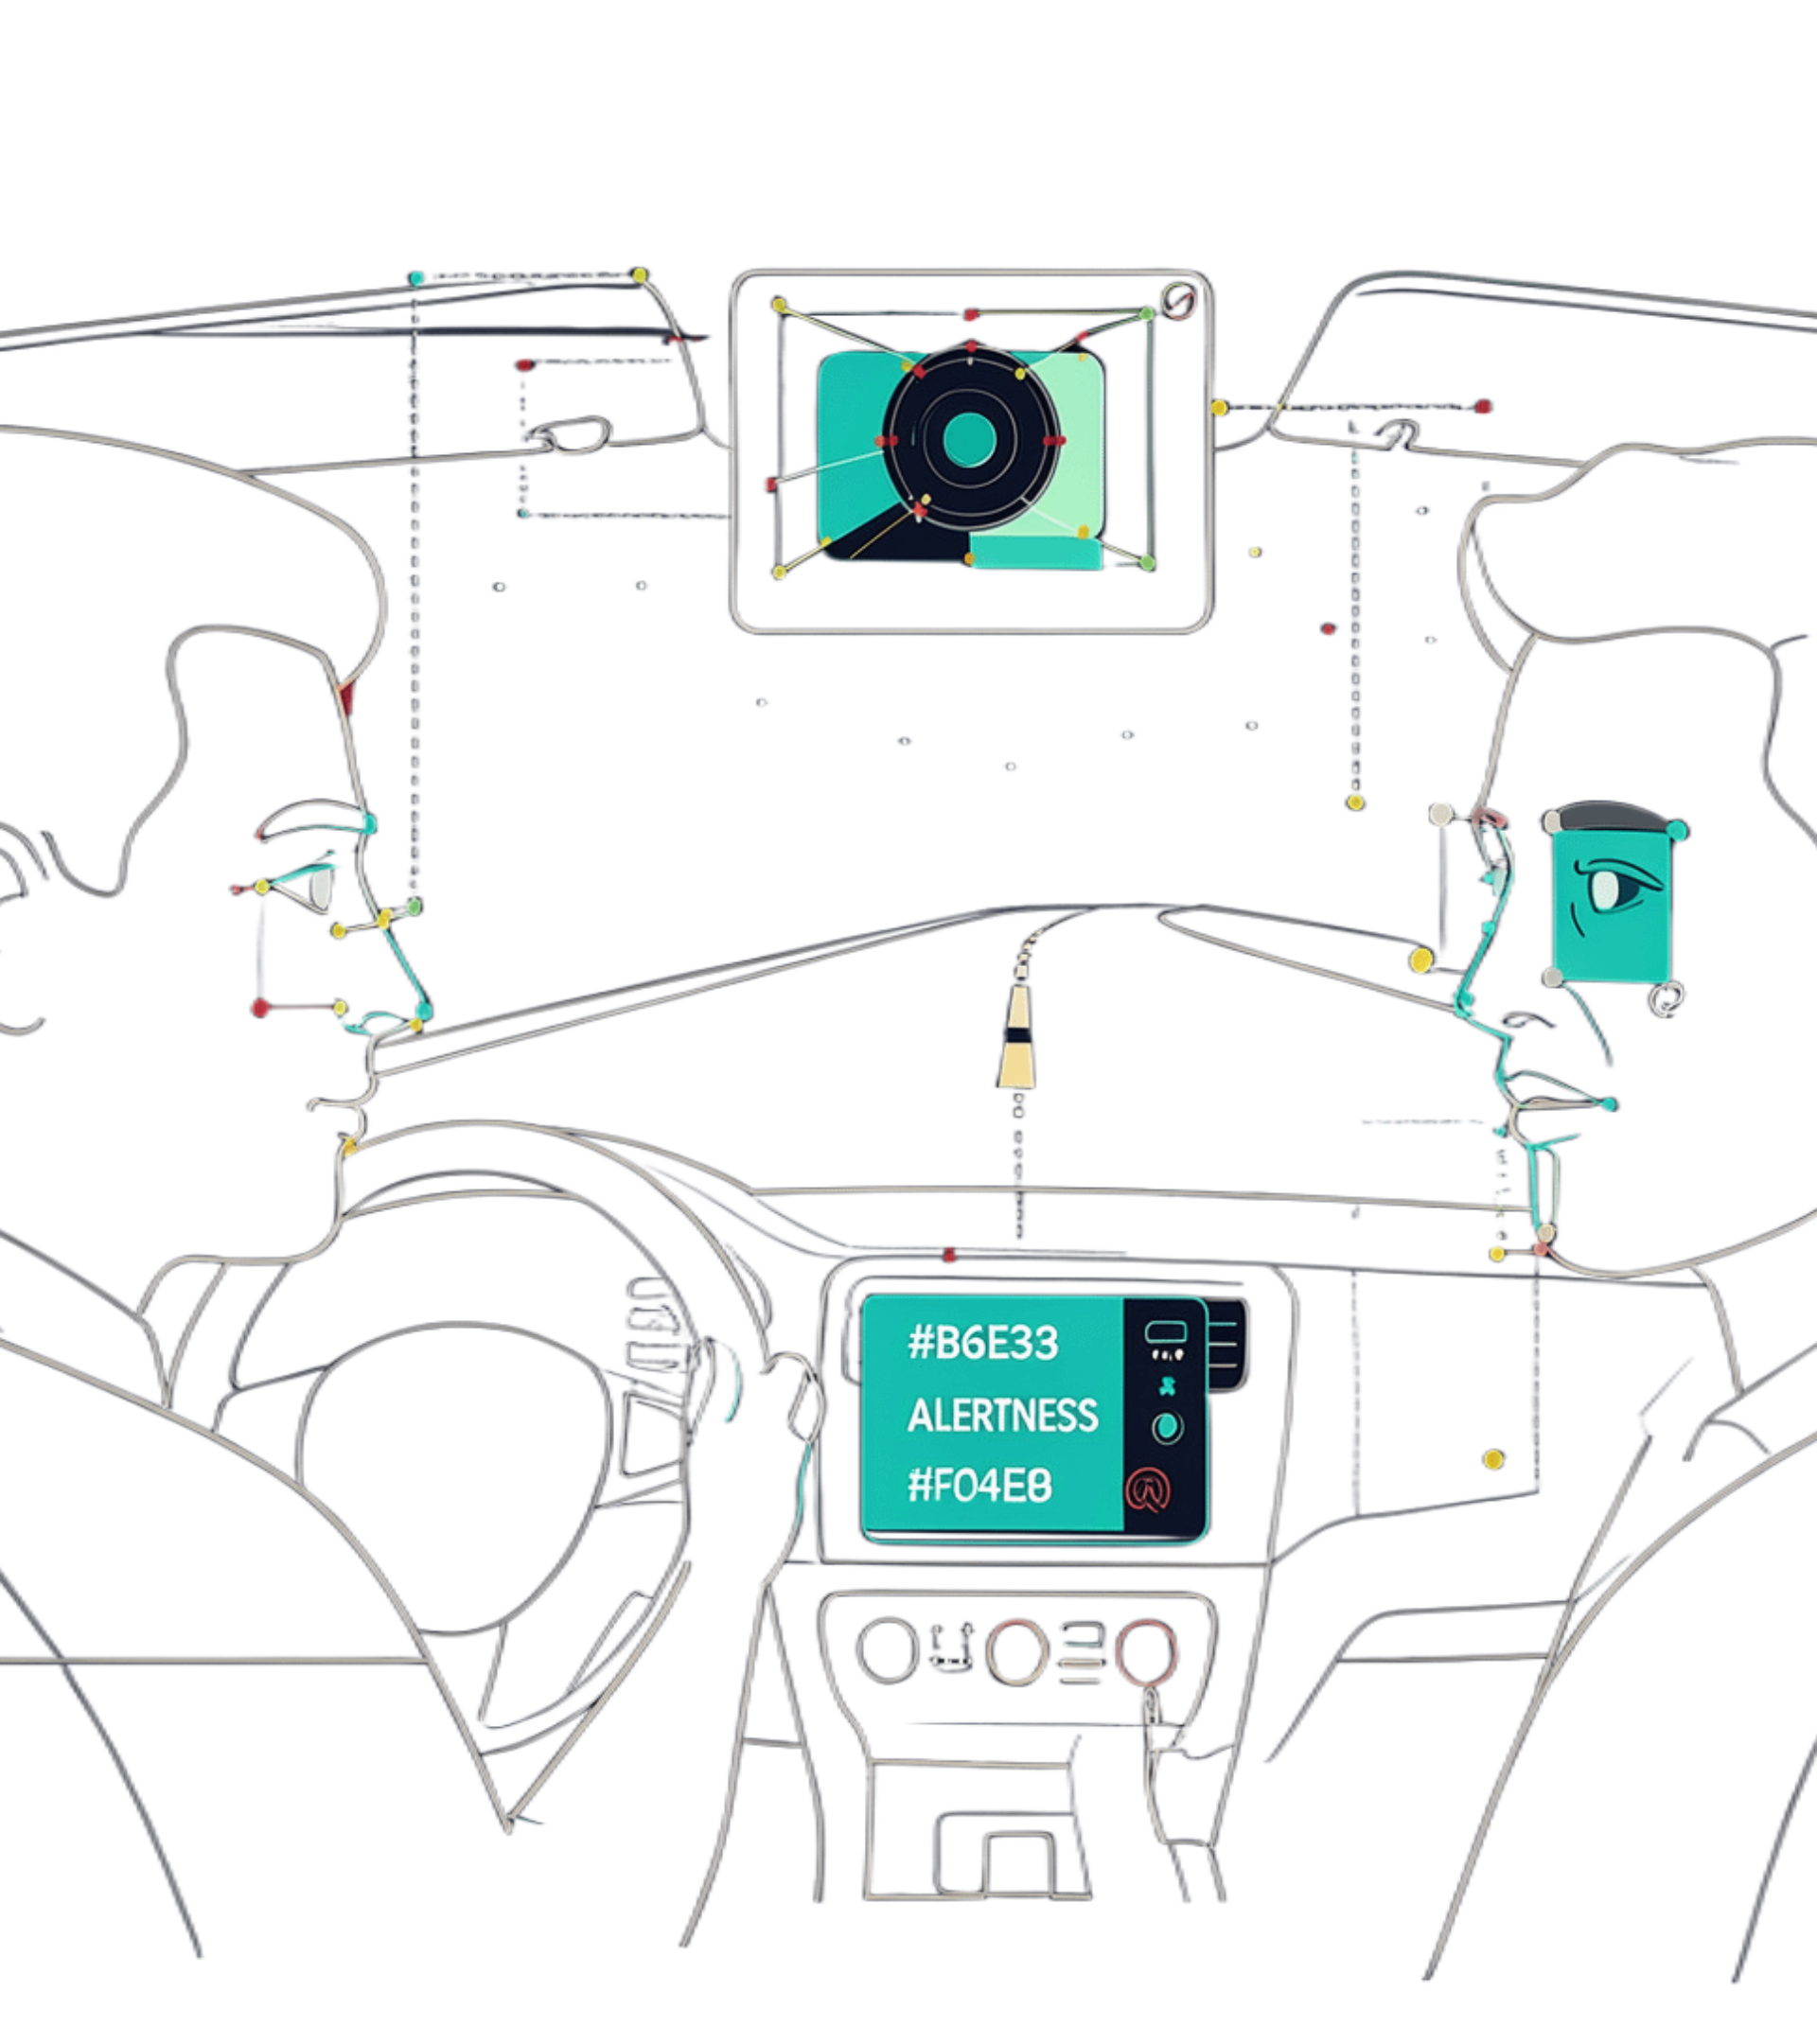
VIGIDRIVE
INTELLIGENT DRIVER DROWSINESS DETECTION
Real-time facial monitoring turns visual cues into an alertness decision.
INPUT
Webcam video processed with Python and OpenCV
SIGNALS
Eye closure · PERCLOS · yawning · head position
OUTCOMES
CO1 · CO2 · CO5 · CO6

Slide 2
/pipeline/frame-to-decision
FROM VIDEO INPUT TO DROWSINESS PREDICTION
A continuous frame-by-frame path from camera data to a monitoring decision.
01
02
03
04
05
WEBCAM INPUT
PREPROCESS
EXTRACT
CLASSIFY
MONITOR
Capture the live video stream.
Prepare each frame for analysis.
Measure facial and behavioral cues.
Estimate alert versus drowsy.
Expose the real-time output.
CURRENT SYSTEM
FUTURE PATH
Feature-based detection with predefined logic.
Labelled data → training → validation → model selection.
02

Slide 3
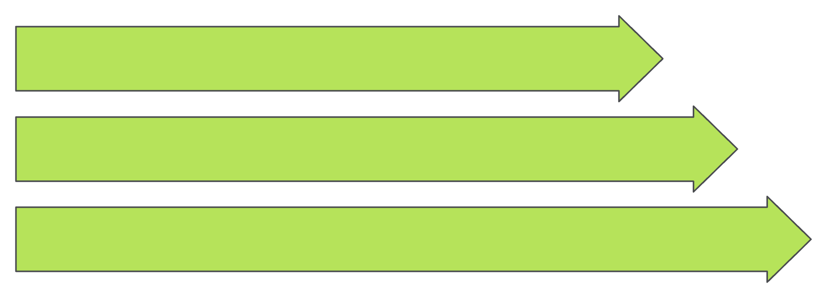
/features/face-to-state
MEANINGFUL FEATURES TURN FACES INTO DECISIONS
The model begins with interpretable signals, not opaque pixels.
VISIBLE FACE CUES
EXTRACTED MEASUREMENTS
ALERT VS DROWSY
OBSERVE + MEASURE
DECIDE
Eye closure and blink duration; yawning indicators and head-position behavior. PERCLOS: proportion of time the eyes remain closed.
Feature-based scoring for alert versus drowsy states.
> proposed enhancement: logistic regression estimates drowsiness probability from labelled features; scaling and regularisation matter.
03

Slide 4
/models/selection-constraint
THE CLASSIFIER MUST FIT THE REAL-TIME CONSTRAINT
APPROACH | STATUS | INTERPRETABILITY / LOGIC | COMPLEXITY / REAL-TIME FIT
Feature-based scoring | Current | Interpretable; predefined decision logic | Lightweight
Logistic regression | Proposed | Labelled binary classifier | Probability output
Random forest | Optional | Alternative for nonlinear feature relationships | Compare computational complexity and real-time suitability
Compare interpretability, computational complexity, and real-time suitability.
MORE COMPLEXITY ≠ AUTOMATICALLY MORE ACCURATE
Evaluation decides.
04

Slide 5
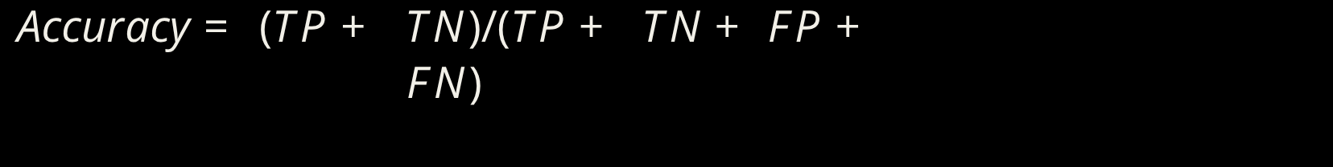
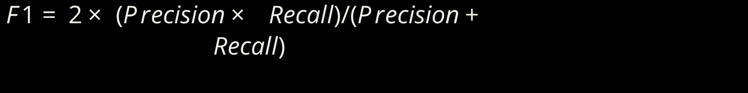
/evaluation/error-cost
RELIABILITY REQUIRES MORE THAN ACCURACY
A drowsiness detector must show what it misses, catches, and how often it raises a false alarm.
CONCEPTUAL CONFUSION MATRIX
METRICS
 | ACTUAL ALERT | ACTUAL DROWSY
PREDICTED ALERT | TN | FN
PREDICTED DROWSY | FP | TP
Conceptual only. No measured performance is shown.
RECALL matters because missed drowsiness can be safety-critical.
VALIDATION must span lighting, facial visibility, and camera-position conditions.
05

Slide 6
/engineering/continuous-inference
REAL-TIME ML ENGINEERING AND FUTURE IMPROVEMENTS
The application is a modular Python/OpenCV system with continuous frame-by-frame inference.
01
02
03
04
CAPTURE
PROCESS
CLASSIFY
DISPLAY
Video frame
Facial features
State estimate
Monitoring status
ENGINEERING PRIORITIES
FUTURE IMPROVEMENTS
Low latency, prediction stability, and detection-failure monitoring.
Labelled datasets, trained classifiers, and evaluation across varied conditions.
VigiDrive combines computer vision, feature engineering, classification, and ML engineering for real-time driver drowsiness monitoring.
06

