Slide 1
Natural Language Processing
Language and Speech Processing

Slide 2
Natural Language Processing (NLP)
NLP is field of computer science and artificial intelligence that concerned with computer linguistics and interaction between human and computer natural language.
Application
Text processing and analysis
Text to speech, speech to text, speech to speech
Machine translation
Search engine
Sentiment analysis and opinion mining
Advanced text editor and IDE
Question answering
Spam and fraud detection

Slide 3
NLP Library
Natural Langugae Toolkit (NLTK)
Textblob
CoreNLP
GenSim
SpaCy
AllenNLP
Ployglot

Slide 4
Regular Expression: 1 Class sets & Dot Symbol
Natural Language Processing

Slide 5
Regular Expression (RE)
Formal language for specifying text string
Application
Search in text, pattern in text, string matching, Linux terminal
Example: Ctrl + F = to match a string in a documents, webpage
Pattern | Example | Description
[0-9] | 1607048 | Match only numeric digit
[A-Z] | FAISAL | Only capital word, if word = ‘Faisal’ then not matching
[A-Za-z] | Faisal Ahmed | Capital and small letter but not digit such as Faisal48
[Hmm* ] | Hm, Hmm, Hmmm, Hmm… | 0 or more matching

Slide 6
Regular Expression: 2 Kleene Closure
Natural Language Processing

Slide 7
Regular Expression (RE): Kleene Closure
0 or more character recognition in a text
Application
Linux terminal
Classification
“*”: 0 or more
“+”: 1 or more
Example 1: New (s)* = New, News, Newss, Newsss, Newssssss
Example 2: New (s)+= News, Newsss, Newssss

Slide 8
Regular Expression: 3 Meta Character: Pipe Symbol (|)
Natural Language Processing

Slide 9
Regular Expression (RE): Pipe Symbol ( I )
Symbol (|) works similar like logical OR
Choose a particular sub string from the input string
Go(es|ing): Goes, Going
S(i|u|a)ng: Sing, Sang, Sung
My name is: (Faisal| Bijoy)

Slide 10
Text Normalization A way of converting text into standard form
Natural Language Processing

Slide 11
Text Normalization in NLP
Normalization is the process converting into a standard form.
Why required text normalization?
Word boundary detection.
Separated word from each other
Example 1: Bangladesh, New York, Cats and dogs
Example 2: #nlp, @faisalahmed, ☺, ☹, :)

Slide 12
Methods of Text Normalization: 1
Tokenization
Input: Bangladesh is beautiful
Output: [Bangladesh, is, beautiful]
Lemmatization: Finding the same root
Input : [Sings, Sung, Sang], [Connection, Connected, Connecting]
Output : [Sing], [Connect]

Slide 13
Methods of Text Normalization: 1
Tokenization
Input: Bangladesh is beautiful
Output: [Bangladesh, is, beautiful]
Lemmatization: Finding the same root
Input : [Sings, Sung, Sang], [Connection, Connected, Connecting]
Output : [Sing], [Connect]

Slide 14
Methods of Text Normalization: 2
Stemming: Porter Stemmer
Rules 1: ational ->ate, ator-> ate
Example 1: Relational -> Relate, operator->operate
Rules 2 : Ing -> Null, s->Null
Output : Going-> Go, Walking -> Walk, Cats-> Cat
Stemming Challenge: Need to handle some exceptional case
Input : King, noting, News
Output : K, noth, New

Slide 15
Tokenization
Natural Language Processing

Slide 16
Lemmatization
Natural Language Processing

Slide 17
Case Folding
Natural Language Processing

Slide 18
Text Normalization: Case Folding
All letter to lower case
Applications
Information extraction, sentiment analysis, machine translation
Example
Input
[CAT, I have an Apple, General Motors, US]
Output
[cat, i have an apple, general motors, us]

Slide 19
Minimum Edit Distance
Natural Language Processing

Slide 20
Minimum Edit Distance
Spell correction
Cornel
Kornel
Corrnel
Cononel
Bioinformatics
sample 1: [A,T,G,G,C]
sample 2: [A,T,C,G,C]
Applications
Search
Machine translation
Information extraction
Speech recognition

Slide 21
Minimum Edit Distance
The minimum number of editing operations need to be transform one string to another
INTENTION
EXECUTION
Editing operation
Insertion, I
Deletion, D
Substitution, S
Operation cost
I=1
D=1
S=2 (D+I)
I N T E * N T I O N
* E X E C U T I O N
D S S I S
Cost = 1+2+2+1+2=8

Slide 22
Minimum Edit Distance
Ambiguity of minimum edit distance calculation
LEDA
DEAL
L E D A
D E A L
S S S
L E D A *
D E * A L
S D I
Operation cost
I=1
D=1
S=2 (D+I)
Cost = 2+2+2=6
Cost = 2+1+1=4

Slide 23
Dynamic Programming for Minimum Edit Distance: 2
Natural Language Processing

Slide 24
Minimum Edit Distance
Ambiguity of minimum edit distance calculation
LEDA
DEAL
L E D A
D E A L
S S S
L E D A *
D E * A L
S D I
Operation cost
I=1
D=1
S=2 (D+I)
Cost = 2+2+2=6
Cost = 2+1+1=4

Slide 25
Minimum Edit Distance
Initialization
D(i,0) = i
D(0,j) = j
Recurrence Relation:
For each i = 1…M
For each j = 1…N
D(i-1,j) + 1
D(i,j)= min D(i,j-1) + 1 2; if X(i) ≠ Y(j)
D(i-1,j-1) +
0; if X(i) = Y(j)
Termination:
D(N,M) is distance

Slide 26
DP for Minimum Edit Distance
Destination (j)
0 1 2 3 4 5
0
1
2
3
4
5
 | # | L | E | D | A
# | 0 | 1 | 2 | 3 | 4
D | 1
E | 2
A | 3
L | 4
Initialization
D (i,0) =i
D (0,j) =j
Source
(i)

Slide 27
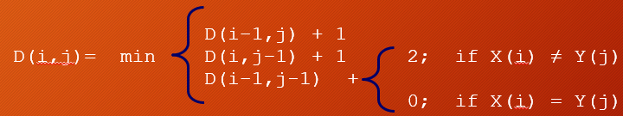
DP for Minimum Edit Distance
Destination (j)
0 1 2 3 4 5
0
1
2
3
4
5
 | # | L | E | D | A
# | 0 | 1 | 2 | 3 | 4
D | 1 | 2 | 3
E | 2
A | 3
L | 4
i = 2 (index value: D)
j = 2 (index value: L)
D (i,j) = min { D(1,2)+1, D (2,1)+1, D(1,1)+2}
= min {2,2,2} = 2
Source
(i)
i = 2 (index value: D)
j = 3 (index value: E)
D (I,j) = min { D(1,3)+1, D (2,2)+1, D(1,2)+2}
= min {3,3,3} = 3

Slide 28
DP for Minimum Edit Distance
Destination (j)
0 1 2 3 4 5
0
1
2
3
4
5
 | # | L | E | D | A
# | 0 | 1 | 2 | 3 | 4
D | 1 | 2 | 3 | 2
E | 2
A | 3
L | 4
i = 2 (index value: D)
j = 4 (index value: D)
D (I,j) = min { D(1,3)+1, D (2,3)+1, D(1,3)+0}
= min {3,3,2} = 2
Source
(i)

Slide 29
DP for Minimum Edit Distance
Destination (j)
0 1 2 3 4 5
0
1
2
3
4
5
 | # | L | E | D | A
# | 0 | 1 | 2 | 3 | 4
D | 1 | 2 | 3 | 2 | 3
E | 2 | 3 | 2 | 3 | 4
A | 3 | 4 | 3 | 4 | 3
L | 4 | 3 | 4 | 5 | 4
i = 5 (index value: L)
j = 5 (index value: A)
D (I,j) = min { D(4,5)+1, D (5,4)+1, D(4,4)+2}
= min {4,6,6} = 4
Source
(i)
Edit Distance
D (n=5,m=5) = 4

Slide 30
DP Code Implementation for Min Edit Distance: 3
Natural Language Processing

Slide 31
Context Free Grammar (CFG)
Natural Language Processing

Slide 32
Context Free Grammar (CFG)
A CFG consists of a finite set of grammar rules is a quadruple (N,T,P,S)
N is a set of non terminal symbol
T is a set of terminal symbol
P is a set of rules
S is the start symbol
Example
N = { S, A }
T = { a, b, c }
P = { S->Aa, A->Ab, A->c}
S = S
S -> Aa
A -> Ab | c
CFG

Slide 33
Categories of CFG
Non Recursive CFG
Recursive CFG
S -> Aa
A -> b | c
Output: { ba, ca}
S -> Aa
-> ba
S -> Aa
A -> Ab | c
S -> Aa
-> Ab a
-> cb a
-> c b a
Output: { ca, cba, cbba, cbbba, …}

Slide 34
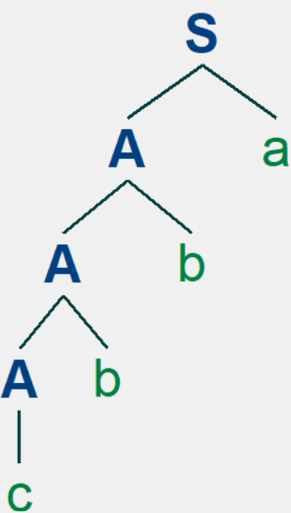
Context Free Grammar (CFG)
Example of a CFG
Input: {c ,b, b, a}
S -> Aa
A -> Ab | c
S -> Aa
-> Ab a
-> Ab b a
-> c b b a
Parsing using CFG
Parse Tree

Slide 35
Context Free Grammar: 2 ( Python Code )
Natural Language Processing

Slide 36
Text Classification Assign a label or class into a text
Natural Language Processing

Slide 37
Text Classification in NLP
Normalization is the process converting into a standard form.
Why required text normalization?
Word boundary detection.
Separated word from each other
Example 1: Bangladesh, New York, Cats and dogs
Example 2: #nlp, @faisalahmed, ☺, ☹, :)

Slide 38
Text Classification in NLP
Normalization is the process converting into a standard form.
Why required text normalization?
Word boundary detection.
Separated word from each other
Example 1: Bangladesh, New York, Cats and dogs
Example 2: #nlp, @faisalahmed, ☺, ☹, :)

Slide 39
Language Models: N-gram Calculate the probability of a word or sentence
Natural Language Processing

Slide 40
Language Model in NLP
Dhaka is the capital of ____________ ?
Bangladeh
India
America

Slide 41
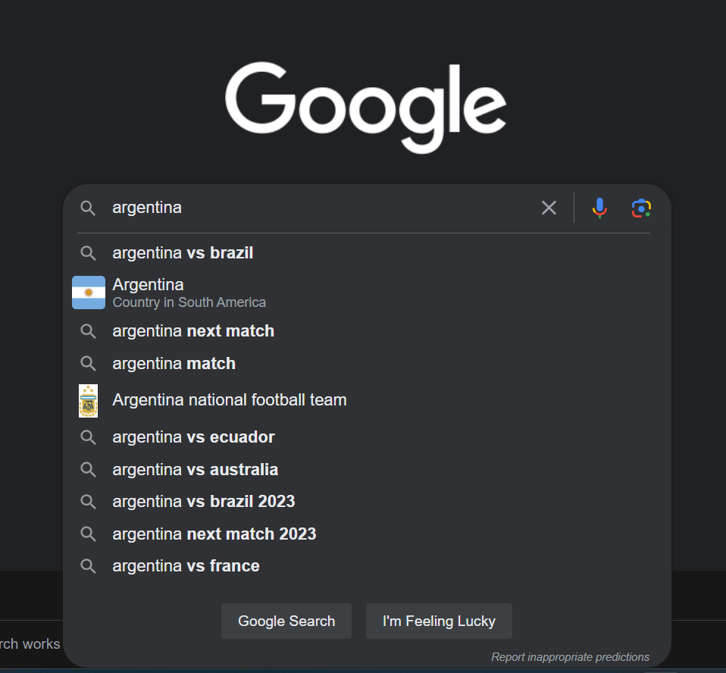
Language Model in NLP
Models that assign probabilities to sequences of words are called language models
vs brazil = 0.5
next match = 0.2
match = 0.1
others = 0.2

Slide 42
Language Model Applications
Spell checking
Grammer checking
Machine translation
Summarization
Question answering
Speech recognition

Slide 43
Probabilistic Language Models Calculate the probability of a word or sentence
Natural Language Processing

Slide 44
Probability of sentence
Grammer correction
I go to school
I goes to school
Probability score: I go to school > I goes to school
Correct: I go to school, Wrong: I goes to school

Slide 45
Probability of sentence or word
Compute the probability of a sentence or sequence of words:
P(W) = P(w1 ,w2 ,w3 ,w4 ,w5…wn )
Probability of an upcoming word:
P(w5 |w1 ,w2 ,w3 ,w4 )
P ( Bangladesh | Dhaka, is, the, capital, of)
A model that computes either of these:
P(W) or P(wn |w1 ,w2…wn-1) is called a language model.

Slide 46
Chain Rule of Probability
Conditional probabilities
P(B|A) = P(A, B)/P(A)
Rewriting: P(A,B) = P(A)P(B|A)
More variables: P(A,B,C,D) = P(A) P(B|A) P(C|A,B) P(D|A,B,C)
The Chain Rule in General
P(x1 ,x2 ,x3 ,…,xn ) = P(x1 )P(x2 |x1 )P(x3 |x1 ,x2 )…P(xn |x1 ,…,xn-1)

Slide 47
Chain Rule of Probability
Chain rule: P(A,B,C,D) = P(A) P(B|A) P(C|A,B) P(D|A,B,C)
Example
= P(Dhaka is the capital of Bangladesh)
= P(Dhaka) x P(is |Dhaka ) x P(the |Dhaka ,is ) x P( capital |Dhaka, is, the)
x P (of | Dhaka, is, the, capital) x P (Bangladesh | Dhaka, is, the, capital, of)

Slide 48
Chain Rule of Probability
Example
= P(Dhaka is the capital of Bangladesh)
= P(Dhaka) x P(is |Dhaka ) x P(the |Dhaka ,is ) x P( capital |Dhaka, is, the)
x P (of | Dhaka, is, the, capital) x P (Bangladesh | Dhaka, is, the, capital, of)
Calculation
= P (Bangladesh | Dhaka, is, the, capital, of)
= count (Dhaka is the capital of Bangladesh) / count(Dhaka is the capital of)

Slide 49
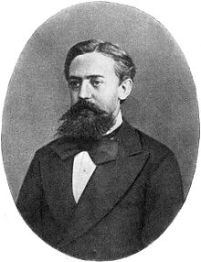
Markov Assumption
Simplifying assumption
= P (Bangladesh | Dhaka, is, the, capital, of)
≈ P (Bangladesh | of)
≈ P (Bangladesh | capital of )
The assumption that the probability of a word depends only on the previous word is called Markov assumption

Slide 50
Bigram Models Condition on previous word
Natural Language Processing

Slide 51
Bigram Models
Please bring me a glass of water
History
Word prediction

Slide 52
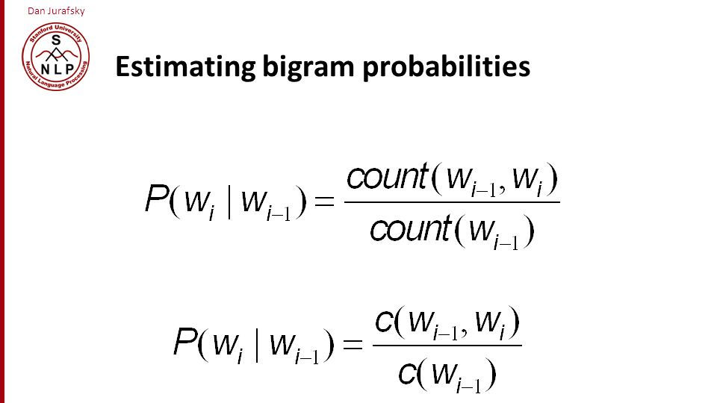
Estimated Bigram Probabilities
<s> I am Sam </s>
<s> Sam I am </s>
<s>I do not like green eggs and ham</s>
P (I | <s>) = 2/3
P (Sam | <s>) = 1/3
P (am | I) = 2/3
P (</s>| Sam) =1/2
P (Sam | am) =1/2
P (do | I)= 1/3
https://web.stanford.edu/~jurafsky/slp3/

Slide 53
Estimated Bigram Probabilities
P(<s> I want english food </s>) = P(I|<s>) × P(want|I) × P(english|want) × P(food|english) × P(</s>|food)
= .000031
Given that
P(i|<s>) = 0.25
P (want | I) =0.33
P(english|want) = 0.0011
P(food|english) = 0.5
P(</s>|food) = 0.68
https://web.stanford.edu/~jurafsky/slp3/

Slide 54
N Gram
2 gram models
3 gram models
4 gram models
5 gram models
In deep learning, language models use higher-gram models to train the dataset.

Slide 55
Google N Gram
https://books.google.com/ngrams/

Slide 56
Perplexity Evaluation Language Models
Natural Language Processing

Slide 57
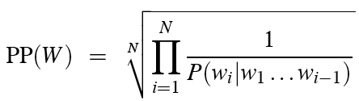
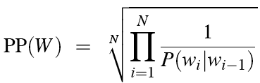
Perplexity
The inverse probability of test set, normalized by the number of words
Chain rule
For bigram
Minimizing perplexity is the maximizing probability

Slide 58
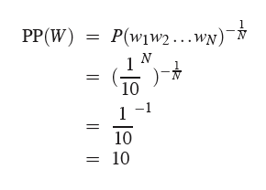
Perplexity
The higher the conditional probability of the word sequence, the lower the perplexity
Calculate perplexity of an sentence
Task of recognizing the digits in English
A sentence consist of random digits
Each digit probability is P=1/10

Slide 59
Corpus and Zeros Language Models
Natural Language Processing

Slide 60
Corpus
A corpus refers to a large and structed set of machine readable texts
Corpus texts are collections from
Books
Articles
Websites
Conversation
Social media
audio

Slide 61
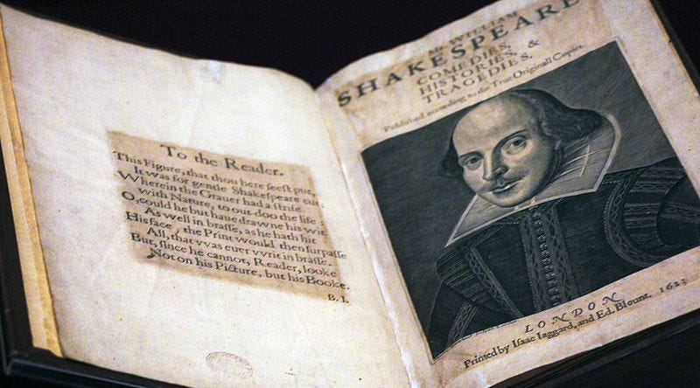
Shakespeare Corpus
Total works: 43
Words: 884,421
Unique word forms: 28,829,
Word occurring only once: 12,493

Slide 62
Why Do We Need Corpus in NLP?
Training machine learning models
Sentiment analysis, speech recognition, machine translation
Language understanding
Grammer, vocabulary
Rule based system
Part-of-speech (POS) tagging, named entity recognition
Statistical analysis
Examine word frequency distribution, statistical features
Domain specific knowledge
Legal documents, medical documents, chatbots

Slide 63
Training corpus
Building a question answering system, we need a training corpus of question answer
To build translating legal documents, we need a training corpus of legal documents
N gram only works well for word prediction
if the test corpus look like the training corpus

Slide 64
Zeros
Training set:
… denied the allegations
… denied the reports
… denied the claims
… denied the request
P(“offer” | denied the) = 0
Test set:
… denied the offer
… denied the load

Slide 65
Zero probability bigrams
Bigram with zero probability
Assign 0 probability to the test set
It is not possible to calculate perplexity
Divide by zero

Slide 66
Unknown Words
If we know the words
Vocabulary V is fixed
Closed vocabulary task
If we don’t know the word
Out of vocabulary = OOV words
Open vocabulary task
Create an unknown word token <UNK>
Create a fixed lexicon L of size V
In normalization phase, any word not in L changed to <UNK>
We train it’s probabilities like a normal word
At decoding time, use UNK probabilities for any word not in training

Slide 67
Smoothing Language Models
Natural Language Processing
https://web.stanford.edu/~jurafsky/slp3/

Slide 68
Smoothing in language models
Book: Historical place of Bangladesh
Context
Cox’s Bazar, Sylhet, Saint martin
Paris ?
Train
Test

Slide 69
Zeros
Training set:
… denied the allegations
… denied the reports
… denied the claims
… denied the request
P(“offer” | denied the) = 0
Test set:
… denied the offer
… denied the load

Slide 70
Smoothing in language models
To keep a language model from not to assign zero probability to the unseen events
Way to do smoothing
Add-1 smoothing
Add-k smoothing
Stupid backoff
Kneser-Ney smoothing

Slide 71
Laplace smoothing
Also called as Add-1 estimation
Probability can not be zero
Just add one to all the counts
MLE estimation
Add-1 estimation

Slide 72
Laplace smoothing: Example
Consider a context
|V| = 5000
Bigram “w1 w2” occurs 10 times
Bigram “w1 w2 w3” occurs 9 times
PMLE (w3 | w1, w2) = 9 /10
PAdd-1 (w3 | w1, w2 ) = (9+1)/(10+5000)
Laplace smoothing problem: Give too much probability to unseen n-grams

Slide 73
Add-k smoothing Language Models
Natural Language Processing
https://web.stanford.edu/~jurafsky/slp3/

Slide 74

Add-k smoothing
Instead of adding 1 to each count, add a fractional count k
K = 0.5, 0.005, 0.01, etc
Consider a context
|V| = 5000
Bigram “w1 w2” occurs 10 times
Bigram “w1 w2 w3” occurs 9 times
Assume, k=0.5
PAdd-k (w3 | w1, w2 ) = (9+0.5)/(10+0.5 * 5000)

Slide 75
Add-k smoothing
Instead of adding 1 to each count, add a fractional count k
K = 0.5, 0.005, 0.01, etc
Consider a context
|V| = 5000
Bigram “w1 w2” occurs 10 times
Bigram “w1 w2 w3” occurs 9 times
Assume, k=0.5
PAdd-k (w3 | w1, w2 ) = (9+0.5)/(10+0.5 * 5000)

Slide 76
Parts of Speech (POS) Tagging
Natural Language Processing
https://web.stanford.edu/~jurafsky/slp3/

Slide 77
Parts of Speech (POS)
Noun
Pronoun
Adjective
Verb
Adverb
Preposition
Conjunction
Intersection

Slide 78
Parts of Speech (POS)
Assign POS to each word in a text
Words often have more than one POS
VERB: Book that flight
NOUN: Hand me that book

Slide 79
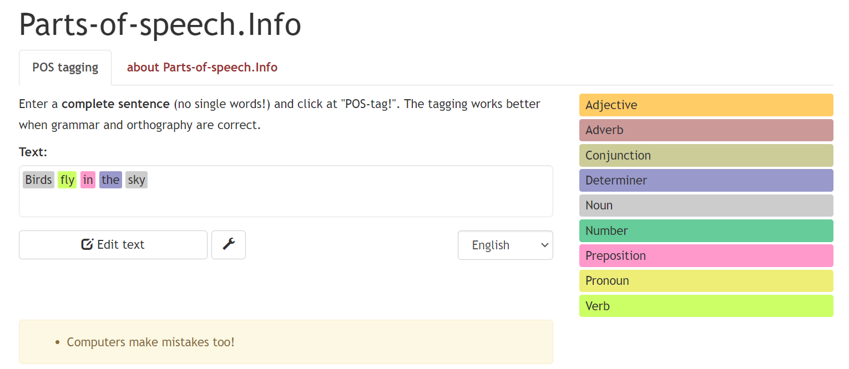
Parts of Speech (POS): Online Tool

Slide 80
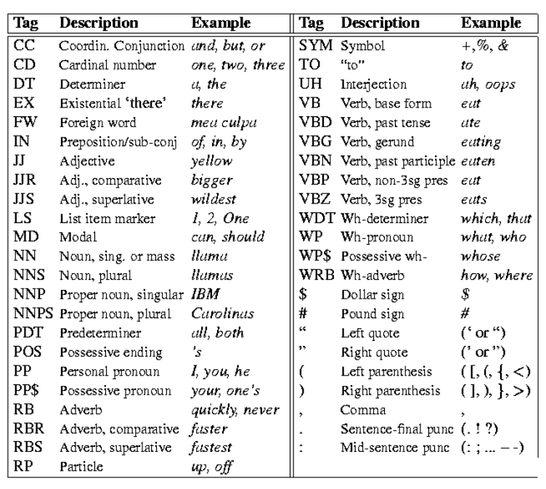
Peen Tree Bank POS Tags

Slide 81
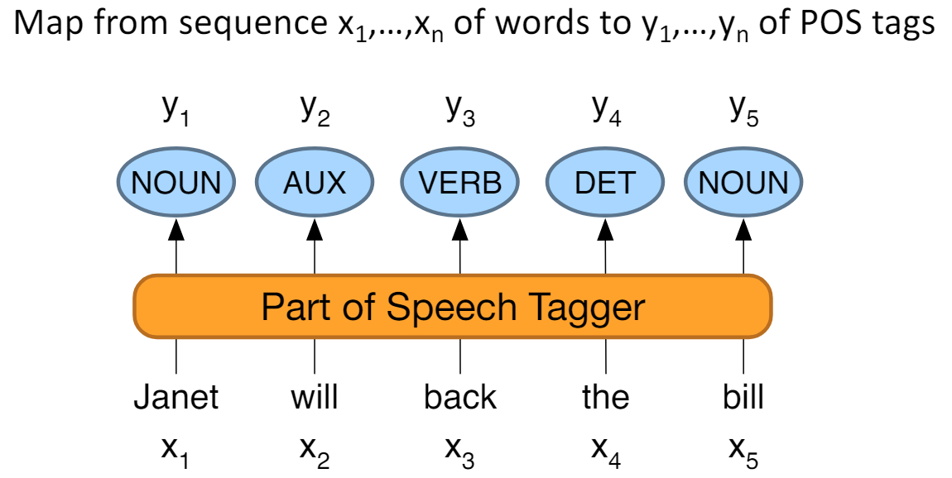
POS Tagging and Mapping

Slide 82
Parts of Speech (POS) Dataset
The input to a tagging algorithm is a string of words specified tag set of the kind
Book that fight
Book = VB, that = DT, flight = NN
Does that flights serve dinner ?
Does = VBZ, that = DT, flight = NN, serve = VB, dinner = NN

Slide 83
Why Parts of Speech Tagging?
NLP tasks
Parsing: improve syntactic parsing
Machine translation: reordering of adjectives and nouns
From English to Bangla
Sentiment tasks: distinguish adjectives in sentence
Language analytic computational tasks

Slide 84
Standard algorithms for POS Tagging?
Supervised machine learning NLP algorithms
Hidden Markov Models (HMM)
Conditional Random Fields (CRF) / Maximum Entropy Markov Models (MEMM)
Neural sequence models ( RNNs or Transformers )
Large language Models (like BERT)

Slide 85
Parts of Speech (POS) Tagging Code Implementation and Demo
Natural Language Processing
https://web.stanford.edu/~jurafsky/slp3/

