Slide 1
Shooter Aircraft Breakout Game Using PyGame Library
Presented By
Faisal Ahmed
Associate AI Engineer
Next Solution Lab

Slide 2
Outline
Introduction
Game overview
Game logic and rules
Winning scenario and game over
Conclusion

Slide 3
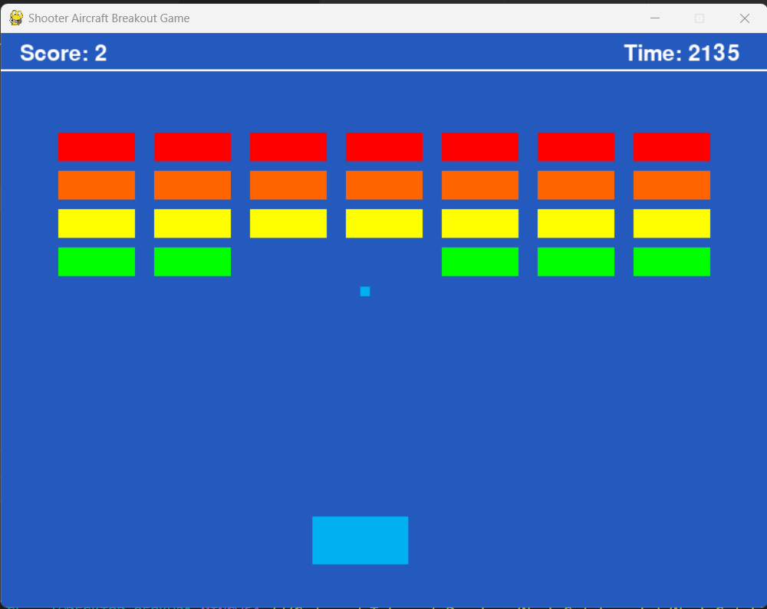
Introduction
The game was developed using the pygame library
The game consist of different elements such as paddle, brick, ball
The score is increased when a ball collision with a brick

Slide 4
Start the Game

Slide 5
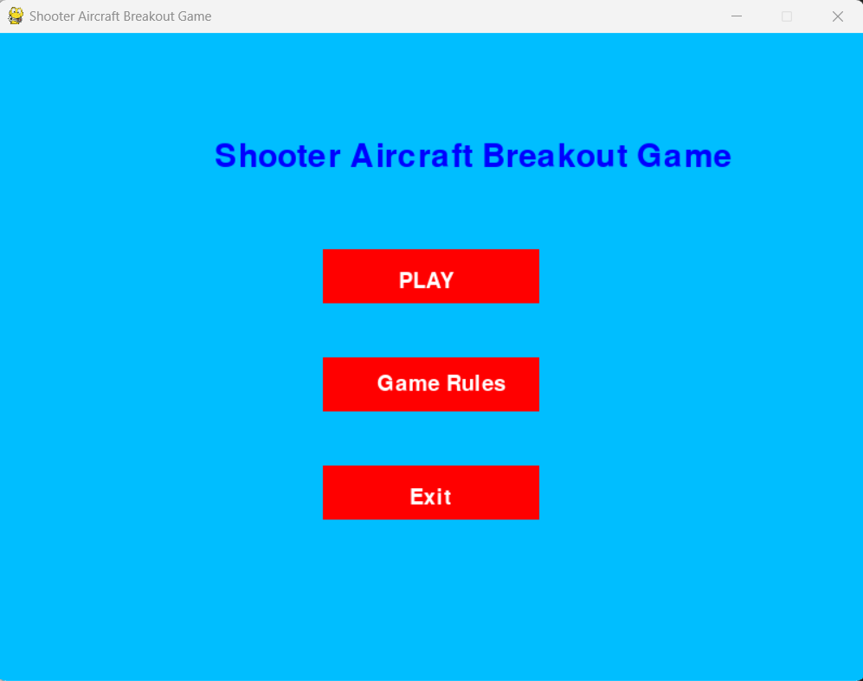
Start Menu

Slide 6
Start Menu
Select

Slide 7
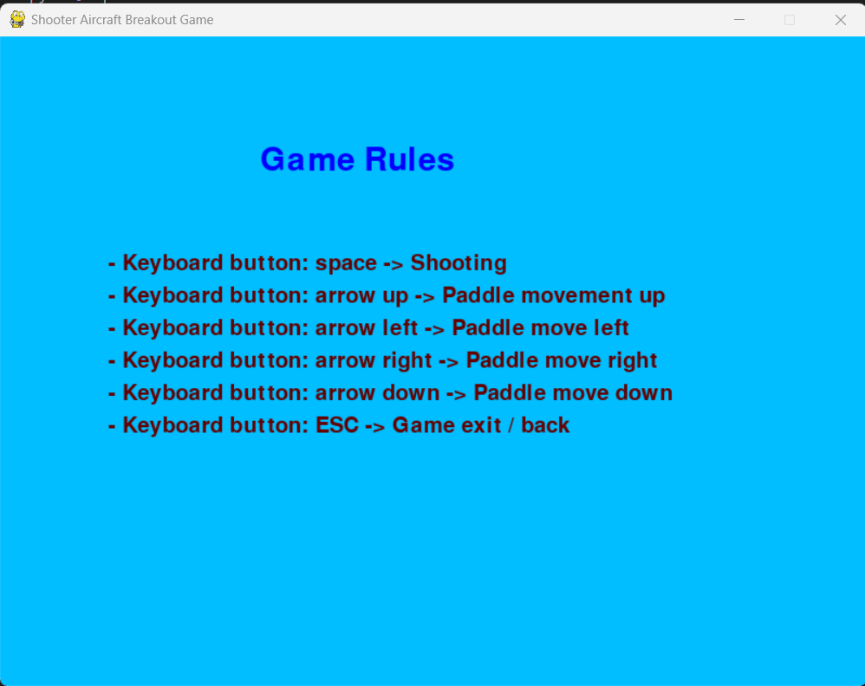
Game Rules

Slide 8
Start Menu
Select

Slide 9
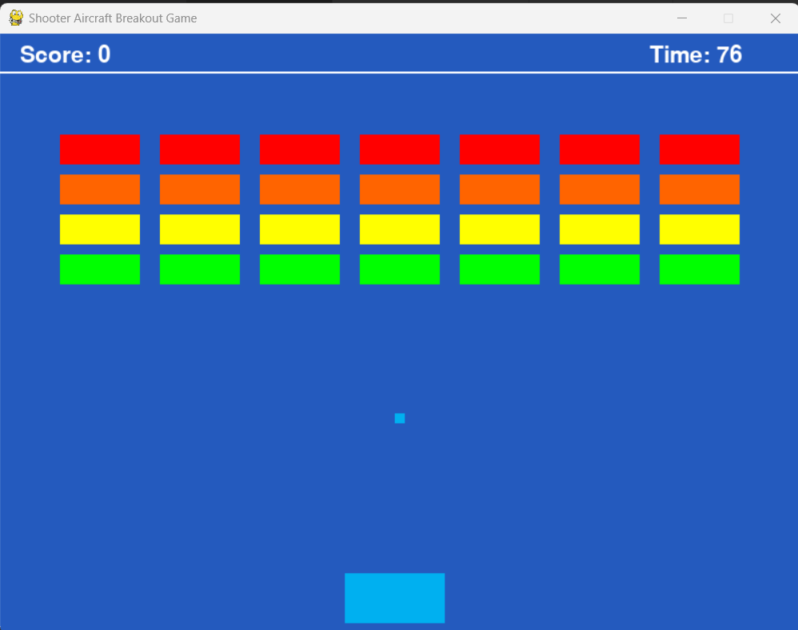
Playing Game

Slide 10
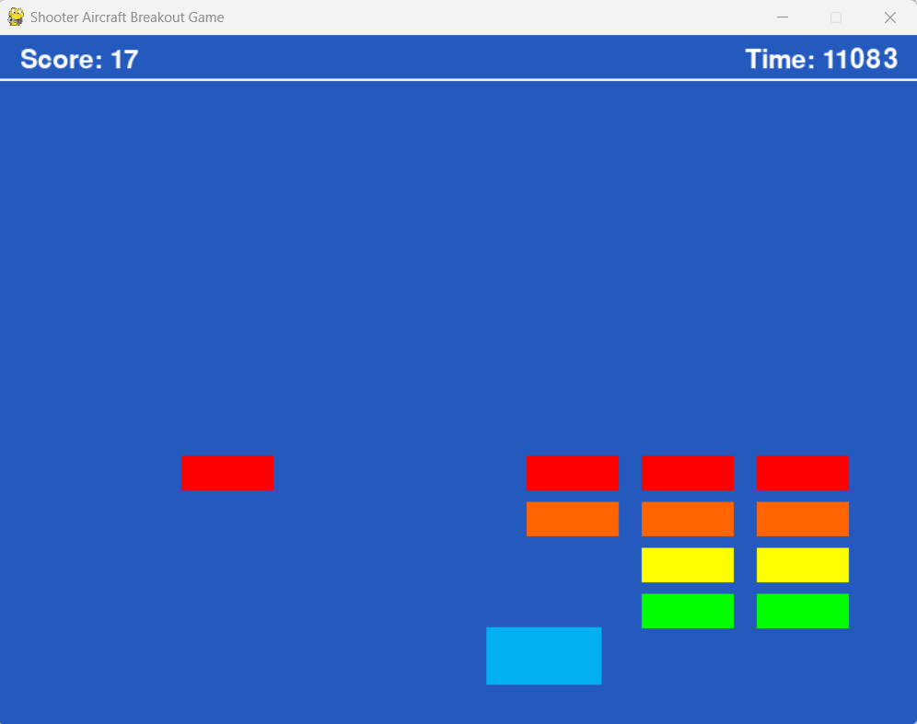
Playing Game

Slide 11
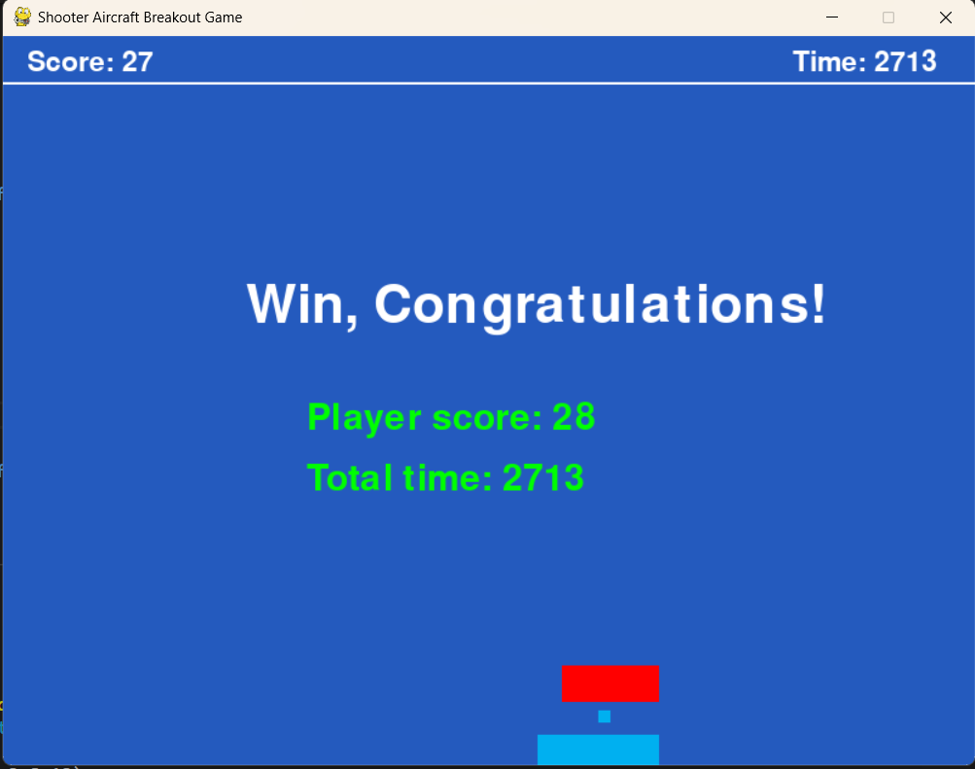
Winning Scenario

Slide 12
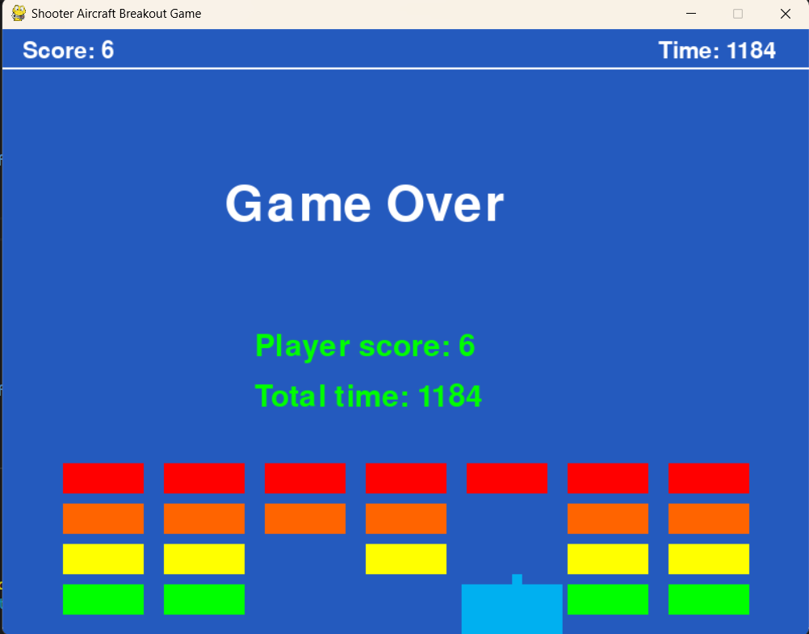
Game Over

Slide 13
Conclusion
The collision detection algorithm is used for the collision between ball and brick

Slide 14
Thank You

