Slide 1
Shooter Aircraft Breakout Game Using PyGame Library
Presented By
Faisal Ahmed
Associate AI Engineer
Next Solution Lab

Slide 2
Outline
Introduction
Game overview
Game logic and rules
Winning scenario
Game over and termination

Slide 3
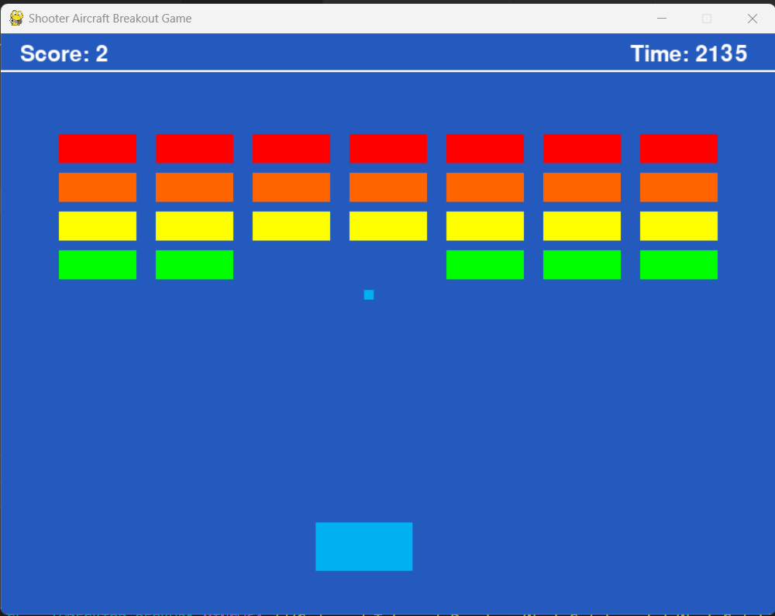
Introduction
The game was developed using the PyGame library
The game consist of different elements such as paddle, bricks, and balls.
The score is increased when a ball collides with a brick

Slide 4
Start the Game

Slide 5
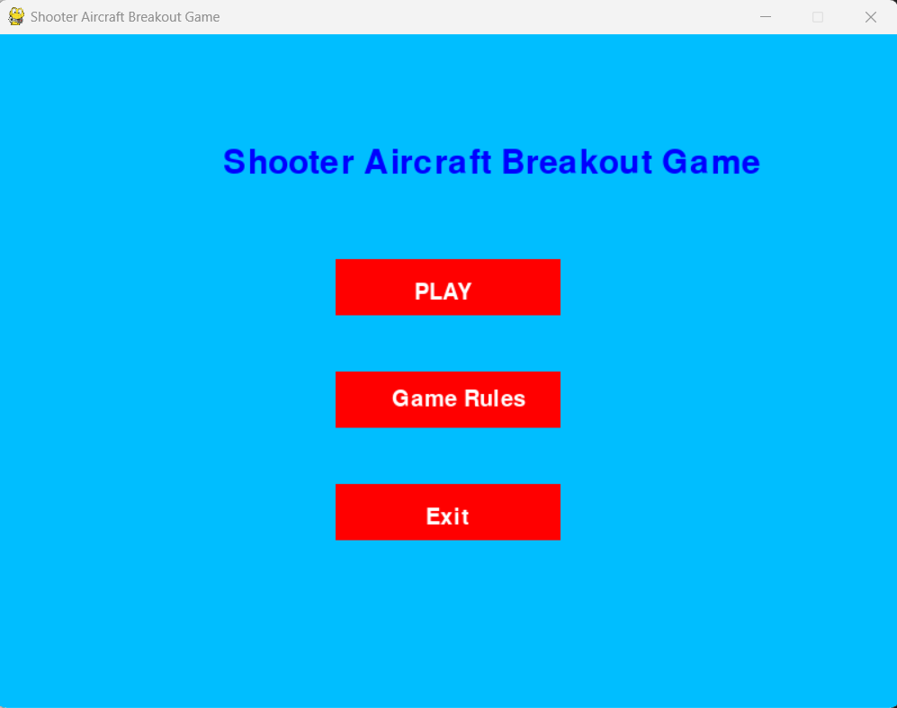
Start Menu

Slide 6
Start Menu
Select

Slide 7
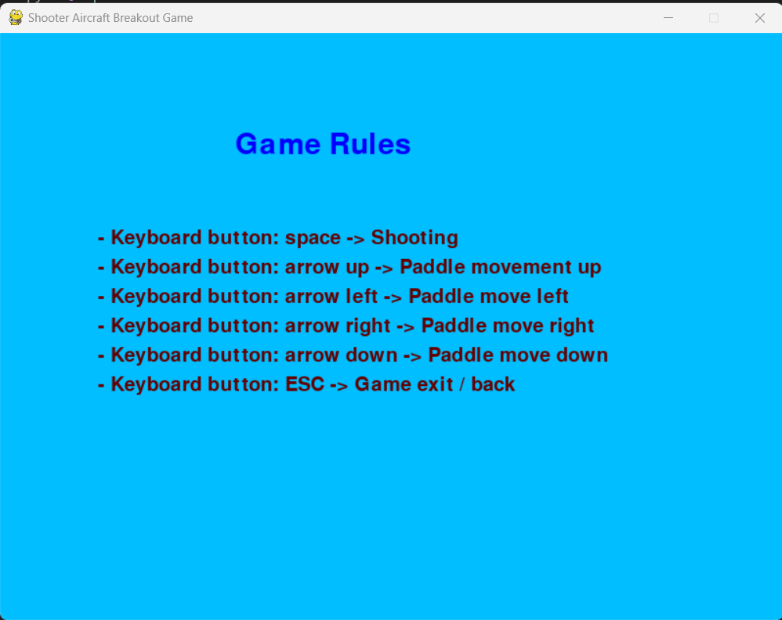
Game Rules

Slide 8
Start Menu
Select

Slide 9
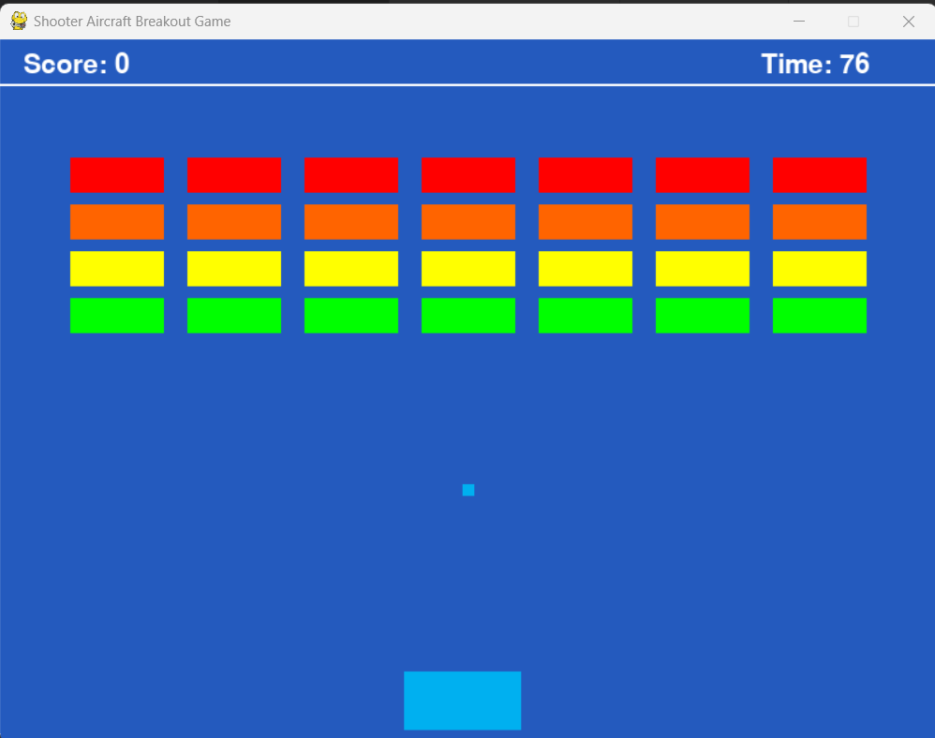
Playing Game

Slide 10
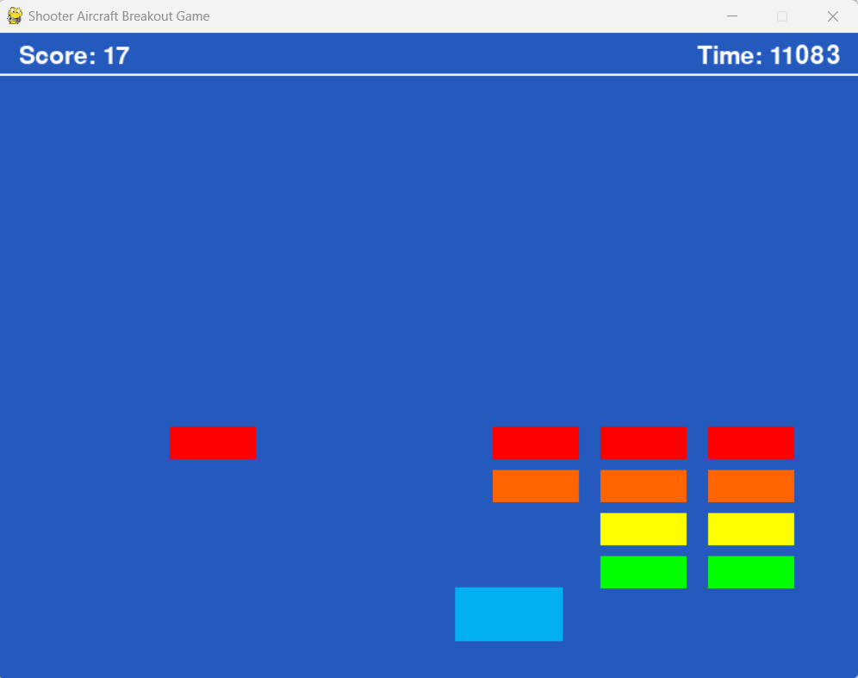
Playing Game

Slide 11
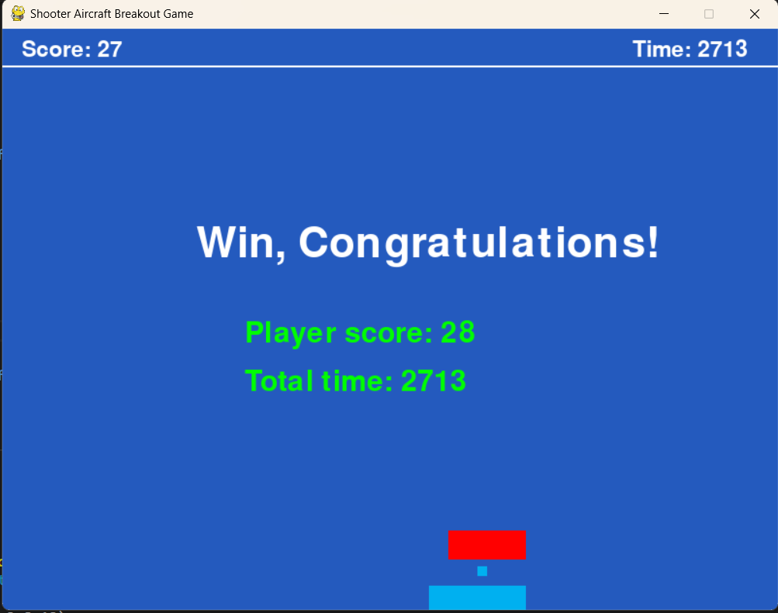
Winning Scenario

Slide 12
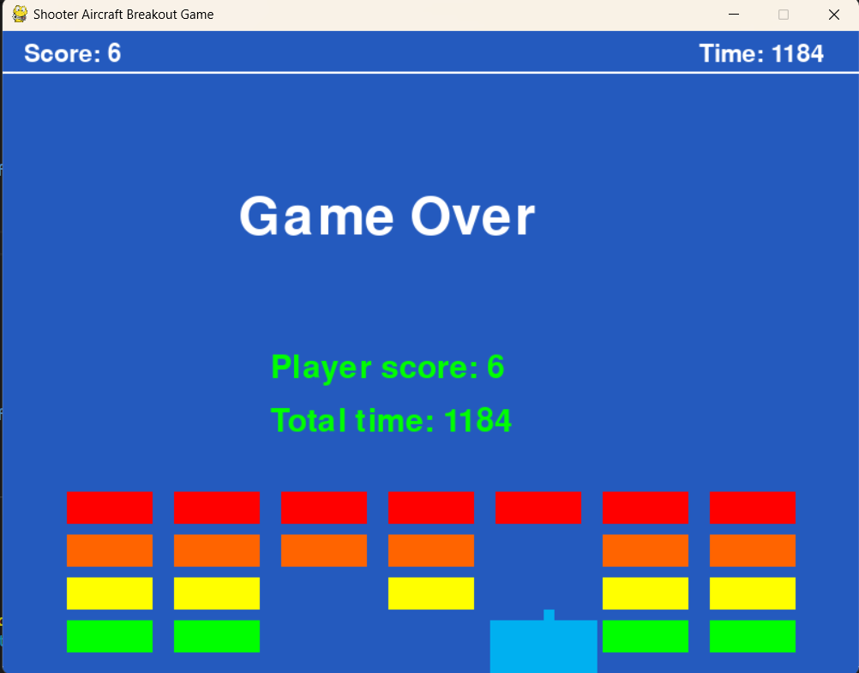
Game Over and Termination

Slide 13
Thank You

