Slide 1

A __new__ way to __init_subclass__
Python Automation
Bridging the everyday with the possible.
Faisal Al-Rayes
Software Delivery Engineer

Slide 2
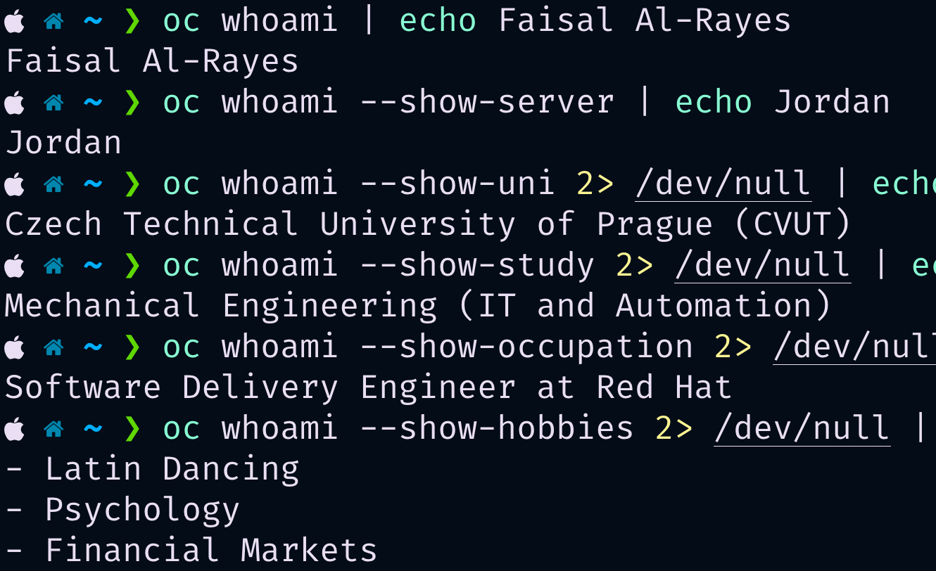

whoami
linkedin.com/in/faisalalrayyess

Slide 3
What can I expect from this talk/demonstration?
A __new__ way to __init_subclass__
What value could this bring me?
The everyday
Programming
The Bridge
Meta Programming

Slide 4
What we’ll discuss today
Agenda
“0”: “Problem Statement / Task”
“1”: “Solution 1 - Hell”
“2”: “Solution 2 - A better hell”
“3”: “Introducing __new__ and __init_subclass__”
“4”: “Solution 3 - Heavenly?”

Slide 5
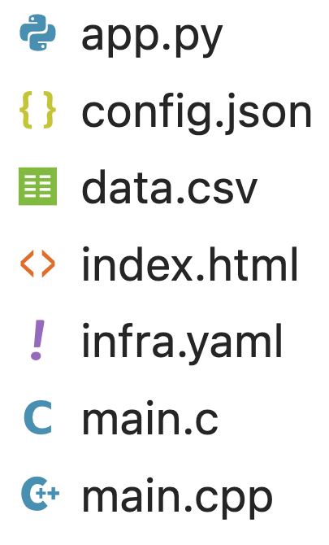
Problem Statement / Task
Interpret the file to extract information:
A __new__ way to __init_subclass__
Information
Dump
Loader

Slide 6
Live Demo!

Slide 7

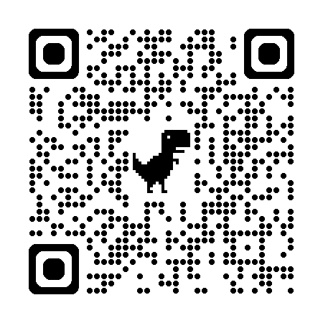
Thank you for you attention!

Slide 8
Q&A

