Slide 1
Data Visualization
Faisal Al-Saadi

Slide 2
Topic: World population analysis
Tools/packages: Pandas, NumPy, Matplotlib, Microsoft Excel (cleaning)

Slide 3
Disclaimer

Slide 4
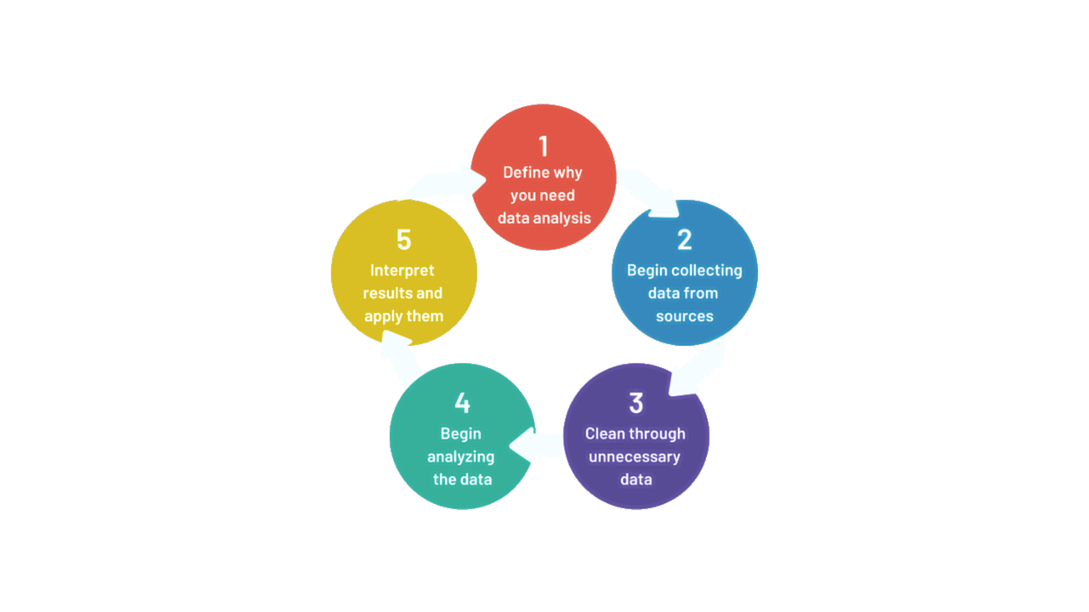
As we learned in this course

Slide 5
Step 2: Collect Data
Datasets source (2020,2021,2022): https://www.kaggle.com/datasets/rsrishav/world-population/versions/698?resource=download

Slide 6
Step 3: Cleaning
Missing data from first dataset for 4 countries
(DRC, Congo, Saint Vincent and Grenadines, and Isle of Man)
Added a “Continent” column from a fourth dataset source: https://www.kaggle.com/datasets/muhammedtausif/world-population-by-countries

Slide 7
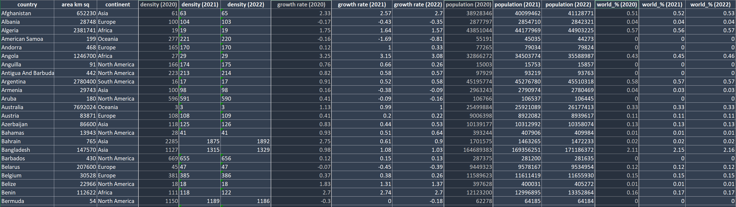
Step 3: Cleaning

Slide 8
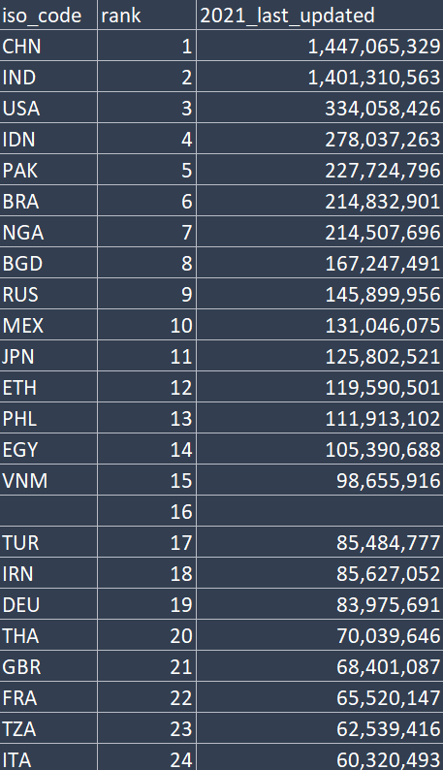
Step 3: Cleaning

Slide 9
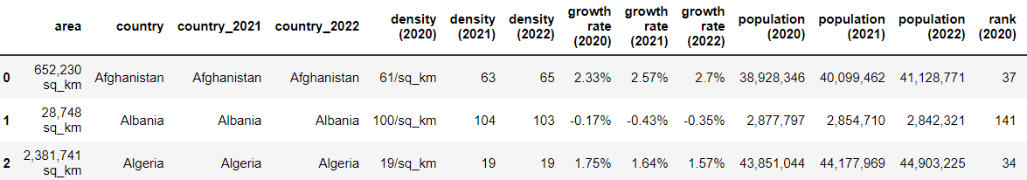
Step 3: Cleaning
df1.sort_values('country', ascending=True, inplace=True)
df2.sort_values('country_2021', ascending=True, inplace=True)
df3.sort_values('country_2022', ascending=True, inplace=True)

Slide 10
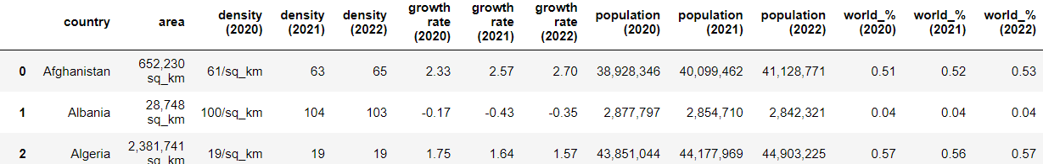
Step 3: Cleaning
I sorted column names lexicographically
Then I moved the country column first

Slide 11
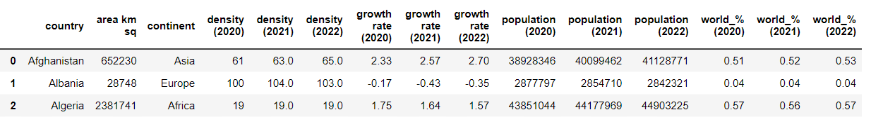
Step 3: Cleaning
Removed unneeded text with Excel’s “Find and Replace” feature

Slide 12
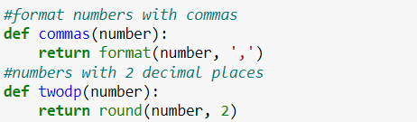
Step 3: Cleaning

Slide 13
Step 4: Analyze Data
Questions:
1- Which continent has the most/least population?
2- Which continent had the most/least population growth?
3- Which continent has the most/least population density?
4- Which continent has the most/least landmass?
5- Which continent has the most/least countries?
6- Which countries have negative growth and what are their count in each continent?

Slide 14
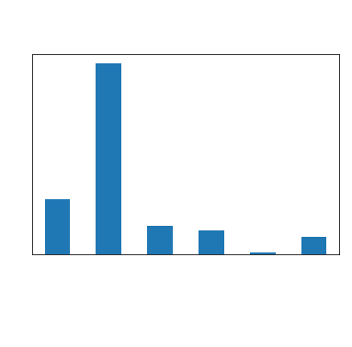
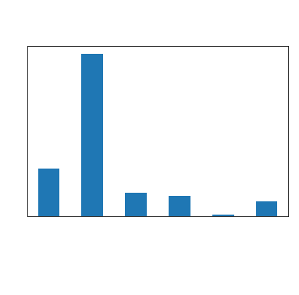

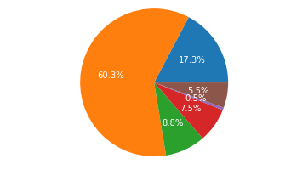


Question 1: Population per continent

Slide 15
Question 1: Population per continent
2020:
The continent with the highest population is Asia with a population of 4,701,442,811
The continent with the lowest population is Oceania with a population of 42,677,813
2021:
The continent with the highest population is Asia with a population of 4,753,659,326
The continent with the lowest population is Oceania with a population of 44,491,724
2022:
The continent with the highest population is Asia with a population of 4,780,755,347
The continent with the lowest population is Oceania with a population of 45,038,554

Slide 16
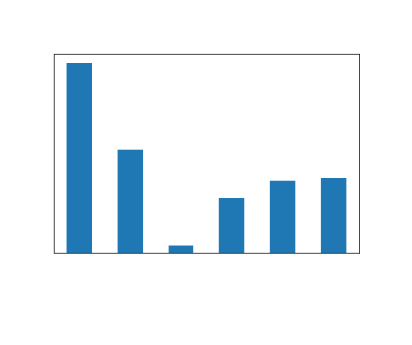
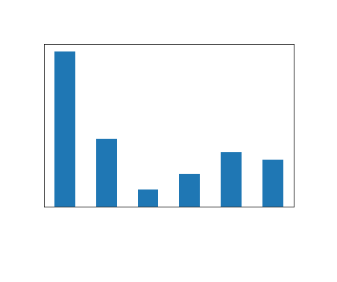
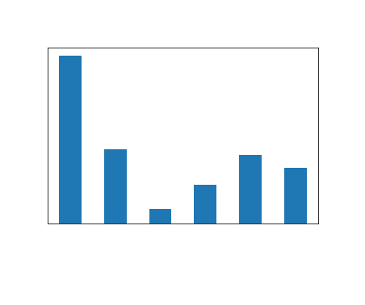
Question 2: Which continent had the most/least population growth?

Slide 17
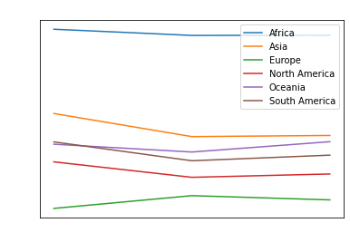
Question 2: Which continent had the most/least population growth?
2020:
The continent with the highest average growth rate is Africa with a growth rate of 2.18%
The continent with the lowest average growth rate is Europe with a growth rate of 0.07%
2021:
The continent with the highest average growth rate is Africa with a growth rate of 2.11%
The continent with the lowest average growth rate is Europe with a growth rate of 0.22%
2022:
The continent with the highest average growth rate is Africa with a growth rate of 2.11%
The continent with the lowest average growth rate is Europe with a growth rate of 0.18%

Slide 18
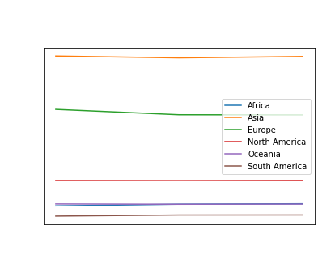
Question 3: Which continent has the most/least population density?

Slide 19
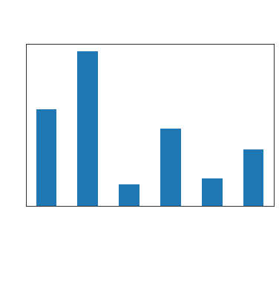
Question 4: Which continent has the most/least landmass?
The continent with the highest landmass is Asia with an area of 48,452,821km²
The continent with the lowest landmass is Europe with an area of 6,695,537km²

Slide 20
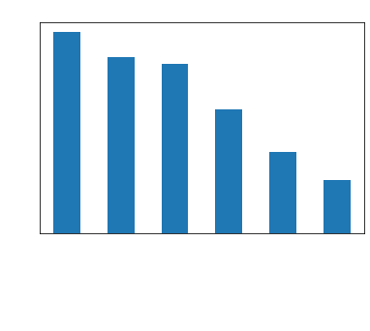
Question 5: Which continent has the most/least countries?
Continent:
Africa 57
Asia 50
Europe 48
North America 35
Oceania 23
South America 15

Slide 21
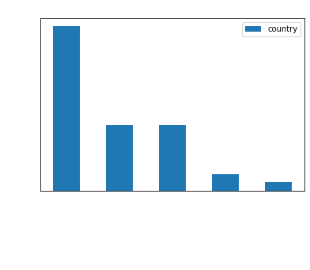
Question 6: Which countries have negative growth and what are their count in each continent?
Continent:
Europe 20
Asia 8
North America 8
Oceania 2
Africa 1

Slide 22
Question 6: Which countries have negative growth and what are their count in each continent?
Continent:
Europe 20
Asia 8
North America 8
Oceania 2
Africa 1

Slide 23
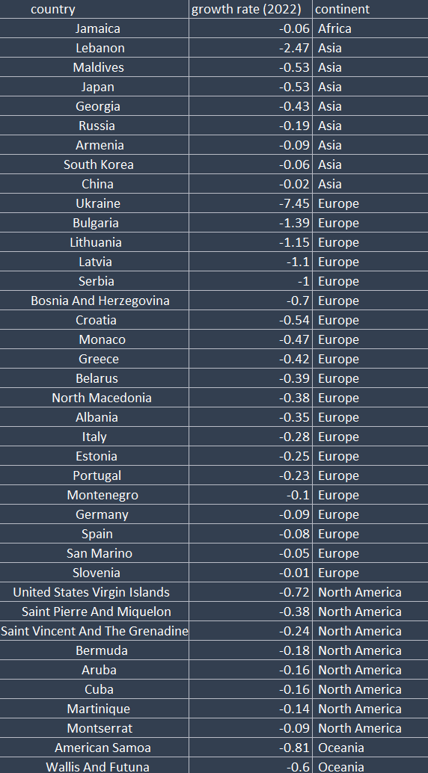
Question 6: Which countries have negative growth and what are their count in each continent?

Slide 24
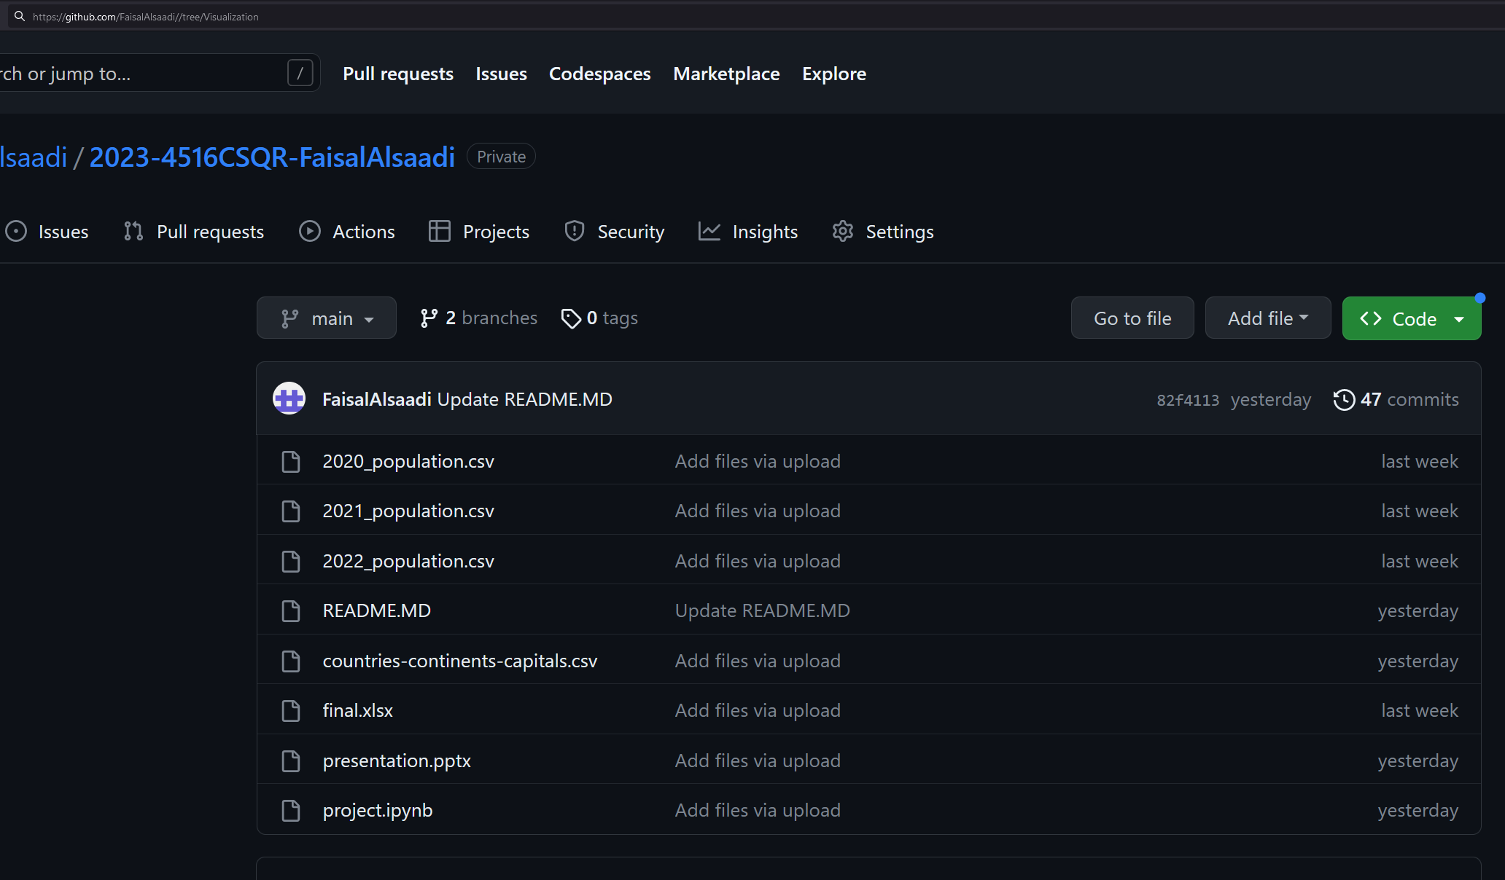
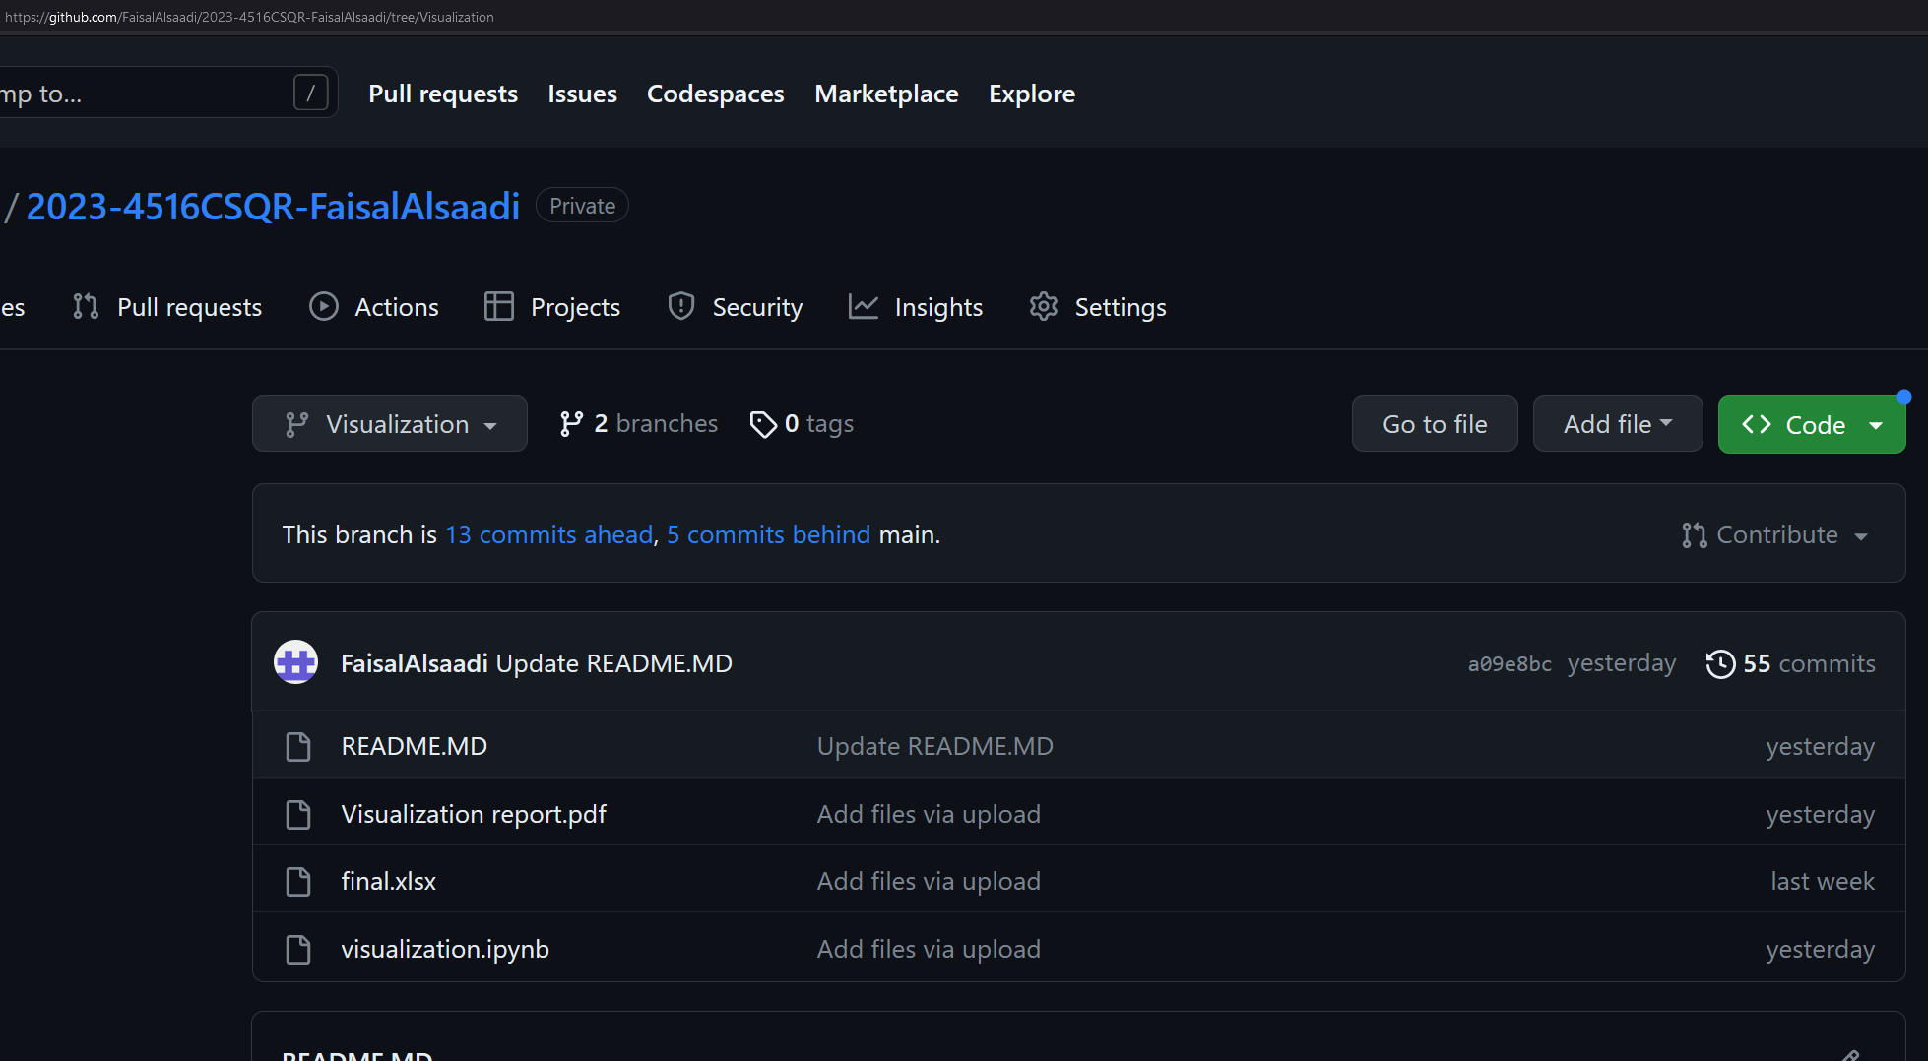
All files are available on GitHub:
https://github.com/FaisalAlsaadi/2023-4516CSQR-FaisalAlsaadi
Main branch
Visualization branch

Slide 25
Thank you

