Slide 1


3o in the
Excitenent of
SNEC ¹25 Hackatho n
Explore the innovative SMEC’25 Hackathon organized by DocCSIT at SSUET to unleash your creativity and skills.
SNEC HACKATHON TEAI'1

Slide 2
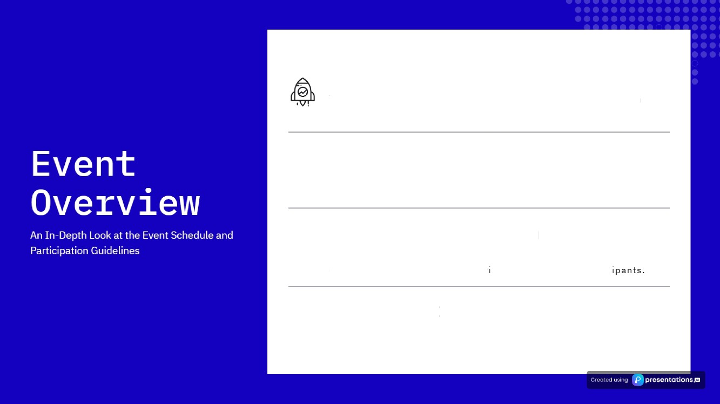



Start Time
The event will commence at 10:30 AM marking the beginning of an
exciting 24-hour journey for participants.
End Time
Th e co n c lu s i on i s seI fo r 1 0:3 0 AM on 3anu ary 2 3, 202 5, aII ow ing p art i ci p an t s t o e n gage f u Ily th ro u gh o u t th e eve nt duraI! an.
Total Duration
Span n n g a f u 11 24 nours, I he eve nt i s d es i gned t o m ax i m i z e ca I lab o rat i ve effo rts an d i nnovat ve th i nking am on g pa rt ie
Equipment
B ri n g Yo ur Lapt o ps.

Slide 3
Problem Statement
Creating Sustainable Solutions for Textile Waste Management
Text:11e Maste Czżsżs
° Impzopez Disposal
°
Need box a Digital
°• Clothes Donation to
The world faces an alarmi ng issue of textile waste, with miltion s of tons of un used
clothes ending up in landfills each year. This not only contributes to enviranm ental
Practices
Nany individuals lack awareness regarding the proper disposal of unused clothing. As a result, a large portion of potentially
Solution
To tackle the textile waste crisis, there is an urgent need for a digital platform that streamlines the process of clothing donation
NGOs
The platform should facilitate seamless clothing donations to registered NGOs, ensuring that usable items are
degradation but also results in
significant economic losses.
reusable garments is discarded
improperly, exacerbating the
and eco-friendly disposal,
making it easier for individuals to
redirected to those in need, th us promotin g socia I
waste problem.
participate.
responsibility.
•• Eco-Friendly Disposal
°• Incentives Koi
Collaboration with
°• Collaboration with
Options
Participation
NG0s and Brands
NGOs and Brands
For clothes deemed
unusab le, the platfo rm must offer eco-friend ly disposal options, such as recycling or upcycling, to minimize
environmentat impact.
In order to encourage active participation, the platform can provide incentives like coupons or vouchers that reward users for don ating or responsibly disposing of their clothes.
Building partnerships with NGOs and partner brands is essential to expand the platform's reach and impact, fosteringa community dedicated to sustainable fashion practices.
Building partnerships with NGOs and partner brands is essential to expand the platform's reach and impact, fosteringa community dedicated to sustainable fashion practices.
c eased u › s presentations ss

Slide 4
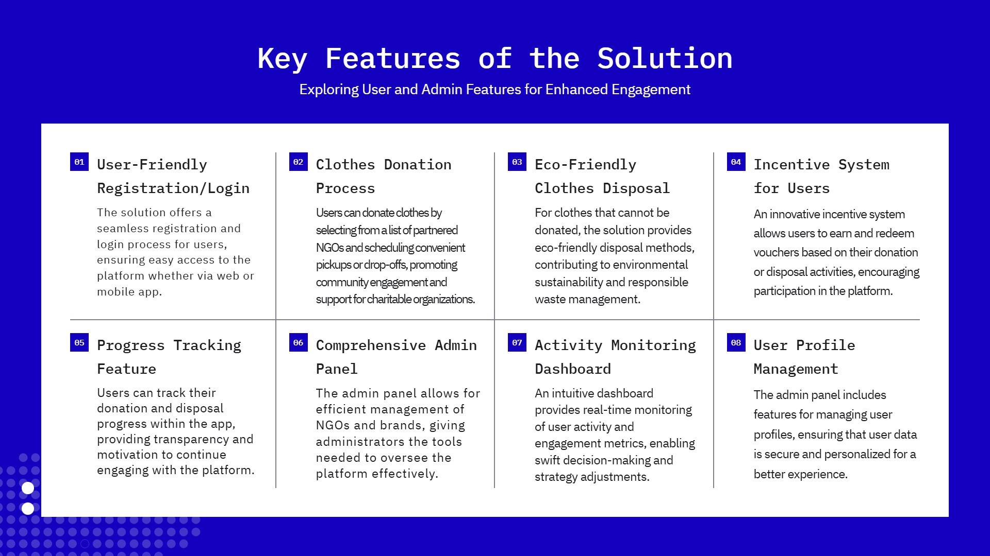


Slide 5

Technical Requirements
A Comprehensive Look at Necessary Technologies
Fz nt - End
Technologies
The front-end of the application can be developed using modern frameworks such as , js,
These tools are essential for creating dynamic and responsive user interfaces that enhance user
experience.
js, or
Bac k - End Fzamewo zks
For the back-end, options include djs,Django, These frameworks are crucial for handling server-
side logic, database interactions, and ensuring smooth communication between the client and the server.
2
Dat:abase Solut:Ions
Choosing the right database is vital for data management. gqg}g ySgL are popular options that offer robust features for handling large datasets, ensuring data integrity, and supporting complex queries.
Th 1zd - Pazt:y Integzat:tons
Integrating third-party services such as p_g, y , can enhance application functionality. These integrations provide users with added features that improve usability and engagement.
4
c eased u › s
presentations ss

Slide 6
Submission Guidelines
Essential Steps *o P oject Submission
Submission Method
All project submissions must be made via Google Form, which can be accessed through the link available in the WhatsApp group. This ensures that all submissions are organized and easy to review.
Required Information
Each submission should include essential information about the Project Name, Color Scheme, Logo, and Design and the specific project being submitted. This helps provide context and background for reviewers.
Project Links
Submit links to your live project URL or APK, GitHub repository, and a Demo Video explaining the project functionality and features (Mandatory).
^œn'ea 1°nç preseutotions

Slide 7



Judging cziteria
Evaluating Projects Based on Key Metrics
Functionality | User Experience | Innovation | Sca1ab:ż1:żty
(30OI) | (25ᵉ ) | (25ᵉ ) | (2õîó)
This criterion assesses the | User experience is critical for | Innovation is n censure oJ | Sca/ability assesses the
overall functionality o] the he success o/ any product. creativity and originality in potential for the product to ^{project or product. It} This criterion focuses on how the project. This criterion grow and handle increased ^{evaluates whether the core} users interact with the era/uafes how unique arid demand. this criterion looks ^{features are working as} product. It considers factors forward-thinking the product at whether the architecture ^{intended and if they meet} such os ease of use, is compared to existing and in/rastructure can ^{the requirements set forth in} accessibility, and overall solutions. An innovative support scaling up operations the project guidelines. A high _{functionality score indicates} satisfaction. A product that project often in produces new without compromising _{a rod ust and reliable} provides a positive user ideas, technologies, or performance. A scalable _{pro duct tho I effectively} experience is more likely to methodologies that ccin sef it product can easily adapt to _{performs its intended tasks.} achieve user adaption and apart in a competitive changing market conditions refenfion. market. and user needs.
c eased u › s P‘ presentations ss

Slide 8
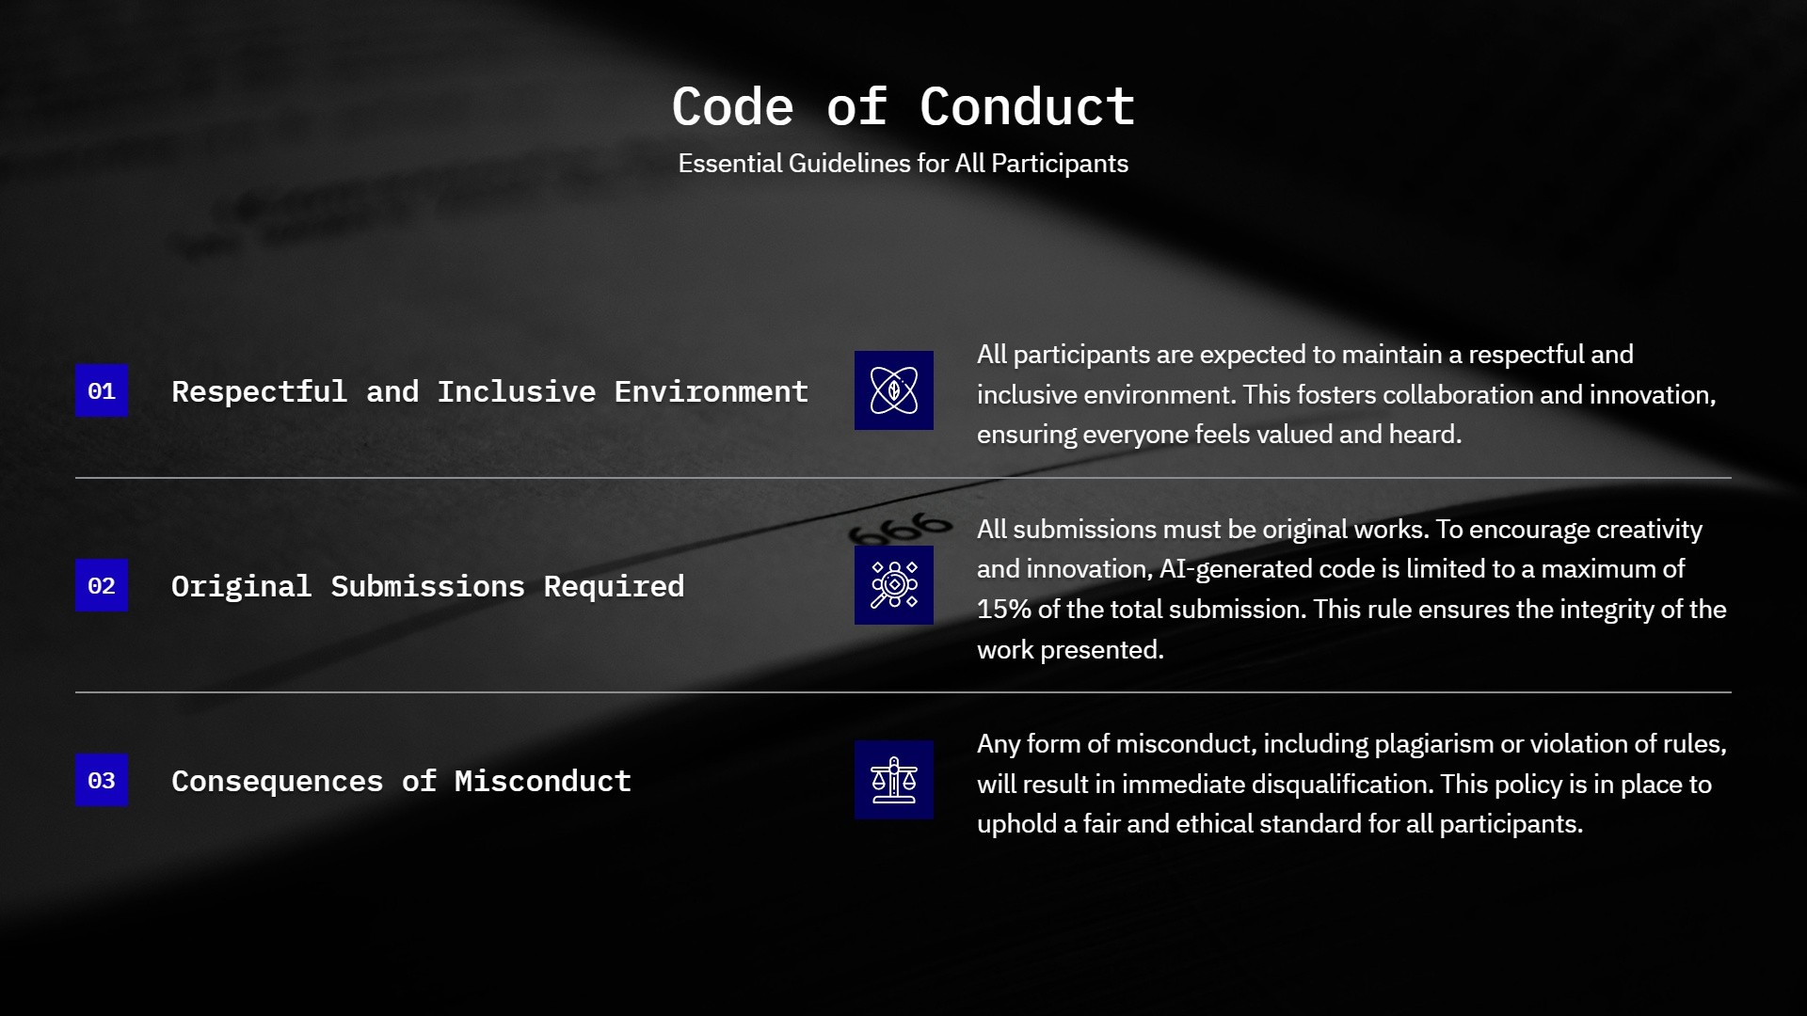

Slide 9
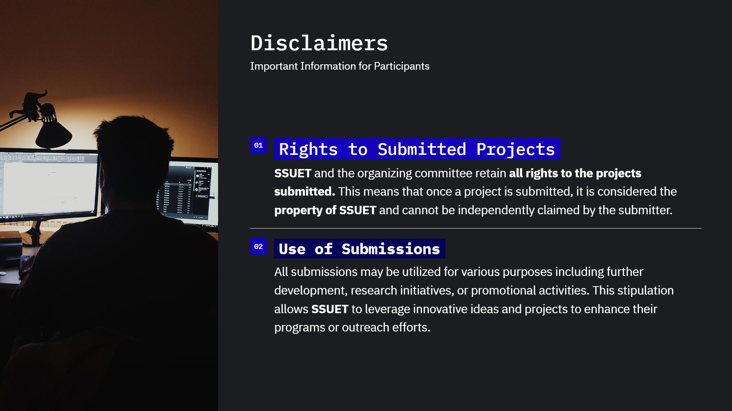

Slide 10










Innovation
Get Ready to Innovate
Embrace creativity and develop impactful solutions; connect for updates via our WhatsApD group.
r rented t sing g presentations ai

