Slide 1





From Tube To Thought
Transform YouTube Videos into Knowledge
01

Slide 2

Hours of valuable content locked in video format
Finding specific information requires watching entire videos
Problem
No search functionality for spoken content
02

Slide 3
AI-powered video intelligence system
Ask questions about video content in natural language
Solution
Get accurate answers from what was actually said
10

Slide 4
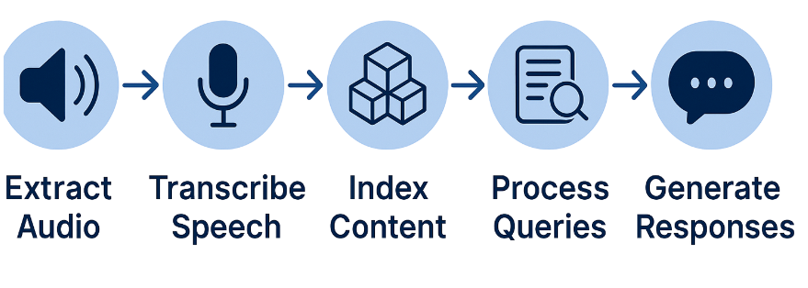
Pipeline
10

Slide 5
Key Features
RAG architecture for grounded responses
Hybrid search combining vector + keyword matching
Customizable processing options
03

Slide 6
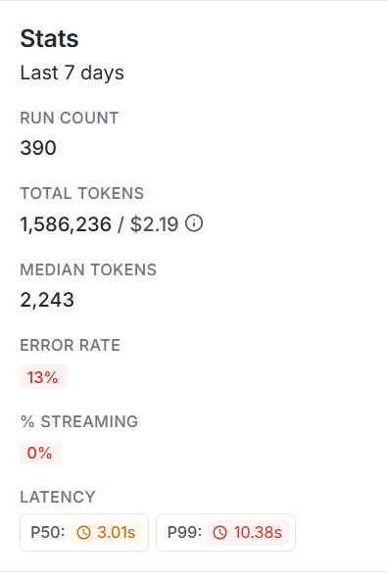
LangSmith
04

Slide 7



User profiles and history
Future Directions
Additional language support
Service 03
05

Slide 8

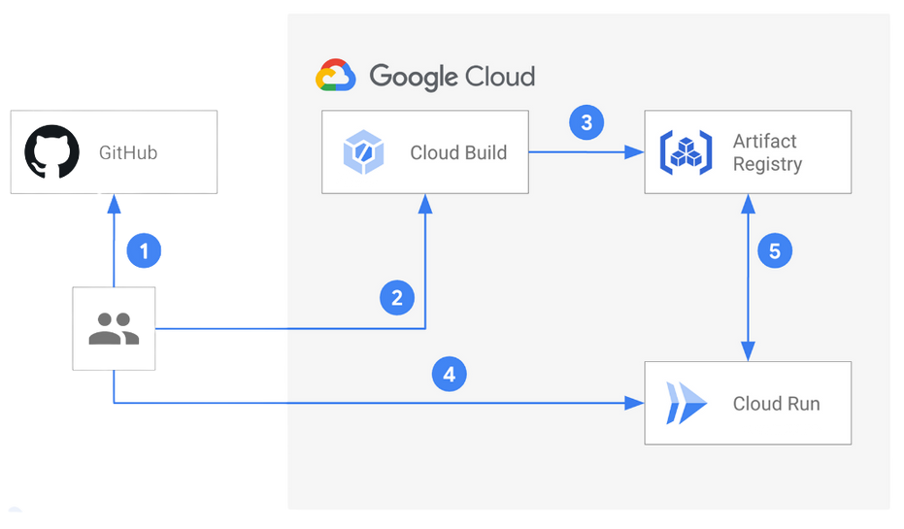
GitHub → Cloud Build → Artifact Registry → Cloud Run pipeline
Cloud Deployment
10

Slide 9


Live Demo
Service 02
06

Slide 10

10

Slide 11
Presented by Faisal Alharbi
Thank
You
any Questions?
10

