Slide 1
KLA PS01 / SEMICON INDIA HACKATHON 2026
Mithai Warriors
2×
grayscale
restoration
SemiRestore: AI restoration of degraded images
for semiconductor inspection
Akhilesh Kancharla
Team Leader • 3rd Year
Md. Faisal Tabrez
Team Member • 3rd Year
Mahatma Gandhi Institute of Technology
Team leader contact • 8688812245
github.com/FaisalTabrez/Semicon
Notes:
[Sources]
- https://i4c.in/hackathon-2026/
- https://github.com/FaisalTabrez/Semicon
[/Sources]

Slide 2
PROBLEM STATEMENT
Degradation can hide defects before inspection
What the solution must achieve
Observed input
128×128 or 256×256 grayscale
speckle + Gaussian noise; raw range may exceed [0,1]
Remove speckle without clipping valid extremes.
Reduce Gaussian noise without blurring boundaries.
Recover 2× spatial resolution in one model.
Generalize to unseen semiconductor sources.
Run fast enough for practical inspection workflows.
Required output
2× restored float32 image
sharp structure, low noise, no artificial patterns
Inspection depends on fine edges and texture; smoothing can conceal the same evidence that restoration is meant to recover.
noise removal + 2× super-resolution + OOD robustness
Problem source: i4C / KLA AI-Based Restoration challenge statement.
02
Notes:
[Sources]
- https://i4c.in/hackathon-2026/
[/Sources]

Slide 3
IDEA DESCRIPTION
One model adapts to every degradation
1 model
4 stats
joint restoration
image-conditioned
A single NAF-SR predicts a clean 2× residual instead of chaining separate denoising and upscaling models.
Mean, standard deviation, minimum and maximum modulate the network through zero-initialized FiLM.
2× skip
0
conservative residual path
public-test labels used
Bicubic carries stable low-frequency structure; the learned branch focuses on missing detail and noise correction.
Model selection uses only organizer training pairs, locked validation-ID and texture-held-out pseudo-OOD evidence.
Core principle: adapt restoration strength to the input while keeping the output path auditable.
03
Notes:
[Sources]
- https://arxiv.org/abs/2204.04676
- https://github.com/FaisalTabrez/Semicon/blob/main/configs/final_conditioned.yaml
- https://github.com/FaisalTabrez/Semicon/blob/main/src/semirestore/models/naf_sr.py
[/Sources]

Slide 4
PROPOSED SOLUTION
Safe input → conditioned NAF-SR → auditable output
1
2
3
Validate + preserve range
→
Conditioned NAF core
→
Pixel-shuffle restore
Load one-channel NumPy safely, reject invalid values, and preserve real intensity extremes before inference.
Width 48 encoder–decoder; residual NAF blocks adapt features using global input statistics.
Predict the high-resolution residual, add the bicubic skip, crop safely, then clamp once to [0,1].
[mean, std, min, max]
zero-initialized FiLM conditioning
9,111,684 parameters
Charbonnier loss • real pairs • D4 geometry
Training: 5,000 steps, batch 16, AdamW, warm-up + cosine decay, EMA/raw checkpoint selection.
04
Notes:
[Sources]
- https://arxiv.org/abs/2204.04676
- https://github.com/FaisalTabrez/Semicon/blob/main/configs/final_conditioned.yaml
- https://github.com/FaisalTabrez/Semicon/blob/main/train.py
[/Sources]

Slide 5
INNOVATION & UNIQUENESS
Only OOD-gated improvements entered the final model
Design choice
Isolated change
Locked evidence
Decision
Texture-held-out split
12 clusters; entire outlying clusters held out
+5.02 dB vs bicubic on pseudo-OOD
CORE
+15% fitted synthetic
train-fitted noise and speckle profile
0 / 3 aggregate OOD metrics improved
REJECT
+statistics conditioning
FiLM from mean / std / min / max
PSNR +0.0071; SSIM +0.00152
KEEP
The architecture is compact; the novelty is evidence discipline—input statistics control restoration strength, and every change must improve locked OOD evidence without material ID loss.
A 4.11M-parameter distilled student was also rejected: +36.9% batch throughput did not offset quality and batch-1 latency misses.
05
Notes:
[Sources]
- https://github.com/FaisalTabrez/Semicon/blob/main/README.md
- https://github.com/FaisalTabrez/Semicon/blob/main/reports/student32_ablation.md
[/Sources]

Slide 6
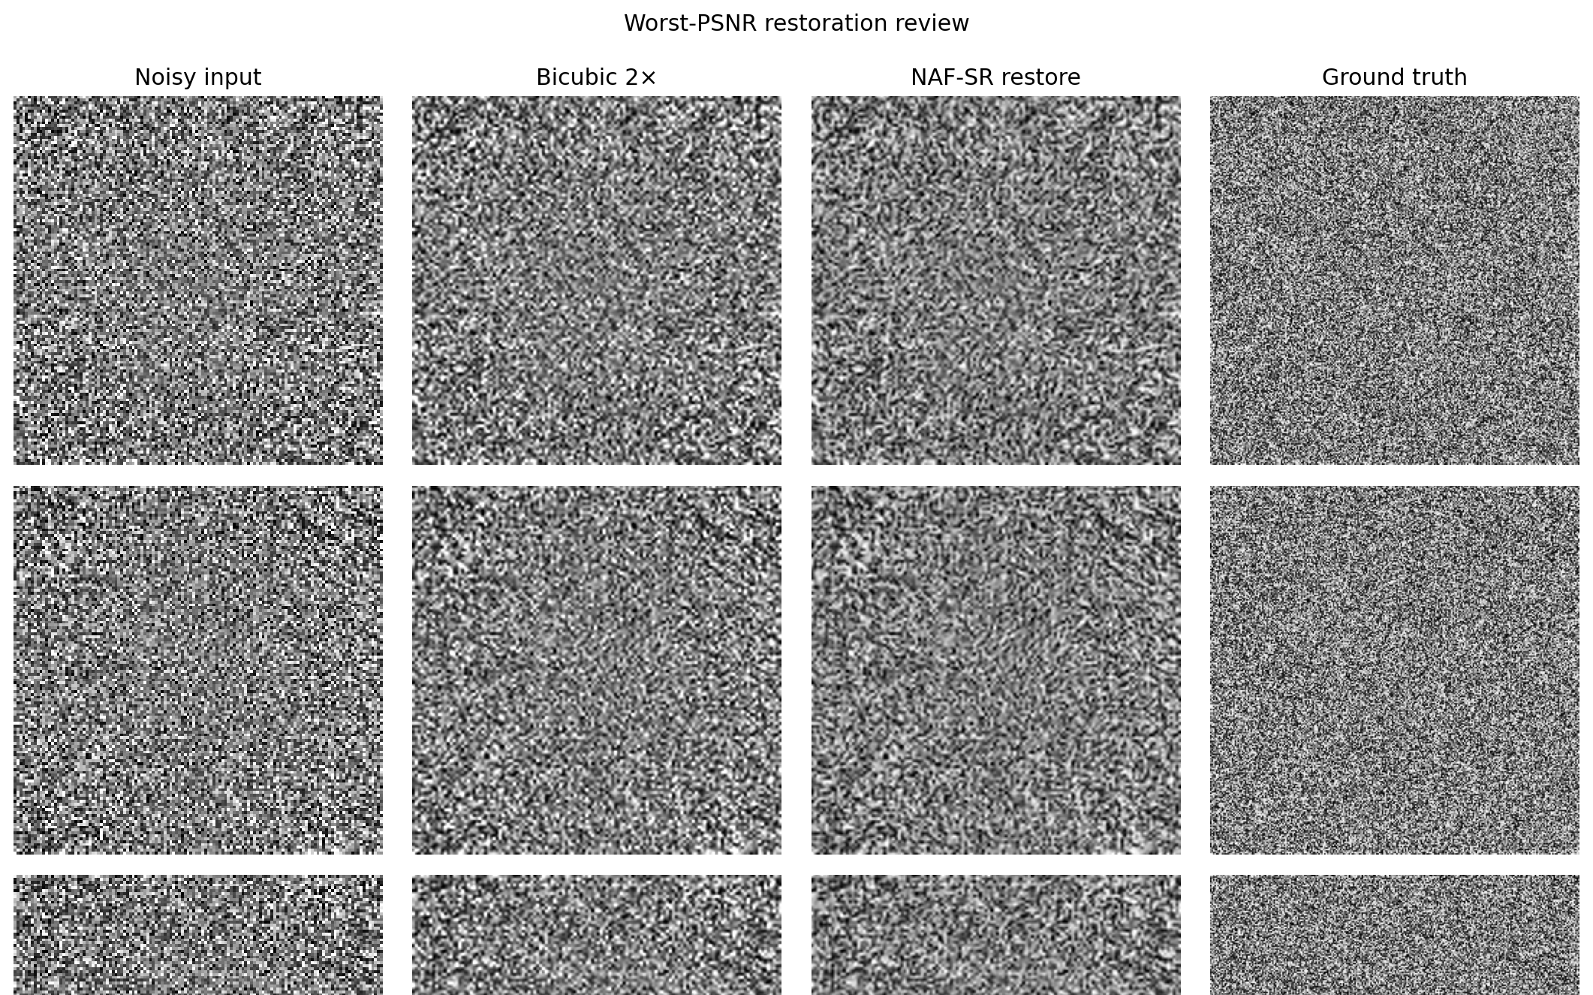
RESULTS
≈5 dB gains survive worst-case visual review
Locked metrics
Validation-ID 29.226 dB • 0.7766 • 0.2714
Pseudo-OOD 25.251 dB • 0.6661 • 0.3530
Bicubic gain +5.43 dB ID
Bicubic gain +5.02 dB OOD
Cold external check
Noise profiles: +8.16 / +4.10 dB
Clean-only: −2.18 dB
PSNR / SSIM / LPIPS-Alex↓. Worst pseudo-OOD cases show no checkerboards or ringing; main risk is fine-texture smoothing.
06
Notes:
[Sources]
- https://github.com/FaisalTabrez/Semicon/blob/main/reports/conditioned_fp32_val_id_summary.json
- https://github.com/FaisalTabrez/Semicon/blob/main/reports/conditioned_fp32_val_ood_summary.json
- https://github.com/FaisalTabrez/Semicon/blob/main/reports/external_carinthia_evidence.md
- https://doi.org/10.5281/zenodo.10715190
[/Sources]

Slide 7
TECHNOLOGY & FEASIBILITY
A100-tested, compact, and clean-clone verified
9.11M
1.890 ms
1,958 img/s
parameters • 34.87 MiB checkpoint
A100 compiled FP32 • batch 1
A100 compiled FP16 • batch 16
Eager FP32
Package gates
Eager FP32 avoids a 20–23 s compile: 14.871 ms batch 1 and 542.61 images/s batch 16 on A100.
400/400 outputs • 52 tests • complete A100 pip freeze
Fresh public clone passed checkpoint hash, output count/path/shape/dtype/range checks, default evaluator smoke, and notebook validation.
git clone → pip install → python evaluation.py INPUT_DIR OUTPUT_DIR → verify_submission.py
Model-only synchronized A100 timing excludes checkpoint loading and file I/O; final H100 timing belongs to KLA.
07
Notes:
[Sources]
- https://github.com/FaisalTabrez/Semicon/blob/main/README.md
- https://github.com/FaisalTabrez/Semicon/blob/main/weights/MODEL_CARD.md
[/Sources]

Slide 8
GITHUB & REPRODUCIBILITY
Clone.
Run.
Verify.
Public repository
github.com/
FaisalTabrez/Semicon
STEP 1
Clone the public repository
Final model
conditioned_naf_sr
Checkpoint
273abd9d…158c28
Public code
and weights included
STEP 2
Install requirements-runtime.txt
STEP 3
Run evaluation.py INPUT_DIR OUTPUT_DIR
STEP 4
Verify all 400 restored arrays
Ready for judge-side execution
STEP 5
Optional Colab training walkthrough
Standalone evaluator • frozen weights • 400 outputs • complete A100 freeze • reproducible Python and Colab training
Notes:
[Sources]
- https://github.com/FaisalTabrez/Semicon
- https://i4c.in/hackathon-2026/
[/Sources]

Slide 9
REFERENCES
Every claim is traceable to code, data, or literature
Data & implementation
Restoration networks
NAFNet — Chen et al., ECCV 2022
EDSR — Lim et al., CVPRW 2017
i4C / KLA AI restoration challenge statement (2026)
KLA paired organizer dataset: 3,200 training samples
Carinthia SEM Defect Dataset, Zenodo 10715190
PyTorch 2.11, scikit-image and LPIPS
Public code, model card and evidence reports in GitHub
Quality metrics
LPIPS — Zhang et al., CVPR 2018
SSIM — Wang et al., IEEE TIP 2004
Architectures and metrics were selected for restoration fidelity—not defect classification.
doi.org/10.5281/zenodo.10715190
Full URLs and per-slide claim sources are recorded in speaker notes.
09
Notes:
[Sources]
- https://i4c.in/hackathon-2026/
- https://arxiv.org/abs/2204.04676
- https://arxiv.org/abs/1707.02921
- https://arxiv.org/abs/1801.03924
- https://doi.org/10.1109/TIP.2003.819861
- https://doi.org/10.5281/zenodo.10715190
- https://github.com/FaisalTabrez/Semicon
[/Sources]

