Slide 1
Title & Motivation

Slide 2
Domain Randomization in Reinforcement Learning
The "Reality Gap": RL agents trained in fixed simulators often fail in the real world due to unexpected friction or weight changes.
Goal: Train an agent across randomized physics environments to build real-world resilience.

Slide 3
Algorithm: Proximal Policy Optimization (PPO) via Stable-Baselines3.
Technique:
Implemented a custom Gymnasium wrapper that randomly alters physical variables (cart mass, pole mass, force magnitude) on every episode reset.

Slide 4
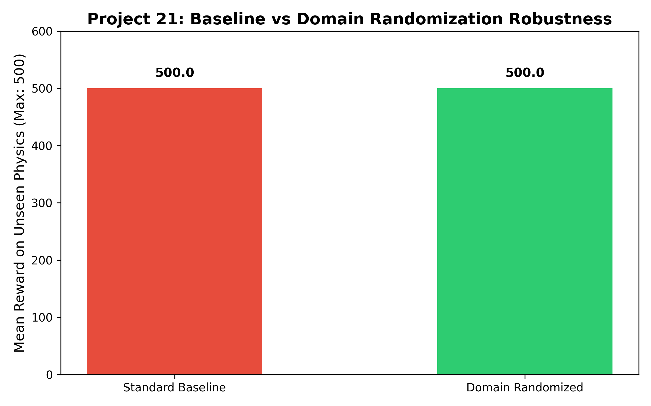
Results & Learning Curves

Slide 5
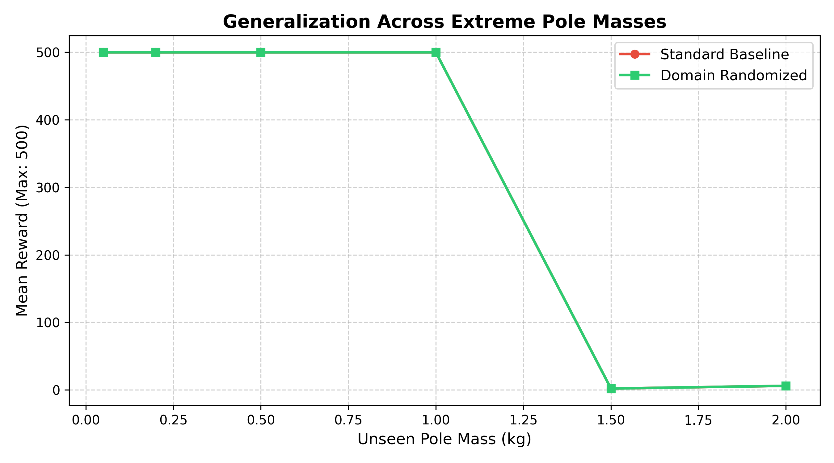
Robustness Horizon Across Escalating Pole Masses

Slide 6
Domain Randomization maintains max performance (500.0) across a 20x mass scaling range. (0.05kg – 1.0kg)
Identifies the physical limit where system momentum exceeds the actuator's physical force capacity. (>1.5kg)

Slide 7
Limitations:
High training variance: Randomizing physics requires more timesteps to converge.
Parameter Bounds: Bounds must be realistically set; over-randomizing creates unsolvable physics.

Slide 8
Ethics & Real-World Safety
Sim-to-Real Reliability: Prevents physical robot damage or crashes when deploying trained policies to real-world hardware.
Critical Systems: Crucial for safety-critical deployments like autonomous driving and medical automation.

