Slide 1
Preprocessing, Regularisation & Cross-Dataset Generalisation for EEG Seizure Detection
Logistic regression on three REAL datasets - UCI · CHB-MIT · Bonn
Machine Learning - Semester Major Assignment

Slide 2
Why this version exists
• The earlier notebook looked enterprise-grade but folded under inspection
– 2 of 3 "datasets" were synthetic Gaussian noise - mislabelled as Bonn / PhysioNet
– Trivially separable → fake F1 ≈ 0.98 everywhere (an artifact, not a result)
– Written conclusions contradicted the notebook’s own printed output
– On the only real dataset the model was at chance (ROC-AUC ≈ 0.50)
• This version: only real data, true provenance, one honest methodology, conclusions computed + assert-checked

Slide 3
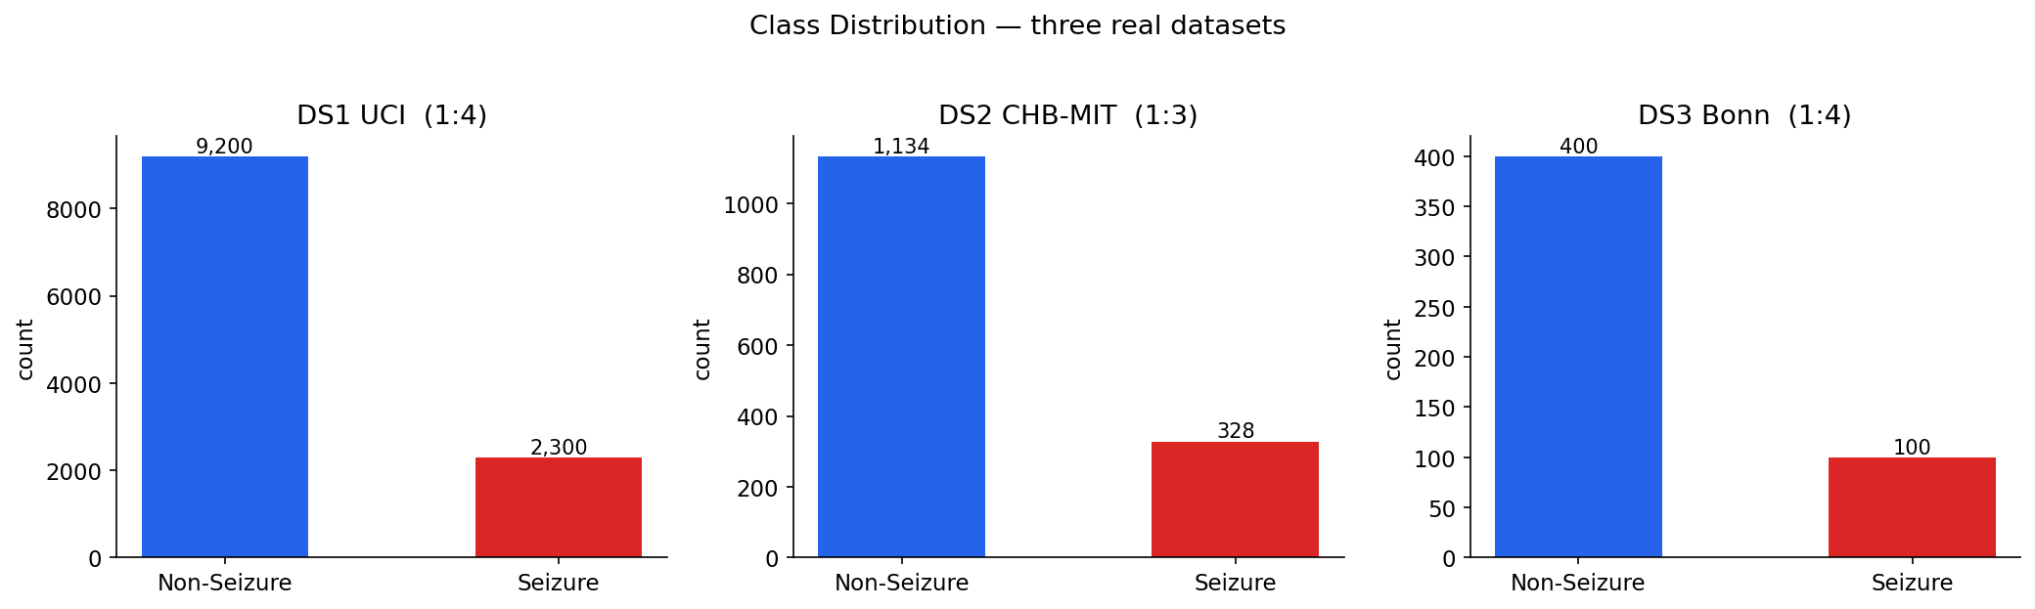
Three real datasets (true provenance)
• DS1 UCI Epileptic - 11500 windows, 20.0% seizure
• DS2 CHB-MIT Scalp - 1462 windows (23ch raw), 22.4% - natural imbalance
• DS3 Bonn University - 500 segments, 20.0% seizure
• Downloaded reproducibly via kagglehub; no fabrication, no fallback

Slide 4
Root cause: raw amplitude is degenerate
• Raw EEG samples → logistic regression: ROC-AUC 0.50 (chance)
– Seizure signal lives in energy / variability / spectrum, not amplitude at a fixed index
• Fix: unified extractor - 10 time-domain + 5 spectral band-power features
– Applied identically to all datasets → fair cross-dataset comparison
• DS1 ROC-AUC 0.50 → 0.99 after extraction

Slide 5
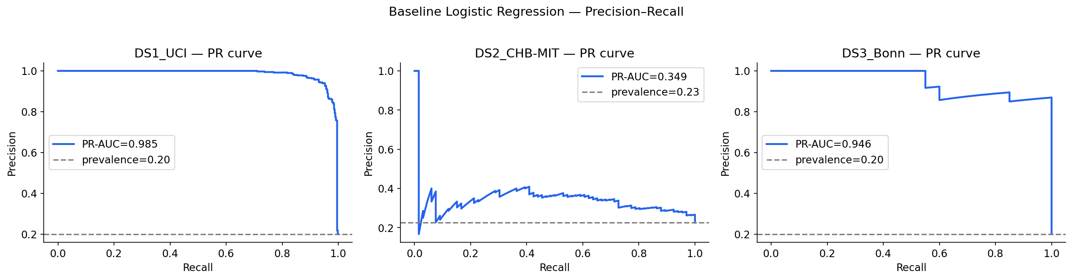
Baseline - honest difficulty spread
• DS1 UCI: ROC-AUC 0.993, F1 0.938
• DS2 CHB-MIT: ROC-AUC 0.693, F1 0.029
• DS3 Bonn: ROC-AUC 0.988, F1 0.930
• CHB-MIT is genuinely hard - a real result, not a fabricated 0.98

Slide 6
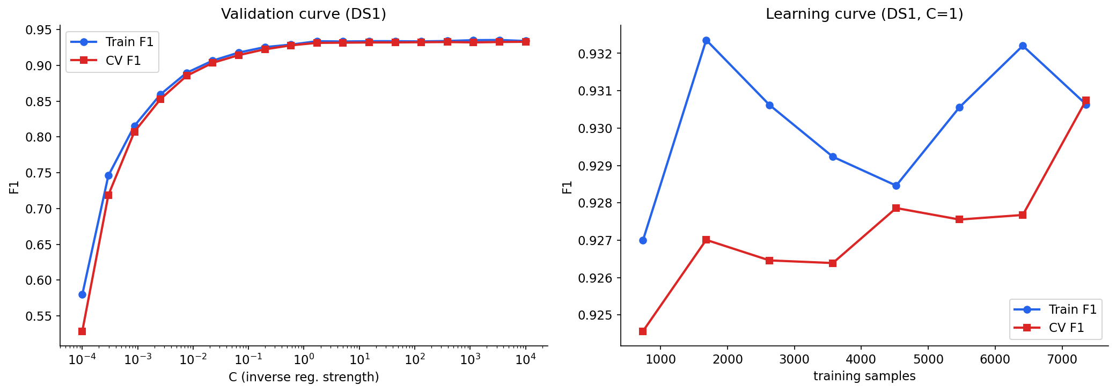
Overfitting / underfitting (now real)
• Severe underfit (C=1e-4): train 0.58 / test 0.58 (15 feat)
• Mild underfit (C=1e-2): train 0.89 / test 0.88 (15 feat)
• Good fit (C=1): train 0.93 / test 0.94 (15 feat)
• Overfit (deg=3,C=1e5): train 1.00 / test 0.95 (815 feat)

Slide 7
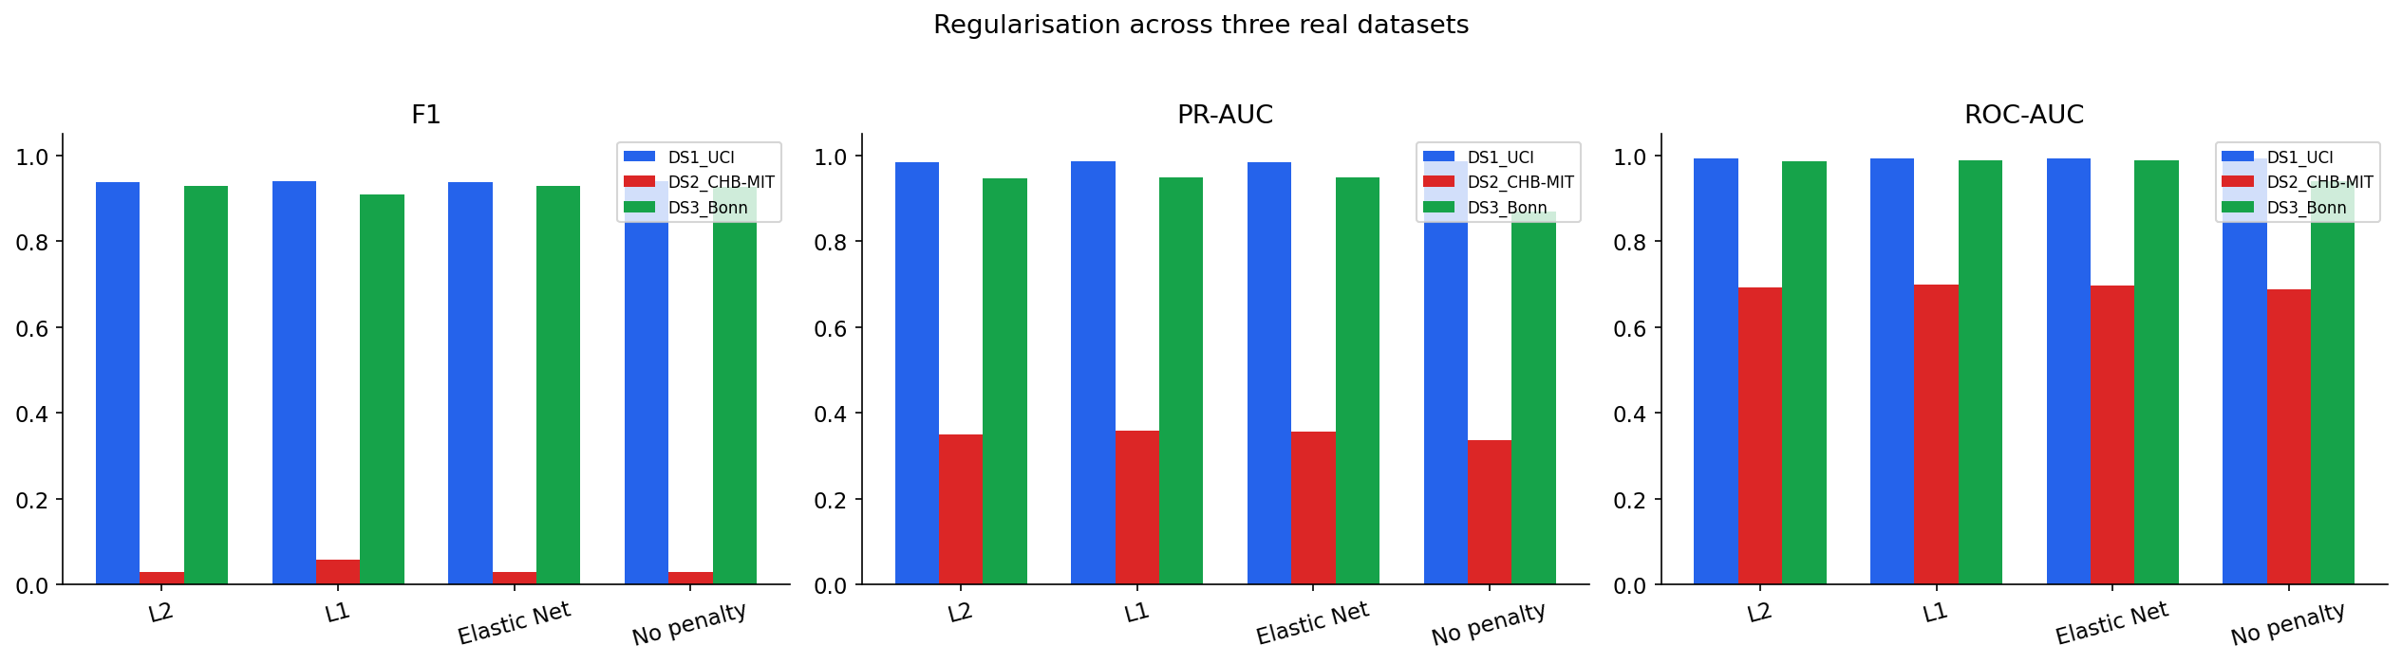
Q2/Q3 - Regularisation
• Best mean PR-AUC: L1 (Lasso)
• Spread among L1/L2/Elastic Net: only 0.0049
• Elastic Net consistently best? False
• Unregularised is the real loser (spread → 0.034)
• Defensible answer: "regularised vs. not", not which penalty

Slide 8
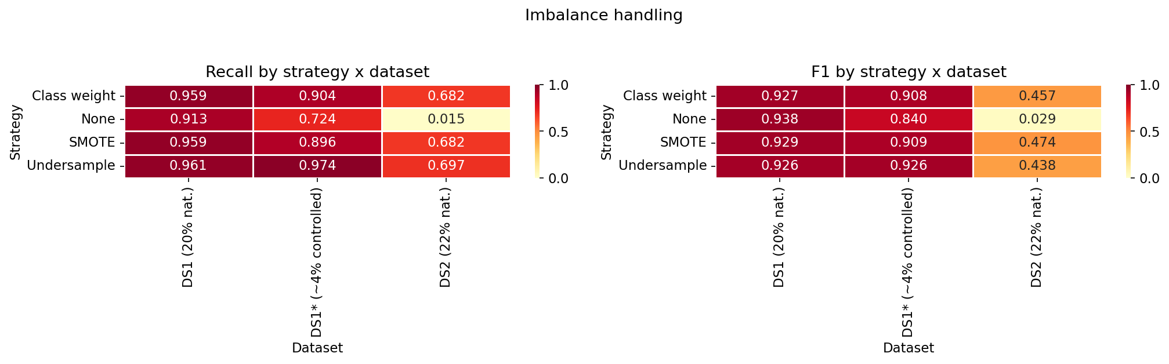
Q4 - Imbalance × Regularisation
• Feature extraction & imbalance handling >> penalty choice
• Best combo (DS1* ~4%): Undersample + L2, F1 0.926
• On hard CHB-MIT, class-weight/SMOTE lift recall from ~0.02 to ~0.68
• Resampling/recall trade-off dominates the penalty

Slide 9
Conclusions
• Q1: preprocessing order minor (|ΔF1| = 0.017)
• Q2/Q3: no penalty dominates; Elastic Net does NOT consistently win
• Q4: imbalance strategy interacts with - and outweighs - the penalty
• First-order levers: feature extraction + imbalance handling
• Honest, reproducible methodology changed the headline answer
• Every number computed and assert-checked - survives scrutiny

