Slide 1

Phishing Awareness Training
Task No.2
Name:Muhammad Faisal Rahman
Reg id:CA/MA1/9298

Slide 2
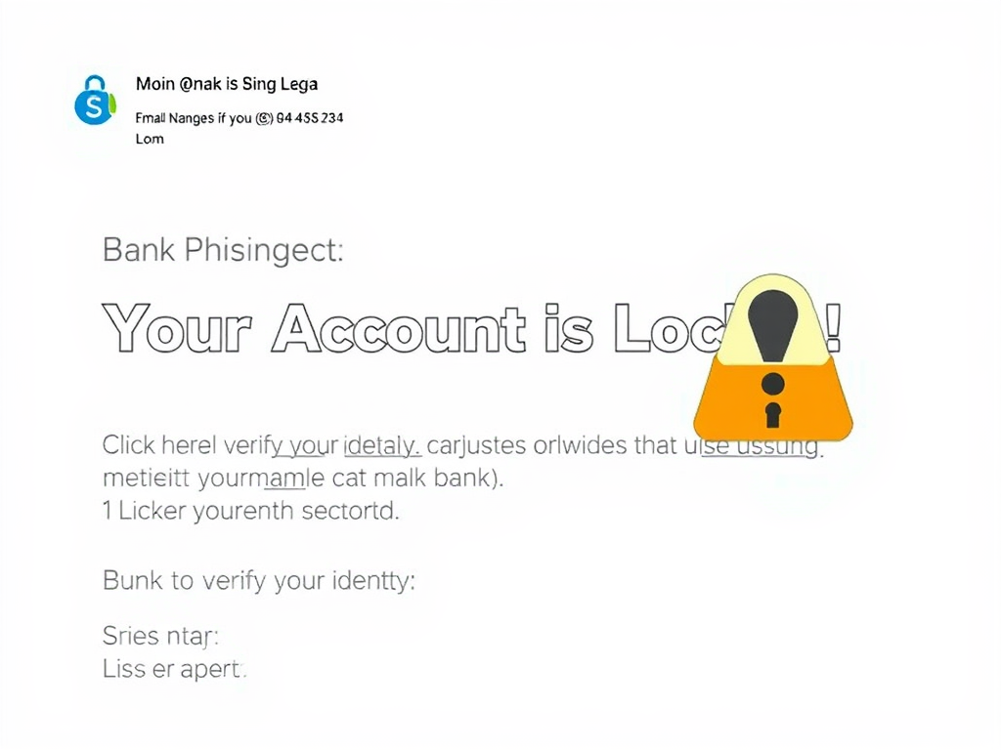
Email Phishing A fake phishing email that looks like it's from a bank. The email has a subject line: "Your Account is Locked!" and a message saying, "Click here to verify your identity." The email layout looks professional but has small details that expose it as fake, such as a suspicious sender address and a misleading link when hovered over.

Slide 3
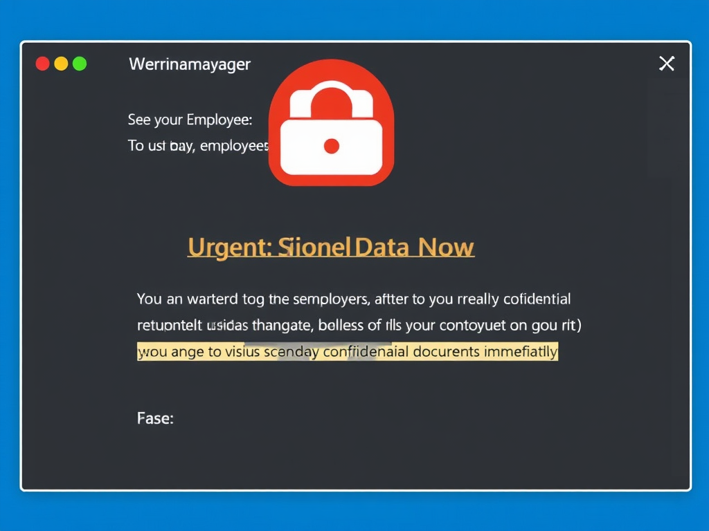
Spear Phishing
A targeted spear phishing email that appears to be from a manager. The email is addressed to an employee, with the subject: "Urgent: Send Client Data Now." The message is written professionally but urges the employee to send confidential documents immediately. The sender’s email is slightly misspelled, hinting that it is fake.

Slide 4
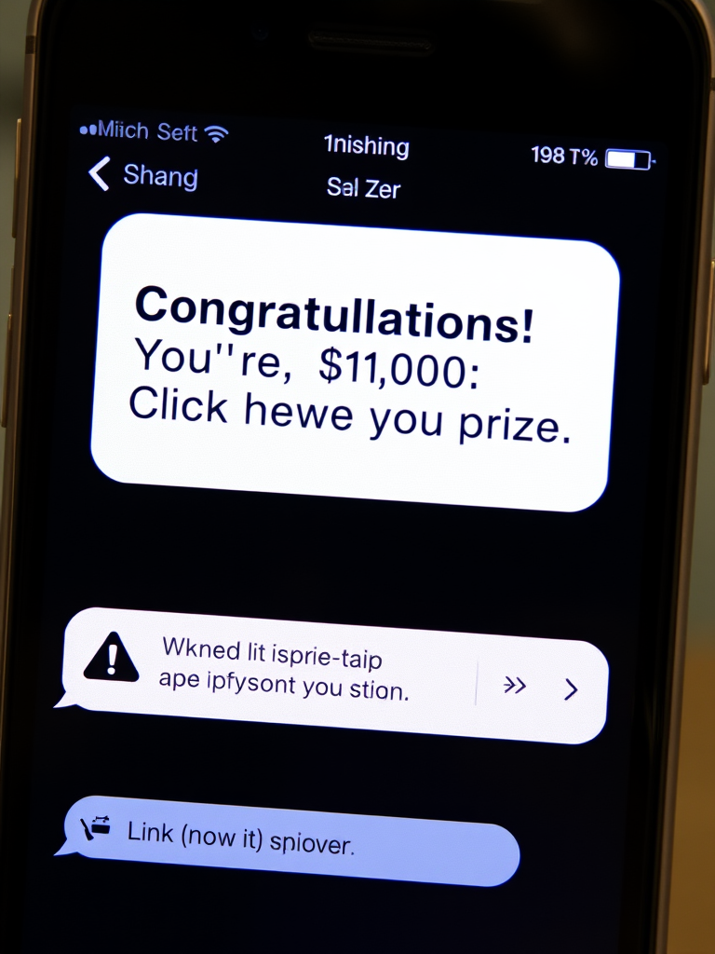
Smishing (SMS Phishing)
A smartphone screen displaying a smishing (SMS phishing) message. The message says: "Congratulations! You've won $1,000. Click here to claim your prize." The link in the message appears suspicious, and there are warning signs like grammatical errors and an unknown sender.

Slide 5
Vishing (Voice Phishing)
A phone call screen displaying an incoming vishing (voice phishing) scam. The caller ID shows "Tech Support - Microsoft," but the number looks suspicious. The screen shows a transcript of the scammer's message: "This is Microsoft Support. Your computer has a virus. Please allow remote access."

Slide 6
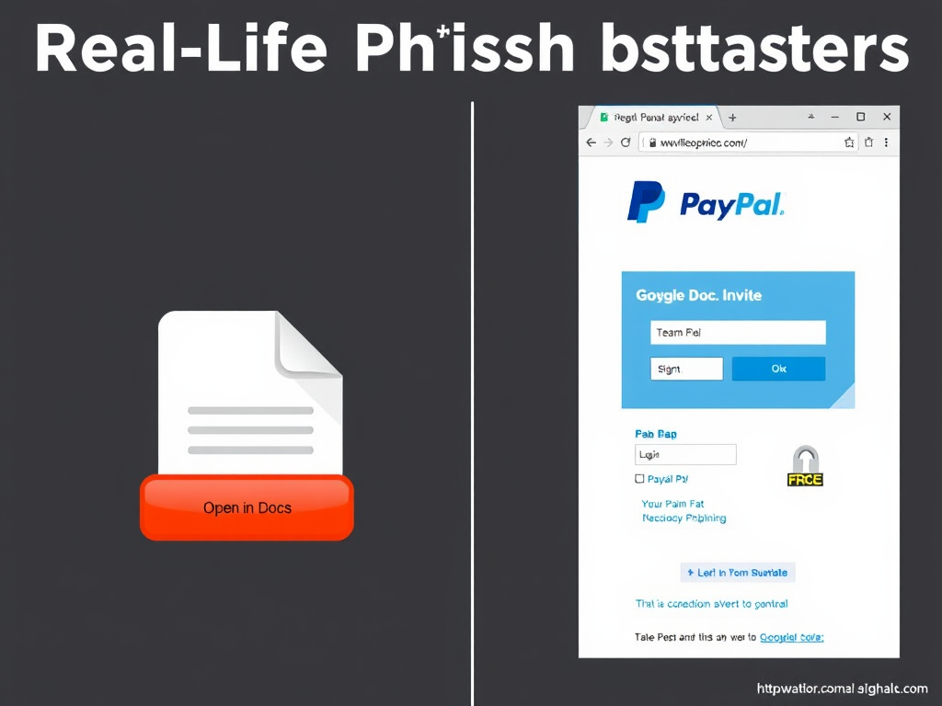
Real-Life Phishing Examples
A visual representation of real-life phishing attacks:
Left side: A fake Google Docs invite with a deceptive "Open in Docs" button.
Right side: A PayPal phishing scam with a fake login page asking for user credentials.

Slide 7
How to Protect Yourself?
A cybersecurity checklist with icons representing protection measures against phishing: ✔ Verify senders ✔ Hover over links ✔ Use Multi-Factor Authentication (MFA) ✔ Report phishing attempts ✔ Never share personal information

