Slide 1

UBER FARES
DATASET ANALYSIS
Final Project Report | July 2025

Slide 2

INTRODUCTION
This project analyzes Uber Fares data to understand ride behavior, fare patterns, and spatial-temporal insights. The goal is to generate business recommendations based on trends.

Slide 3


METHODOLOGY
1. Data collection from Kaggle Uber dataset
2. Cleaning and preprocessing using Python (Pandas, NumPy)
3. Feature engineering (hour, day, month extraction)
4. Visualization in Power BI
5. Dashboard and report creation

Slide 4
DATA CLEANING PROCESS
1. Removed Null Values and Invalid Locations: Cleaning the dataset by removing null values ensures that your data analysis is based on complete and accurate information. Invalid location data, which could include incorrect or nonsensical geographic coordinates, has been filtered out to maintain data integrity.
2. Filtered Negative/Zero Fares and Unrealistic Distances: By filtering out negative or zero fares and unrealistic distances, you are ensuring that the data reflects real-world scenarios. This step helps avoid skewed results or misleading insights during analysis.
3. Converted Datetime Formats: Standardizing datetime formats is crucial for temporal analysis. It allows for consistency across the dataset, making it easier to perform time-based analyses and ensuring compatibility with Power BI’s datetime functionalities.
4. Saved Cleaned Datasets as CSV for Power BI: Saving the cleaned dataset as a CSV file is a practical choice for importing data into Power BI. CSV files are widely supported and ensure that the data is easily accessible and ready for visualization and further analysis.
.

Slide 5
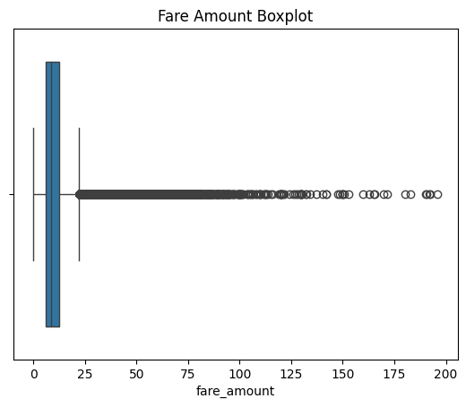
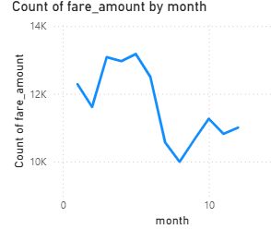

KEY VISUALIZATIONS
• Fare Amount vs. Hour of Day (Box Plot)
• Ride Volume by Day of Week (Bar Chart)
• Ride Distribution by Month (Line Chart)
• Pickup Locations Map
• Time series trend lines and interactive filters

Slide 6
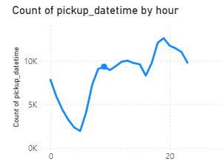
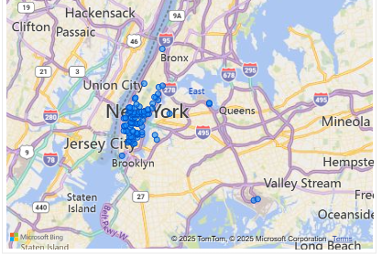
INSIGHTS AND OUTCOMES
•• Ride demand peaks between 5 PM - 8 PM
•• Fridays and Saturdays have highest ride counts
•• Manhattan and airports are high-fare pickup zones
•• Summer months show increased ride frequency

Slide 7

RECOMMENDATIONS
• Deploy more drivers during peak hours and weekends
• Consider surge pricing based on time trends
• Target promotions for low-demand periods
• Improve coverage in high-fare pickup zones

Slide 8
CONCLUSION
The Uber Fares Data Analysis project provided valuable insights into ride patterns, fare behavior, and temporal trends using both Python and Power BI. Through comprehensive data cleaning, exploratory analysis, and feature engineering, we revealed key patterns such as peak ride hours, fare variations by time of day and day of week, and spatial distributions across pickup locations.
In summary, this project demonstrates the power of data analytics in transportation services and showcases how visual storytelling tools like Power BI can turn raw data into actionable insights.

Slide 9

THANK
YOU
•Prepared by: Faisal Shingiro
•July 2025
•For: Uber Fares Data Analysis Project
+123-456-7890
faisalshingiro10@gmail.com

