Slide 1
GPTeacher
GPTeacher is a web application that can help you to create a curriculum and generate questions automatically.

Slide 2
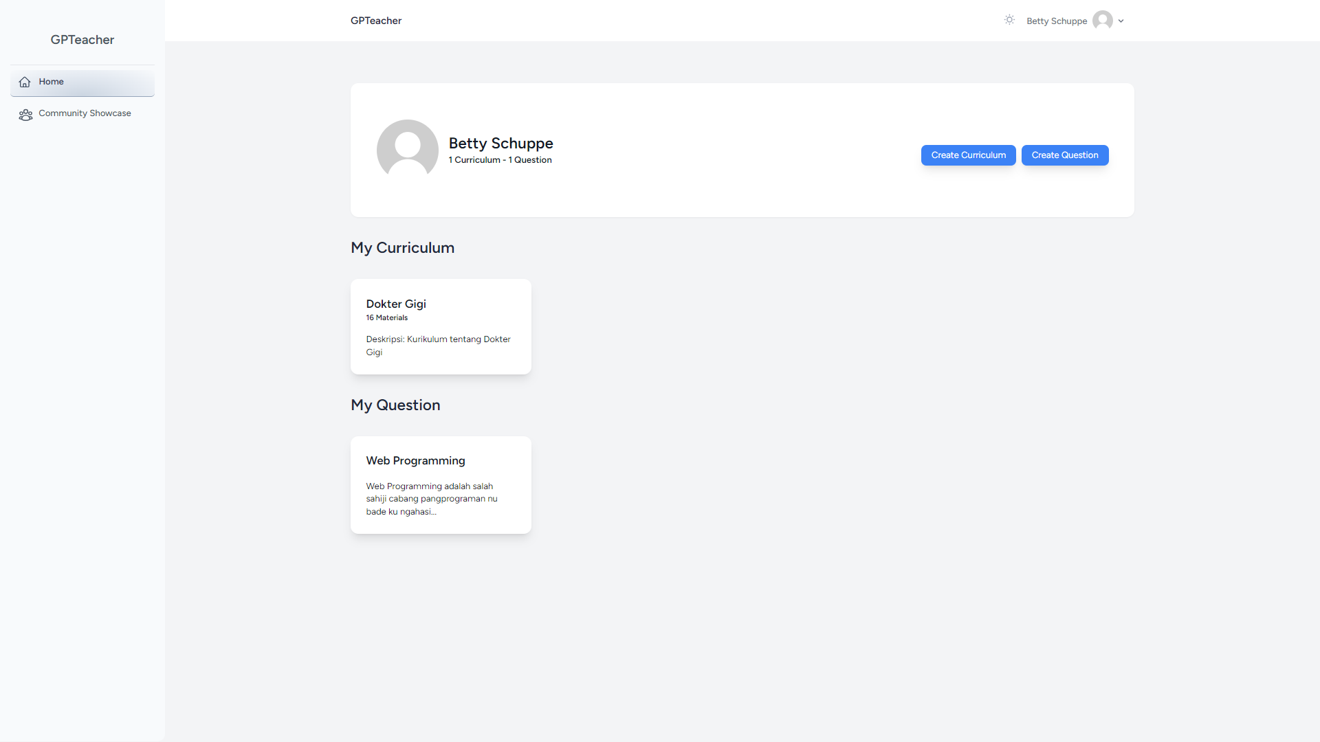
Dashboard

Slide 3
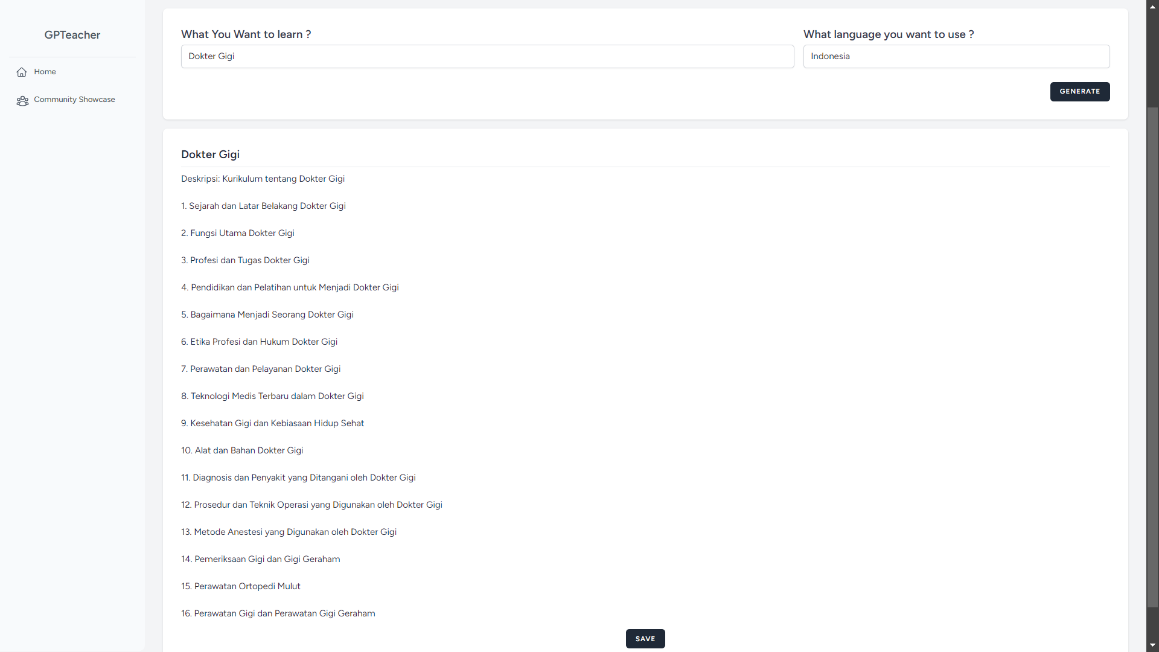
Generate Qurriqulum

Slide 4
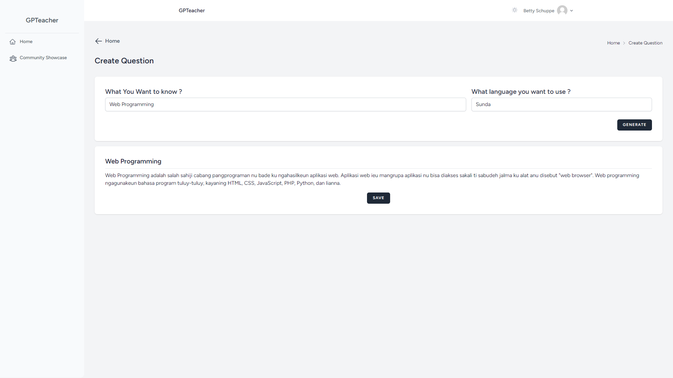
Generate Question

Slide 5
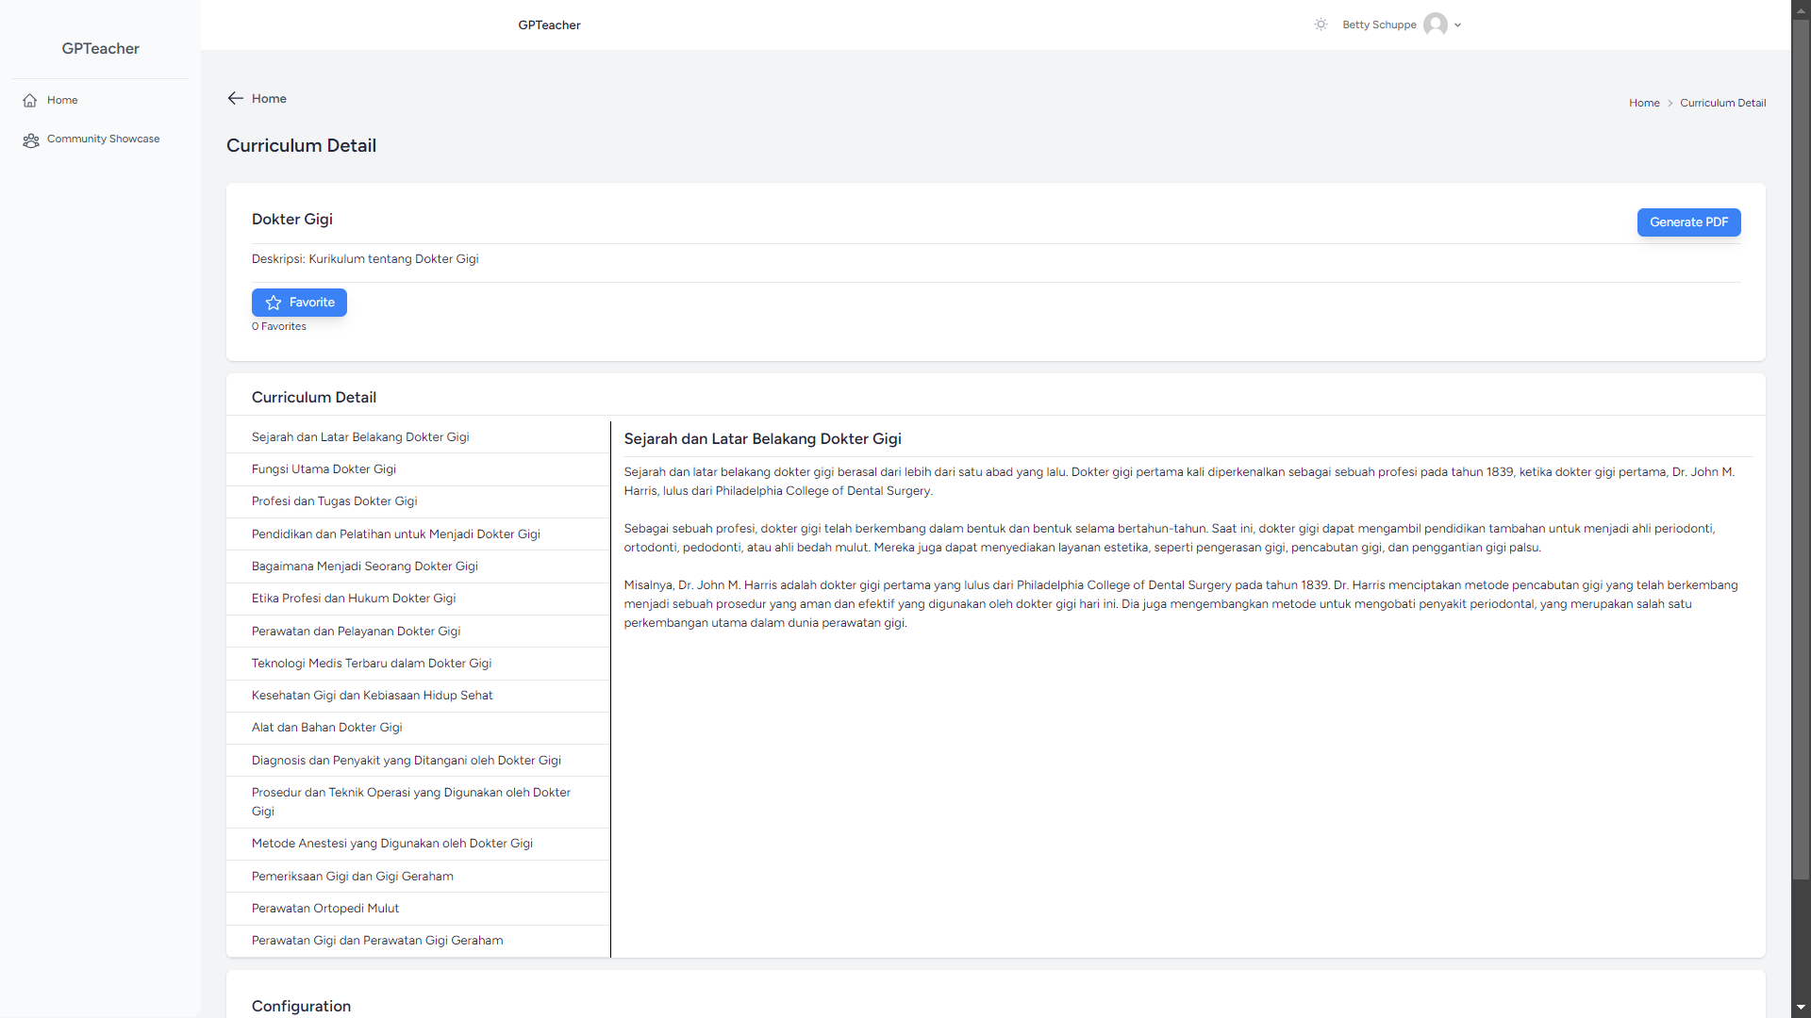
Curriculum Detail

Slide 6
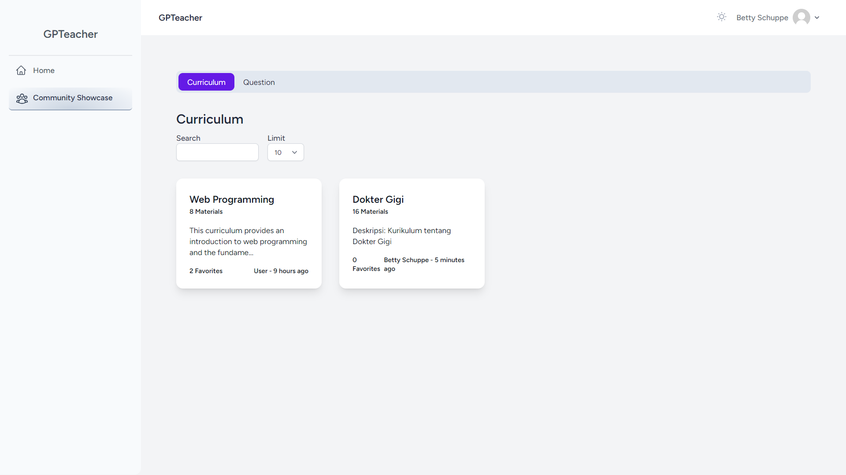
Community Showcase

