Slide 1
Submitted by: Faisha Marshooka K 962821104030 computer science and engineering
Final Project
Fashion GAN
3/21/2024 Annual Review

Slide 2
PROJECT TITLE
FashionGAN: Generating Fashion MNIST-Inspired Images using Generative Adversarial Networks
3/21/2024 Annual Review

Slide 3

AGENDA
Introduction to GANs and project objective
Dataset exploration and sample visualization
Overview of model architecture and key design choices
Code implementation and setup
Training, evaluation, and hyperparameter tuning
Results showcase
3/21/2024 Annual Review

Slide 4

PROBLEM STATEMENT
Creating an automated system capable of generating fashion-inspired images to assist designers and consumers in exploring trends efficiently, using Generative Adversarial Networks (GANs) and the Fashion MNIST dataset.
3/21/2024 Annual Review

Slide 5

PROJECT OVERVIEW
FashionGAN is a machine learning project that leverages Generative Adversarial Networks (GANs) to generate fashion-inspired images resembling those in the Fashion MNIST dataset. By training a generator and discriminator network, the system aims to produce high-quality images that can serve as inspiration for designers and consumers. Through dataset exploration, model architecture design, and training, FashionGAN seeks to automate and streamline the process of fashion trend exploration and inspiration.
3/21/2024 Annual Review

Slide 6

WHO ARE THE END USERS?
Fashion designers seeking inspiration for new designs and trends.
Fashion retailers looking to visualize potential product offerings.
Fashion enthusiasts interested in exploring and experimenting with diverse styles.
Online platforms and apps offering personalized fashion recommendations.
Researchers and educators studying fashion trends and image generation techniques.
3/21/2024 Annual Review

Slide 7
YOUR SOLUTION AND ITS VALUE PROPOSITION
Our solution, FashionGAN, utilizes advanced machine learning techniques to automatically generate high-quality fashion-inspired images. By leveraging Generative Adversarial Networks (GANs) and the Fashion MNIST dataset, FashionGAN provides a novel way for designers, retailers, enthusiasts, and researchers to explore trends efficiently. This system offers the value of accelerating the design process, facilitating trend exploration, and enhancing creativity in the fashion industry.
3/21/2024 Annual Review

Slide 8
THE WOW IN YOUR SOLUTION
FashionGAN revolutionizes trend exploration in the fashion industry by seamlessly generating high-fidelity fashion images indistinguishable from real ones.
Its ability to autonomously create diverse and stylish designs empowers users with endless inspiration, streamlining the design process and fostering creativity.
With FashionGAN, users can effortlessly explore new trends, visualize product offerings, and push the boundaries of fashion innovation, marking a significant leap forward in fashion technology.
3/21/2024 Annual Review
8

Slide 9
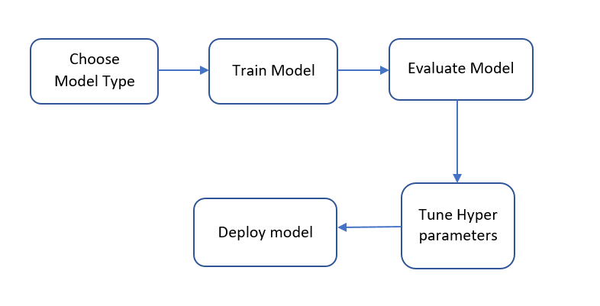
MODELLING
3/21/2024 Annual Review
9

Slide 10
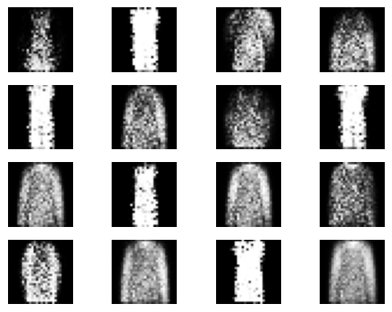
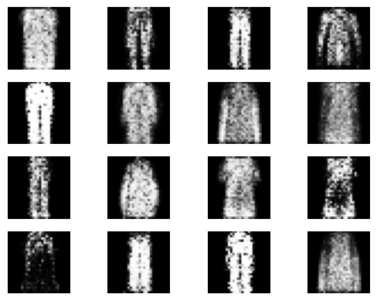
RESULTS
3/21/2024 Annual Review
10

