Slide 1
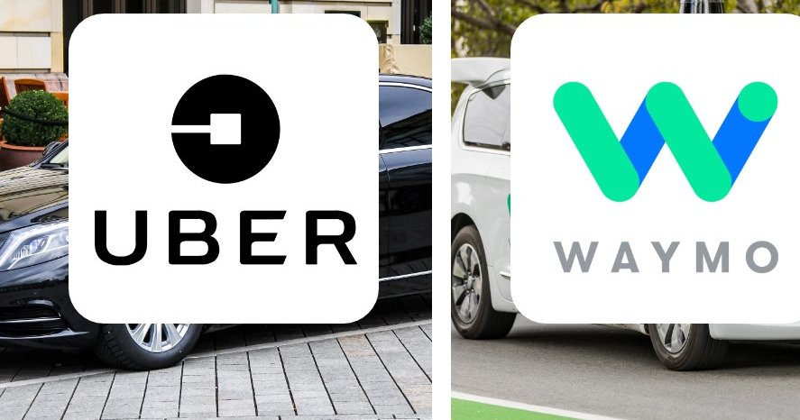
Waymo v. Uber (2017) Insider Threats, Trade Secret Theft & Corporate Governance MITS 5600G: Security Policies and Risk Management Case Study : 30 Group Members — Shah Md Julhash Tamim (101002572) Faishal Youshuf (101044804)
Submission Date : 22 June, 2026

Slide 2

Presentation Overview
Background: Organizations & Incident
Attack Timeline: How the Incident Unfolded
Technical Aspects: The Stolen Trade Secrets
Organizational & Governance Failures
Incident Response Evaluation
Legal, Ethical & Business Implications
Recommendations & Lessons Learned
Connection to Class Concepts
Discussion Questions

Slide 3

1. Case Background
Background of the Organizations
Waymo: A subsidiary of Alphabet Inc. (Google’s parent company) focused on autonomous vehicle (AV) development. Waymo invested over $1.1 billion and years of intensive R&D into mastering autonomous technology.
Uber Technologies: A global ride-hailing giant that viewed autonomous driving as vital to its long-term corporate survival, attempting to build a competing program rapidly.

Slide 4
Background – The Key Individuals
The Central Figure: Anthony Levandowski
Anthony Levandowski
Senior engineer / manager on Waymo's self-driving car project
Deeply involved in Waymo's LiDAR technology development
Left Waymo in January 2016 to found Otto
The Allegation:
Downloaded over 14,000 confidential files before resigning
Transferred 9.7 GB of proprietary Waymo data to an external hard drive
Used stolen IP to launch Otto, which Uber then acquired

Slide 5
Incident Timeline
Summer 2015
Levandowsi meets with Uber executive about starting a self-driving startup Uber could acquire
3 Dec. 2015
Levandowski searches for access to Waymo's "highly confidential" design server
11 Dec. 2015
Installs special software, downloads 14,000+ files (9.7 GB)
Jan. 2016
Levandowski resigns from Waymo
Jan. 2016
Founds Otto (self-driving truck startup)
Aug. 2016
Uber acquires Otto for ~$680M
Feb. 2017
Waymo sues Uber

Slide 6
Legal Proceedings
Feb. 2017
Waymo files lawsuit: trade secret misappropriation, patent infringement, unfair competition
Apr. 2017
Levandowski invokes Fifth Amendment, refuses to testify
May 2017
Judge Alsup grants limited preliminary injunction against Uber
May 2017
Judge refers case to U.S. Department of Justice for criminal investigation
Sep. 2017
Judge denies Uber's motion to move case to arbitration
Feb. 2018
Settlement reached mid-trial — Uber pays $245M in equity
s

Slide 7
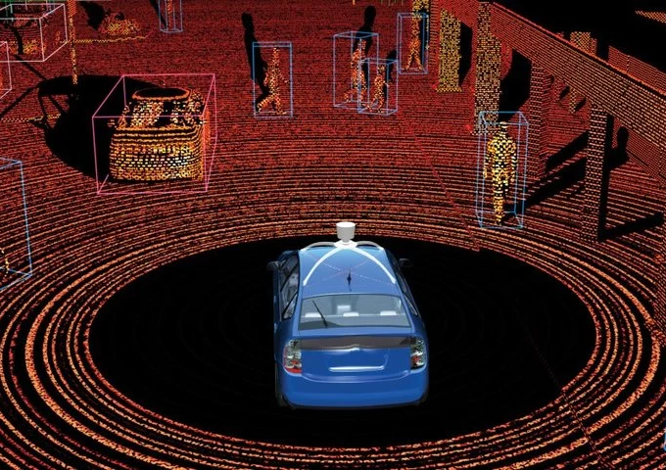
Technical Aspects: LiDAR (stolen technology)
What is LiDAR?
Light Detection and Ranging — the "electronic eyes" of autonomous vehicles
Enables self-driving cars to detect traffic, pedestrians, and obstacles
Each manufacturer develops proprietary, unique LiDAR systems
What Levandowski Took:
14,000+ confidential files
Technical blueprints, design files, schematics
Circuit board designs (Trade Secret 14: positioning guide pins)
System architectures and specifications
Source: google

Slide 8
Technical Aspects: The Evidence
How Was the Theft Discovered?
The "Smoking Gun" Email
Waymo employee was inadvertently copied on an email from a LiDAR supplier
Email contained circuit board drawings eerily similar to Waymo's proprietary designs
Forensic Evidence
Forensic analysis confirmed 14,000+ files were transferred to external storage
Levandowski accessed Waymo's SVN schematic repository on Dec 11, 2015
Downloaded data included 9.7 GB of confidential information

Slide 9
Organizational Failures and Incident Response
Organizational Failures
No restrictions on mass downloads – Levandowski had legitimate, unrestricted access
No real‑time DLP alerts for abnormal file transfers
Sensitive files were not persistently encrypted
Documents lacked automatic classification as trade secrets
Offboarding controls did not prevent data exfiltration before resignation
No behavioral monitoring correlated download activity with risk context
Incident Response
Waymo conducted an internal investigation, filed suit promptly (Feb 2017), obtained a preliminary injunction, and referred the case to the DOJ
Uber initially denied using Waymo technology, failed to disclose vital evidence, and demoted Levandowski only after legal pressure
Settlement reached mid‑trial: Uber paid $245M in equity
Levandowski was charged with 33 counts and sentenced to 18 months in federal prison (later pardoned)

Slide 10
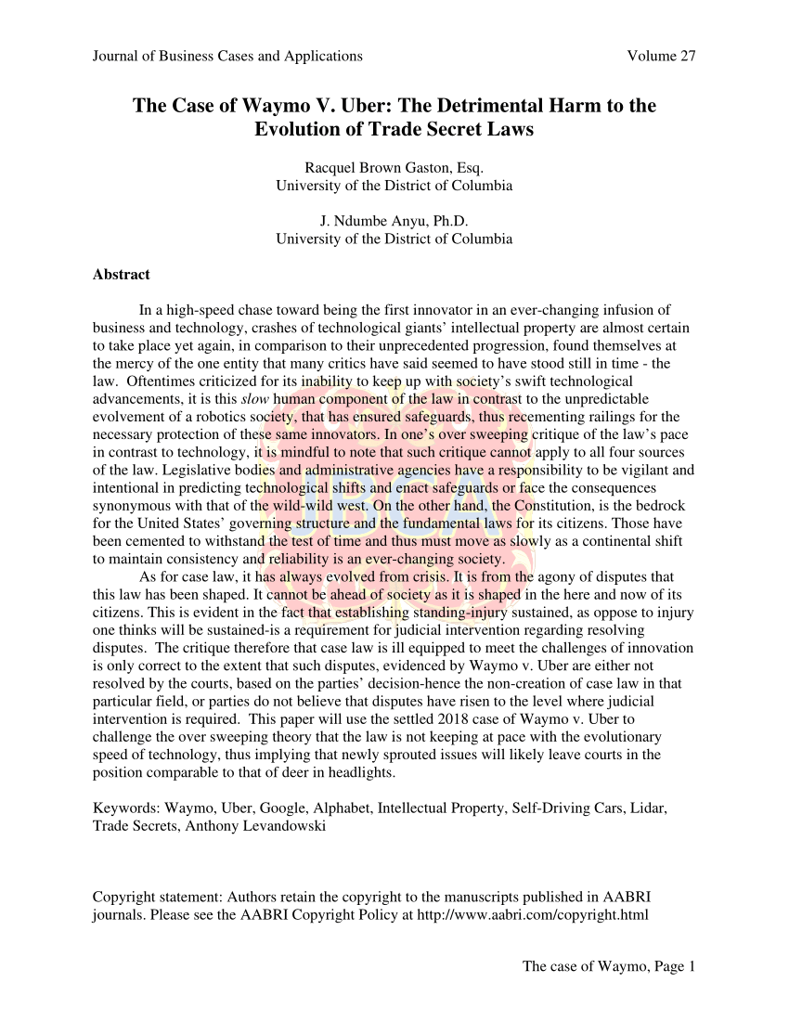
Legal, Ethical and Business Impact
Legal Consequences
Civil suit under the Defend Trade Secrets Act and California Uniform Trade Secrets Act – settled for $245M
Criminal charges: 33 counts of trade secret theft – Levandowski received 18 months in prison
Judge Alsup referred the case to the DOJ, which also triggered shareholder lawsuits against Uber’s board
Ethical Issues
Did Uber knowingly hire an engineer who had stolen trade secrets?
Levandowski’s Fifth Amendment invocation raised questions of guilt
Corporate culture that prioritized speed over ethical conduct
Business Impact
Reputational damage to Uber’s brand and leadership
Uber’s self‑driving program was delayed by years
Financial toll: $245M settlement + legal fees + lost competitive advantage
Waymo’s ~$1.1B R&D investment was partially devalued

Slide 11
Lessons Learned: Access Control
Lesson 1: Strengthen Access Controls
Principle of Least Privilege
Restrict access to IP strictly to those who need it
Regularly audit permissions and rotate credentials
Monitor Data Activity
Track abnormal file transfers, especially before resignations
Correlate download behavior with risk context (e.g., resignation notices)
Segmentation & Encryption
Persistently encrypt sensitive files
Implement network segmentation to limit data exfiltration pathways

Slide 12
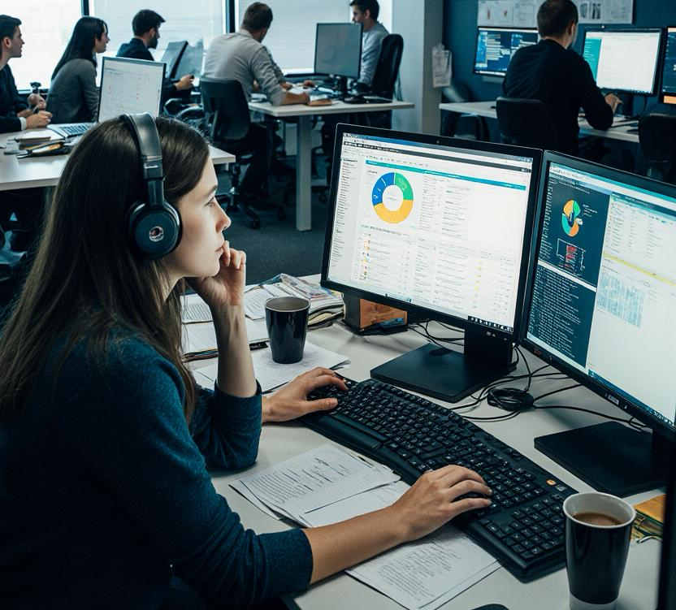
DLP, Monitoring, Offboarding & Hiring
DLP & Monitoring
Auto‑classify and encrypt sensitive files
Behavioral analytics for abnormal mass downloads
Real‑time alerts for data transfers before resignations
Prioritize monitoring of high‑risk IP‑access employees
Offboarding & Hiring
Revoke access immediately upon termination
Monitor activity during notice periods
Conduct exit interviews; collect all devices
Vet competitor hires for trade secret exposure
Enforce strong NDAs, non‑competes, and IP clauses
Short Example: Waymo lacked a DLP rule to block mass USB transfers. A simple policy restricting external drives would have stopped the 9.7 GB exfiltration instantly.

Slide 13
Course Connections & Recommondations
Insider Threats – Malicious insider with fully authorized access
Access Control – Failure of least privilege and network segmentation
Data Classification – No automatic tagging of files as trade secrets
Incident Response – Detection occurred only via a vendor email (major gap)
Governance – Uber’s board approved acquisition without proper IP due diligence
Risk Management – Overlooked insider risk and third‑party hiring risks
Key Recommendations
Zero Trust – Verify every access request, regardless of user role
AI‑Driven DLP – Deploy behavioral analytics to detect anomalies in real time
Continuous Monitoring – Prioritize departing employees and high‑risk users
Secure Offboarding – Automate access revocation and device collection
Legal Safeguards – Strengthen NDAs, non‑competes, and IP ownership clauses
Culture – Foster security awareness with regular, role‑specific training

Slide 14
Discussion Questions /1
If you were leaving a company, would you expect your access to sensitive files to be restricted or monitored?
Should companies have the right to monitor everything an employee does on their work devices?
Is it fair that Uber had to pay $245 million even though Levandowski was the one who stole the files?

Slide 15
Discussion Question /2
4.What would you do if you discovered a new hire brought confidential files from their previous employer?
5.How much monitoring is too much monitoring in the workplace? When does it cross into invading privacy?

Slide 16
Thank You

