Slide 1
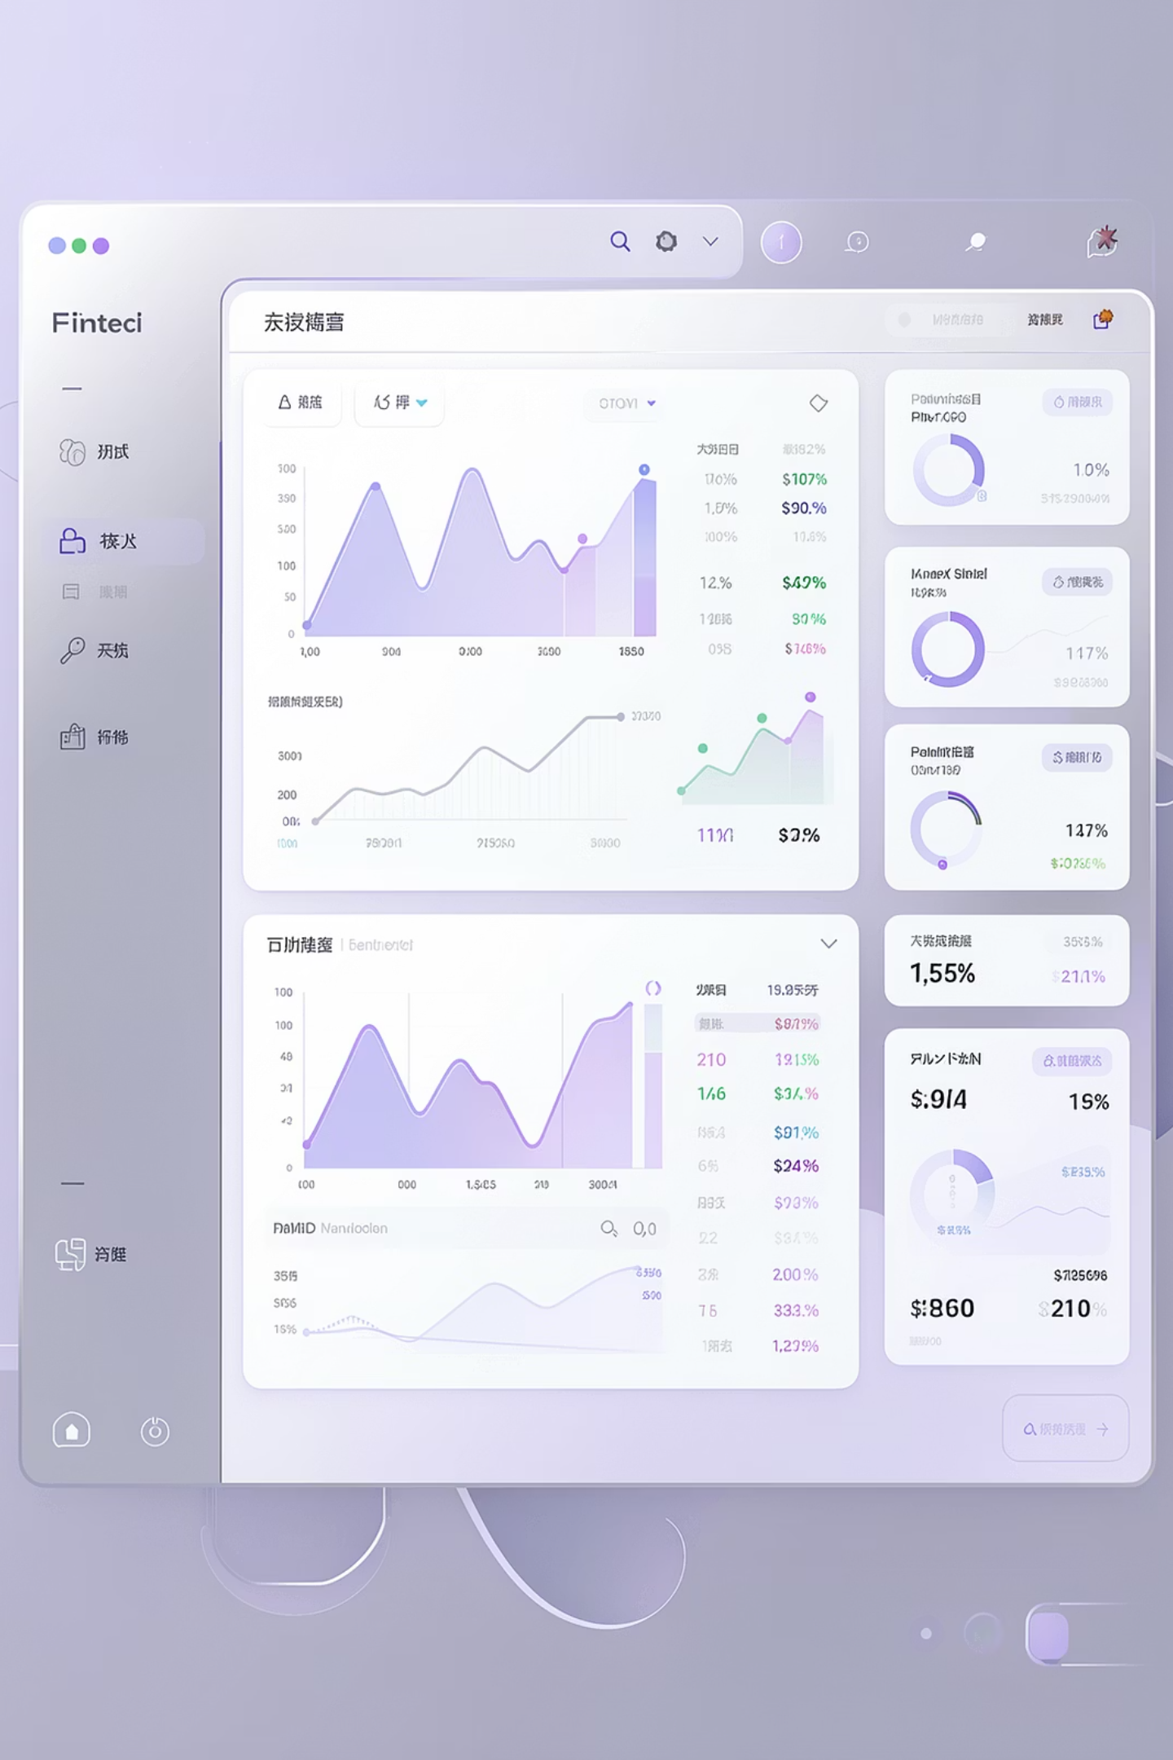
WealthWise
An Intelligent Portfolio Analytics and Goal-Planning Platform for Indian Mutual Fund Investors
VTU Internship 2026 | Team 8 | Java Full Stack | May 2026
Team Members: Faishal Rahman Ansari (TL), Spoorthi V Gowda, Sushmitha S, Vishak Bharadwaj HN, Prakruthi L, Pallavi KS, Darshan Ganesh Naik, Iffah Aafreen, Manish Anand, Sai Sumanth C, Sai Vrushabh R, Preetham US

Slide 2


The Hidden Cost of Financial Blindness
Portfolio Fragmentation
An investor with SBI, HDFC, and Axis funds has no single dashboard showing total portfolio value, overall gain/loss, or combined risk exposure. Each AMC app shows only its own funds — creating dangerous blind spots.
Return Calculations Are Misleading
Platforms show absolute returns (e.g., "+22%") but never XIRR — the only mathematically accurate measure for SIP investors with irregular cashflows. An investor showing +22% absolute may actually have just 8% XIRR over 3 years.
Risk Is Invisible
No free tool tells a retail investor their portfolio's Sharpe Ratio, annualized volatility, or max drawdown. Without these metrics, investors unknowingly hold portfolios that take excessive risk for the returns they generate
Goal Planning Uses Fantasy Math
"Invest ₹10,000/month at 12% for 20 years = ₹1 Crore" — this flat-rate projection ignores market volatility entirely. In reality, outcomes range from ₹60L to ₹1.8Cr depending on sequence of returns.e.

Slide 3
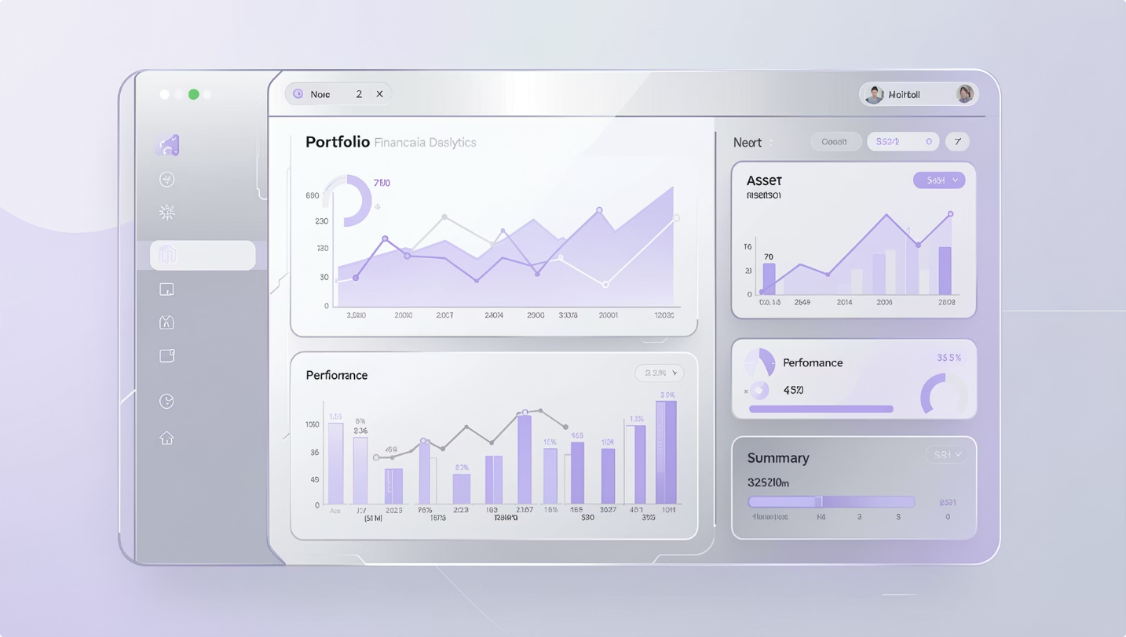
Intelligent Solution: Your Mutual Fund Command Center
WealthWise is a production-grade full-stack platform that consolidates all mutual fund investments into one intelligent dashboard, delivering real-time valuations, institutional-grade analytics, probabilistic goal planning, and automated tax tracking.
01
02
Fragmented Data
Misleading Returns
Unified portfolio from CSV import + manual entry across any AMC
Newton-Raphson XIRR engine with 1e-7 precision per fund
03
04
Invisible Risk
Fantasy Goal Planning
Sharpe Ratio, Volatility, Max Drawdown, SEBI Riskometer (1-6)
10,000 Monte Carlo simulations with inflation-adjusted P10/P50/P90
05
06
Tax Leakage
Stale NAV Data
Automated FIFO lot tracking with STCG/LTCG split on every redemption
4-level NAV fallback: DB → Scheme Master → Live MFAPI → Cost basis
Technology Stack: React 19 SPA + Spring Boot 3.2 REST API + PostgreSQL 15 (Supabase) + Render Cloud

Slide 4
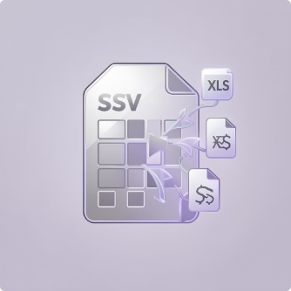


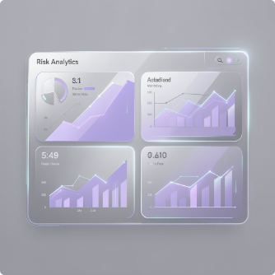

Core Capabilities
Multi-Source Transaction Import
Real-Time Portfolio Valuation
XIRR & Returns Engine
Risk Analytics Dashboard
CSV bulk import: 6 date formats, 11 transaction types
Manual form with auto-NAV lookup
Auto-folio generation with scheme resolution
45,000+ AMFI scheme database
Holdings aggregated from investment_lots
4-level NAV fallback chain
Portfolio totals with overall gain/loss
Monthly growth timeline from NAV history
Newton-Raphson (1,000 iter, 1e-7 tolerance)
Bisection fallback for edge cases
Absolute Return + CAGR calculations
Per-fund: units, cost, current value, gain/loss
Sharpe Ratio: (Return − 7% RFR) / Volatility
12-category weighted volatility
SEBI Riskometer (1-6), Max Drawdown
Diversification Score (0-10)
Monte Carlo Goal Engine
10,000 Gaussian simulations per goal
P10/P50/P90 in today's rupees
Required SIP calculator
3 sensitivity scenarios

Slide 5
Intelligent Features
1
2
3
FIFO Tax Automation
SIP Intelligence
45K Scheme DB + Live NAV
BUY creates InvestmentLot
SELL iterates oldest lots first (FIFO)
≥365 days = LTCG, else STCG
Auto-computed per transaction
SIP vs Lumpsum comparison per fund
Rupee-cost averaging quantification
Advantage ranking across portfolio
Nightly AMFI NAVAll.txt sync
pg_trgm fuzzy search
On-demand MFAPI live fetch
4
5
Notifications & Alerts
Profile & Settings
In-app alerts (Info/Watch/Action)
Email notifications via Gmail SMTP
Profile: name, PAN, DOB, nominee
OTP-based password reset
Dark theme UI

Slide 6
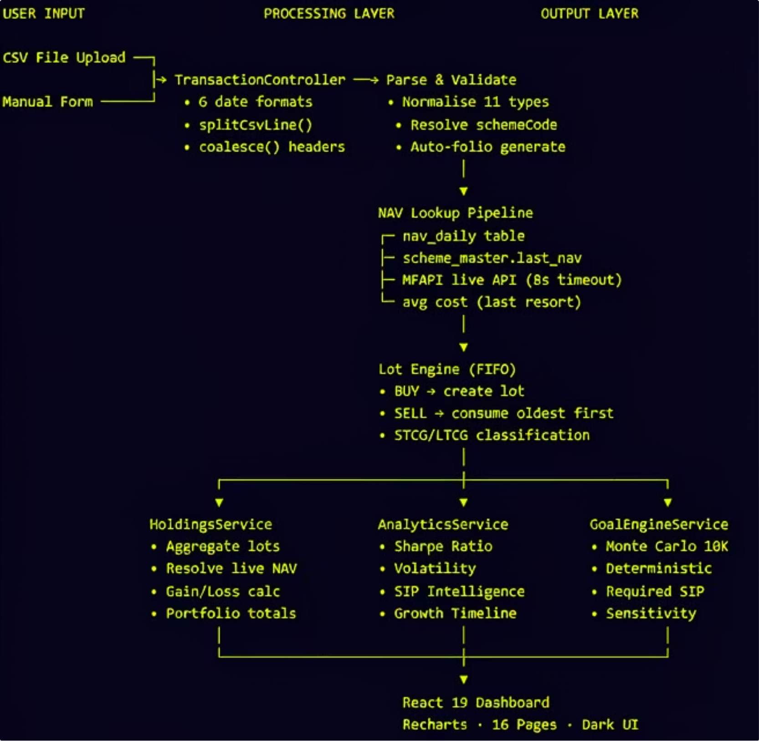
End-to-End Data Flow

Slide 7
Core Engineering Challenges
Multi-Strategy NAV Resolution
XIRR Convergence on Real-World Data
Problem: NAV data from multiple sources with varying freshness. A failed API call shouldn't break the portfolio view.
Problem: 50-120+ irregular cashflows. Newton-Raphson can diverge with bad guesses or zero derivatives.
Solution: 4-level fallback in HoldingsService.getHoldings(): nav_daily → scheme_master → Live MFAPI (8s timeout, cached back) → avg cost NAV. Stale detection: >5 days triggers refresh; >1 year = discontinued, skip.
Solution: Triple-strategy in XirrService: Newton-Raphson (guess=0.1) → Newton-Raphson (guess=-0.5) → Bisection [-0.999, 5.0]. NaN/Infinity guards, short-period bypass (<7 days), sanity clamp [-99%, +500%].
Concurrent NAV Upsert Race Conditions
CSV Import Flexibility
Problem: Multiple requests for same scheme may INSERT the same (scheme_code, nav_date) row simultaneously.
Problem: Users export CSVs from different platforms with inconsistent headers, dates, and types.
Solution: PostgreSQL UNIQUE constraint + app-level existsBySchemeCodeAndNavDate() + try-catch silently ignoring duplicate key. First writer wins; others proceed with fetched value.
Solution: coalesce() tries 5+ header variants per field. 6 date parsers. Type normalizer maps 30+ aliases → 11 canonical types. RFC 4180 CSV parser with quoted fields.

Slide 8
Algorithms & Intelligence
Newton-Raphson XIRR
1
Used In: XirrService
Details: NPV(r) = Σ[Cᵢ/(1+r)^(tᵢ/365.25)] = 0. Iterative: 1,000 max iterations, 1e-7 tolerance. Bisection fallback for convergence issues.
Monte Carlo Simulation
2
Used In: GoalEngineService
Details: 10,000 Gaussian simulations. r = μ + σ×N(0,1) with volatility floor. P10/P50/P90 inflation-deflated projections.
FIFO Lot Consumption
3
Used In: TransactionController
Details: Oldest lots consumed first. Holding ≥365d = LTCG, else STCG. Per-lot gain computed automatically.
Sharpe Ratio
4
Used In: AnalyticsService
Details: Sharpe = (Return − 7% RFR) / Volatility. Category-weighted across 12 MF categories for comprehensive risk assessment.
Required SIP Calculator
5
Used In: GoalEngineService
Details: Inflation-adjust target → subtract FV of corpus → solve annuity for SIP. Includes extra months calculator for flexibility.
SIP vs Lumpsum
6
Used In: AnalyticsService
Details: Actual multi-lot DCA value vs hypothetical day-1 lumpsum. Ranked by advantage to optimize investment strategy.

Slide 9


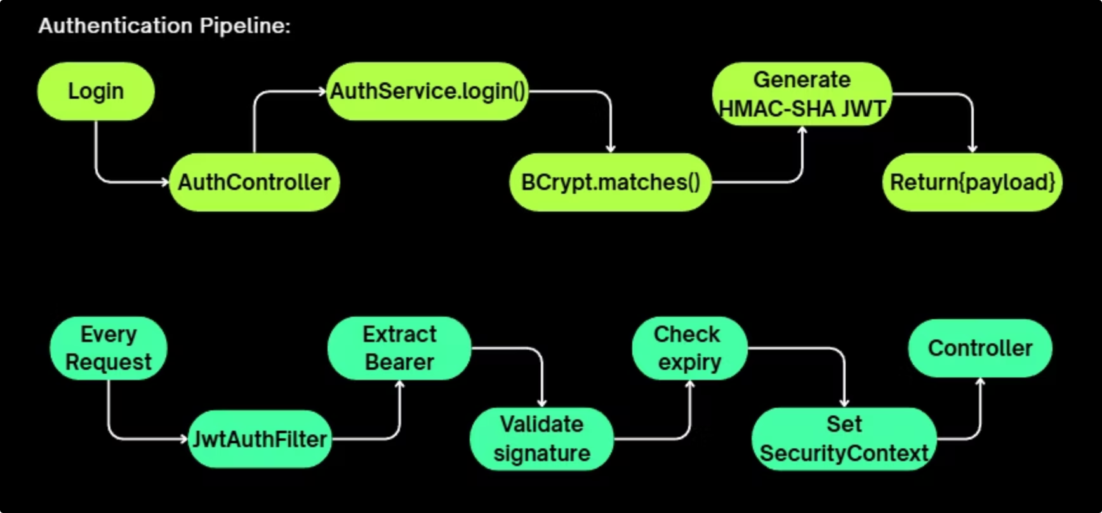
Security & Authentication Pipeline
Login Request
User credentials captured and validated
AuthService.login()
BCrypt.matches() verifies password hash
Generate HMAC-SHA JWT
AuthTokenService creates signed token with 54-char secret
Return Payload
AuthController sends JWT to client with user details
Every Request
JwtAuthFilter extracts Bearer token and validates signature
Set SecurityContext
Controller receives authenticated user context for authorization

Slide 10
Security Measures
Password Theft Protection
Session Hijacking Prevention
BCrypt adaptive hashing (Spring Security PasswordEncoder) with salt rounds prevents rainbow table attacks
Stateless JWT eliminates server-side session storage, reducing attack surface significantly
Token Forgery Defense
Brute Force Reset Protection
HMAC-SHA256 signed with 54-character secret ensures message integrity and authenticity
SecureRandom OTP via Gmail SMTP with rate limiting prevents automated attacks on password reset
Cross-Origin Attack Prevention
SQL Injection Prevention
Configurable CORS whitelist restricts API access to authorized domains only
JPA parameterized queries only, never string concatenation for database operations
Transport Security
Secret Exposure Prevention
PostgreSQL sslmode=require encrypts all data in transit with TLS 1.2+
Environment variables on Render cloud, never hardcoded in source code or version control

Slide 11

Scalability
Docker Optimization
Leveraging multi-stage builds for a 200MB JRE-only image (vs. ~800MB JDK), significantly reducing deployment size and startup times.
High-Performance Caching
Caffeine cache with 500 entries and a 10-minute TTL, enhancing responsiveness for frequently accessed data.
Robust Connection Pool
HikariCP configured with 5 max connections, 60s keepalive, and health-check SQL, ensuring efficient and reliable database interactions.
NAV Deduping Strategy
PostgreSQL UNIQUE constraint combined with app-level checks prevents race conditions and duplicate entries during NAV upserts.
Stateless JWT Authentication
Enables horizontal scaling by eliminating server-side sessions, where JWTs are HMAC-SHA256 signed with a 54-character secret for authenticity.
Enhanced Security
Includes SecureRandom OTP for password resets, configurable CORS whitelist, JPA parameterized queries, PostgreSQL SSL encryption, and environment variables for secret management.

Slide 12
Performance Metrics & Testing
<50ms
<2s
XIRR Computation
Monte Carlo Simulation
Calculates for 120+ cashflows, ensuring rapid financial analysis.
Executes 10,000 simulations over 240 months per goal, delivering quick risk assessments.
45K+
<500ms
AMFI Scheme Database
API Response Time
Supports over 45,000 mutual fund schemes, providing comprehensive market coverage.
Retrieves user holdings in under 500ms with intelligent caching, enhancing user experience.
~200MB
8s
Optimized Docker Image
NAV Live Fetch
JRE-only build reduces image size, enabling faster deployment and lower resource consumption.
API calls for Net Asset Value data are designed with an 8-second timeout and robust caching.

Slide 13
Testing Architecture
Our robust testing architecture ensures the reliability and integrity of the WealthWise platform, covering every layer from individual services to full end-to-end user flows.
Layer
Tool
Test Suite
Key Verifications
Service
JUnit 5 + Mockito
AuthServiceTest
BCrypt hashing, JWT generation, password change logic
Service
JUnit 5
XirrServiceTest
Newton-Raphson convergence, edge cases for XIRR calculation
Service
JUnit 5
GoalProjectionServiceTest
Monte Carlo simulations, deterministic projections, required SIP calculations
Controller
MockMvc
AuthControllerTest
HTTP status codes, authentication flow responses
Controller
MockMvc
HoldingsControllerTest
Holdings retrieval, NAV fallback mechanisms
Frontend
Vitest + RTL
App.test.jsx
Router navigation, authentication guards, component rendering
Frontend
Vitest
goalHelpers / mfApi
Helper function logic, API utility correctness
E2E
Playwright
auth / dashboard / goals
Comprehensive user flows for authentication, dashboard interactions, and goal management

Slide 14

Conclusion: WealthWise Achievements
Democratized Analytics
1
Institutional-grade tools like Sharpe Ratio, XIRR, and Monte Carlo simulations are now free and accessible to all retail investors.
Production-Ready Engineering
2
Robust architecture includes a 12-table schema, FIFO lot tracking, 4-level NAV fallback, advanced Monte Carlo, multi-stage Docker, and JWT security.
Solving a Real Problem
3
WealthWise addresses the ₹50 Trillion market gap for 50M+ Indian MF investors, providing unified portfolio intelligence and goal analysis.

Slide 15

Thank You
WealthWise Team 8 · Java Full Stack · VTU Internship 2026
GitHub: github.com/Faishal058/VTU_INTERN_2026_Team8_JAVA

