Slide 1

HEALTH DISCERNMENT SYSTEM
Under the guidance of
DR. ALEENA SWETAPADMA
Pranav Jain (1706243)
Rituraj Saha (1706256)
Anish Kumar (1706200)

Slide 2
Content
Introduction
Literature Survey
Motivation
Methodology and System Design
Results
Conclusion
Future Scope

Slide 3
Introduction
The significant growth of medical images and techniques requires comprehensive and exhaustive efforts from a medical professional who is susceptible to human error and the result can also vary widely among various experts.
ML and AI techniques have been used for medical image processing and image recognition. Deep learning-based algorithms have demonstrated remarkable outcomes in the medical field with works like computer-aided diagnosis, speech recognition and so on.
In this project, we have used the above stated idea behind disease detection, to develop a system using convolutional neural network (CNN) that will help in detection of four types of chronic disease such as Malaria, Pneumonia, Breast Cancer, and Skin Cancer.
The system has been made user-friendly with the help of GUI, so that it can be used not only by the medical professionals but also by the population at large.

Slide 4
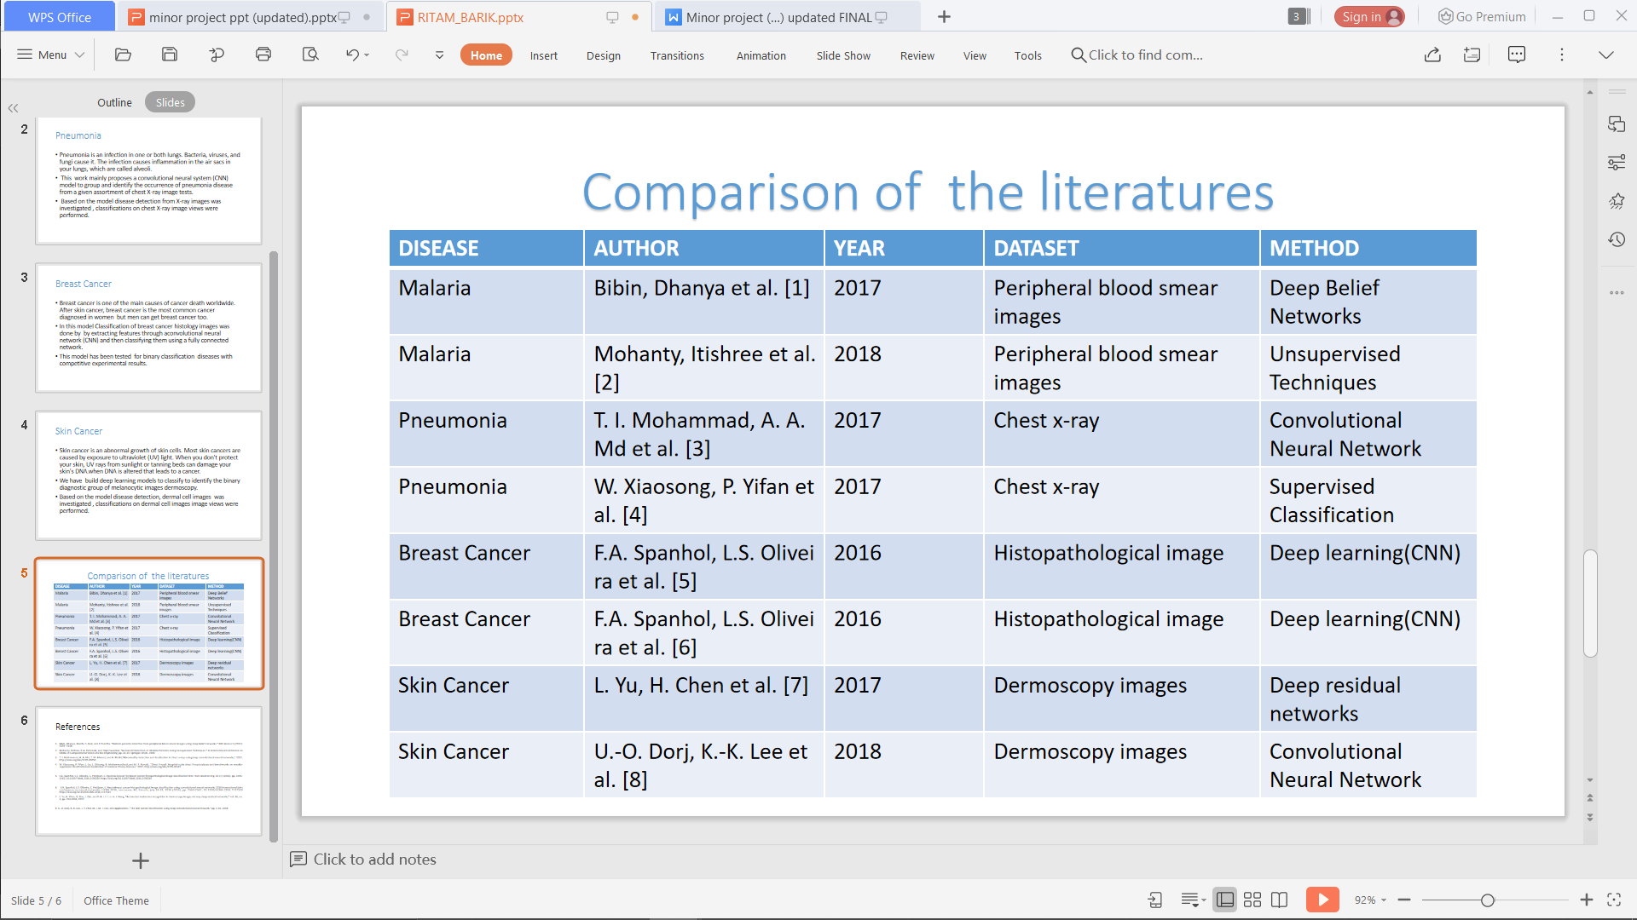
Literature Survey
Table 1. Comparison of different literatures

Slide 5
Motivation
Disease detection plays a very important role in the process of diagnosis. Therefore, the motivation lies in accurate classification and detection of the diseases based on medical images.
The main aim is to minimize the chances of error that might happen due to the doctor's misjudgement.
Developing a system that will not only help in detecting the diseases efficiently but will also save the time and effort of the medical practitioners.
This will also save the patients from running to the doctor to get their medical reports verified.

Slide 6
Methodology and System Design
Image Processing
Image processing can be defined as the technical analysis of an image by using complex algorithms.
The purpose of early image processing was to improve the quality of the image. Its use has been increasing exponentially in the last decades.
Its applications range from medicine to entertainment, passing by geological processing and remote sensing.

Slide 7
Contd..
Convolutional Neural Network (CNN)
A Convolutional Neural Network (CNN) is comprised of one or more convolutional layers (often with a subsampling step) and then followed by one or more fully connected layers as in a standard multilayer neural network.
The architecture of a CNN is designed to take advantage of the 2D structure of an input image. This is achieved with local connections and tied weights followed by some form of pooling which results in translation invariant features.
Another benefit of CNNs is that they are easier to train and have fewer parameters than fully connected networks with the same number of hidden units.

Slide 8
Contd..
The MVC model
Model-view-controller (MVC) is an architectural pattern widely used to design user interfaces, which divides an application into three interrelated components.
The design pattern of MVC decouples these major components to allow efficient reuse of code and also allows parallel development of each of the component.
This architecture is mostly used for desktop graphical user interfaces (GUIs) and is popular in designing web applications.
It consists of 3 components- the Model, the View and the Controller.

Slide 9
Contd..
The Model
A Model is the principal central component of an application.
The Model used in this work comprises of 4 various sub-models which represent each disease.
The View
A View is something available to the user.
It helps UI / UX people to operate in parallel with the people at the back-end of the user interface.
The Controller
A Controller is a master that synchronizes the Model along with View.
It obtains the user's interaction with the View, transmits them on to the Model that then processes the input information for output production.

Slide 10
Contd..
Malaria Detection Model
For designing the malaria disease model, a dataset has been taken comprising of cell images of 50 x 50 pixels in .png format.
The dataset is then divided into the train set and test set of 22046 and 5512 images respectively.
The custom CNN model used had 3 Convolutional layers and one fully-connected layer. ‘relu’ and ‘softmax’ activation functions are applied to the hidden layers and the output layer respectively.
Pneumonia Detection Model
In the pneumonia model, a dataset comprising of chest x-rays has been taken. The images are of 224x224 pixels.
The dataset is then divided into the train set and test set of 22046 and 5512 images respectively.
CNN model having 10 convolutional layers and one fully-connected layer has been used.
For activation purpose, ‘relu’ and ‘sigmoid’ functions are used in the hidden and output layer respectively.

Slide 11
Contd..
Skin Cancer Detection Model
The dataset comprising of RGB images of skin samples has been taken. The images were of 224x224 pixels.
The dataset is then divided into the train set and test set of 2637 and 660 images respectively.
A CNN model of 4 convolutional layers and one fully connected layer has been developed.
For activation, ‘softmax’ and ‘relu’ are applied to the output layer and hidden layers respectively.
Breast Cancer Detection Model
For this, a dataset has been taken of cell images of microanatomy that contains RGB images of 50x50 pixels.
To the dataset, a CNN model has been applied of 6 convolutional layers and one fully-connected layer.
To the output layer and the hidden layers, ‘sigmoid’ and ‘relu’ activation functions are applied respectively.

Slide 12
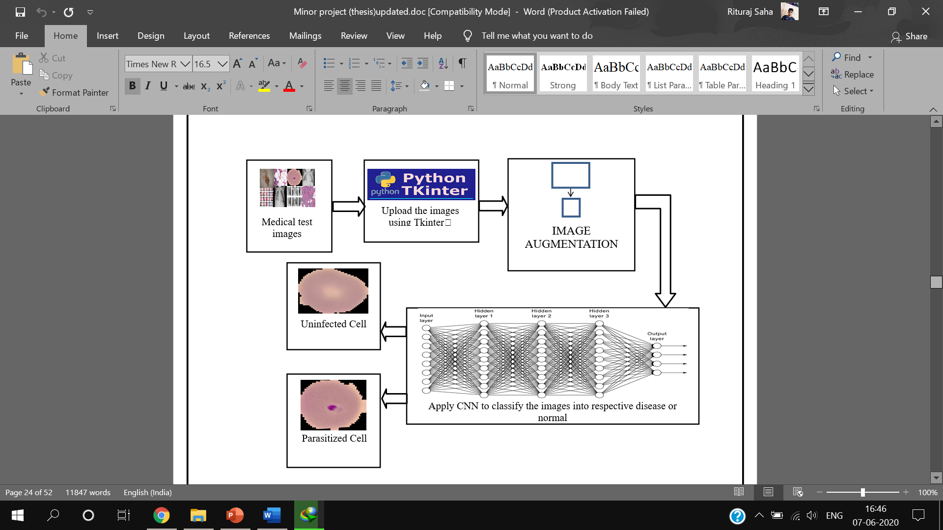
Contd..
Figure 2. Flowchart of the proposed model

Slide 13
Contd..
Implementation of MVC model in our Project
There are mainly three files in the project: main.py, detector and upload which contains the GUI, Detector and Controller components, respectively
We can alter and run the GUI component separately without compromising the functionality of the other components.
A single Controller component works for all the Views and Detectors.

Slide 14
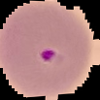
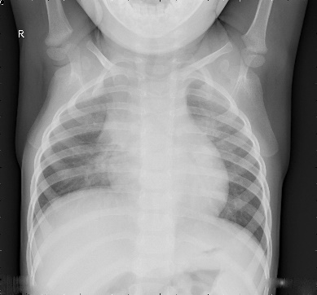

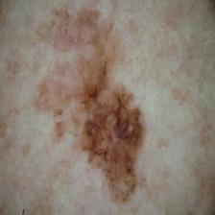
Results
Sample Test Cases
Test ID | Test Case Title | Test Condition | System Behaviour | Expected Result
T01 | Malaria Detection |  | Parasitized Cell Detected | Parasitized Cell Detected
T02 | Pneumonia Detection |  | Normal Detected | Normal Detected
T03 | Breast Cancer Detection |  | Benign Tissue Detected | Benign Tissue Detected
T04 | Skin Cancer Detection |  | Malignant Skin Detected | Malignant Skin Detected
Test Results
Test Name | Result
Malaria | 95.21%
Pneumonia | 90.47%
Breast Cancer | 86.88%
Skin Cancer | 84.60%

Slide 15
Conclusion
A “Health Discernment System” has been proposed for medical image classification that will work in real-life scenarios.
The proposed method is based on MVC architecture.
Different sub-models pertaining to the four diseases (malaria, pneumonia, breast cancer, and skin cancer) have been designed using convolutional neural network (CNN) and they have all been tested separately.
A GUI based web application has been designed using Tkinter so that the system can take real-life image inputs for detection.

Slide 16
Future Scope
Implementation of various other algorithms and using several optimization techniques. Also more data will be collected in order to recognize the features more accurately.
Major attention will be given to increase the accuracy such that our proposed system can be used to detect a large number of chronic and critical diseases.
When these enhancements are done, the system can be integrated with an android application to make it more convenient and easily portable. This will allow people from all strata to use it effectively even if they do not have a personal computer.

Slide 17
Thank You!

