Slide 1
Big Book Study Group
by District 23
Front Matter through Page 16
903 Court Street, Port Huron
Wednesdays · 7:00 PM

Slide 2
Copyright Notice
“These materials are copyright © by Alcoholics Anonymous World Services, Inc. ("A.A.W.S."). All rights reserved. Individual printing or photocopying of a single copy is permitted. Intended for personal use only, and not to be reproduced further or distributed for resale.”
Displayed at the request of A.A. World Services, Inc. Reproduced with permission for use during this A.A. meeting.

Slide 3
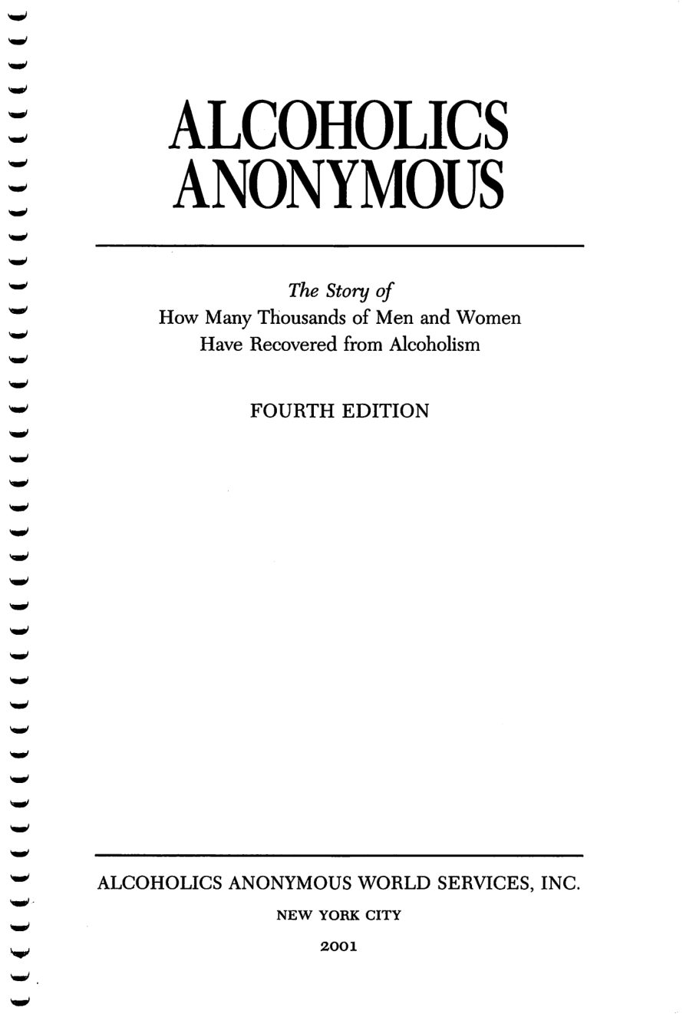
Copyright © Alcoholics Anonymous World Services, Inc. All rights reserved. Intended for personal use only, and not to be reproduced further or distributed for resale.

Slide 4
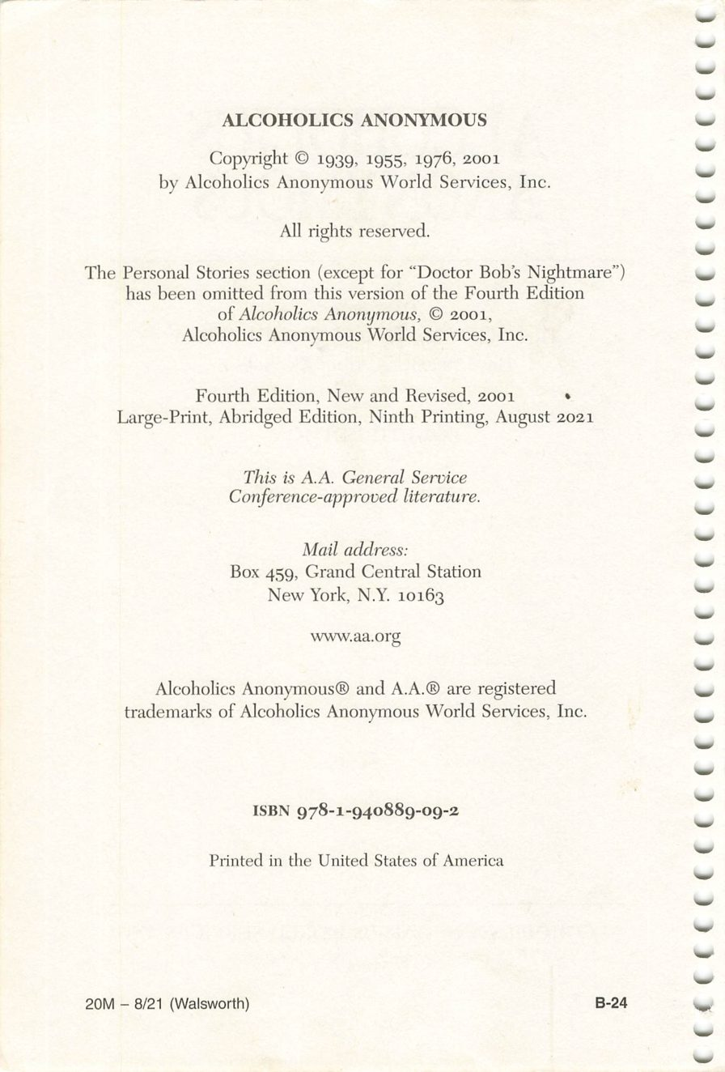
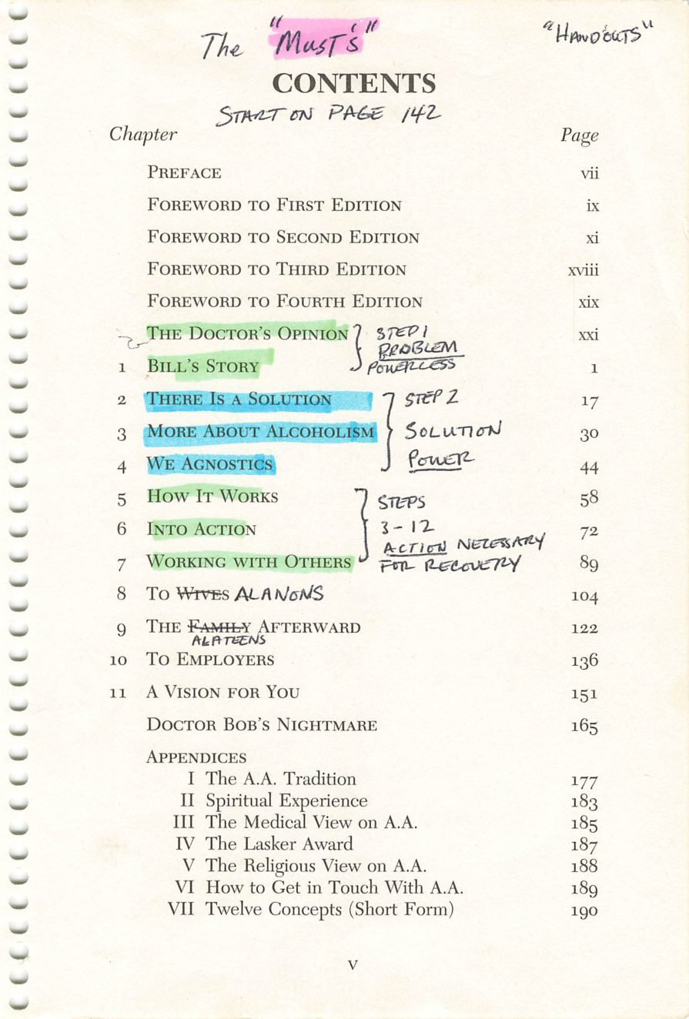
Copyright © Alcoholics Anonymous World Services, Inc. All rights reserved. Intended for personal use only, and not to be reproduced further or distributed for resale.
v

Slide 5
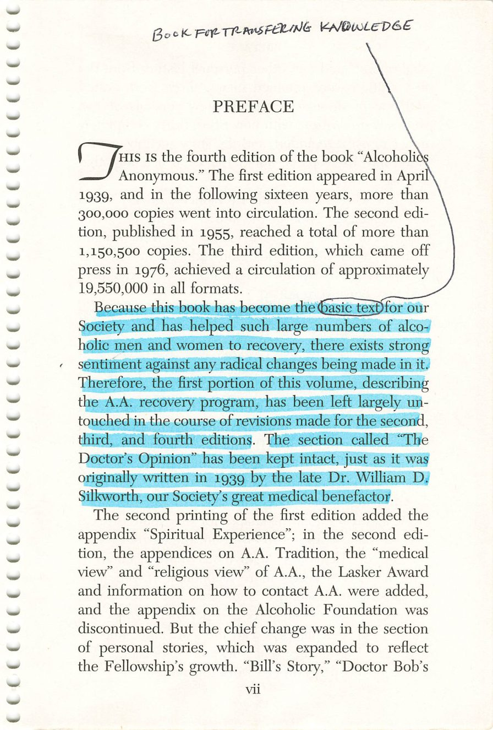
Copyright © Alcoholics Anonymous World Services, Inc. All rights reserved. Intended for personal use only, and not to be reproduced further or distributed for resale.
vii

Slide 6
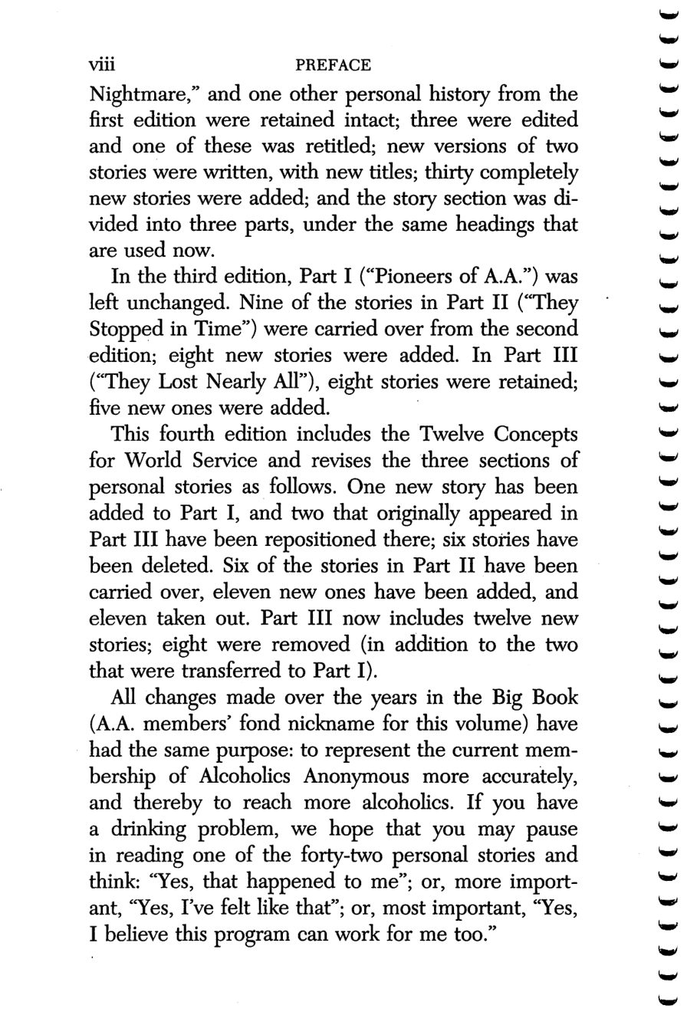
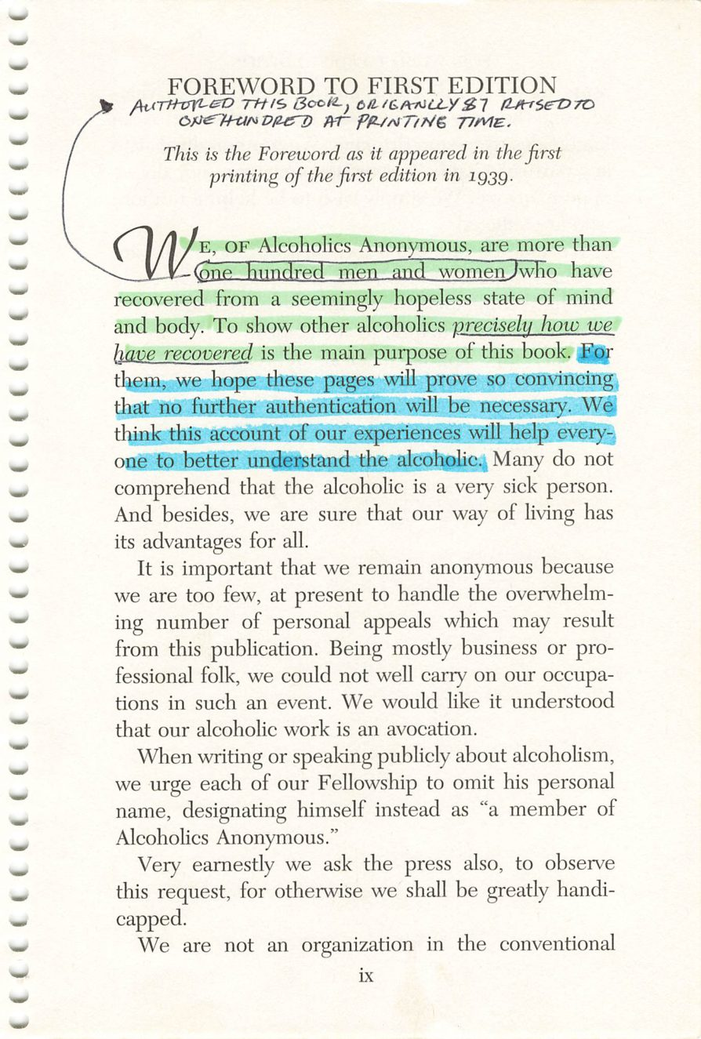
viii
ix
Copyright © Alcoholics Anonymous World Services, Inc. All rights reserved. Intended for personal use only, and not to be reproduced further or distributed for resale.

Slide 7
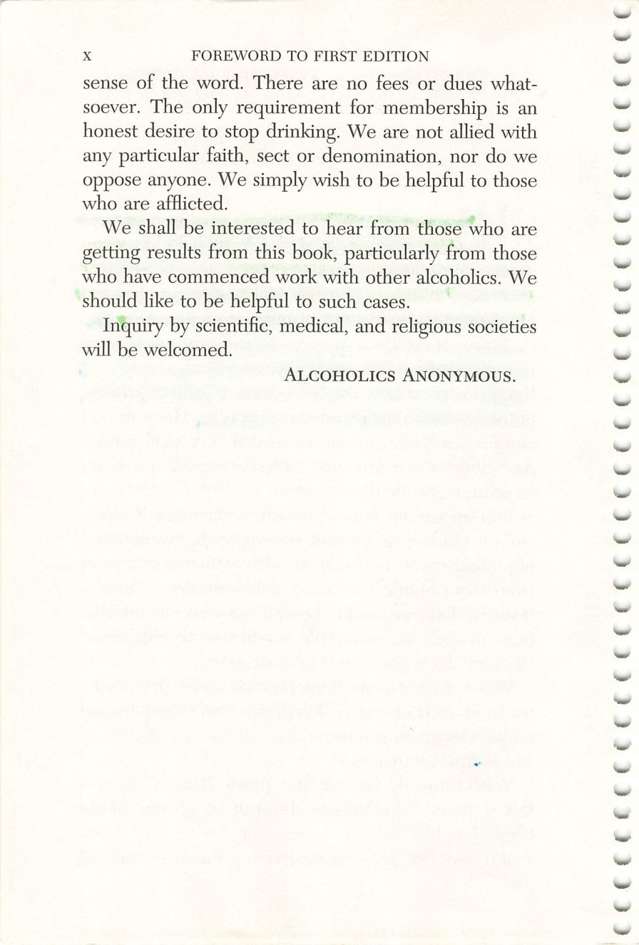
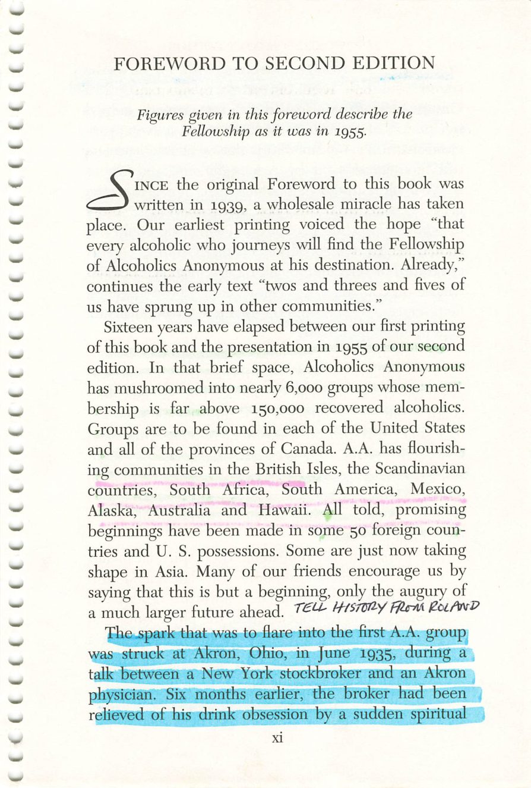
x
xi
Copyright © Alcoholics Anonymous World Services, Inc. All rights reserved. Intended for personal use only, and not to be reproduced further or distributed for resale.

Slide 8
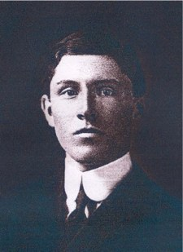
Rowland Hazard
Page xi
Photograph, with a brief history.
Credit: Rowland Hazard III, 1881-1945. Early A.A. archival photograph, via aamidsurrey.org.uk. Displayed for in-group study only.

Slide 9
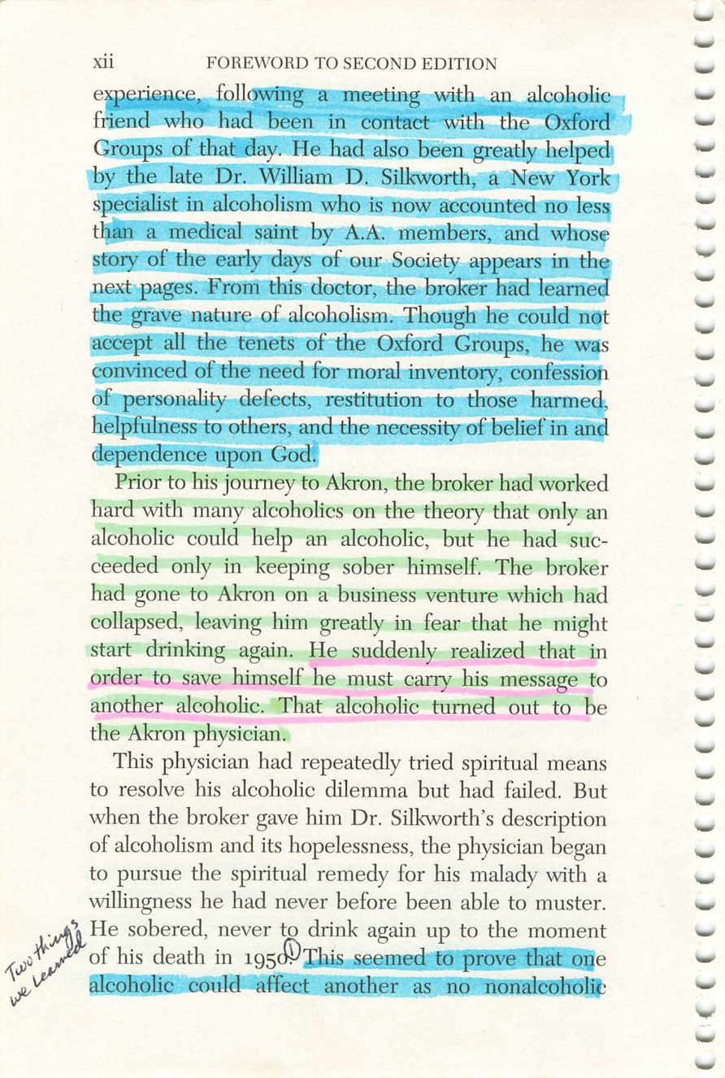
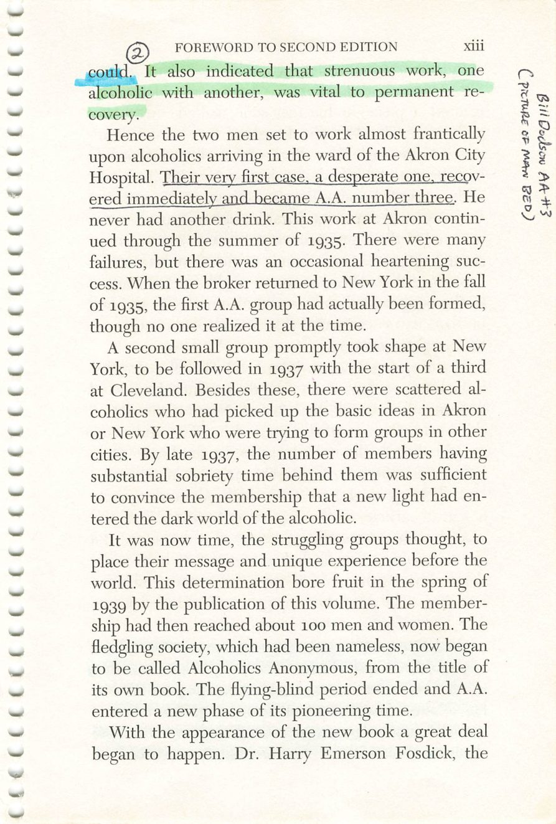
xii
xiii
Copyright © Alcoholics Anonymous World Services, Inc. All rights reserved. Intended for personal use only, and not to be reproduced further or distributed for resale.

Slide 10
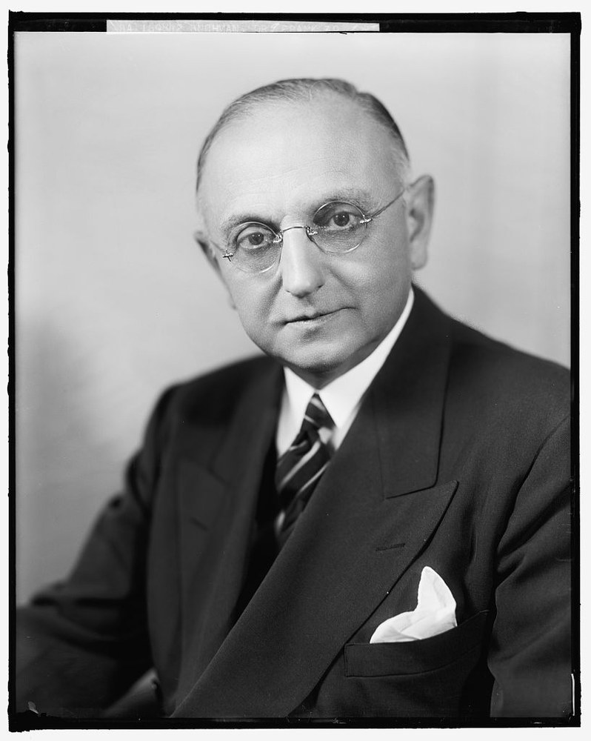
The Oxford Group
Page xii
Frank N. D. Buchman, the group’s founder.
Credit: Rev. Frank N. D. Buchman, ca. 1940. Harris & Ewing, Library of Congress Prints and Photographs Division (LC item 2016862679). No known restrictions on publication.

Slide 11
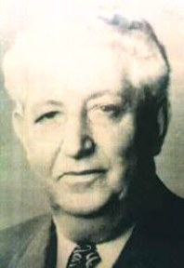
A.A. Number Three
Page xiii
Bill D. — the man in the bed, Akron City Hospital, 1935.
Credit: Bill D. (Dotson), A.A. Number Three, 1879-1954. Early A.A. archival photograph, via aamidsurrey.org.uk. Displayed for in-group study only.

Slide 12
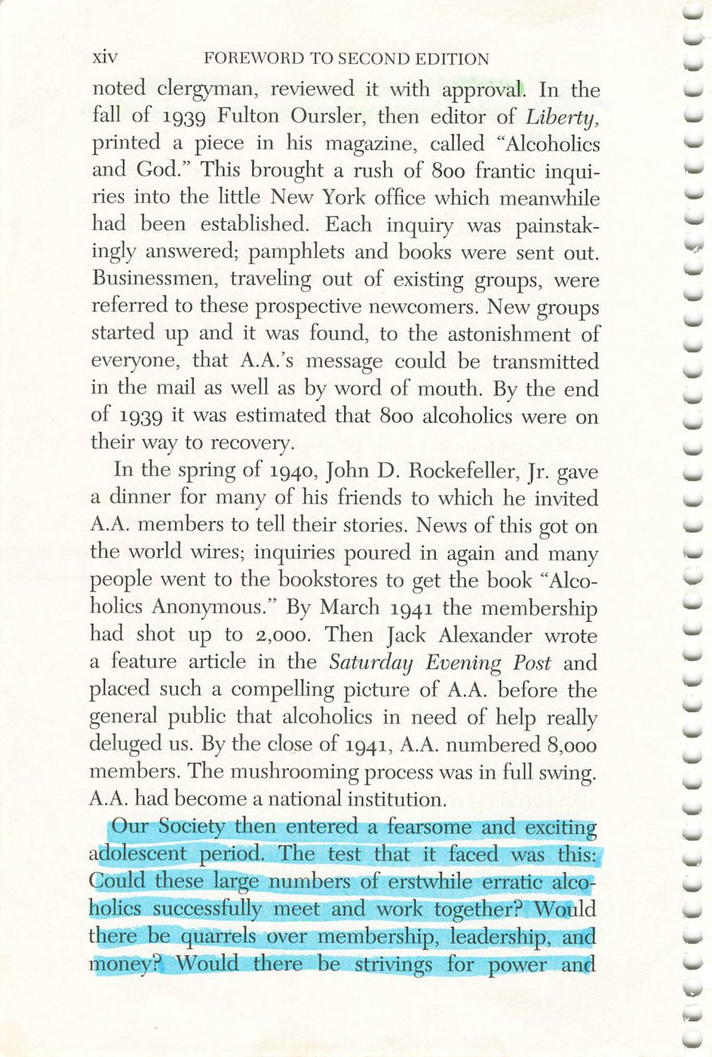
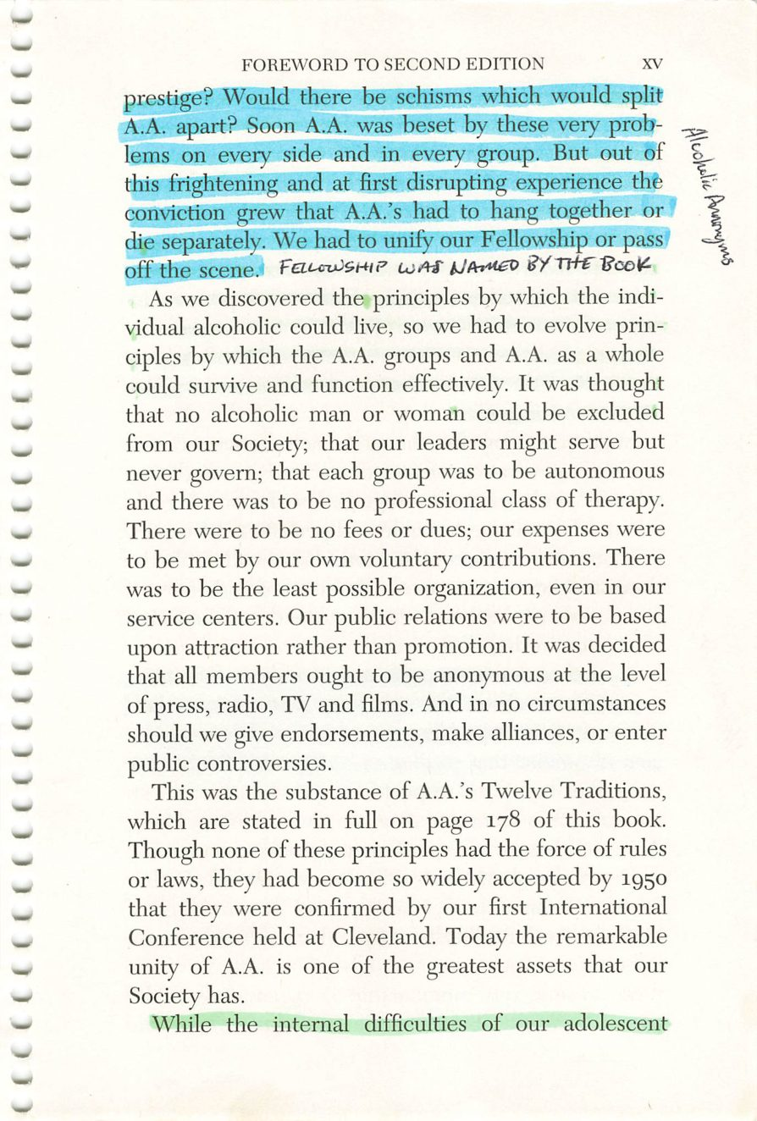
xiv
xv
Copyright © Alcoholics Anonymous World Services, Inc. All rights reserved. Intended for personal use only, and not to be reproduced further or distributed for resale.

Slide 13
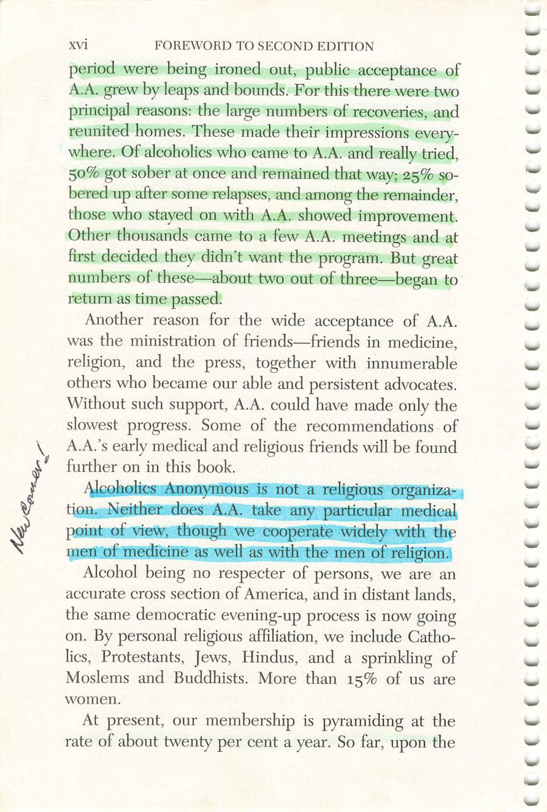
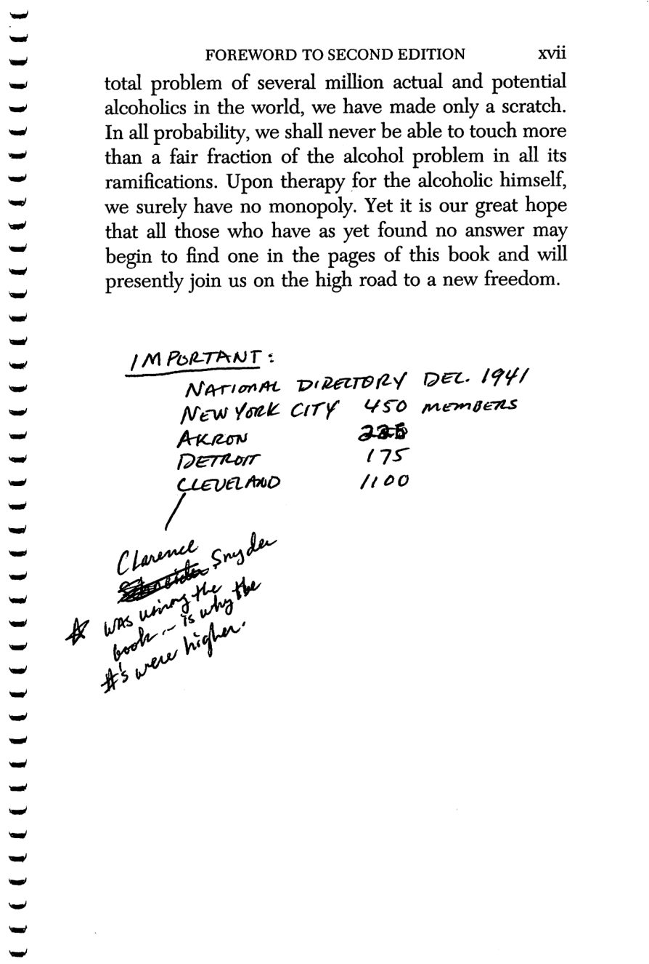
xvi
xvii
Copyright © Alcoholics Anonymous World Services, Inc. All rights reserved. Intended for personal use only, and not to be reproduced further or distributed for resale.

Slide 14
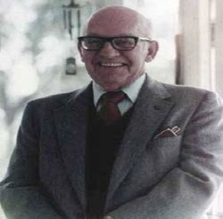
Clarence Snyder
Page xvii
Credit: Clarence H. Snyder, 1902-1984. Early A.A. archival photograph, via aamidsurrey.org.uk. Displayed for in-group study only.

Slide 15
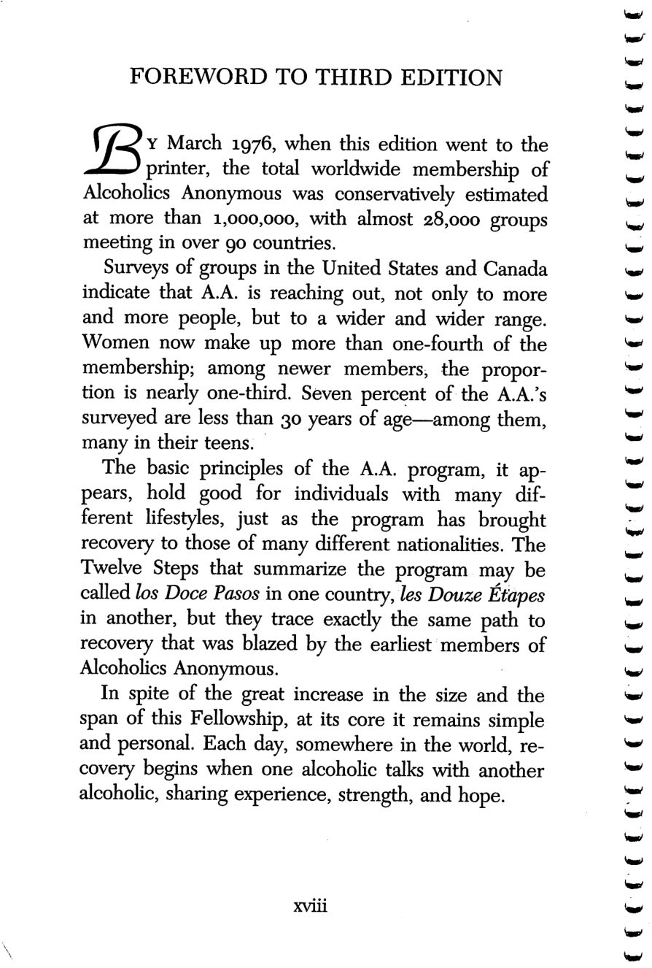
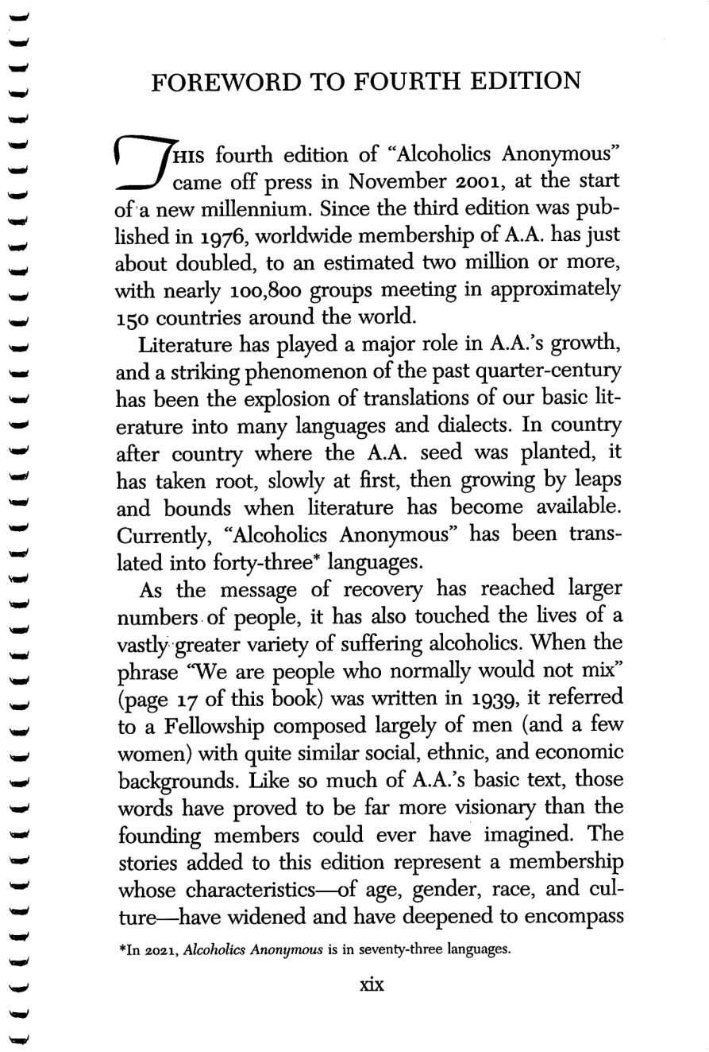
xviii
xix
Copyright © Alcoholics Anonymous World Services, Inc. All rights reserved. Intended for personal use only, and not to be reproduced further or distributed for resale.

Slide 16
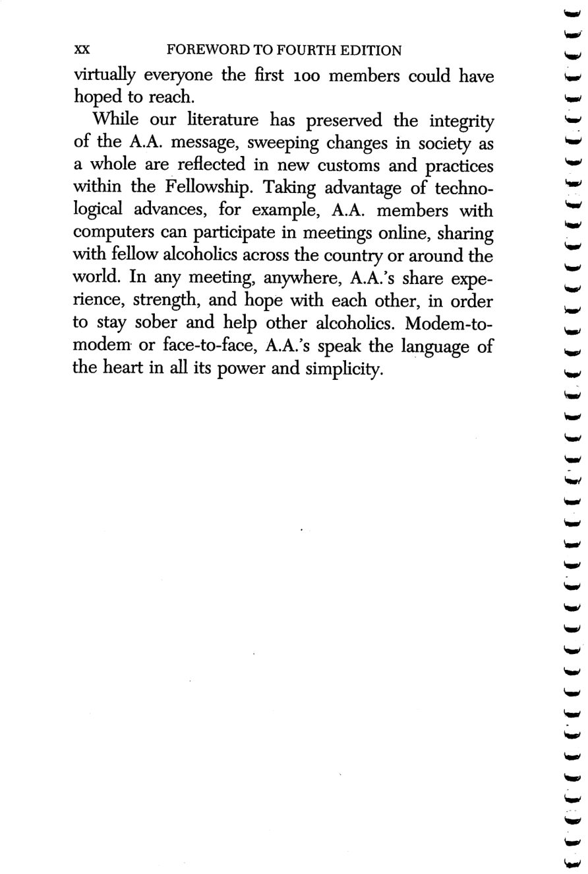
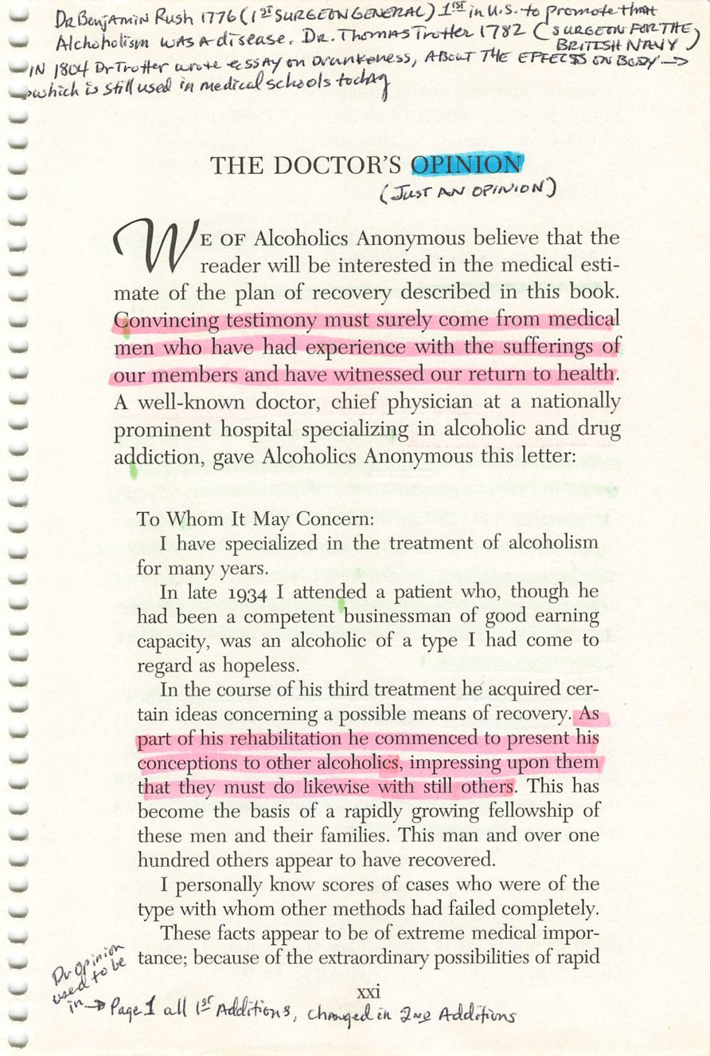
xx
xxi
Copyright © Alcoholics Anonymous World Services, Inc. All rights reserved. Intended for personal use only, and not to be reproduced further or distributed for resale.

Slide 17
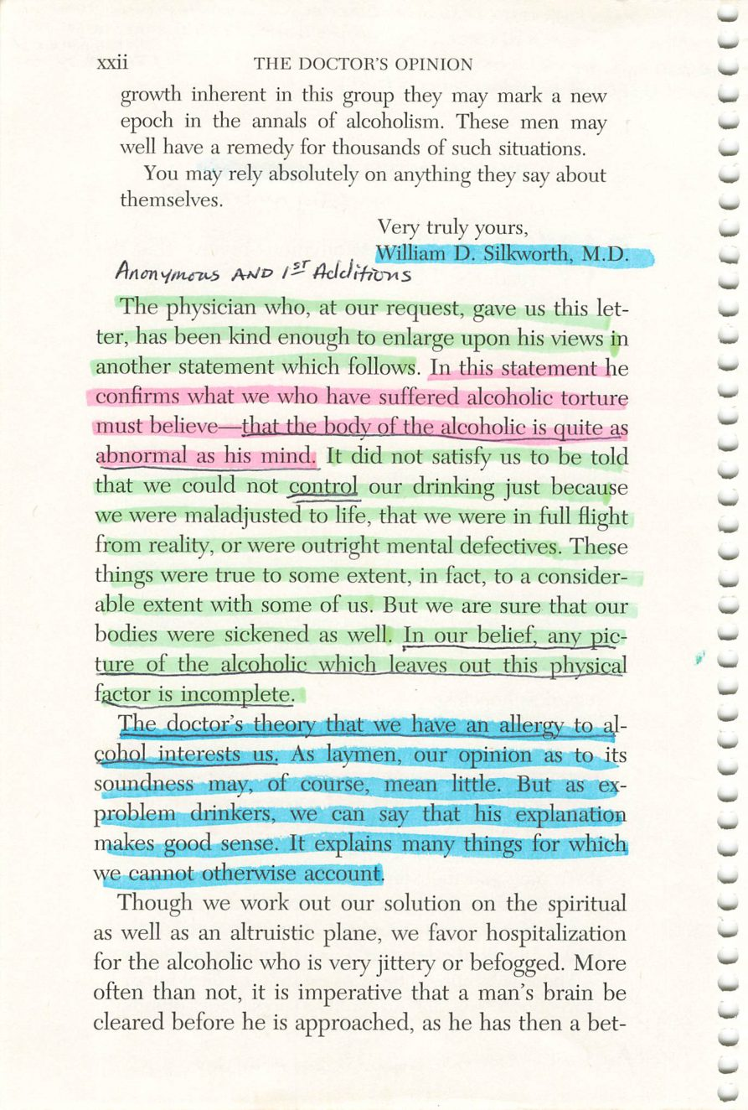
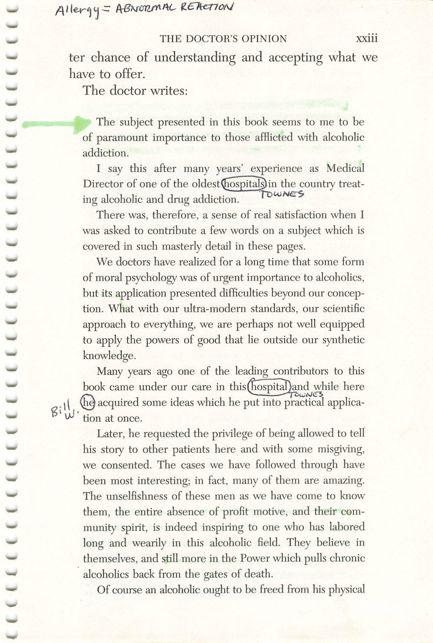
xxii
xxiii
Copyright © Alcoholics Anonymous World Services, Inc. All rights reserved. Intended for personal use only, and not to be reproduced further or distributed for resale.

Slide 18
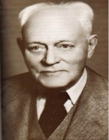
William D. Silkworth, M.D.
Page xxii
Credit: William Duncan Silkworth, M.D., 1873-1951. Early A.A. archival photograph, via aamidsurrey.org.uk. Displayed for in-group study only.

Slide 19
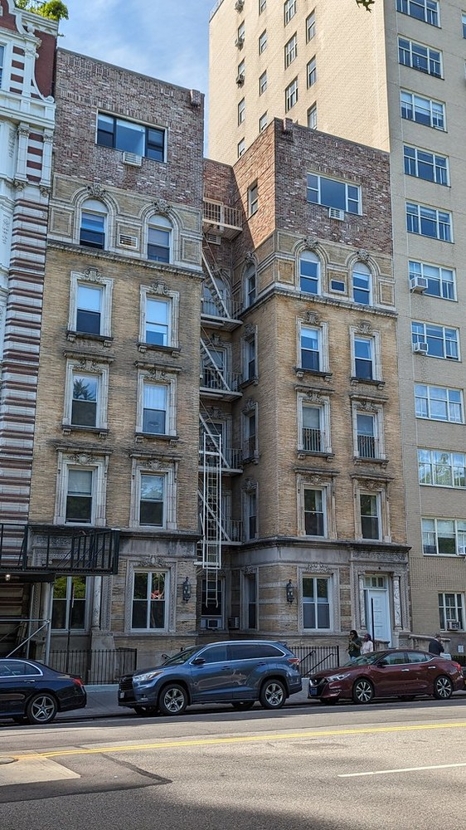
Towns Hospital
Page xxiii
293 Central Park West, New York City — the building today.
Credit: 293 Central Park West, the former Charles B. Towns Hospital, photographed in 2024. Eden, Janine and Jim, via Flickr, CC BY 2.0.

Slide 20
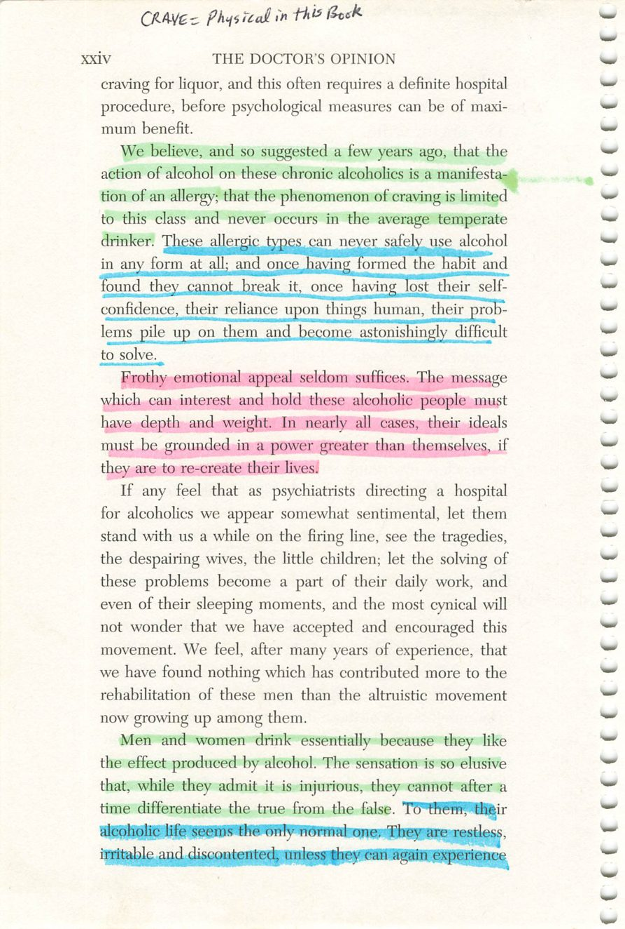
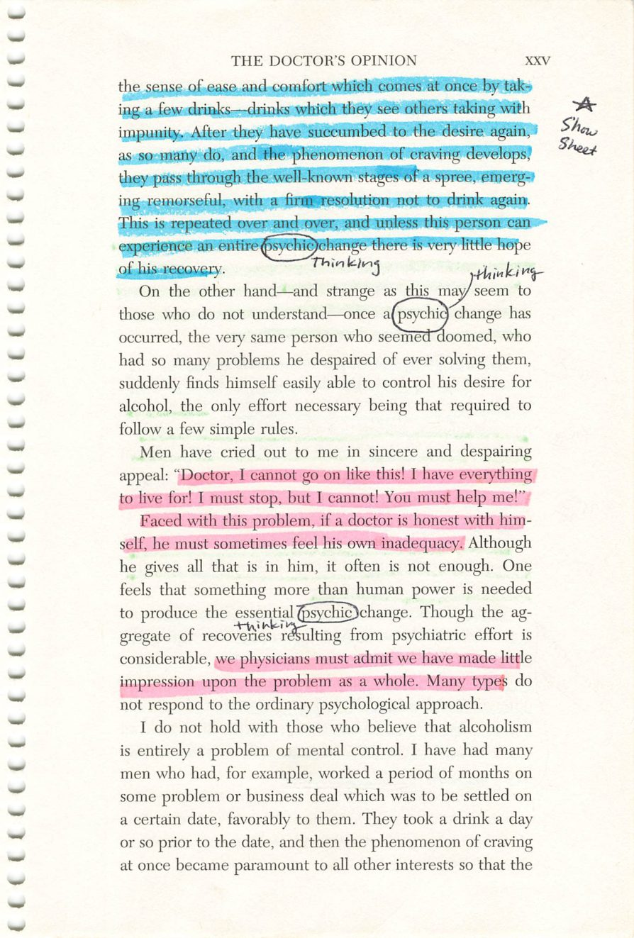
xxiv
xxv
Copyright © Alcoholics Anonymous World Services, Inc. All rights reserved. Intended for personal use only, and not to be reproduced further or distributed for resale.

Slide 21
Alcohol Metabolism
Page xxv
DIAGRAM
Diagram.
Drop the image into this frame in PowerPoint.
Credit:

Slide 22
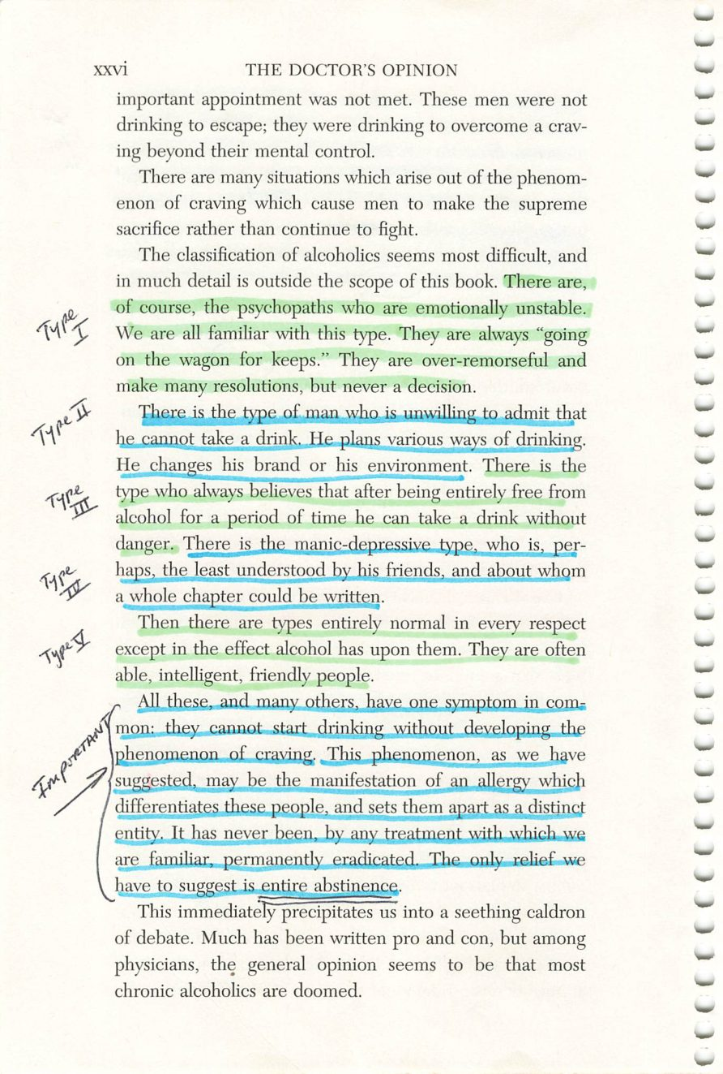
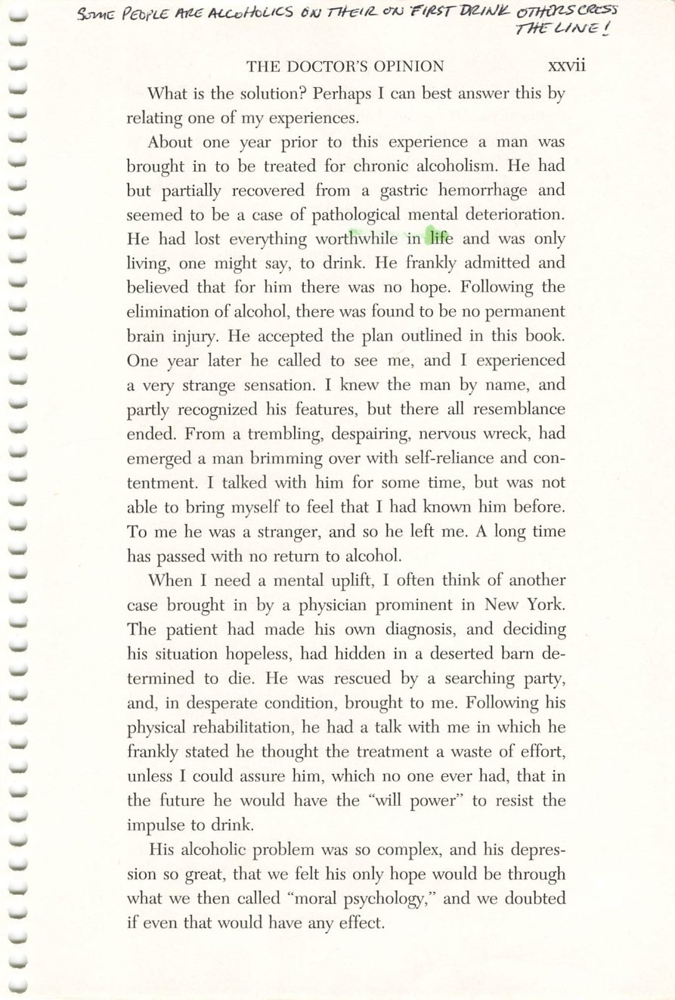
xxvi
xxvii
Copyright © Alcoholics Anonymous World Services, Inc. All rights reserved. Intended for personal use only, and not to be reproduced further or distributed for resale.

Slide 23
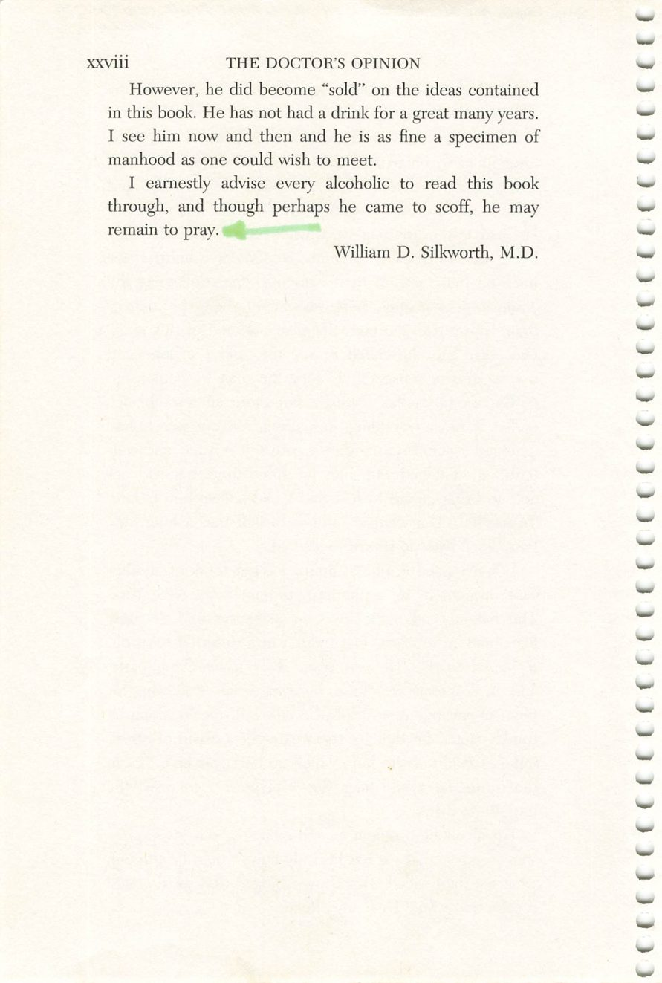
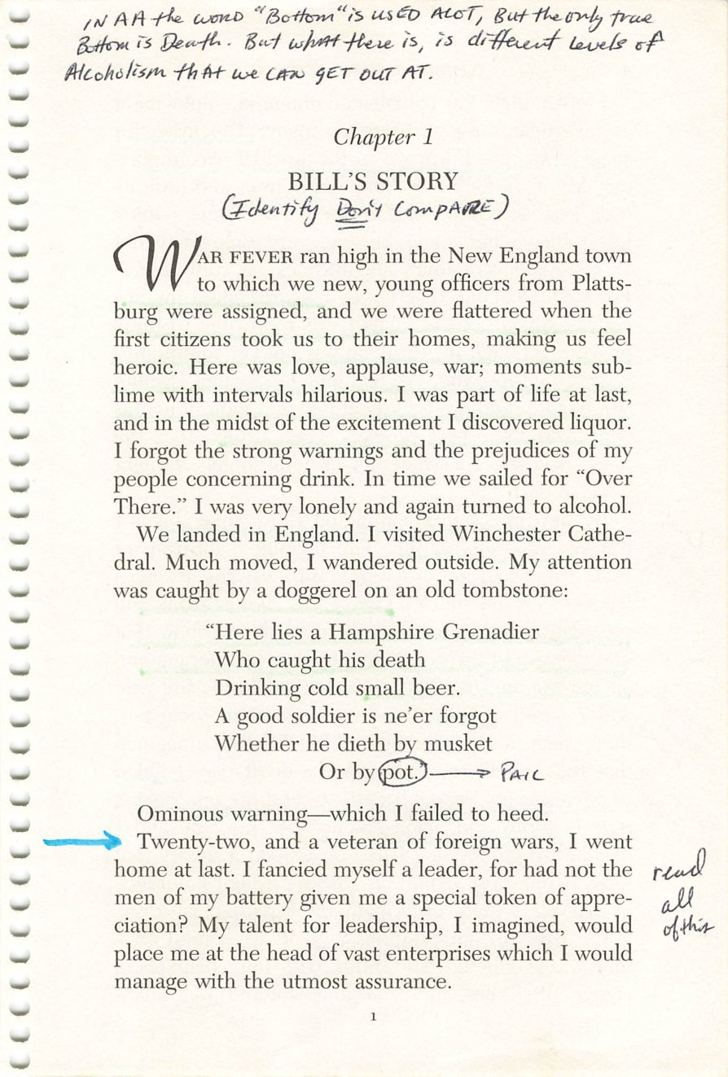
xxviii
1
Copyright © Alcoholics Anonymous World Services, Inc. All rights reserved. Intended for personal use only, and not to be reproduced further or distributed for resale.

Slide 24
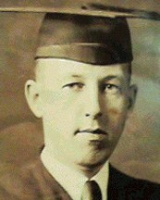
Bill W.
Page 1
Credit: William Griffith Wilson, 1895-1971. Early A.A. archival photograph, via aamidsurrey.org.uk. Displayed for in-group study only.

Slide 25
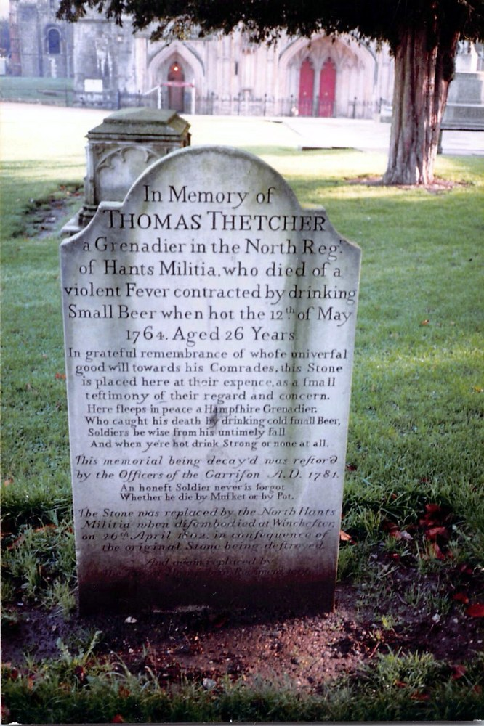
The Tombstone
Page 1
Thomas Thetcher, Winchester Cathedral — “Or by pot.”
Credit: User:Supertechguy. Wikimedia Commons, CC BY-SA 3.0.

Slide 26
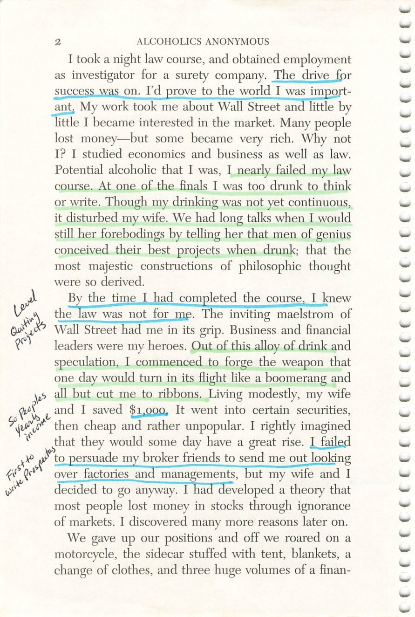
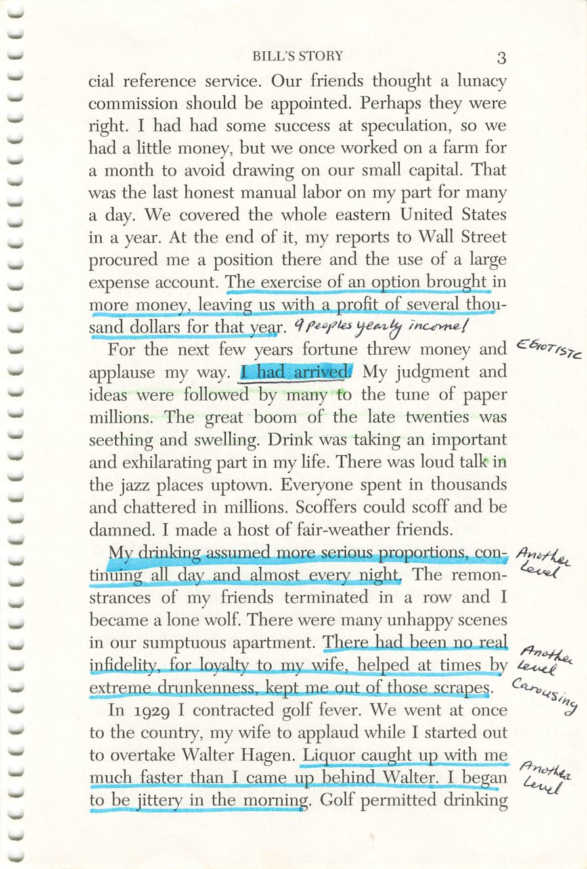
2
3
Copyright © Alcoholics Anonymous World Services, Inc. All rights reserved. Intended for personal use only, and not to be reproduced further or distributed for resale.

Slide 27
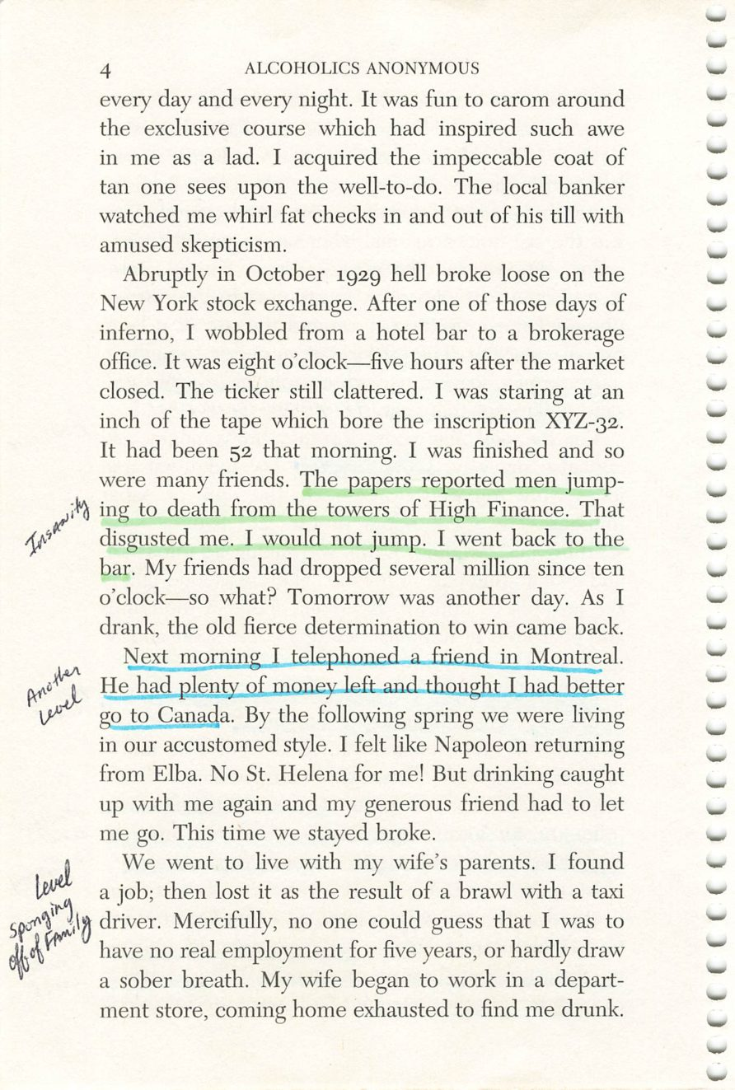
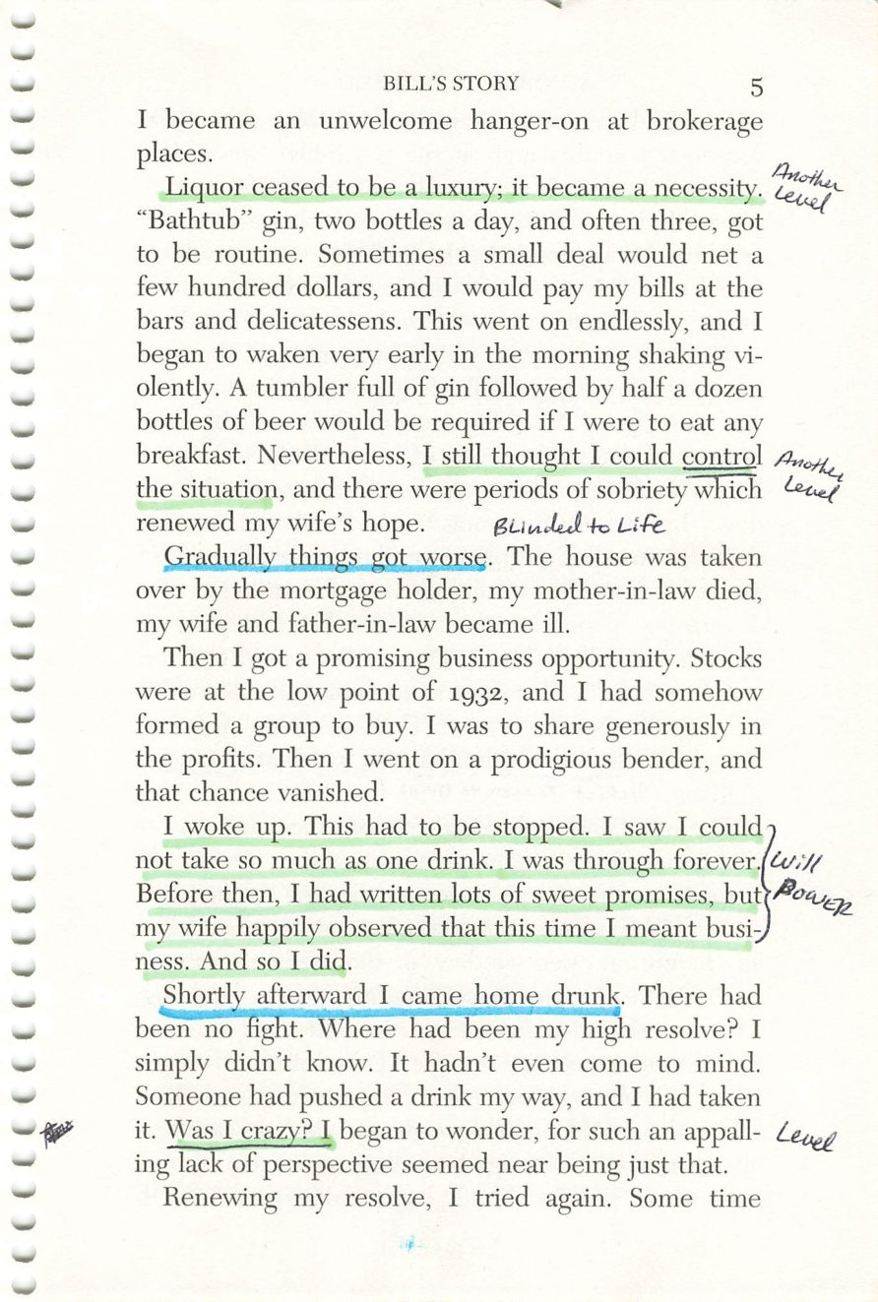
4
5
Copyright © Alcoholics Anonymous World Services, Inc. All rights reserved. Intended for personal use only, and not to be reproduced further or distributed for resale.

Slide 28
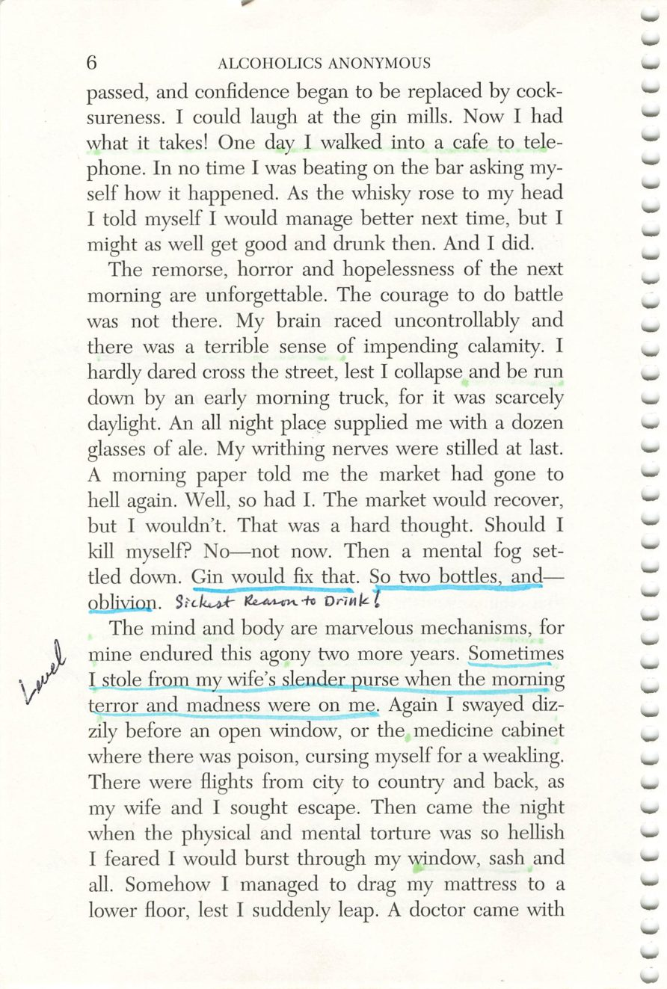
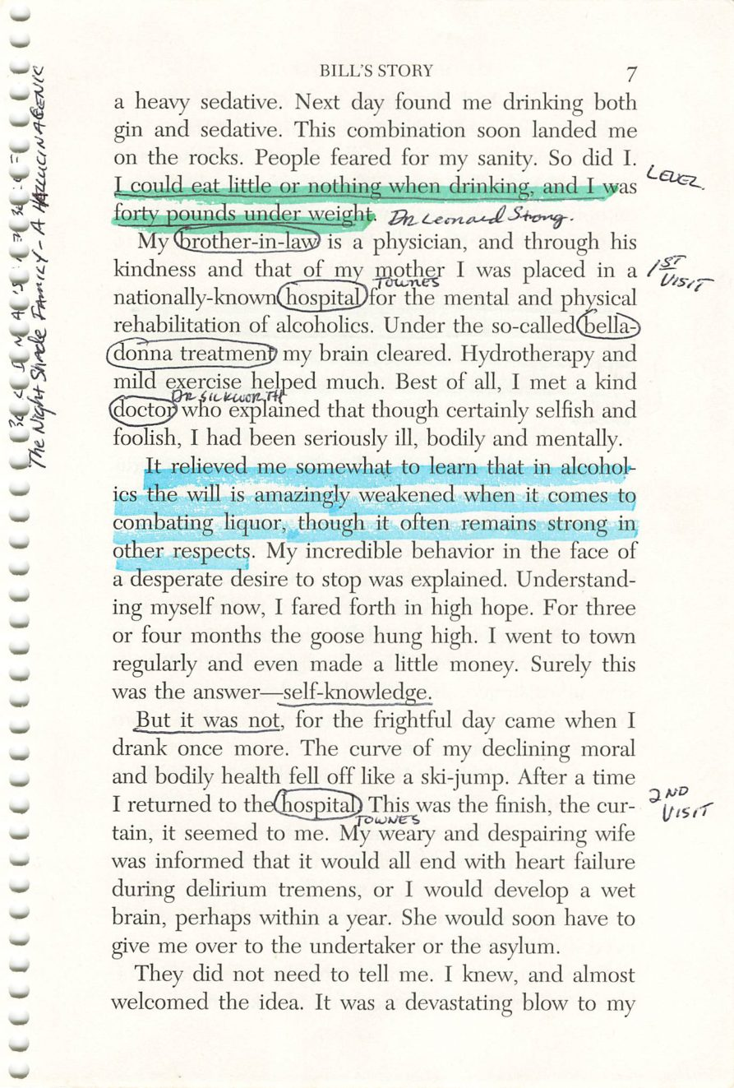
6
7
Copyright © Alcoholics Anonymous World Services, Inc. All rights reserved. Intended for personal use only, and not to be reproduced further or distributed for resale.

Slide 29
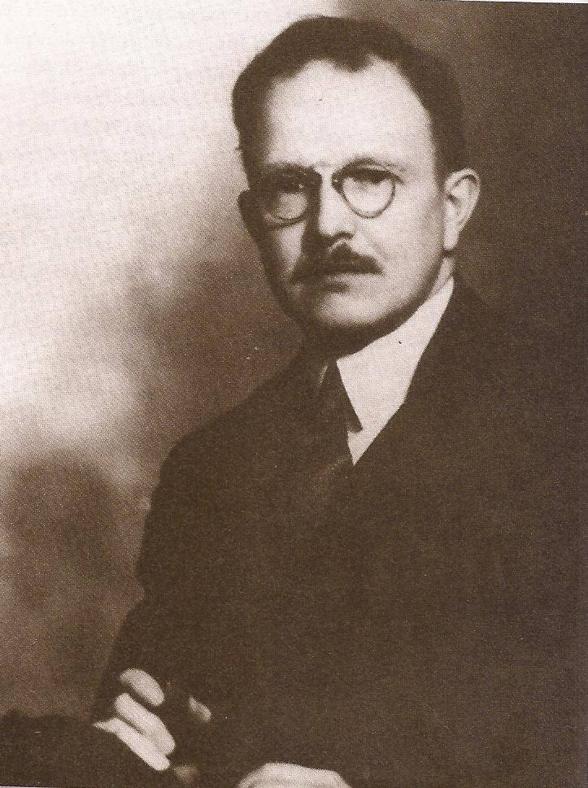
Dr. Leonard V. Strong, Jr.
Page 7
Bill’s brother-in-law, an osteopath.
Credit: Dr. Leonard V. Strong, Jr., 1899-1989. Early A.A. archival photograph, via aalkies.wordpress.com. Displayed for in-group study only.

Slide 30
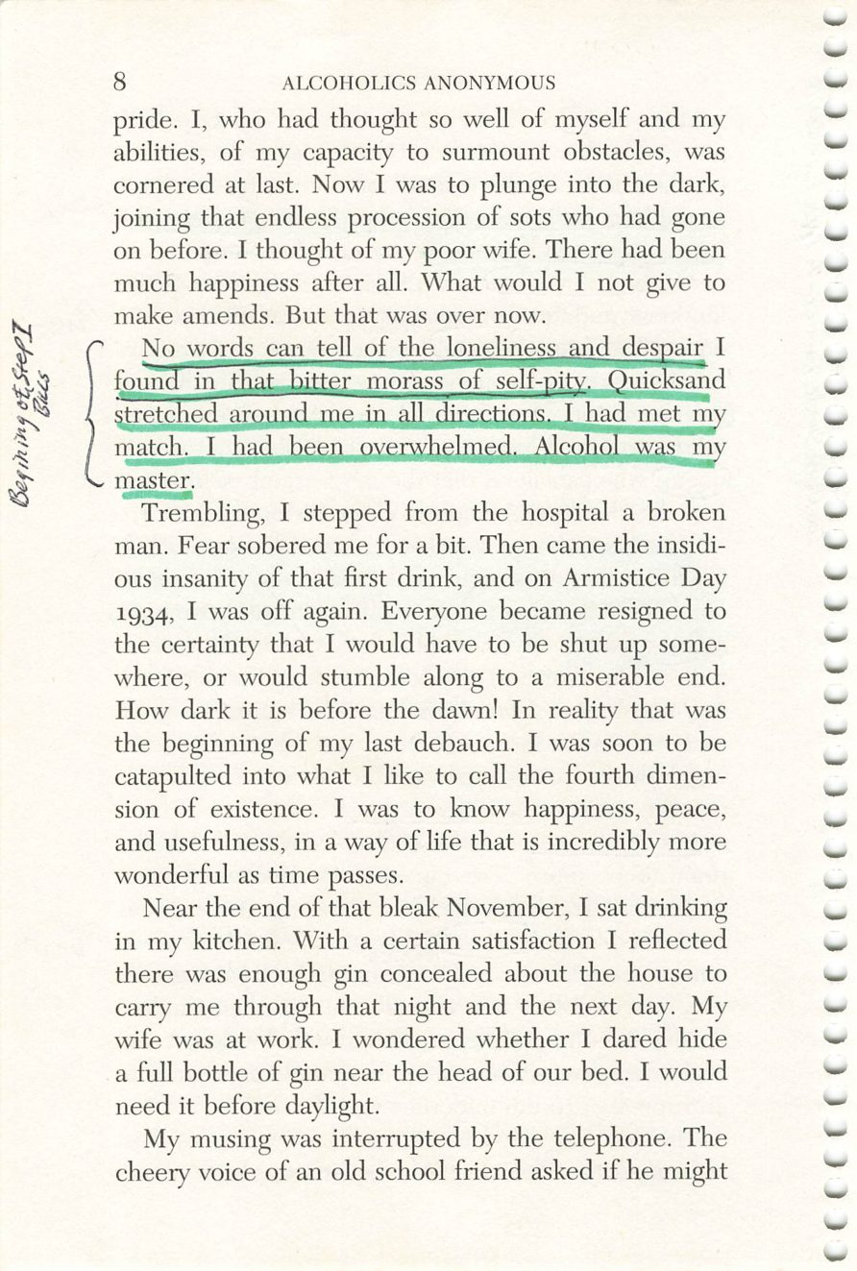
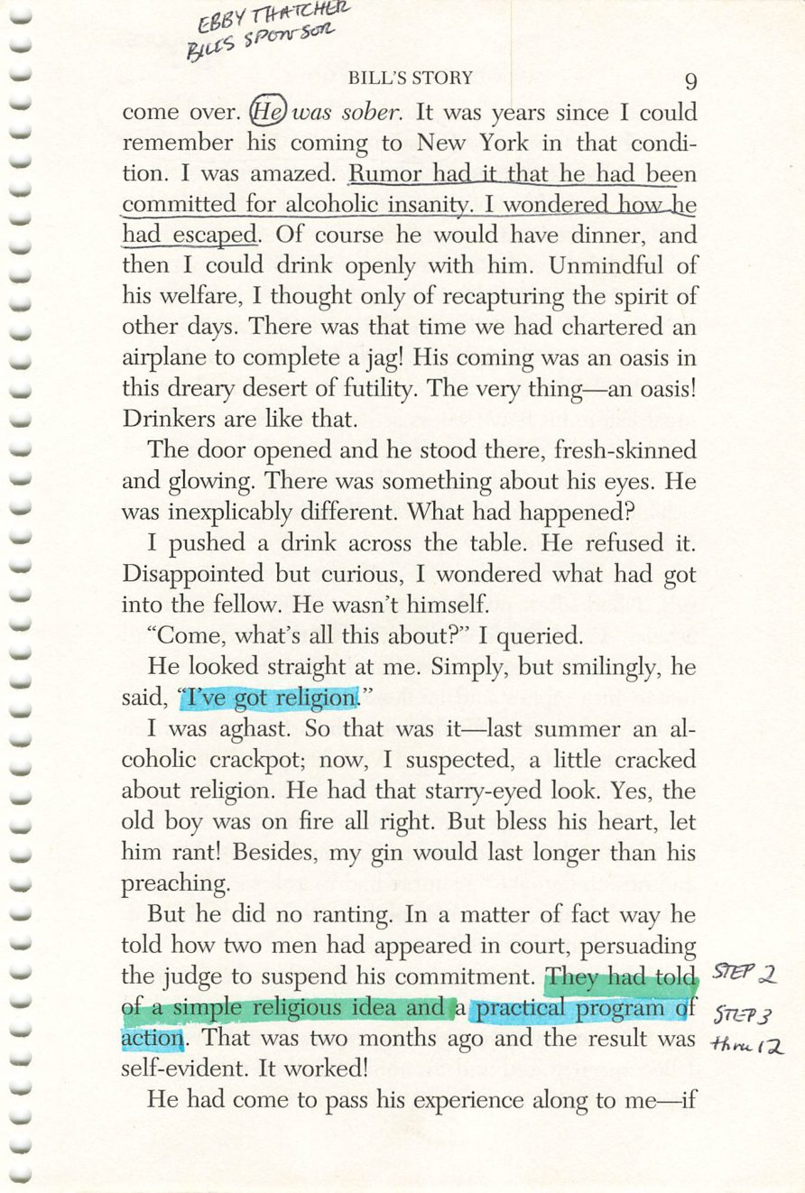
8
9
Copyright © Alcoholics Anonymous World Services, Inc. All rights reserved. Intended for personal use only, and not to be reproduced further or distributed for resale.

Slide 31
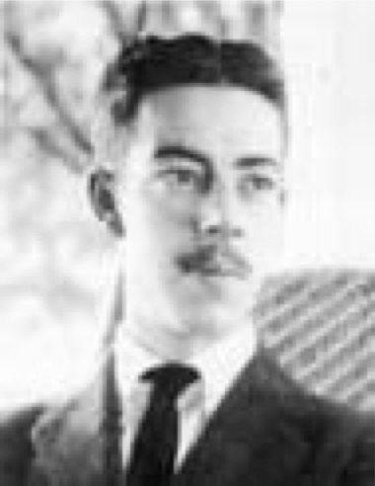
Ebby Thatcher
Page 9
Bill’s sponsor.
Credit: Edwin Throckmorton Thacher, 1896-1966. Early A.A. archival photograph, via aamidsurrey.org.uk. Displayed for in-group study only.

Slide 32
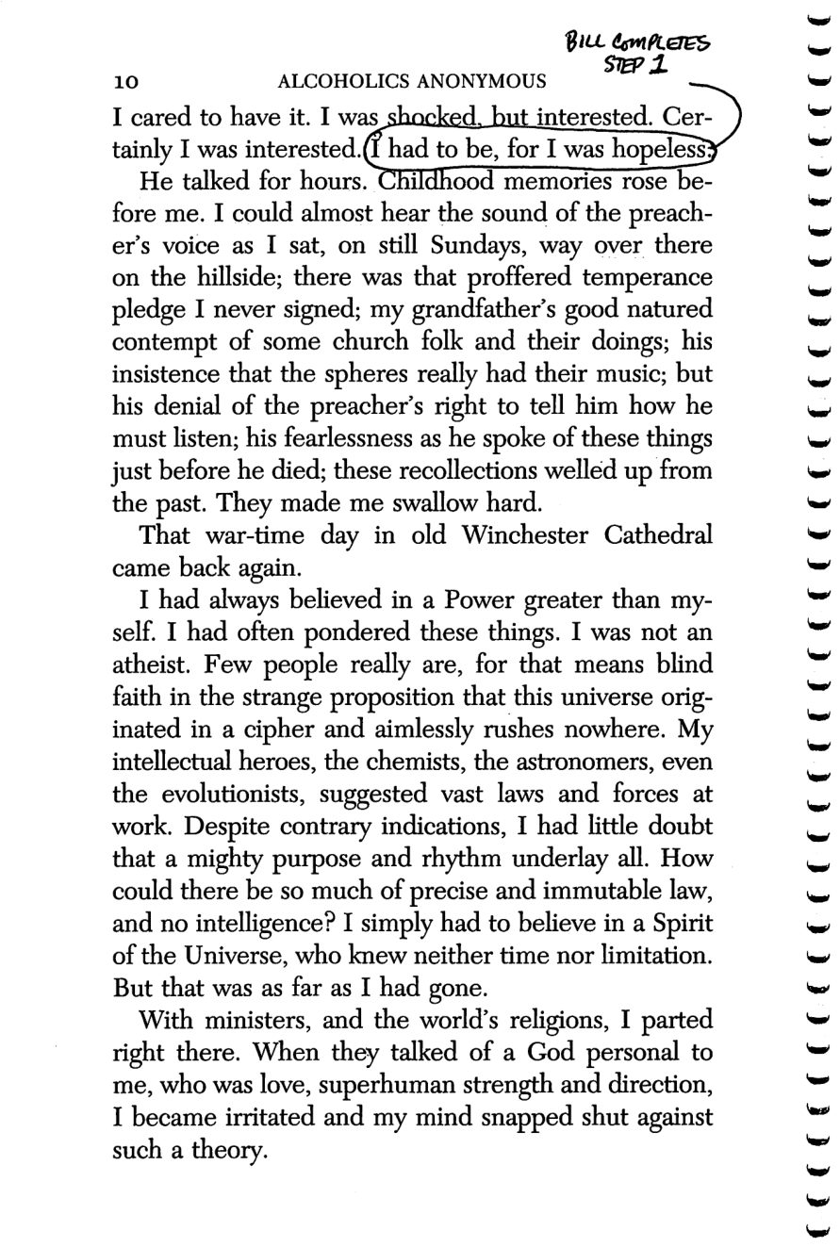
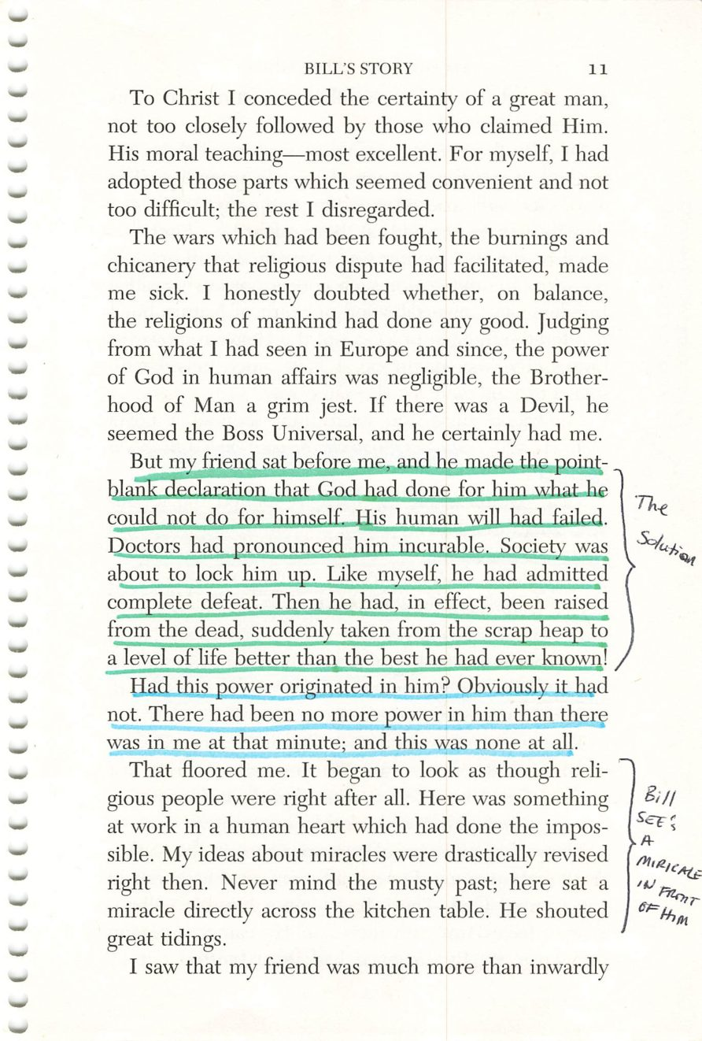
10
11
Copyright © Alcoholics Anonymous World Services, Inc. All rights reserved. Intended for personal use only, and not to be reproduced further or distributed for resale.

Slide 33
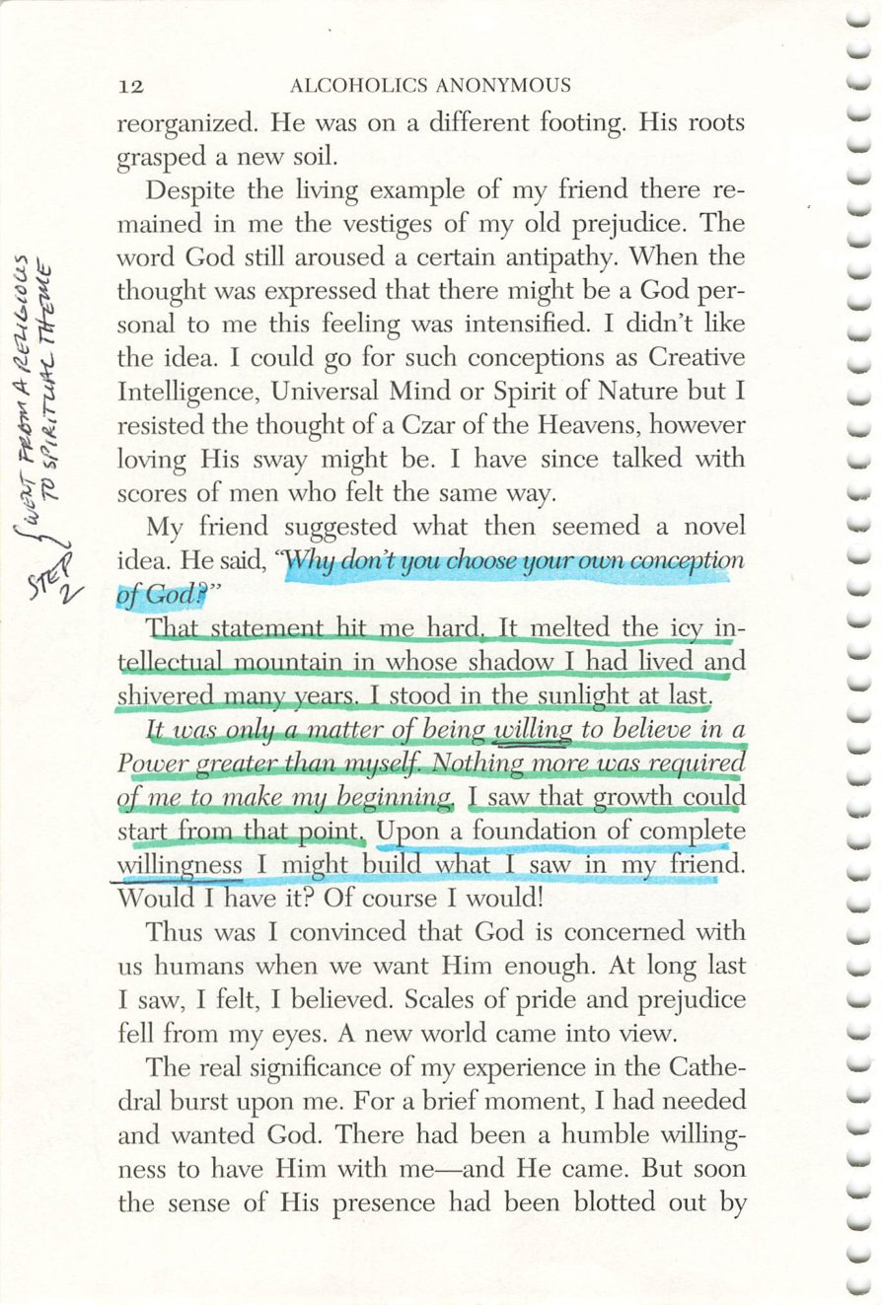
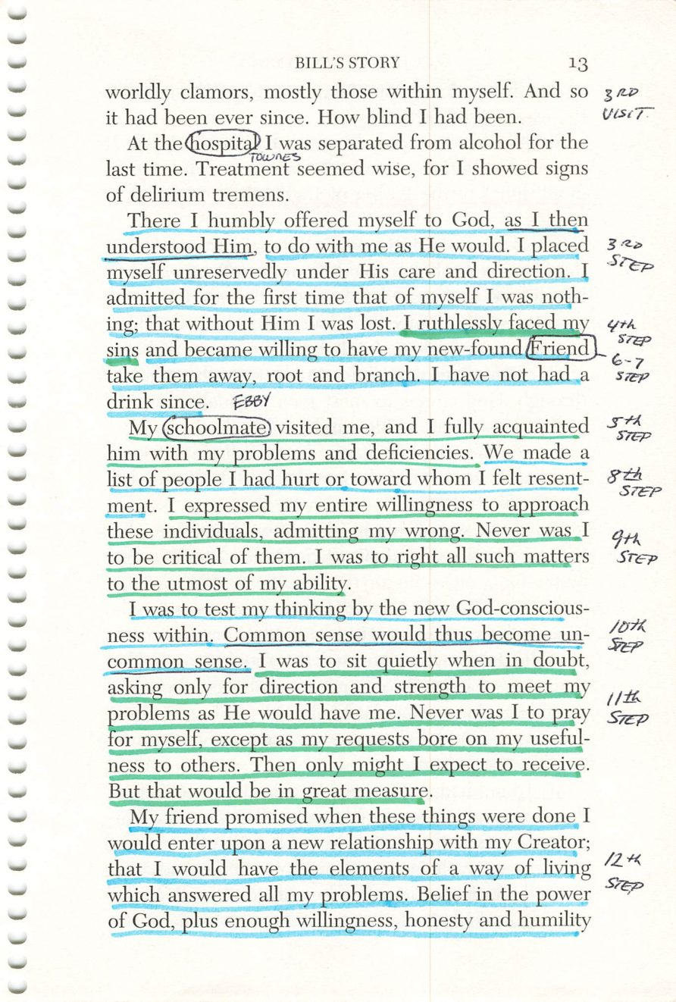
12
13
Copyright © Alcoholics Anonymous World Services, Inc. All rights reserved. Intended for personal use only, and not to be reproduced further or distributed for resale.

Slide 34
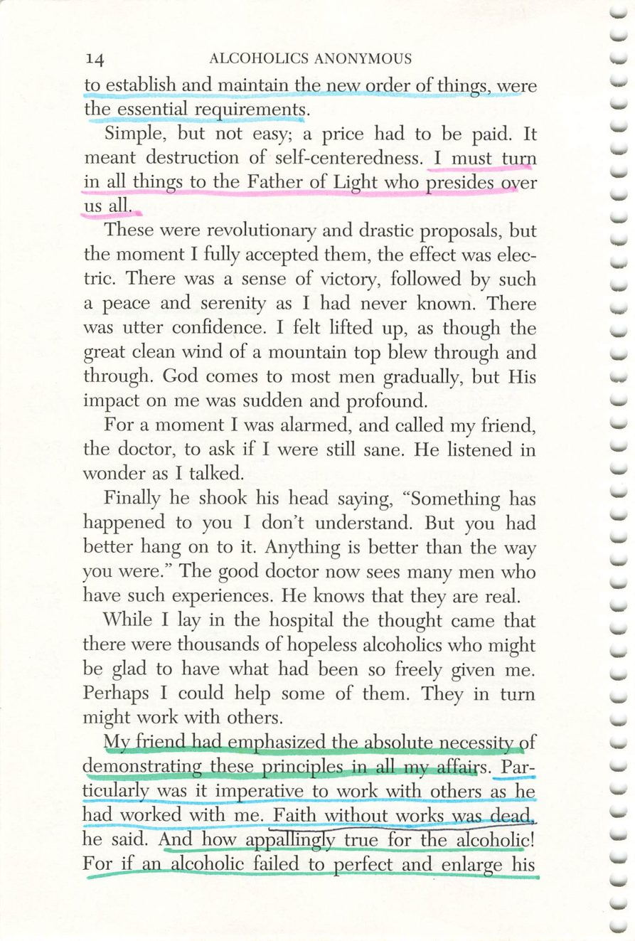
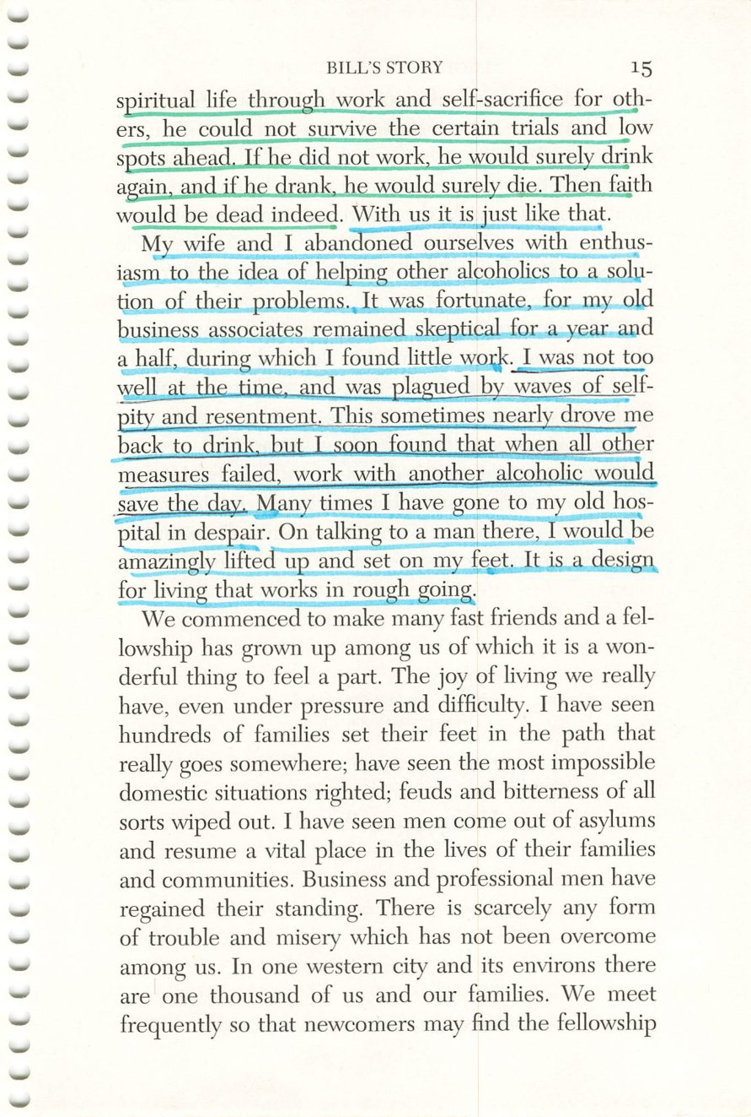
14
15
Copyright © Alcoholics Anonymous World Services, Inc. All rights reserved. Intended for personal use only, and not to be reproduced further or distributed for resale.

Slide 35

16
Copyright © Alcoholics Anonymous World Services, Inc. All rights reserved. Intended for personal use only, and not to be reproduced further or distributed for resale.

