Slide 1
Big Book Study Group
by District 23
Into Action — Pages 73 to 140
903 Court Street, Port Huron
Wednesdays · 7:00 PM

Slide 2
Copyright Notice
“These materials are copyright © by Alcoholics Anonymous World Services, Inc. ("A.A.W.S."). All rights reserved. Individual printing or photocopying of a single copy is permitted. Intended for personal use only, and not to be reproduced further or distributed for resale.”
Displayed at the request of A.A. World Services, Inc. Reproduced with permission for use during this A.A. meeting.

Slide 3
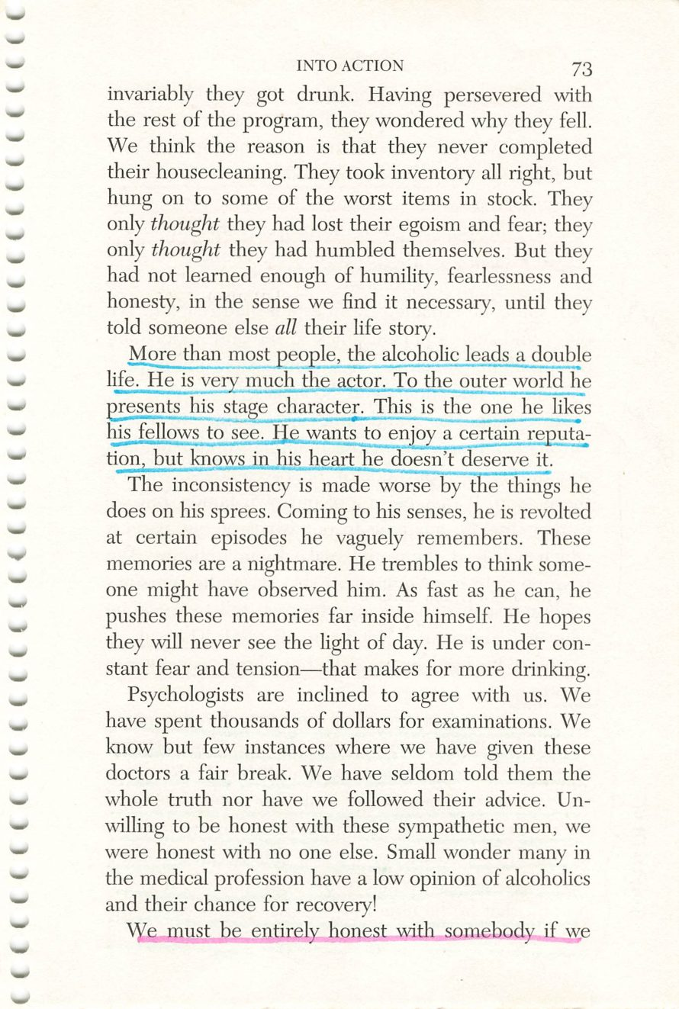
Copyright © Alcoholics Anonymous World Services, Inc. All rights reserved. Intended for personal use only, and not to be reproduced further or distributed for resale.
73

Slide 4
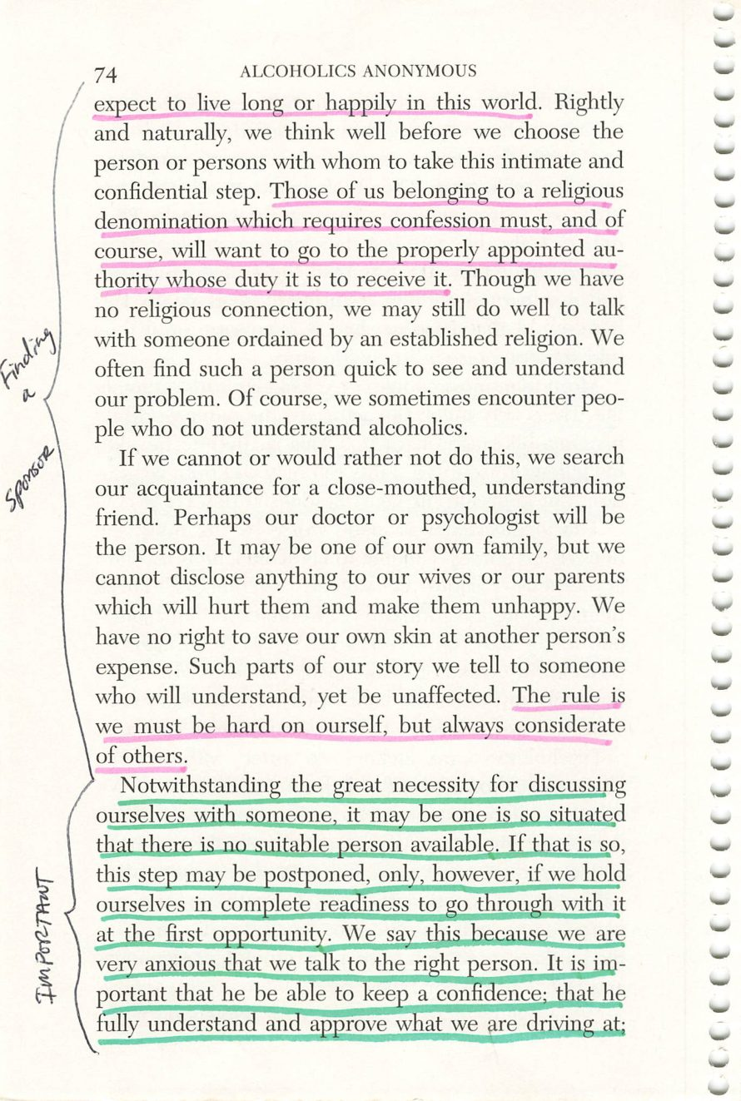
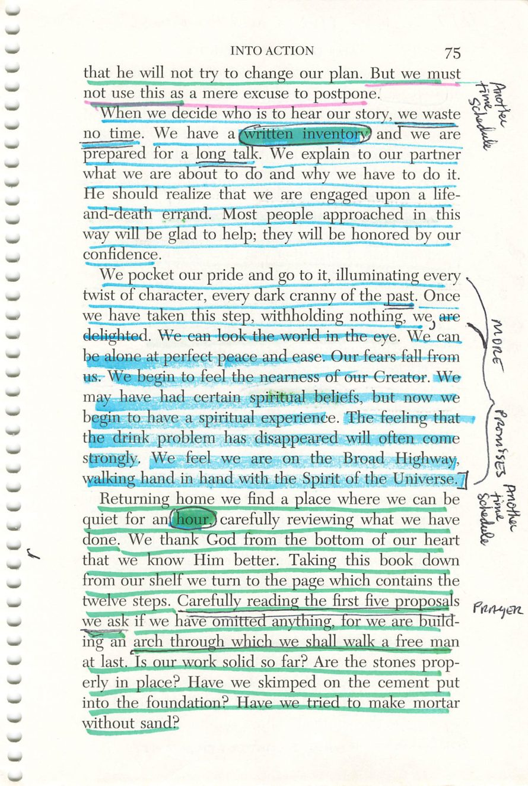
74
75
Copyright © Alcoholics Anonymous World Services, Inc. All rights reserved. Intended for personal use only, and not to be reproduced further or distributed for resale.

Slide 5
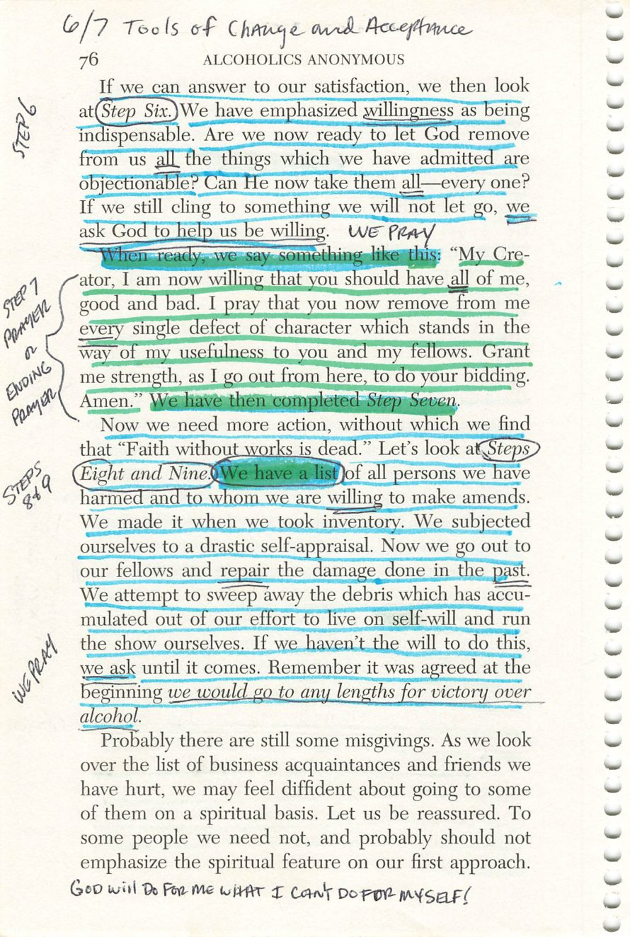
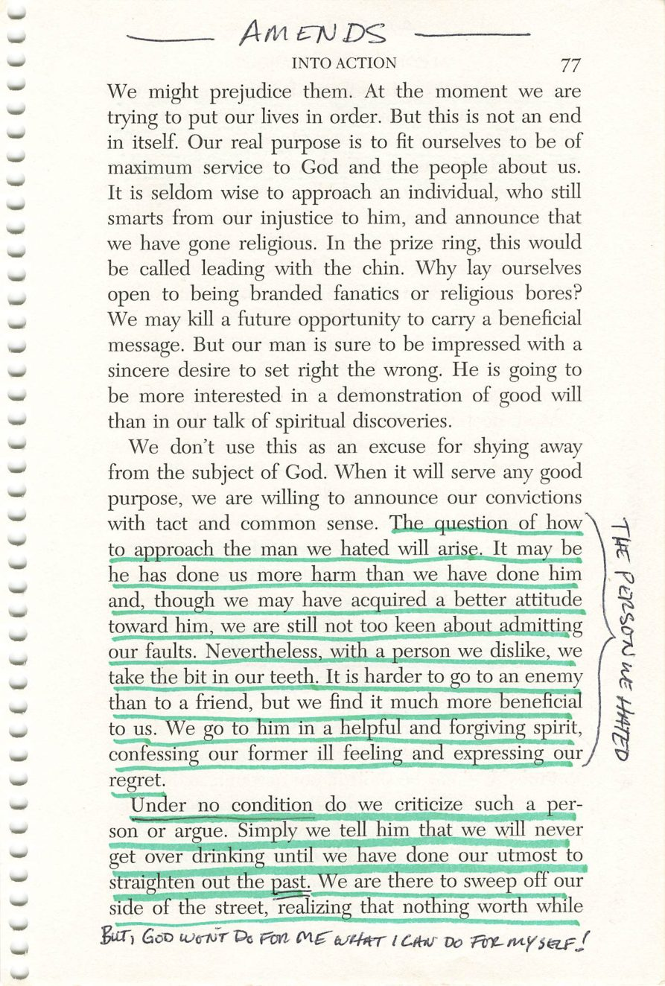
76
77
Copyright © Alcoholics Anonymous World Services, Inc. All rights reserved. Intended for personal use only, and not to be reproduced further or distributed for resale.

Slide 6
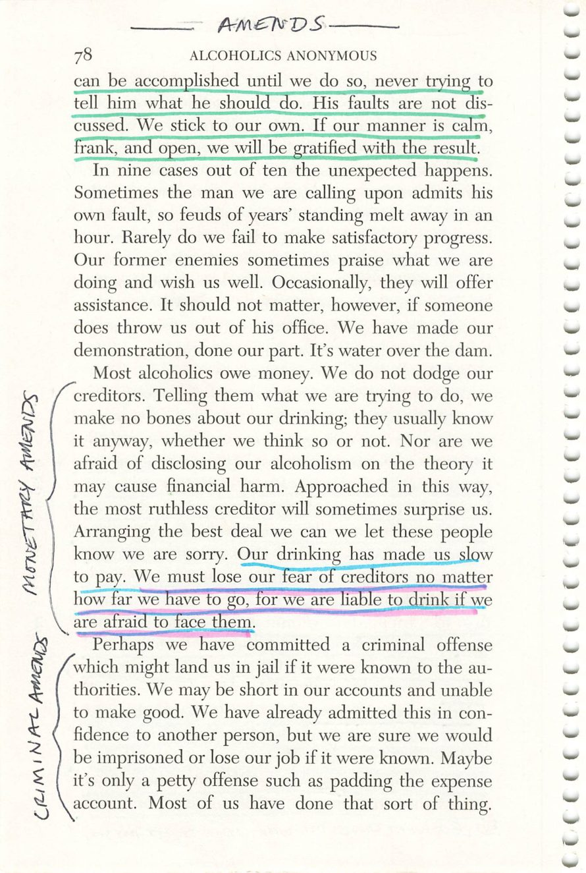
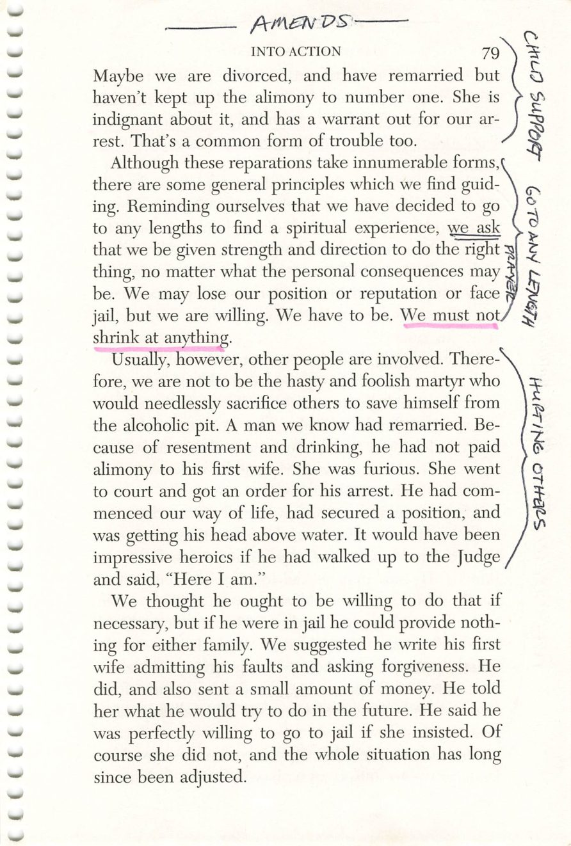
78
79
Copyright © Alcoholics Anonymous World Services, Inc. All rights reserved. Intended for personal use only, and not to be reproduced further or distributed for resale.

Slide 7
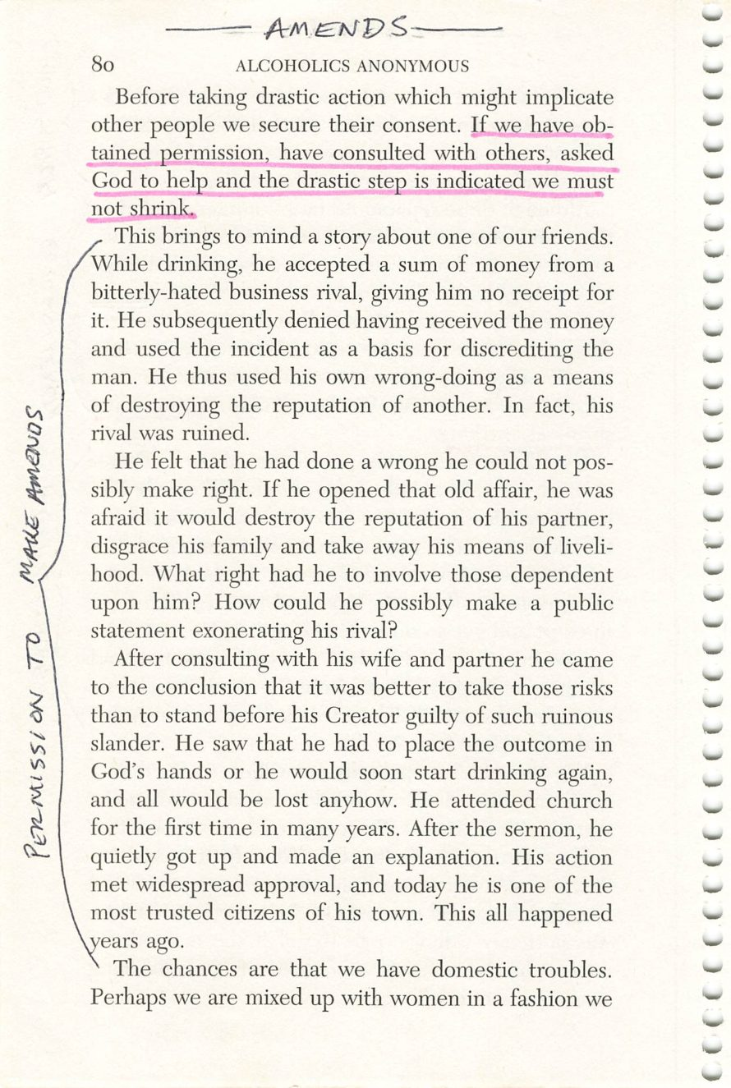
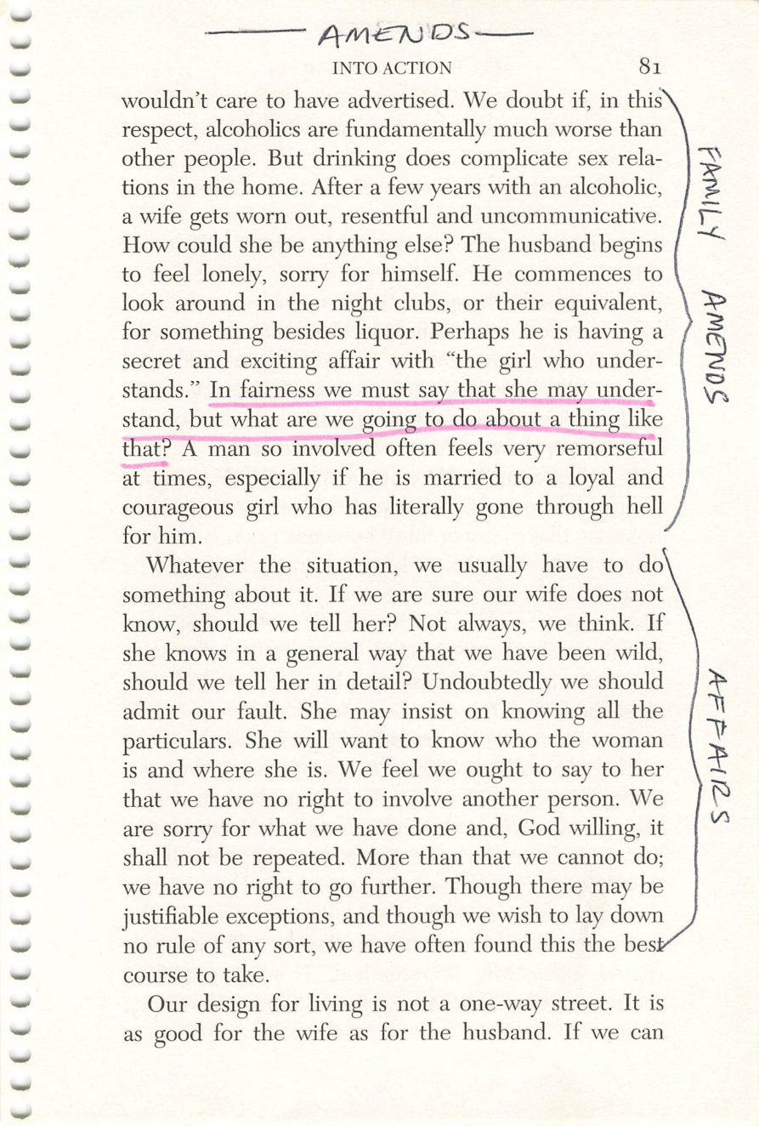
80
81
Copyright © Alcoholics Anonymous World Services, Inc. All rights reserved. Intended for personal use only, and not to be reproduced further or distributed for resale.

Slide 8
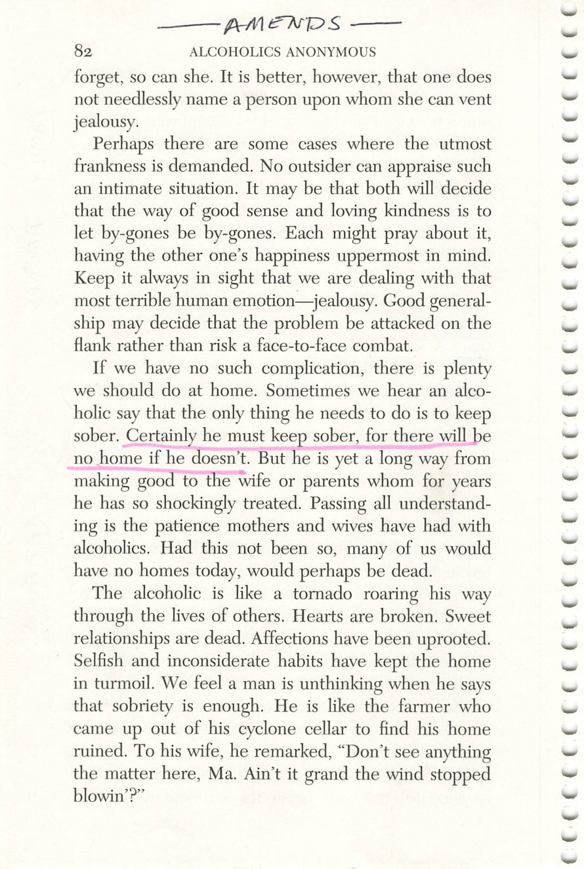
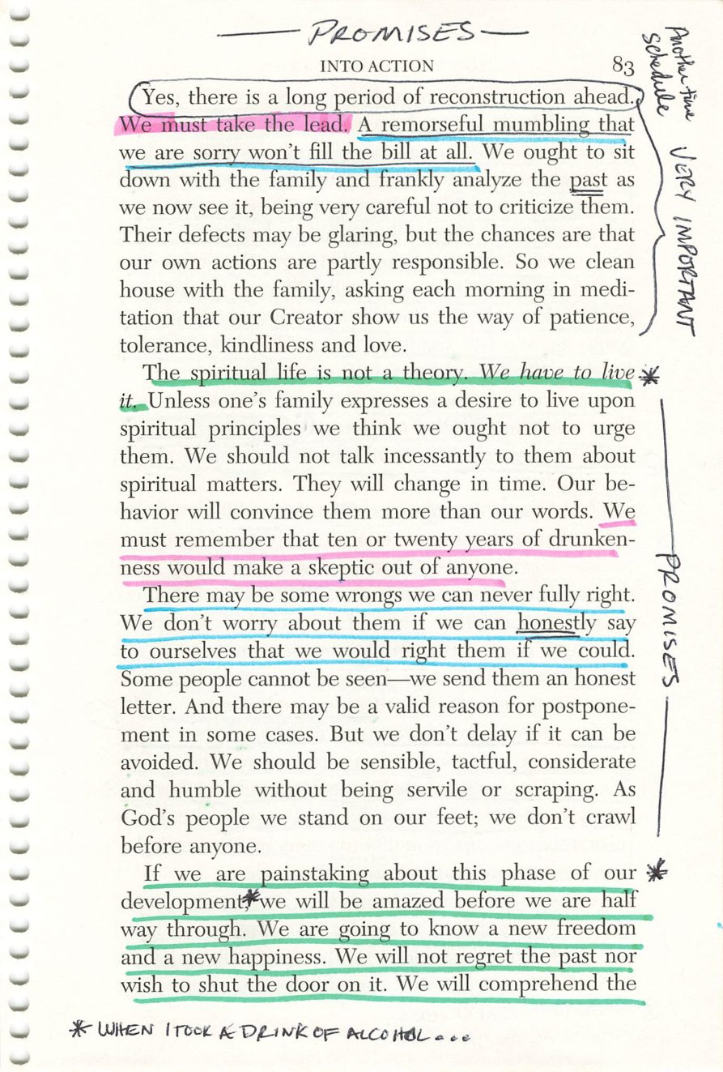
82
83
Copyright © Alcoholics Anonymous World Services, Inc. All rights reserved. Intended for personal use only, and not to be reproduced further or distributed for resale.

Slide 9
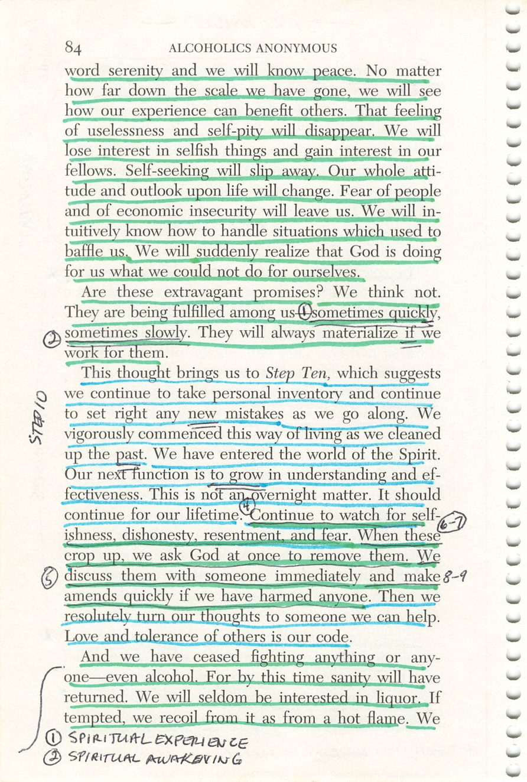
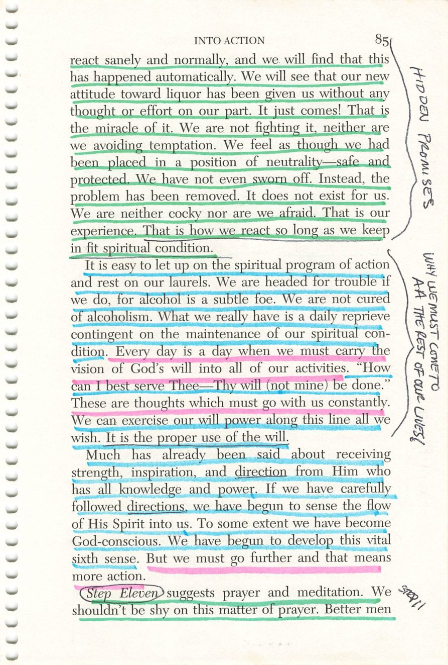
84
85
Copyright © Alcoholics Anonymous World Services, Inc. All rights reserved. Intended for personal use only, and not to be reproduced further or distributed for resale.

Slide 10
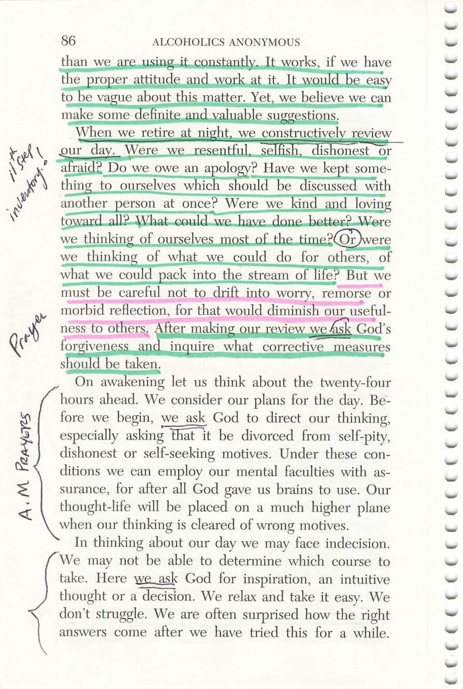
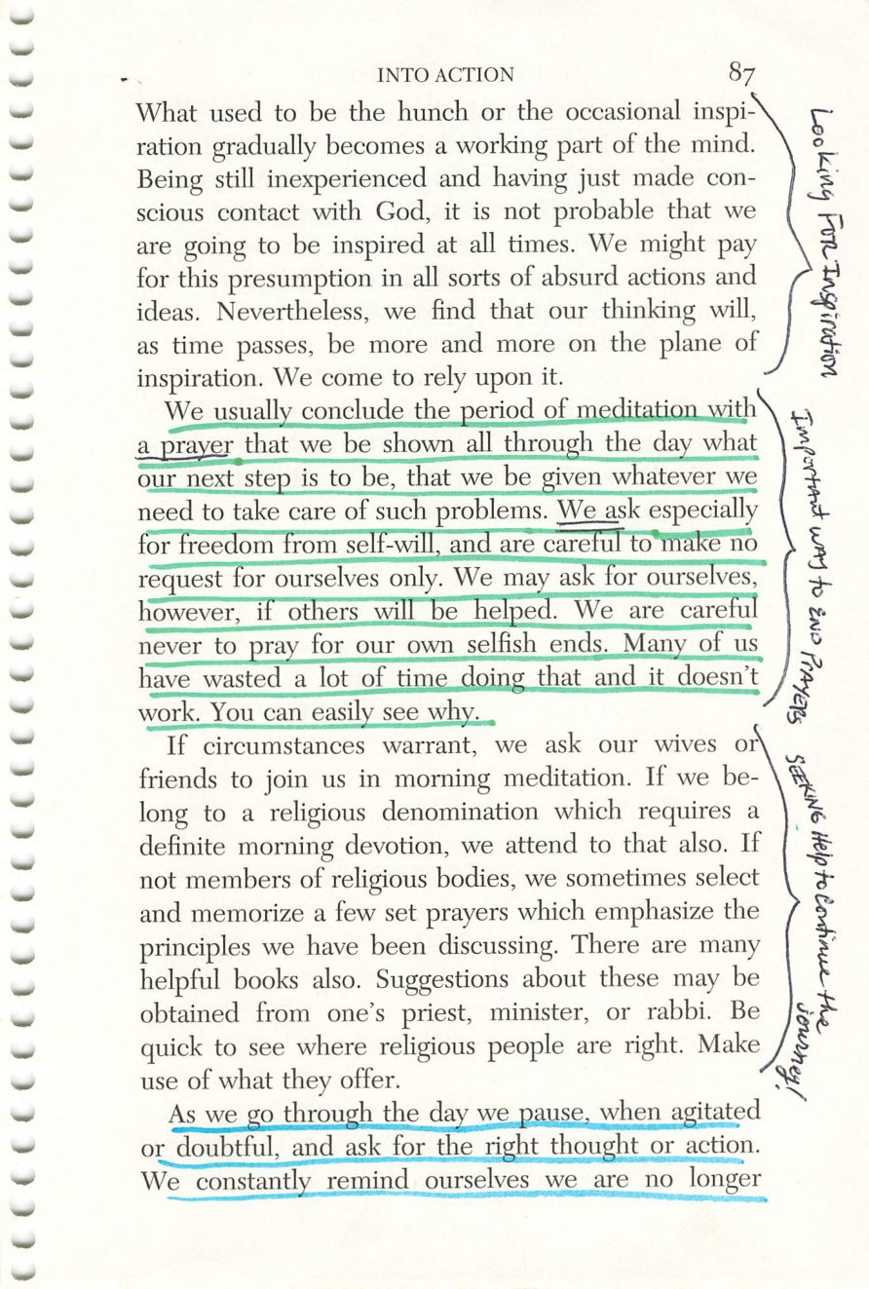
86
87
Copyright © Alcoholics Anonymous World Services, Inc. All rights reserved. Intended for personal use only, and not to be reproduced further or distributed for resale.

Slide 11
Eleventh Step Inventory
Page 86
HANDOUT
Handout.
Drop the image into this frame in PowerPoint.
Credit:

Slide 12
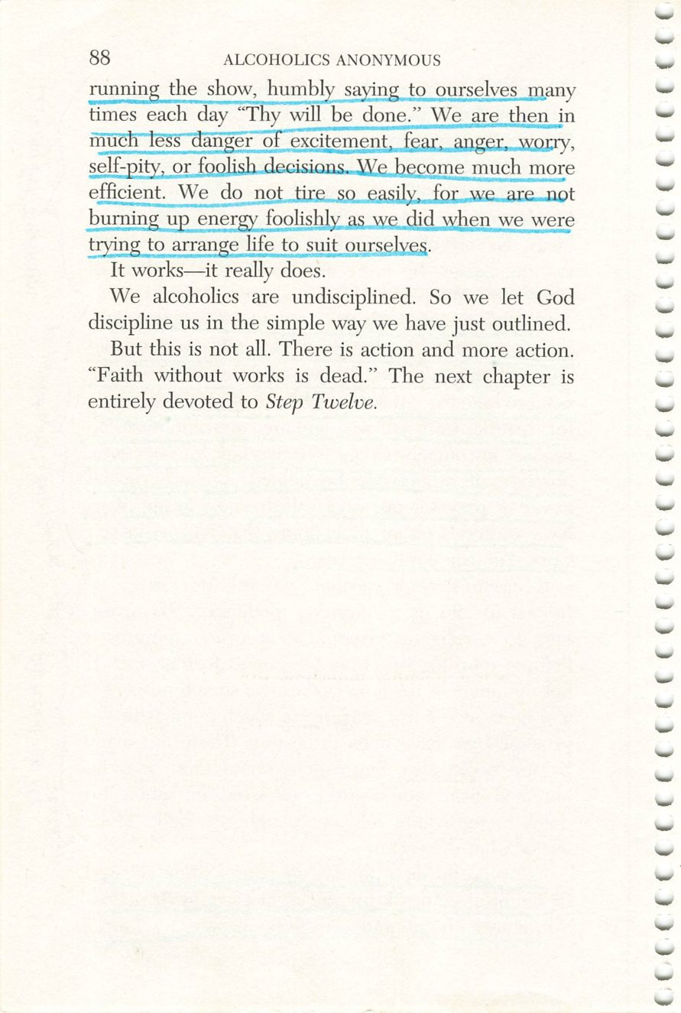
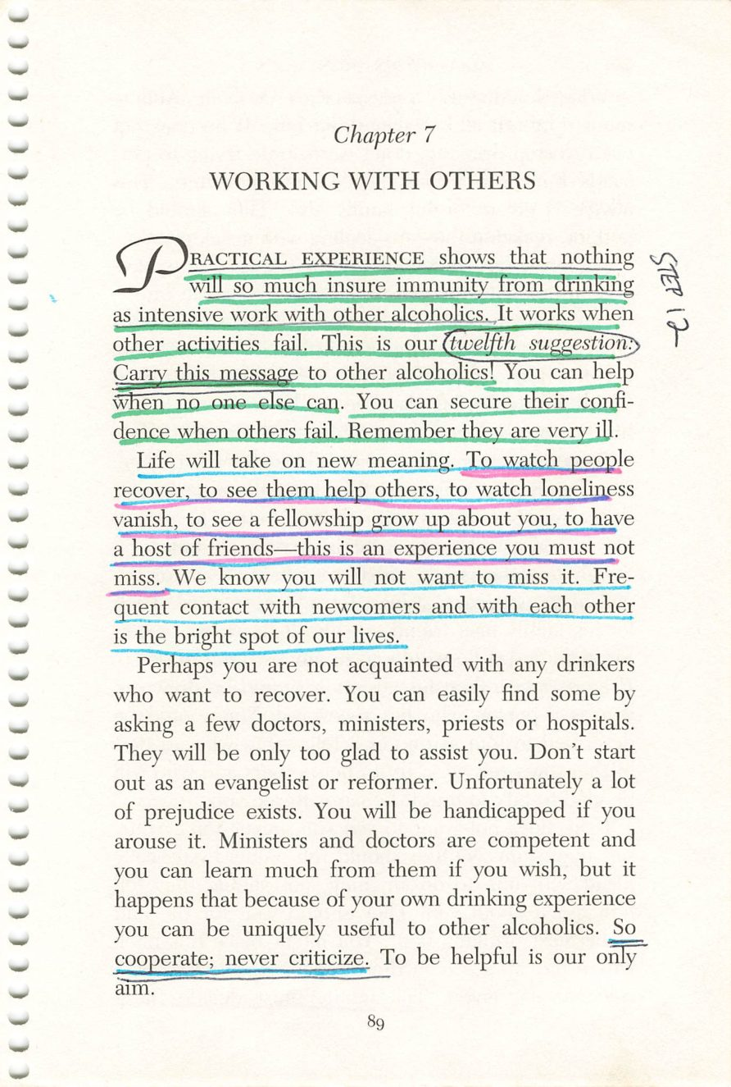
88
89
Copyright © Alcoholics Anonymous World Services, Inc. All rights reserved. Intended for personal use only, and not to be reproduced further or distributed for resale.

Slide 13
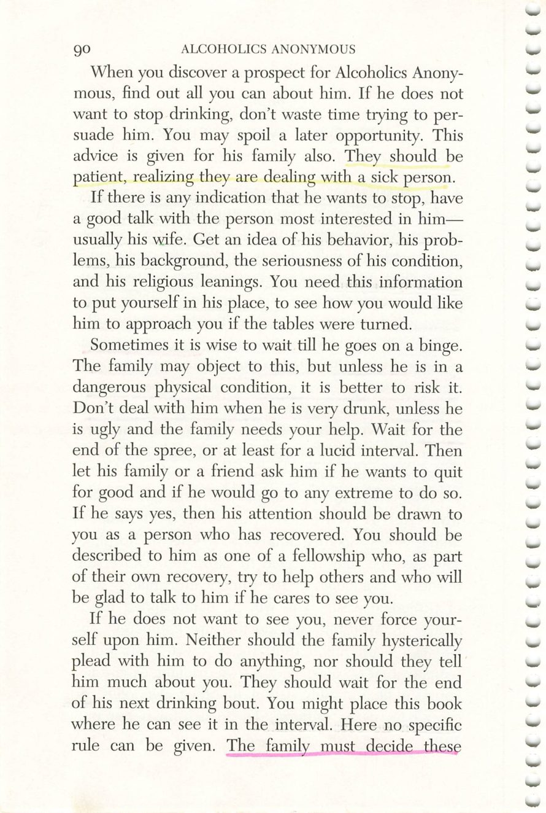
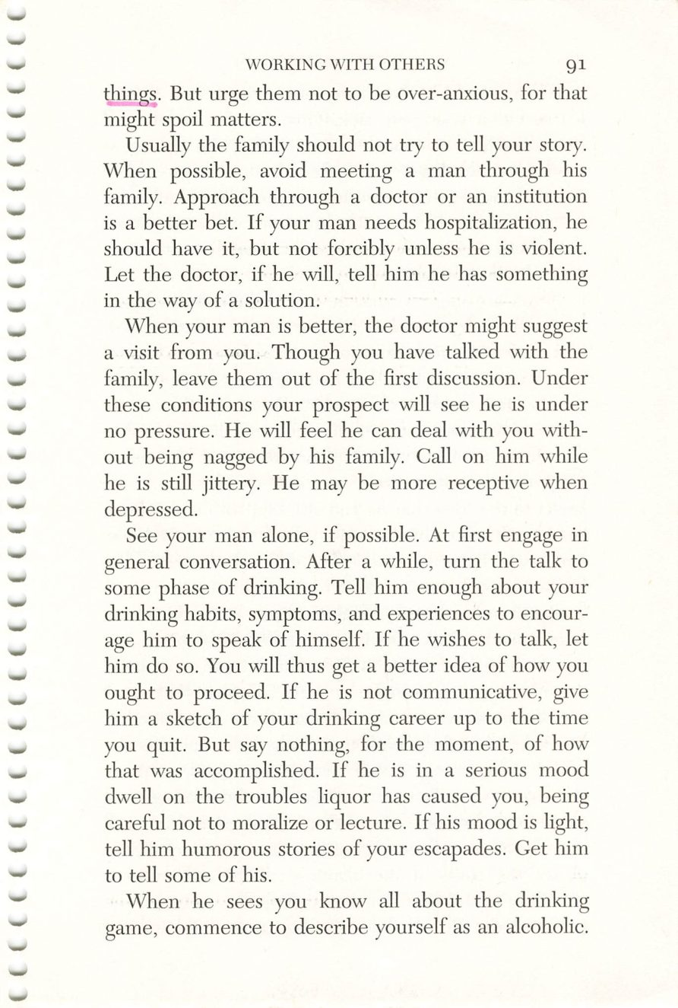
90
91
Copyright © Alcoholics Anonymous World Services, Inc. All rights reserved. Intended for personal use only, and not to be reproduced further or distributed for resale.

Slide 14
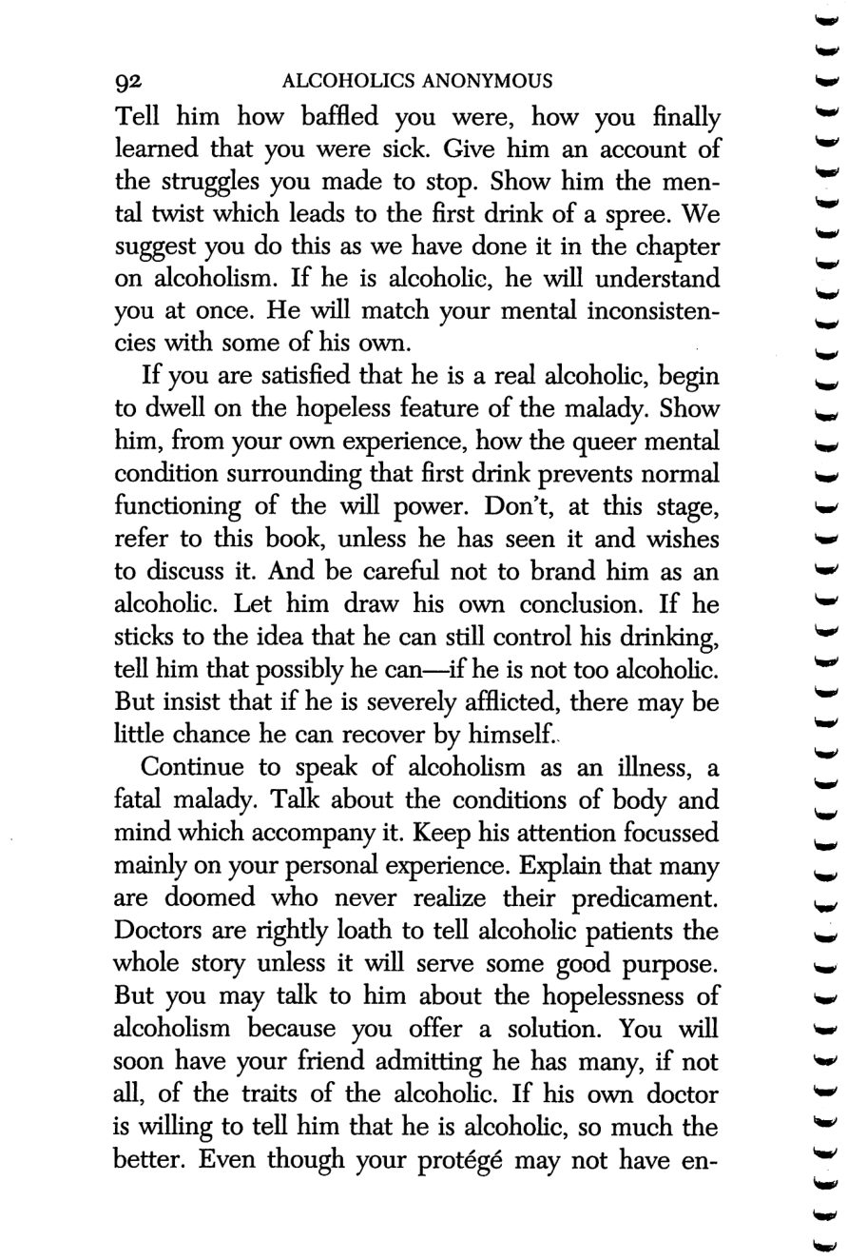
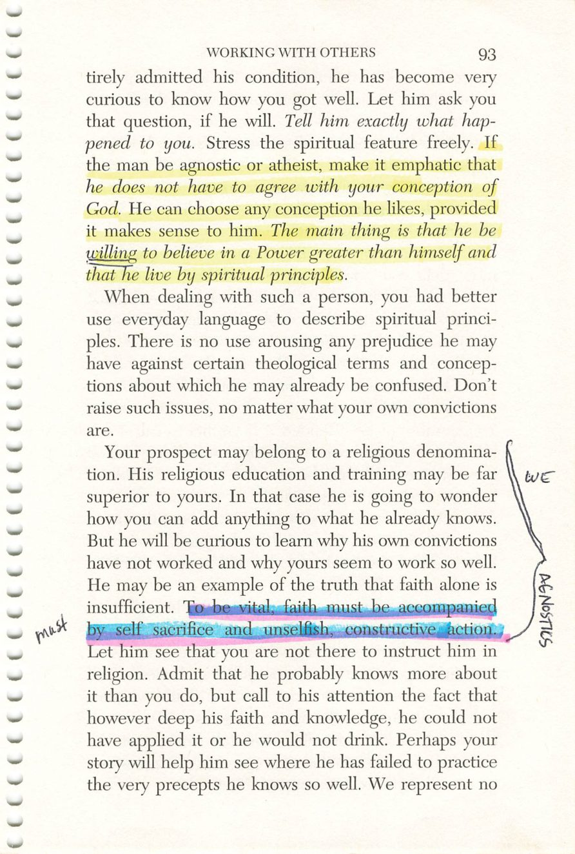
92
93
Copyright © Alcoholics Anonymous World Services, Inc. All rights reserved. Intended for personal use only, and not to be reproduced further or distributed for resale.

Slide 15
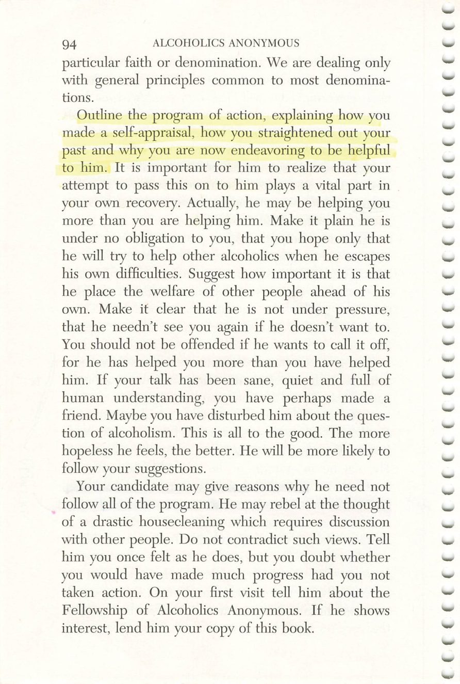
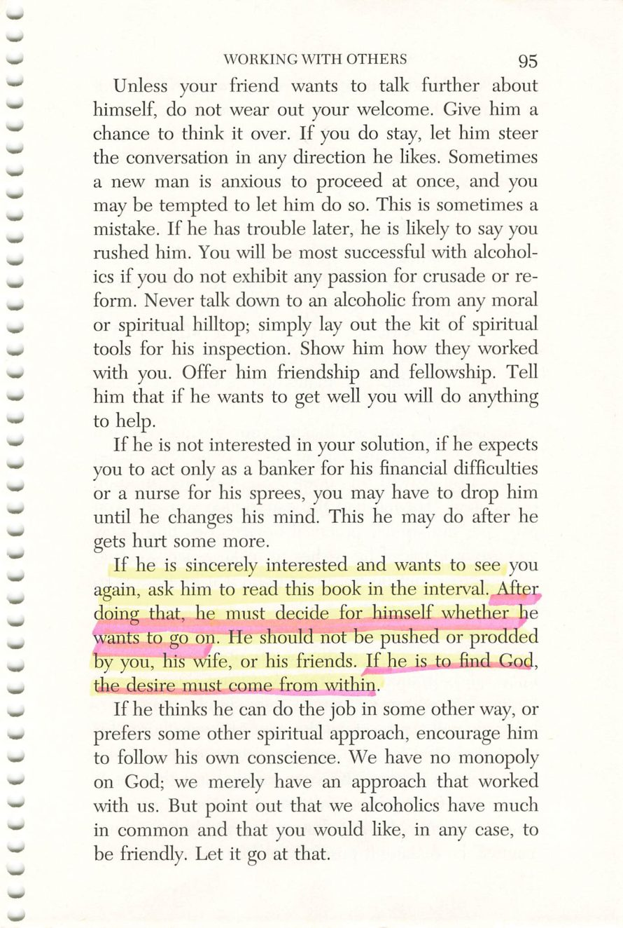
94
95
Copyright © Alcoholics Anonymous World Services, Inc. All rights reserved. Intended for personal use only, and not to be reproduced further or distributed for resale.

Slide 16
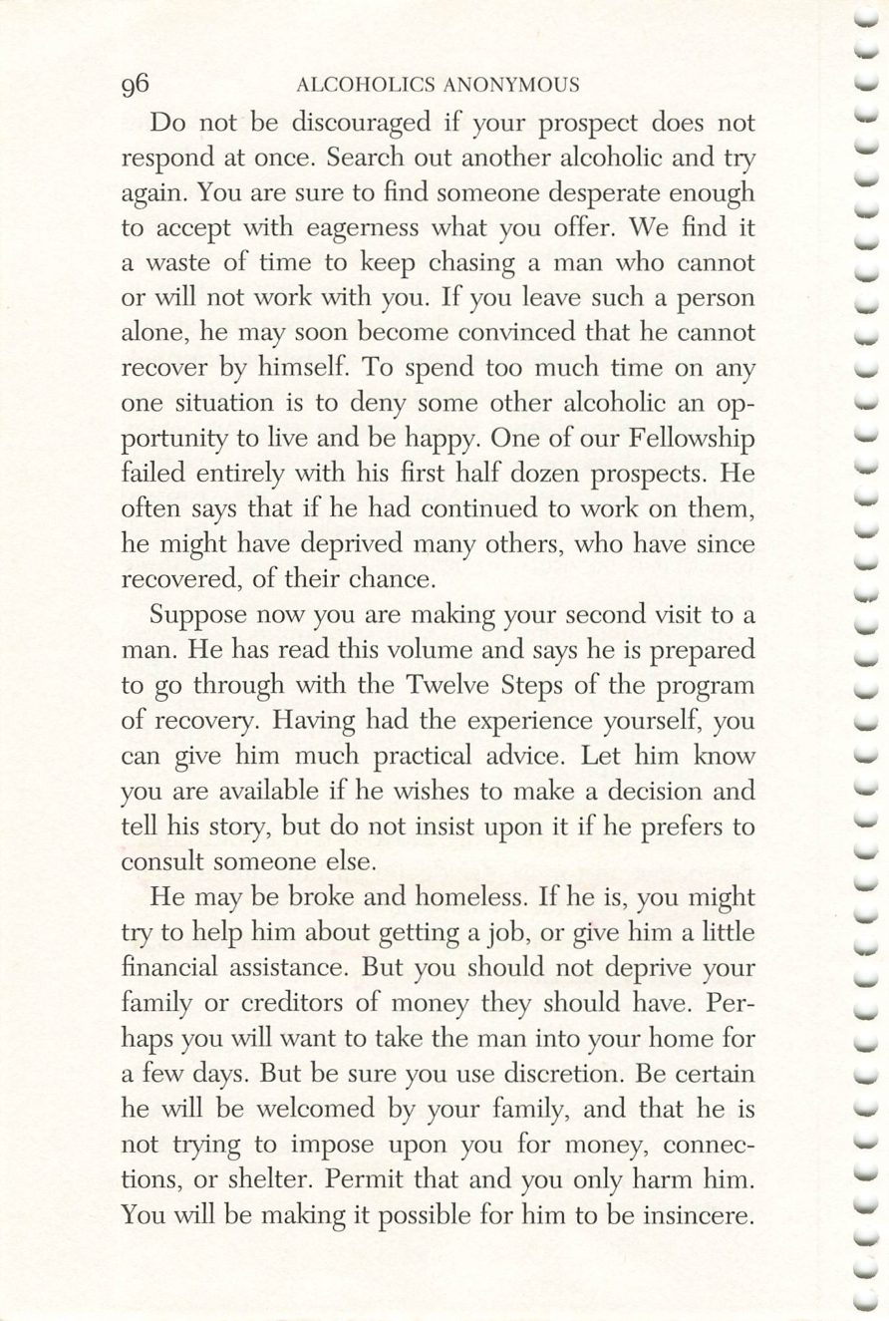
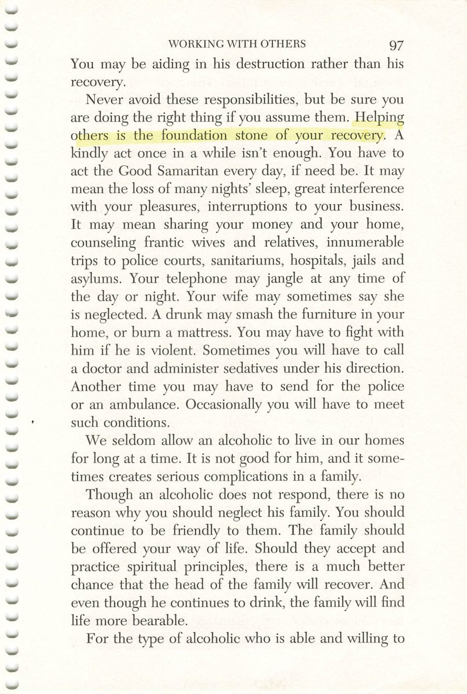
96
97
Copyright © Alcoholics Anonymous World Services, Inc. All rights reserved. Intended for personal use only, and not to be reproduced further or distributed for resale.

Slide 17
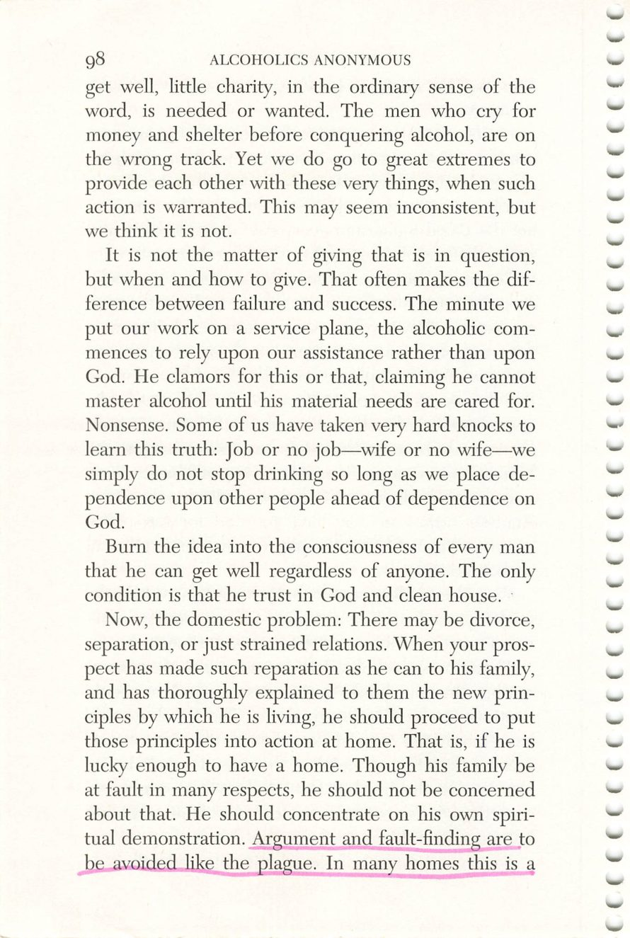
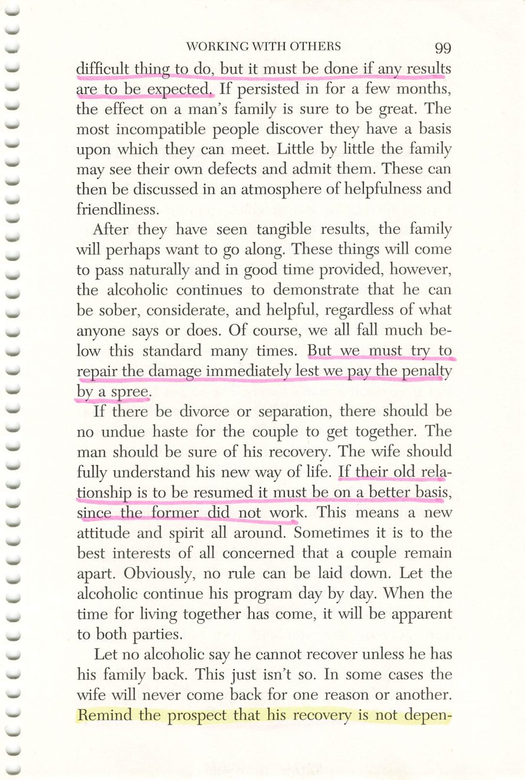
98
99
Copyright © Alcoholics Anonymous World Services, Inc. All rights reserved. Intended for personal use only, and not to be reproduced further or distributed for resale.

Slide 18
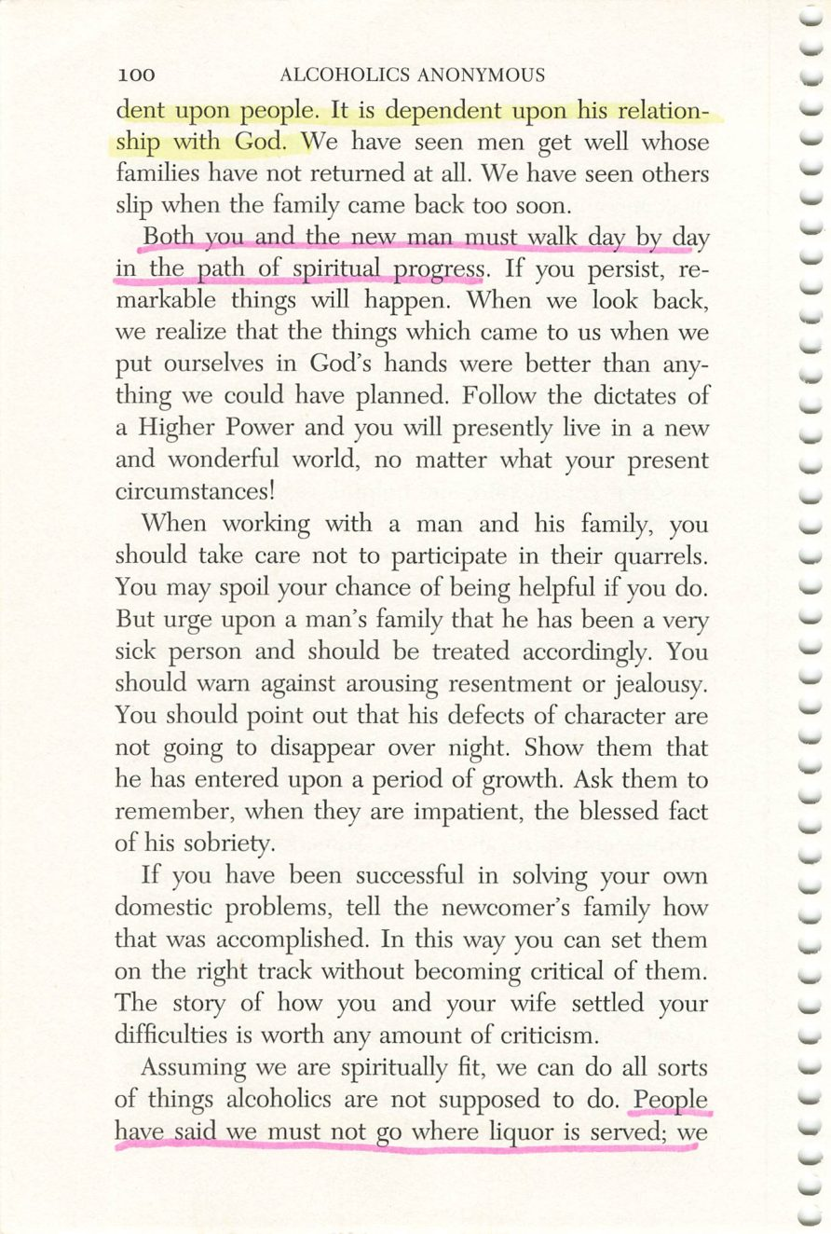
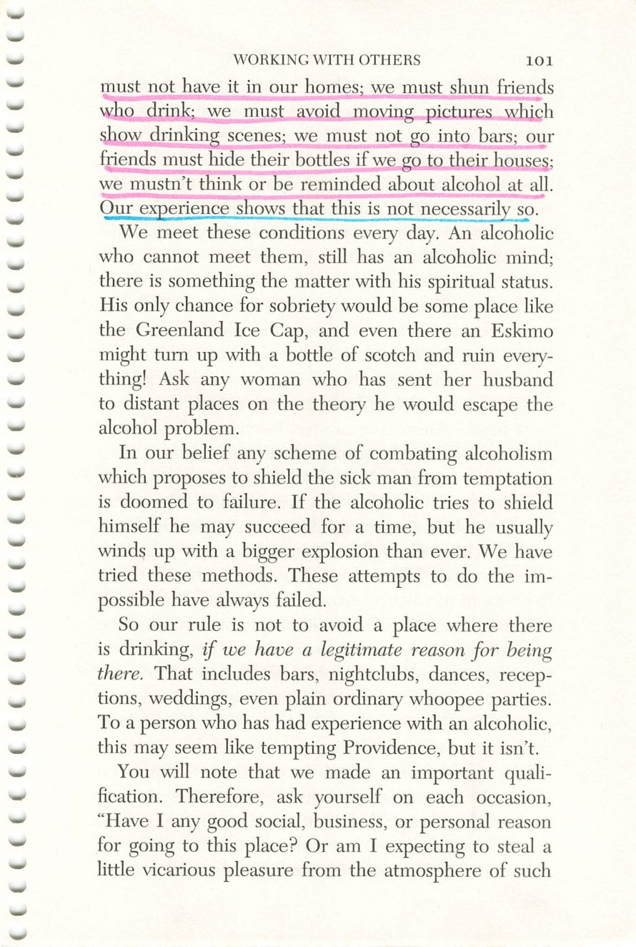
100
101
Copyright © Alcoholics Anonymous World Services, Inc. All rights reserved. Intended for personal use only, and not to be reproduced further or distributed for resale.

Slide 19
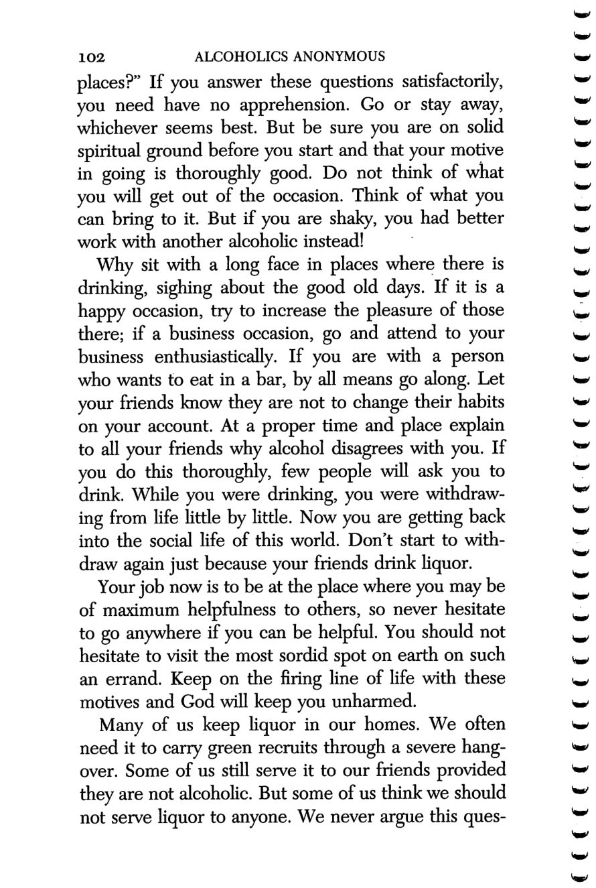
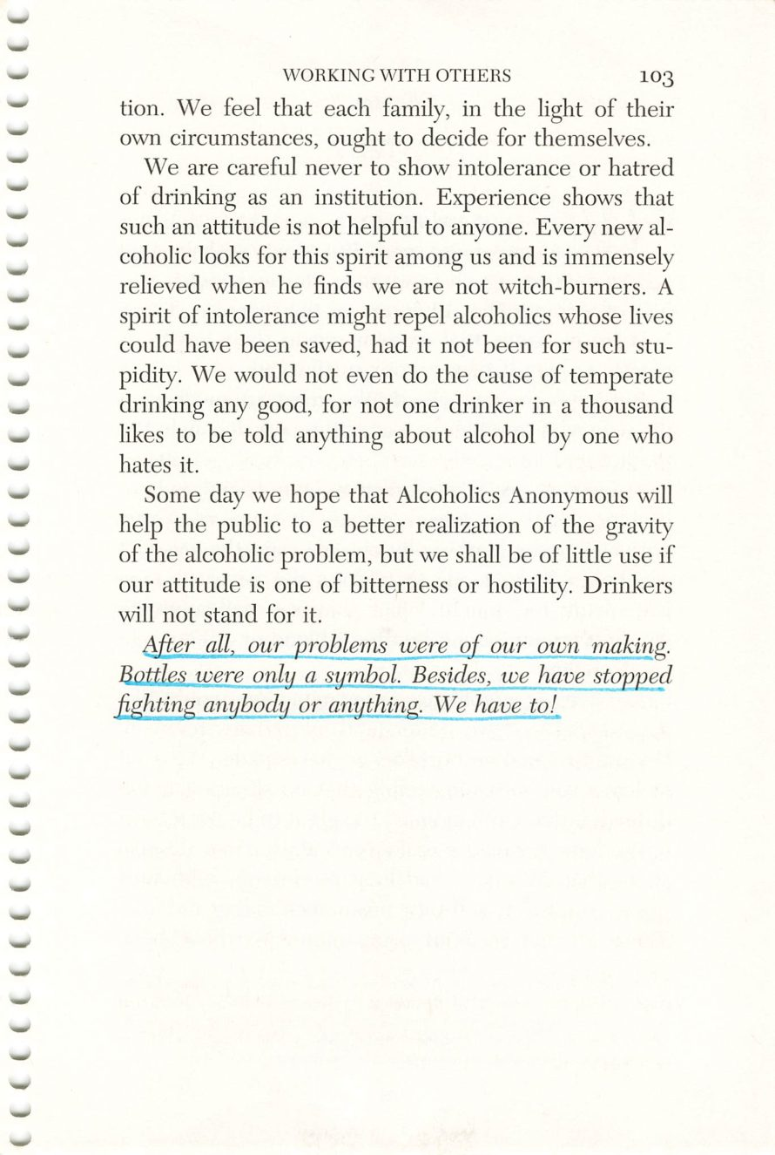
102
103
Copyright © Alcoholics Anonymous World Services, Inc. All rights reserved. Intended for personal use only, and not to be reproduced further or distributed for resale.

Slide 20
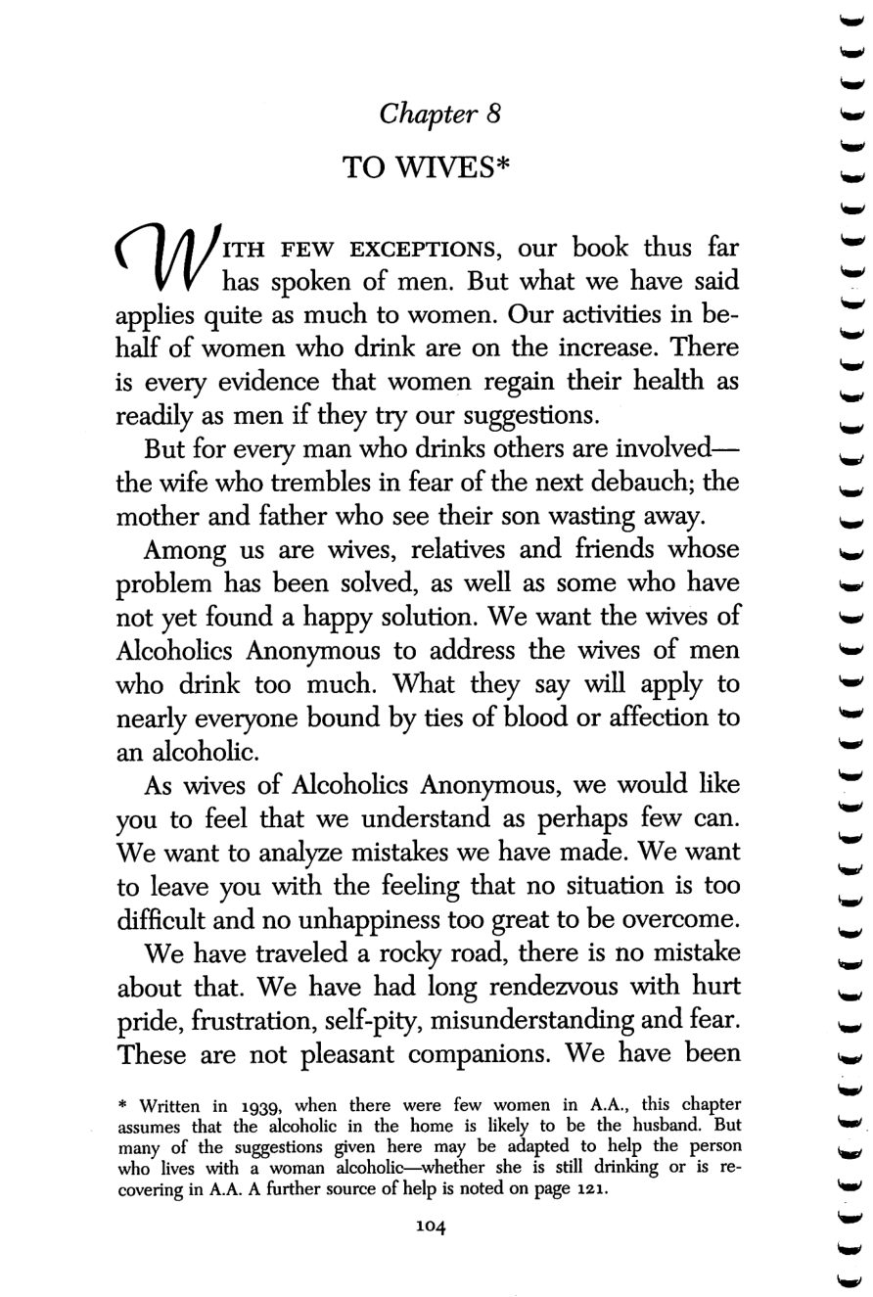
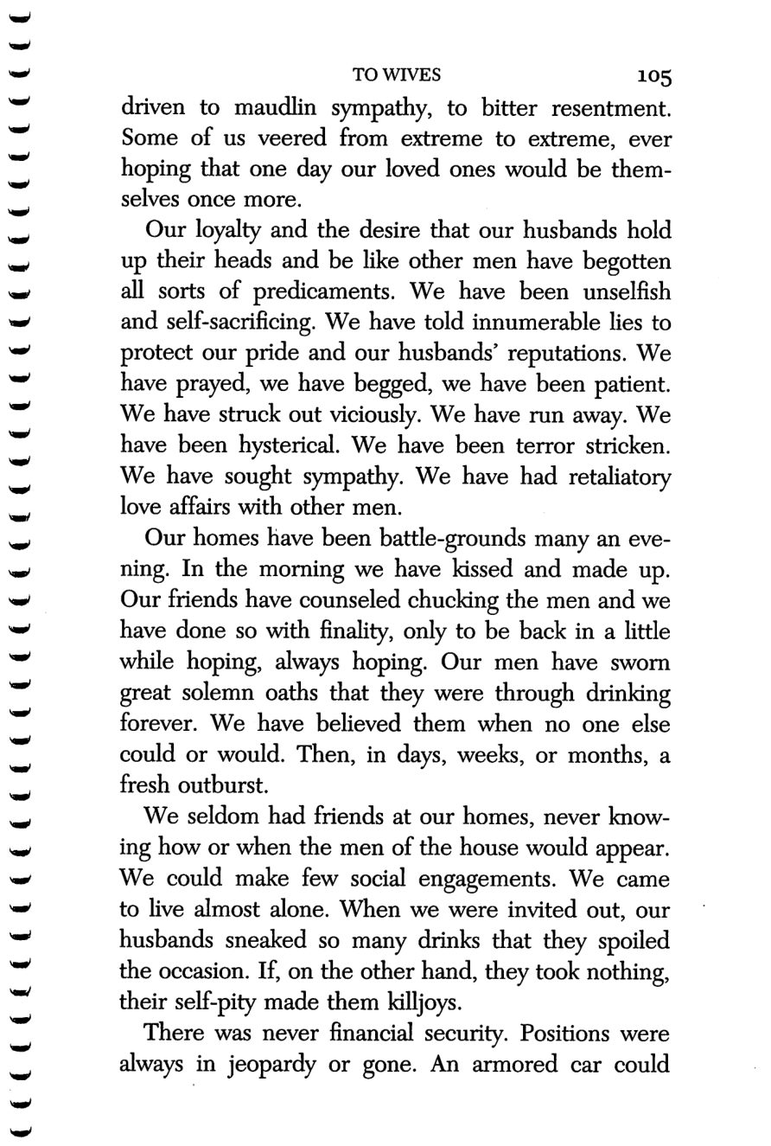
104
105
Copyright © Alcoholics Anonymous World Services, Inc. All rights reserved. Intended for personal use only, and not to be reproduced further or distributed for resale.

Slide 21
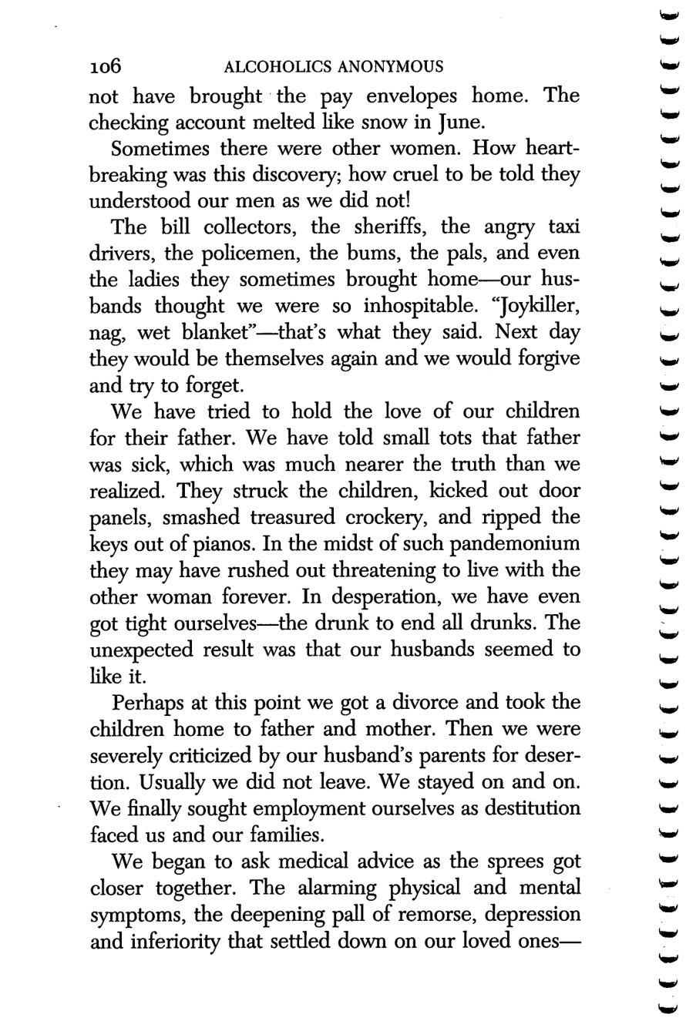
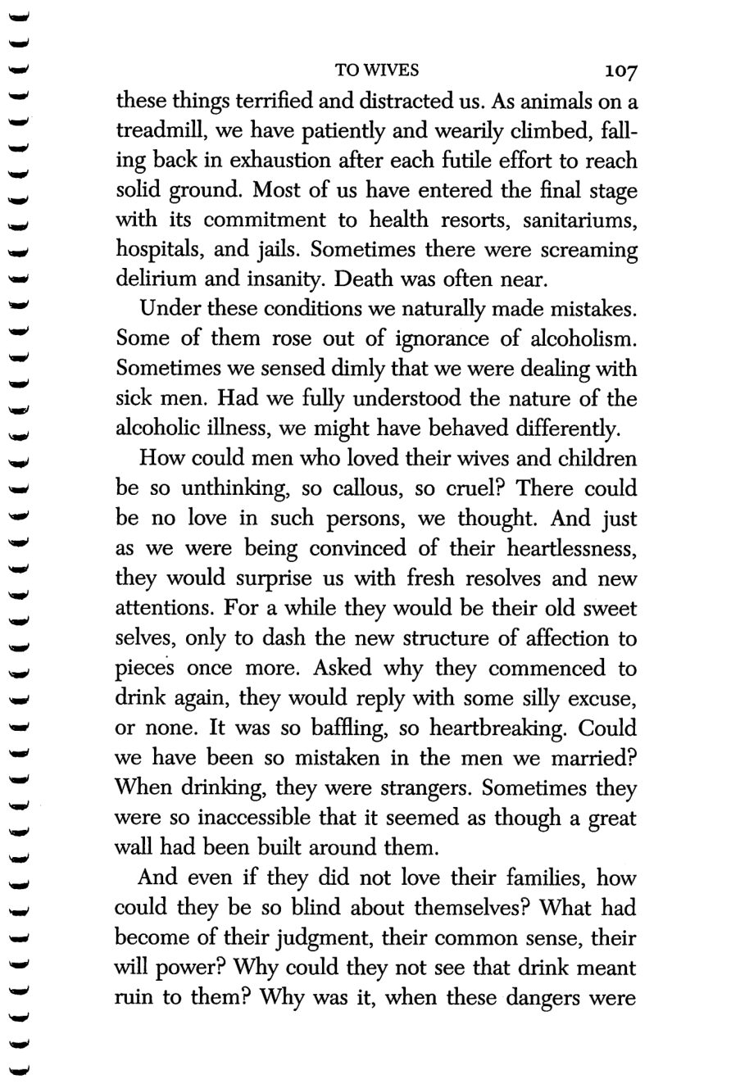
106
107
Copyright © Alcoholics Anonymous World Services, Inc. All rights reserved. Intended for personal use only, and not to be reproduced further or distributed for resale.

Slide 22
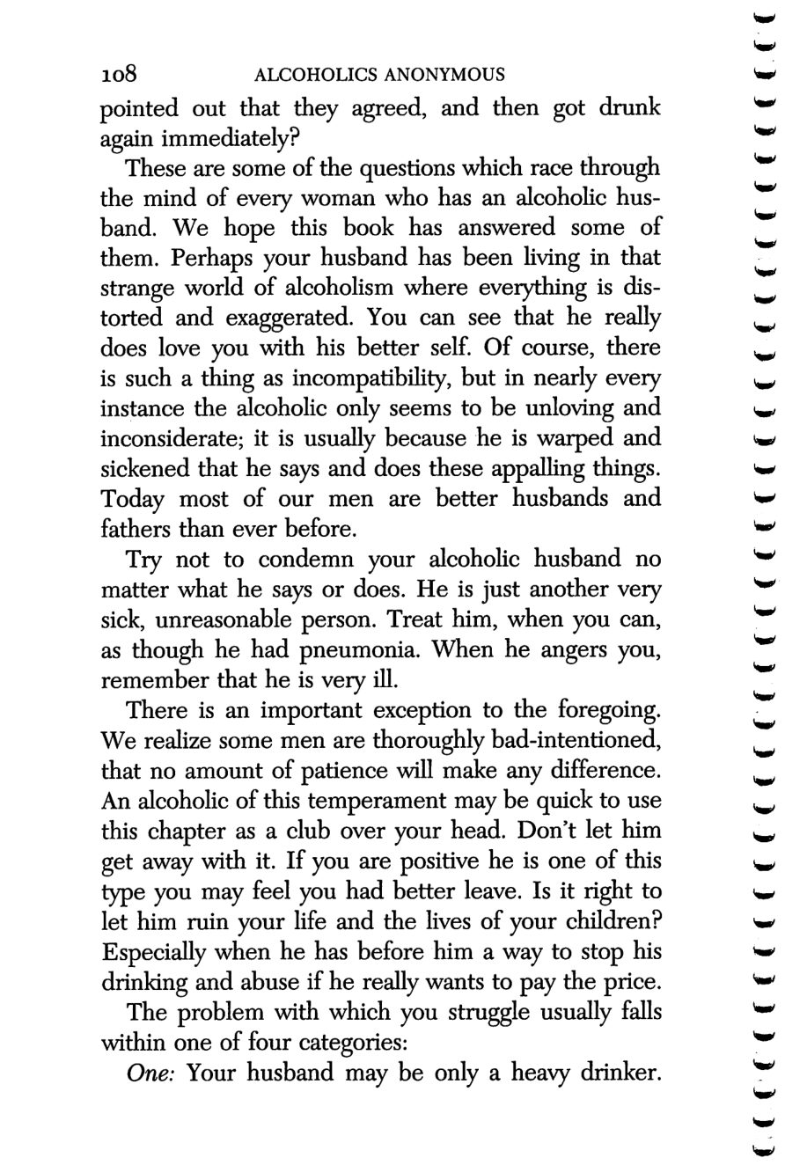
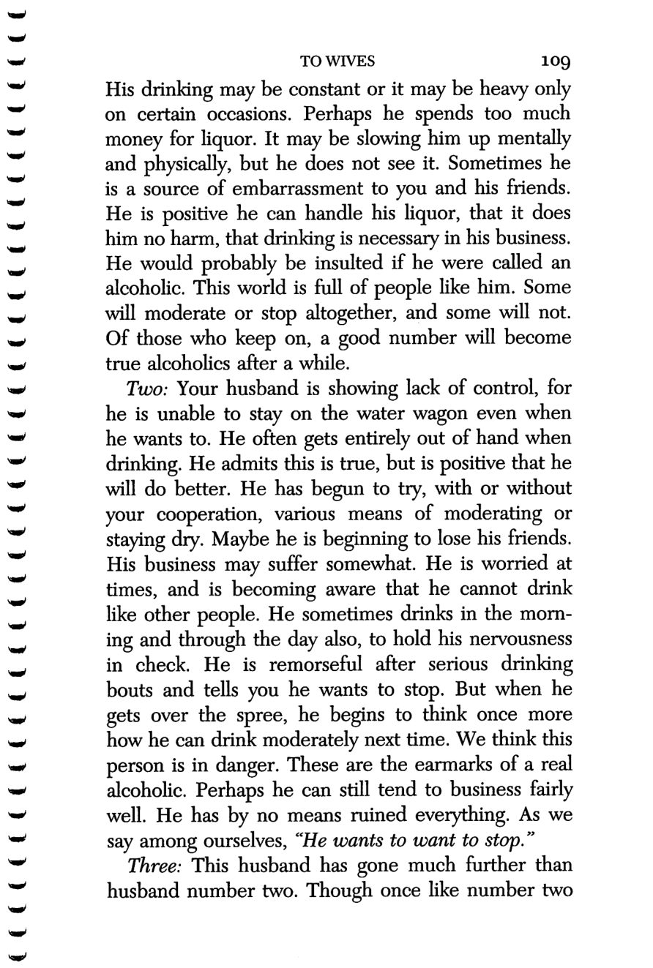
108
109
Copyright © Alcoholics Anonymous World Services, Inc. All rights reserved. Intended for personal use only, and not to be reproduced further or distributed for resale.

Slide 23
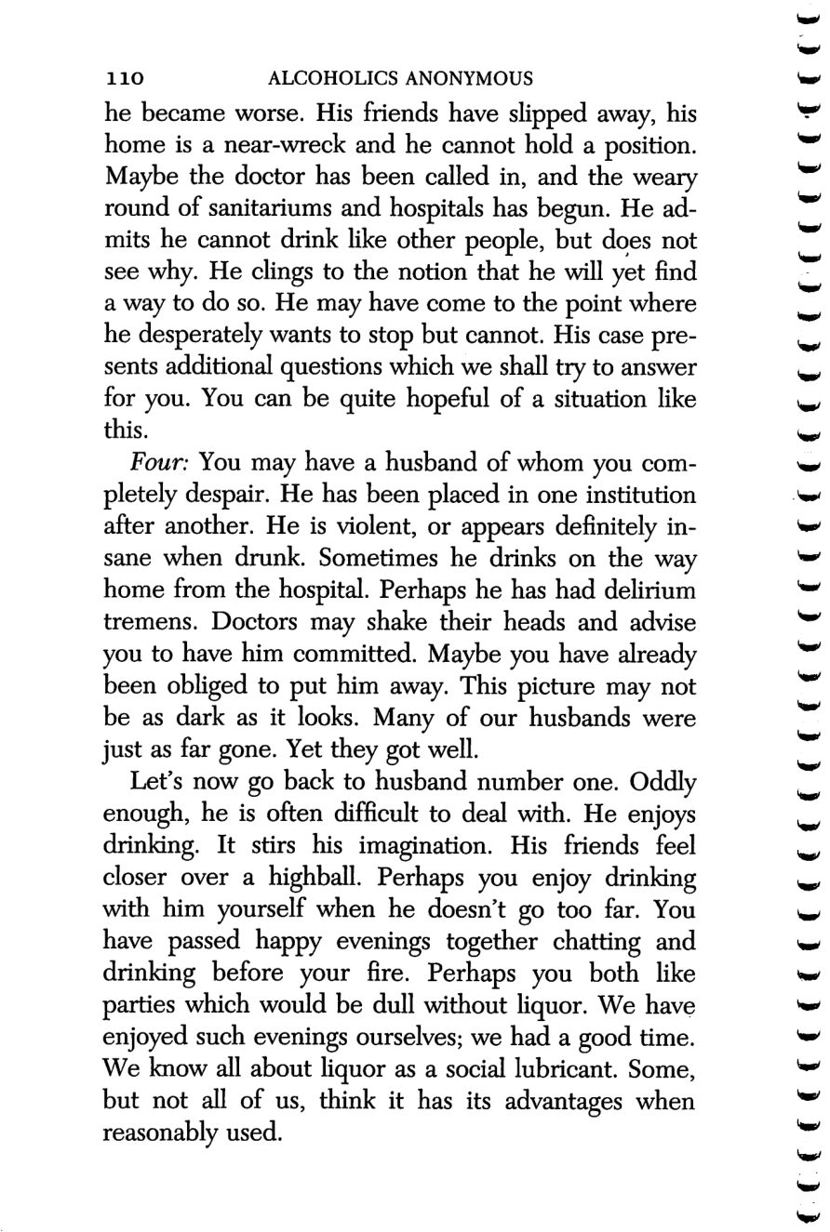
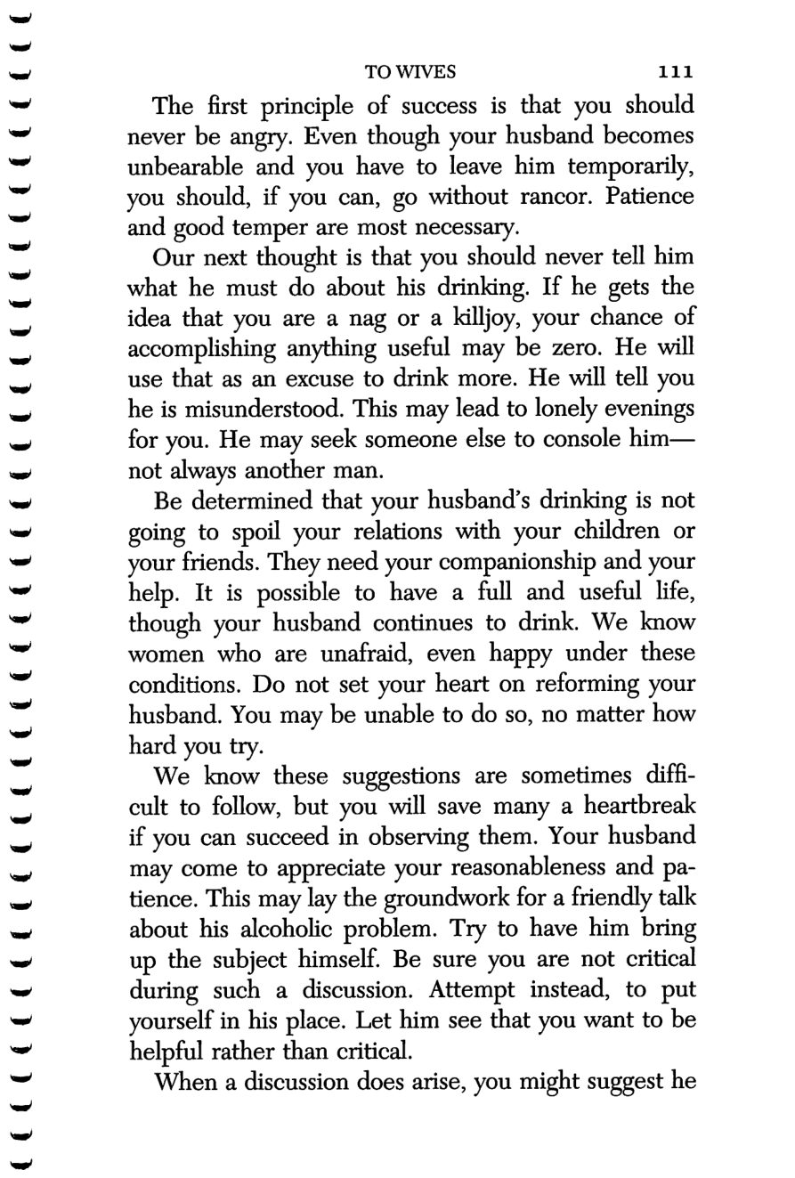
110
111
Copyright © Alcoholics Anonymous World Services, Inc. All rights reserved. Intended for personal use only, and not to be reproduced further or distributed for resale.

Slide 24
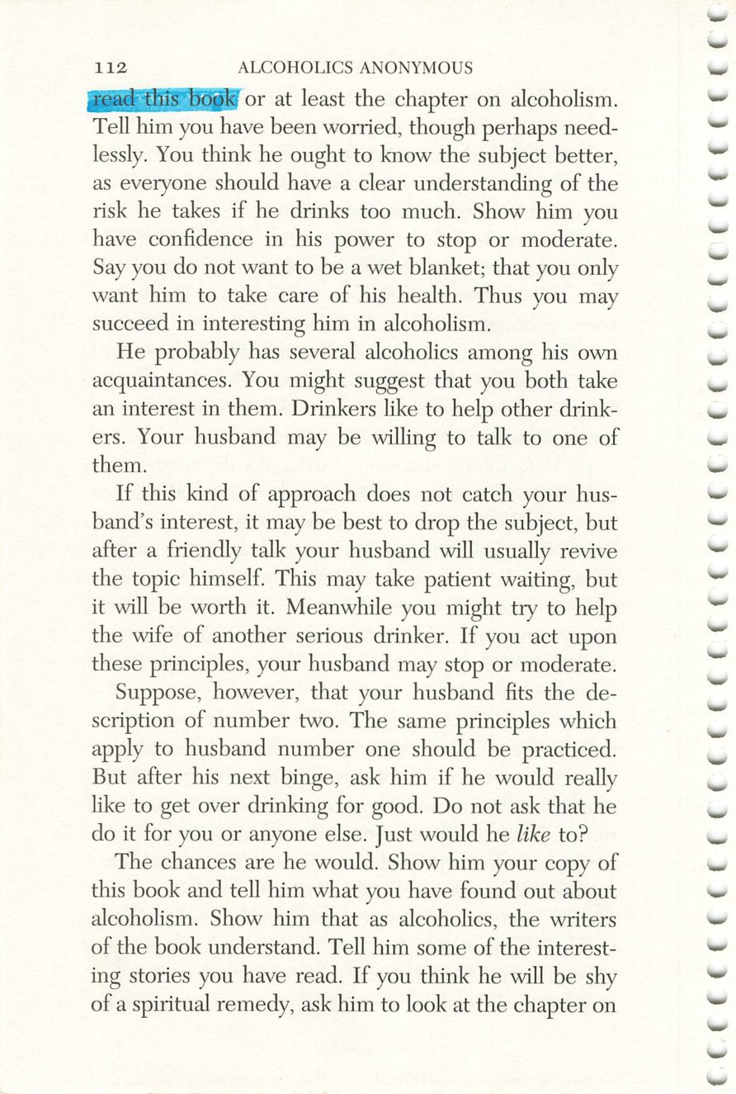
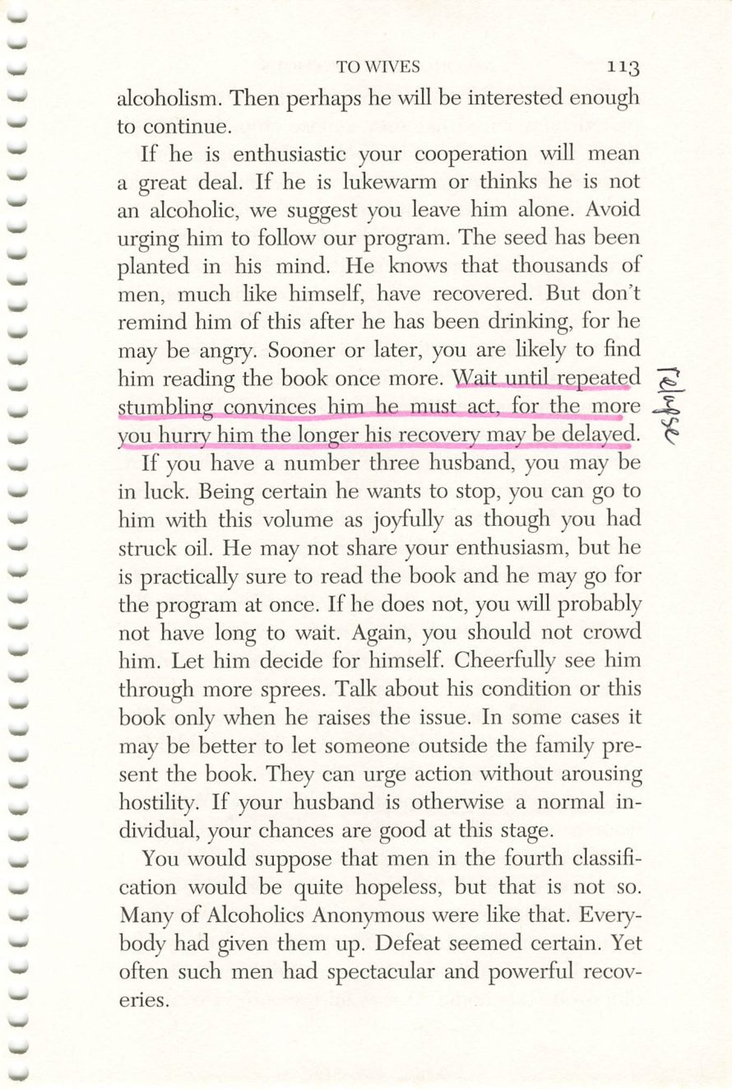
112
113
Copyright © Alcoholics Anonymous World Services, Inc. All rights reserved. Intended for personal use only, and not to be reproduced further or distributed for resale.

Slide 25
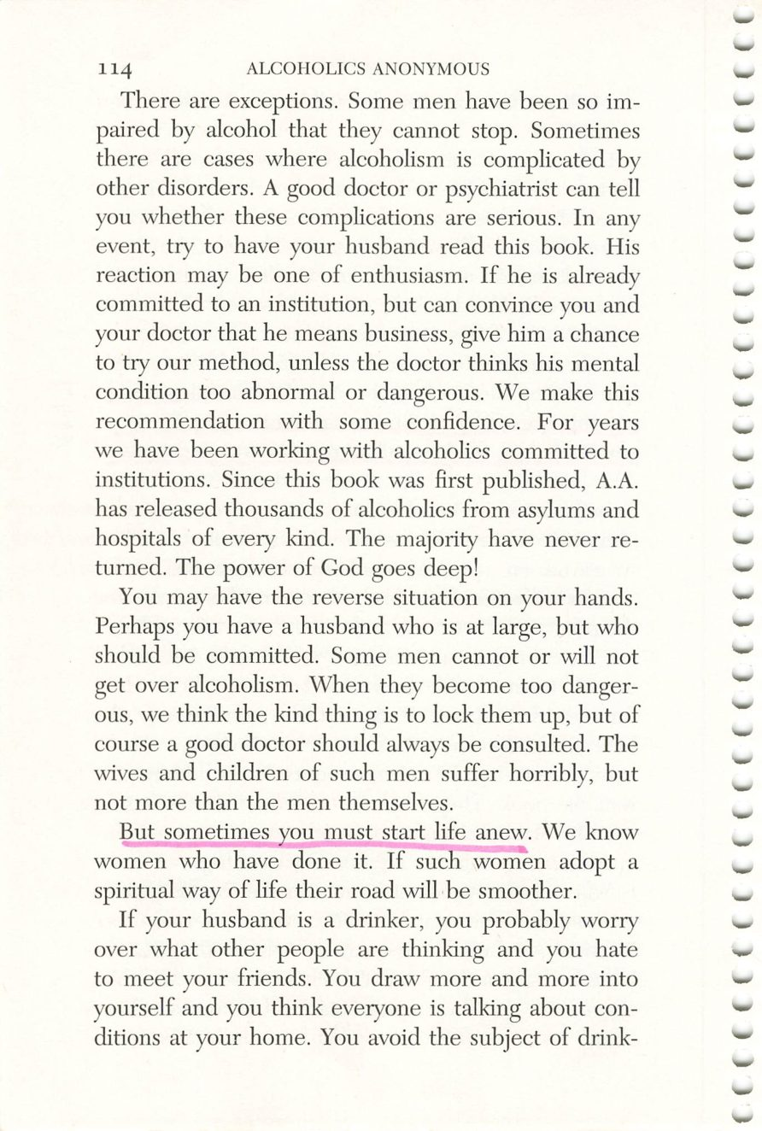
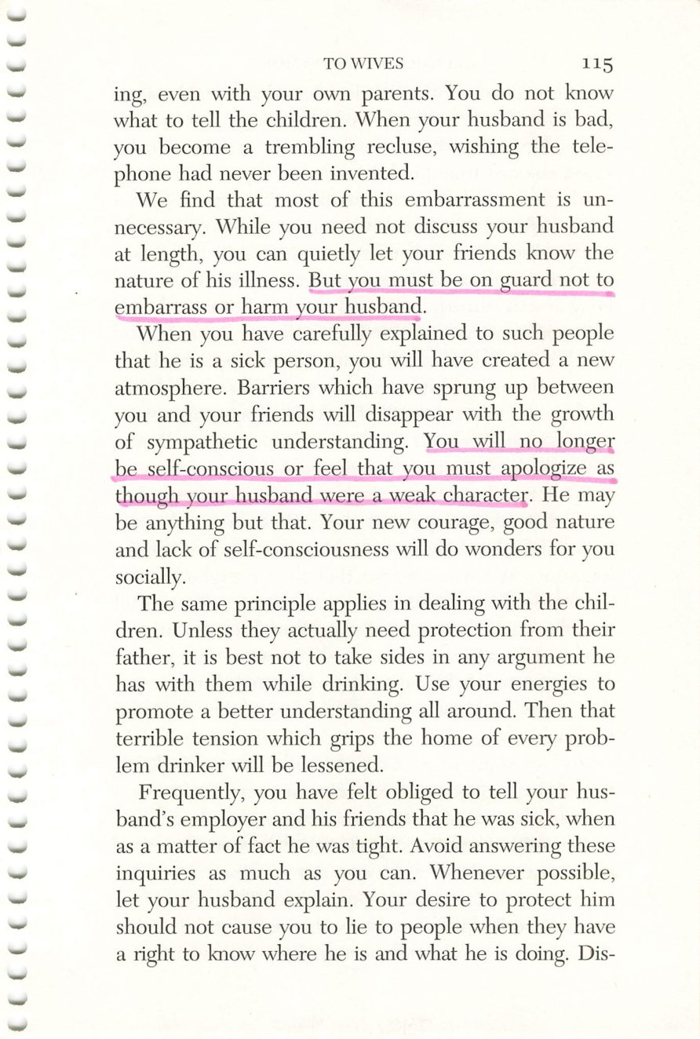
114
115
Copyright © Alcoholics Anonymous World Services, Inc. All rights reserved. Intended for personal use only, and not to be reproduced further or distributed for resale.

Slide 26
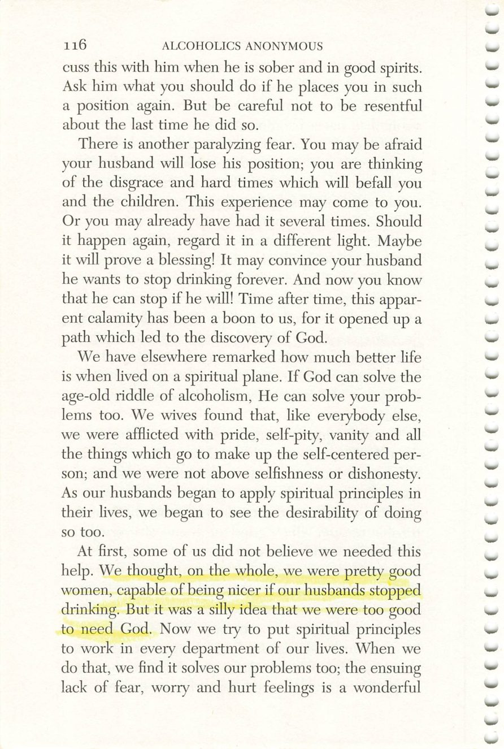
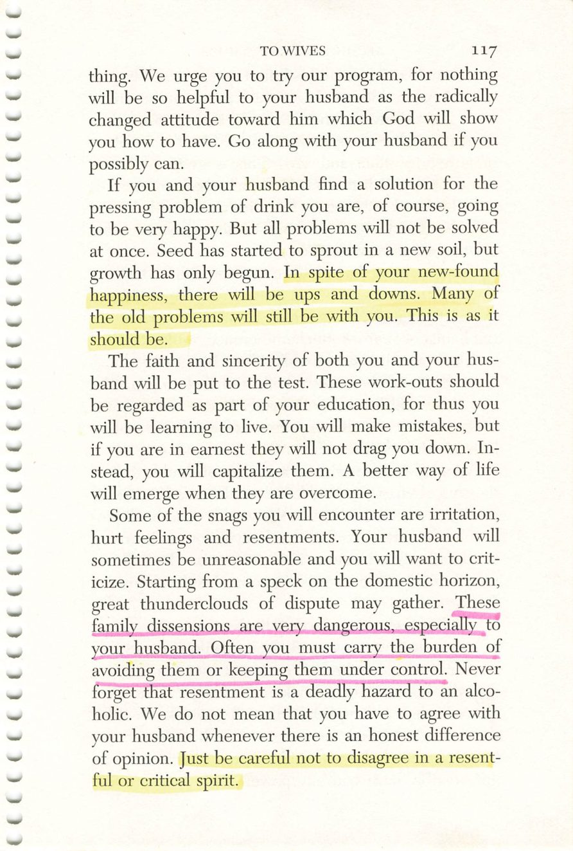
116
117
Copyright © Alcoholics Anonymous World Services, Inc. All rights reserved. Intended for personal use only, and not to be reproduced further or distributed for resale.

Slide 27
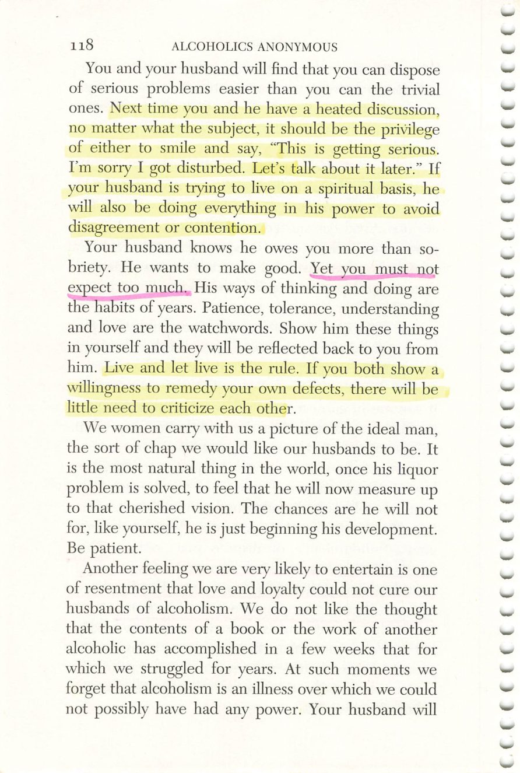
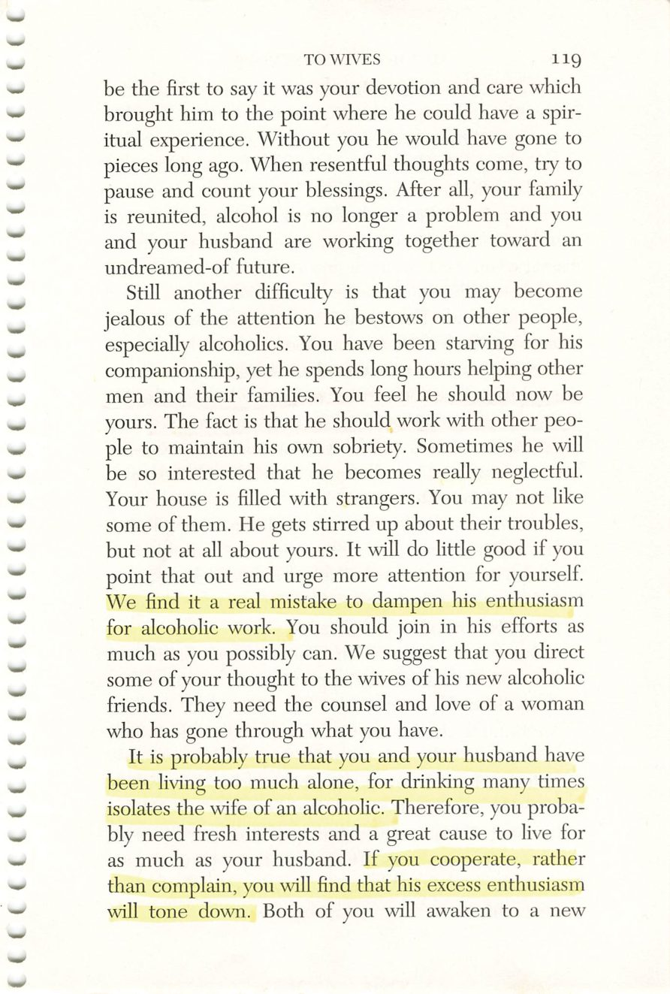
118
119
Copyright © Alcoholics Anonymous World Services, Inc. All rights reserved. Intended for personal use only, and not to be reproduced further or distributed for resale.

Slide 28
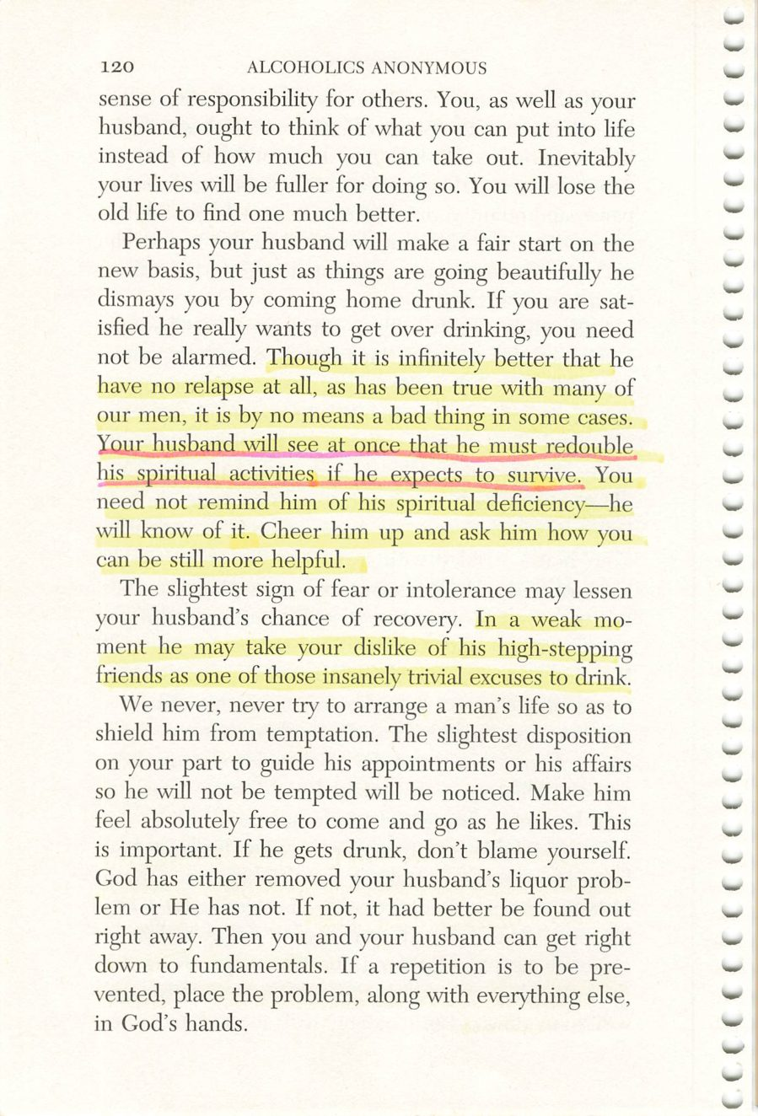
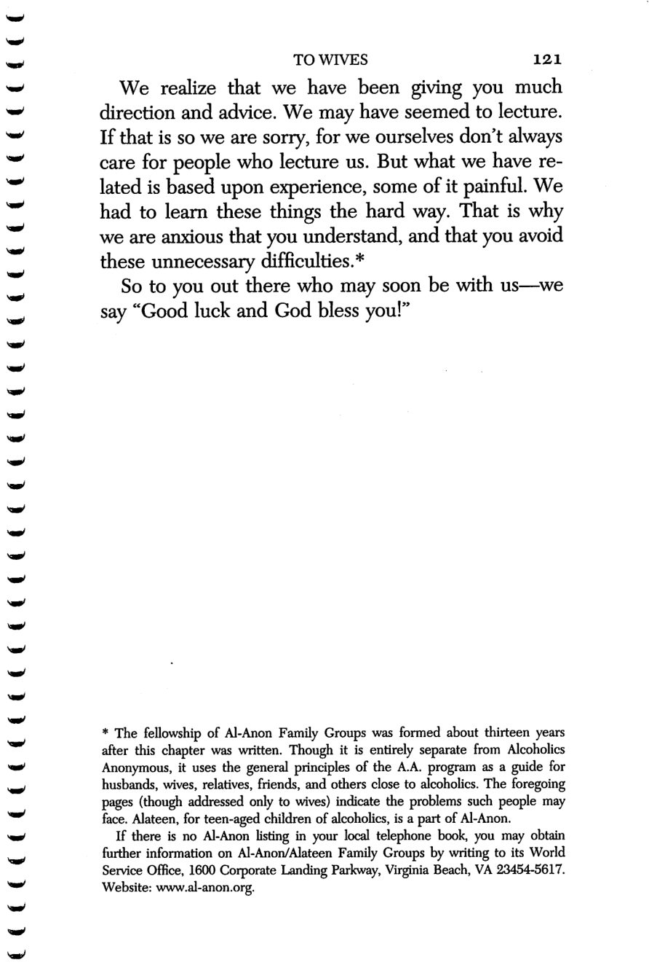
120
121
Copyright © Alcoholics Anonymous World Services, Inc. All rights reserved. Intended for personal use only, and not to be reproduced further or distributed for resale.

Slide 29
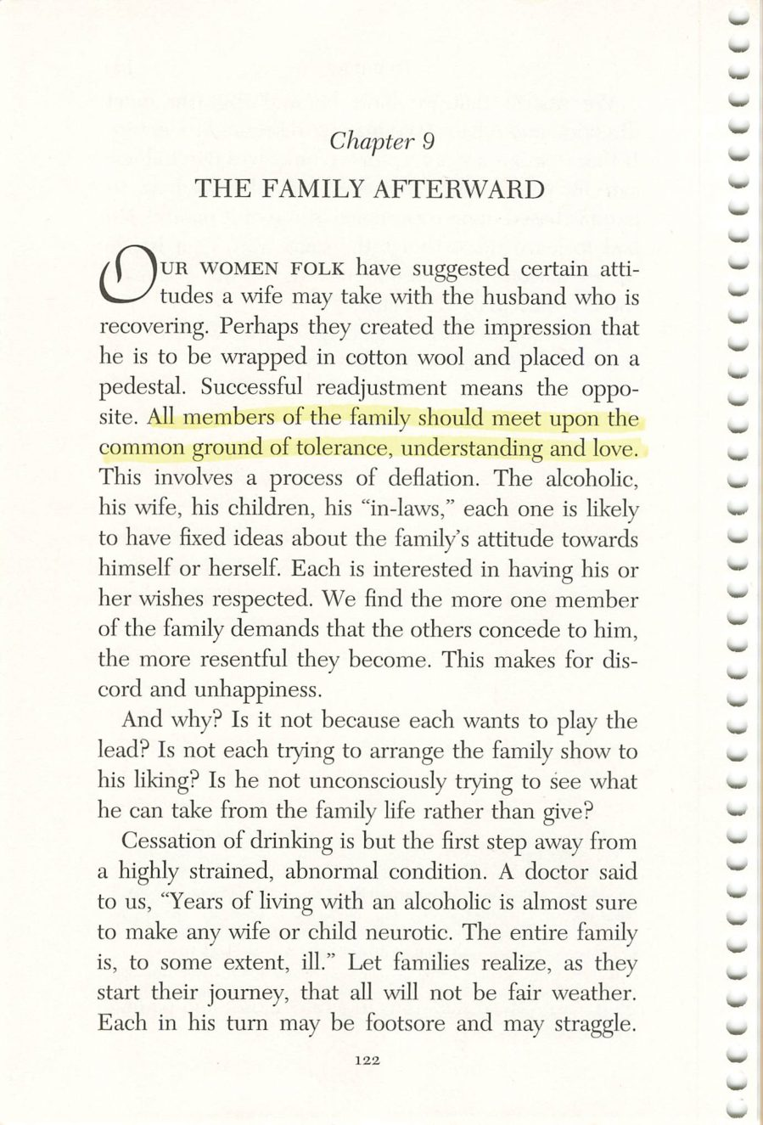

122
123
Copyright © Alcoholics Anonymous World Services, Inc. All rights reserved. Intended for personal use only, and not to be reproduced further or distributed for resale.

Slide 30


124
125
Copyright © Alcoholics Anonymous World Services, Inc. All rights reserved. Intended for personal use only, and not to be reproduced further or distributed for resale.

Slide 31


126
127
Copyright © Alcoholics Anonymous World Services, Inc. All rights reserved. Intended for personal use only, and not to be reproduced further or distributed for resale.

Slide 32


128
129
Copyright © Alcoholics Anonymous World Services, Inc. All rights reserved. Intended for personal use only, and not to be reproduced further or distributed for resale.

Slide 33


130
131
Copyright © Alcoholics Anonymous World Services, Inc. All rights reserved. Intended for personal use only, and not to be reproduced further or distributed for resale.

Slide 34


132
133
Copyright © Alcoholics Anonymous World Services, Inc. All rights reserved. Intended for personal use only, and not to be reproduced further or distributed for resale.

Slide 35


134
135
Copyright © Alcoholics Anonymous World Services, Inc. All rights reserved. Intended for personal use only, and not to be reproduced further or distributed for resale.

Slide 36


136
137
Copyright © Alcoholics Anonymous World Services, Inc. All rights reserved. Intended for personal use only, and not to be reproduced further or distributed for resale.

Slide 37

Hank Parkhurst
Page 136
Chapter 10, To Employers.
Credit: Henry G. Parkhurst, 1895-1954. Early A.A. archival photograph, via aamidsurrey.org.uk. Displayed for in-group study only.

Slide 38


138
139
Copyright © Alcoholics Anonymous World Services, Inc. All rights reserved. Intended for personal use only, and not to be reproduced further or distributed for resale.

Slide 39

140
Copyright © Alcoholics Anonymous World Services, Inc. All rights reserved. Intended for personal use only, and not to be reproduced further or distributed for resale.

