Slide 1
Big Book Study Group
by District 23
Front Matter through Page 16
903 Court Street, Port Huron
Wednesdays · 7:00 PM

Slide 2
Copyright Notice
“These materials are copyright © by Alcoholics Anonymous World Services, Inc. ("A.A.W.S."). All rights reserved. Individual printing or photocopying of a single copy is permitted. Intended for personal use only, and not to be reproduced further or distributed for resale.”
Displayed at the request of A.A. World Services, Inc. Reproduced with permission for use during this A.A. meeting.

Slide 3
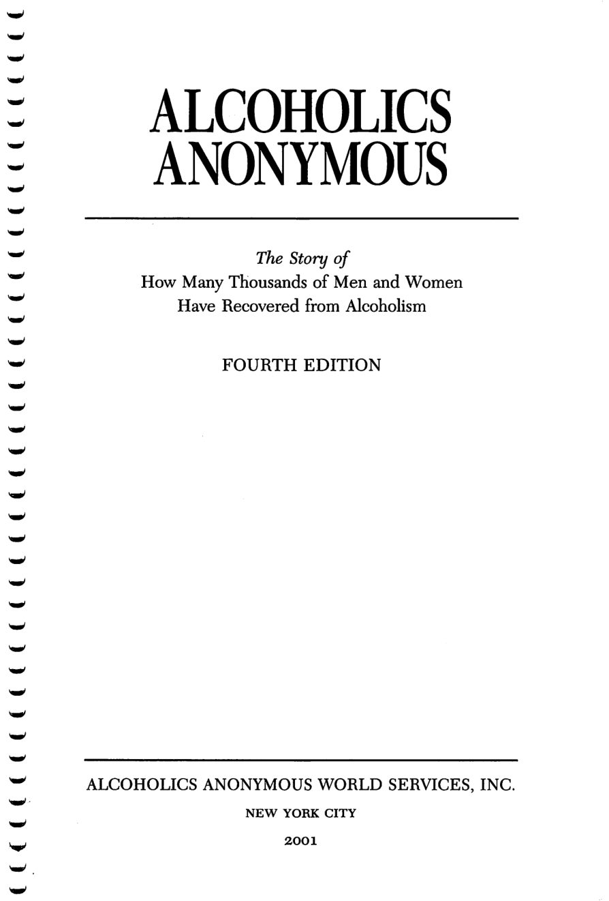
Copyright © Alcoholics Anonymous World Services, Inc. All rights reserved. Intended for personal use only, and not to be reproduced further or distributed for resale.

Slide 4
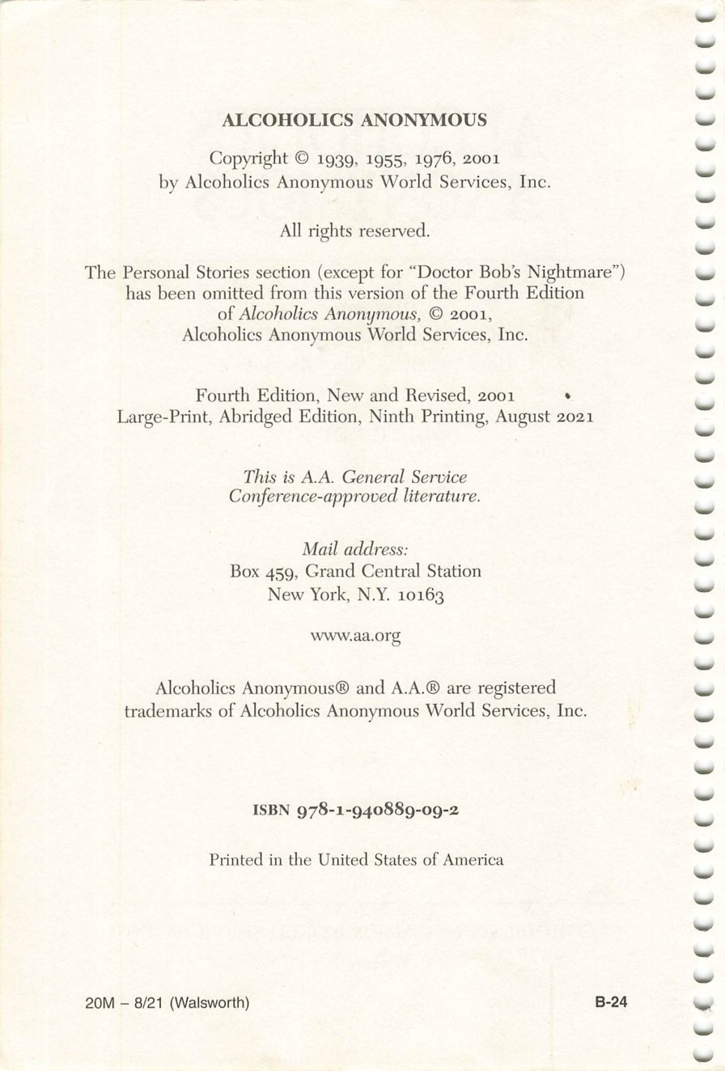
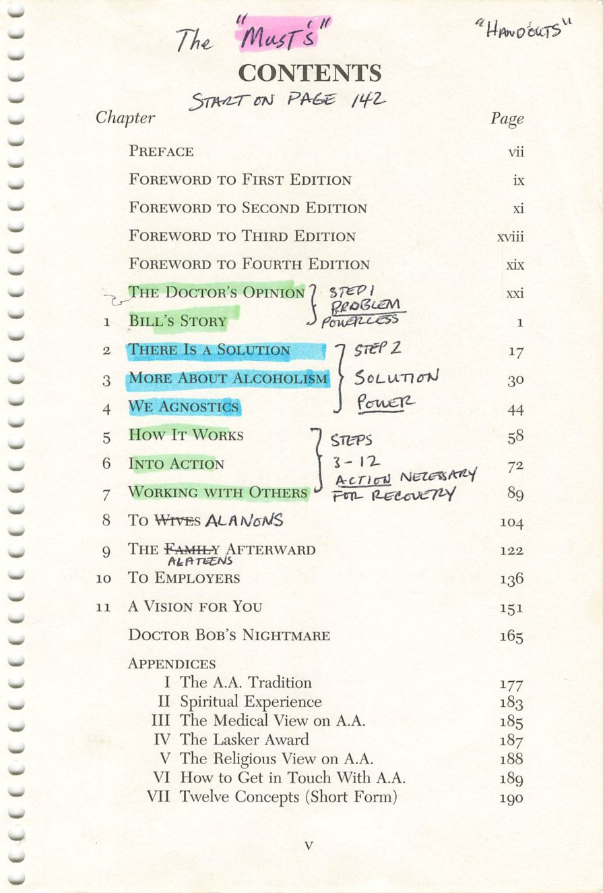
Copyright © Alcoholics Anonymous World Services, Inc. All rights reserved. Intended for personal use only, and not to be reproduced further or distributed for resale.
v

Slide 5
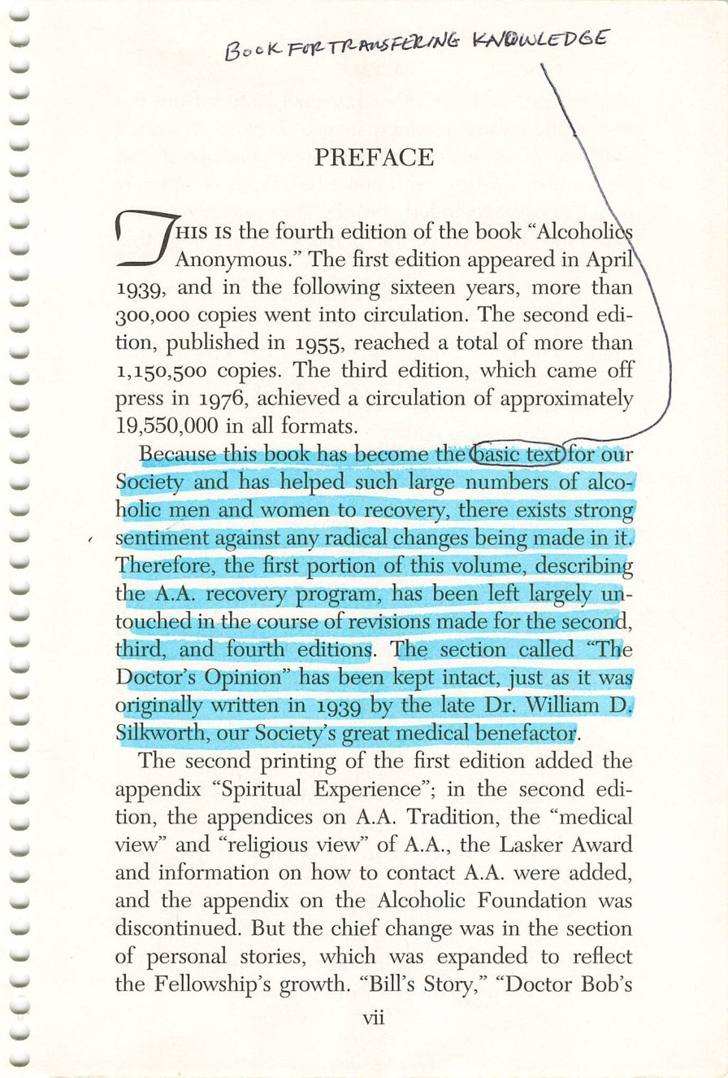
Copyright © Alcoholics Anonymous World Services, Inc. All rights reserved. Intended for personal use only, and not to be reproduced further or distributed for resale.
vii

Slide 6
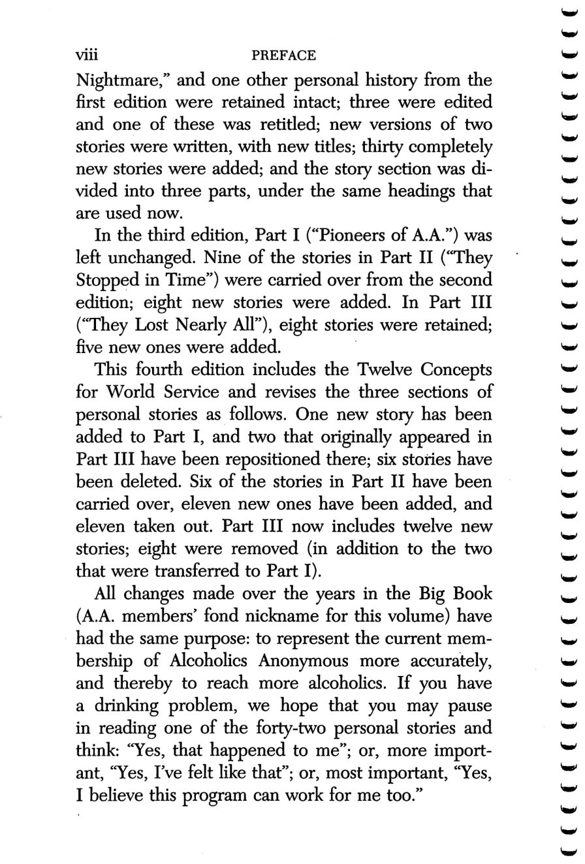
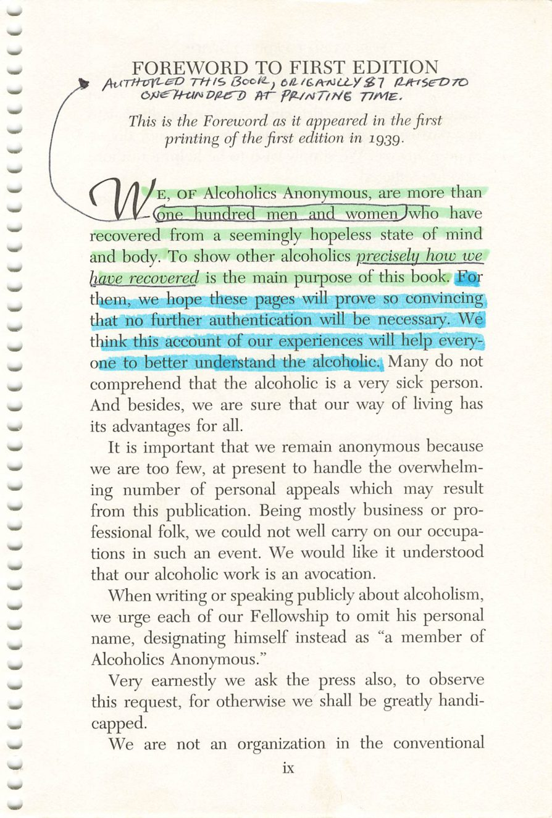
viii
ix
Copyright © Alcoholics Anonymous World Services, Inc. All rights reserved. Intended for personal use only, and not to be reproduced further or distributed for resale.

Slide 7
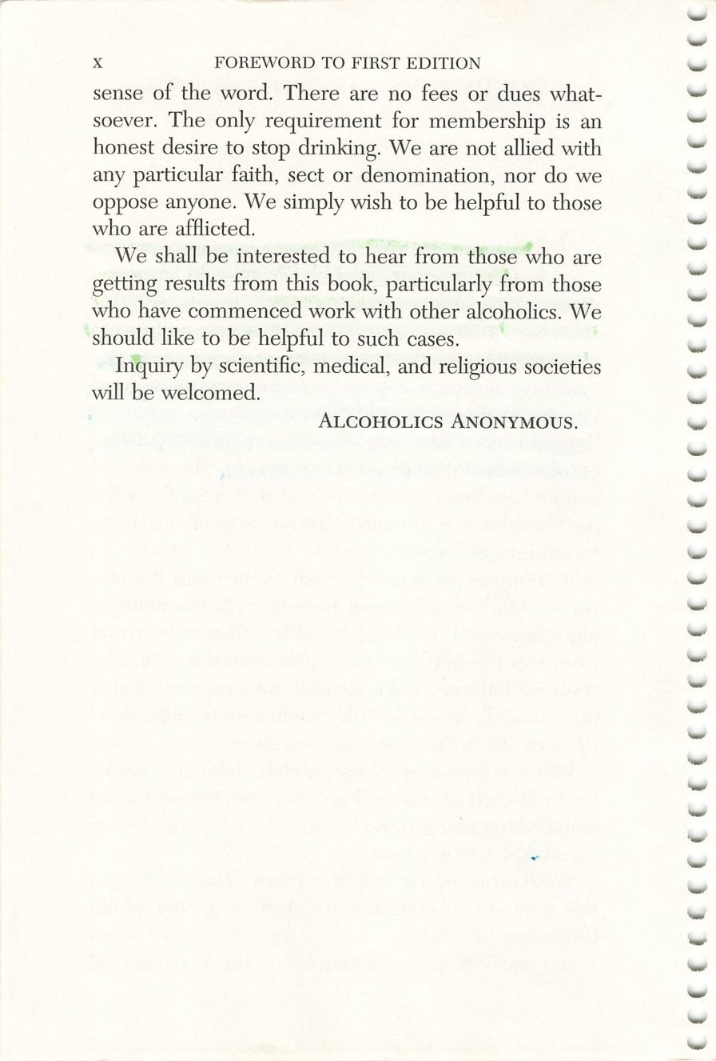
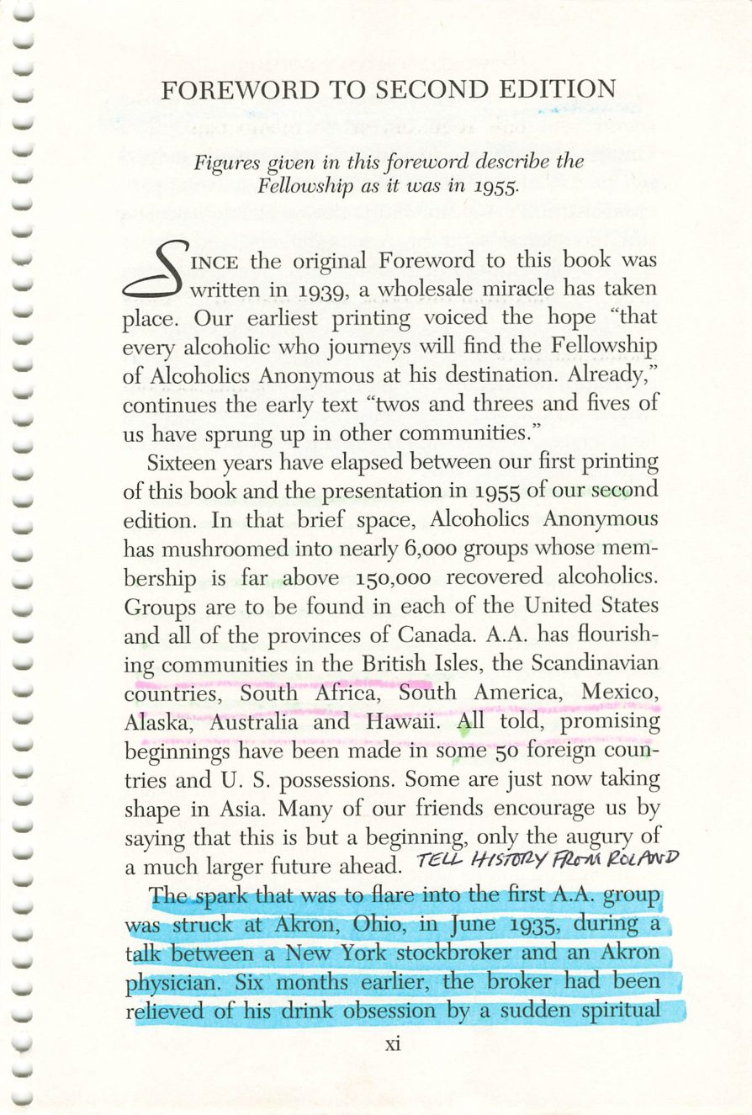
x
xi
Copyright © Alcoholics Anonymous World Services, Inc. All rights reserved. Intended for personal use only, and not to be reproduced further or distributed for resale.

Slide 8
Rowland Hazard
Page xi
PHOTO
Photograph, with a brief history.
Drop the image into this frame in PowerPoint.
Credit:

Slide 9
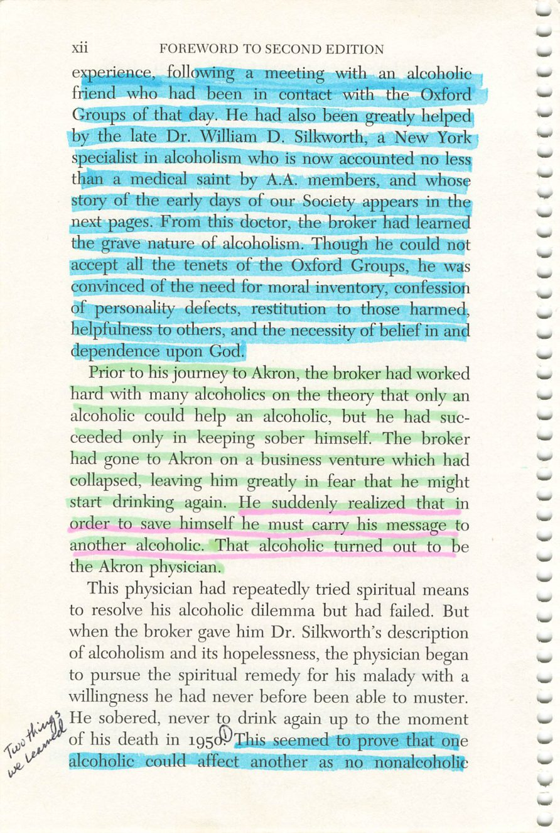
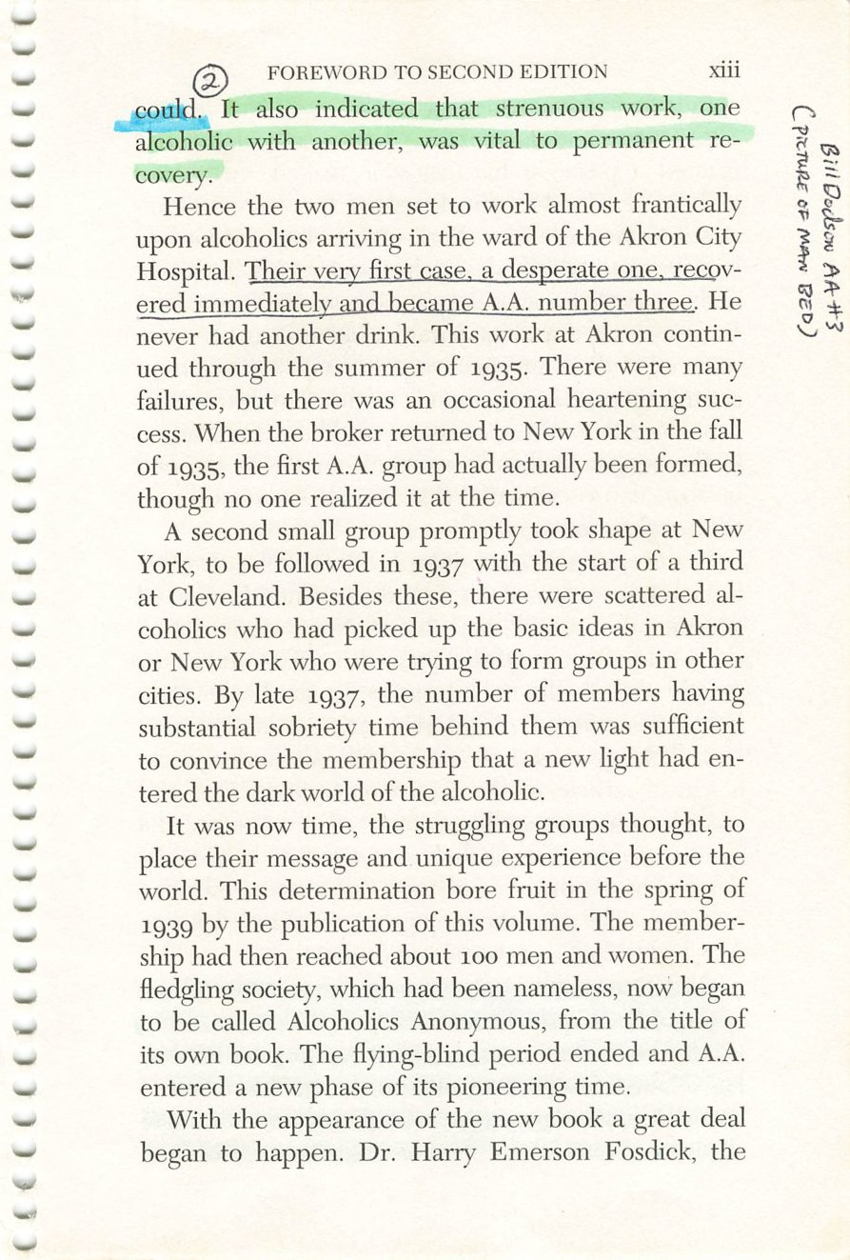
xii
xiii
Copyright © Alcoholics Anonymous World Services, Inc. All rights reserved. Intended for personal use only, and not to be reproduced further or distributed for resale.

Slide 10
The Oxford Group
Page xii
PHOTO
Photograph.
Drop the image into this frame in PowerPoint.
Credit:

Slide 11
A.A. Number Three
Page xiii
PHOTO
Bill D. — the man in the bed, Akron City Hospital, 1935.
Drop the image into this frame in PowerPoint.
Credit:

Slide 12
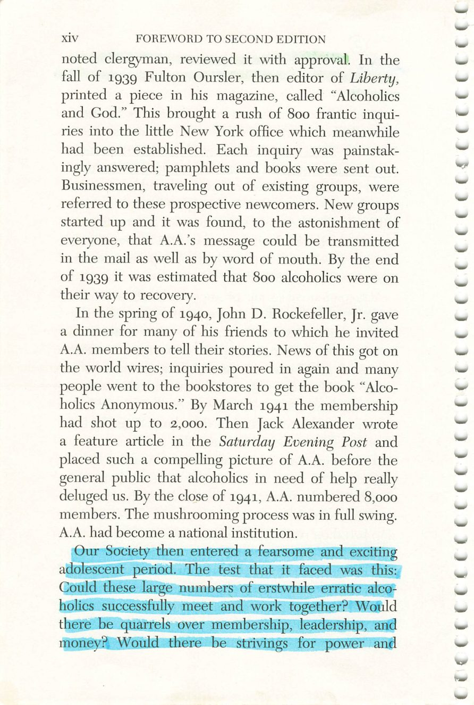
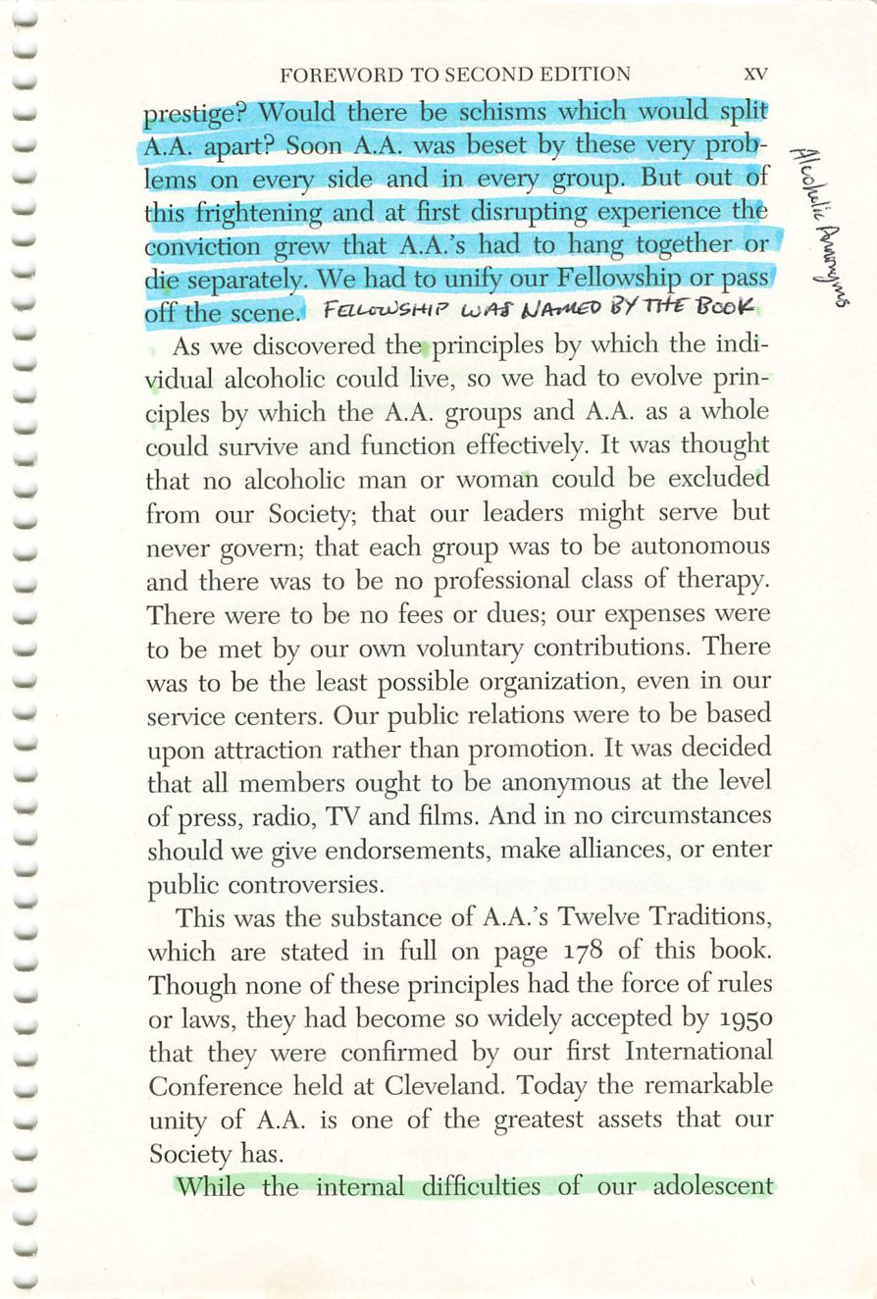
xiv
xv
Copyright © Alcoholics Anonymous World Services, Inc. All rights reserved. Intended for personal use only, and not to be reproduced further or distributed for resale.

Slide 13
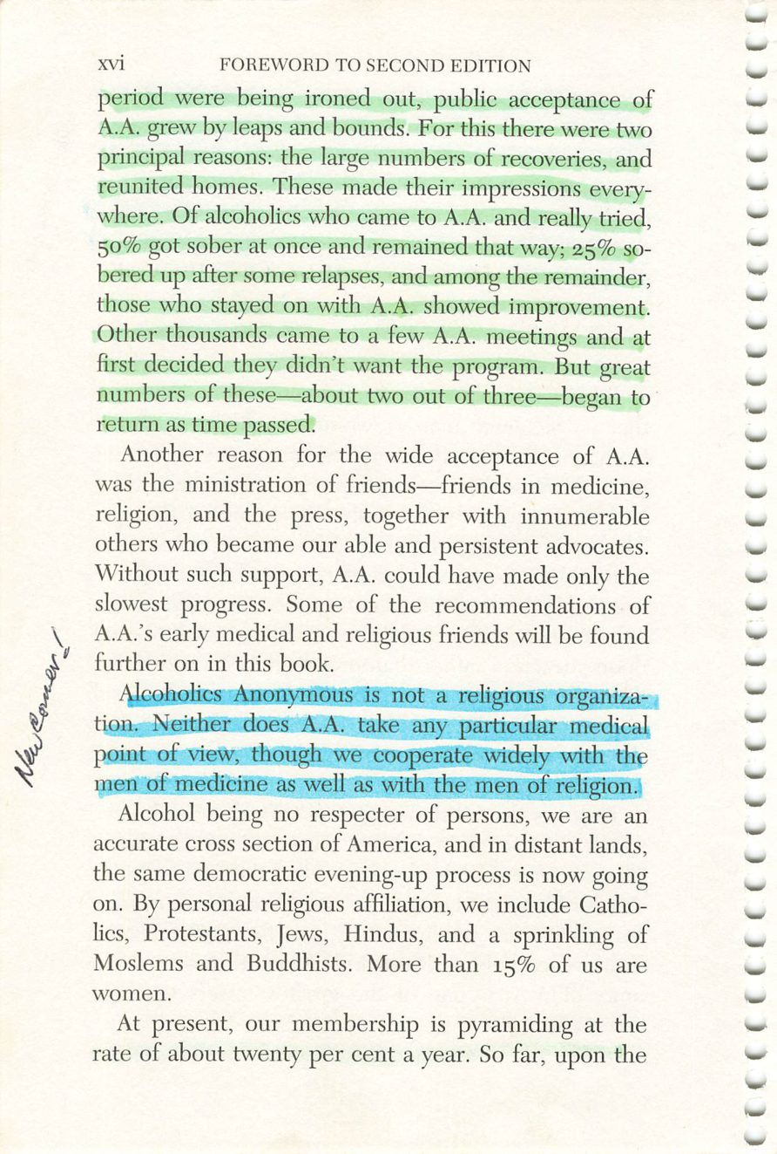
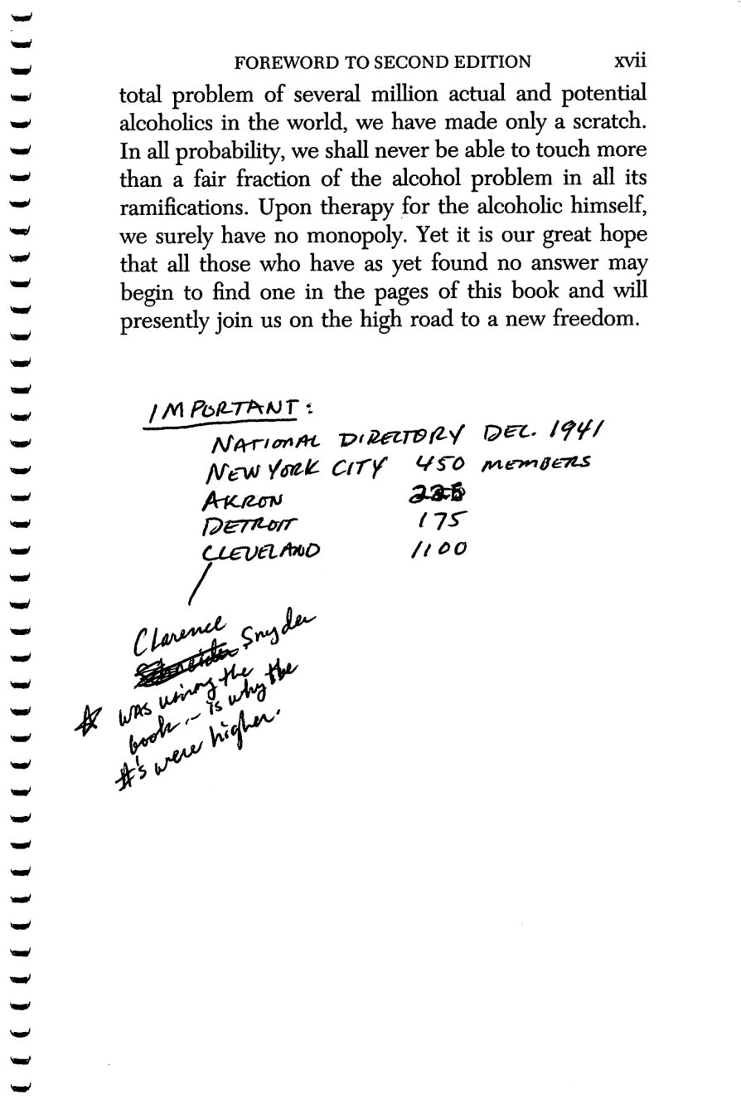
xvi
xvii
Copyright © Alcoholics Anonymous World Services, Inc. All rights reserved. Intended for personal use only, and not to be reproduced further or distributed for resale.

Slide 14
Clarence Snyder
Page xvii
PHOTO
Photograph.
Drop the image into this frame in PowerPoint.
Credit:

Slide 15
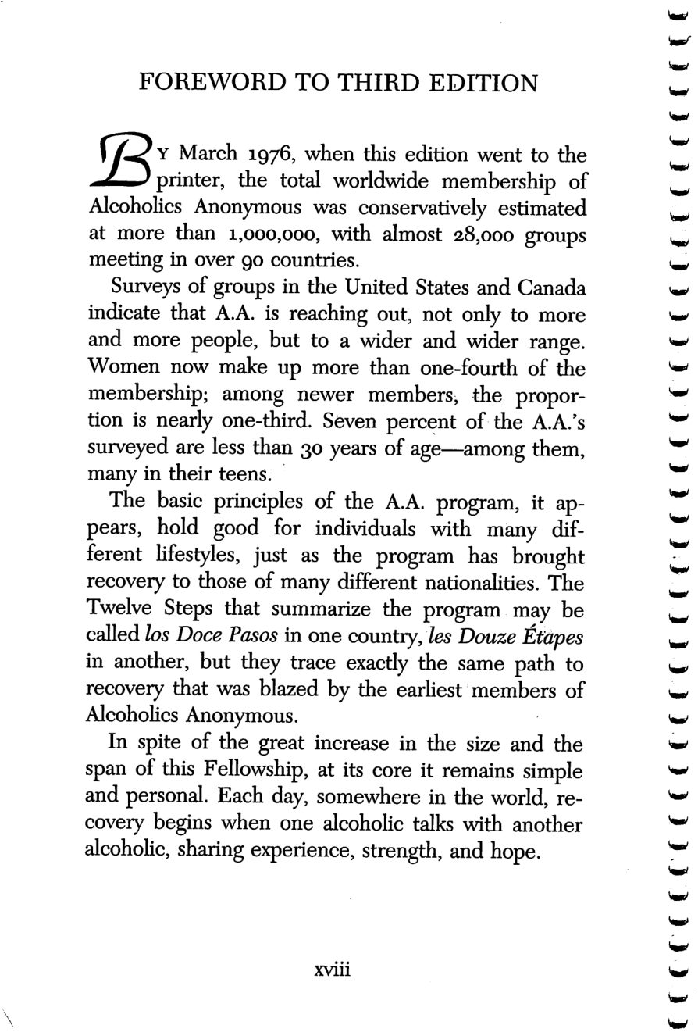
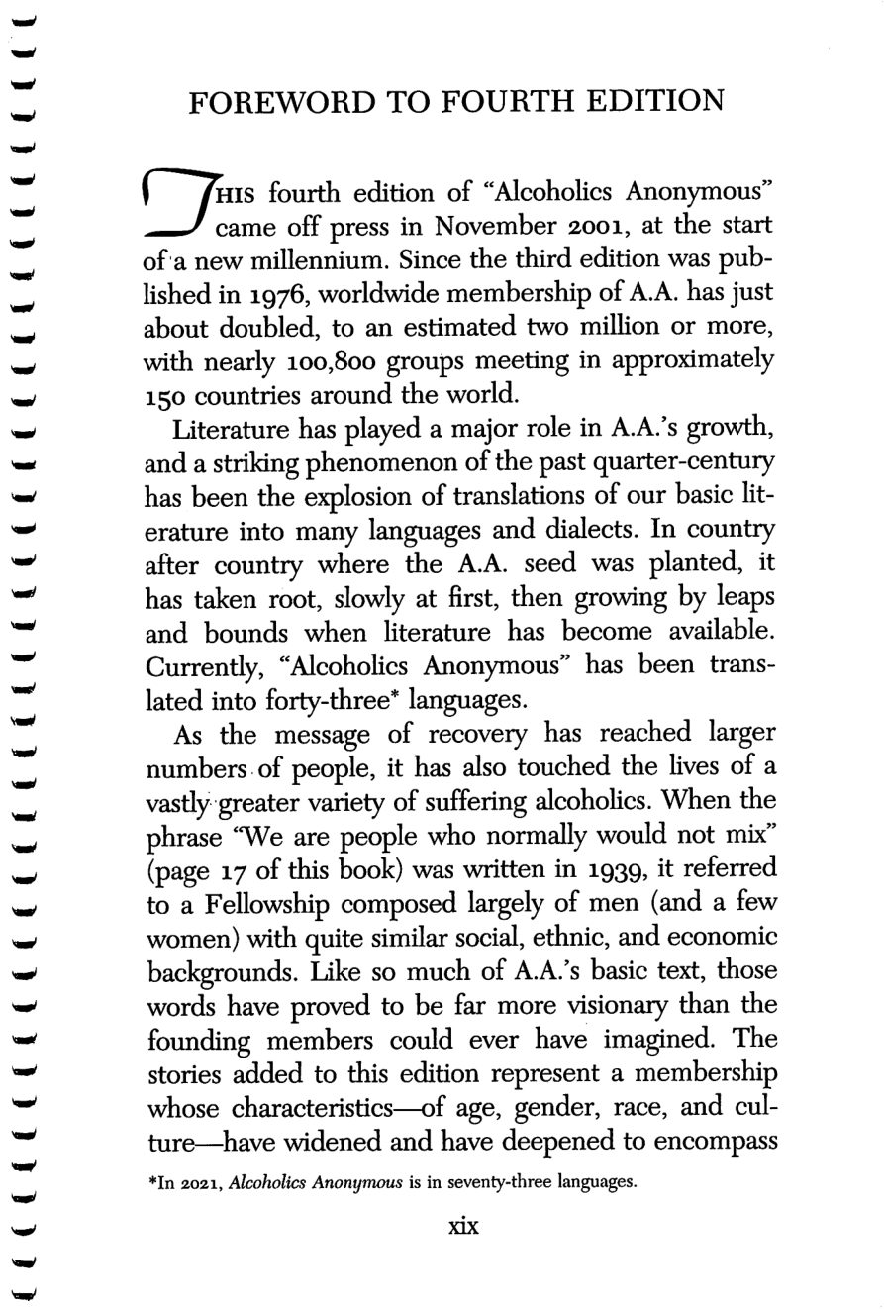
xviii
xix
Copyright © Alcoholics Anonymous World Services, Inc. All rights reserved. Intended for personal use only, and not to be reproduced further or distributed for resale.

Slide 16
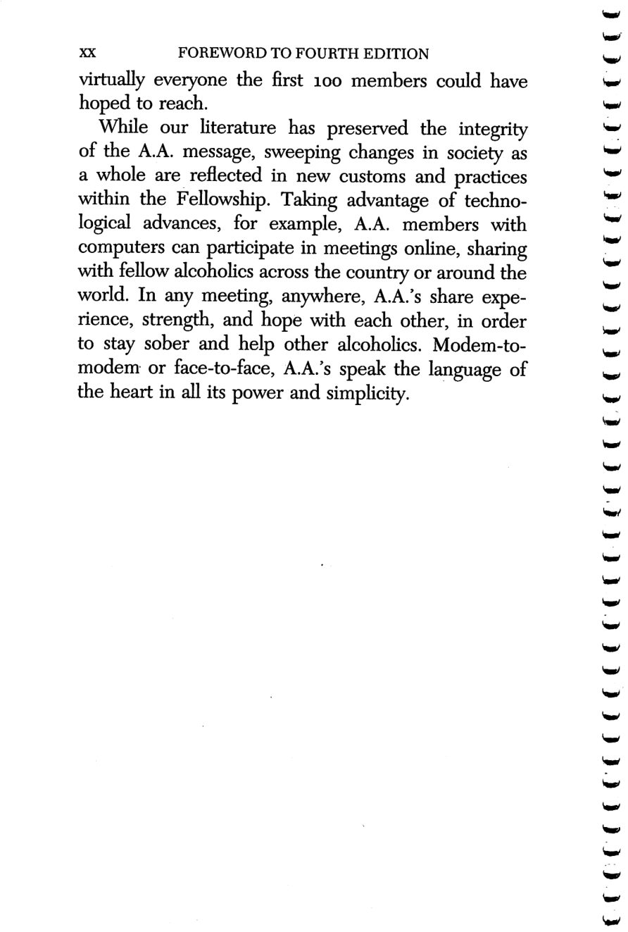
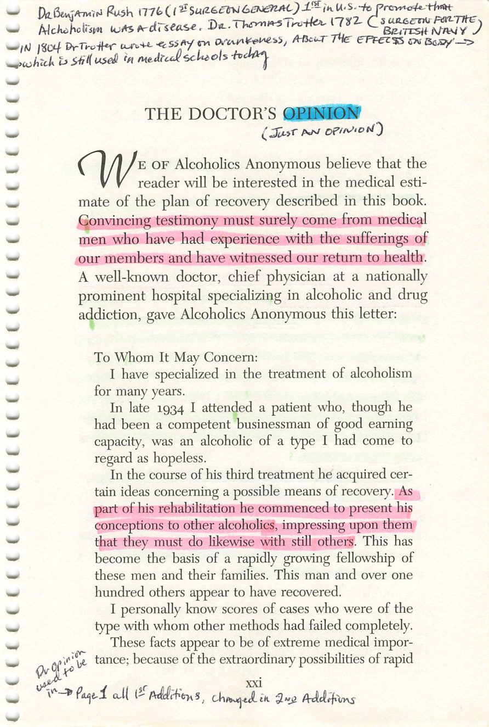
xx
xxi
Copyright © Alcoholics Anonymous World Services, Inc. All rights reserved. Intended for personal use only, and not to be reproduced further or distributed for resale.

Slide 17
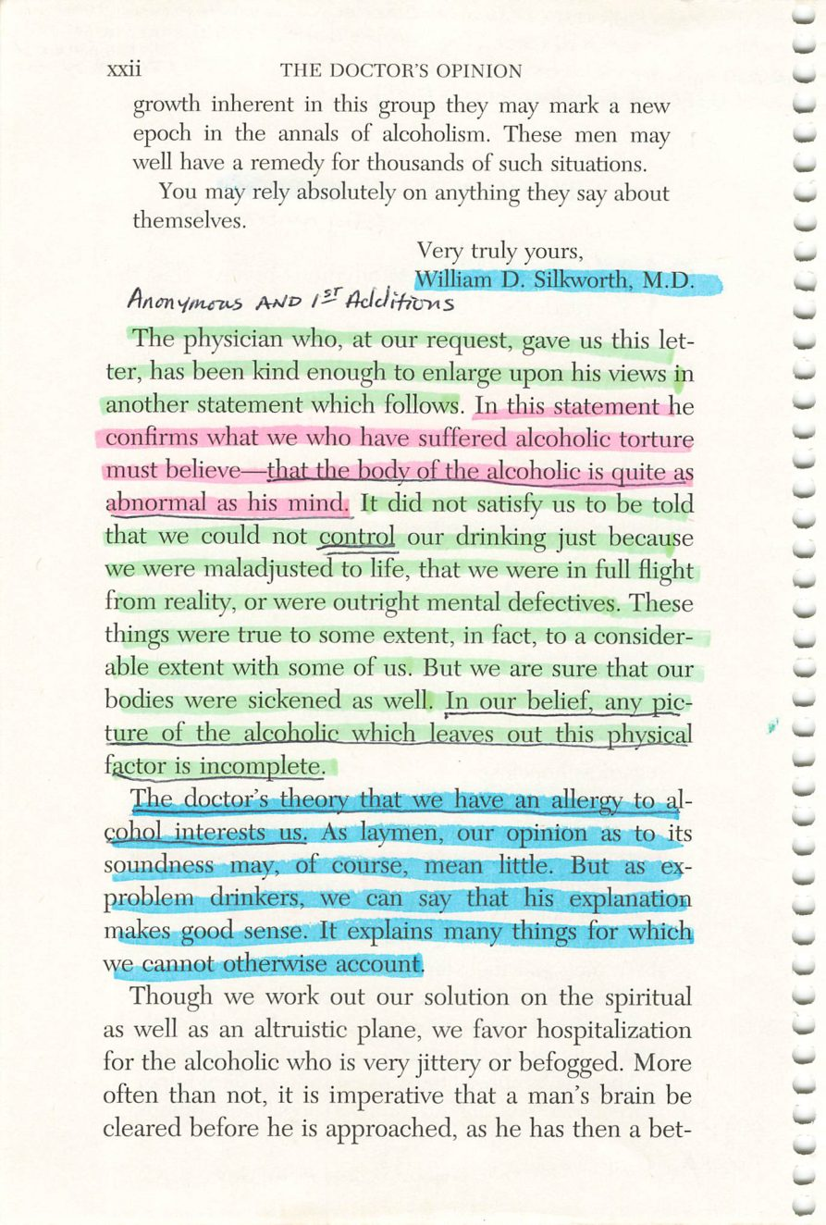
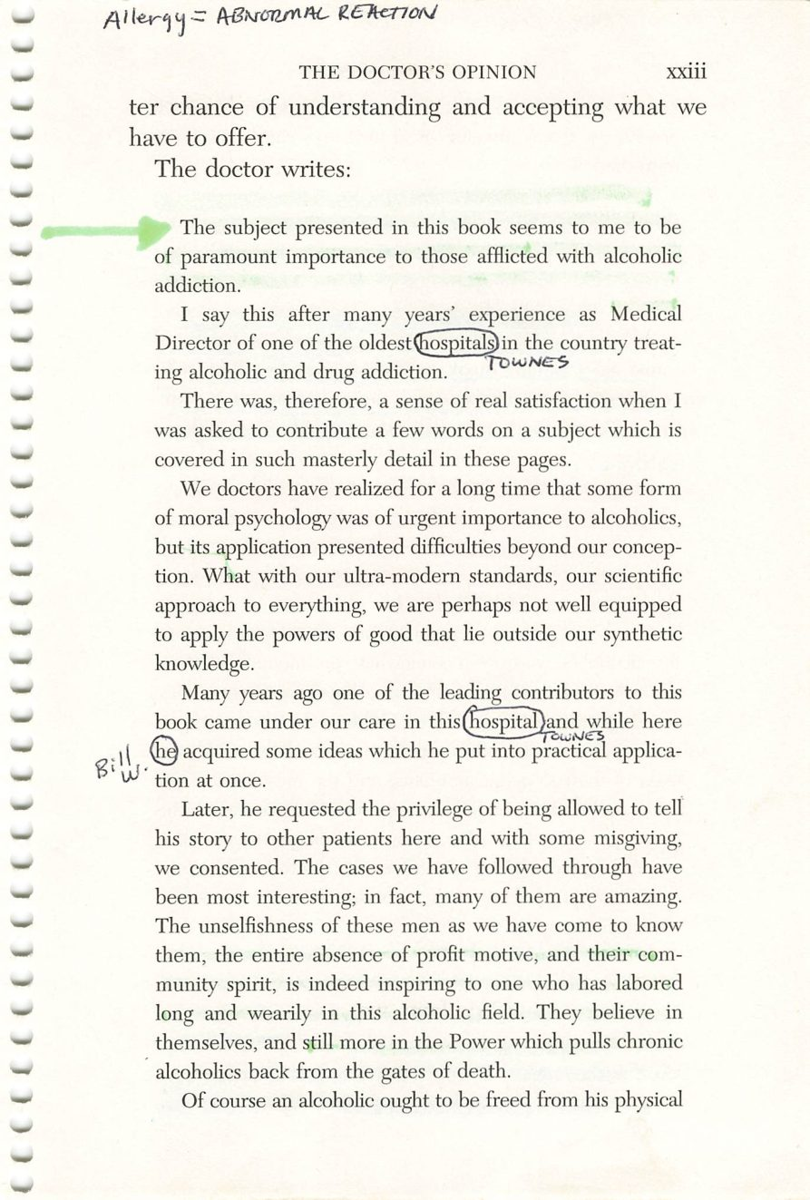
xxii
xxiii
Copyright © Alcoholics Anonymous World Services, Inc. All rights reserved. Intended for personal use only, and not to be reproduced further or distributed for resale.

Slide 18
William D. Silkworth, M.D.
Page xxii
PHOTO
Photograph.
Drop the image into this frame in PowerPoint.
Credit:

Slide 19
Towns Hospital
Page xxiii
PHOTO
293 Central Park West, New York City.
Drop the image into this frame in PowerPoint.
Credit:

Slide 20
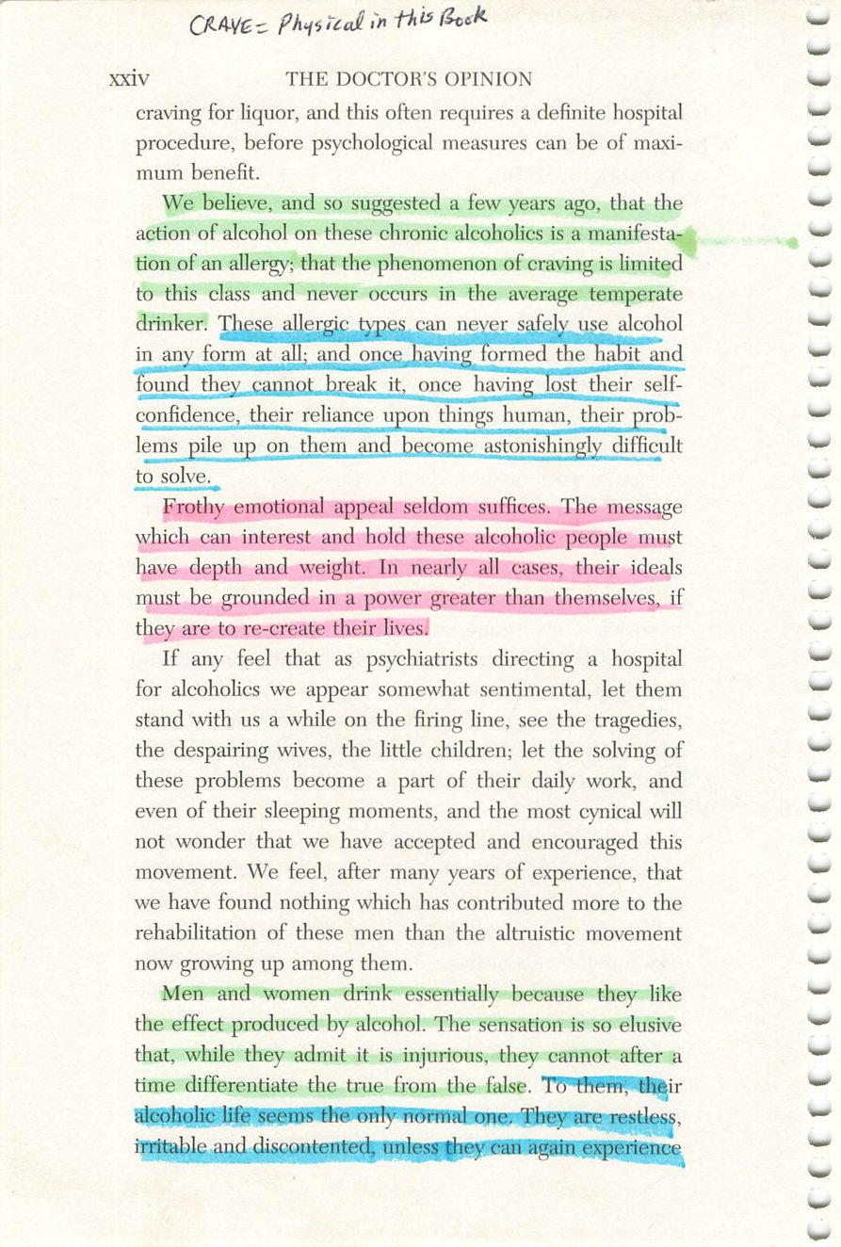
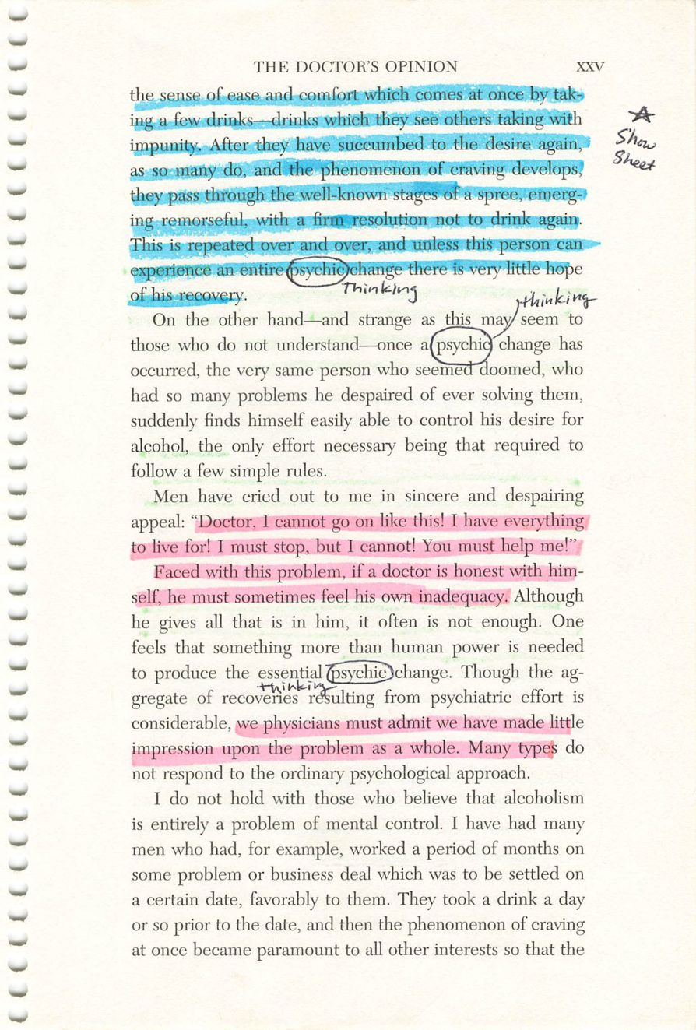
xxiv
xxv
Copyright © Alcoholics Anonymous World Services, Inc. All rights reserved. Intended for personal use only, and not to be reproduced further or distributed for resale.

Slide 21
Alcohol Metabolism
Page xxv
DIAGRAM
Diagram.
Drop the image into this frame in PowerPoint.
Credit:

Slide 22
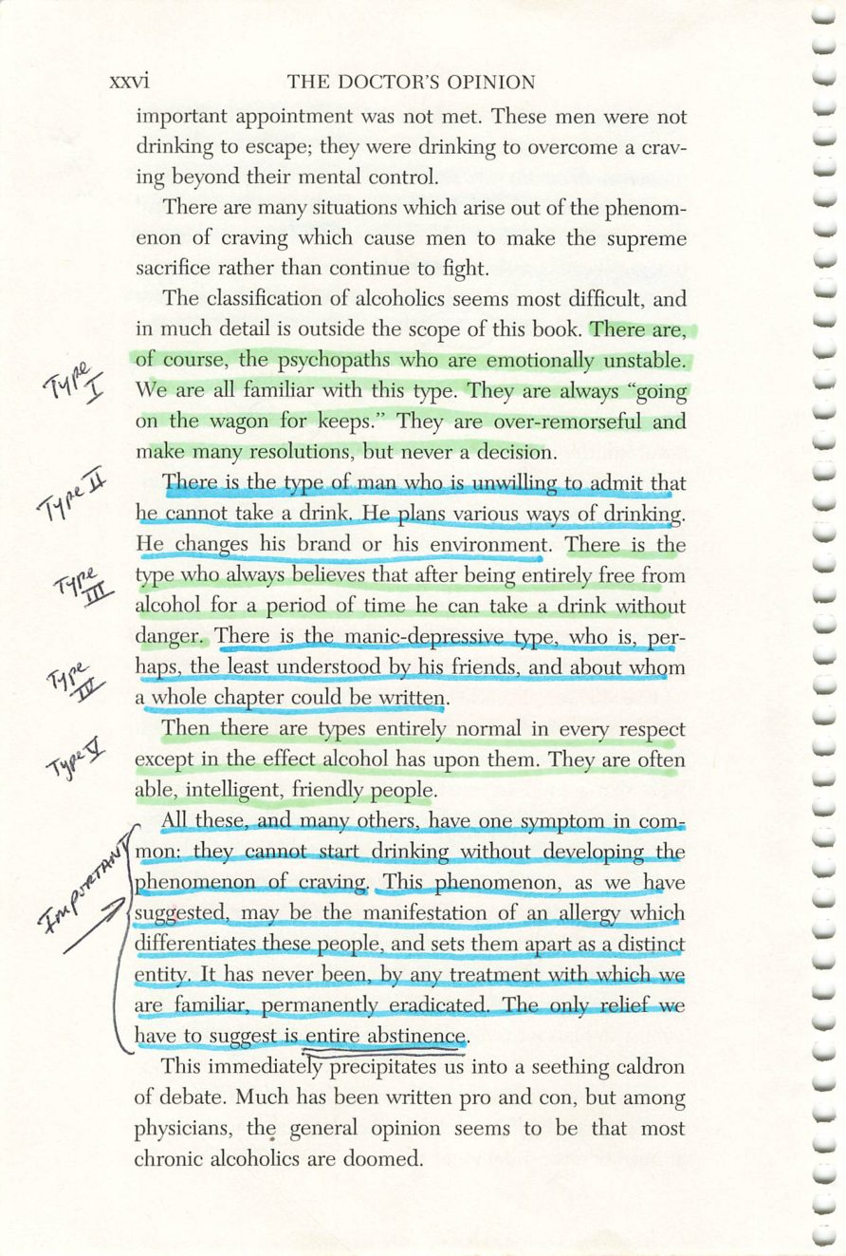
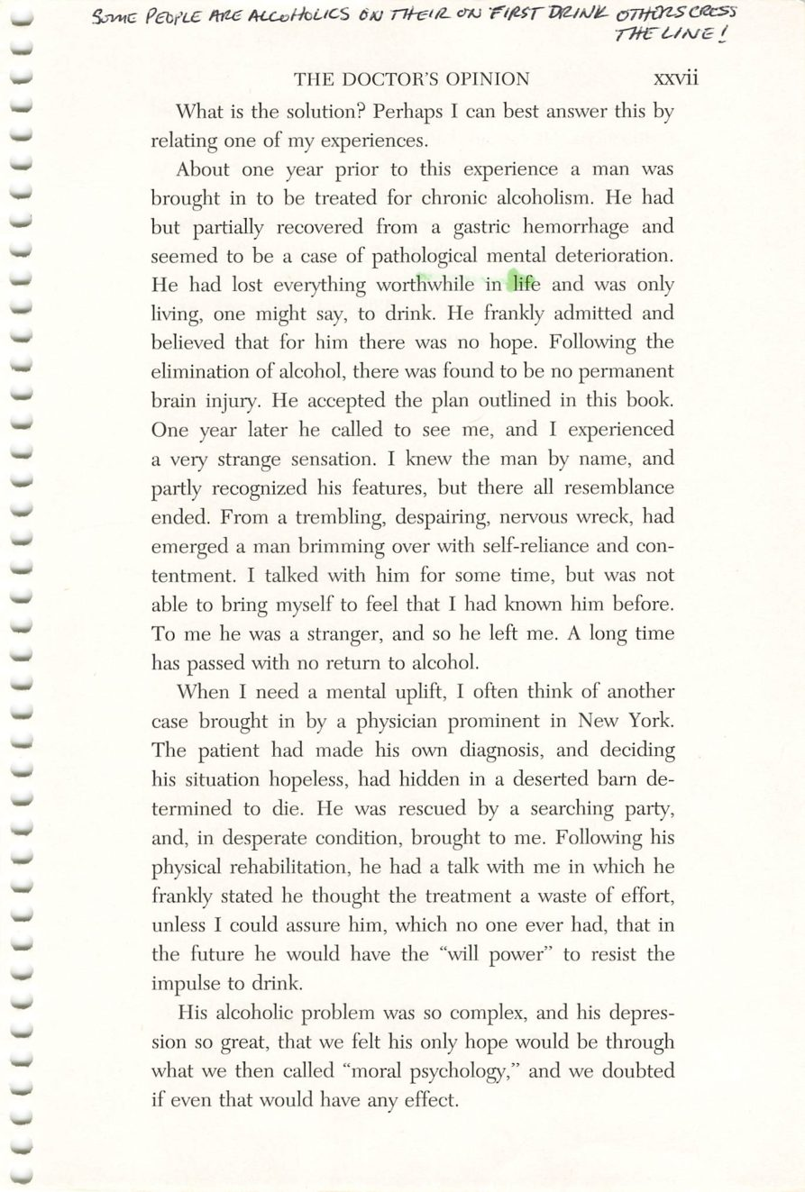
xxvi
xxvii
Copyright © Alcoholics Anonymous World Services, Inc. All rights reserved. Intended for personal use only, and not to be reproduced further or distributed for resale.

Slide 23
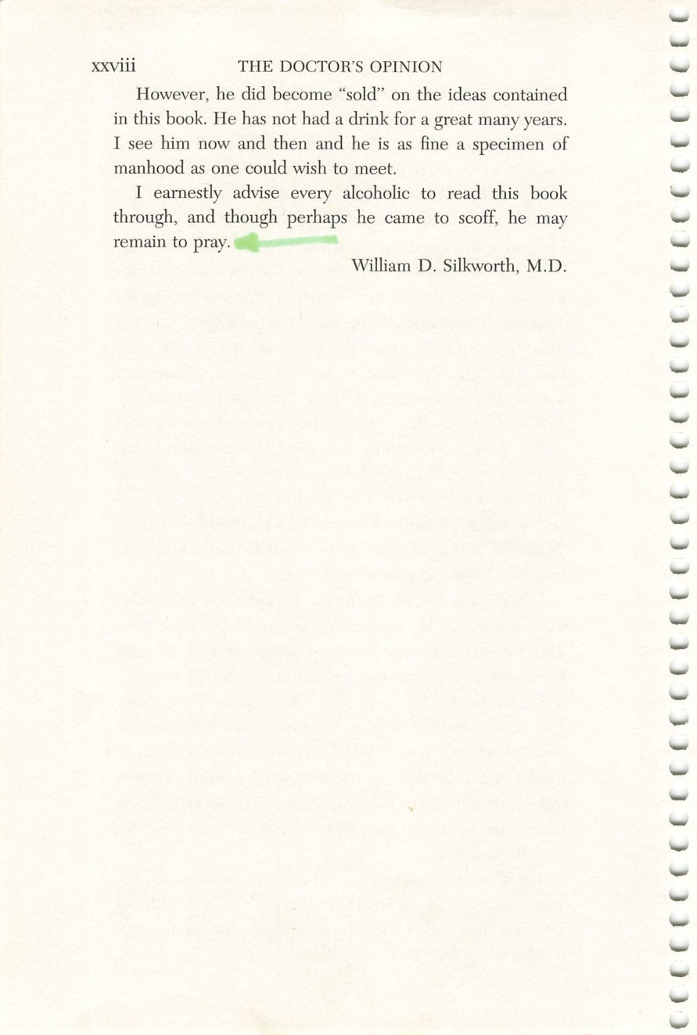
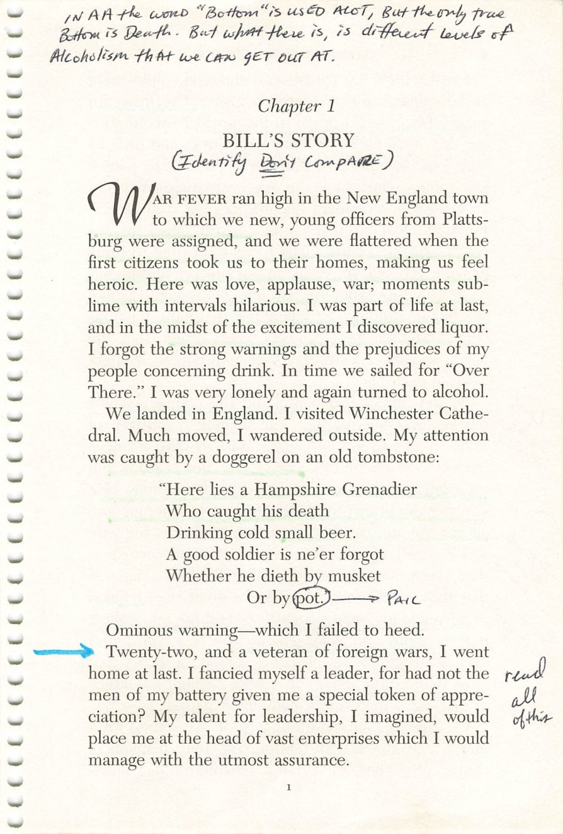
xxviii
1
Copyright © Alcoholics Anonymous World Services, Inc. All rights reserved. Intended for personal use only, and not to be reproduced further or distributed for resale.

Slide 24
Bill W.
Page 1
PHOTO
Photograph.
Drop the image into this frame in PowerPoint.
Credit:

Slide 25
The Tombstone
Page 1
PHOTO
Thomas Thetcher, Winchester Cathedral — “Or by pot.”
Drop the image into this frame in PowerPoint.
Credit:

Slide 26
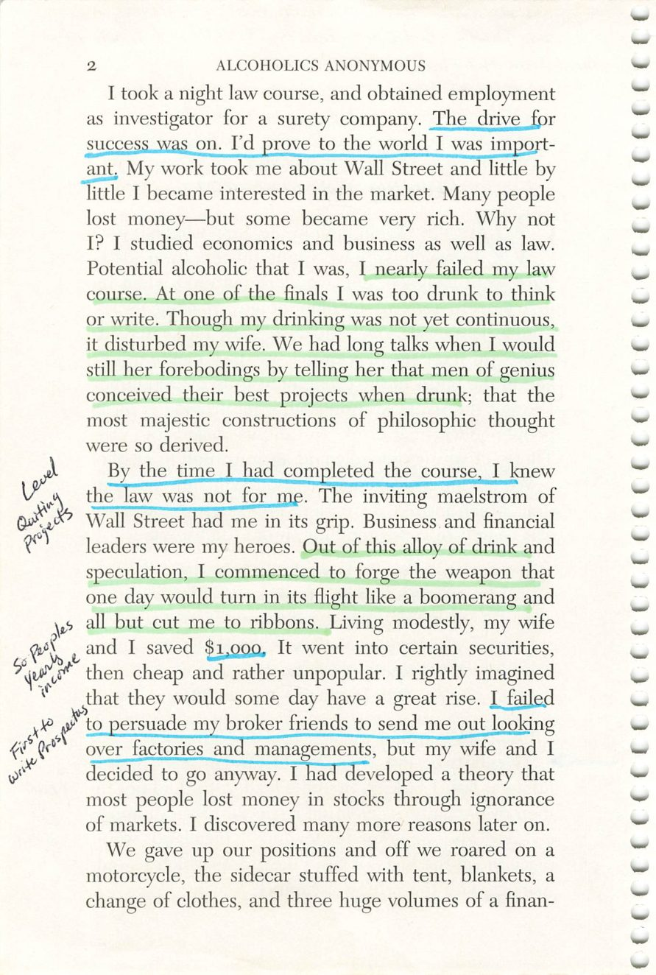
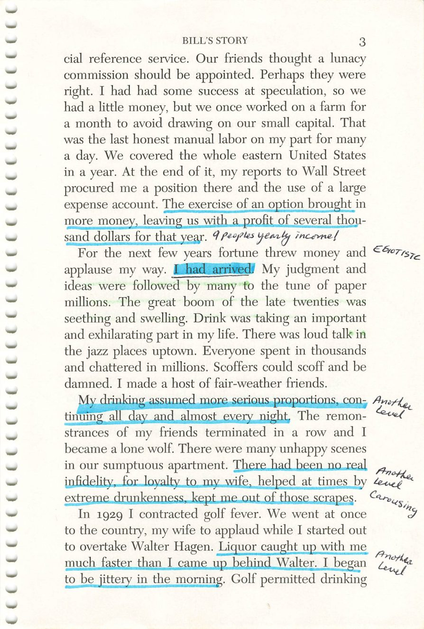
2
3
Copyright © Alcoholics Anonymous World Services, Inc. All rights reserved. Intended for personal use only, and not to be reproduced further or distributed for resale.

Slide 27
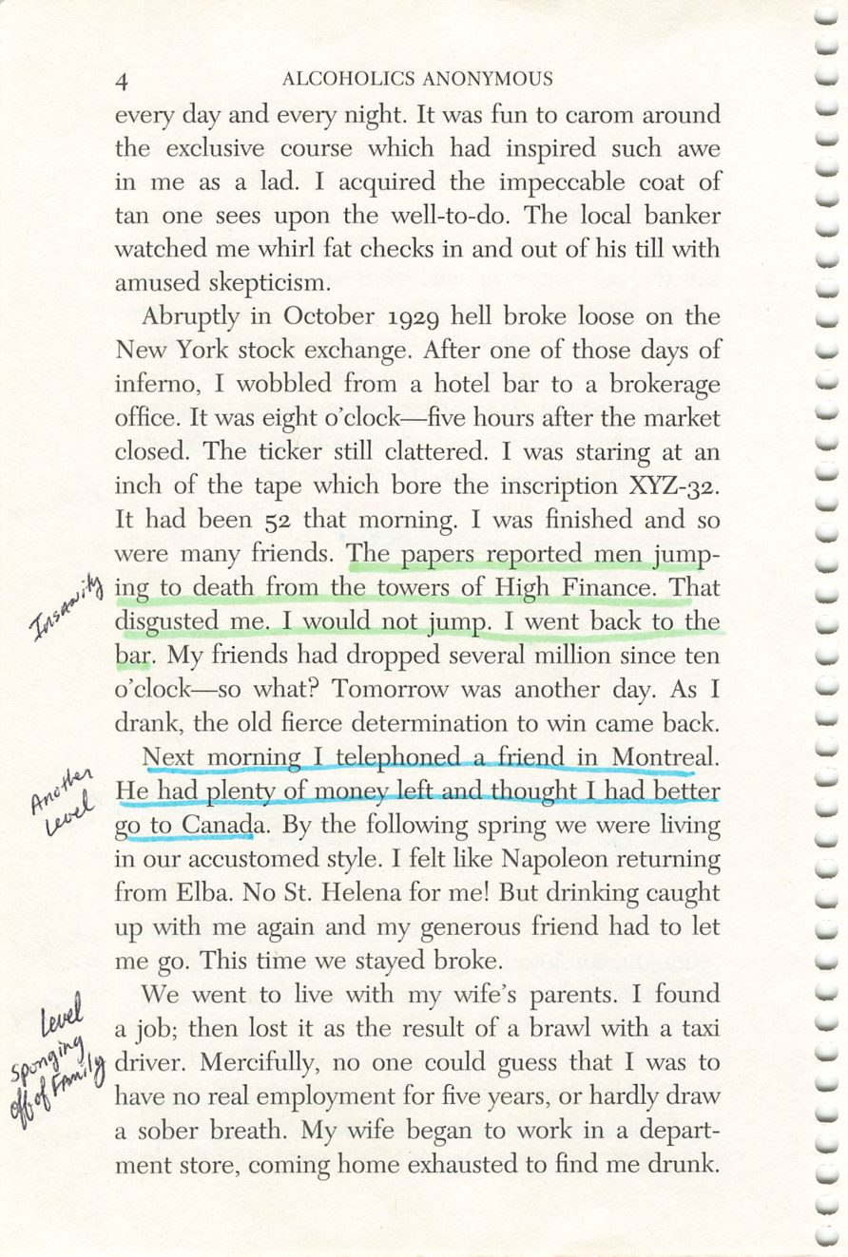
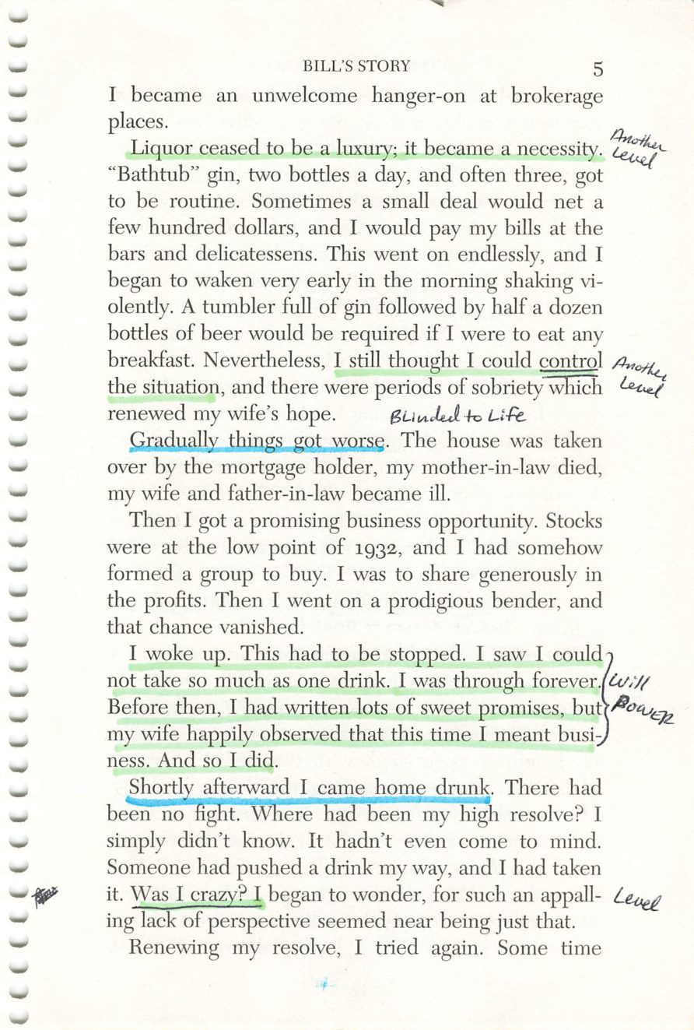
4
5
Copyright © Alcoholics Anonymous World Services, Inc. All rights reserved. Intended for personal use only, and not to be reproduced further or distributed for resale.

Slide 28
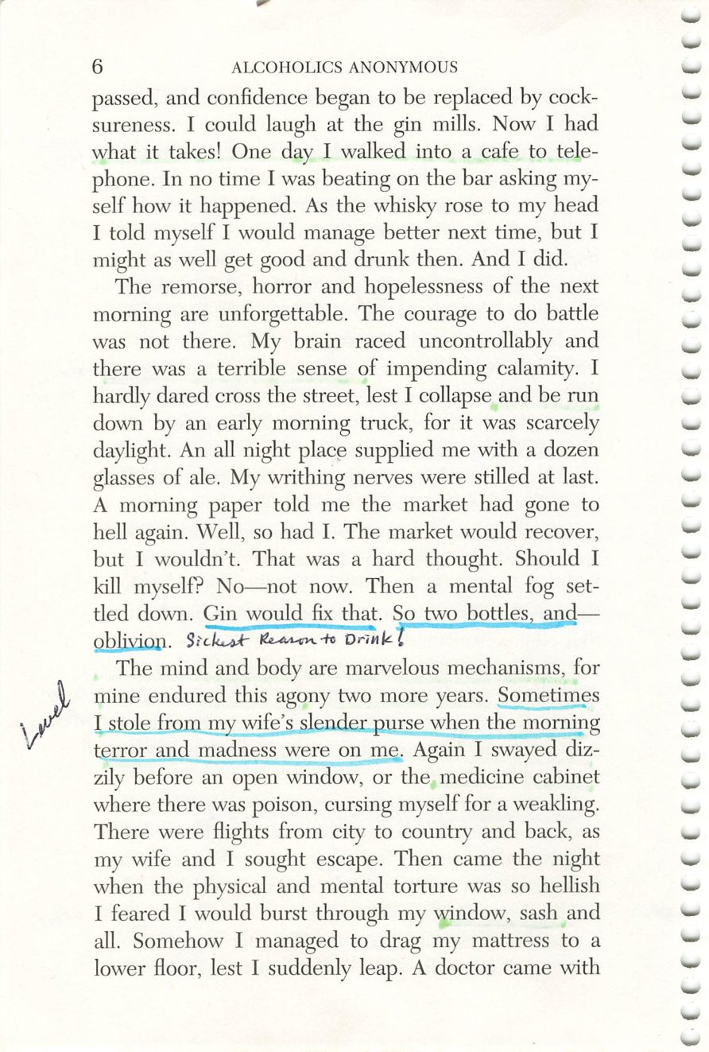
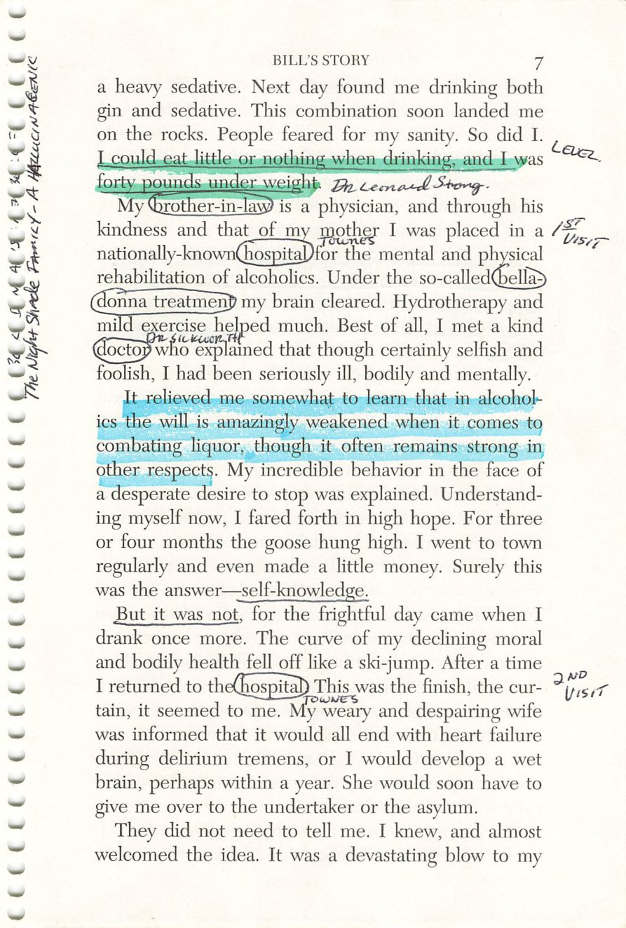
6
7
Copyright © Alcoholics Anonymous World Services, Inc. All rights reserved. Intended for personal use only, and not to be reproduced further or distributed for resale.

Slide 29
Dr. Leonard Strong, M.D.
Page 7
PHOTO
Bill’s brother-in-law.
Drop the image into this frame in PowerPoint.
Credit:

Slide 30
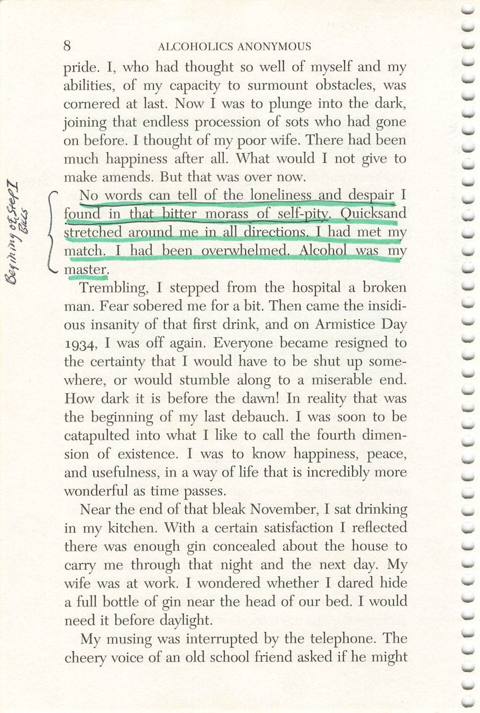
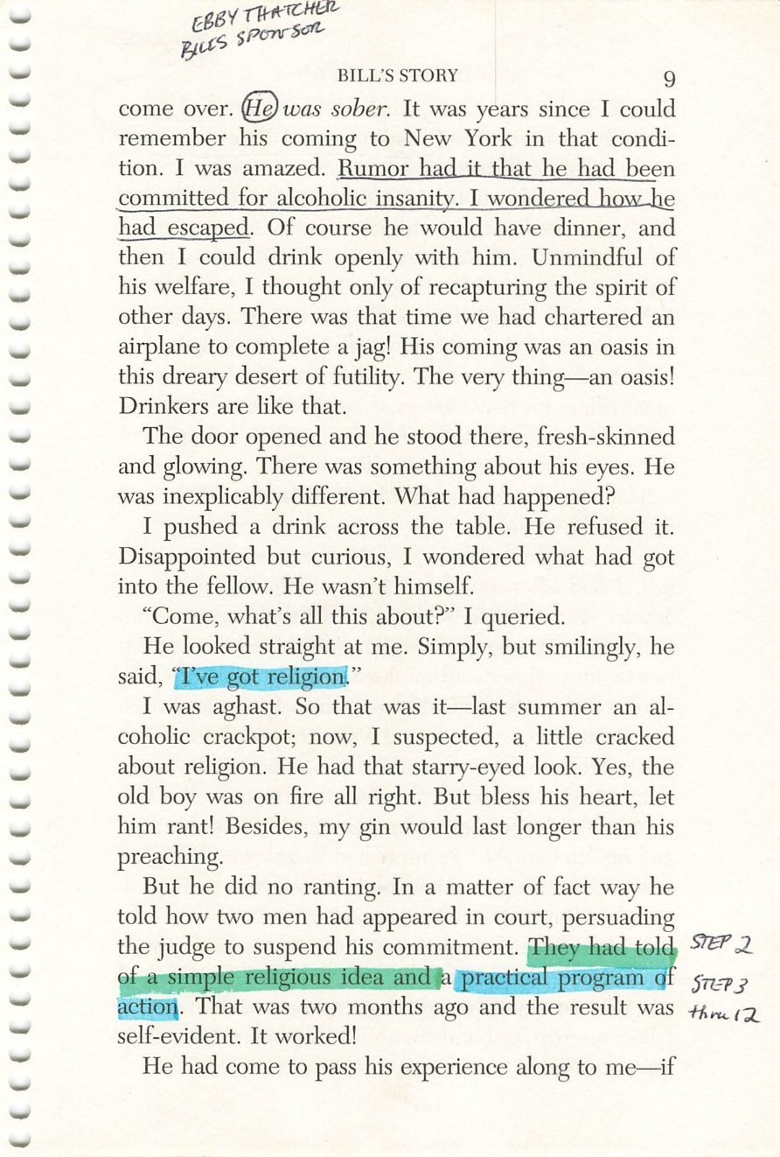
8
9
Copyright © Alcoholics Anonymous World Services, Inc. All rights reserved. Intended for personal use only, and not to be reproduced further or distributed for resale.

Slide 31
Ebby Thatcher
Page 9
PHOTO
Bill’s sponsor.
Drop the image into this frame in PowerPoint.
Credit:

Slide 32
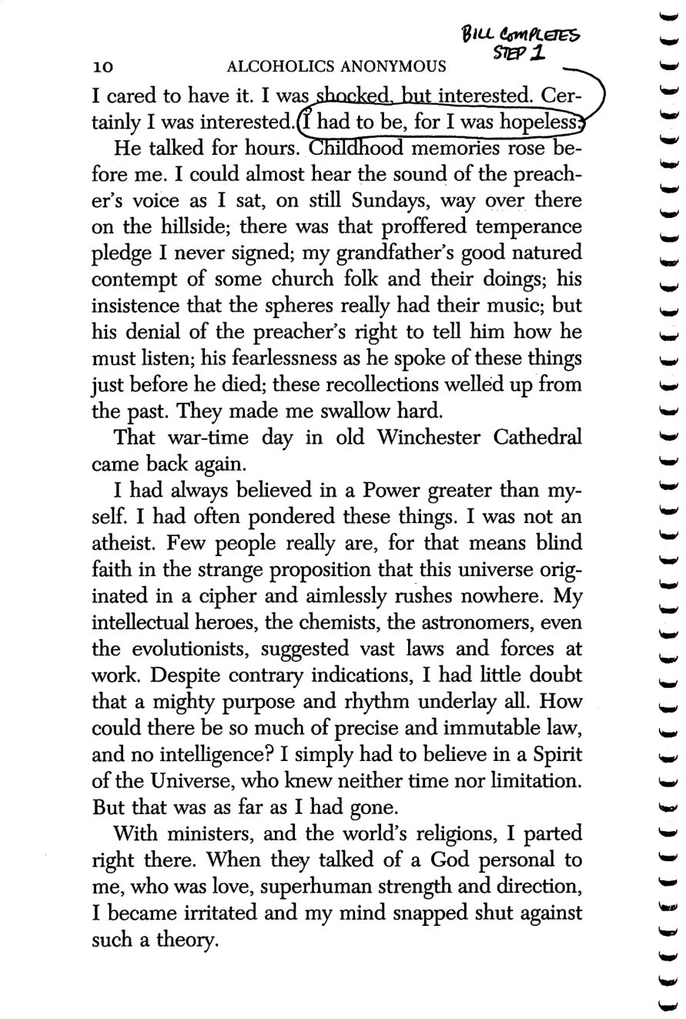
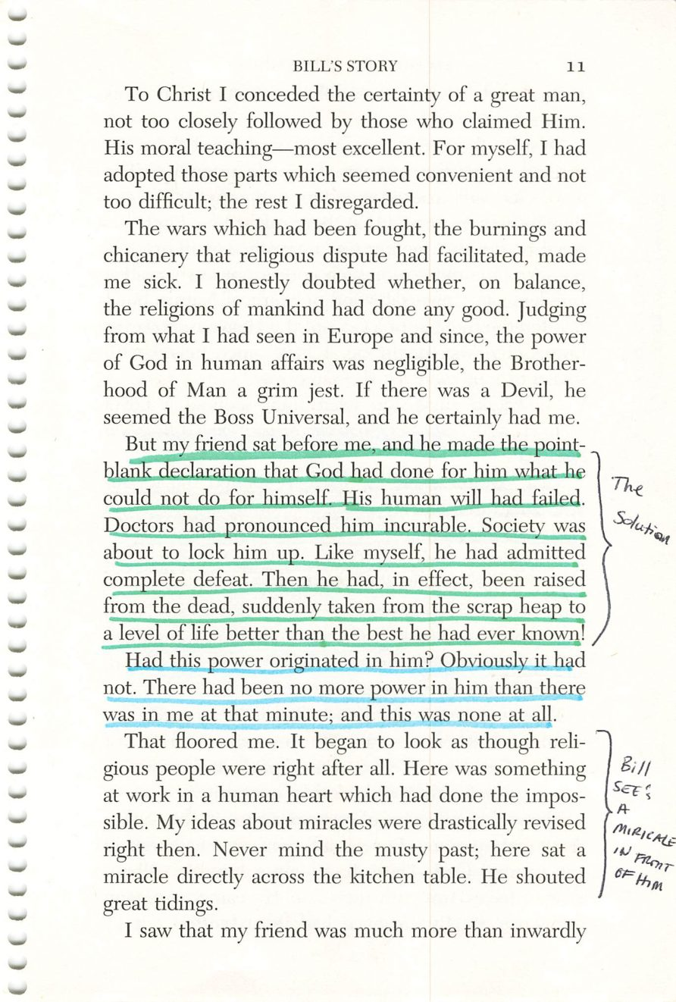
10
11
Copyright © Alcoholics Anonymous World Services, Inc. All rights reserved. Intended for personal use only, and not to be reproduced further or distributed for resale.

Slide 33
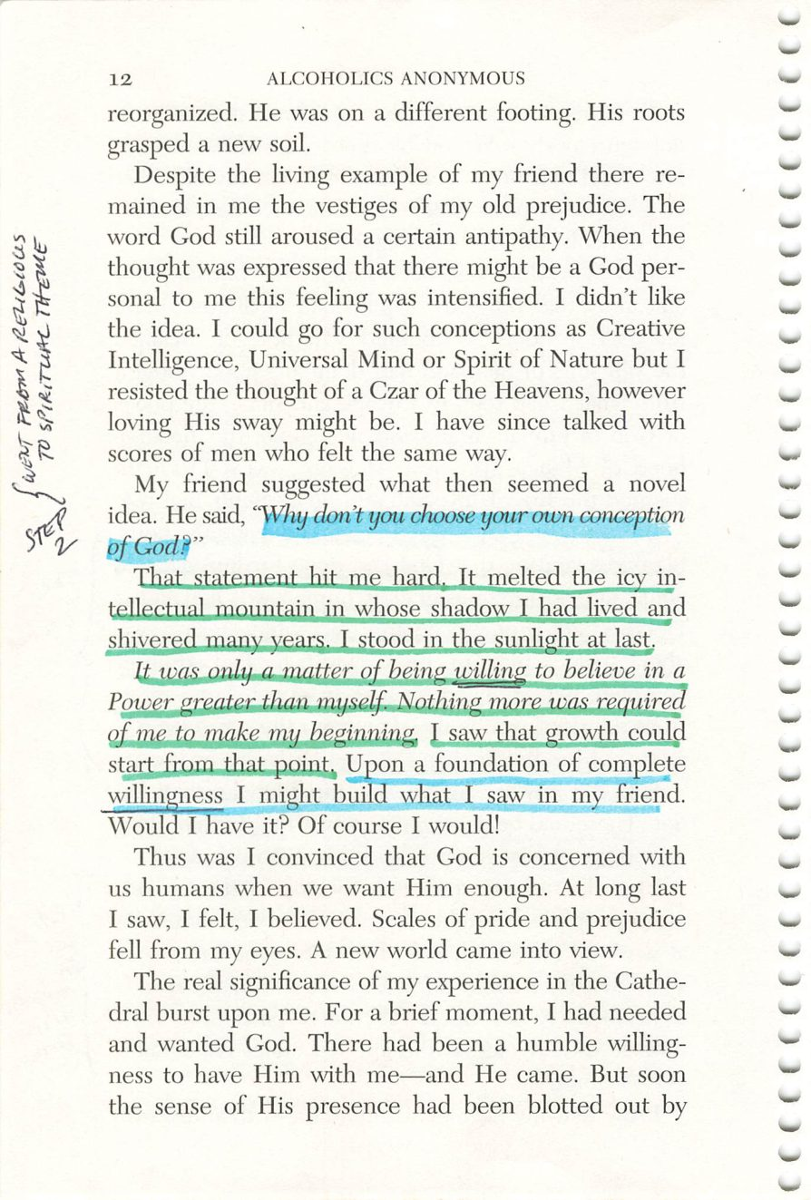
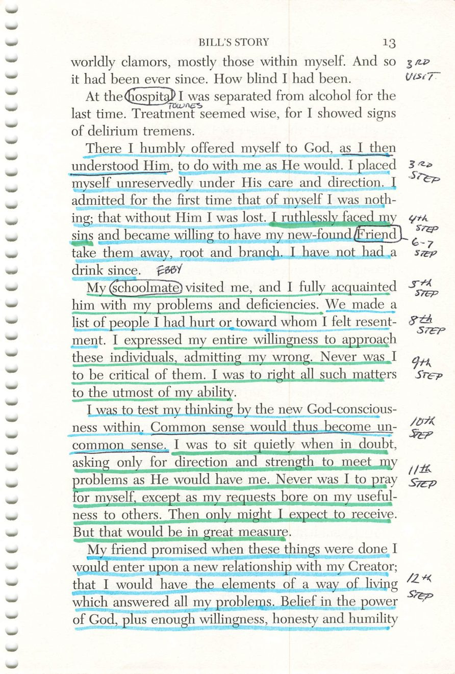
12
13
Copyright © Alcoholics Anonymous World Services, Inc. All rights reserved. Intended for personal use only, and not to be reproduced further or distributed for resale.

Slide 34
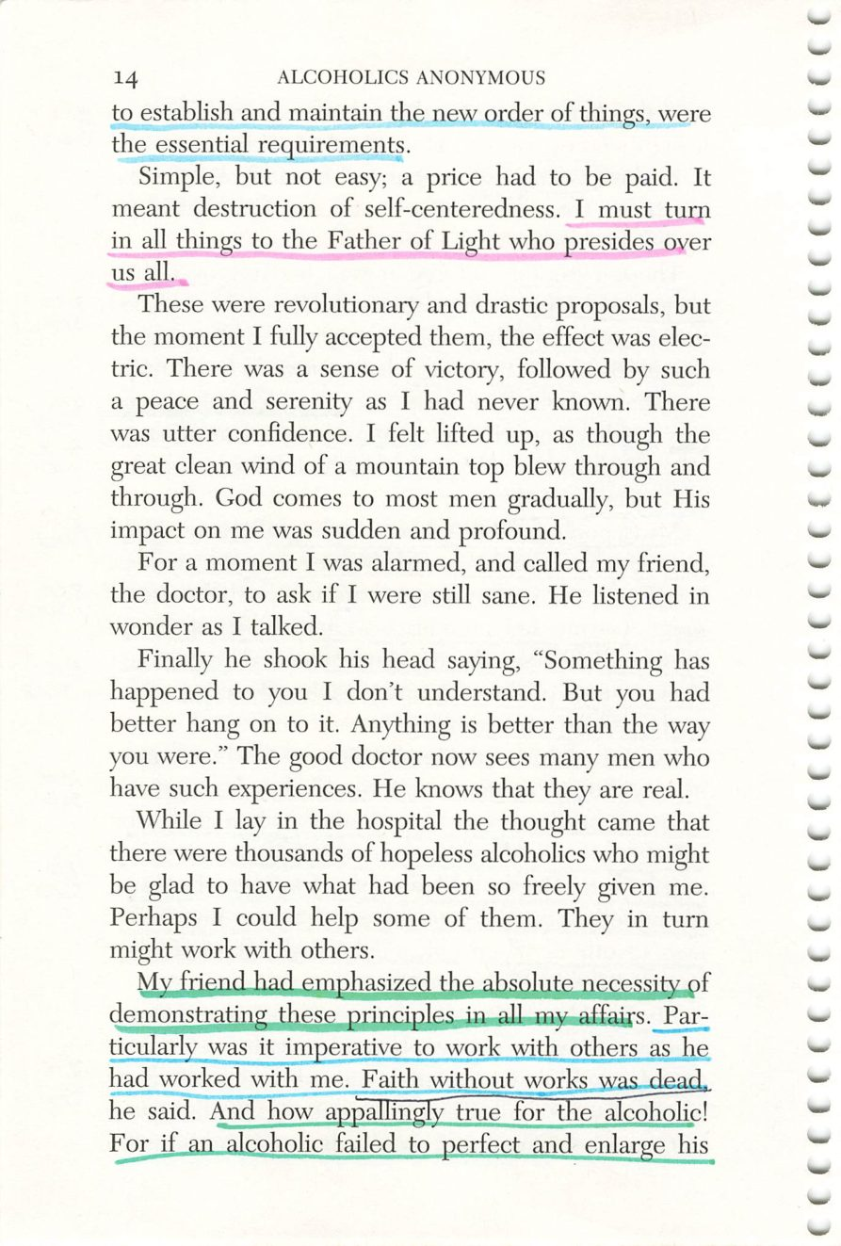
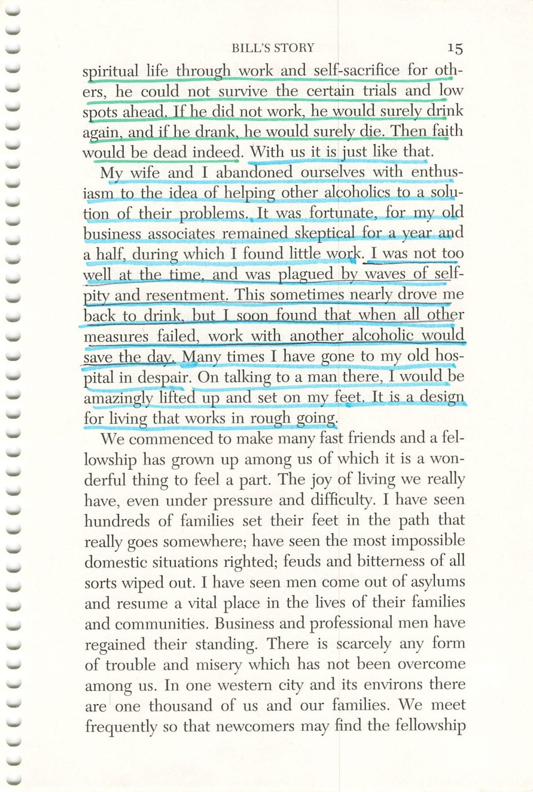
14
15
Copyright © Alcoholics Anonymous World Services, Inc. All rights reserved. Intended for personal use only, and not to be reproduced further or distributed for resale.

Slide 35
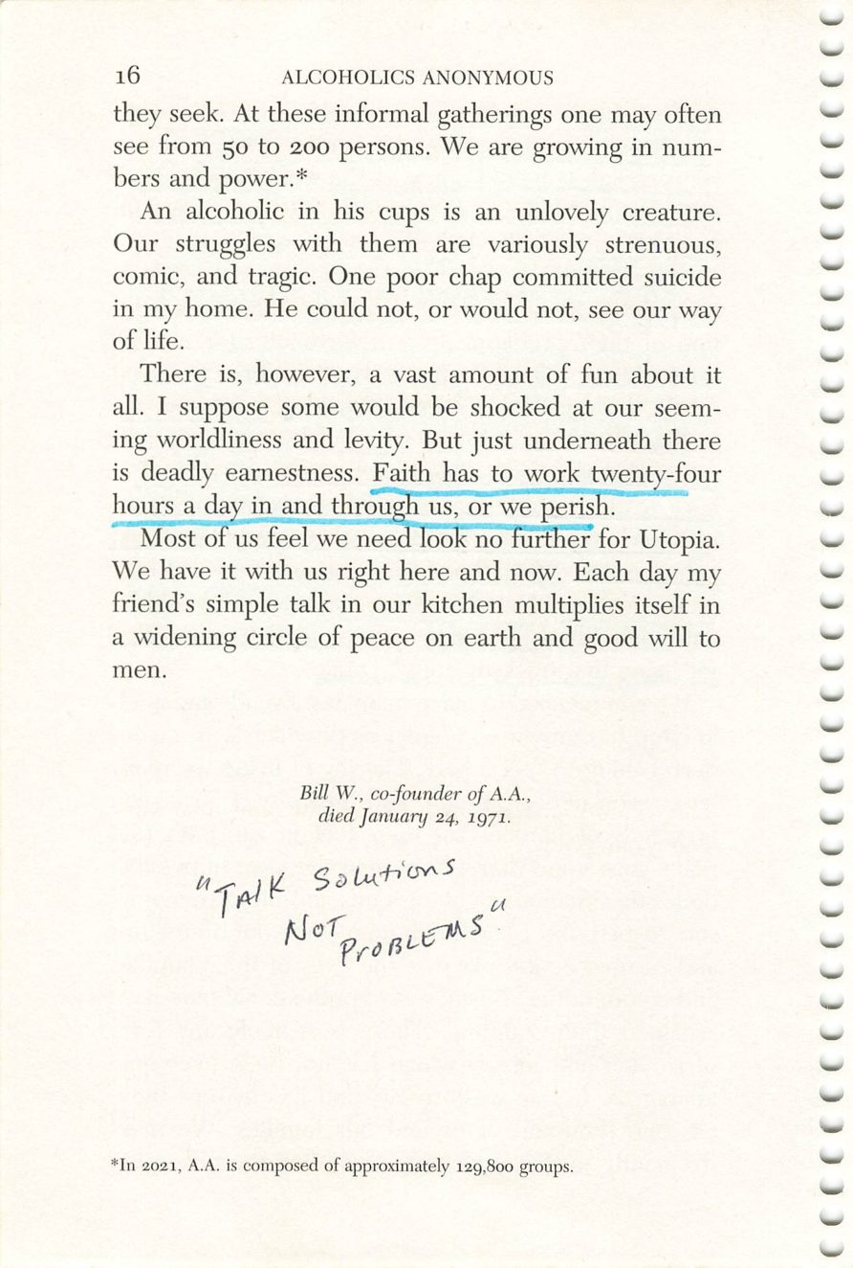
16
Copyright © Alcoholics Anonymous World Services, Inc. All rights reserved. Intended for personal use only, and not to be reproduced further or distributed for resale.

