Slide 1
Big Book Study Group
by District 23
There Is a Solution — Pages 17 to 72
903 Court Street, Port Huron
Wednesdays · 7:00 PM

Slide 2
Copyright Notice
“These materials are copyright © by Alcoholics Anonymous World Services, Inc. ("A.A.W.S."). All rights reserved. Individual printing or photocopying of a single copy is permitted. Intended for personal use only, and not to be reproduced further or distributed for resale.”
Displayed at the request of A.A. World Services, Inc. Reproduced with permission for use during this A.A. meeting.

Slide 3
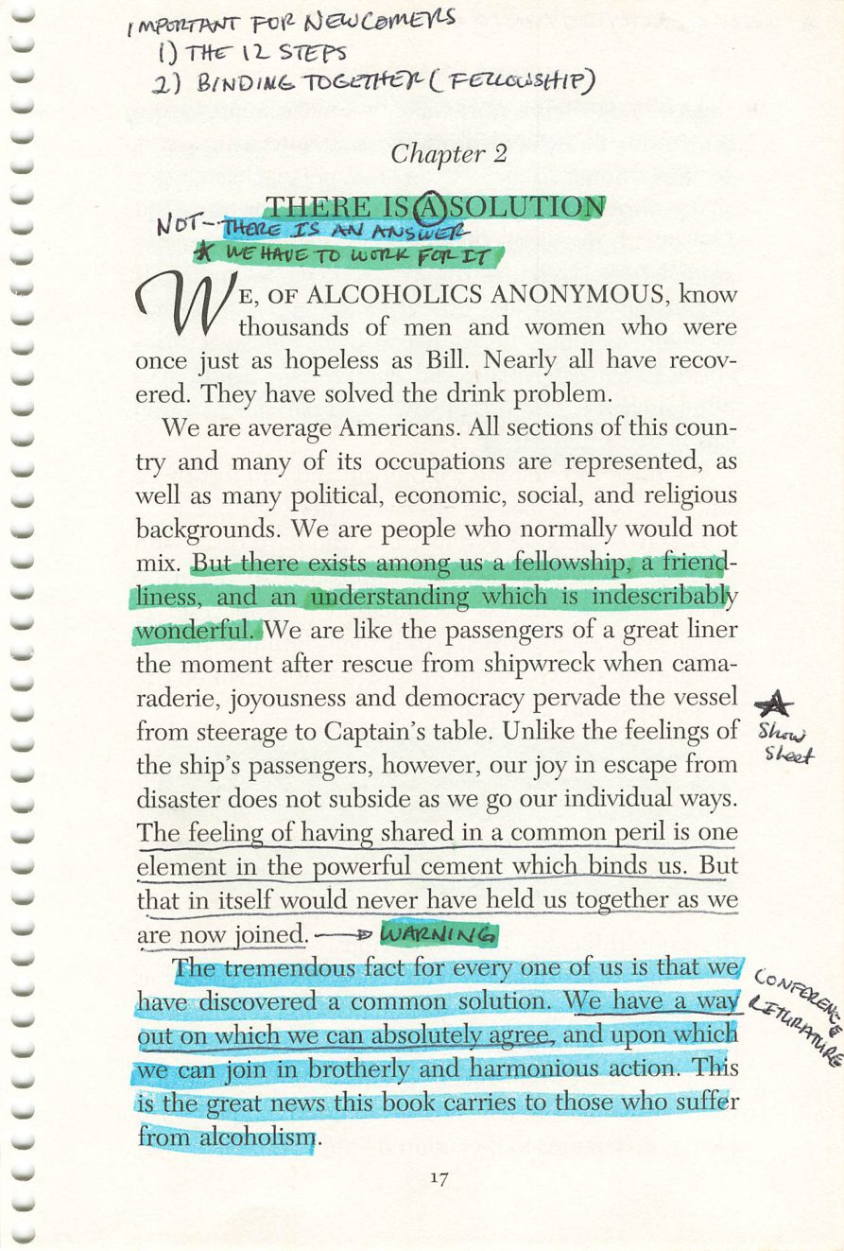
Copyright © Alcoholics Anonymous World Services, Inc. All rights reserved. Intended for personal use only, and not to be reproduced further or distributed for resale.
17

Slide 4
The Fellowship
Page 17
DIAGRAM
Diagram.
Drop the image into this frame in PowerPoint.
Credit:

Slide 5
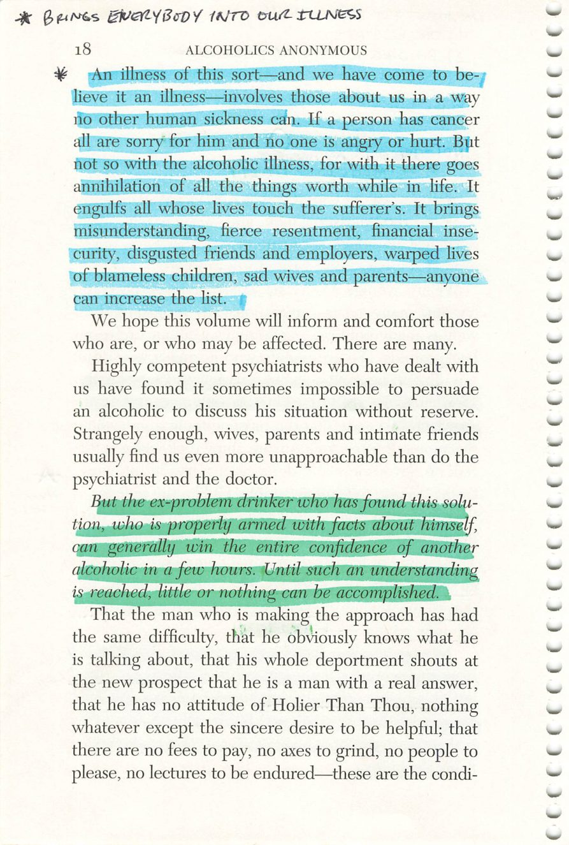
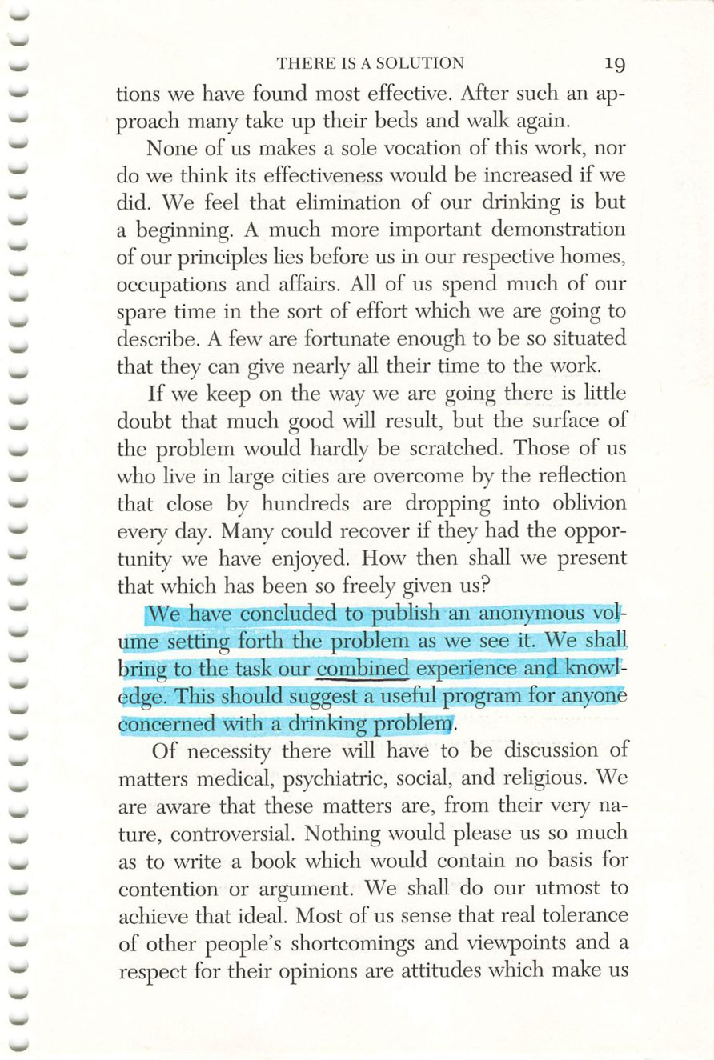
18
19
Copyright © Alcoholics Anonymous World Services, Inc. All rights reserved. Intended for personal use only, and not to be reproduced further or distributed for resale.

Slide 6
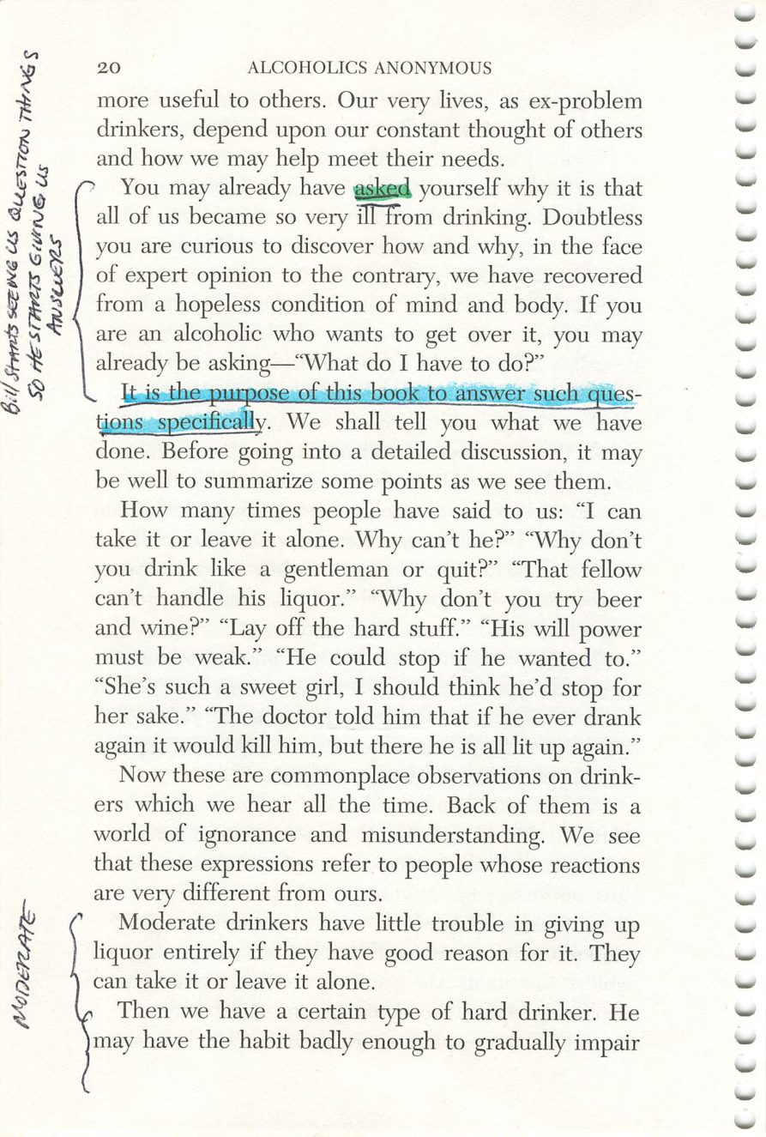
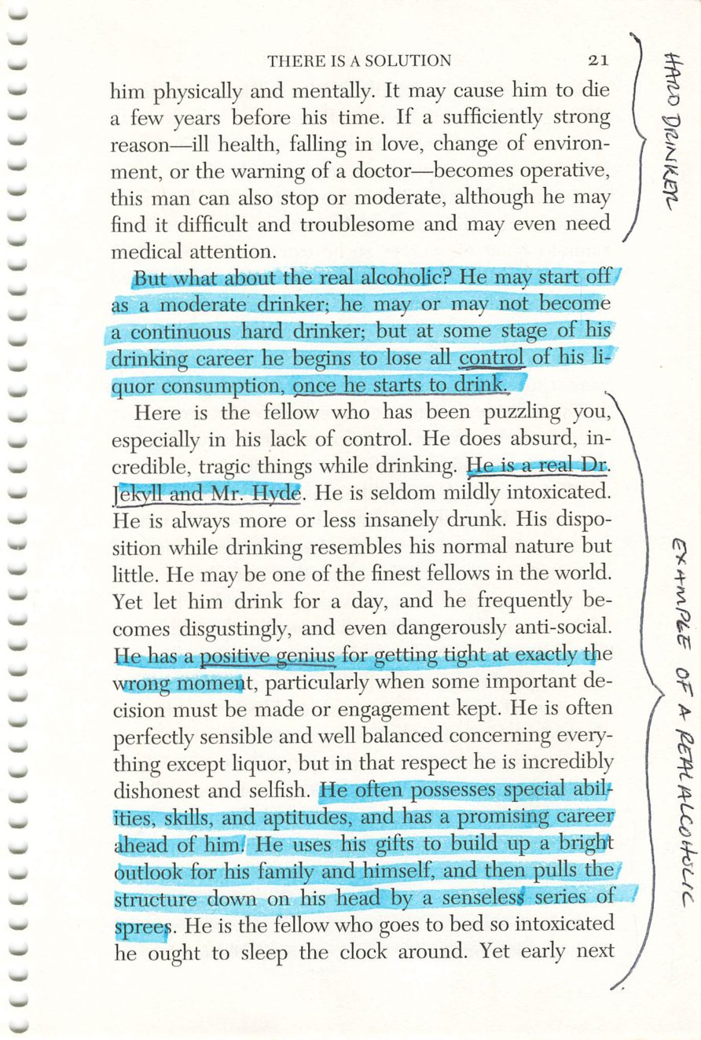
20
21
Copyright © Alcoholics Anonymous World Services, Inc. All rights reserved. Intended for personal use only, and not to be reproduced further or distributed for resale.

Slide 7
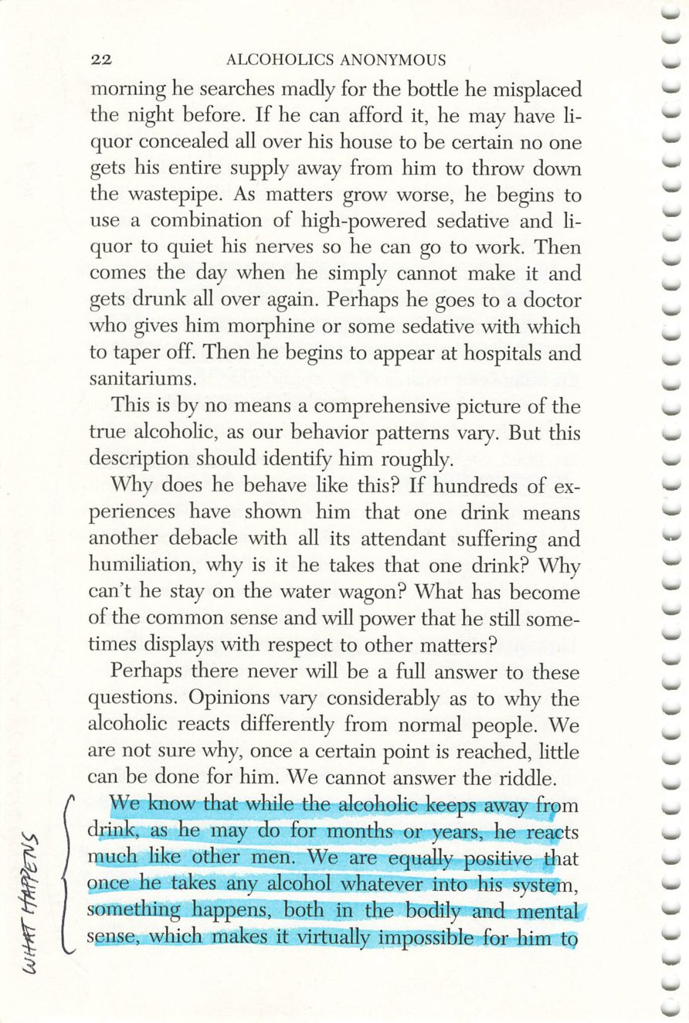
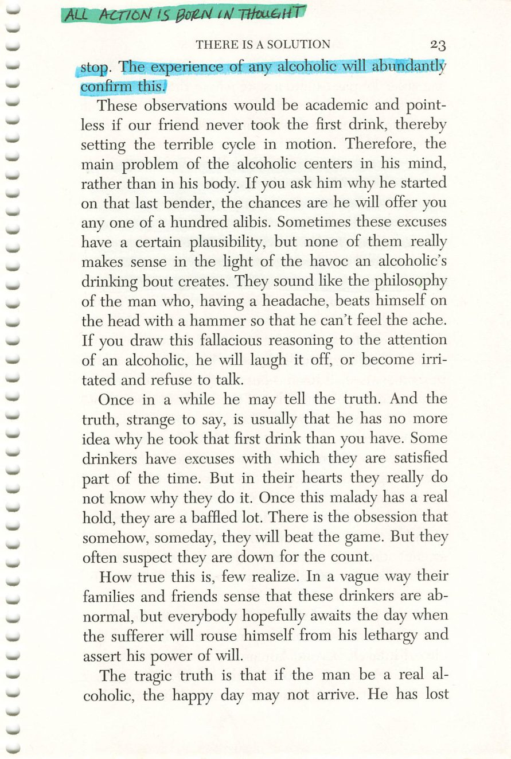
22
23
Copyright © Alcoholics Anonymous World Services, Inc. All rights reserved. Intended for personal use only, and not to be reproduced further or distributed for resale.

Slide 8
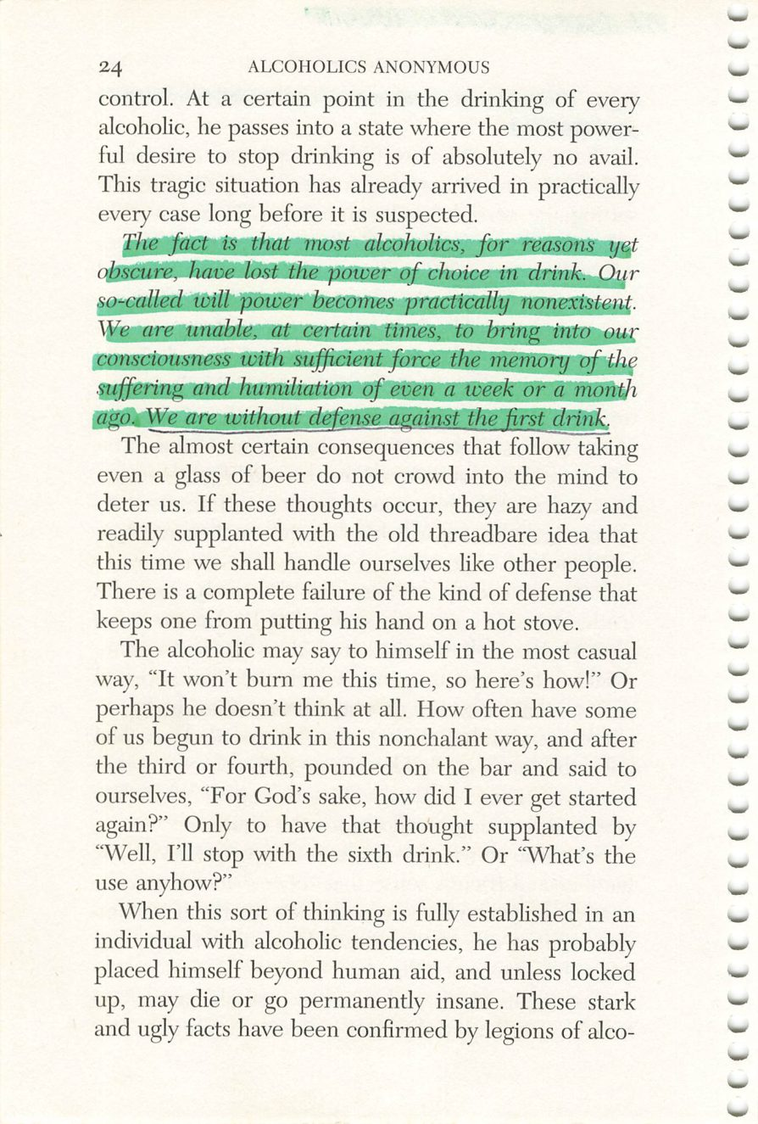
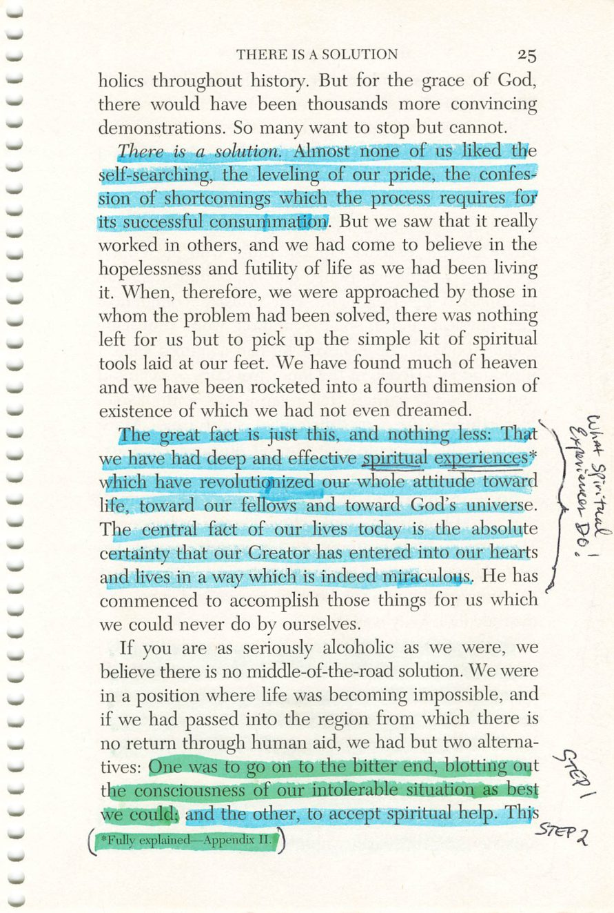
24
25
Copyright © Alcoholics Anonymous World Services, Inc. All rights reserved. Intended for personal use only, and not to be reproduced further or distributed for resale.

Slide 9
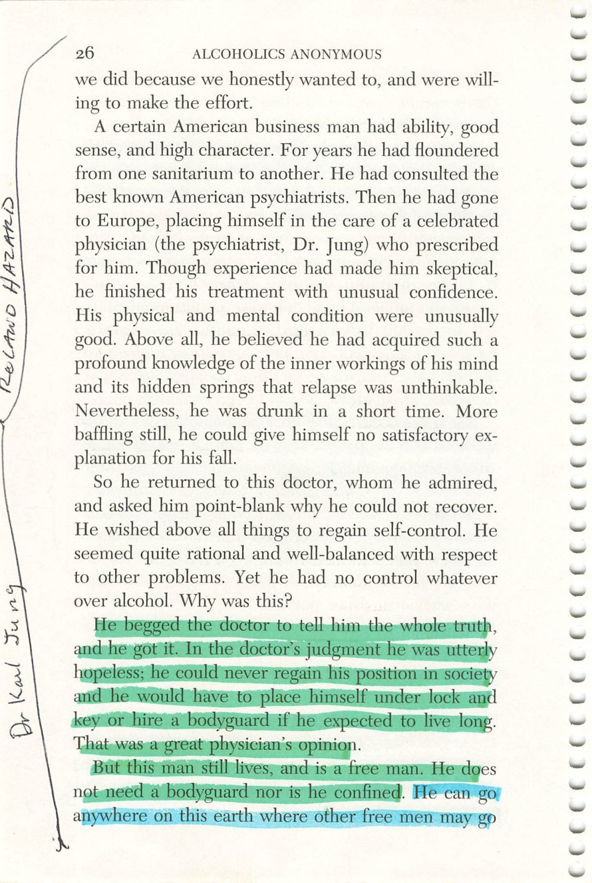
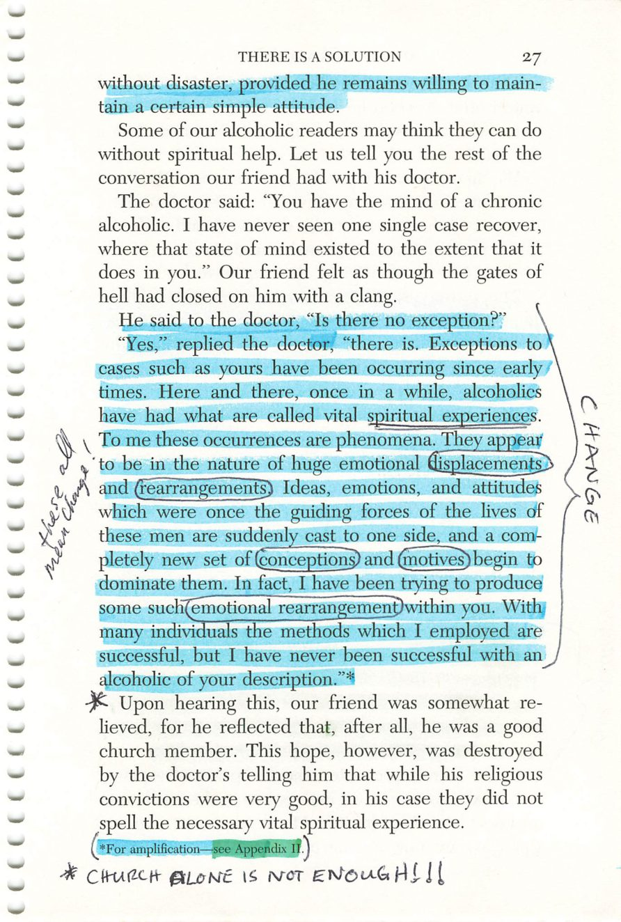
26
27
Copyright © Alcoholics Anonymous World Services, Inc. All rights reserved. Intended for personal use only, and not to be reproduced further or distributed for resale.

Slide 10
Dr. Carl Jung
Page 26
PHOTO
Photograph.
Drop the image into this frame in PowerPoint.
Credit:

Slide 11
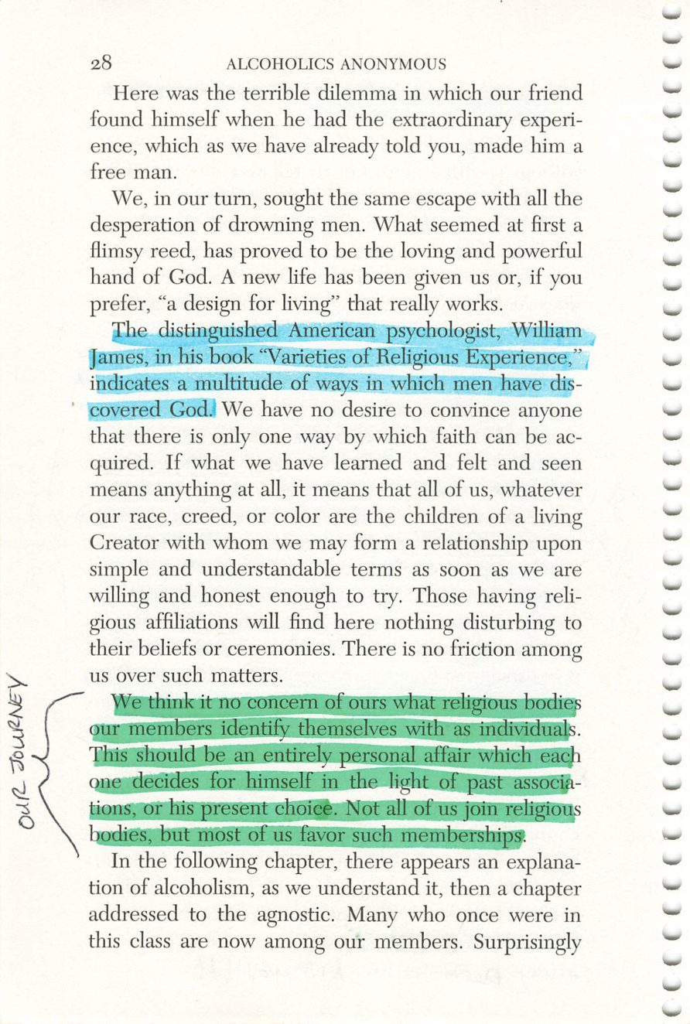
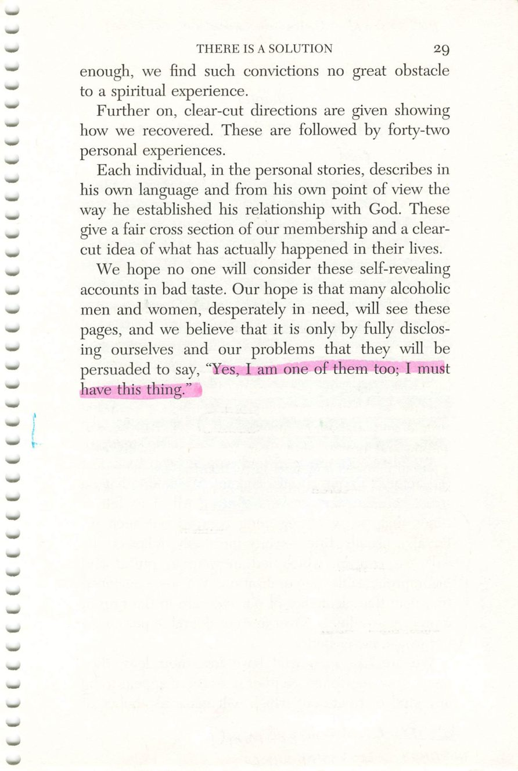
28
29
Copyright © Alcoholics Anonymous World Services, Inc. All rights reserved. Intended for personal use only, and not to be reproduced further or distributed for resale.

Slide 12
William James
Page 28
PHOTO
Photograph.
Drop the image into this frame in PowerPoint.
Credit:

Slide 13
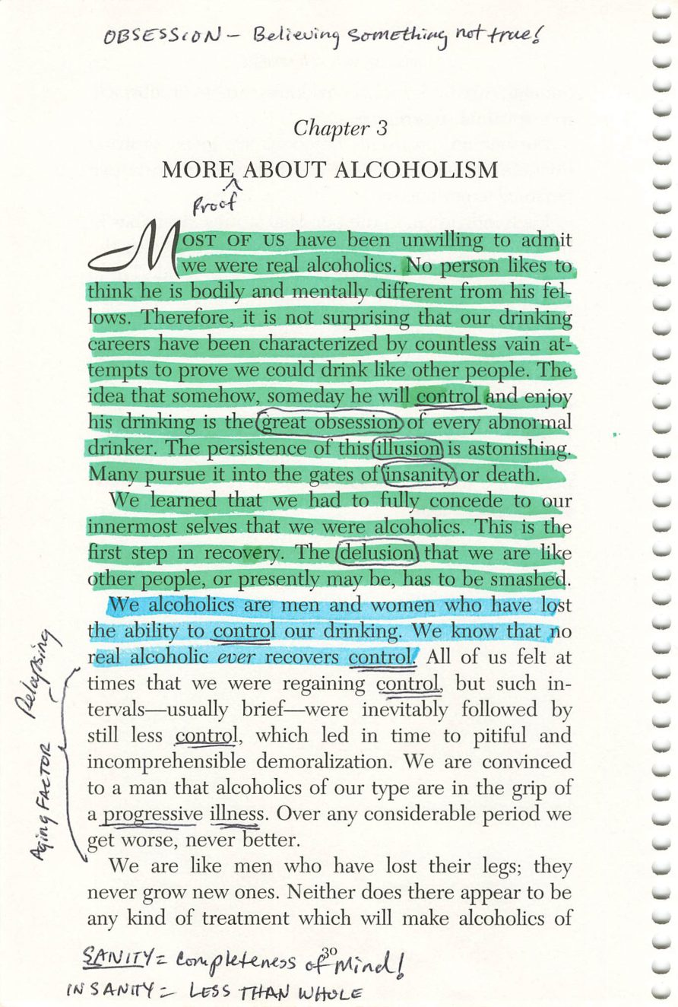
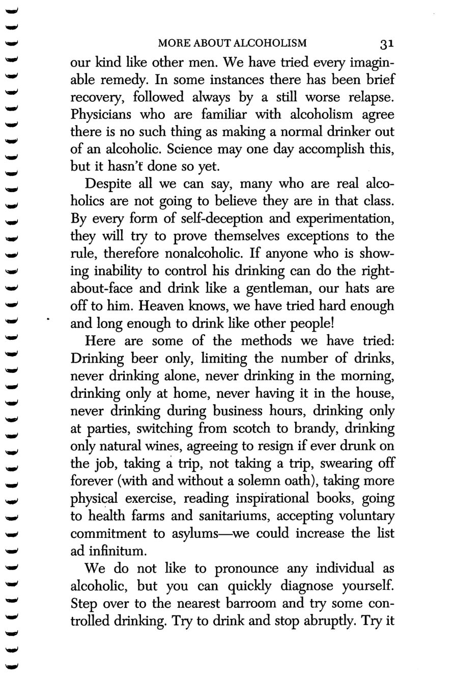
30
31
Copyright © Alcoholics Anonymous World Services, Inc. All rights reserved. Intended for personal use only, and not to be reproduced further or distributed for resale.

Slide 14
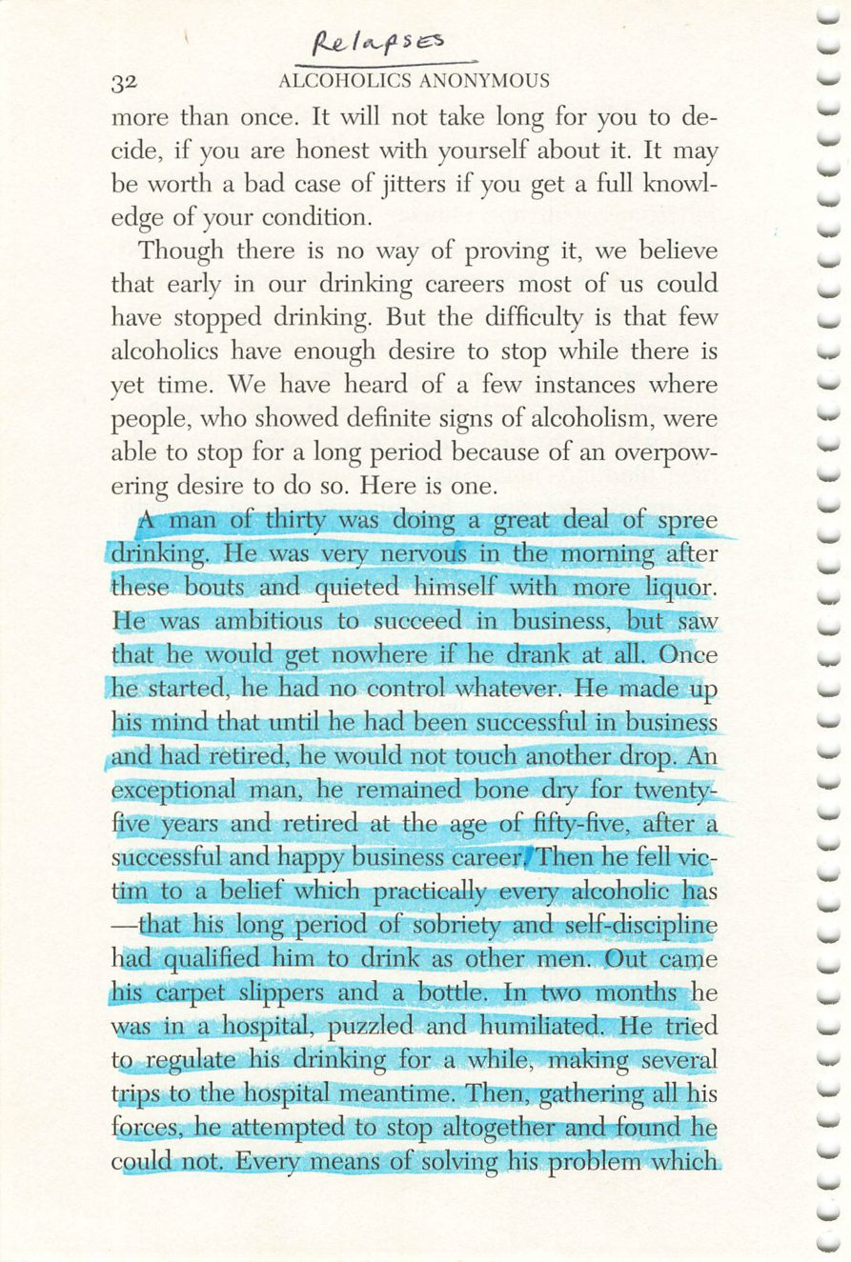
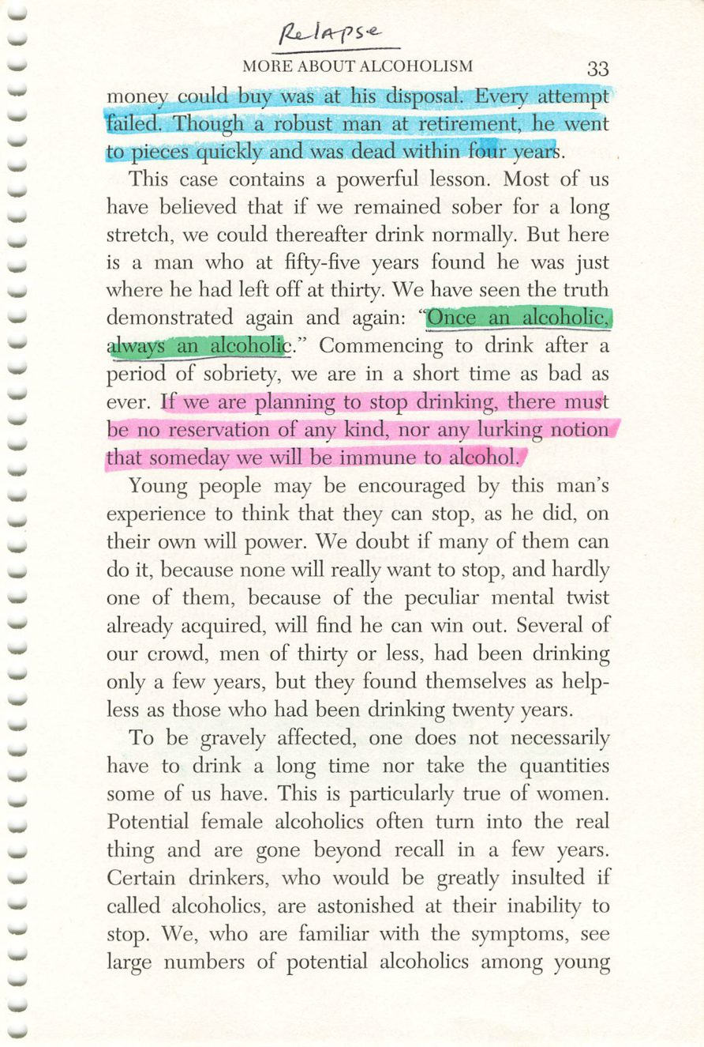
32
33
Copyright © Alcoholics Anonymous World Services, Inc. All rights reserved. Intended for personal use only, and not to be reproduced further or distributed for resale.

Slide 15
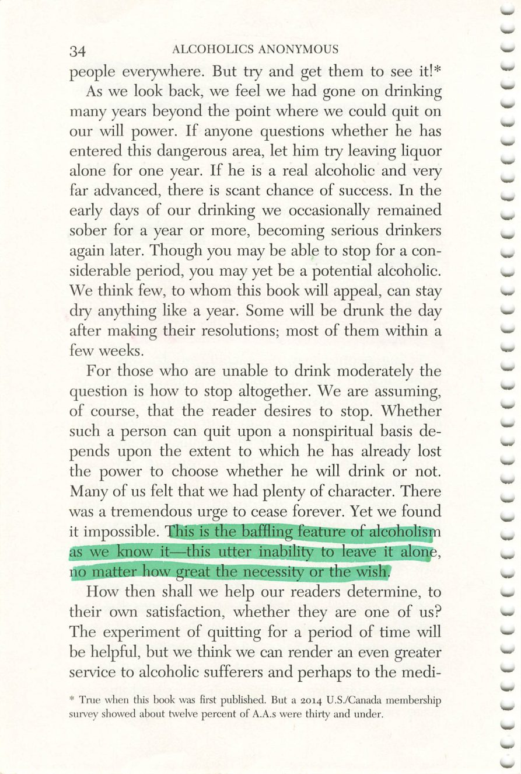
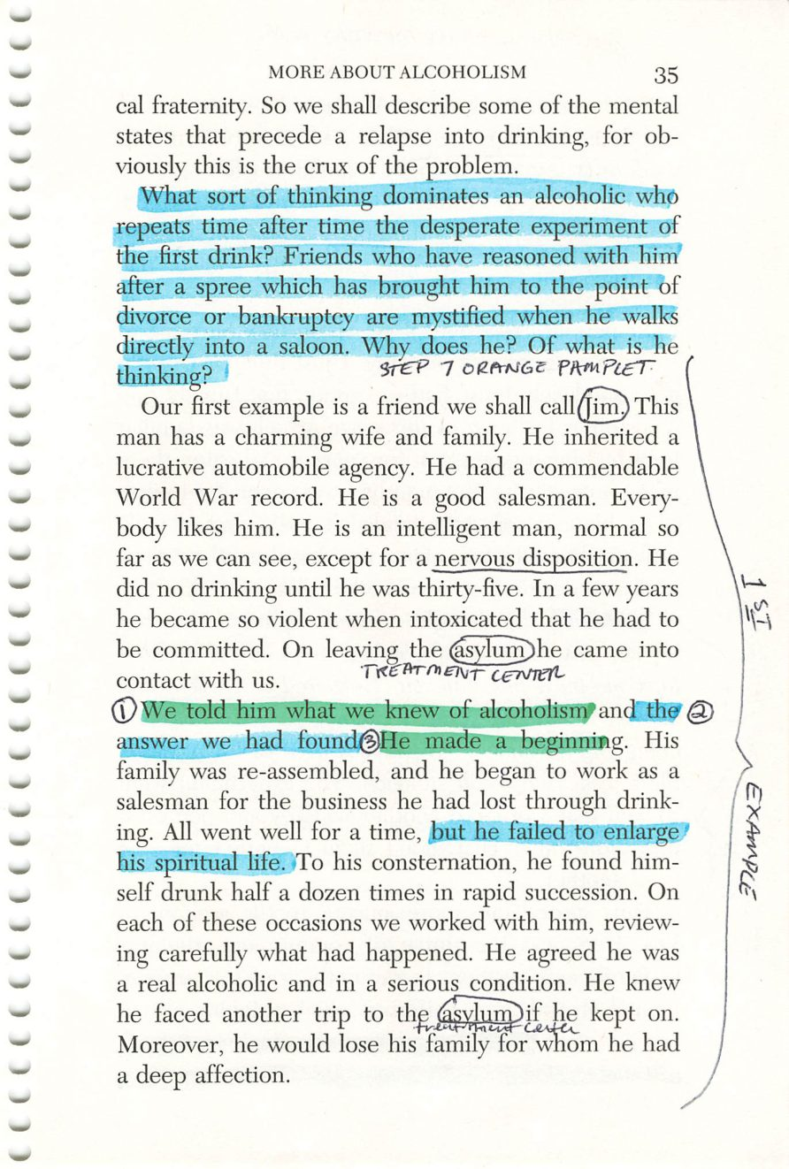
34
35
Copyright © Alcoholics Anonymous World Services, Inc. All rights reserved. Intended for personal use only, and not to be reproduced further or distributed for resale.

Slide 16
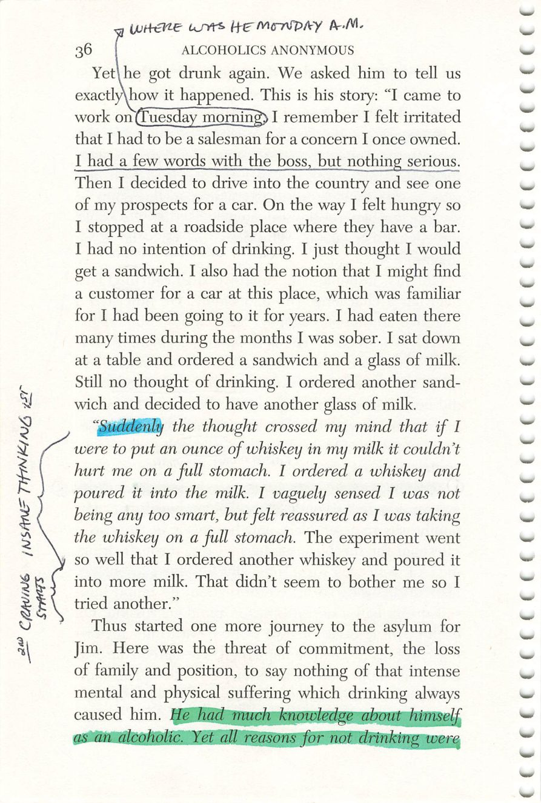
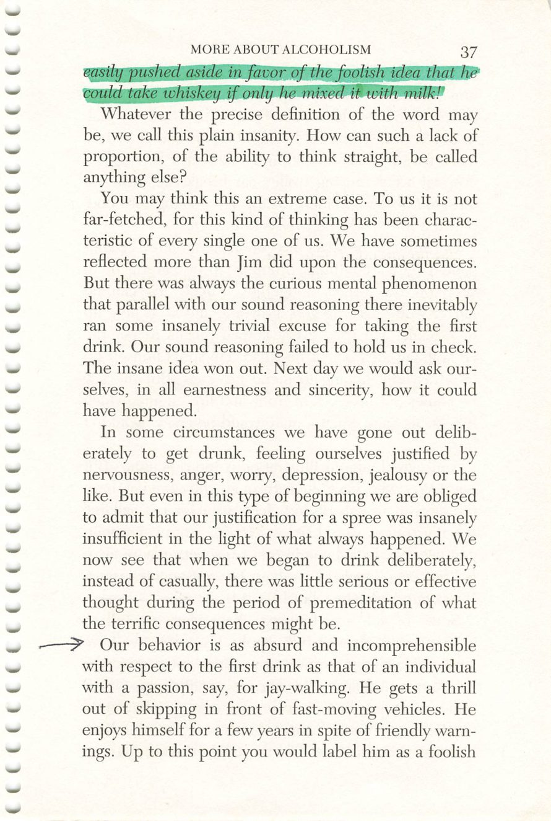
36
37
Copyright © Alcoholics Anonymous World Services, Inc. All rights reserved. Intended for personal use only, and not to be reproduced further or distributed for resale.

Slide 17
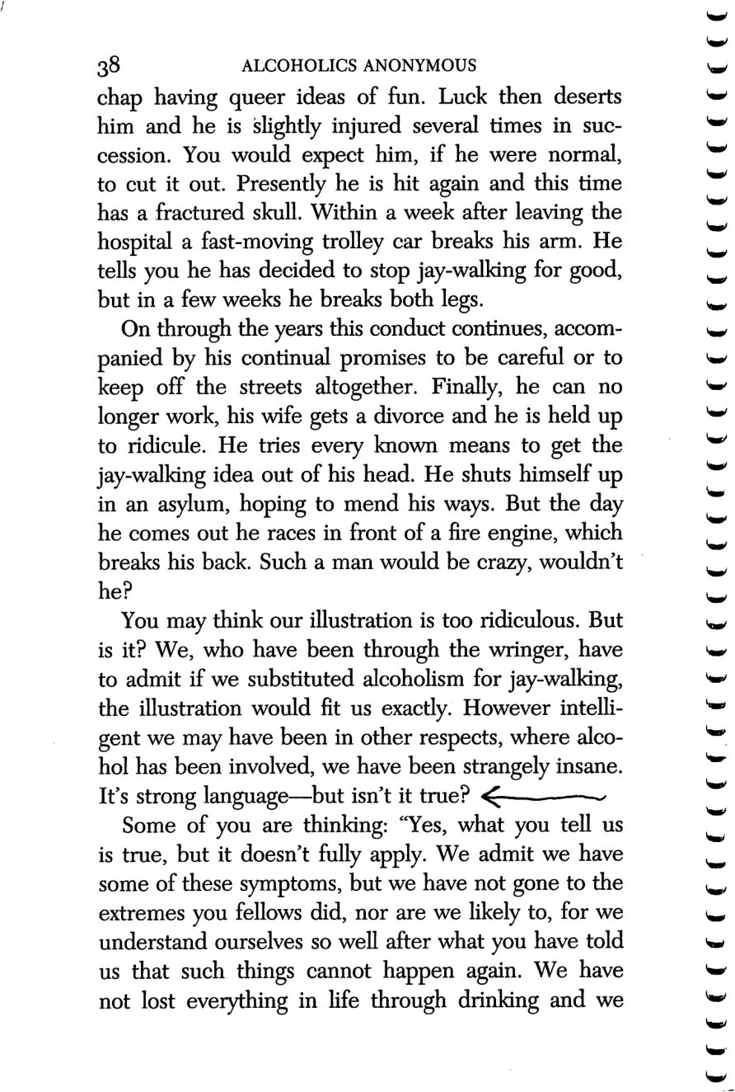
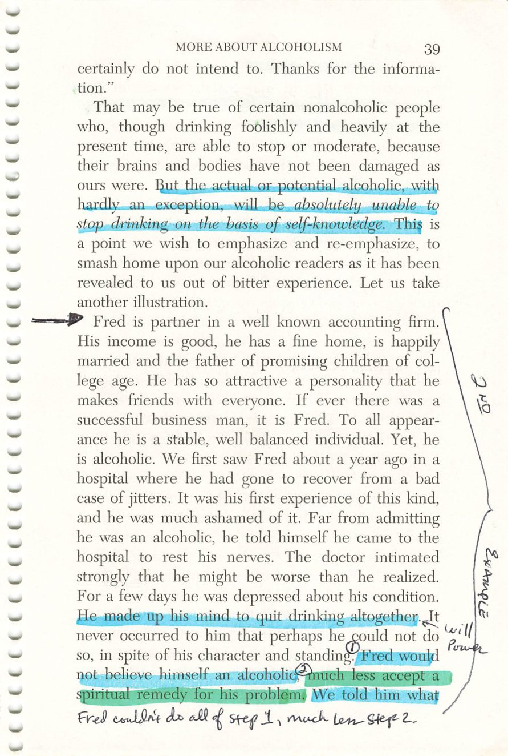
38
39
Copyright © Alcoholics Anonymous World Services, Inc. All rights reserved. Intended for personal use only, and not to be reproduced further or distributed for resale.

Slide 18
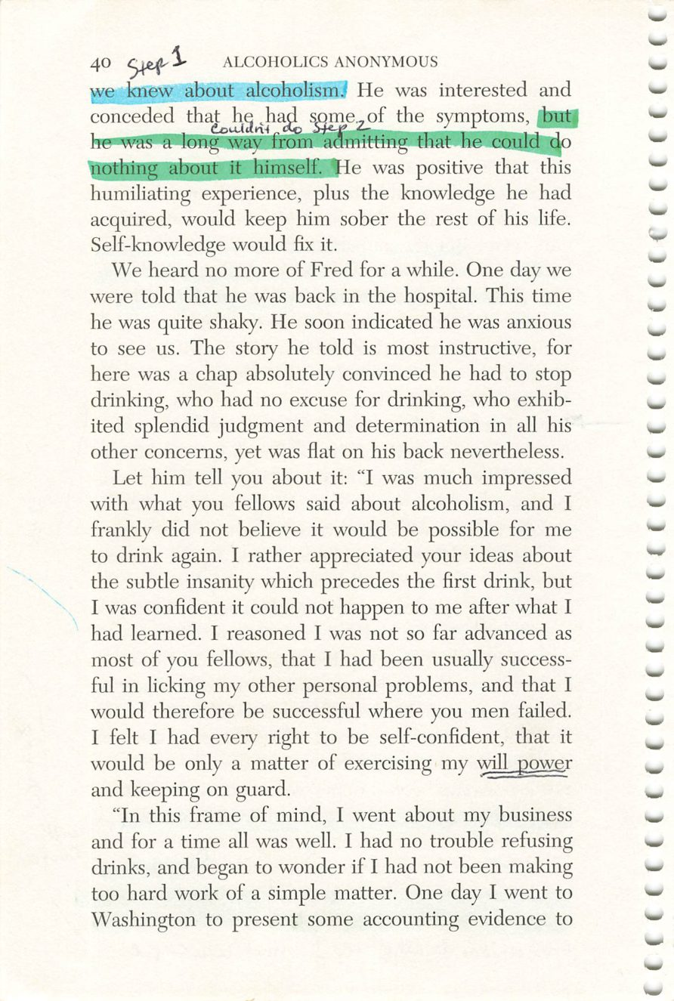
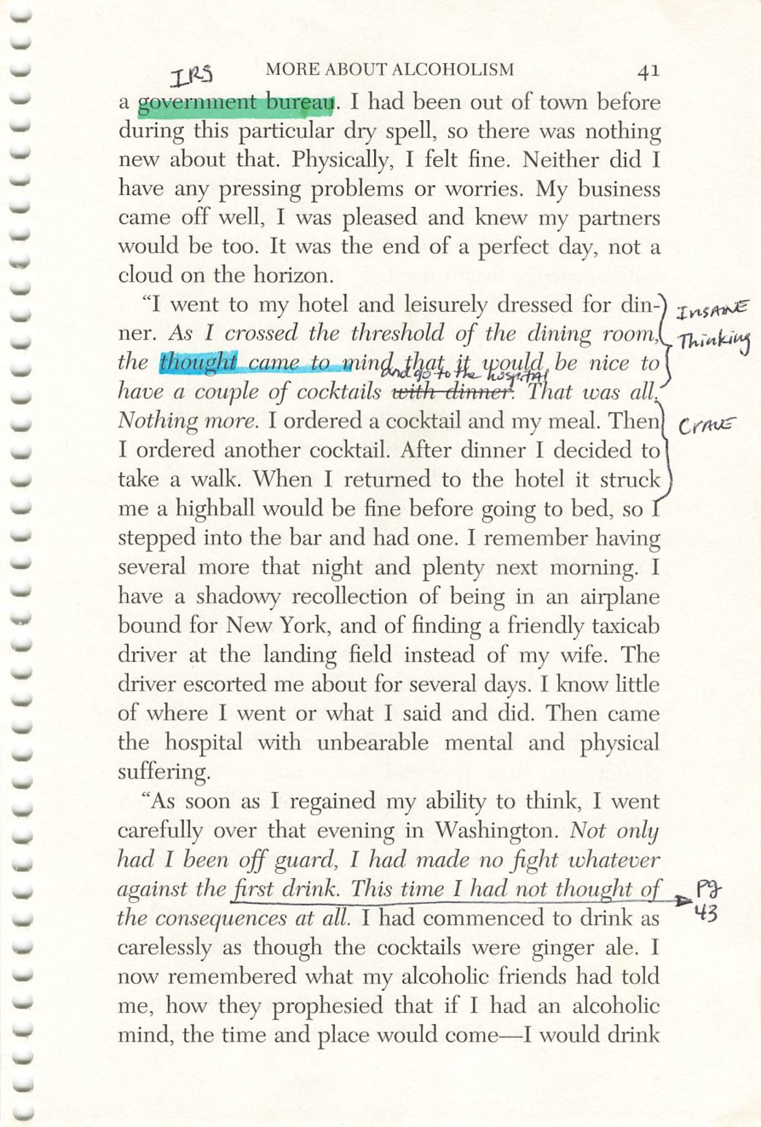
40
41
Copyright © Alcoholics Anonymous World Services, Inc. All rights reserved. Intended for personal use only, and not to be reproduced further or distributed for resale.

Slide 19
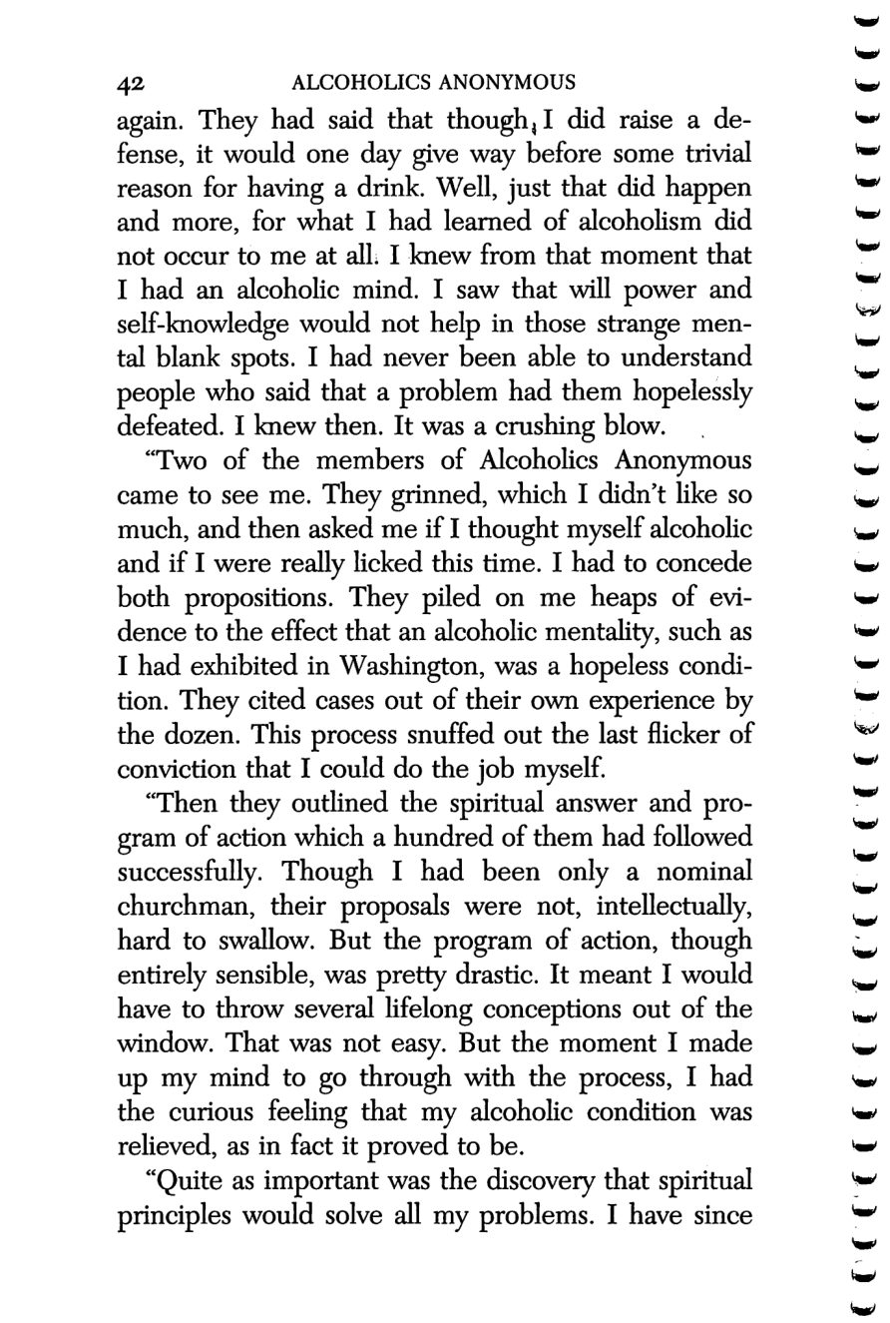
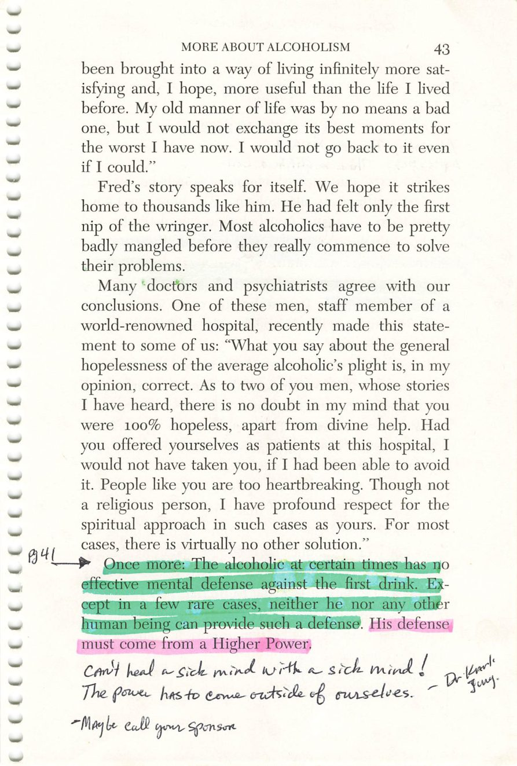
42
43
Copyright © Alcoholics Anonymous World Services, Inc. All rights reserved. Intended for personal use only, and not to be reproduced further or distributed for resale.

Slide 20
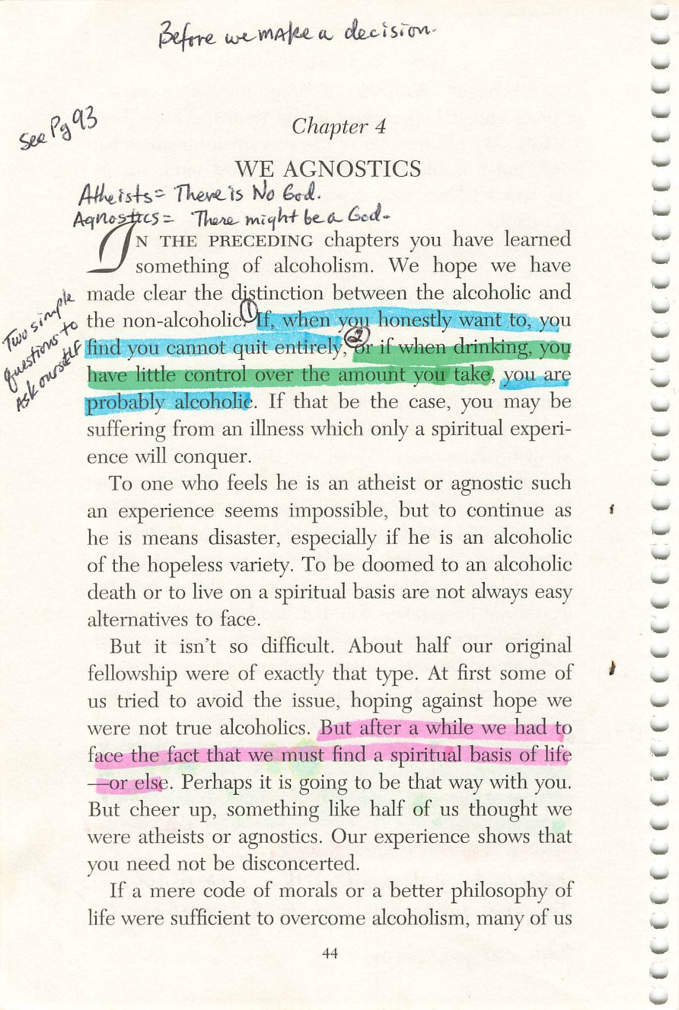
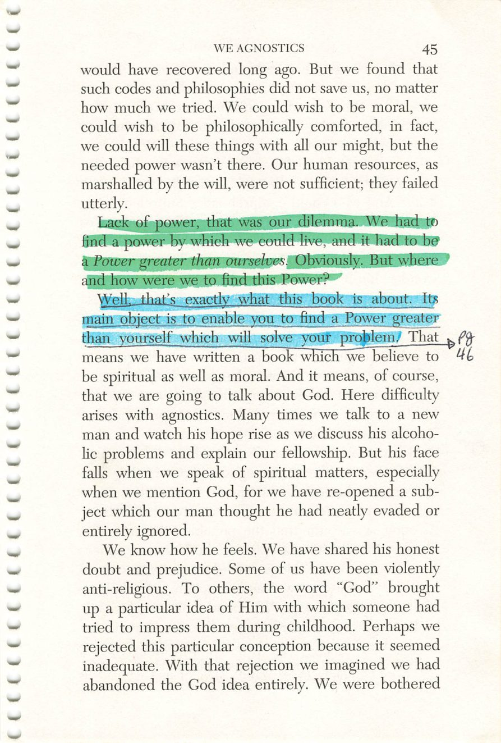
44
45
Copyright © Alcoholics Anonymous World Services, Inc. All rights reserved. Intended for personal use only, and not to be reproduced further or distributed for resale.

Slide 21
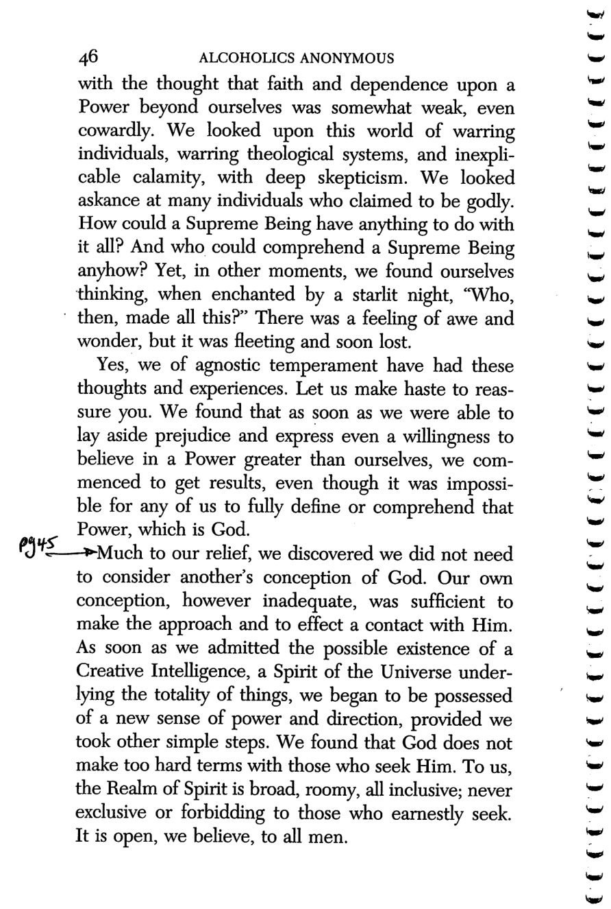
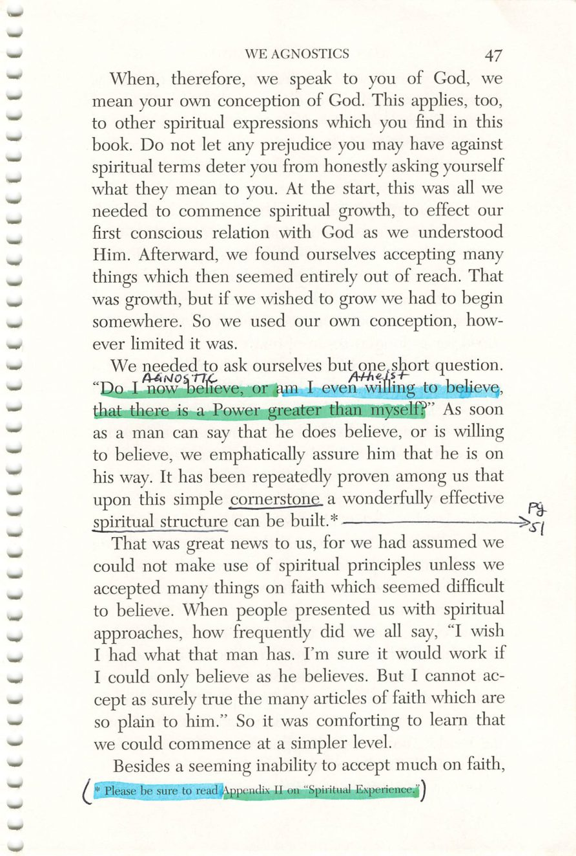
46
47
Copyright © Alcoholics Anonymous World Services, Inc. All rights reserved. Intended for personal use only, and not to be reproduced further or distributed for resale.

Slide 22
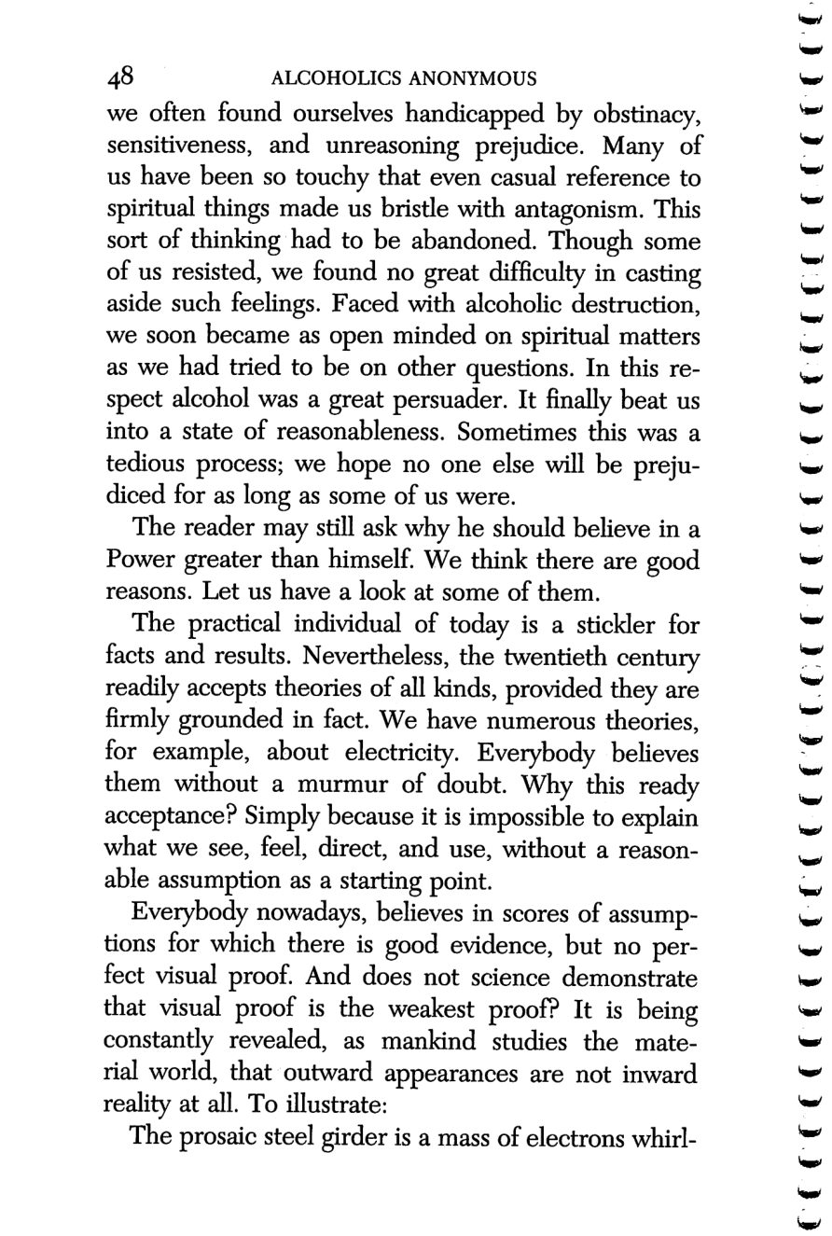
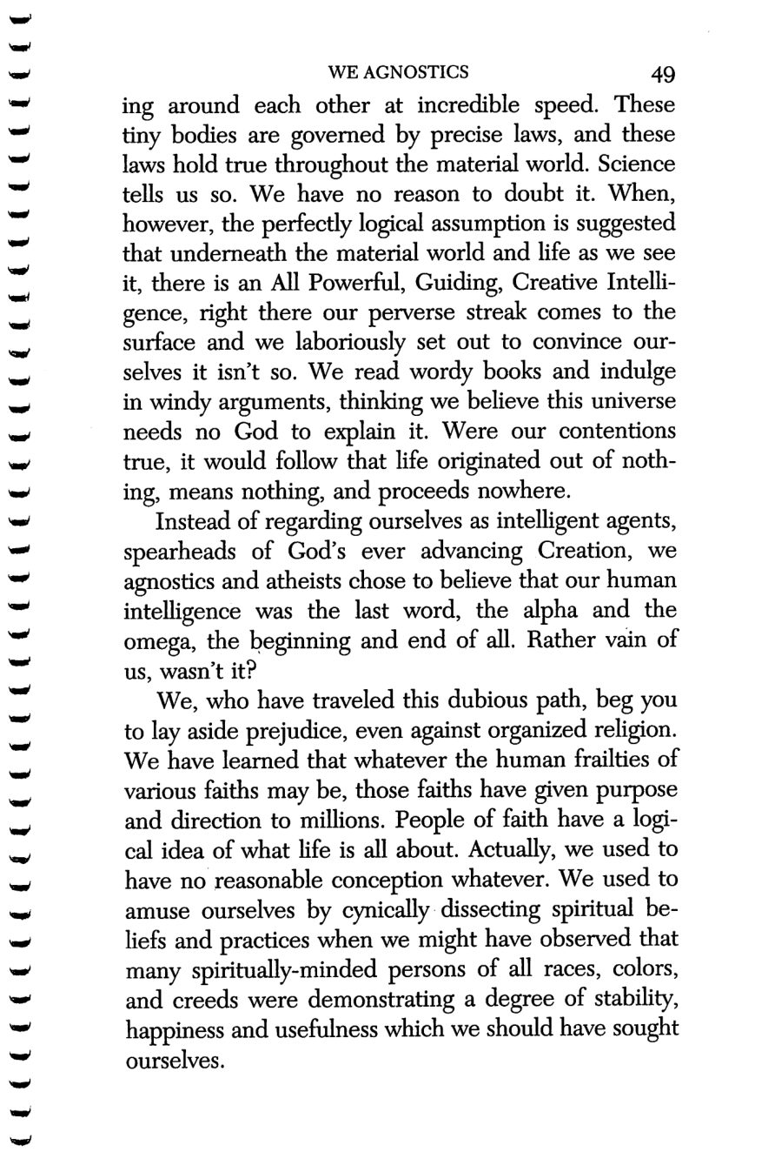
48
49
Copyright © Alcoholics Anonymous World Services, Inc. All rights reserved. Intended for personal use only, and not to be reproduced further or distributed for resale.

Slide 23
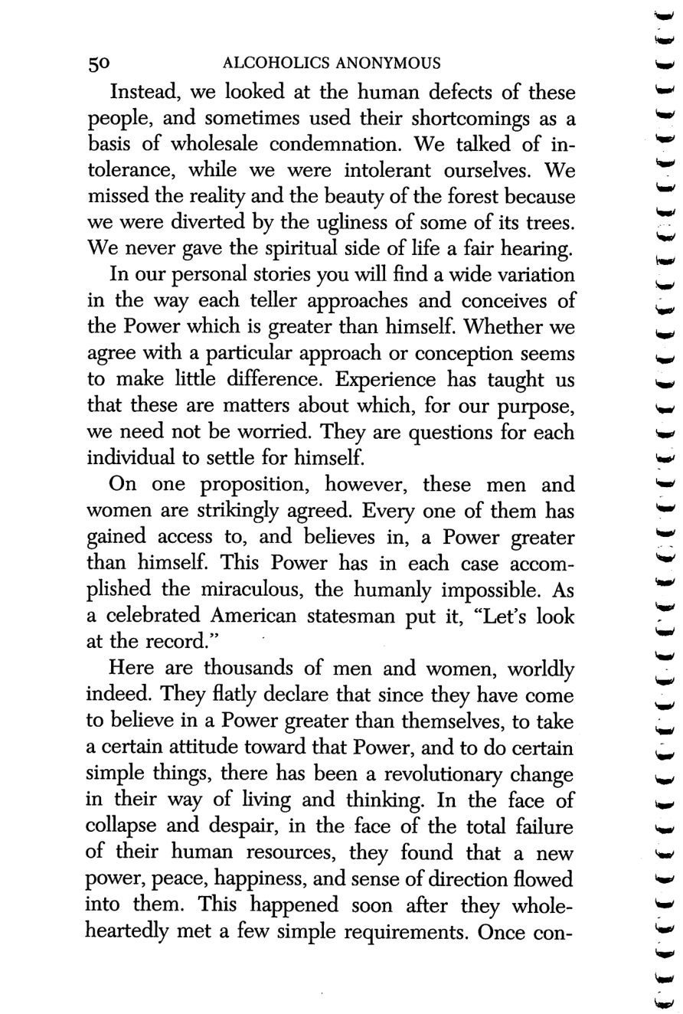
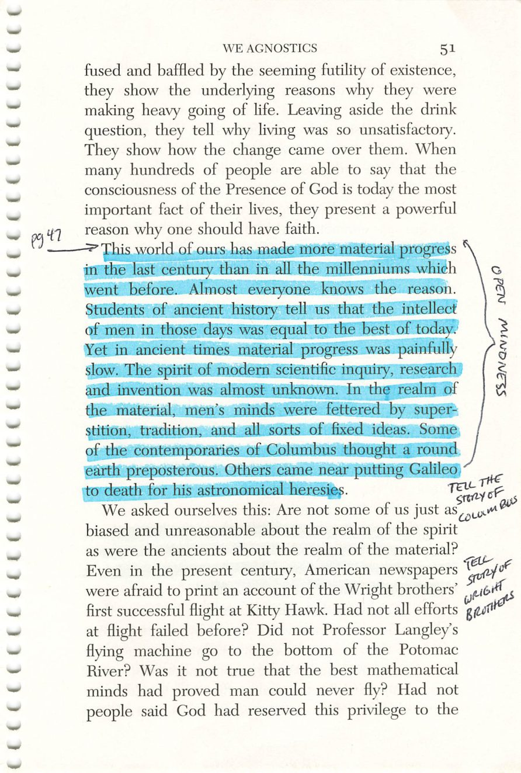
50
51
Copyright © Alcoholics Anonymous World Services, Inc. All rights reserved. Intended for personal use only, and not to be reproduced further or distributed for resale.

Slide 24
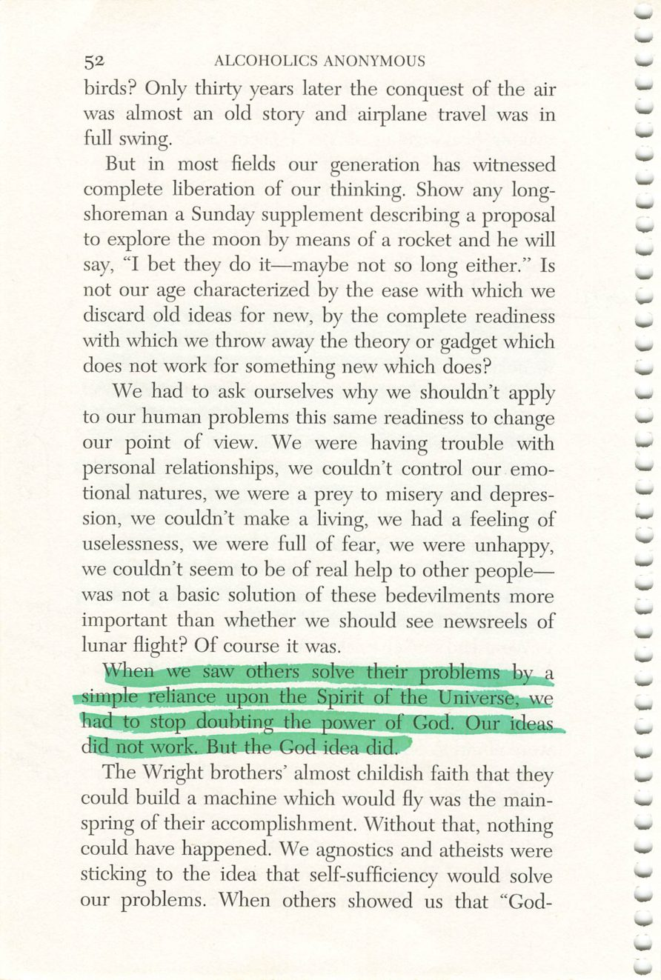
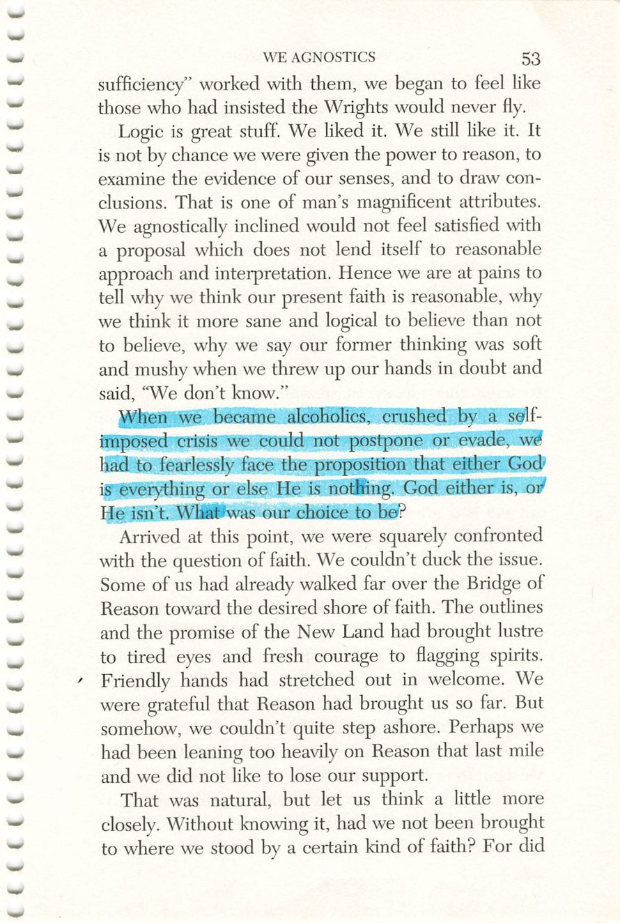
52
53
Copyright © Alcoholics Anonymous World Services, Inc. All rights reserved. Intended for personal use only, and not to be reproduced further or distributed for resale.

Slide 25
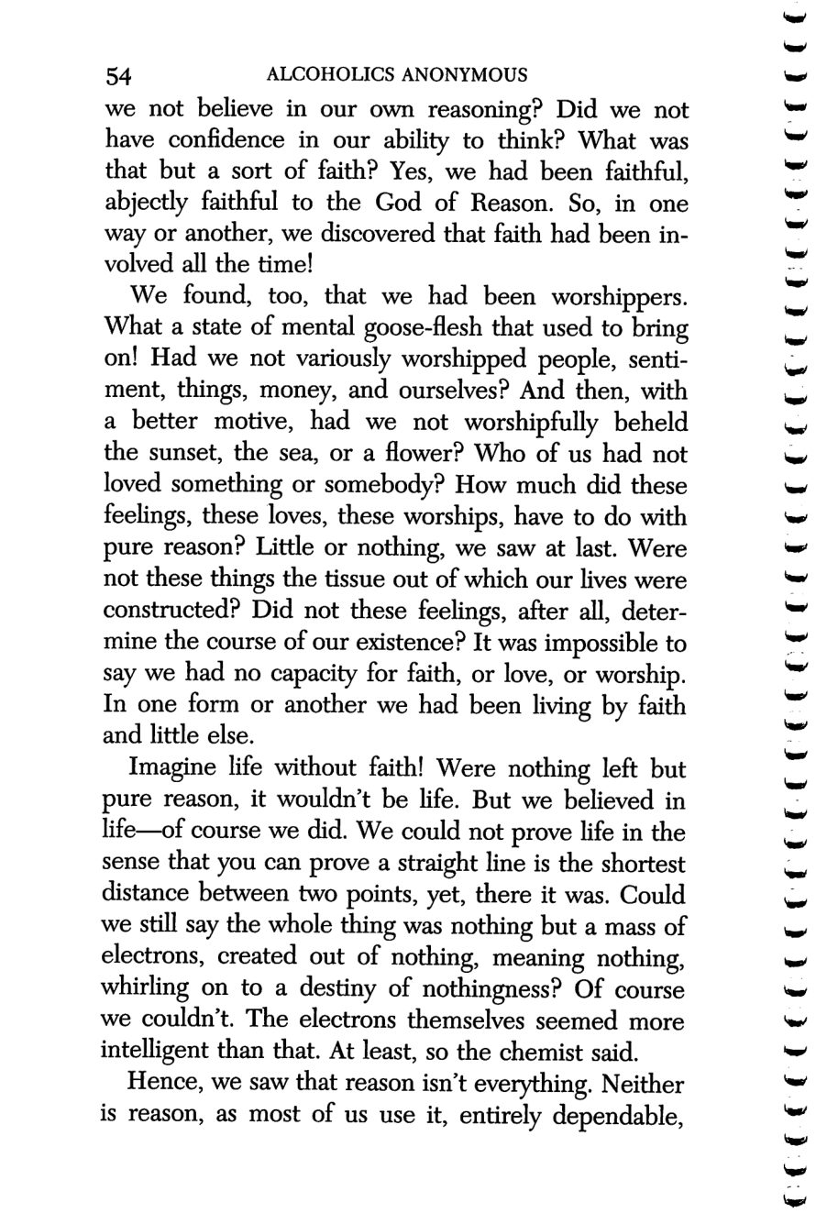
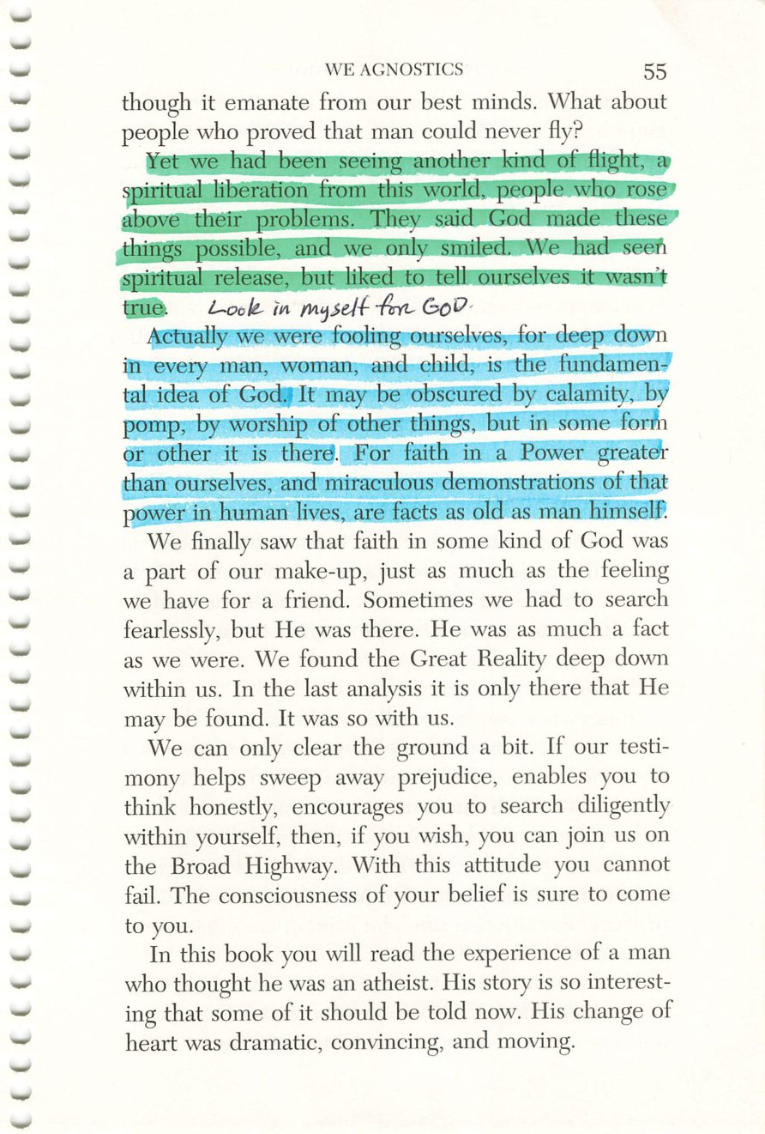
54
55
Copyright © Alcoholics Anonymous World Services, Inc. All rights reserved. Intended for personal use only, and not to be reproduced further or distributed for resale.

Slide 26
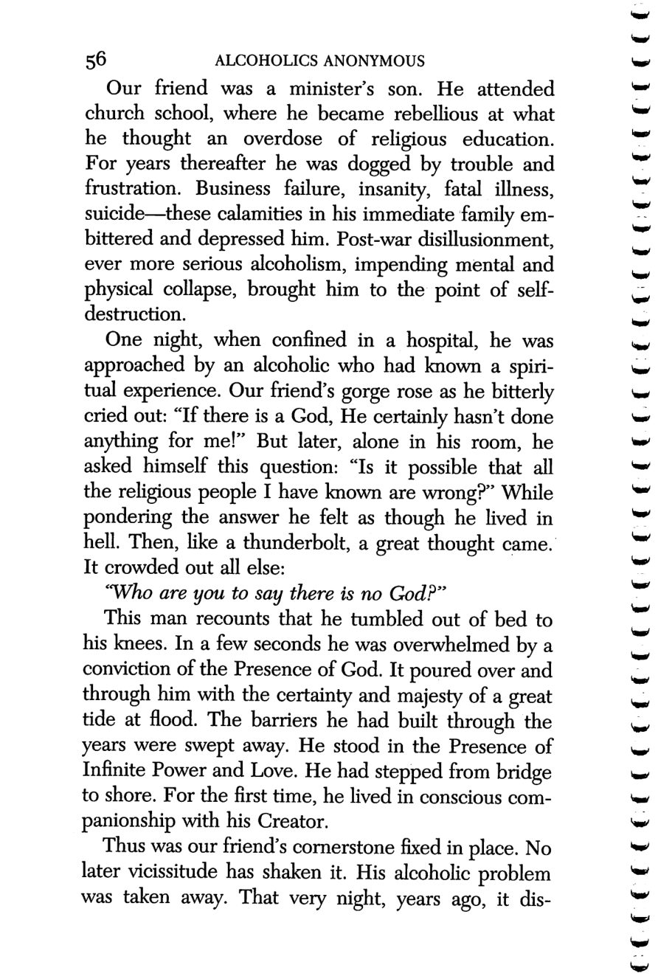
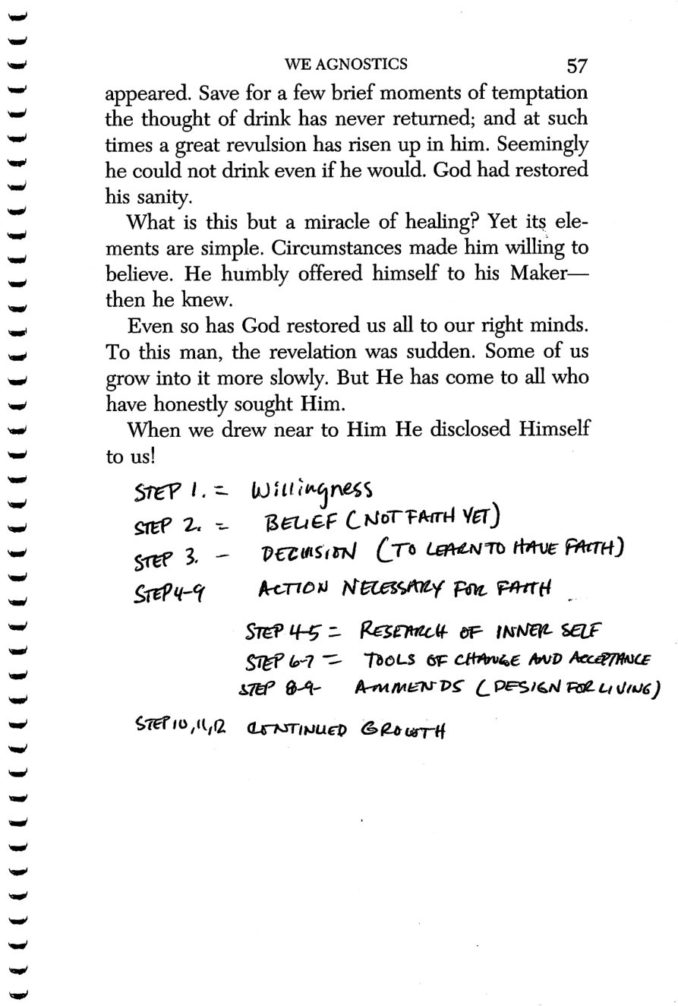
56
57
Copyright © Alcoholics Anonymous World Services, Inc. All rights reserved. Intended for personal use only, and not to be reproduced further or distributed for resale.

Slide 27
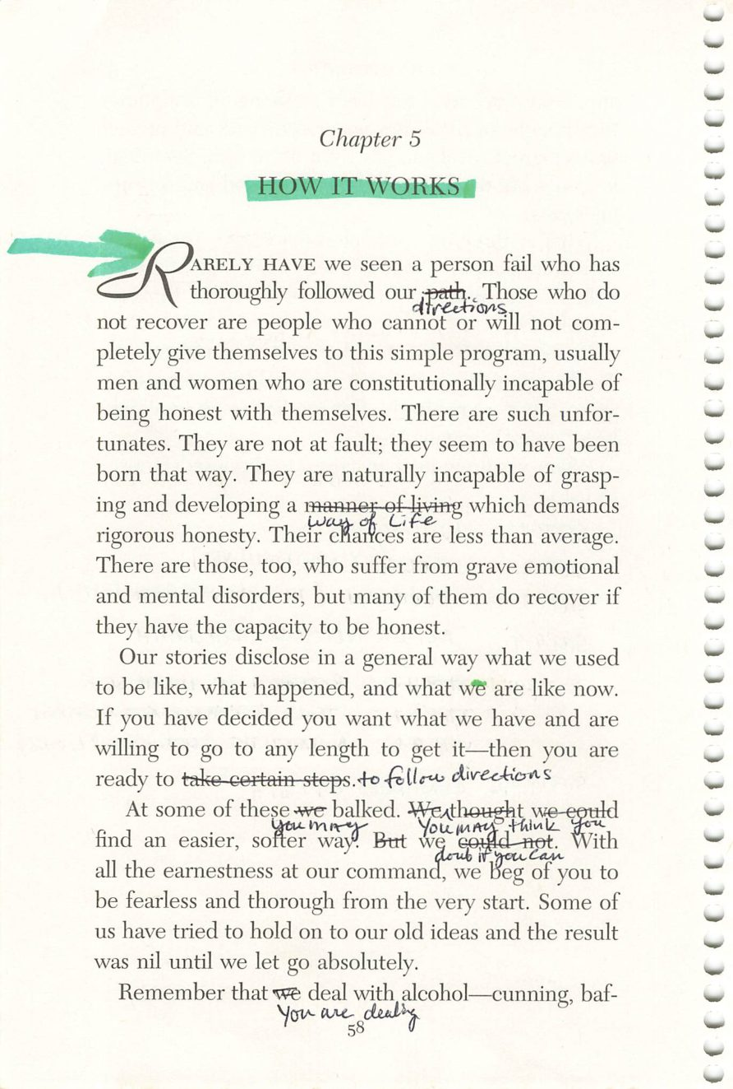
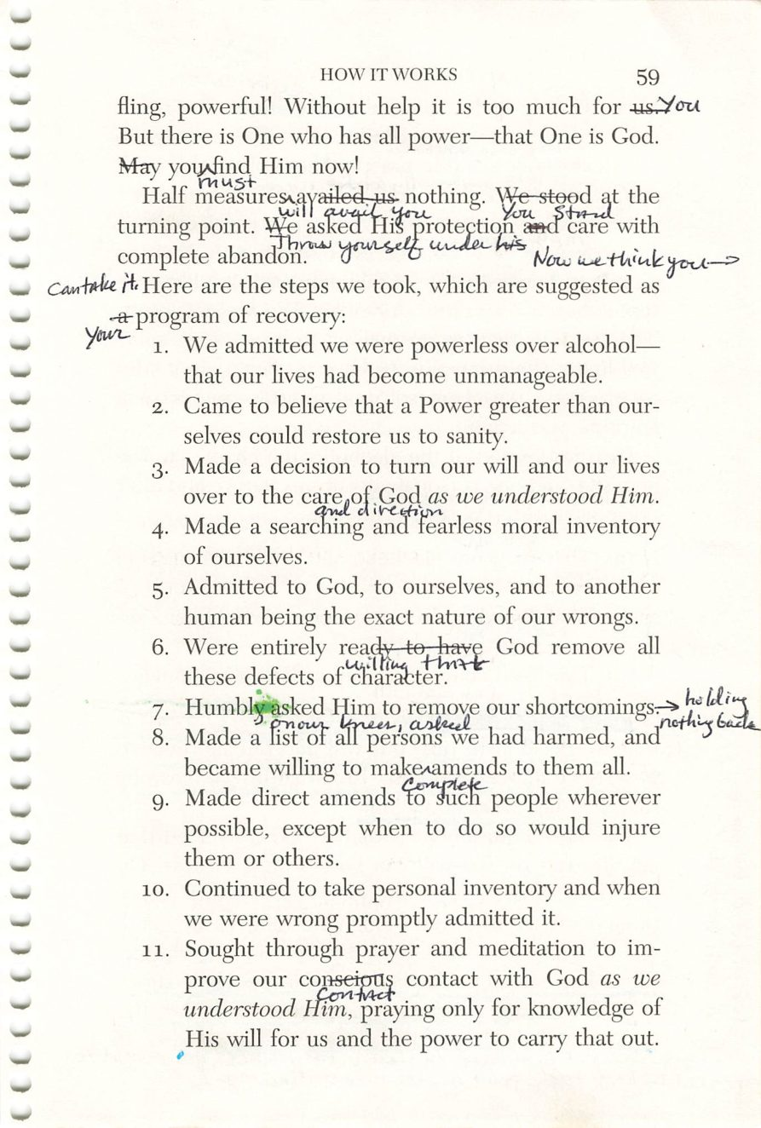
58
59
Copyright © Alcoholics Anonymous World Services, Inc. All rights reserved. Intended for personal use only, and not to be reproduced further or distributed for resale.

Slide 28
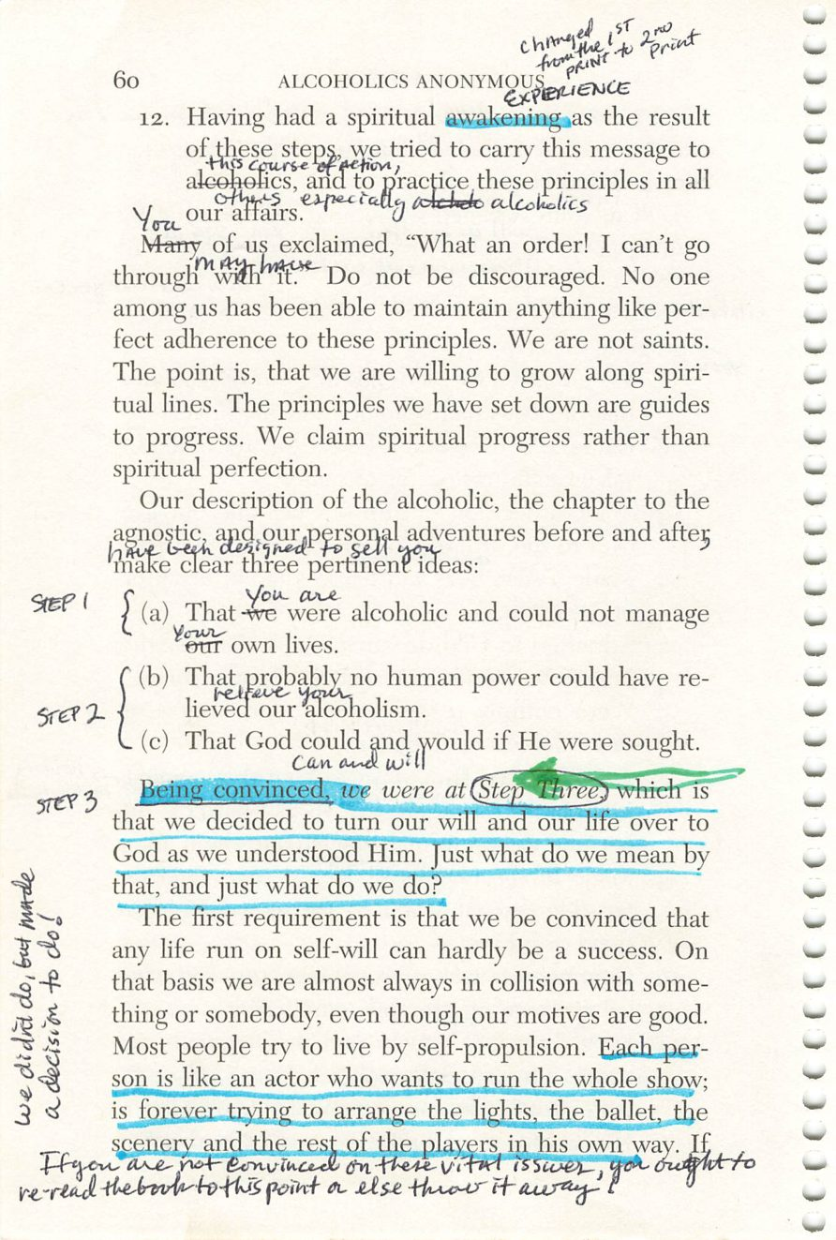
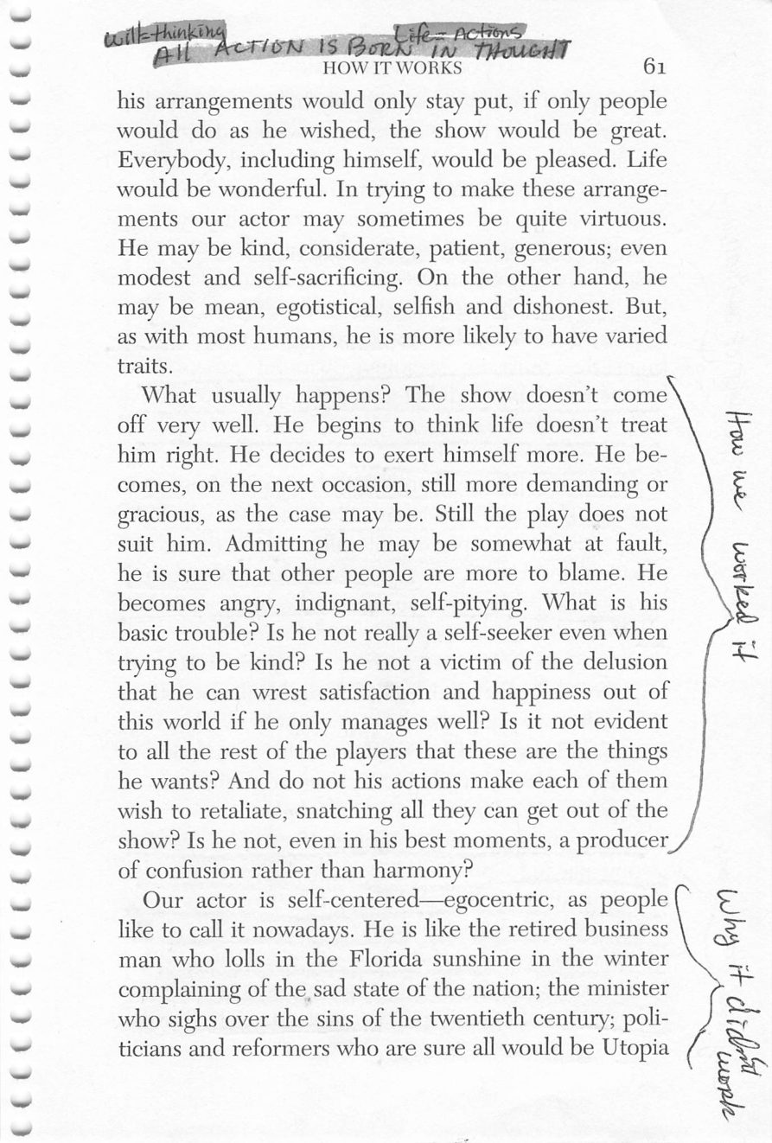
60
61
Copyright © Alcoholics Anonymous World Services, Inc. All rights reserved. Intended for personal use only, and not to be reproduced further or distributed for resale.

Slide 29
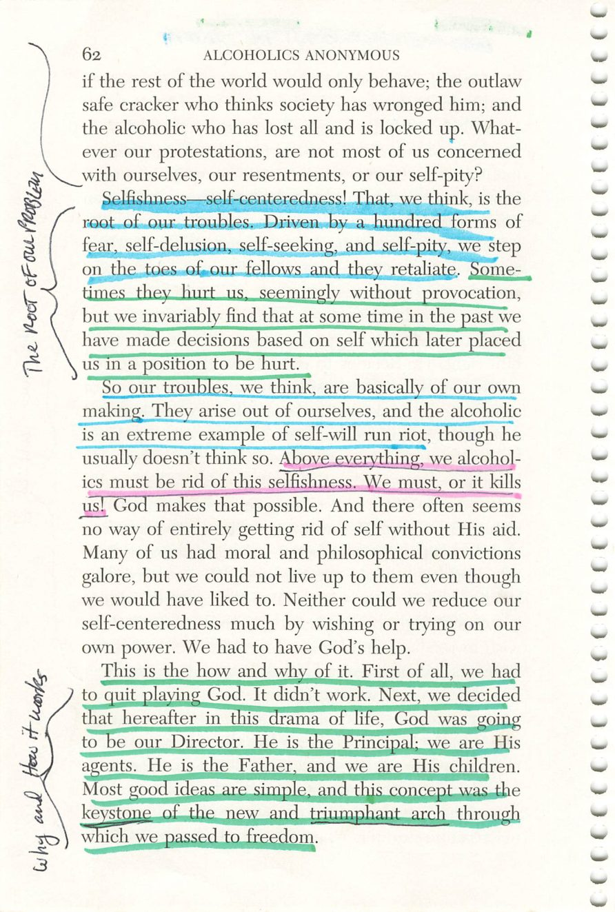
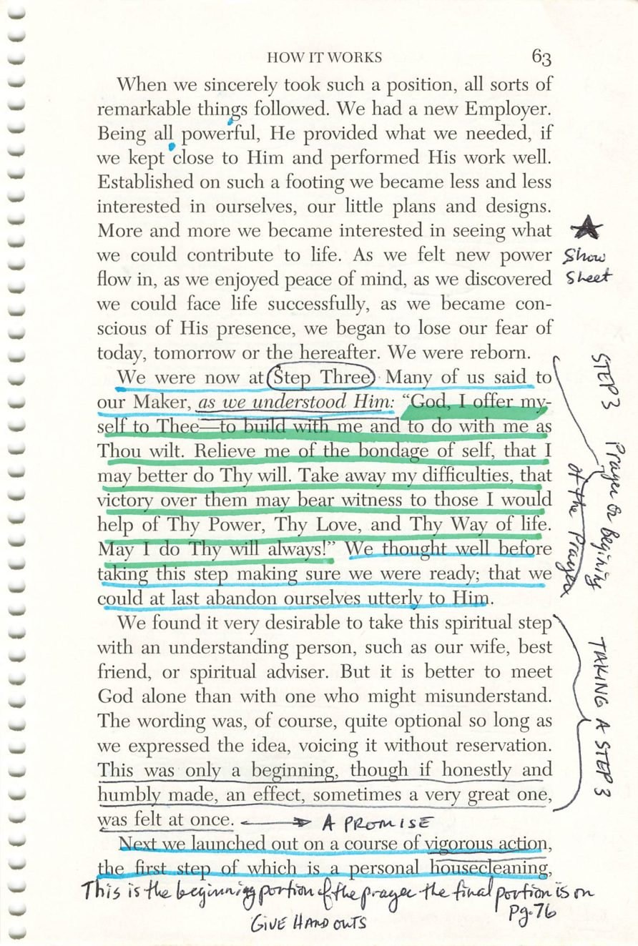
62
63
Copyright © Alcoholics Anonymous World Services, Inc. All rights reserved. Intended for personal use only, and not to be reproduced further or distributed for resale.

Slide 30
Handout Sheet
Page 63
HANDOUT
Handout.
Drop the image into this frame in PowerPoint.
Credit:

Slide 31
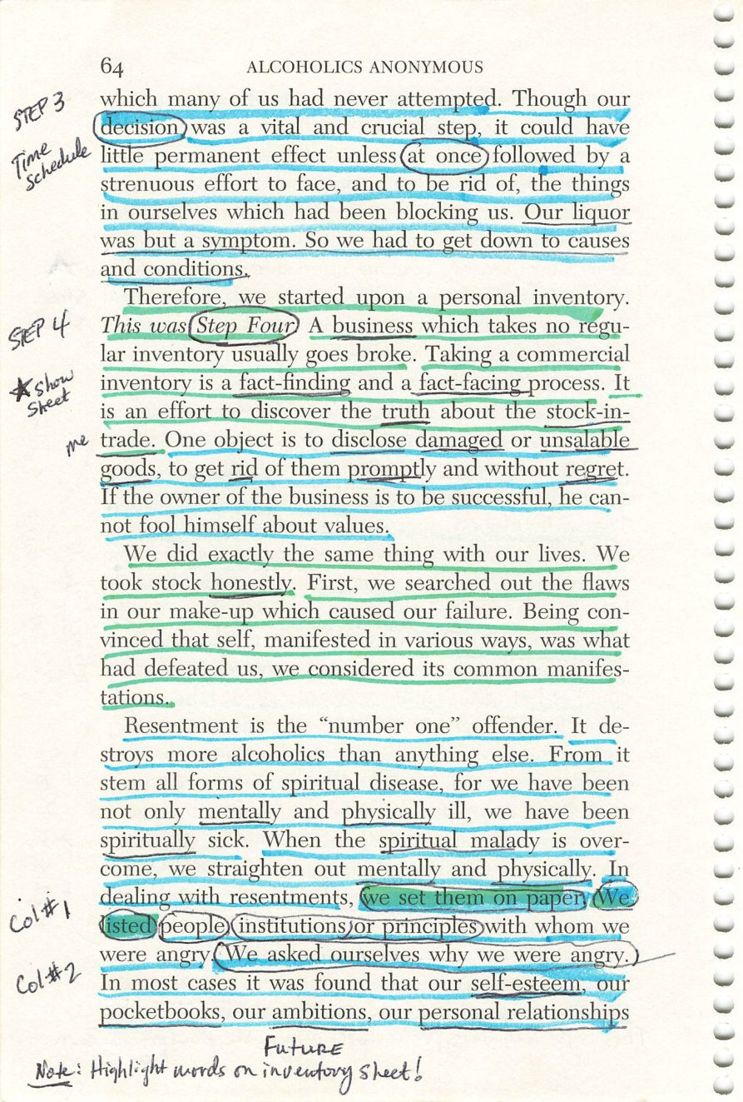
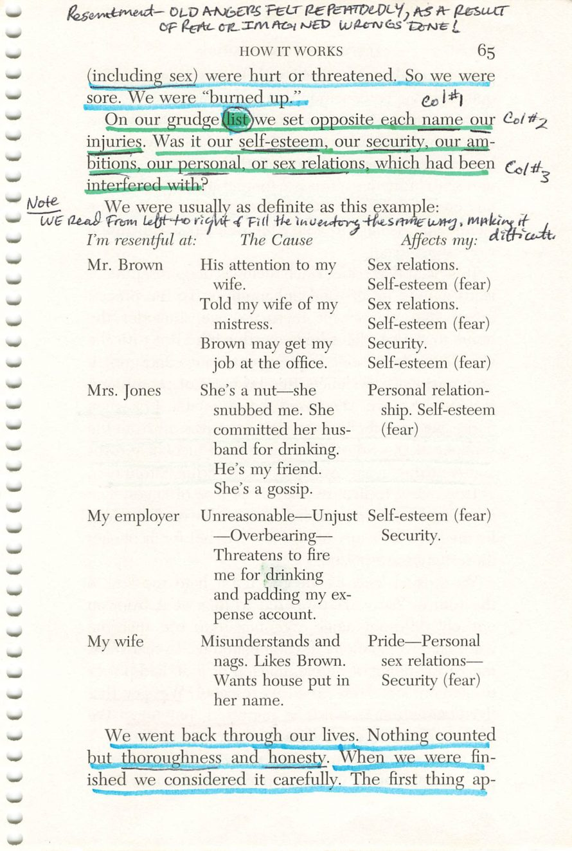
64
65
Copyright © Alcoholics Anonymous World Services, Inc. All rights reserved. Intended for personal use only, and not to be reproduced further or distributed for resale.

Slide 32
Inventory Handouts
Page 64
HANDOUT
Handout.
Drop the image into this frame in PowerPoint.
Credit:

Slide 33
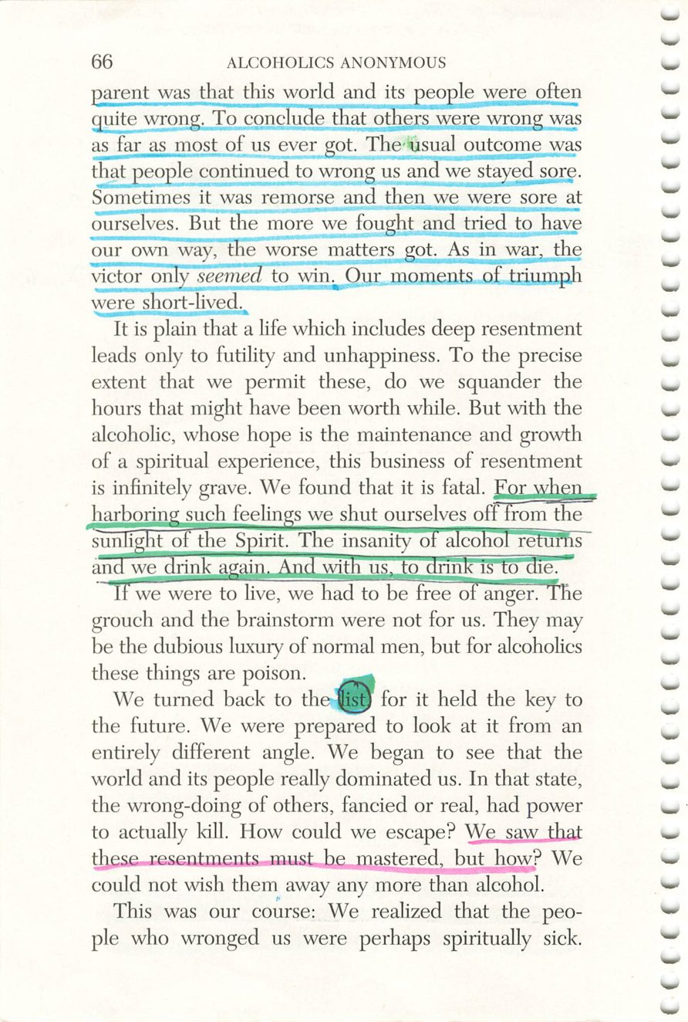

66
67
Copyright © Alcoholics Anonymous World Services, Inc. All rights reserved. Intended for personal use only, and not to be reproduced further or distributed for resale.

Slide 34


68
69
Copyright © Alcoholics Anonymous World Services, Inc. All rights reserved. Intended for personal use only, and not to be reproduced further or distributed for resale.

Slide 35


70
71
Copyright © Alcoholics Anonymous World Services, Inc. All rights reserved. Intended for personal use only, and not to be reproduced further or distributed for resale.

Slide 36

72
Copyright © Alcoholics Anonymous World Services, Inc. All rights reserved. Intended for personal use only, and not to be reproduced further or distributed for resale.

