Slide 1
Big Book Study Group
by District 23
To Employers — Pages 141 to the End
903 Court Street, Port Huron
Wednesdays · 7:00 PM

Slide 2
Copyright Notice
“These materials are copyright © by Alcoholics Anonymous World Services, Inc. ("A.A.W.S."). All rights reserved. Individual printing or photocopying of a single copy is permitted. Intended for personal use only, and not to be reproduced further or distributed for resale.”
Displayed at the request of A.A. World Services, Inc. Reproduced with permission for use during this A.A. meeting.

Slide 3
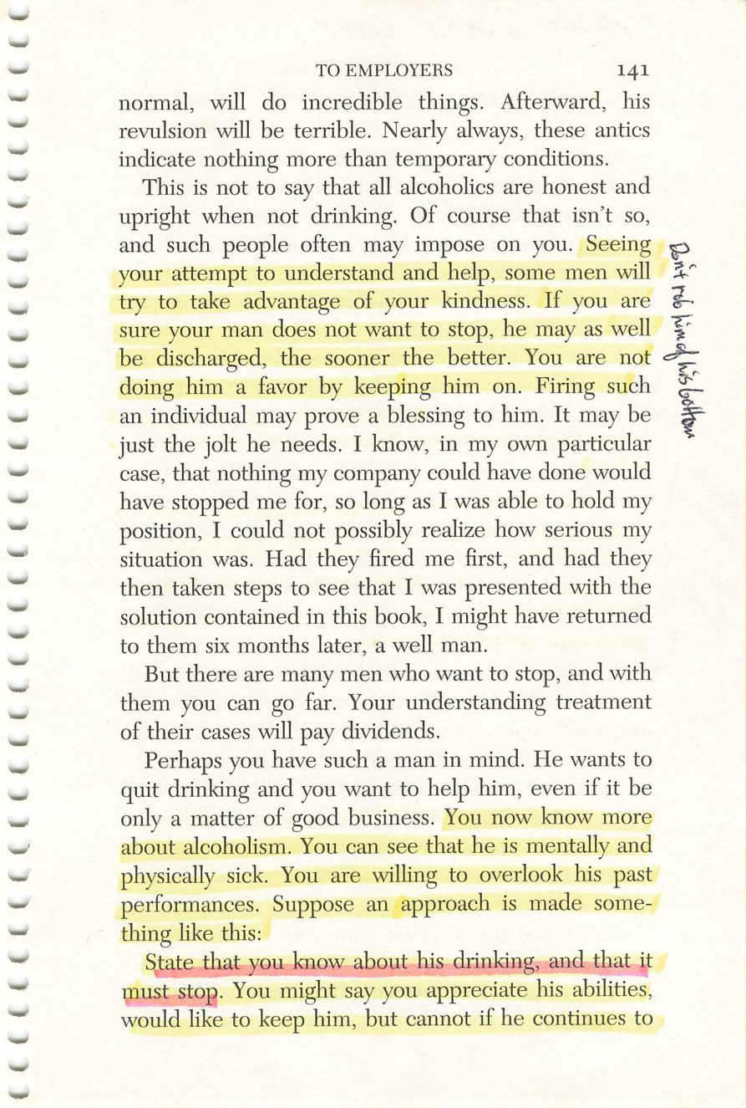
Copyright © Alcoholics Anonymous World Services, Inc. All rights reserved. Intended for personal use only, and not to be reproduced further or distributed for resale.
141

Slide 4
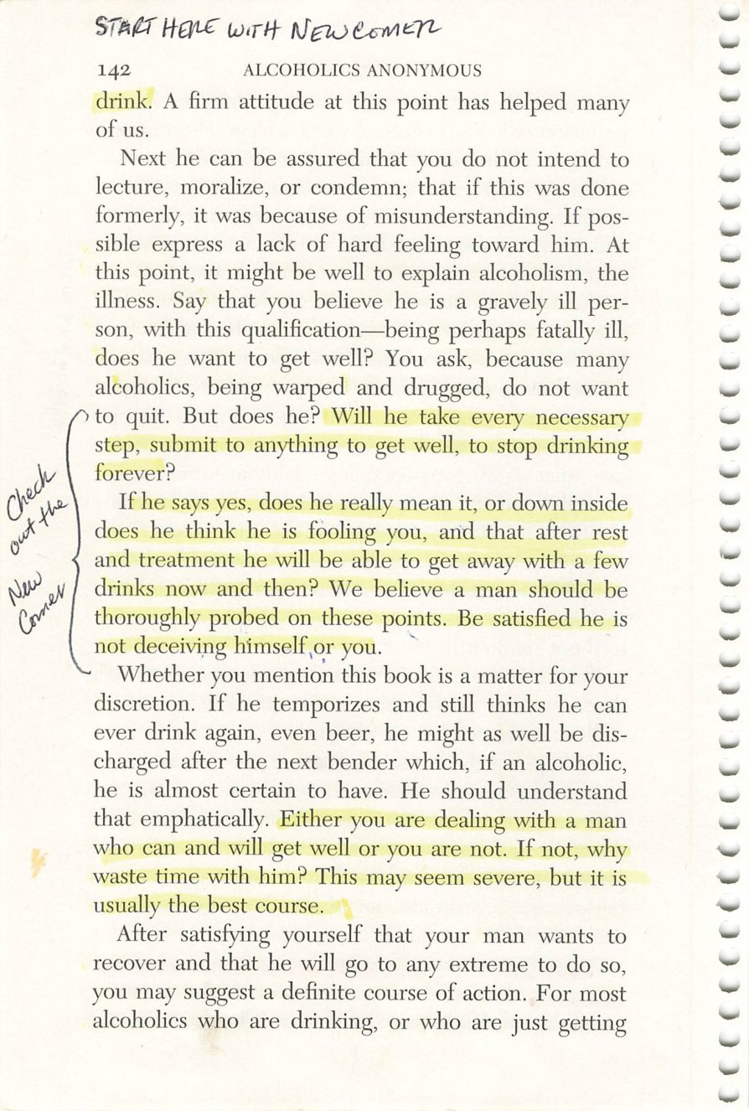
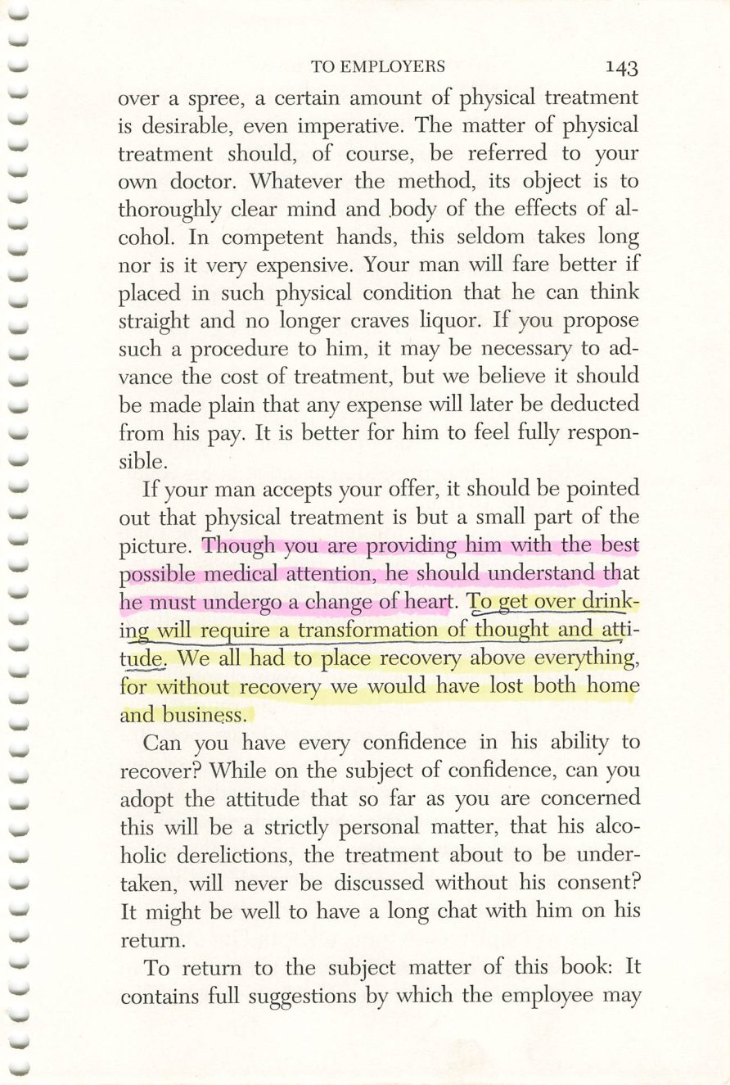
142
143
Copyright © Alcoholics Anonymous World Services, Inc. All rights reserved. Intended for personal use only, and not to be reproduced further or distributed for resale.

Slide 5
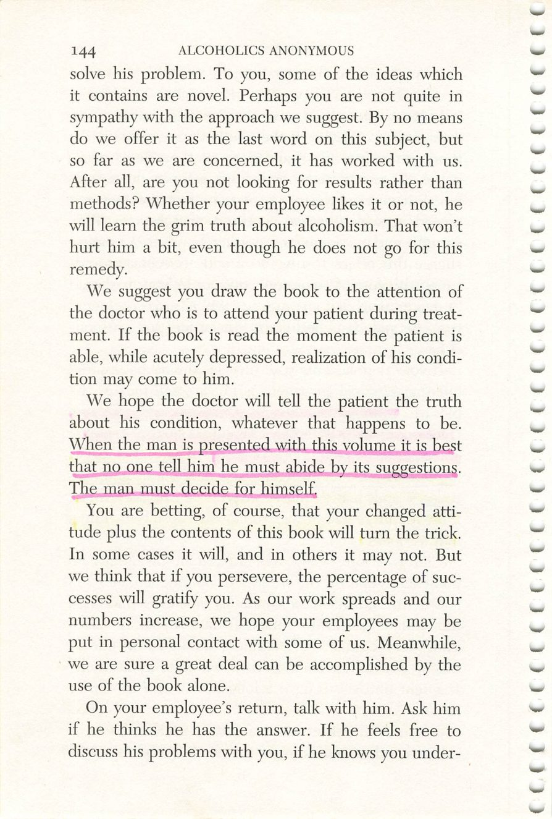
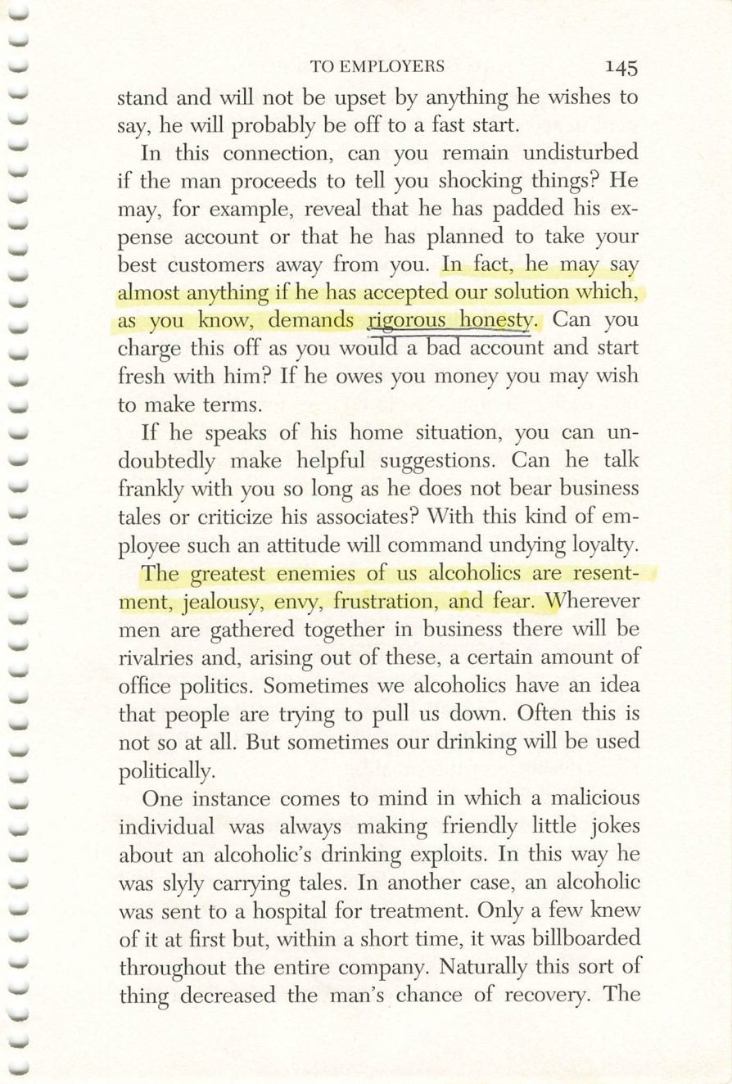
144
145
Copyright © Alcoholics Anonymous World Services, Inc. All rights reserved. Intended for personal use only, and not to be reproduced further or distributed for resale.

Slide 6
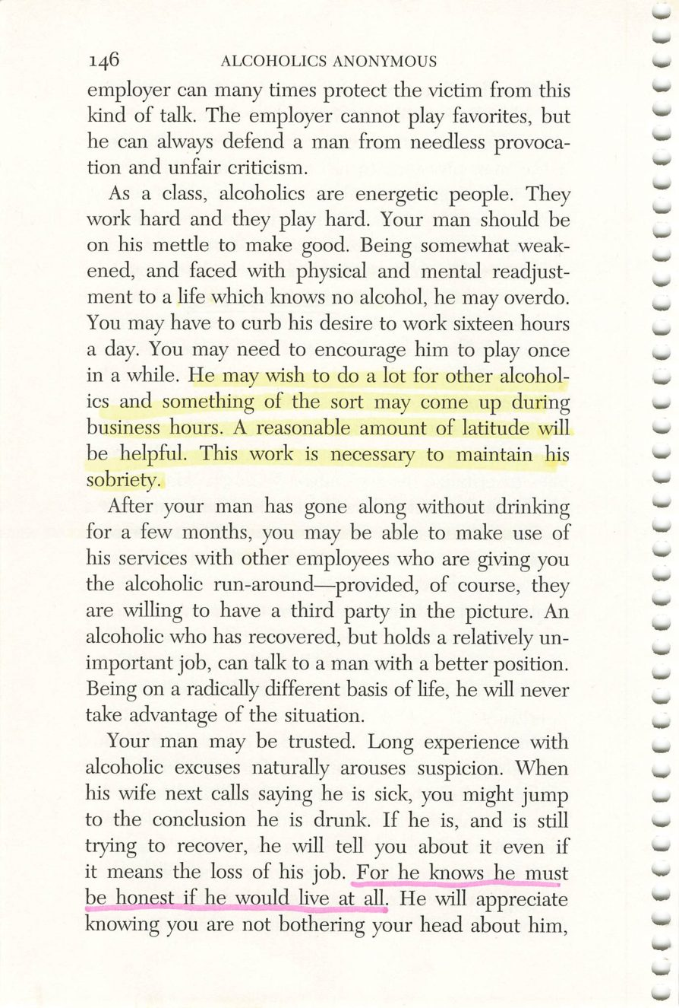
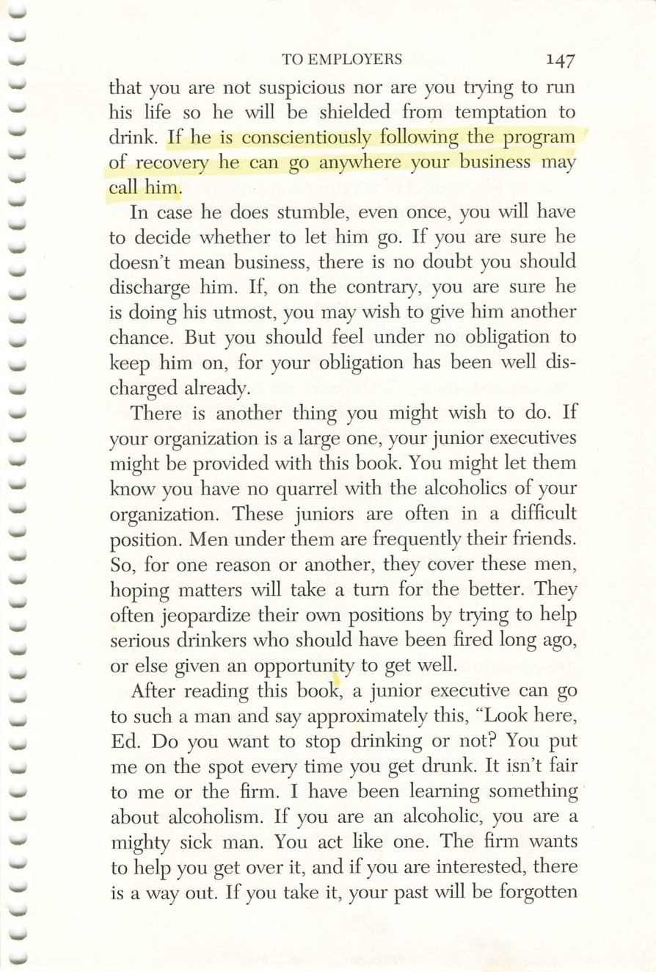
146
147
Copyright © Alcoholics Anonymous World Services, Inc. All rights reserved. Intended for personal use only, and not to be reproduced further or distributed for resale.

Slide 7
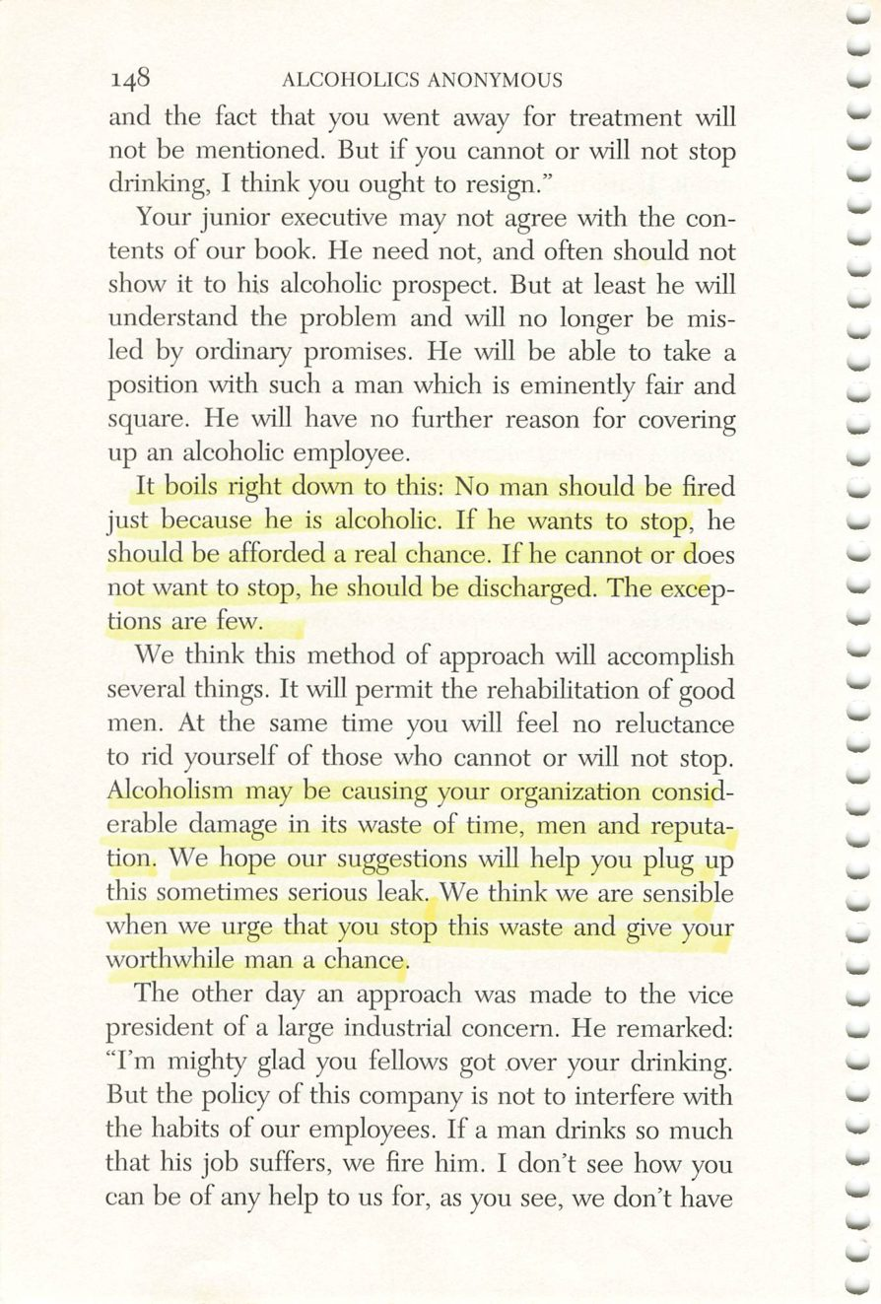
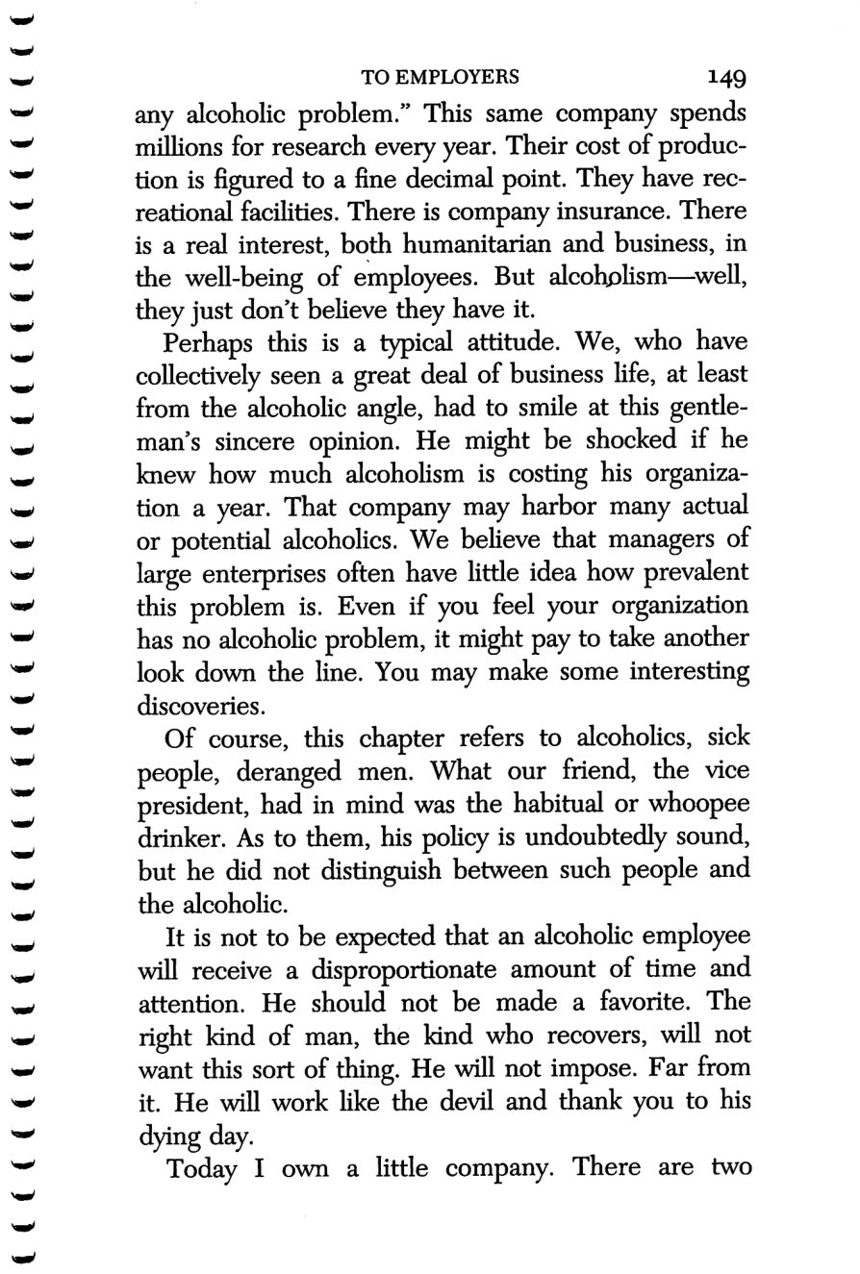
148
149
Copyright © Alcoholics Anonymous World Services, Inc. All rights reserved. Intended for personal use only, and not to be reproduced further or distributed for resale.

Slide 8
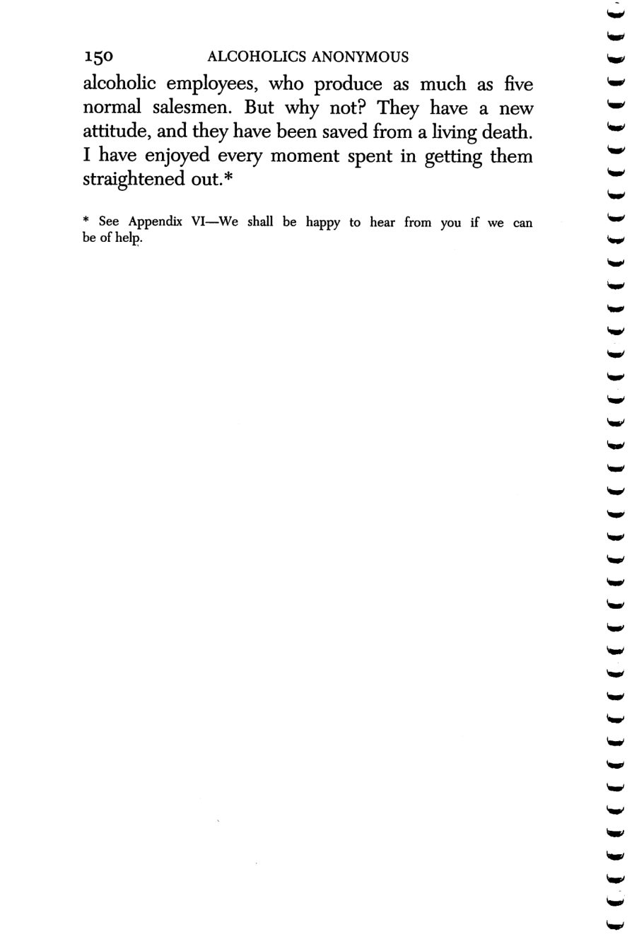
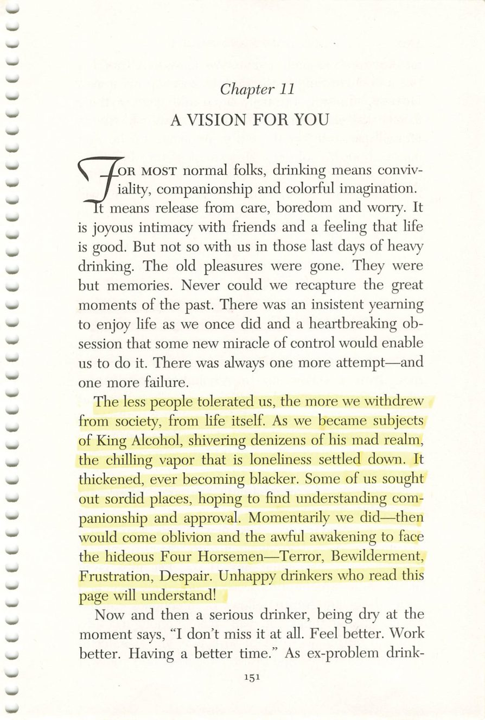
150
151
Copyright © Alcoholics Anonymous World Services, Inc. All rights reserved. Intended for personal use only, and not to be reproduced further or distributed for resale.

Slide 9
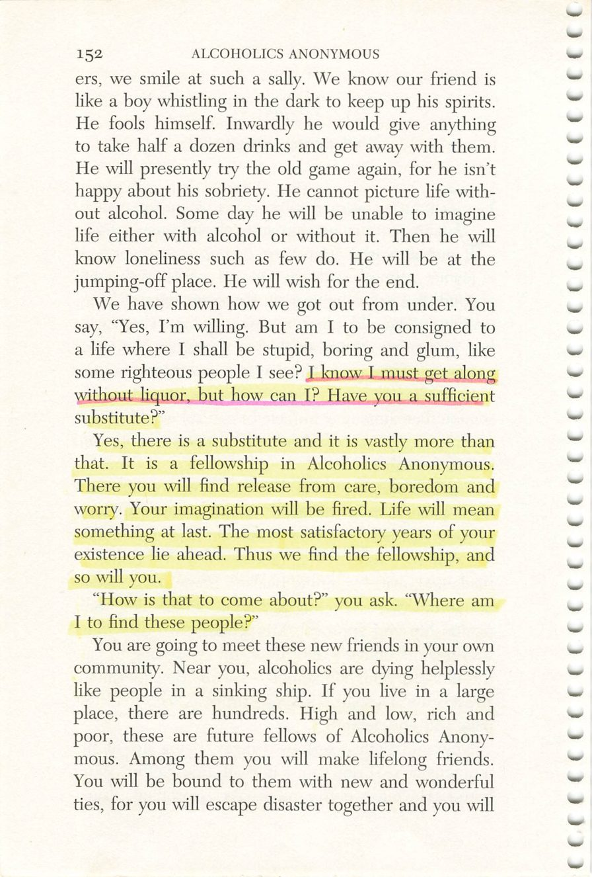
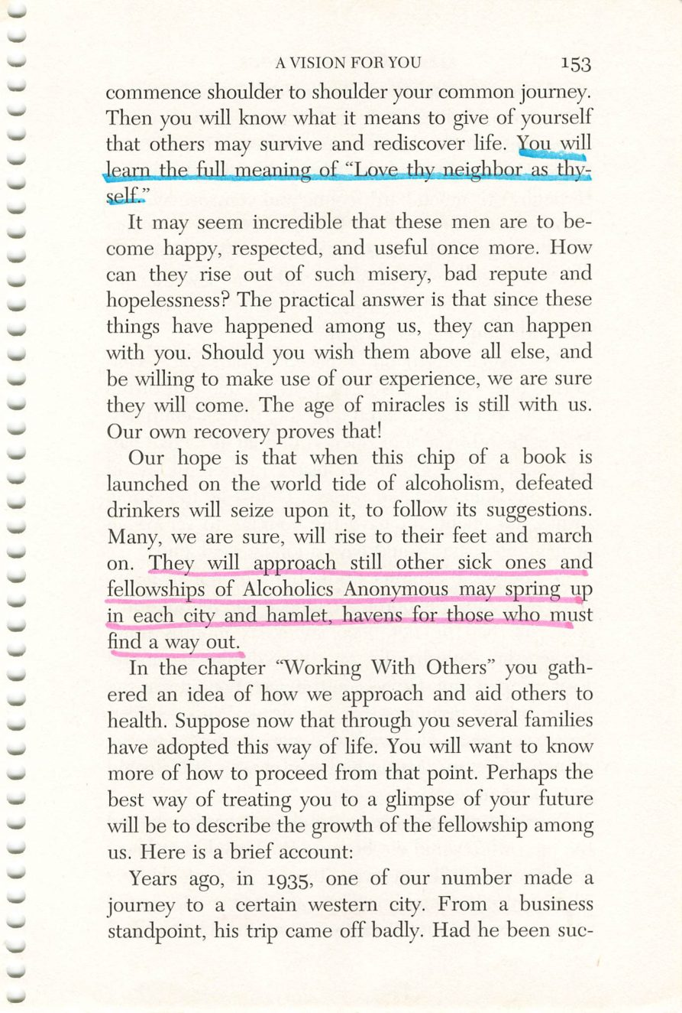
152
153
Copyright © Alcoholics Anonymous World Services, Inc. All rights reserved. Intended for personal use only, and not to be reproduced further or distributed for resale.

Slide 10
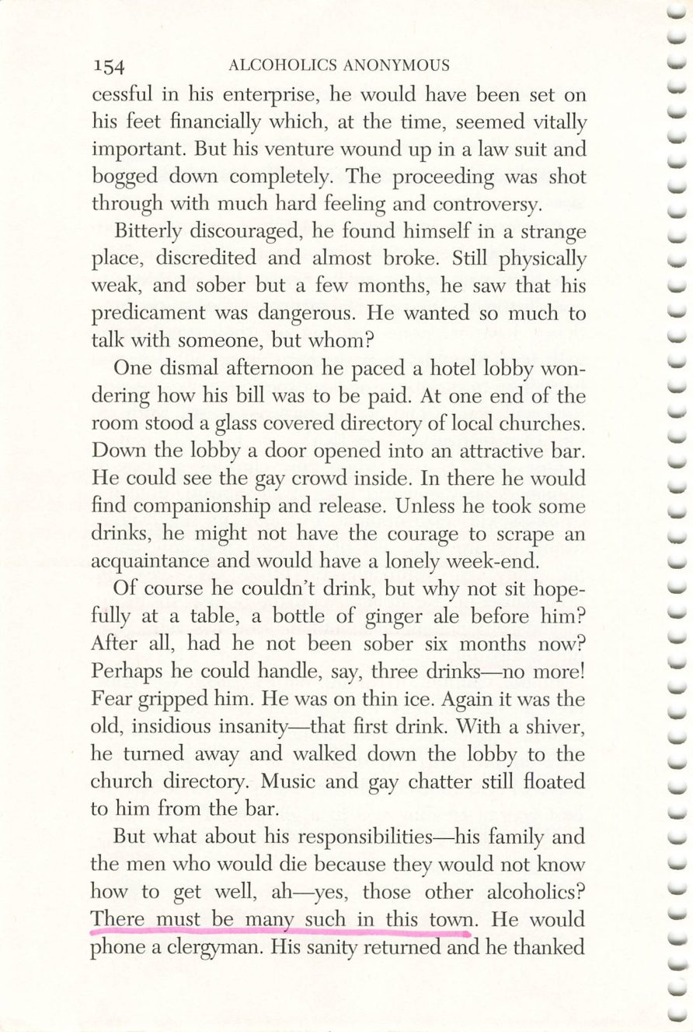
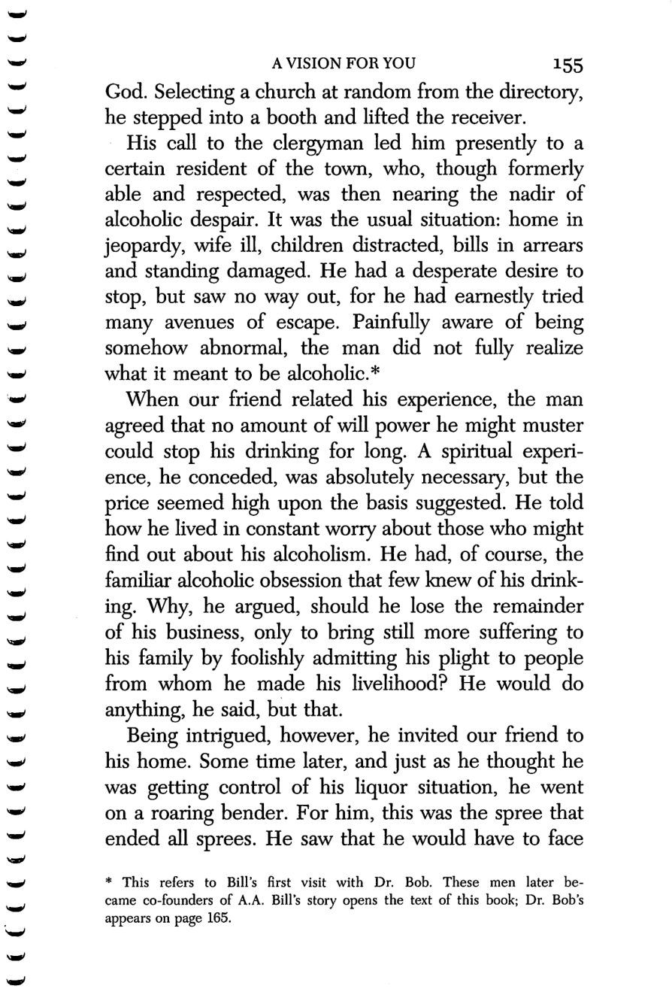
154
155
Copyright © Alcoholics Anonymous World Services, Inc. All rights reserved. Intended for personal use only, and not to be reproduced further or distributed for resale.

Slide 11
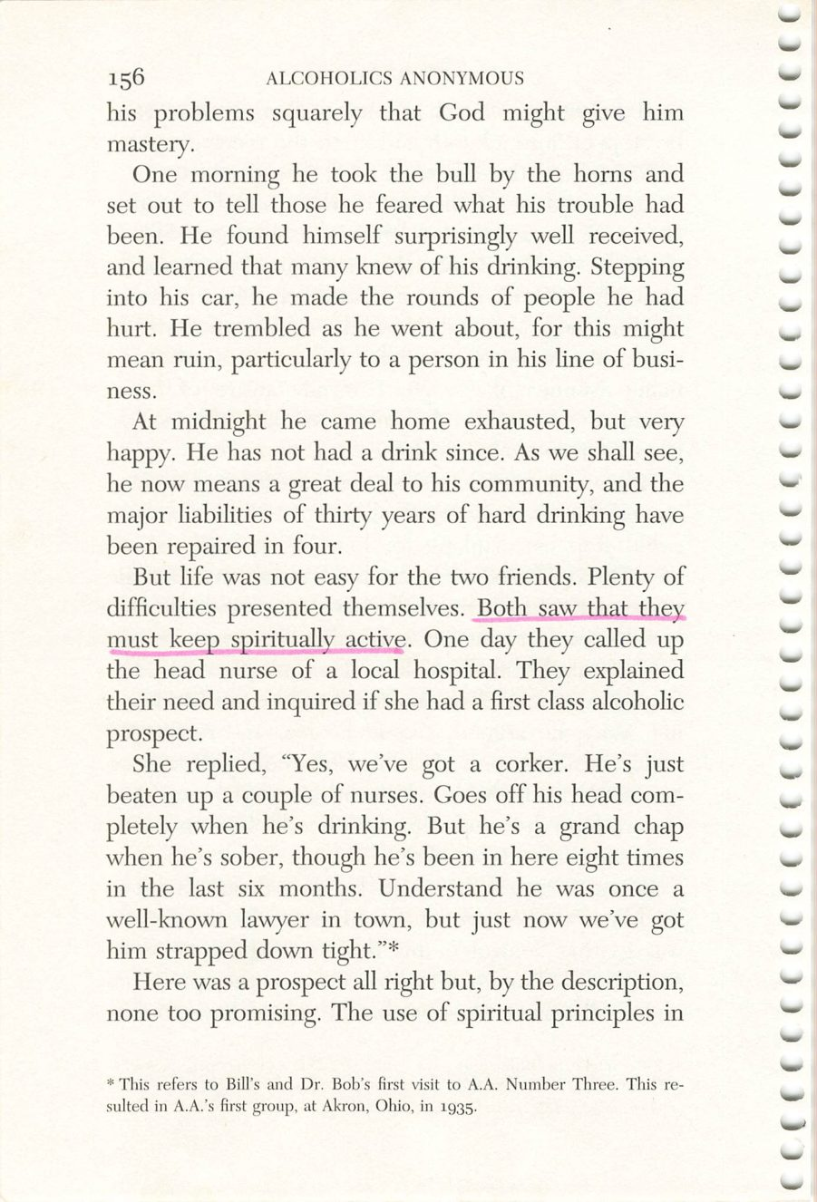
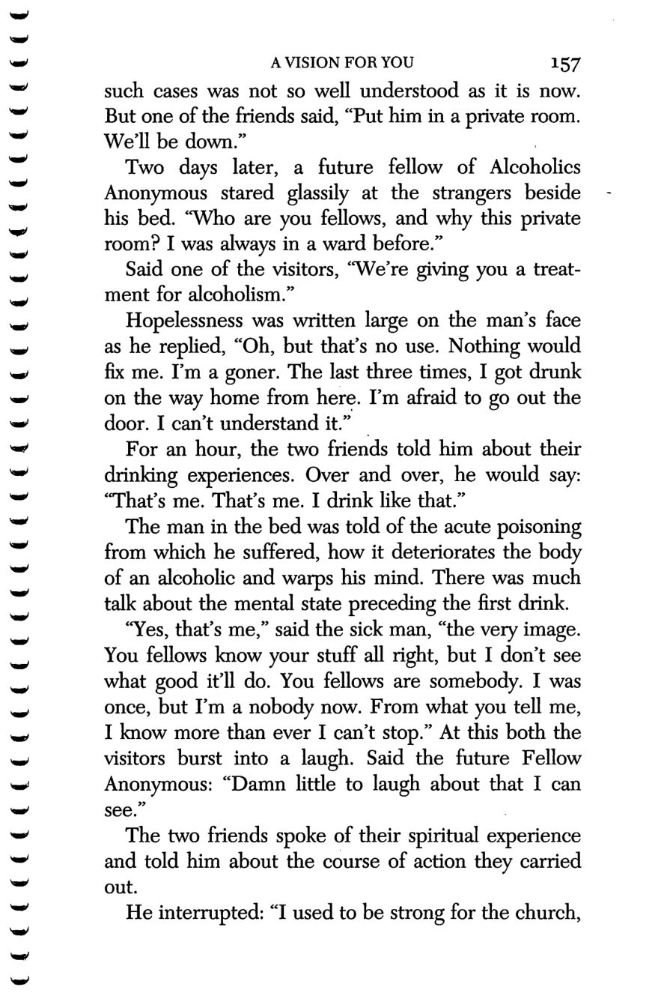
156
157
Copyright © Alcoholics Anonymous World Services, Inc. All rights reserved. Intended for personal use only, and not to be reproduced further or distributed for resale.

Slide 12
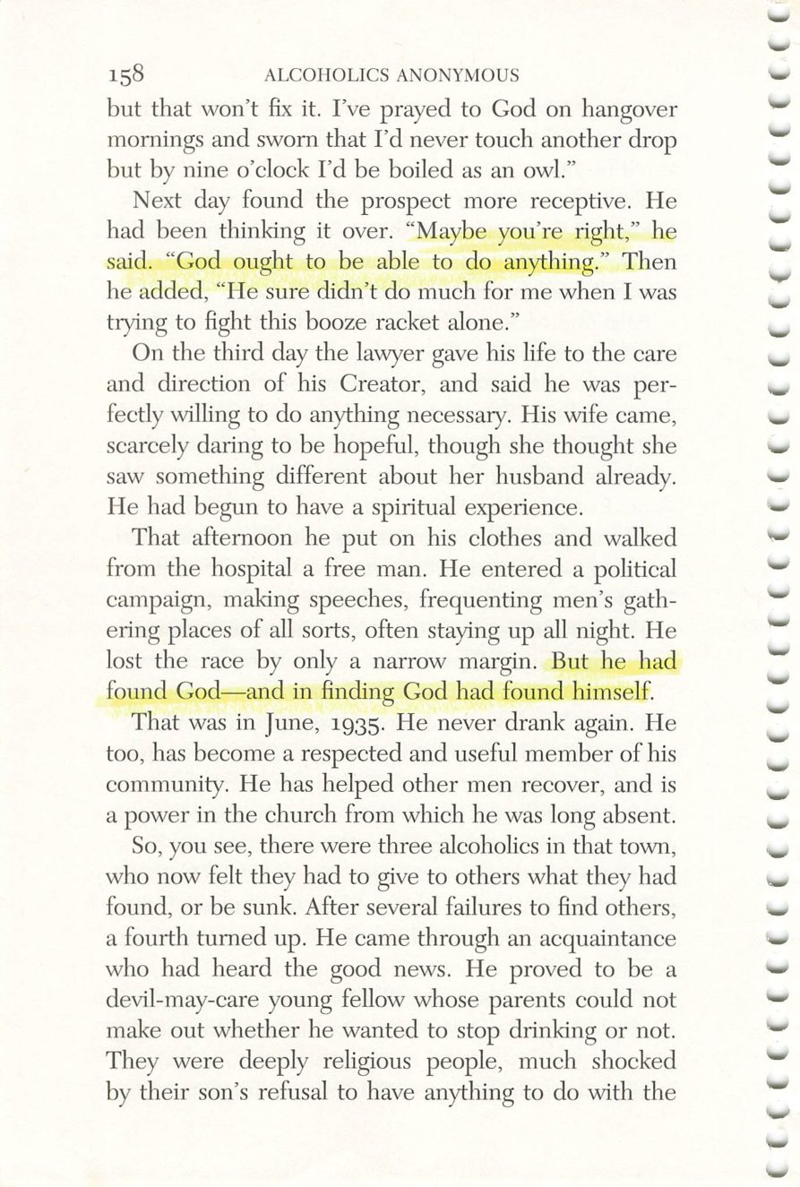
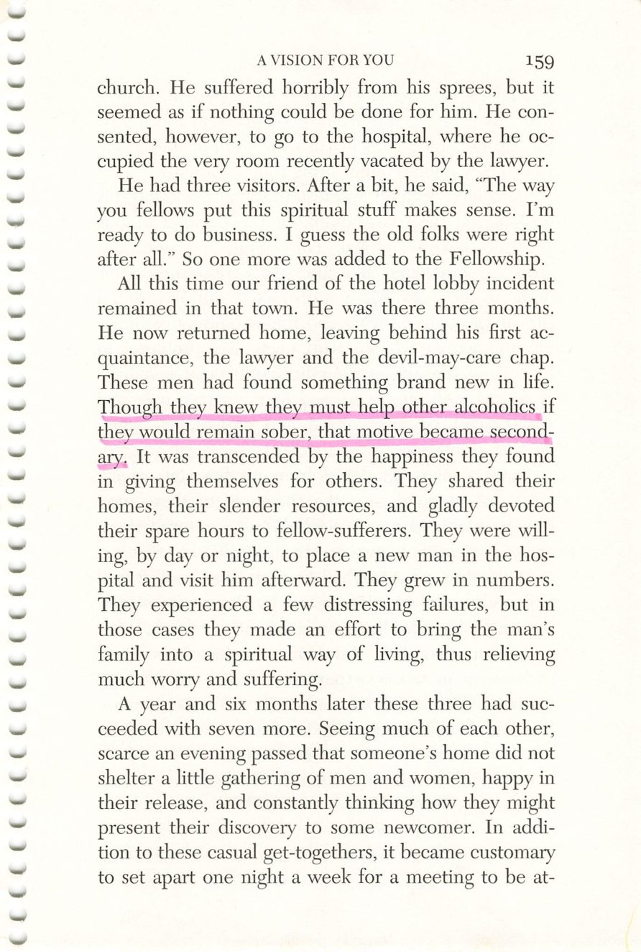
158
159
Copyright © Alcoholics Anonymous World Services, Inc. All rights reserved. Intended for personal use only, and not to be reproduced further or distributed for resale.

Slide 13
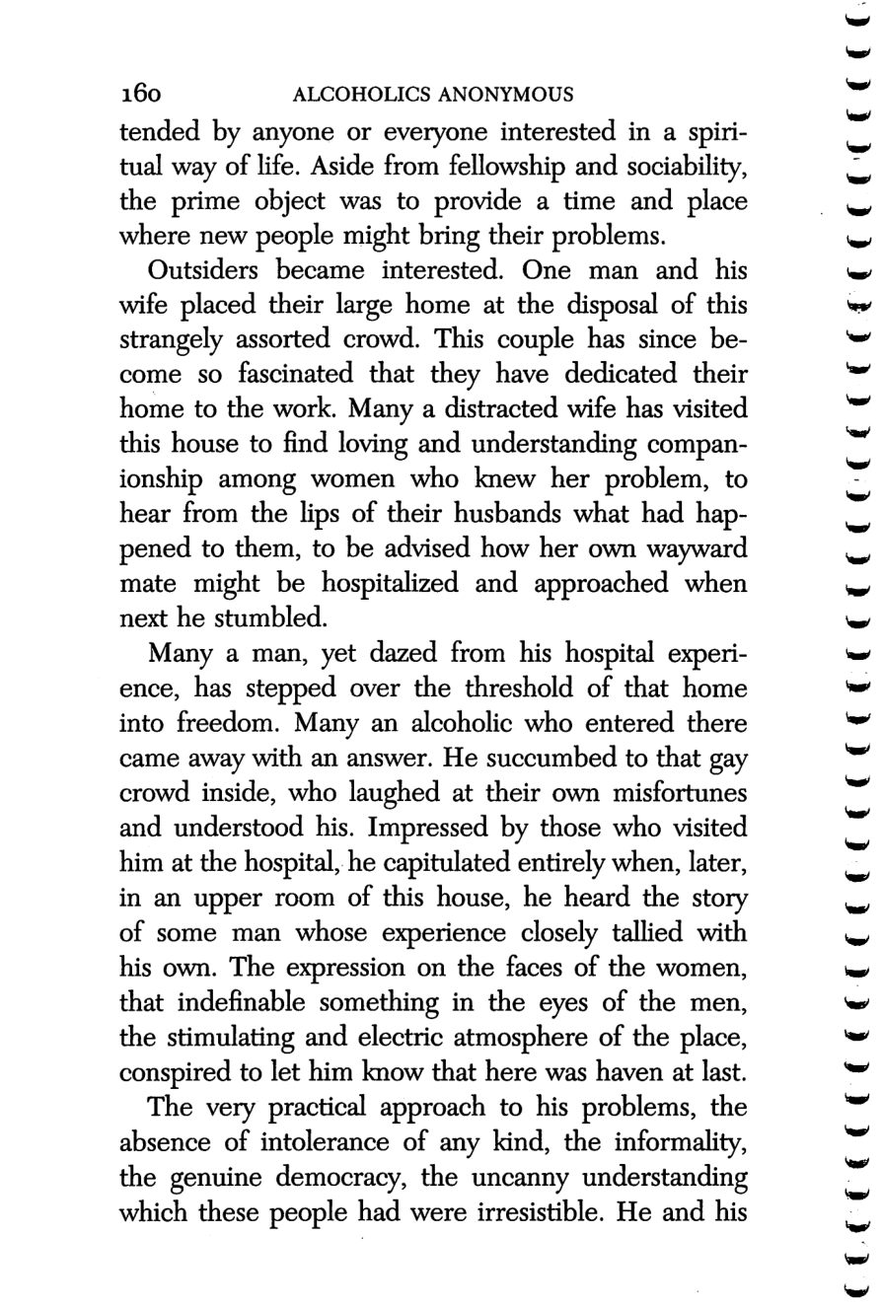
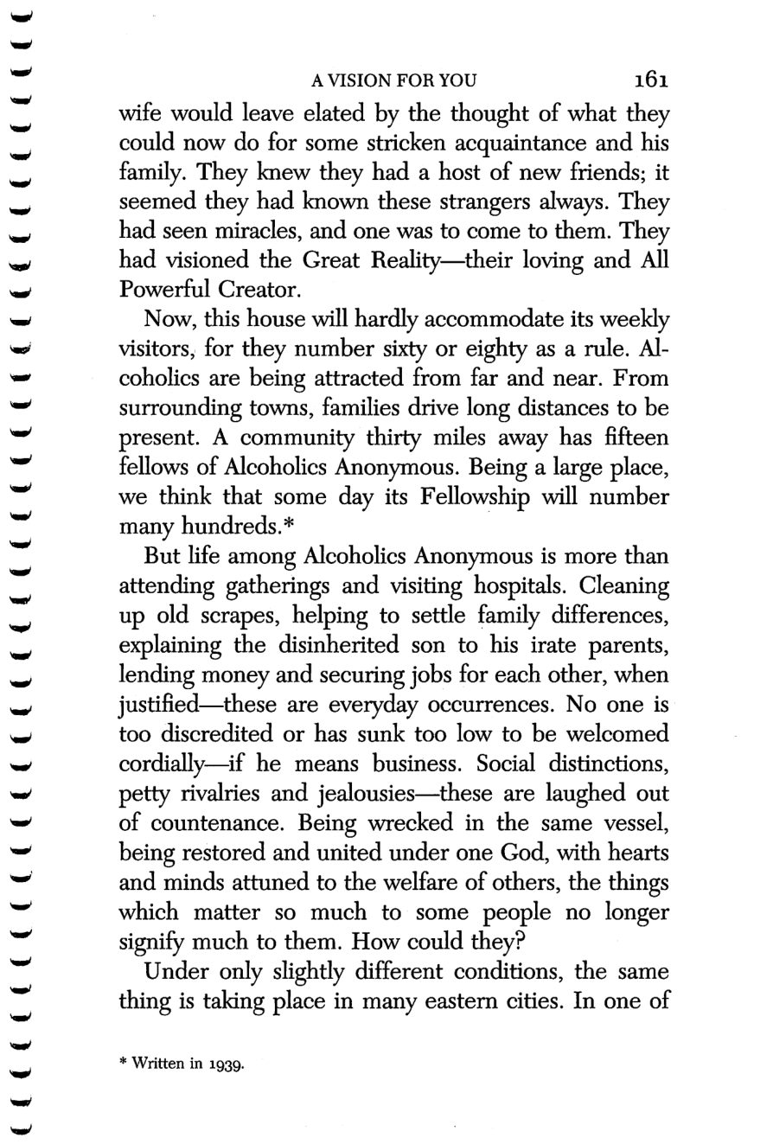
160
161
Copyright © Alcoholics Anonymous World Services, Inc. All rights reserved. Intended for personal use only, and not to be reproduced further or distributed for resale.

Slide 14
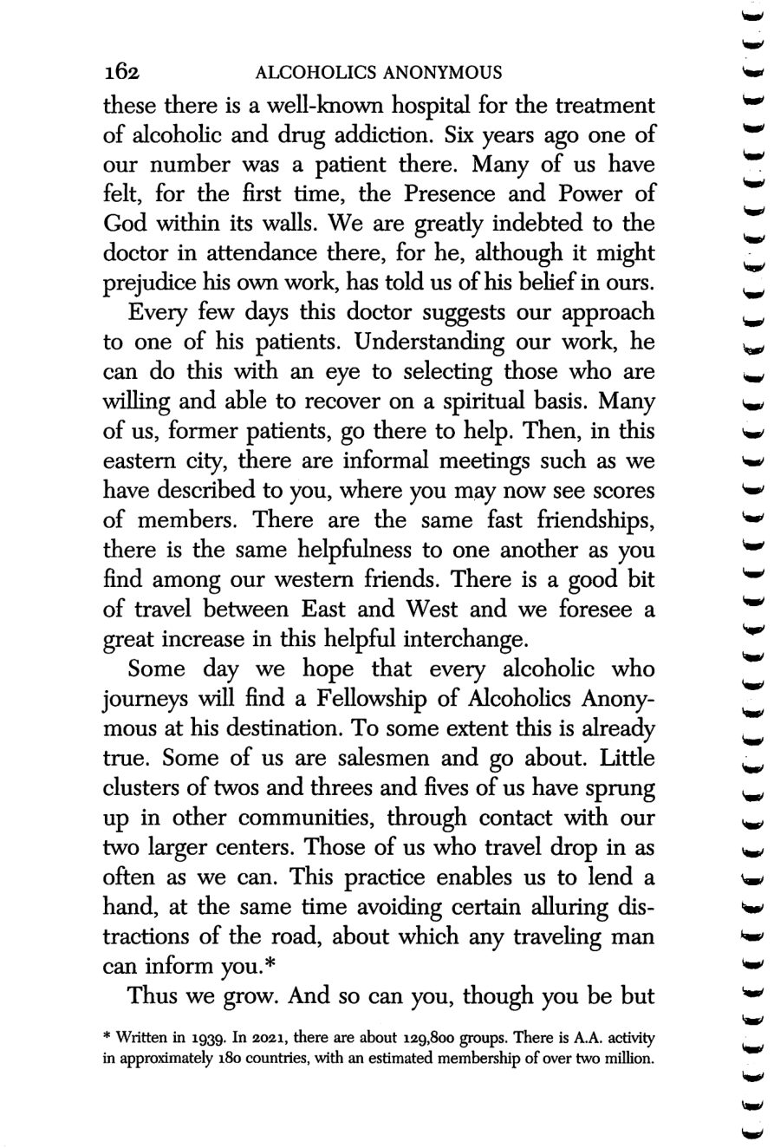
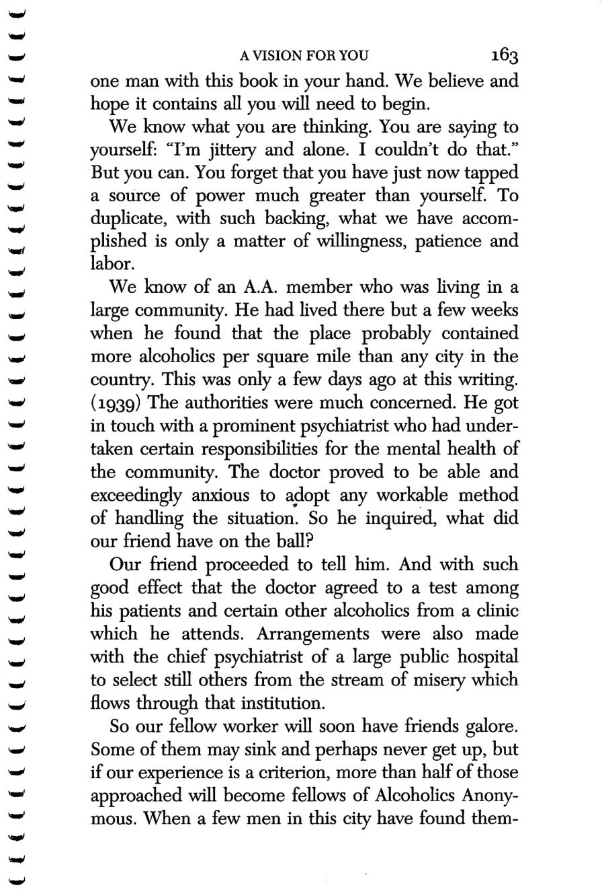
162
163
Copyright © Alcoholics Anonymous World Services, Inc. All rights reserved. Intended for personal use only, and not to be reproduced further or distributed for resale.

Slide 15
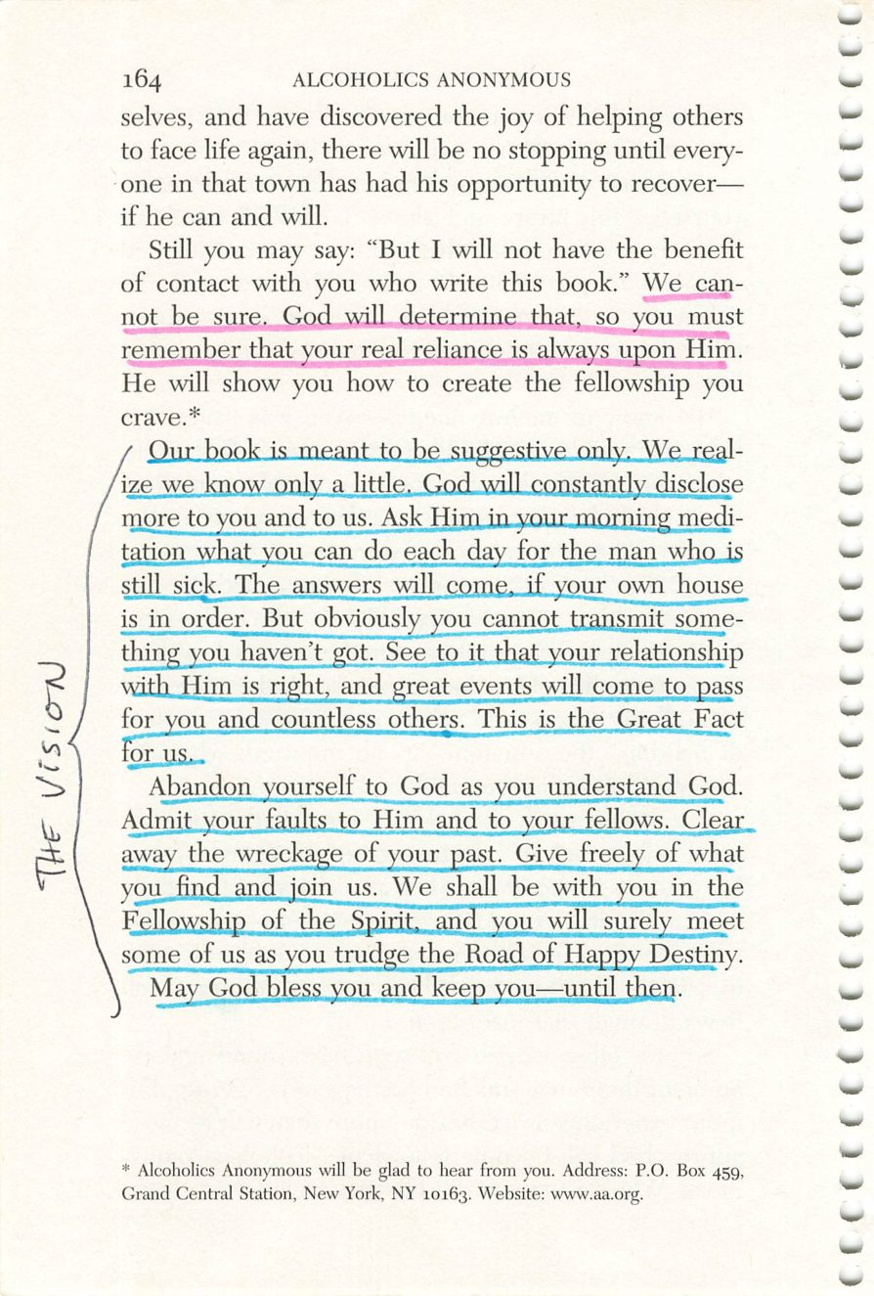
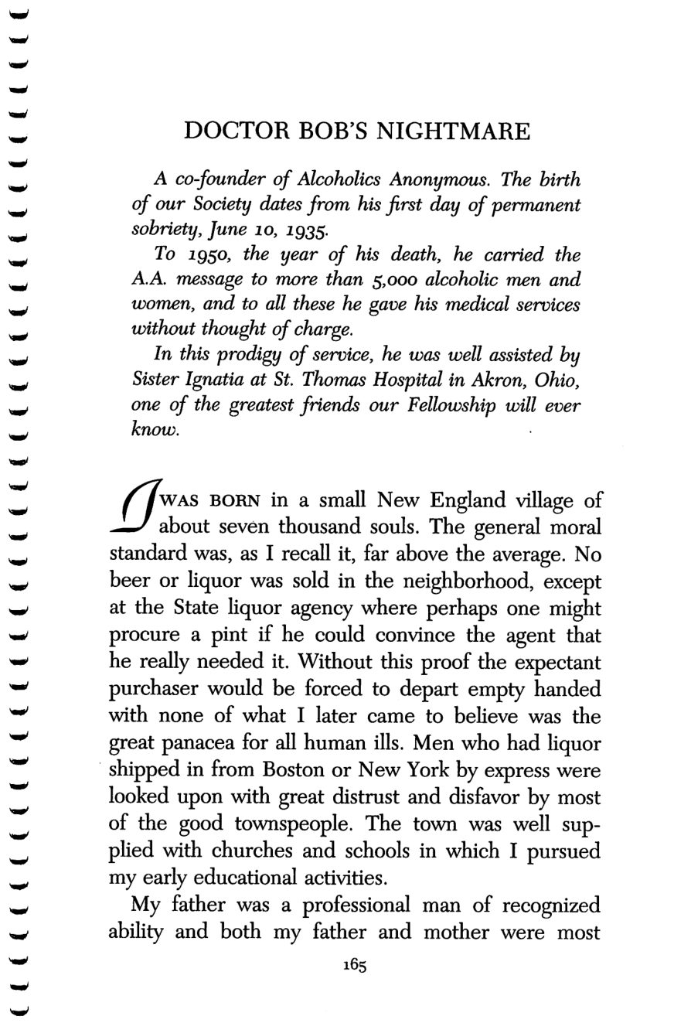
164
165
Copyright © Alcoholics Anonymous World Services, Inc. All rights reserved. Intended for personal use only, and not to be reproduced further or distributed for resale.

Slide 16
Dr. Bob
Page 165
PHOTO
Photograph.
Drop the image into this frame in PowerPoint.
Credit:

Slide 17
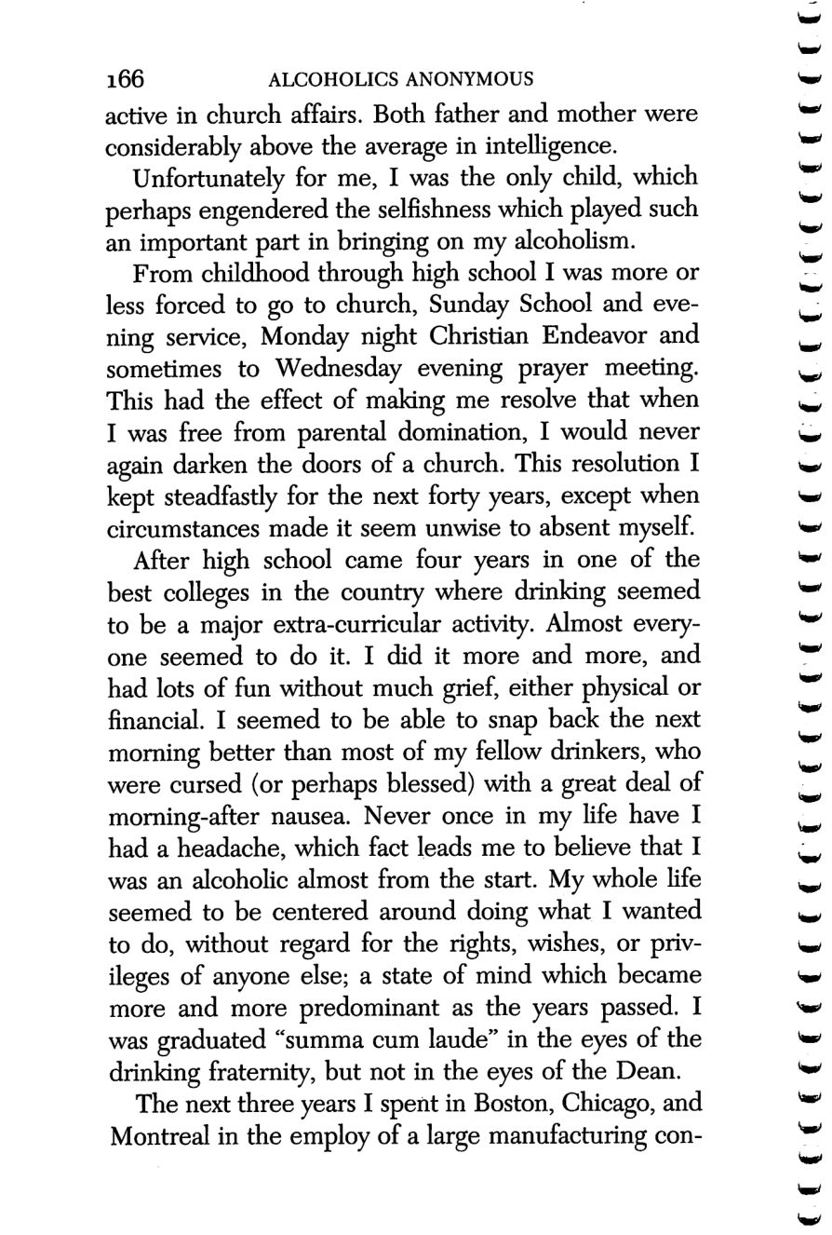
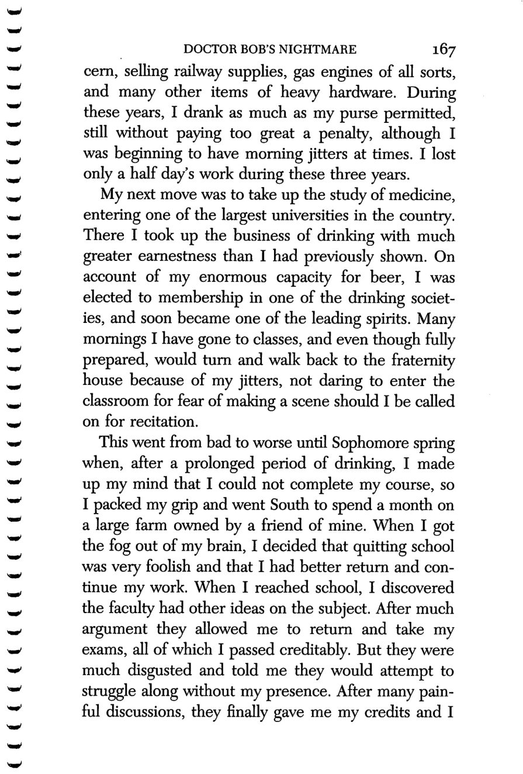
166
167
Copyright © Alcoholics Anonymous World Services, Inc. All rights reserved. Intended for personal use only, and not to be reproduced further or distributed for resale.

Slide 18
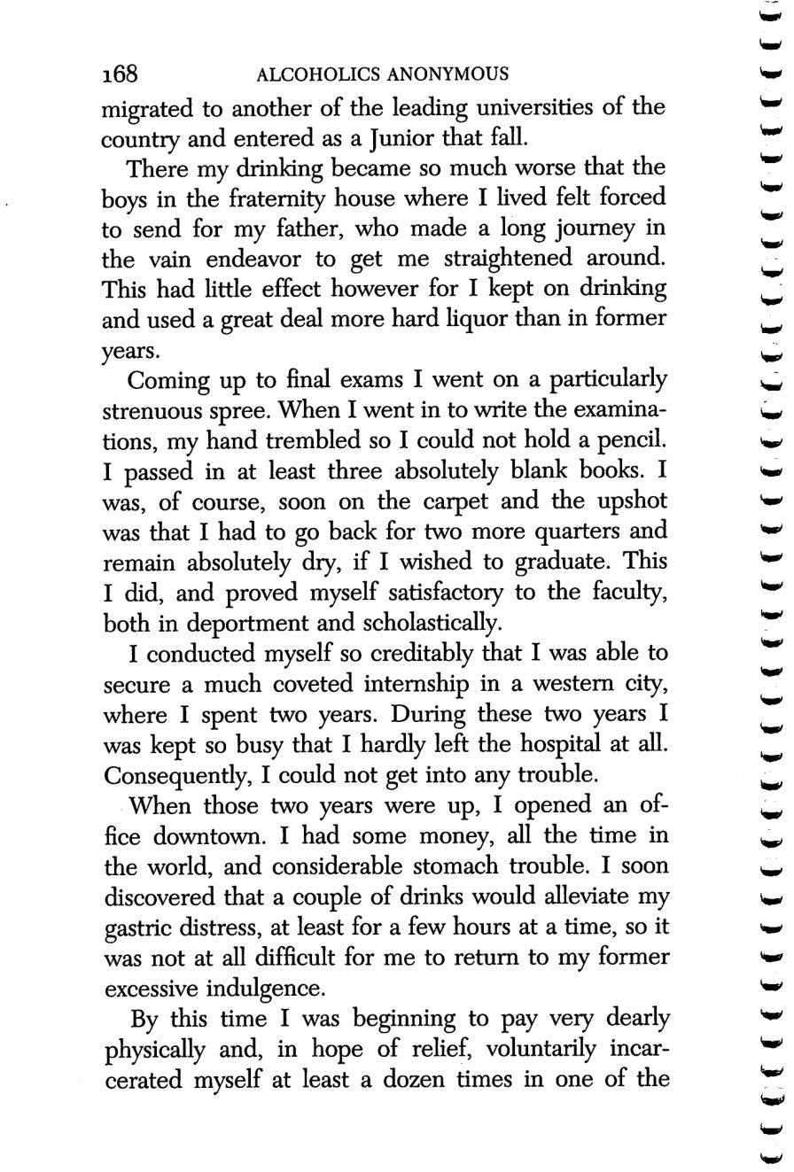
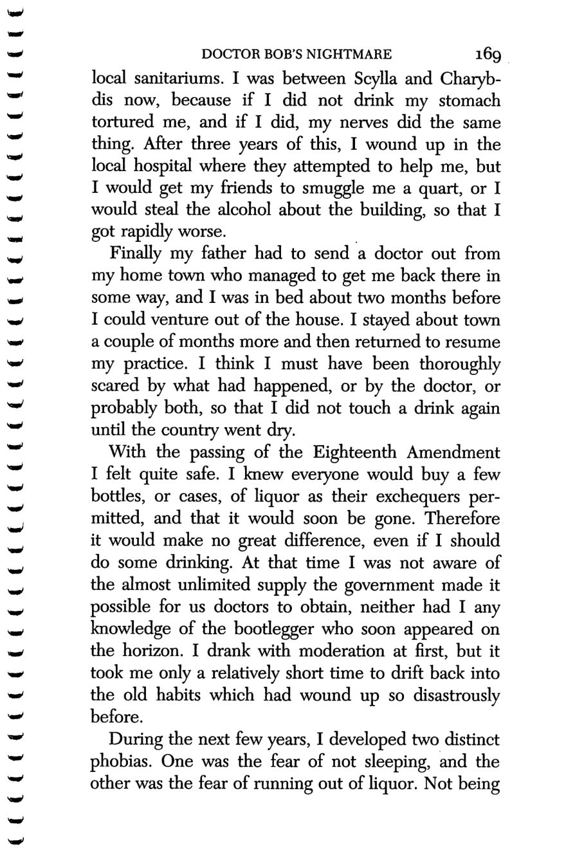
168
169
Copyright © Alcoholics Anonymous World Services, Inc. All rights reserved. Intended for personal use only, and not to be reproduced further or distributed for resale.

Slide 19
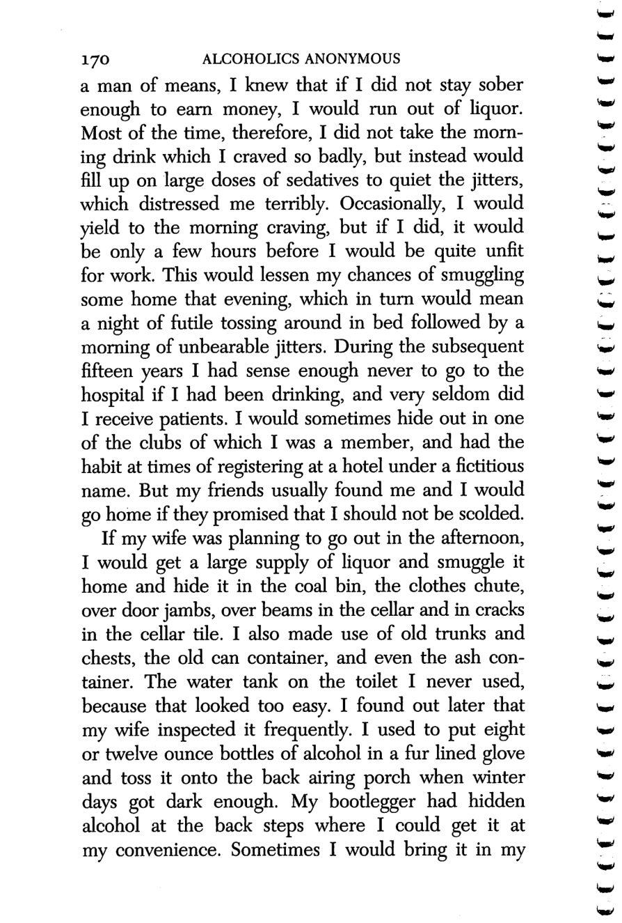
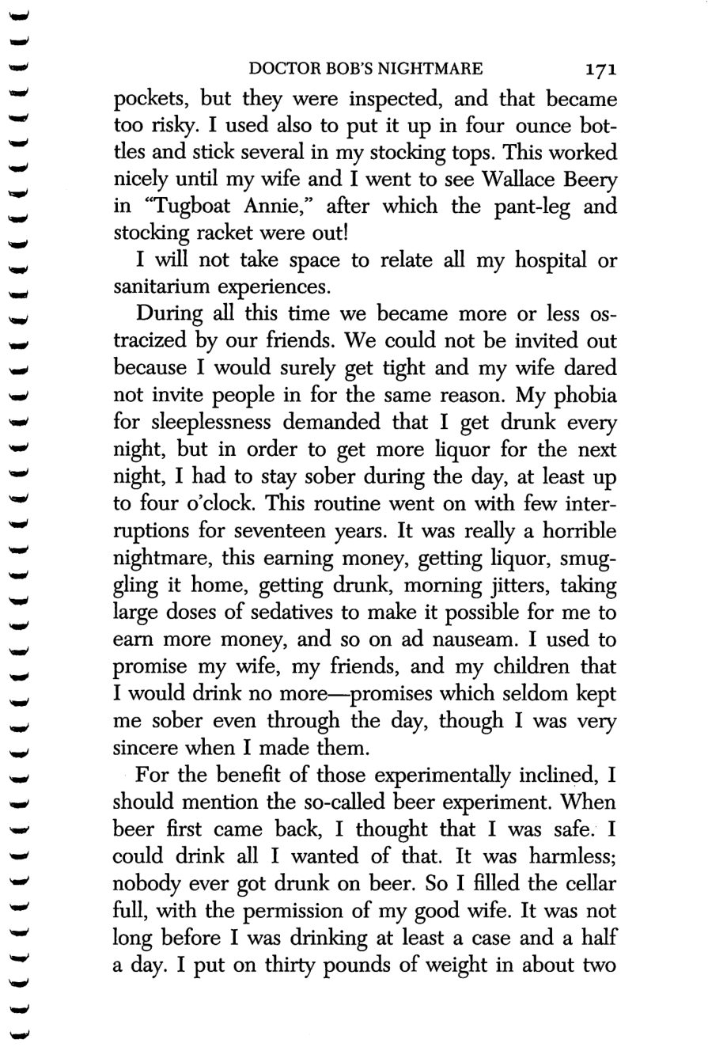
170
171
Copyright © Alcoholics Anonymous World Services, Inc. All rights reserved. Intended for personal use only, and not to be reproduced further or distributed for resale.

Slide 20
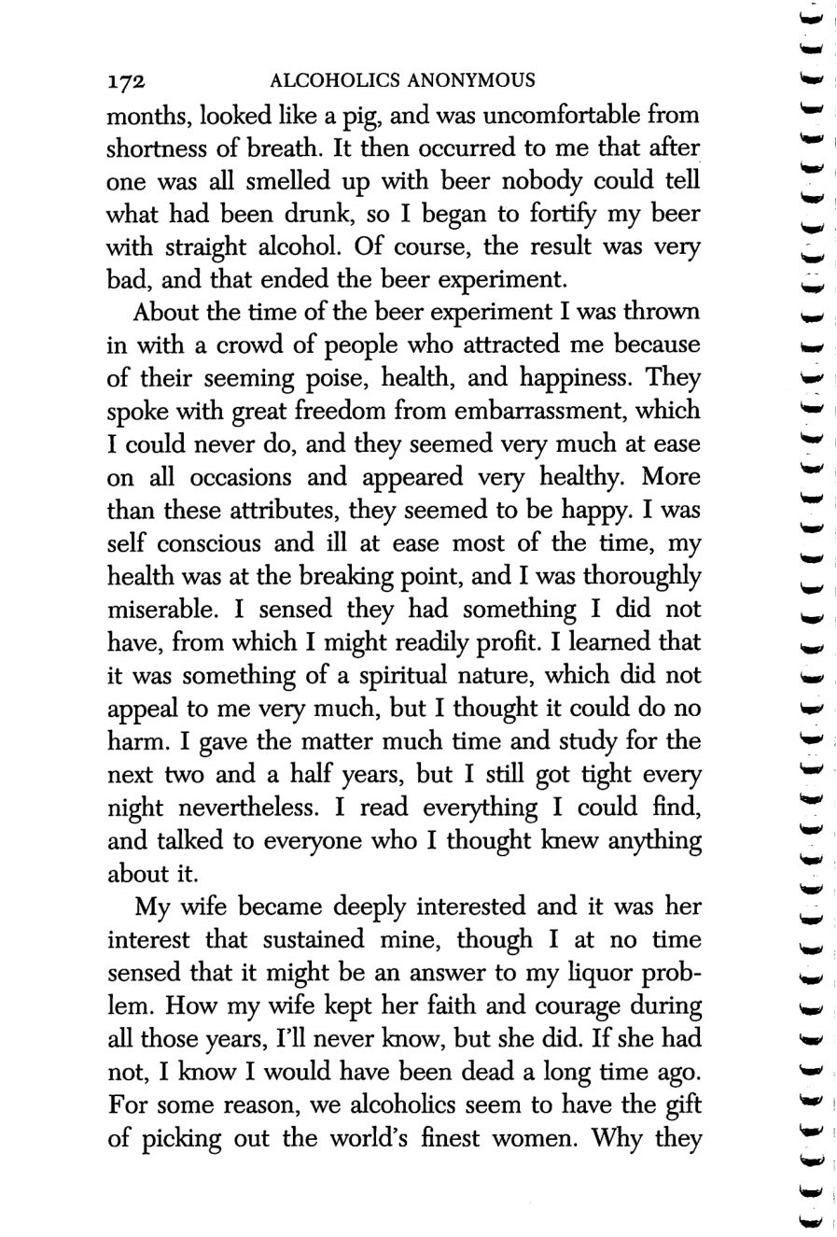
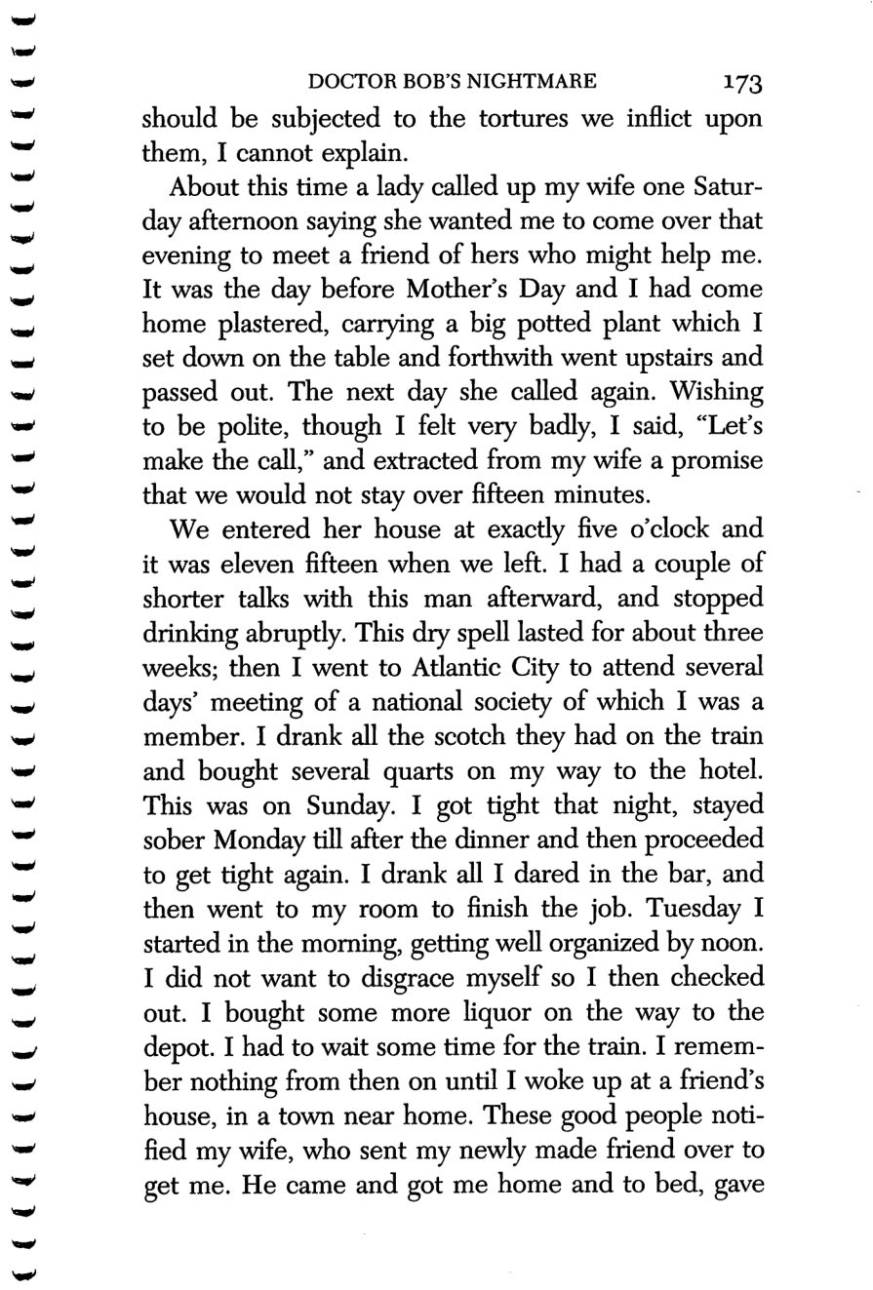
172
173
Copyright © Alcoholics Anonymous World Services, Inc. All rights reserved. Intended for personal use only, and not to be reproduced further or distributed for resale.

Slide 21
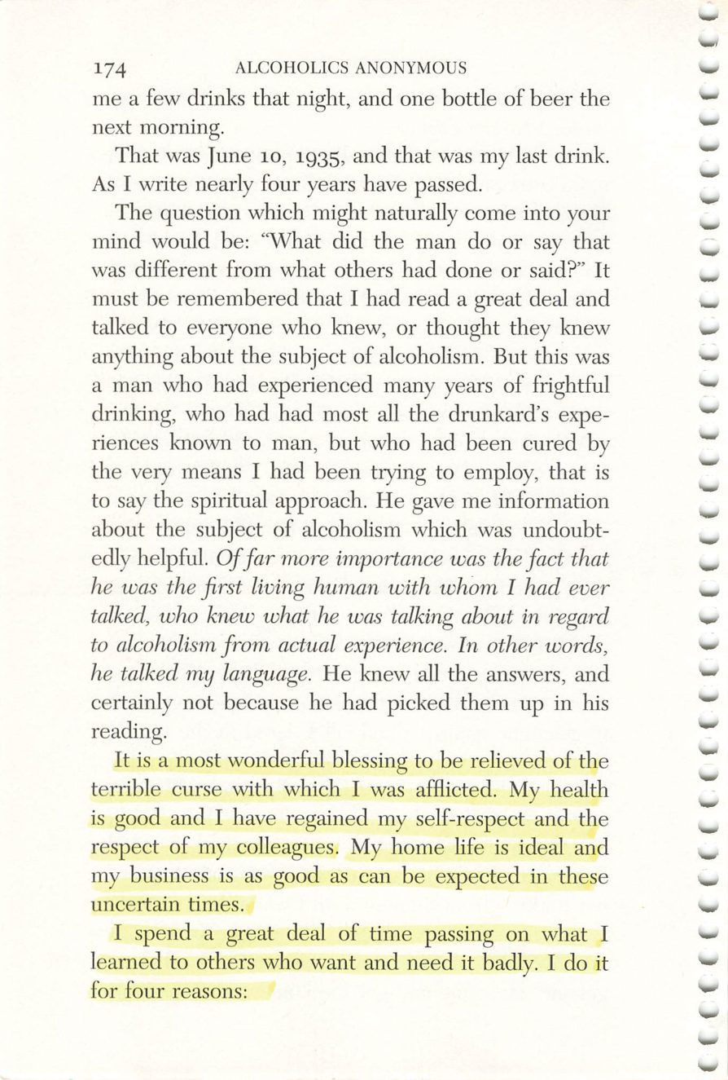
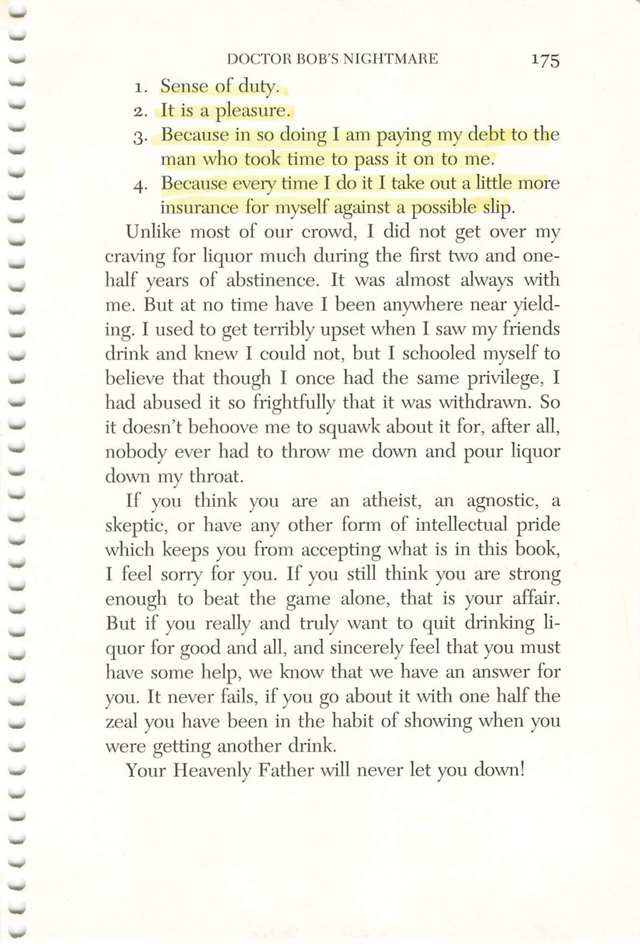
174
175
Copyright © Alcoholics Anonymous World Services, Inc. All rights reserved. Intended for personal use only, and not to be reproduced further or distributed for resale.

Slide 22
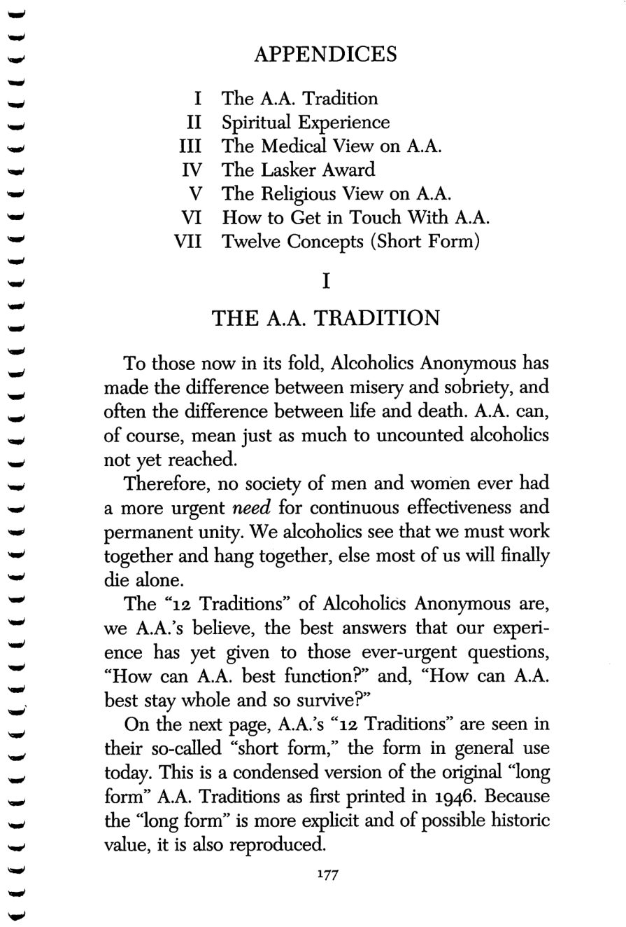
Copyright © Alcoholics Anonymous World Services, Inc. All rights reserved. Intended for personal use only, and not to be reproduced further or distributed for resale.
177

Slide 23
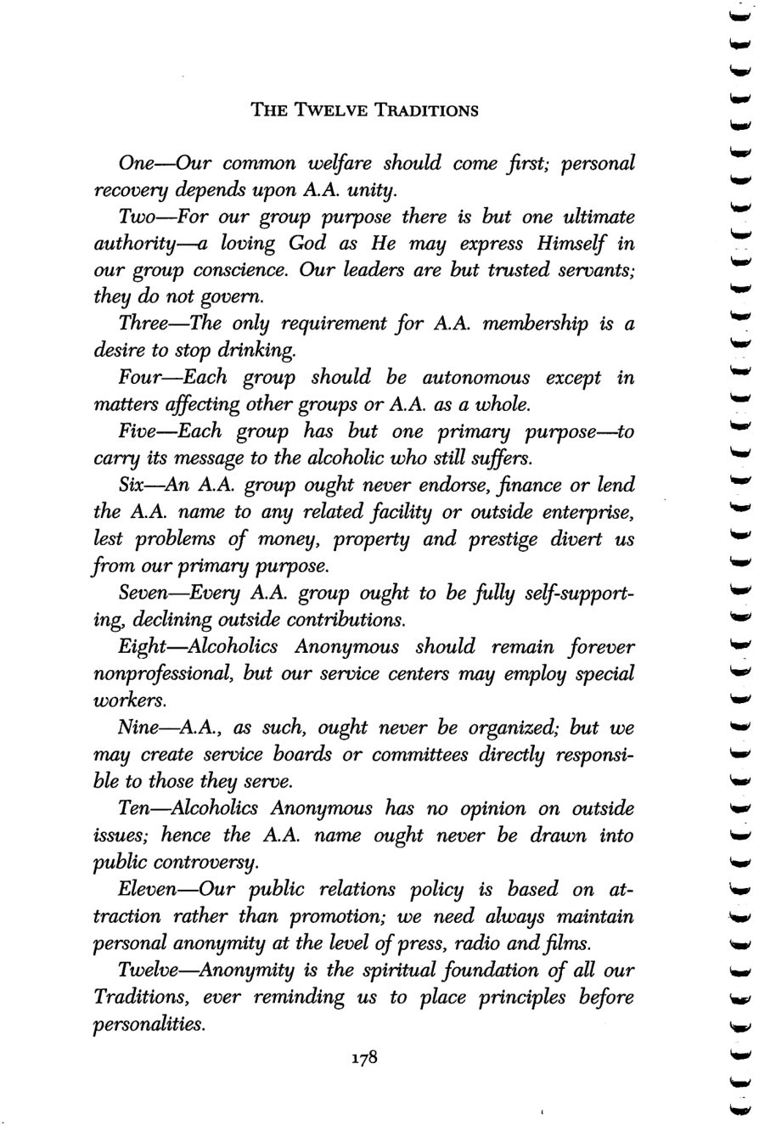
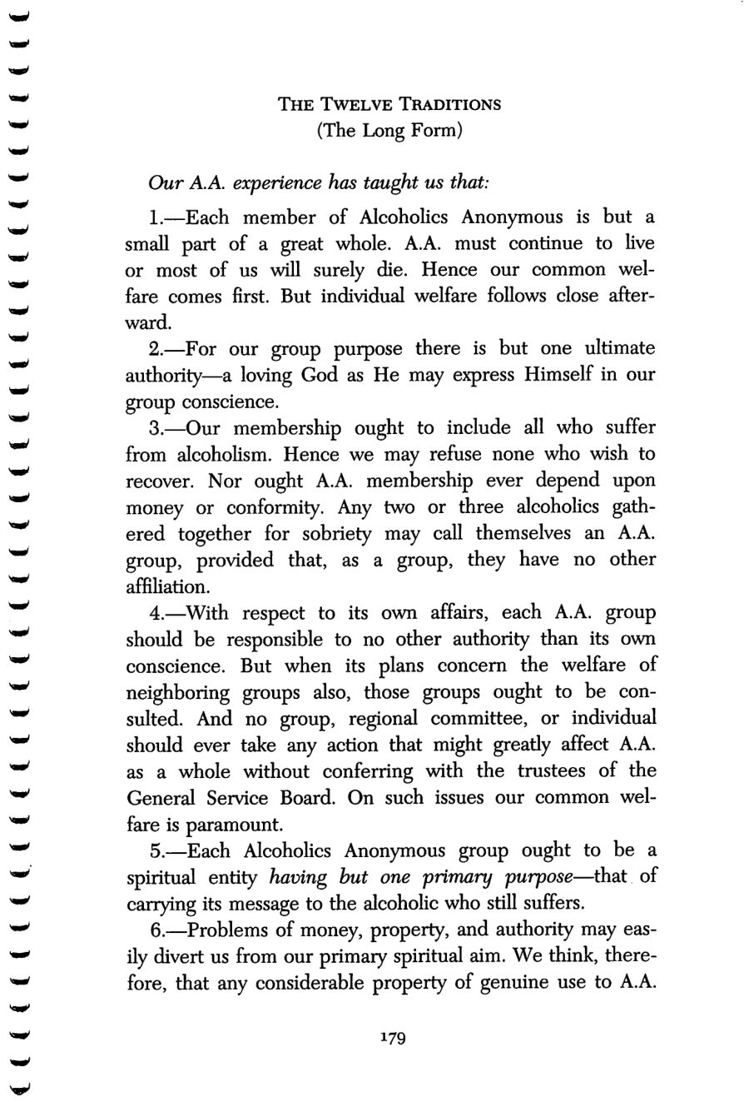
178
179
Copyright © Alcoholics Anonymous World Services, Inc. All rights reserved. Intended for personal use only, and not to be reproduced further or distributed for resale.

Slide 24
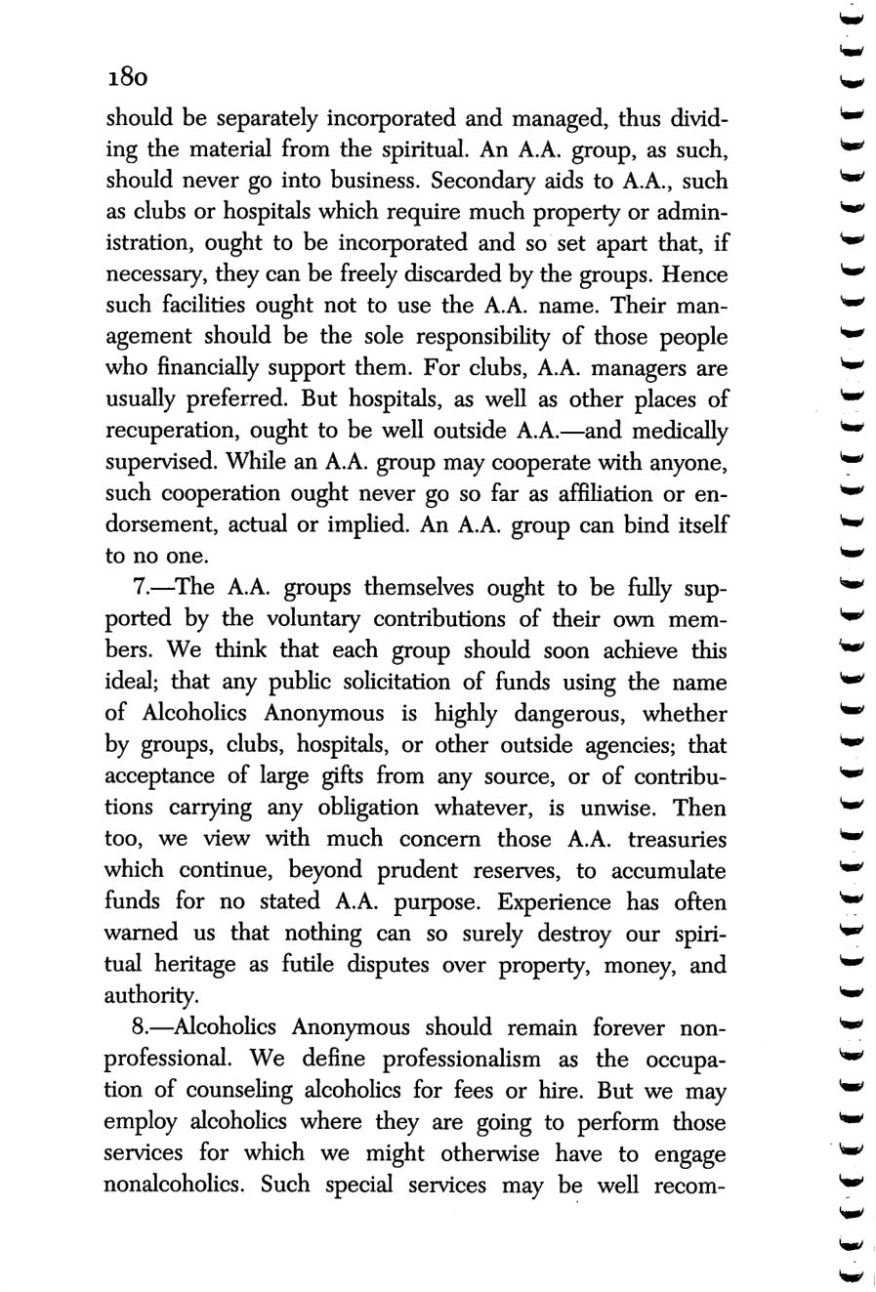
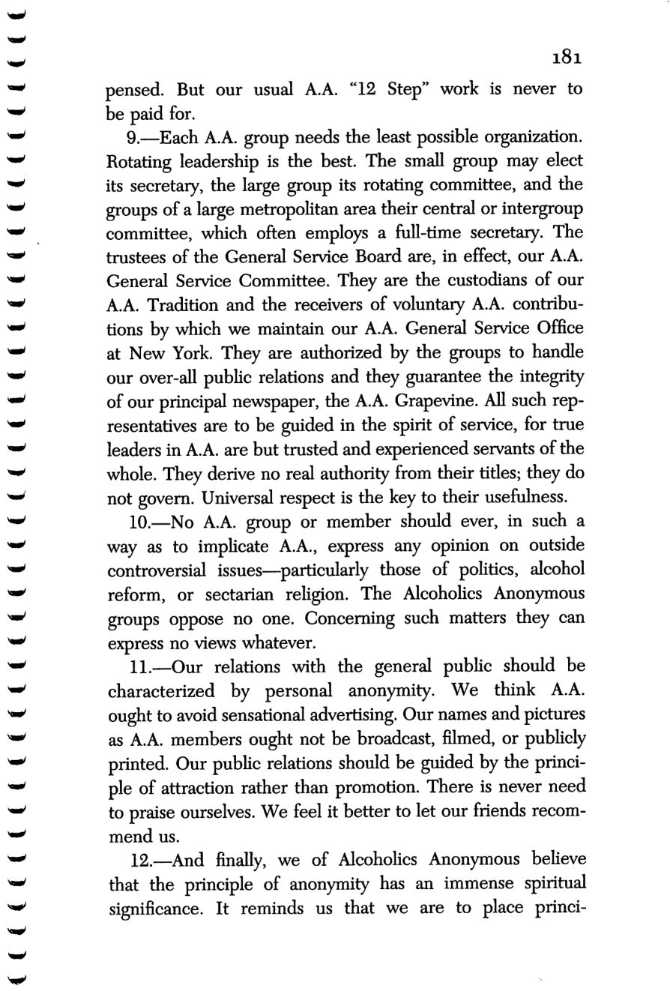
180
181
Copyright © Alcoholics Anonymous World Services, Inc. All rights reserved. Intended for personal use only, and not to be reproduced further or distributed for resale.

Slide 25
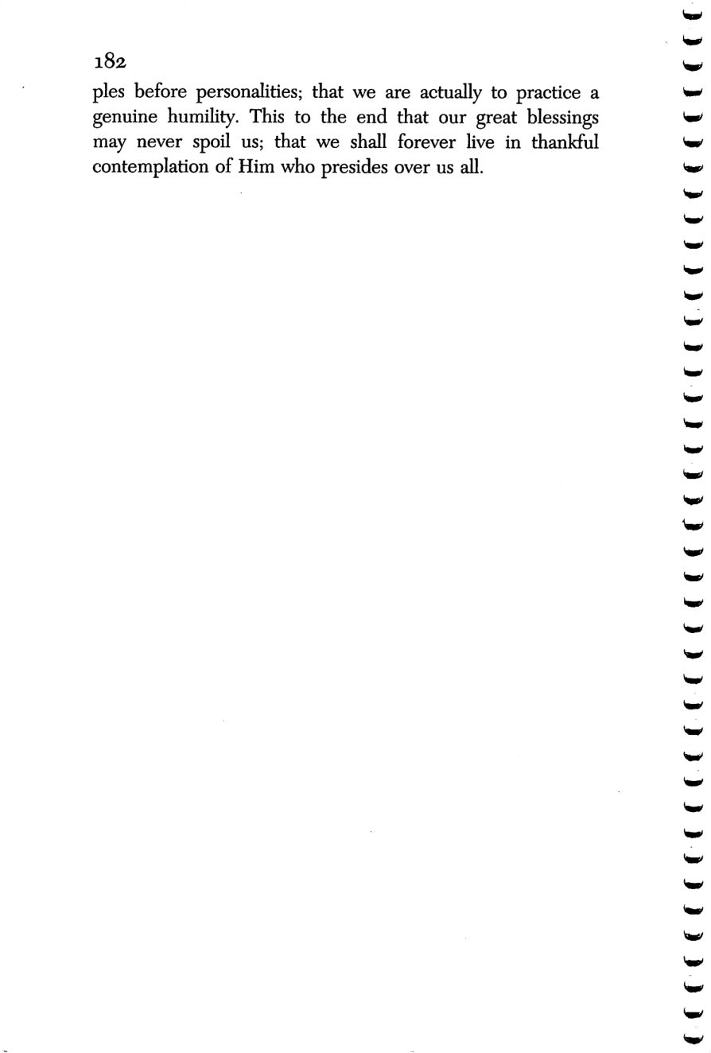
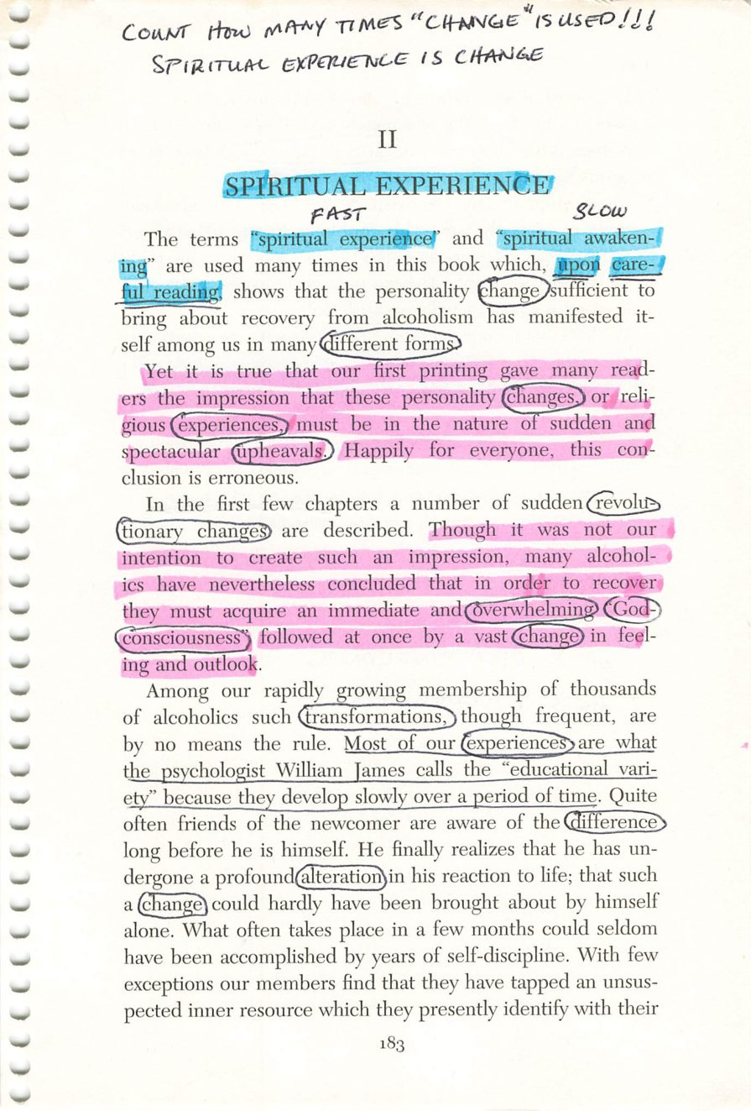
182
183
Copyright © Alcoholics Anonymous World Services, Inc. All rights reserved. Intended for personal use only, and not to be reproduced further or distributed for resale.

Slide 26
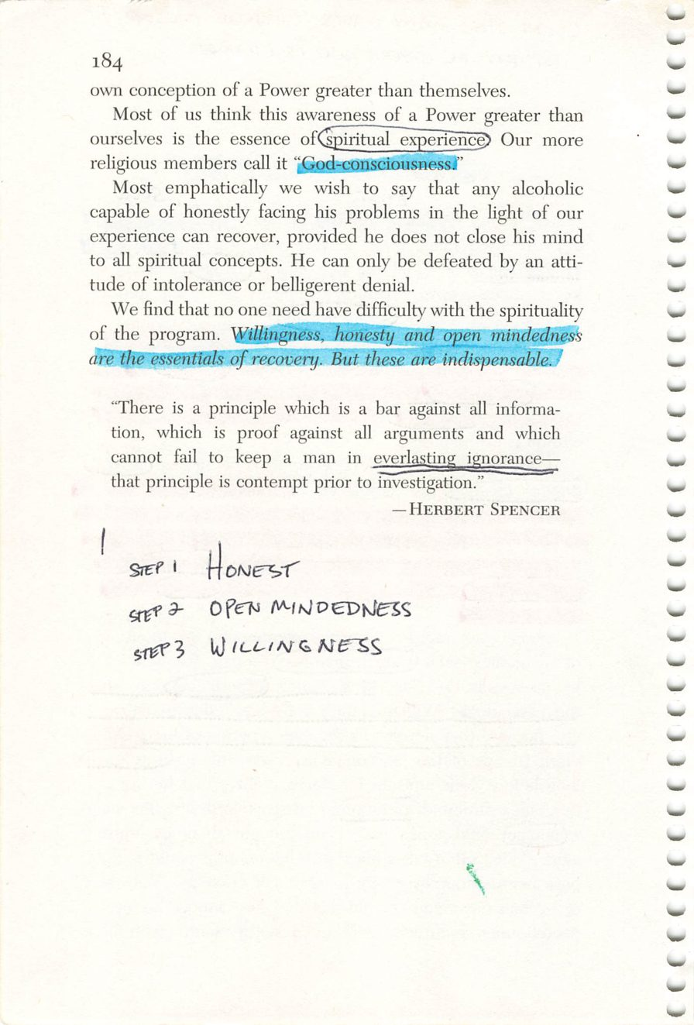
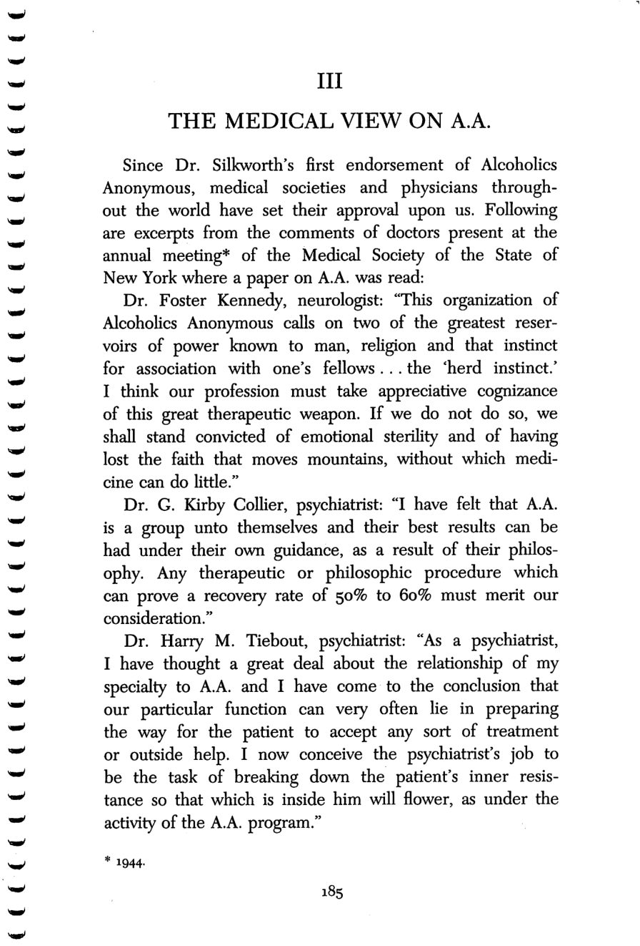
184
185
Copyright © Alcoholics Anonymous World Services, Inc. All rights reserved. Intended for personal use only, and not to be reproduced further or distributed for resale.

Slide 27
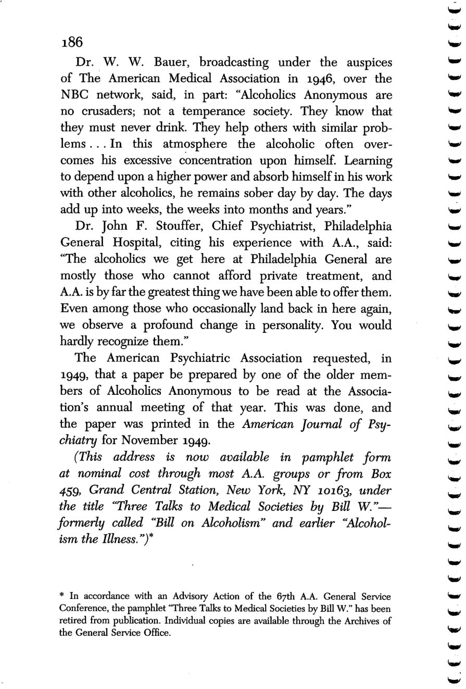
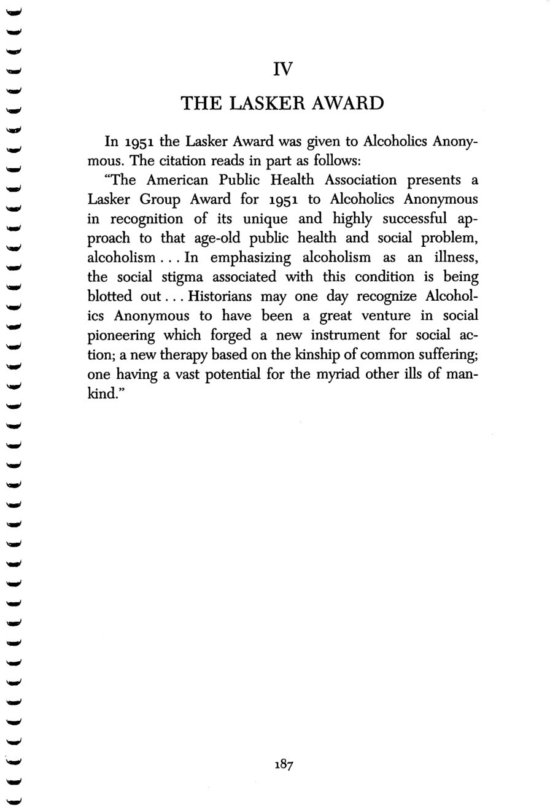
186
187
Copyright © Alcoholics Anonymous World Services, Inc. All rights reserved. Intended for personal use only, and not to be reproduced further or distributed for resale.

Slide 28
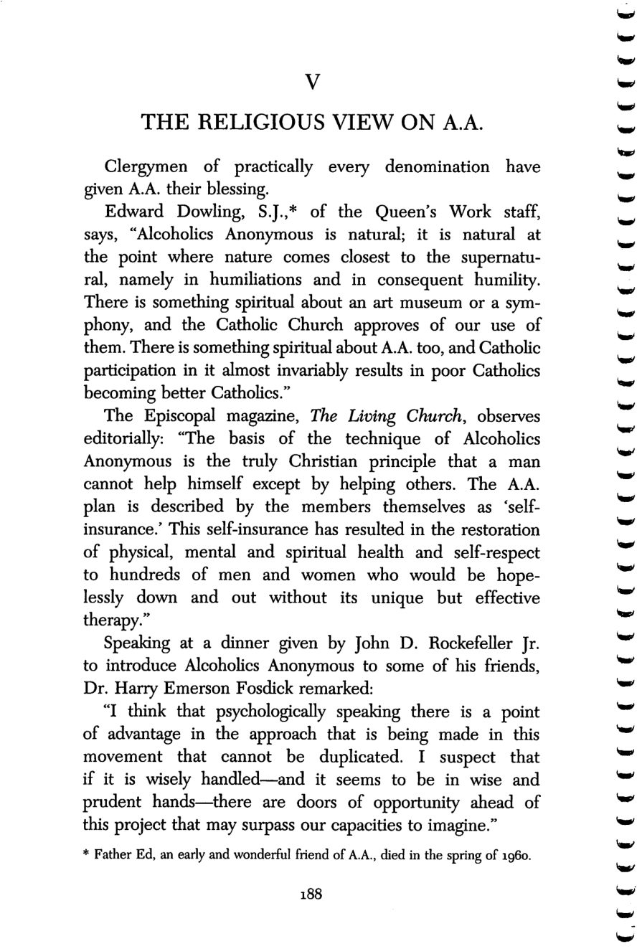
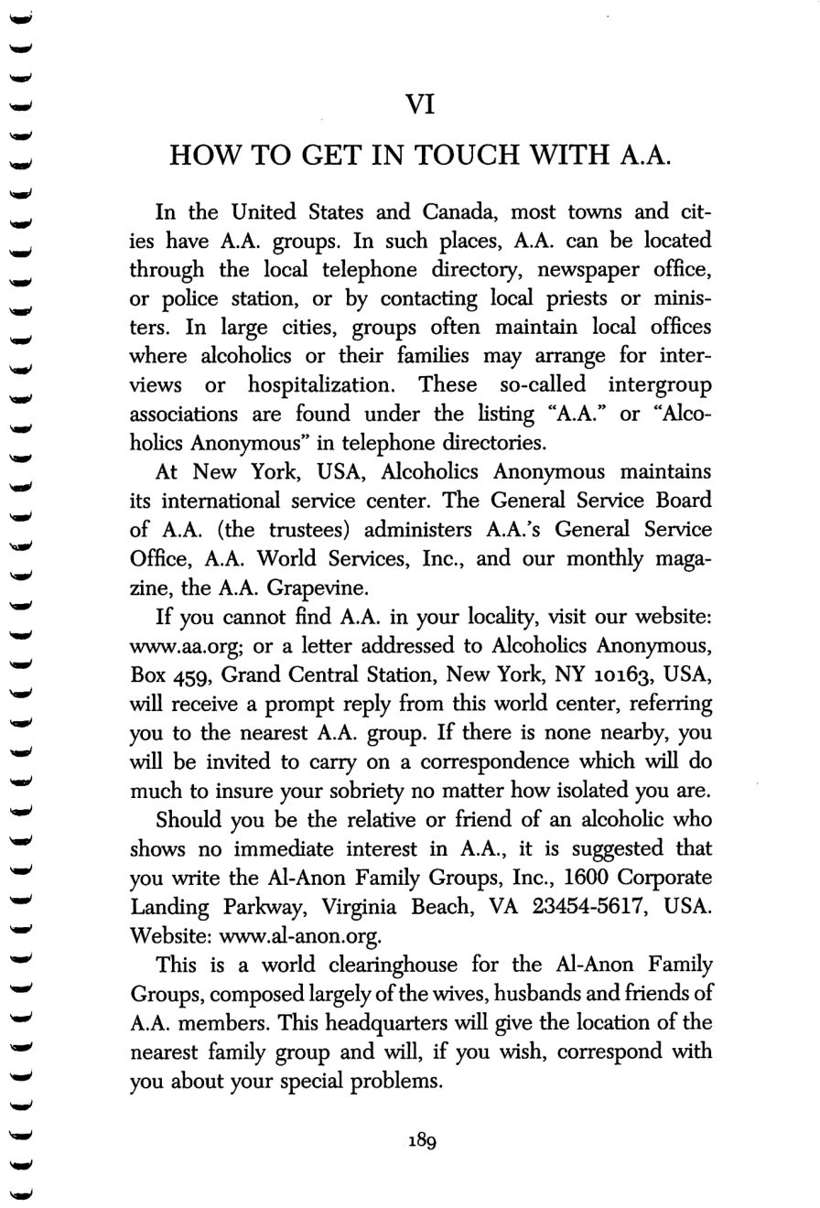
188
189
Copyright © Alcoholics Anonymous World Services, Inc. All rights reserved. Intended for personal use only, and not to be reproduced further or distributed for resale.

Slide 29
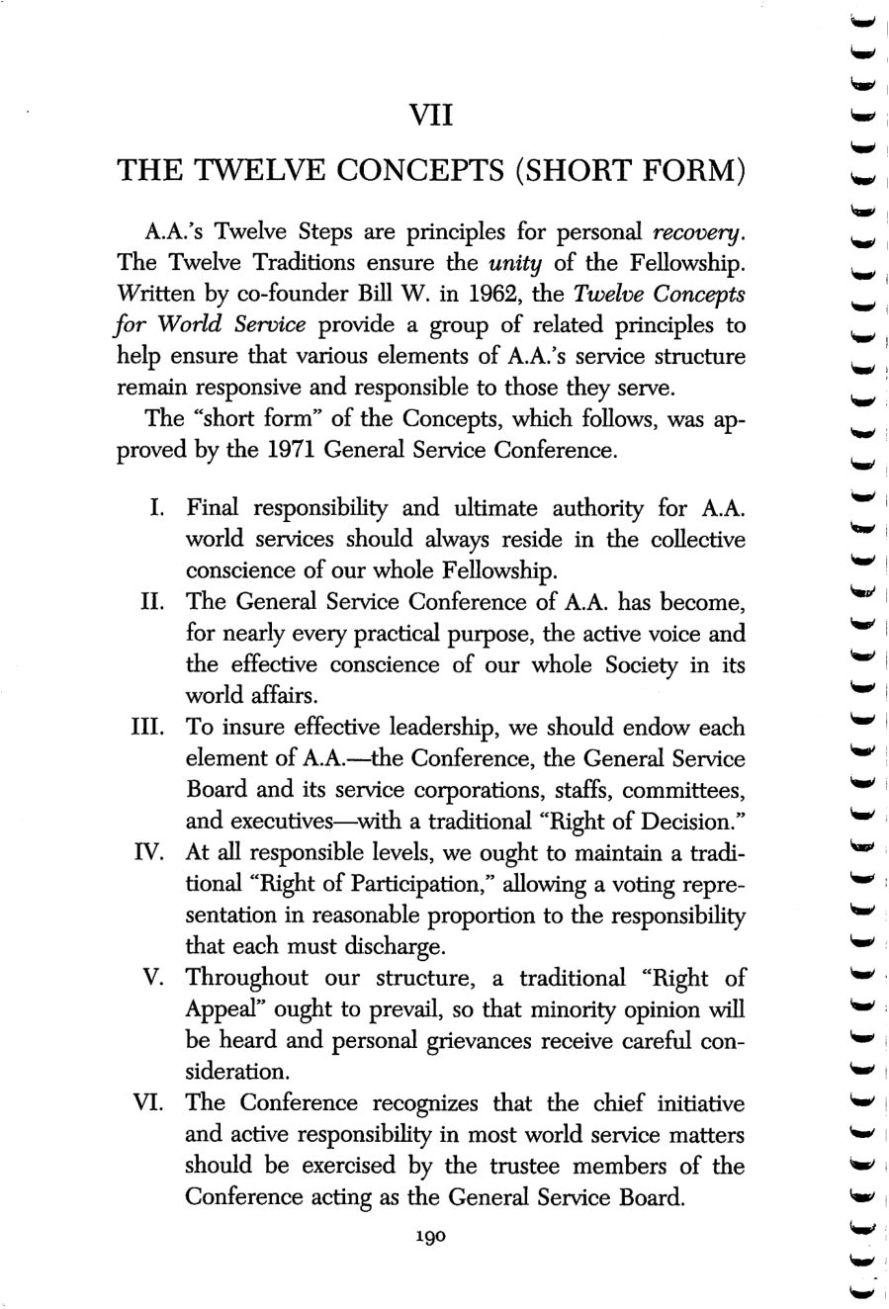
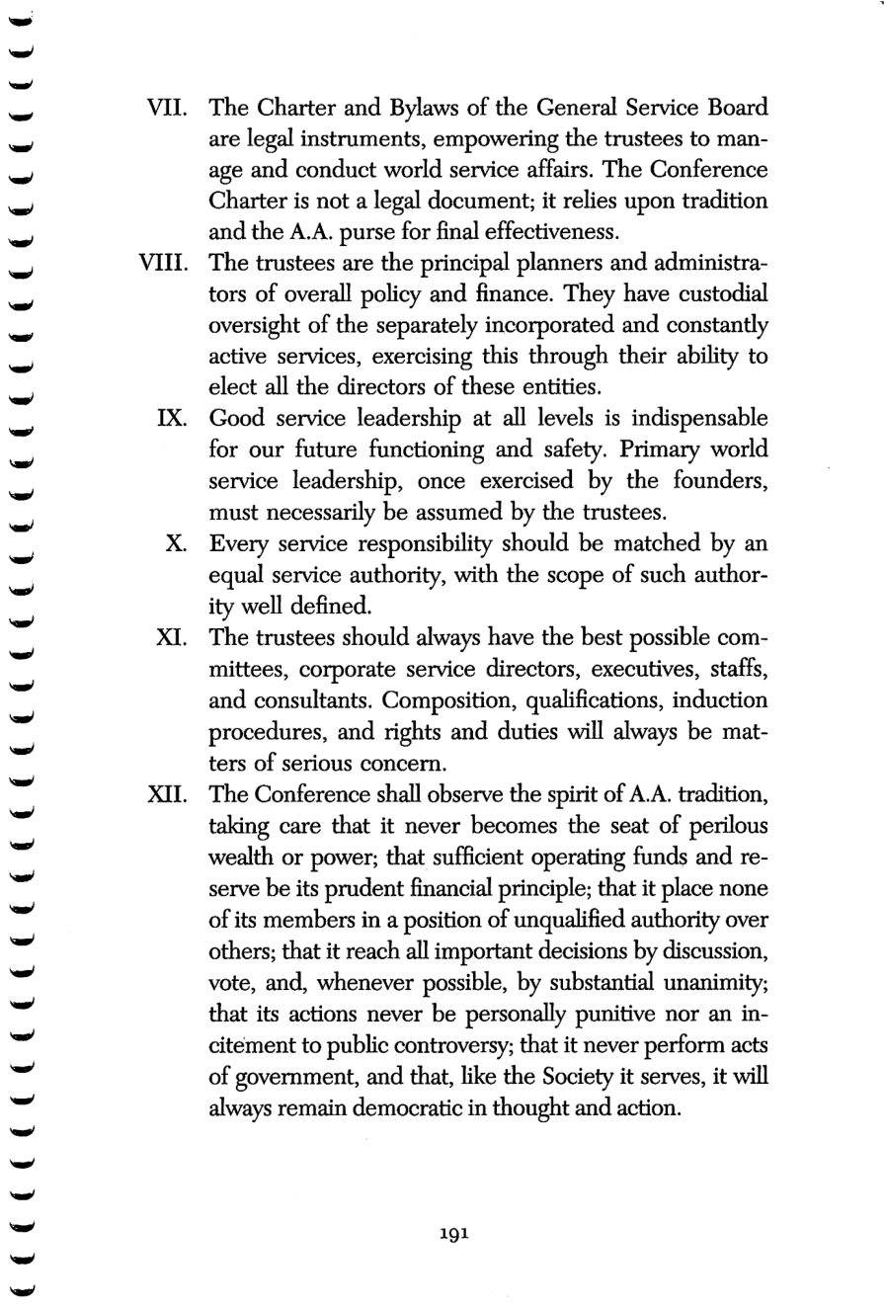
190
191
Copyright © Alcoholics Anonymous World Services, Inc. All rights reserved. Intended for personal use only, and not to be reproduced further or distributed for resale.

Slide 30

192
Copyright © Alcoholics Anonymous World Services, Inc. All rights reserved. Intended for personal use only, and not to be reproduced further or distributed for resale.

