Slide 1


PATIENT FLOW ANALYSIS
Hospital Patient Admissions & Treatment Outcomes
Patient-flow analytics to support resource planning
1
Notes:
Introduce the group and the hospital patient-flow story.

Slide 2


PROJECT OVERVIEW
Challenges, Objectives & Desired Outcome
Introduction
The goal of this project was to help the hospital administration understand Patient Flow by analyzing Admissions trend by Month, Average Length of Stay by Department and Outcome Distribution, Average Billing by Department, Outcome by Age Group and Readmission; so, the information can support resource planning and further investigation.
Understanding Patient Flow
Patient Flow refers to how patients move through the hospital system; from admission through their hospital stay and recorded outcome, with readmission providing another indicator of what happens after an earlier admission.
Our project focuses on using hospital admission data to understand patient flow and treatment outcomes.
2
Notes:
Roles follow the project plan team-split method. Add member names here.

Slide 3



THE TOOLKIT
From raw sheet to live dashboard
Excel
Cleaning, formulas, pivot tables, flag columns
Power BI
KPI cards, charts, slicers, calendar table
KEY DAX MEASURES
Total_Admissions = COUNTROWS(PatientData)
Average_LOS = AVERAGE(PatientData[Length of Stay])
Recovery_Rate = DIVIDE(CALCULATE(COUNTROWS(...), Outcome="Recovered"), COUNTROWS(...))
Readmission_Rate = DIVIDE(CALCULATE(COUNTROWS(...), Readmission="Yes"), COUNTROWS(...))
3
Notes:
Excel for cleaning and pivots, Power Query for import, Power BI and DAX for measures and visuals.

Slide 4





THE DATA
The raw data was messy, so we cleaned it first
ISSUE FOUND
HOW WE TREATED IT
Department names
"Icu" vs "ICU"
One standard label for all 7 departments
Billing amounts
Text like "$16,910.89"
Numeric currency values
Admission/discharge dates
Mixed numbers and text
One consistent date type
Invalid date pairs
273 records (28%) discharge before admission
Flagged, not guessed; used the existing Length of Stay field
Outlier check (IQR)
Stays range 1 to 14 days
0 outliers found; no extreme values
4
Notes:
Dates were not guess-fixed: no reliable evidence showed which of the two dates was wrong.

Slide 5
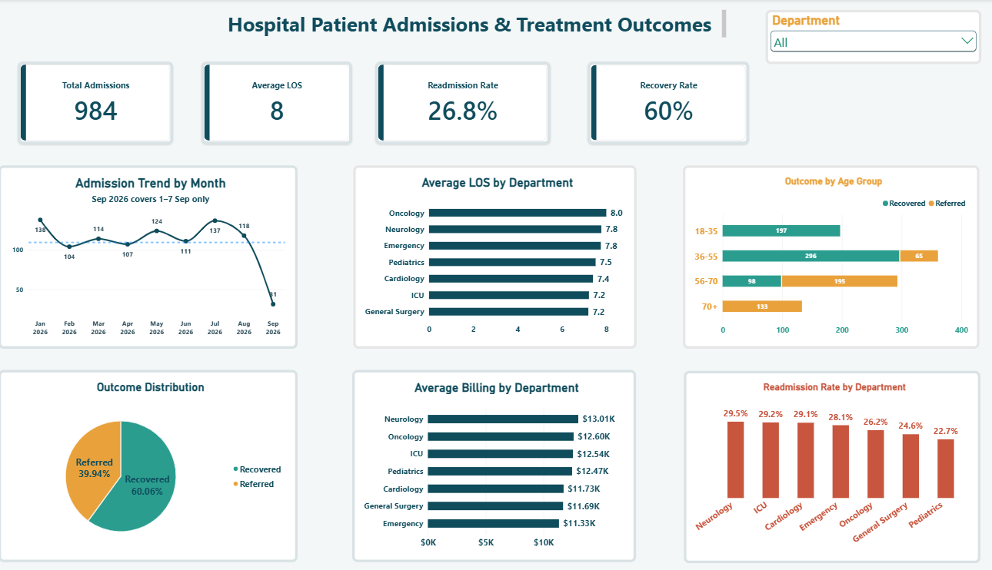

LIVE DASHBOARD DEPLOYED
Refreshable metrics ready for administrative deployment
5
Notes:
Pattern, not causation. The age-outcome split is unusually deterministic; validate with representative data.

Slide 6


THE BIG PICTURE
Total admissions: Steady flow
984
Total admissions
8 days
Avg length of stay
What the trend tells us
The dashboard’s top-line numbers include a total admission of 984 patients, an average length of stay across the admission records of 8 days. These figures give the overall snapshot of the records in the dataset. The Admissions Trend chart shows that admissions were relatively steady from January through August, followed by a marked drop in September.
6
Notes:
September data stops on 7 Sep, so the dip is a partial month, not a confirmed seasonal pattern.

Slide 7
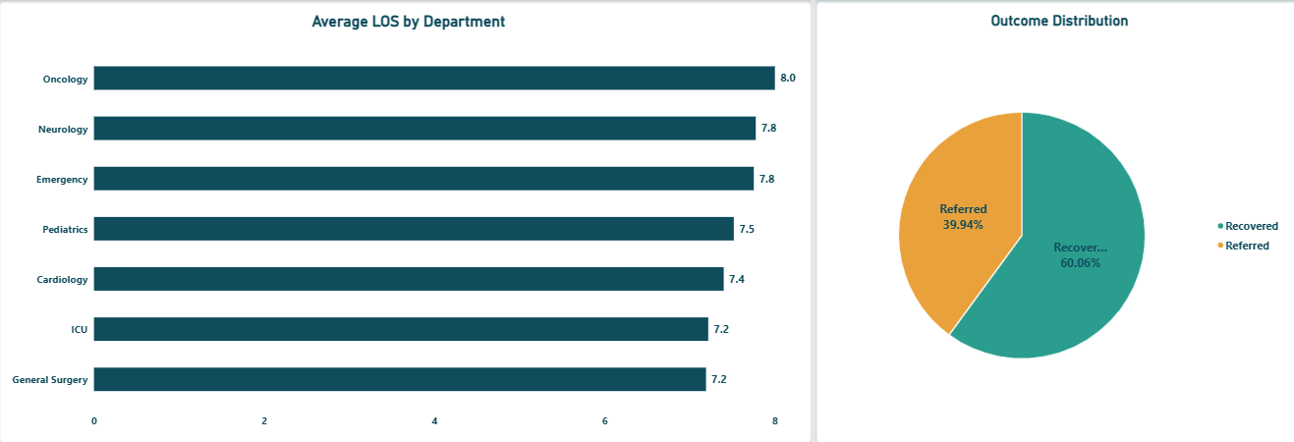
AVERAGE LENGTH OF STAY AND OUTCOME DISTRIBUTION
Stays are remarkably uniform across departments
Insight
The Average Length of Stay by Department chart shows that stays are tightly clustered between approximately 7 and 8 days across all departments. Oncology has the highest average at 8 days, while General Surgery is among the lowest at about 7 days. This means the differences in average stay between departments are relatively small in this dataset
7
Notes:
Differences between departments are small in this dataset.

Slide 8
THE COST OF CARE
Billing: Neurology costs the most, Emergency the least
Insight
The chart shows that Emergency has the lowest average at approximately $11,328, while Neurology has the highest at approximately $13,008. The main observation is that billing averages are fairly close compared with one another.
Recommendation
This information can help administrators identify departments whose average billing levels may warrant further review alongside patient volume, procedures, and other operational information. The billing figures alone do not establish why one department costs more.
8
Notes:
Billing alone does not establish why one department costs more.

Slide 9
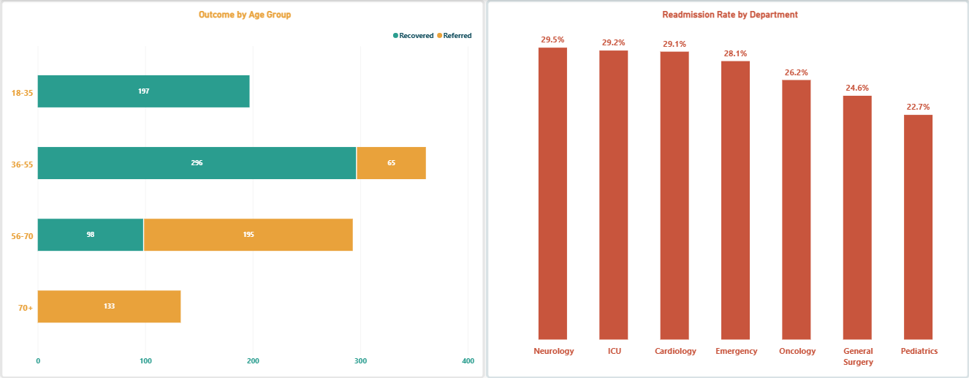
OUTCOME BY AGE GROUP AND RE-ADMISSION RATE
The relationship between age and recovery rates
Insight
Patients aged 18 to 35 had a 100% recovery rate, while patients aged 70 and above had a 100% referral rate. The intermediate age groups that are 36 through 69, fall between these two extremes. We report this as an observed pattern, not as proof that age causes a particular outcome. The Readmission Rate by Department ranges from 22.7% in Pediatrics to 29.5% in Neurology. The rates for the other departments fall between these values.
9
Notes:
Pattern, not causation. The age-outcome split is unusually deterministic; validate with representative data.

Slide 10



RECOMMENDATIONS
What the hospital should do next
1. Plan beds on a flat 7.6-day stay
No department-specific buffers are justified yet; revisit with more data.
2. Prepare referral pathways for older patients
56+ patients account for 326 of 393 referrals; plan transfer capacity.
3. Audit Neurology and ICU
Readmission near 29% and above-average billing: review discharge and care processes.
4. Fix date capture at source
28% of records had invalid dates; add entry validation.
5. Extend the data window
Add 12+ months to confirm seasonality and validate the age-outcome pattern.
10
Notes:
Each recommendation is tied to a finding in the analysis.

Slide 11

CONCLUSION
From messy records to a decision-ready dashboard
Cleaned and documented
Names, billing and dates standardized; 273 invalid date pairs flagged
Dashboard delivered
KPIs, trend, length of stay, billing, outcomes and readmission, built in Power BI with DAX.
Findings are indicative
Under 12 months of data and a very clean age-outcome split call for validation.
11
Notes:
Close the story: messy data became evidence for planning.

Slide 12

Thank You
Questions & Discussion
12
Notes:
Invite questions.

