Slide 1
Event 2 Go
Senior engineering project Prof. Jeff Fortuna
By: Thomson Philip Sanket Patel

Slide 2
Agenda
About the application
Tech stack
Demo
Code run through
Future implementation
IOS and Android sample

Slide 3
About the application
Event 2 Go
A cross platform event management app that can be used by users to create events that other users can join in on.

Slide 4
Tech Stack
Tech | Usage
Firebase | Backend server
GitHub | Version Control
PhoneGap | Cloud based software used for cross platform applications
AngularJS | Client side JavaScript

Slide 5
Demo

Slide 6
Code run through

Slide 7
Future implementation
Location feature | User will able use in-built location feature for event location
Messaging feature | Users will able to communicate through message who joined same group
Signup and login through various API | Users will able to signup or login account through Facebook, google and many different API
Verification by SMS | Users will able to verify account through SMS
Invite to an event | Users can invite an event to other users through social media
Profile picture | User will able to add or edit picture for account and event
Add more UI component | More functionality toward user interface such as carousal, more animation related to gestures.
User check | If a user account is deleted, then the user profile and events created by the user should no longer exist
Resend Email Verification | Option to allow user to resend email verification email

Slide 8
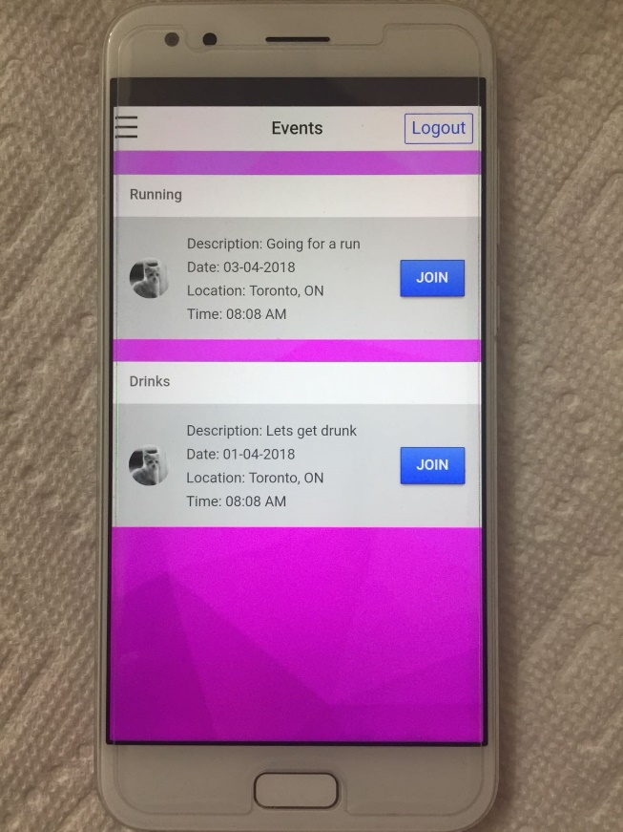
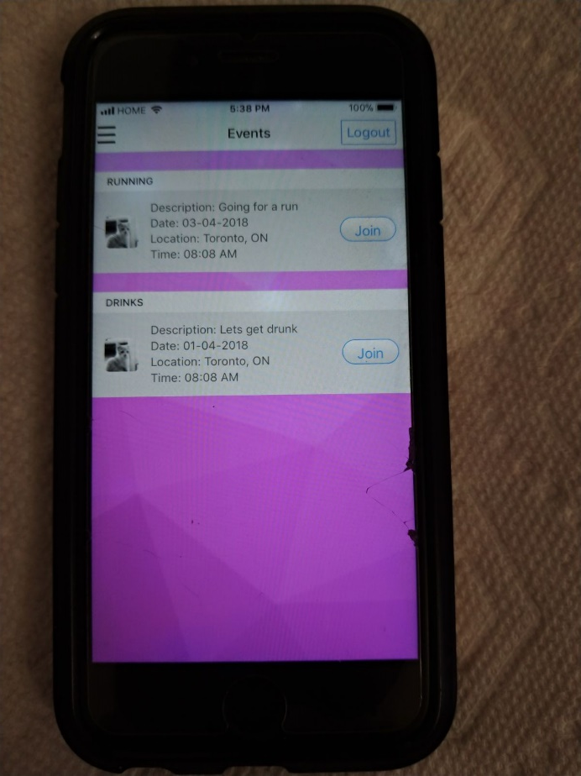
IOS and android samples

Slide 9

Thanks
Questions?

