Slide 1

Presented by:
Visualization and interpretation
Faith ubara-collins

Slide 2
AGENDA
Introduction​
Business questions
​Areas of interest
​Summary​

Slide 3
Introduction
This presentation provides insights from the analysis of the SPOCKET CENTRAL PLT LTD company dataset about their 1000 new customers.
The data exploration analysis reveals some hidden information that the marketing team should consider in other to achieve success in their sales.
This data set were wrangled using python to uncover some truth about the dataset provided.

Slide 4
Business questions
What are the trends in the underlying data?
Which customer segment has the highest customer value?
What do you propose should be Sprocket Central Pty Ltd ’s marketing and growth strategy?

Slide 5
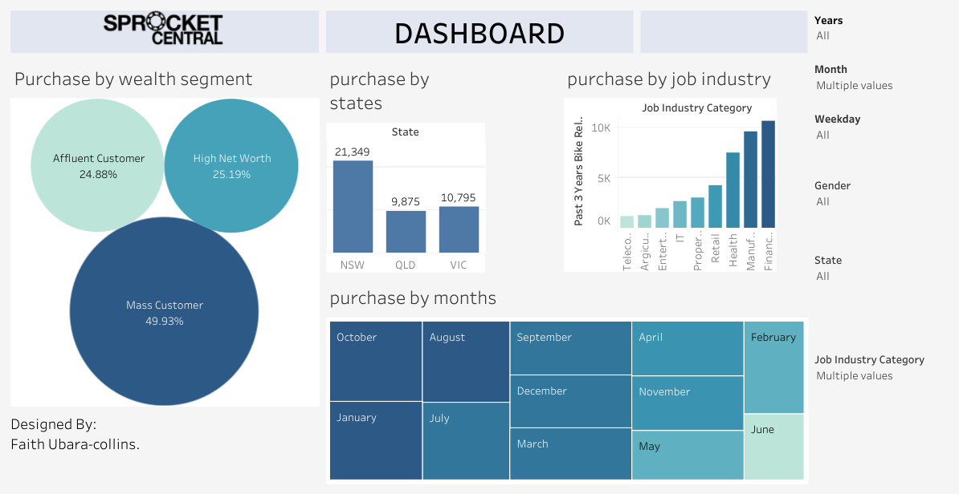
Dashboard analysis

Slide 6
Dashboard: by wealth
1.1 Purchase by wealth
The charts reveal the a large percentage of customer are “mass customers”, with 49.93% of all wealth category.
Both the affluent and high net worth customers shares almost equal percent of all wealth category .
CONCLUSIONS:
From the wealth distribution category, it shows that the marketing team should target the mass customers for their campaigns

Slide 7
DASHBOARD: BY STATES
1.2 Purchase by Sates
The charts reveal the a large percentage of customer are from “NSW”.
The remaining other two states have almost equal numbers of customers.
Note as this company is fiction; the states name are allocated in abbreviation.
CONCLUSIONS:
From the visualization, the marketing team should focus on their customers from NSW city their marketing campaigns

Slide 8
DASHBOARD: By months
1.3 Purchase by months
All the months have relatively equal amount of customers, nevertheless, October, Janaury and August has the highest purchase while June has the lest amount of customers
CONCLUSIONS:
The marketing team should include all months in their strategic campaigns with special regards to October, January and August.

Slide 9
DASHBOARD: job industry
1.3 Purchase by job industry
The most productive job industry were financial services, management and health
The remaining job industries contributed relatively low numbers of customers, the lowest was telecommunication and agriculture.
CONCLUSIONS:
The marketing team should include the customers who work in the financial services, management and health as their top priority when marketing.

Slide 10
SUMMARY
By adhering to the conclusions from all 4 categories, it is clear that SPROCKET CENTRAL PLY LTD should considerate their efforts in marketing bikes to the mass customers, people who work in the financial services, management and health, also a lager number of their new customers reside in the NSW.

Slide 11
THANK YOU
Faith Ubara-collins​
ubarajf@gmail.com
Github: Faithjf · GitHub

