Slide 1

Risk Assessment for Aircraft Acquisition
Risk Assessment for Aircraft Acquisition
Risk Assessment for Aircraft Acquisition

Slide 2

Why Aircraft Risk Matters
In my research, I found that aircraft safety varies widely across models, manufacturers, and usage types.
Choosing high-risk aircraft could expose us to liability, downtime, and insurance issues.
So, I focused on reducing our risk exposure in this strategic expansion.

Slide 3
About the Data
I worked with aviation incident reports from reliable sources over multiple years.
I focused on key data: Aircraft Make & Model, Purpose of Flight, Injury Severity, and a custom Risk Score.
This allowed me to uncover consistent risk patterns across different aircraft types.

Slide 4
Our Approach
Here’s how I approached the analysis:
I cleaned the data to remove incomplete records.
I calculated a risk score based on injury outcomes and flight purpose.
Then I grouped aircraft by model and visualized the insights through a dashboard.

Slide 5
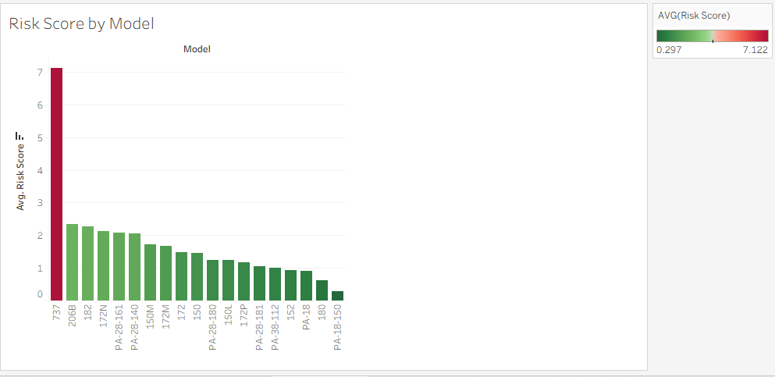
Average Risk Score by Aircraft Model

Slide 6
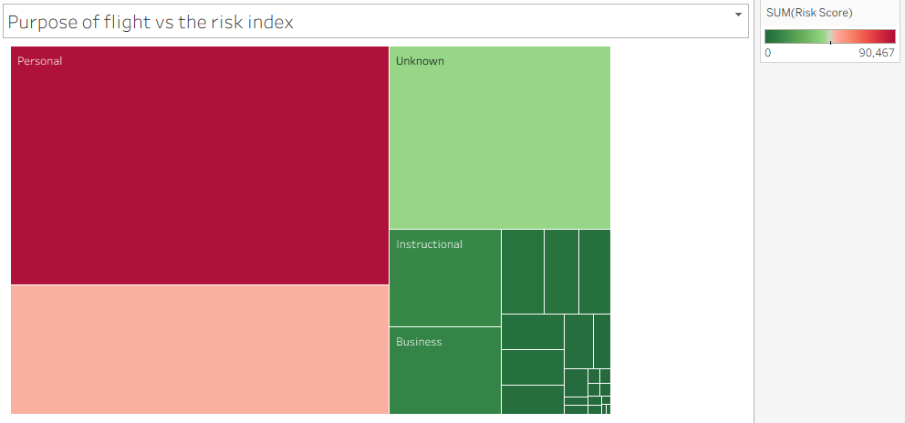
Flight Purpose and Its Risk Correlation

Slide 7
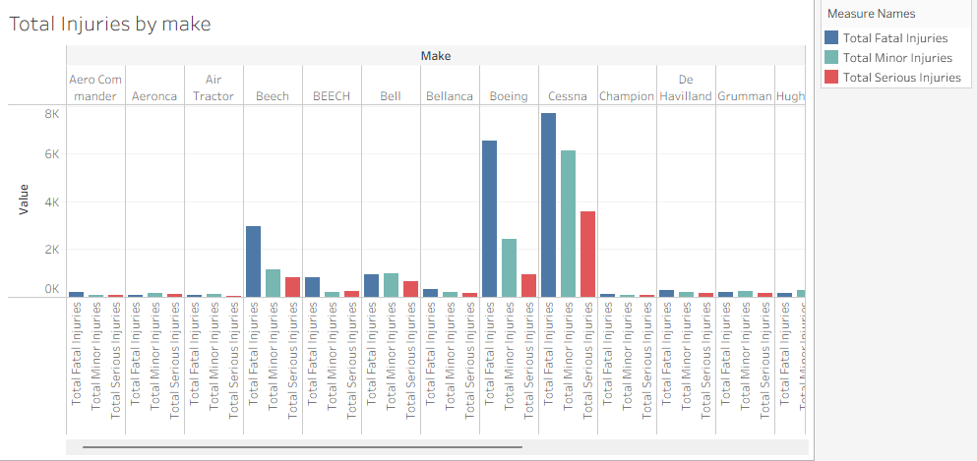
Total Injuries by Aircraft Make

Slide 8
Business Recommendations
Based on my analysis, I recommend avoiding high-risk aircraft like the 737 in our initial investments.
We should focus on models with lower average risk scores, especially those used commercially.
This risk index should support our purchase decision framework.
In the next phase, I’ll refine risk estimates using flight-hour data.

Slide 9
Next Steps & Improvements
To strengthen our assessment, I plan to:
Integrate more detailed data like maintenance records and pilot reports.
Normalize injuries by flight hours for greater accuracy.
Add external factors such as weather, route complexity, and flight duration.
Eventually, I’ll expand the dashboard to monitor our fleet in real time.

Slide 10
Contact
Analyst: Faith Njuguna
Email: faithnjugunaa@gmail.com
Date: July 2025

