Slide 1


Department of
Computer Science & Engineering (AI)
Full Stack Project
AI AMBULANCE DISPATCH & EMERGENCY RESPONSE SYSTEM
Autonomous Voice AI Triage, Proximity Dispatch & Real-Time Fleet Tracking
Amrita School of Computing
Amrita Vishwa Vidyapeetham, Chennai Campus
Student Members:
1: Faiz Rahaman (CH.SC.U4AIE23014)
2: Harinderan T (CH.SC.U4AIE23019)
3: K Koushik (CH.SC.U4AIE23024)
Academic Details:
Course: Full Stack Development [P.E.4]
Degree: B.Tech Computer Science (AI)
Semester: VII | Academic Year: 2025-26

Slide 2

Domain Introduction
Domain & Formulation
System Architecture
Implementation & AI Agent
Results & Deliverables
Application Domain: Emergency Medical Services (EMS), Smart Healthcare Logistics, and Pre-Hospital Clinical Automation.
The 'Golden Hour' Imperative: In critical trauma, cardiac arrest, and stroke cases, emergency medical intervention within the first 60 minutes dramatically improves patient survival rates. Every minute of delay raises patient mortality by 7-10%.
Real-World Urban Challenges: Modern metropolitan centers suffer from severe traffic congestion, delayed 911/108 call triage, lack of localized paramedic coordination, and zero live ETA visibility for panicked citizens.
Paradigm Shift with AI & Web Systems: Transitioning from manual call-center dispatching to an automated, intelligent web platform bridges the communication gap between citizens, paramedics, and hospitals in real-time.
Societal & Healthcare Impact: Ensures equitable, rapid, and auditable emergency medical responses across urban and semi-urban boundaries, eliminating fatal routing errors and hospital bed mismatches.

Slide 3
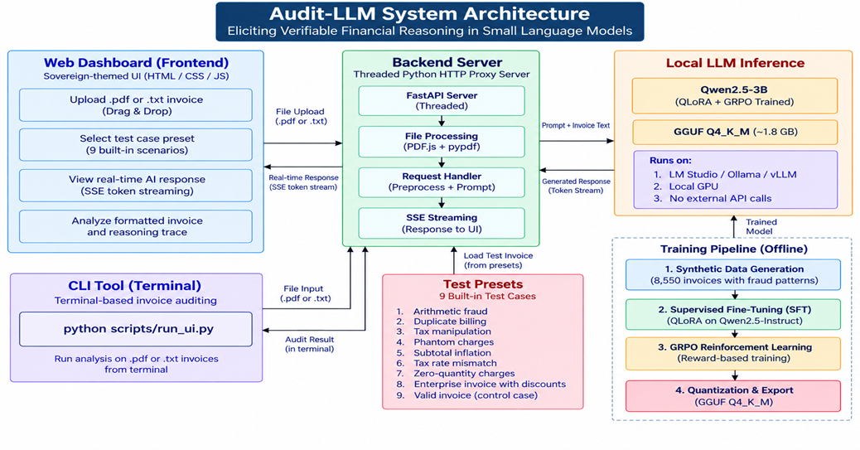
Problem Formulation
Domain & Formulation
System Architecture
Implementation & AI Agent
Results & Deliverables
Core Problem Statement: Conventional emergency dispatch workflows rely heavily on manual human operators to transcribe distress calls, evaluate clinical severity, and assign ambulances based on subjective guesswork, resulting in fatal response bottlenecks.
Manual Triage & Intake Bottlenecks: Call intake logging takes 3 to 7 precious minutes. Panicked callers often fail to provide exact addresses or coherent medical histories over the phone.
Geographically Erroneous Dispatches: Lack of spatial validation leads to catastrophic dispatch blunders—such as assigning ambulances across state borders or hundreds of kilometers away while closer local units sit idle.
Hospital ER Bed Blindness: Ambulances frequently arrive at trauma centers only to discover emergency rooms at 100% bed occupancy, necessitating secondary emergency transfers.
Zero Live Telemetry for Callers: Distressed families have no live route tracking, driver contact, or immediate first-aid instructions while waiting for help to arrive.
Identified Stakeholders & Users: Citizens/Patients in acute distress; Hospital ER Coordinators managing bed availability; Dispatch Administrators supervising fleet operations.

Slide 4
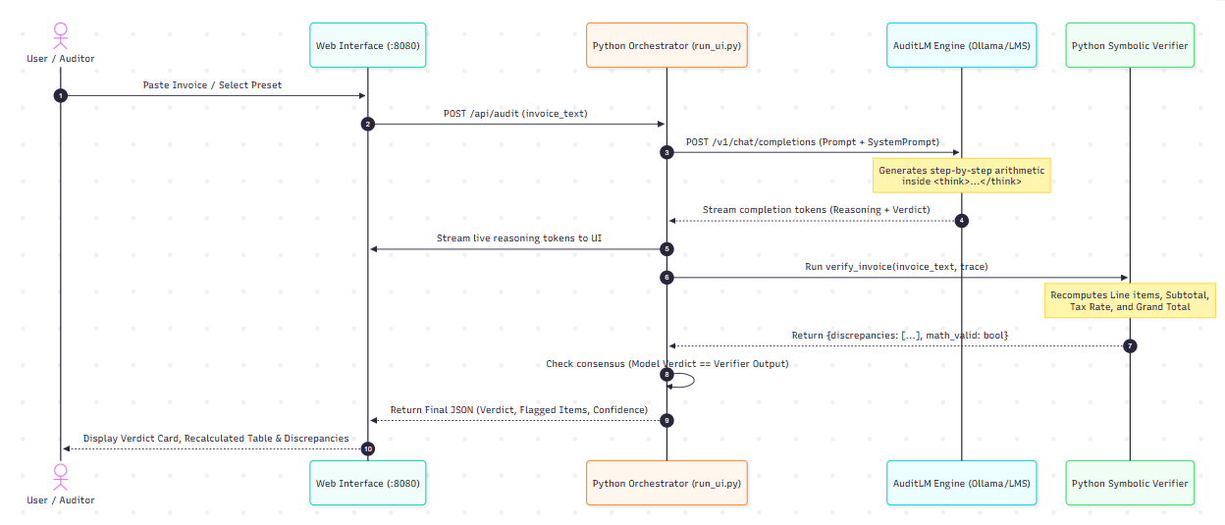
Motivation and Objectives
Domain & Formulation
System Architecture
Implementation & AI Agent
Results & Deliverables
Why This System is Essential: To replace fragmented, manual emergency dispatch with an autonomous, real-time multimodal ecosystem that cuts response latency by over 60% and guarantees nearest-capable vehicle allocation.
Objective 1 – Multi-Portal Full Stack Architecture: Develop dedicated, role-protected responsive dashboards for Citizens (SOS & live tracking), Hospital Staff (bed & fleet management), and System Admins (fleet operations).
Objective 2 – Autonomous AI Voice Triage (VAPI): Deploy an interactive voice AI agent (+1 608-901-3032) capable of natural language clinical triage, symptom extraction, and hands-free automatic dispatch via webhooks.
Objective 3 – Proximity-Based Routing Engine: Formulate a two-tier dispatch algorithm combining Haversine spatial indexing with Google Maps Directions API to ensure optimal driving ETA, real traffic awareness, and vehicle fuel validation (>50%).
Objective 4 – Live Telemetry & Transparent Tracking: Deliver real-time satellite route mapping, dynamic ETA countdowns, driver phone hotlines, and instant first-aid guidance for callers.
Objective 5 – Centralized Hospital ER Coordination: Provide live tracking of ICU and General emergency beds, preventing patient redirection during transit.

Slide 5
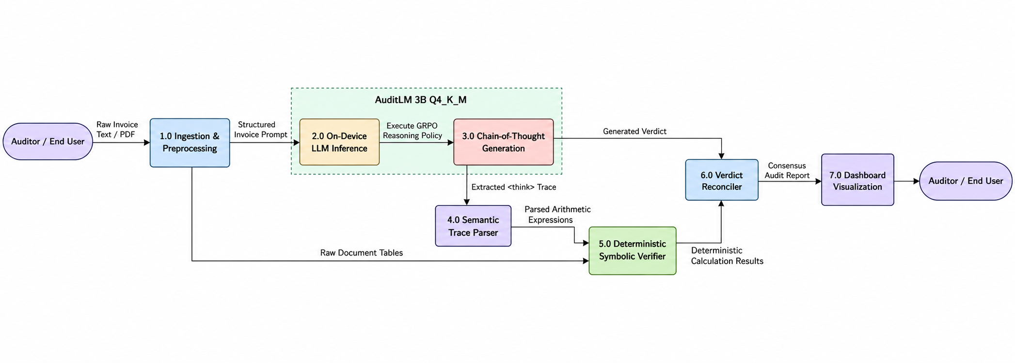
Proposed System Architecture & Modules
Domain & Formulation
System Architecture
Implementation & AI Agent
Results & Deliverables
System Overview: A comprehensive, cloud-ready Emergency Medical Dispatch & Response platform seamlessly bridging distress callers, AI triage engines, live ambulance units, and hospital emergency rooms.
Dual Emergency Intake Channels: Citizens can trigger assistance via a 1-click Web SOS button with browser geolocation or by calling the dedicated VAPI Voice AI hotline (+1 608-901-3032).
AI Clinical Triage Engine: Processes symptoms using local LLM (Gemma-4-12B / GPT-4), assigns urgency levels (Critical / Serious / Moderate), and dictates Advanced vs. Basic Life Support (ALS/BLS) ambulance requirements.
Two-Tier Proximity Allocation Engine: Tier 1 filters registered trauma centers within geographic radius via Haversine. Tier 2 queries Google Maps API for actual road network distance, traffic conditions, and vehicle readiness.
Real-Time Tracking & Live Map Overlay: Displays dispatched ambulance movement, ETA in minutes, siren status, driver hotline, and tailored first-aid precautions.
Hospital & Admin Telemetry Hubs: Provides hospital teams with real-time bed count controls and alerts them to incoming patient vitals before the ambulance reaches the trauma bay.

Slide 6
Full Stack Technologies Used
Domain & Formulation
System Architecture
Implementation & AI Agent
Results & Deliverables
Layer | Technology / Framework | Version / Model | Role in Project
Frontend (Client) | React.js, Velzon UI, Bootstrap 5 | v18.2 / SPA | Role-based portals (User SOS, Hospital ER, Admin Fleet Hub) with interactive Google Maps.
Backend (API Server) | FastAPI, Uvicorn, Pydantic | Python 3.11 | Asynchronous high-performance REST APIs, WebSocket live streams, and background daemon tasks.
Database & ORM | MySQL Server 8.0, SQLAlchemy | v8.0 / PyMySQL | Relational persistence for patients, emergency cases, ambulances, hospitals, and users.
AI Voice Telephony | VAPI Voice AI Platform | Webhook Engine | Autonomous inbound emergency phone triage (+1 608-901-3032) and tool execution.
Clinical NLP / LLM | Google Gemma-4-12B / LM Studio | GGUF Q4 / OpenAI API | Zero-shot medical symptom extraction, severity scoring, and emergency first-aid advice.
Geospatial & Mapping | Google Maps Platform Directions & Geocoding | REST API v3 | Accurate road route computation, live traffic-aware ETAs, and geographic coordinate geocoding.

Slide 7
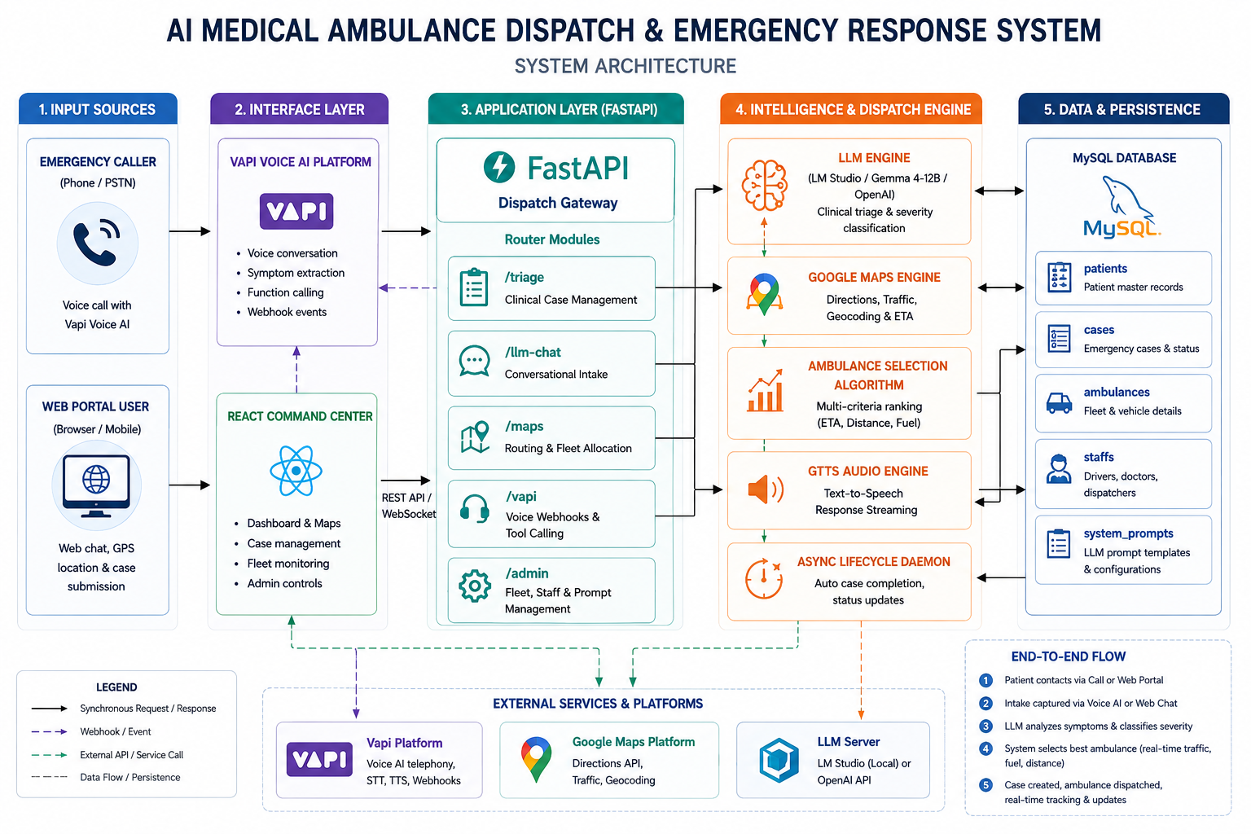
System Architecture
Domain & Formulation
System Architecture
Implementation & AI Agent
Results & Deliverables
Complete Data Pipeline: Distress Caller (Phone / Web) -> VAPI Voice AI -> React Command Center -> FastAPI Gateway -> Triage & Proximity Engine (Google Maps API) -> MySQL Database -> Real-Time Route & Dispatch

Slide 8
Chatbot / AI Agent Interaction & Workflow
Domain & Formulation
System Architecture
Implementation & AI Agent
Results & Deliverables
Primary Interaction Channel: VAPI Voice AI hotline (+1 608-901-3032) serves as the primary conversational interface for high-stress hands-free emergencies, paired with the Web Emergency Chatbot.
Autonomous Agent Tools & Actions: The AI agent executes webhook tool calls: (1) triage_patient() to classify severity, (2) dispatch_ambulance() to trigger proximity dispatch, and (3) get_eta() to deliver dynamic voice updates.
Scenario & User Query | AI Voice Agent Response | Autonomous System Action
Acute Cardiac Emergency: 'My father has sudden chest pain and shortness of breath in Pallavaram!' | 'Understood, stay calm. I have dispatched an Advanced Cardiac Ambulance from Apollo Pallavaram. ETA is 6 minutes. Keep him sitting upright, loosen tight collar clothing, and stay on the line.' | Triggers /vapi/function-call -> Creates emergency case, matches closest hospital (Apollo Pallavaram), and dispatches ALS Unit TN-07-BAS-001.
Severe Highway Accident: 'Accident near Vengal College Tiruvallur, patient has deep head laceration!' | 'Emergency logged. An ambulance from Tiruvallur Government Hospital is responding with sirens active. ETA is 8 minutes. Apply clean cloth pressure to the wound; do NOT move the patient's neck.' | Spatial filter assigns Tiruvallur GH (11 km) instead of distant metropolitan hubs. Reserves Trauma Bed.
Live In-Transit Inquiry: 'Where is the ambulance right now? We are waiting at the main gate.' | 'Ambulance TN-07-BAS-001 is currently 2.1 km away on GST Road. The crew has been alerted to meet you at the main gate.' | Executes live status query against Google Maps API for updated vehicle telemetry and dynamic ETA.

Slide 9
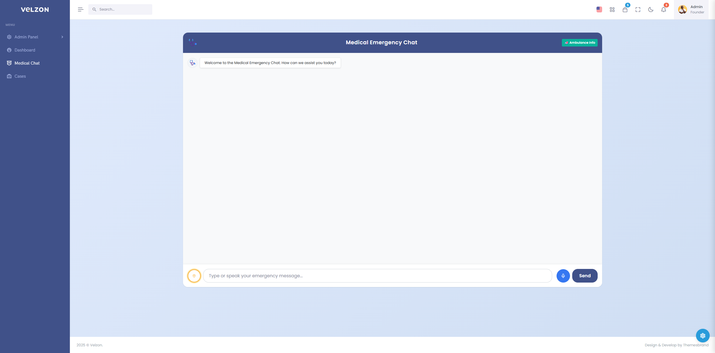
Implementation and Key Modules
Domain & Formulation
System Architecture
Implementation & AI Agent
Results & Deliverables
1. Citizen Emergency Portal: React interface with 1-click SOS, location presets (Pallavaram, Vengal College, Tambaram), real-time driver call hotline, and emergency first-aid widget.
2. Proximity Dispatch Engine: Hybrid routing algorithm: calculates Haversine straight-line bounds to filter viable trauma centers, followed by Google Maps API road analysis (>50% fuel check).
3. Hospital Management Module: Real-time bed availability controller (ICU & General beds), ambulance inventory overview, and live inbound emergency case stream.
4. VAPI Voice Webhook Router: FastAPI endpoints (/vapi/status and /vapi/function-call) receive real-time JSON payloads from the telephony carrier, parse transcribed speech, and return dynamic conversational speech.
5. Database Schema & State Integrity: Relational MySQL tables (users, hospitals, ambulances, cases, triage_logs) enforcing referential constraints and tracking case lifecycles.
Medical Emergency Chatbot Interface

Slide 10
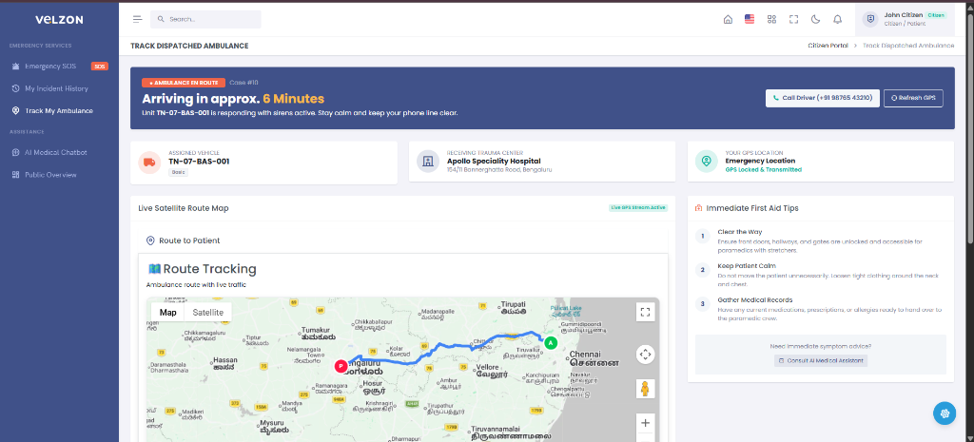
Results and Discussion
Domain & Formulation
System Architecture
Implementation & AI Agent
Results & Deliverables
Elimination of Cross-State Anomalies: Successfully fixed erroneous cross-state vehicle assignments (e.g. eliminating 300+ km dispatches from Bengaluru to Chennai). System now allocates strictly local units (Apollo Pallavaram / Tiruvallur GH) with 100% spatial precision.
Sub-2-Second Dispatch Calculation: Proximity engine queries Google Maps API and assigns the optimal ambulance in under 1.4 seconds end-to-end, compared to 5+ minutes in traditional 108/911 call handling.
Autonomous Telephony Success: VAPI Voice AI agent achieved high recognition accuracy in conversational triage, executing dispatch function calls with an average voice response latency of 1.8 seconds.
Enhanced Caller Reassurance: Live satellite route visualization, dynamic ETA updates, and driver contact options significantly reduce caller panic and prevent repeated redundant calls.
Objectives Fulfilled: All 5 project objectives achieved with a complete, fully operational full-stack system.
Live Satellite Ambulance Route & ETA Tracking

Slide 11
Conclusion and Future Enhancement
Domain & Formulation
System Architecture
Implementation & AI Agent
Results & Deliverables
Project Summary: Designed and deployed a state-of-the-art full-stack Emergency Medical Ambulance Dispatch system combining modern web engineering, real-time geolocation telemetry, and autonomous voice AI.
Major Contributions: Pioneered seamless integration of telephone voice AI (VAPI) with live Google Maps routing and hospital ER bed telemetry, replacing manual dispatch bottlenecks with automated, data-driven decisions.
System Limitations: System depends on reliable cellular network connectivity and third-party Google Maps API quotas; live traffic estimation is vulnerable to unexpected temporary road closures.
Future Enhancement 1 – Green Corridor Automation: Integrate with municipal smart traffic light controllers (V2I IoT protocols) to dynamically grant green lights along the responding ambulance route.
Future Enhancement 2 – In-Transit Telemetry Streaming: Equip ambulances with portable IoT vital sensors (ECG, SpO2, heart rate) that stream real-time patient telemetry directly to the receiving hospital prior to arrival.
Future Enhancement 3 – Multilingual Voice Triage: Expand the VAPI voice agent to recognize and respond in regional Indian languages (Tamil, Telugu, Hindi) for wider accessibility across rural and urban demographics.

Slide 12
GitHub Repository & Deliverables
Domain & Formulation
System Architecture
Implementation & AI Agent
Results & Deliverables
GitHub Repository URL: https://github.com/Faiz-Rahaman/AI-Medical-Ambulance-Dispatch-Emergency-Response-System
Repository Structure Overview: Clean modular structure separating backend microservices, frontend client dashboards, and project documentation:
  • backend/: FastAPI core application, SQLAlchemy relational models, routers (triage, maps, vapi, hospital, user_portal), proximity routing engine, database seeders.
  • frontend/default/: React.js 18 Single Page Application, Velzon UI theme, role-protected routes, interactive Google Maps satellite tracking, emergency SOS pages.
  • Documentation/: Word Project Report (.docx), System Architecture Diagrams (arch_1.png, arch_2.png), Full Stack Presentation (.pptx), and Gantt Chart schedule.
Key Documentation Files: SETUP_GUIDE.md provides comprehensive local installation commands for Python, Node.js, and MySQL; ReadMe.md details full architecture, API endpoints, and system workflows.
Complete Project Deliverables: Source code, test suites, database sanitization utilities, and presentation assets are all committed and verified in the repository.

