Slide 1


Department of
Computer Science & Engineering (AI)
Full Stack Development Project
AI Medical Ambulance Dispatch
Autonomous Real-Time Emergency Triage & Multi-Criteria Ambulance Dispatch System
Amrita School of Computing
Amrita Vishwa Vidyapeetham, Chennai Campus
Student Members
1: Faiz Rahaman (CH.SC.U4AIE23014)
2: Harinderan T (CH.SC.U4AIE23019)
3: K Koushik (CH.SC.U4AIE23024)
Guide Details
Bharathi Mohan

Slide 2

Literature Review
Literature Review
Literature Survey
Problem Identification
Problem Statement
Significance of the Project
Objectives
Scope
Methodology
Technologies Used
Gantt Chart
References
S.NO | Title | Author/year | Journal name | Technologies / Methods Used | Methodology | Results & Performance Metrics | Key Contribution
1 | Use of a Large Language Model (LLM) for Ambulance Dispatch and Triage 10.1016/j.ajem.2024.12.032 | Shekhar et al., 2025 | American Journal of Emergency Medicine | ChatGPT-4o Mini, LLM | GPT-4o Mini was evaluated using 392 real ambulance requests grouped into prioritization tasks. The LLM selected the highest-priority case in each group, and its decisions were compared with assessments from experienced critical-care paramedics. | Achieved 76.5% overall agreement with paramedics and 93.8% agreement when experts unanimously identified the highest-priority case. | Demonstrates the potential of LLMs for ambulance dispatch triage, supporting faster prioritization and more efficient allocation of emergency resources.
2 | Building a Machine Learning-based Ambulance Dispatch Triage Model for EMS 10.34133/hds.0008 | Wang et al., 2023 | Health Data Science | Random Forest, ML classifiers | Multiple ML classifiers were trained using more than 360,000 Singapore EMS call records. Dispatch and patient-related variables were used to predict case acuity and determine whether incidents required higher-priority ambulance responses. | Random Forest reduced over-triage by approximately 15% while maintaining a similar under-triage level, providing a better balance in dispatch prioritization. | Provides an ML-based dispatch triage system that reduces unnecessary high-priority responses and improves utilization of limited ambulance resources.
3 | An End-to-End Solution for Out-of-Hospital Emergency Medical Dispatch Triage 10.1016/j.artmed.2025.103264 | Ferri et al., 2025 | Artificial Intelligence in Medicine | Deep Learning, Multimodal Learning, Continual Learning | The E2eDeepEMC² framework was trained using approximately 2.05 million emergency incidents. It combines clinical, demographic and textual information through multimodal deep learning and applies continual learning to adapt to changing EMS data patterns. | F1 improved by 18.46% for severity, 25.96% for response delay and 3.63% for jurisdiction, demonstrating improved EMS prediction performance. | Introduces multimodal continual learning for EMS triage, combining structured and textual data while adapting to changing emergency-call patterns.

Slide 3
Literature Review
Literature Review
Literature Survey
Problem Identification
Problem Statement
Significance of the Project
Objectives
Scope
Methodology
Technologies Used
Gantt Chart
References
S.NO | Title | Author/year | Journal name | Technologies / Methods Used | Methodology | Results & Performance Metrics | Key Contribution
4 | Ambulance Route Optimization in a Mobile Ambulance Dispatch System Using DNN 10.1038/s41598-025-95048-0 | Selvan et al., 2025 | Scientific Reports | Decision Tree, SVM, CNN/DNN | The framework combines historical demand prediction, patient-priority classification and intelligent route optimization. Decision Tree/SVM techniques support demand and priority decisions, while a CNN/DNN-based component dynamically identifies efficient ambulance routes. | The CNN-based route optimization component achieved approximately 99.15% accuracy, demonstrating highly effective ambulance route selection and dispatch support. | Integrates demand prediction, patient prioritization and route optimization into one AI framework for faster and more coordinated ambulance response.
5 | Applications and Performance of Machine Learning Algorithms in EMS: A Scoping Review 10.1017/S1049023X24000414 | Alrawashdeh et al., 2024 | Prehospital and Disaster Medicine | ML, Neural Networks, Ensemble Models | A scoping review examined 164 studies involving ML applications across emergency medical services. The studies were categorized into clinical and operational applications, with algorithms, prediction tasks and reported performance metrics systematically analyzed. | Clinical applications reported 85.6% AUC and 88.1% accuracy, while operational applications reached approximately 96.1% AUC and 90% accuracy. | Provides comprehensive evidence of ML effectiveness across clinical and operational EMS, including triage, prediction and resource-management applications.
6 | Real-Time Optimization for Relocation and Dispatching of EMS 10.1016/j.cie.2023.109823 | Essus et al., 2024 | Computers & Industrial Engineering | Online Optimization, Simulation, Survival Functions | A real-time ambulance relocation and dispatch framework was developed using online optimization and simulation. The system considers ambulance workload, emergency coverage and response objectives while also evaluating ride-hailing services for suitable lower-priority incidents. | Increased responses within four minutes by >10%, reduced ambulance workload by 13.5%, and achieved estimated savings of $141,220/day. | Balances response performance, workload and operational cost, while showing how alternative transport can preserve ambulance capacity for critical emergencies.

Slide 4
Literature Review
Literature Review
Literature Survey
Problem Identification
Problem Statement
Significance of the Project
Objectives
Scope
Methodology
Technologies Used
Gantt Chart
References
S.NO | Title | Author/year | Journal name | Technologies / Methods Used | Methodology | Results & Performance Metrics | Key Contribution
7 | Adaptive Variable Neighbourhood Search for Joint Ambulance Location and Dispatching 10.1016/j.cor.2023.106355 | Nadar et al., 2023 | Computers & Operations Research | AVNS, MINLP, Particle Swarm, Queueing | A joint ambulance location and dispatching model was developed for a multi-tier EMS system. It considers station locations, ambulance allocation, dispatch preferences, time-dependent demand and ambulance availability, with AVNS used to solve large problem instances. | AVNS improved the expected number of successfully served emergency calls and efficiently solved large Kolkata-based instances with reduced computational difficulty. | Integrates ambulance location, allocation and dispatch decisions, providing a more realistic framework for planning multi-tier emergency medical services.
8 | LSTM and ResNet18 for Optimized Ambulance Routing and Traffic Signal Control 10.1038/s41598-025-89651-4 | Alruwaili et al., 2025 | Scientific Reports | LSTM, ResNet18, MFCC, Raspberry Pi | A multimodal system combines ambulance siren recognition using MFCC/LSTM with visual ambulance detection using ResNet18. Once detected, the system communicates with traffic infrastructure to provide real-time signal priority to approaching ambulances. | Audio recognition achieved 98.3%, visual detection 98.1%, and the fused multimodal approach reached approximately 99% accuracy. | Combines multimodal ambulance detection with adaptive traffic-signal control to reduce delays at congested intersections during emergency response.
9 | Stochastic Programming Model for Ambulance (Re)location-Allocation 10.1016/j.eswa.2024.123665 | Gago-Carro et al., 2024 | Expert Systems with Applications | Two-stage Stochastic Programming, MILP | A two-stage stochastic ambulance relocation-allocation model was developed under uncertain emergency demand. The model simultaneously optimizes response efficiency and geographic equity between urban and rural regions, where ambulance accessibility can differ substantially. | Rural service success improved by approximately 23 percentage points, while the reduction in overall system performance remained below nine percentage points. | Introduces equity-aware ambulance allocation, significantly improving rural emergency coverage without causing excessive reduction in overall EMS performance.

Slide 5
Literature Review
Literature Review
Literature Survey
Problem Identification
Problem Statement
Significance of the Project
Objectives
Scope
Methodology
Technologies Used
Gantt Chart
References
S.NO | Title | Author/year | Journal name | Technologies / Methods Used | Methodology | Results & Performance Metrics | Key Contribution
10 | Online Algorithms for Ambulance Routing in Disaster Response 10.1007/s00291-024-00744-4 | Shiri et al., 2024 | OR Spectrum | Online Optimization, Competitive Analysis, Heuristics | Online algorithms were developed for disaster ambulance routing when travel times, triage information and victim conditions change over time. Routing decisions are continuously updated as new information becomes available during disaster response. | Proposed heuristics achieved experimental competitive ratios close to 1 while maintaining low computational requirements under dynamically changing disaster conditions. | Supports dynamic disaster ambulance routing by adapting decisions to changing victim conditions, traffic information and incomplete emergency data.
11 | Short-Term Forecasting of EMS Demand Exploring Machine Learning 10.1016/j.cie.2024.110765 | Shahidian et al., 2025 | Computers & Industrial Engineering | Gradient Boosting, AdaBoost, RF, SVM, GA | Nine ML algorithms were evaluated for short-term EMS demand forecasting. Feature-selection methods and hyperparameter optimization were applied to predict hourly emergency calls, priority demand and required ambulance resources. | Gradient Boosting and AdaBoost achieved the strongest forecasting performance, with feature selection and parameter optimization further improving prediction quality. | Enables proactive EMS resource planning through accurate forecasting of emergency demand, priority calls and required ambulance resources.
12 | Optimal Placement of Ambulance Stations Using Data-Driven Search Methods 10.1016/j.ijmedinf.2025.105790 | Bozorgmanesh & Rydén, 2025 | International Journal of Medical Informatics | GPS, Surrogate Search, Simulation | Swedish EMS data and simulation were used to evaluate alternative ambulance-station locations. GPS direct search and surrogate-based optimization explored different station configurations to minimize response time for high-priority incidents. | Optimized ambulance-station locations reduced median Priority-1 response time by approximately 80–100 seconds compared with the existing configuration. | Shows that data-driven station relocation can significantly reduce urgent response times without necessarily increasing the number of ambulances.

Slide 6
Literature Review
Literature Review
Literature Survey
Problem Identification
Problem Statement
Significance of the Project
Objectives
Scope
Methodology
Technologies Used
Gantt Chart
References
S.NO | Title | Author/year | Journal name | Technologies / Methods Used | Methodology | Results & Performance Metrics | Key Contribution
13 | Online Optimisation for Ambulance Routing with Partial or No Victim Information 10.1016/j.cor.2023.106314 | Shiri et al., 2023 | Computers & Operations Research | Online Optimization, Competitive Analysis, Heuristics | The study models ambulance routing when victim triage information is partially known or unavailable at the beginning of a disaster. Three online heuristics update routing decisions as ambulances obtain new victim information. | Across 1,296 instances, the utility-based heuristic generally performed best, while runtime remained below one second for the largest instances. | Enables rapid ambulance routing with incomplete victim information, allowing dispatch decisions to adapt as new disaster information becomes available.
14 | Ambulance Location Routing Problem Considering All Sources of Uncertainty 10.1016/j.cor.2023.106400 | Khoshgehbari & Mirzapour Al-e-Hashem, 2023 | Computers & Operations Research | Two-stage Stochastic Programming, PEA | An integrated stochastic model simultaneously optimizes ambulance station location, heterogeneous fleet allocation and routing. Demand and travel uncertainty are incorporated, while a Progressive Estimating Algorithm addresses larger computational instances. | Reduced costs by approximately 30% compared with the benchmark and up to 58% compared with the evaluated existing EMS configuration. | Integrates location, heterogeneous fleet allocation and ambulance routing under uncertainty, creating a comprehensive EMS optimization framework.
15 | Multiobjective Evolutionary Algorithm for Ambulance Dispatching and Relocation During COVID-19 10.1016/j.asoc.2023.110282 | Hemici et al., 2023 | Applied Soft Computing | MOEA/D, Simulated Annealing, CDR | A hybrid G-MOEA/D-SA multiobjective evolutionary algorithm was developed to optimize ambulance dispatch and relocation simultaneously. The approach was evaluated under COVID-19 conditions characterized by rapidly changing and geographically uneven emergency demand. | Outperformed MOEA/D, MOEA/D-M2M and NSGA-II, with optimized strategies reducing uncovered emergency calls by approximately 9–60%. | Provides multiobjective ambulance dispatch and relocation optimization capable of adapting EMS coverage to rapidly changing pandemic demand.

Slide 7
Literature Review
Literature Review
Literature Survey
Problem Identification
Problem Statement
Significance of the Project
Objectives
Scope
Methodology
Technologies Used
Gantt Chart
References
S.NO | Title | Author/year | Journal name | Technologies / Methods Used | Methodology | Results & Performance Metrics | Key Contribution
16 | Emergency Vehicle Routing Optimization Considering Complex Traffic Conditions 10.1371/journal.pone.0301637 | Luan & Jiang, 2024 | PLOS ONE | MIPSSTW, Modified Cuckoo Search | A mixed-integer programming model with semi-soft time windows was developed for emergency-vehicle routing. It considers time-varying urban traffic, intersections and highway conditions, with Modified Cuckoo Search used for route optimization. | Modified Cuckoo Search produced high-quality routing solutions with improved computational efficiency under complex and time-varying traffic conditions. | Incorporates realistic traffic conditions into emergency routing, improving ambulance route selection even when emergency vehicles receive traffic priority.
17 | Forecasting Daily Demand for Emergency Medical Ambulances in England and Wales 10.1186/s12911-023-02218-z | Monks et al., 2023 | BMC Medical Informatics and Decision Making | Prophet, ARIMA, Time-Series Forecasting | Fourteen forecasting approaches were compared using historical ambulance-demand data. The selected forecasting approach was then externally validated across multiple ambulance services in England and Wales to assess generalizability. | Achieved MASE 0.68 during development and 0.73 during external validation, demonstrating stable forecasting performance across independent ambulance-service datasets. | Provides an externally validated ambulance-demand forecasting benchmark, supporting reliable operational planning across different EMS organizations and geographical regions.
18 | Improving Triage Performance in EDs Using ML and NLP: Systematic Review 10.1186/s12873-024-01135-2 | Porto, 2024 | BMC Emergency Medicine | ML, NLP, XGBoost, DNN, LR | A systematic review examined 60 studies and 57 machine-learning algorithms for emergency-department triage. It evaluated approaches using structured clinical variables as well as NLP-derived information from unstructured clinical text. | XGBoost, Gradient Boosting and DNNs were among the strongest methods, while NLP-derived text information further improved automated triage prediction. | Shows that combining NLP with structured clinical data can strengthen AI-based emergency triage and patient-priority classification.

Slide 8
Literature Review
Literature Review
Literature Survey
Problem Identification
Problem Statement
Significance of the Project
Objectives
Scope
Methodology
Technologies Used
Gantt Chart
References
S.NO | Title | Author/year | Journal name | Technologies / Methods Used | Methodology | Results & Performance Metrics | Key Contribution
19 | Application of Artificial Intelligence in Triage in Emergencies and Disasters 10.1186/s12889-024-20447-3 | Tahernejad et al., 2024 | BMC Public Health | AI, YOLO, OpenPose, E-triage | A PRISMA-based systematic review analyzed 19 high-quality studies involving intelligent triage technologies for emergencies and disasters. Applications included ML, computer vision, electronic triage and automated casualty assessment systems. | AI systems improved rapid classification and resource management, with individual applications reporting diagnostic/triage accuracy of up to approximately 94.57%. | Highlights the potential of AI-enabled disaster and mass-casualty triage while identifying important real-world implementation challenges.
20 | Effects of Applying Artificial Intelligence to Triage in the Emergency Department 10.1111/jnu.13024 | Yi et al., 2025 | Journal of Nursing Scholarship | ML, Neural Networks, Fuzzy Logic | A systematic review analyzed seven prospective studies of AI-assisted emergency-department triage. The studies evaluated ML, neural-network and fuzzy-logic systems for supporting clinical prioritization and reducing triage errors. | Prediction accuracy ranged from 80.5% to 99.1%, while one fuzzy-logic model reported approximately 99% sensitivity and specificity. | Supports AI as clinical decision support for emergency triage, with potential to improve prioritization accuracy and reduce triage errors.

Slide 9
Literature Survey
Literature Review
Literature Survey
Problem Identification
Problem Statement
Significance of the Project
Objectives
Scope
Methodology
Technologies Used
Gantt Chart
References
S.No | Author & Year | Focus Area | Method Used | Major Finding
1 | Shekhar et al. (2025) | AI-based Ambulance Triage | LLM / ChatGPT-4o Mini | Achieved 76.5% overall agreement with expert paramedics; showed that LLMs can support ambulance dispatch triage.
2 | Wang et al. (2023) | EMS Dispatch Triage | Random Forest and ML Classifiers | Reduced over-triage by about 15% while maintaining similar under-triage levels.
3 | Ferri et al. (2025) | Emergency Medical Dispatch Triage | Deep Learning, Multimodal & Continual Learning | Improved severity classification, response-delay prediction and jurisdiction prediction using around 2.05 million emergency incidents.
4 | Selvan et al. (2025) | Ambulance Route Optimization | Decision Tree, SVM, CNN, DNN | Combined demand prediction, patient priority and route optimization; CNN achieved about 99.15% accuracy.
5 | Alrawashdeh et al. (2024) | ML in Emergency Medical Services | Scoping Review of ML Algorithms | Reviewed 164 studies and showed strong ML performance in both clinical and operational EMS applications.
6 | Essus et al. (2024) | Real-Time Ambulance Relocation & Dispatch | Online Optimization & Simulation | Achieved more than 10% additional responses within four minutes and reduced workload by 13.5%.
7 | Nadar et al. (2023) | Ambulance Location & Dispatch | Adaptive Variable Neighbourhood Search (AVNS), MINLP, PSO | Improved ambulance allocation and the number of successfully served emergency calls.
8 | Alruwaili et al. (2025) | Ambulance Routing & Traffic Signal Control | LSTM, ResNet18, Audio-Visual Detection | Achieved around 99% accuracy by combining siren/audio and visual ambulance detection for traffic signal priority.
9 | Gago-Carro et al. (2024) | Ambulance Relocation & Allocation | Two-Stage Stochastic Programming, MILP | Improved rural emergency service success by about 23 percentage points while considering uncertain demand.
10 | Shiri et al. (2024) | Ambulance Routing in Disasters | Online Optimization & Heuristics | Developed routing methods that adapt to changing travel times, triage information and victim conditions.

Slide 10
Literature Survey
Literature Review
Literature Survey
Problem Identification
Problem Statement
Significance of the Project
Objectives
Scope
Methodology
Technologies Used
Gantt Chart
References
S.No | Author & Year | Focus Area | Method Used | Major Finding
11 | Shahidian et al. (2025) | EMS Demand Forecasting | Gradient Boosting, AdaBoost, Random Forest, SVM | Gradient Boosting and AdaBoost provided the strongest short-term EMS demand forecasts.
12 | Bozorgmanesh & Rydén (2025) | Ambulance Station Placement | GPS Data, Simulation & Data-Driven Search | Optimized station locations and reduced median Priority-1 response time by approximately 80–100 seconds.
13 | Shiri et al. (2023) | Routing with Incomplete Patient Information | Online Optimization & Heuristics | Utility-based heuristics performed well even when victim information was incomplete; large instances were solved in under one second.
14 | Khoshgehbari & Mirzapour Al-e-Hashem (2023) | Ambulance Location, Allocation & Routing | Two-Stage Stochastic Programming | Reduced operational costs by about 30% compared with the benchmark and up to 58% compared with an existing EMS configuration.
15 | Hemici et al. (2023) | Ambulance Dispatch & Relocation | MOEA/D, Simulated Annealing | Reduced uncovered emergency calls by approximately 9–60% during changing COVID-19 demand.
16 | Luan & Jiang (2024) | Emergency Vehicle Routing | MIPSSTW, Modified Cuckoo Search | Produced high-quality ambulance routes while considering complex and time-varying traffic conditions.
17 | Monks et al. (2023) | Daily EMS Demand Forecasting | Prophet, ARIMA & Time-Series Models | Compared 14 forecasting approaches and achieved good forecasting performance for ambulance demand.
18 | Porto (2024) | Emergency Department Triage | ML, NLP, XGBoost, DNN, Logistic Regression | ML and NLP can improve emergency triage, especially when clinical text is included.
19 | Tahernejad et al. (2024) | AI in Emergency & Disaster Triage | ML, Computer Vision & e-Triage | AI can support rapid patient classification and resource management, with reported triage accuracy up to about 94.57%.
20 | Yi et al. (2025) | AI-Based Emergency Department Triage | ML, Neural Networks & Fuzzy Logic | Reported prediction accuracy ranging from 80.5% to 99.1% across the reviewed prospective studies.

Slide 11
Problem Identification
Literature Review
Literature Survey
Problem Identification
Problem Statement
Significance of the Project
Objectives
Scope
Methodology
Technologies Used
Gantt Chart
References
Traditional emergency dispatch relies on manual symptom intake, subjective triage over the phone, and ambulance allocation by straight-line proximity rather than real-time traffic, vehicle readiness, or equipment tier.
Conventional dispatch tools (fixed-radius lookup, manual radio dispatch) speed up call intake but ignore live traffic ETA, fuel level, and clinical severity, often sending the nearest unit rather than the most appropriate one.
Voice-only emergency lines and basic dispatch software automate call logging, but few systems combine LLM-based clinical triage, live routing, and multi-criteria fleet selection into one real-time platform.
This project addresses these gaps by building an end-to-end platform that automates clinical triage, multi-criteria ambulance selection, and live command-center coordination for time-critical emergencies.
Research Gap found :-
Most systems focus on only one part (triage or routing).
Very few combine LLM triage + live traffic + multi-criteria fleet selection in one real-time platform. Almost none offer both web chat and voice AI intake together with a live command-center dashboard. This project fills that gap.

Slide 12
Problem Statement
Literature Review
Literature Survey
Problem Identification
Problem Statement
Significance of the Project
Objectives
Scope
Methodology
Technologies Used
Gantt Chart
References
This project aims to build the AI Medical Ambulance Dispatch & Emergency Response System, a full-stack platform that uses an LLM triage engine, live Google Maps routing, and Vapi voice AI to automate emergency intake and select the optimal ambulance in real time.
The objective is a reliable, low-latency dispatch system that classifies severity, ranks the fleet on ETA, distance and fuel level, and gives dispatchers a live command-center view of every case.

Slide 13
Significance of the Project
Literature Review
Literature Survey
Problem Identification
Problem Statement
Significance of the Project
Objectives
Scope
Methodology
Technologies Used
Gantt Chart
References
Ambulance response time is one of the strongest predictors of survival in cardiac, trauma and stroke emergencies, yet most dispatch operations still rely on manual phone triage and nearest-by-distance guesswork.
This project enables faster, more accurate dispatch: an LLM classifies severity in seconds, live traffic data replaces straight-line guesses, and a fuel/availability check prevents an ambulance breaking down mid-route.
It demonstrates how modern web, AI and voice technologies (React, FastAPI, LLMs, Google Maps, Vapi) can be combined into a single system for time-critical, real-world operations.

Slide 14
Objectives
Literature Review
Literature Survey
Problem Identification
Problem Statement
Significance of the Project
Objectives
Scope
Methodology
Technologies Used
Gantt Chart
References
Accept patient reports through web chat or a live voice call, and automatically extract the caller's symptoms and location.
Use an LLM to classify each case into a clinical triage level (Red / Orange / Yellow) and required ambulance tier (ICU / Advanced / Basic).
Rank the available fleet using a multi-criteria algorithm based on live driving ETA, distance and fuel level, and automatically dispatch the most suitable ambulance.
Give dispatchers a real-time command-center dashboard with live routing, fleet telemetry and case tracking, and confirm dispatch to the caller via synthesized voice.

Slide 15
Scope
Literature Review
Literature Survey
Problem Identification
Problem Statement
Significance of the Project
Objectives
Scope
Methodology
Technologies Used
Gantt Chart
References
Covers the full emergency-response pipeline: patient intake (web chat and Vapi voice calls), LLM-based triage classification, multi-criteria ambulance selection, live map routing, and a dispatcher command center backed by MySQL.
Built and demonstrated as a local/regional deployment with a seeded demo fleet across nearby areas, using a local LLM server (LM Studio / Gemma) with an OpenAI-compatible fallback, and a Haversine fallback if the Google Maps API is unreachable.
Hospital admission workflows, insurance/billing processing, and nationwide production-scale rollout are outside the current scope; the focus is on proving the intake-to-dispatch pipeline works reliably end to end.

Slide 16
Methodology
Literature Review
Literature Survey
Problem Identification
Problem Statement
Significance of the Project
Objectives
Scope
Methodology
Technologies Used
Gantt Chart
References
Requirements & Database Design: Define patient intake, triage and dispatch use cases; design the MySQL schema (Patients, Cases, Ambulances, Staff, System Prompts).
Backend API Development: Build the FastAPI backend with modular routers (/triage, /llm-chat, /maps, /vapi, /admin), tested via Swagger and Postman.
AI Triage & Dispatch Logic: Integrate the LLM triage engine for severity classification and implement the multi-criteria ambulance selection algorithm (fuel filter, live ETA/distance ranking, Haversine fallback).
Frontend Command Center: Build the React + Redux command-center dashboard with live map routing, fleet monitoring and case tracking.
Voice AI, Testing & Deployment: Integrate Vapi.ai voice telephony with gTTS audio, run end-to-end tests, and deploy the backend and frontend.

Slide 17
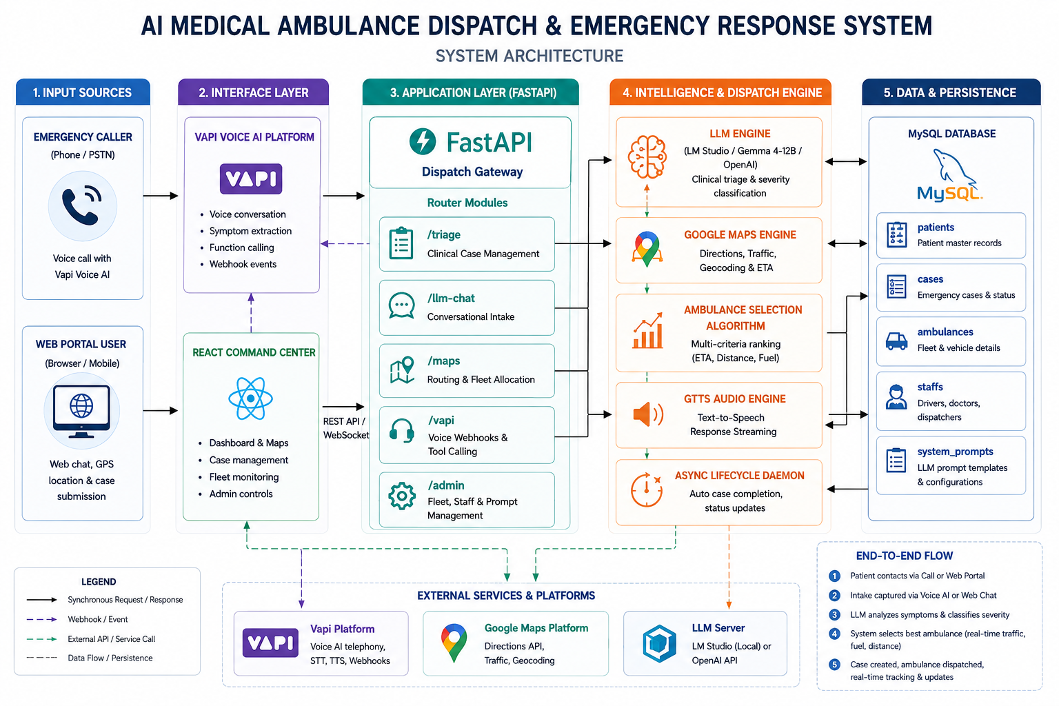
Methodology
Literature Review
Literature Survey
Problem Identification
Problem Statement
Significance of the Project
Objectives
Scope
Methodology
Technologies Used
Gantt Chart
References

Slide 18
Methodology
Literature Review
Literature Survey
Problem Identification
Problem Statement
Significance of the Project
Objectives
Scope
Methodology
Technologies Used
Gantt Chart
References
The project follows a clear step-by-step development process:-
First, the requirements are defined and the database is designed to store patients, cases, ambulances and staff.
Next, the FastAPI backend is built with separate modules for triage, maps, voice and admin.
An LLM is connected to automatically classify emergency severity (Red / Orange / Yellow) and choose the right ambulance type.
A multi-criteria algorithm then ranks available ambulances using fuel level, live traffic ETA and distance.
The React dashboard shows live map routing, fleet status and case tracking for dispatchers.
Voice AI (Vapi + gTTS) allows patients to call and receive spoken confirmation.
Finally, the complete system is tested end-to-end and deployed for demonstration.

Slide 19
Technologies Used
Literature Review
Literature Survey
Problem Identification
Problem Statement
Significance of the Project
Objectives
Scope
Methodology
Technologies Used
Gantt Chart
References
Backend: FastAPI, Uvicorn, SQLAlchemy ORM, Pydantic, PyMySQL.
Frontend: React, Redux Toolkit, Bootstrap / Reactstrap, ApexCharts / ECharts.
Database: MySQL 8.0.
AI & Voice: LLM engine (LM Studio / Gemma, OpenAI-compatible API), Vapi.ai voice telephony, gTTS text-to-speech.
Maps & Routing: Google Maps Directions and Geocoding API, with a Haversine distance fallback.
Dev & Testing Tools: Postman, Ngrok.

Slide 20
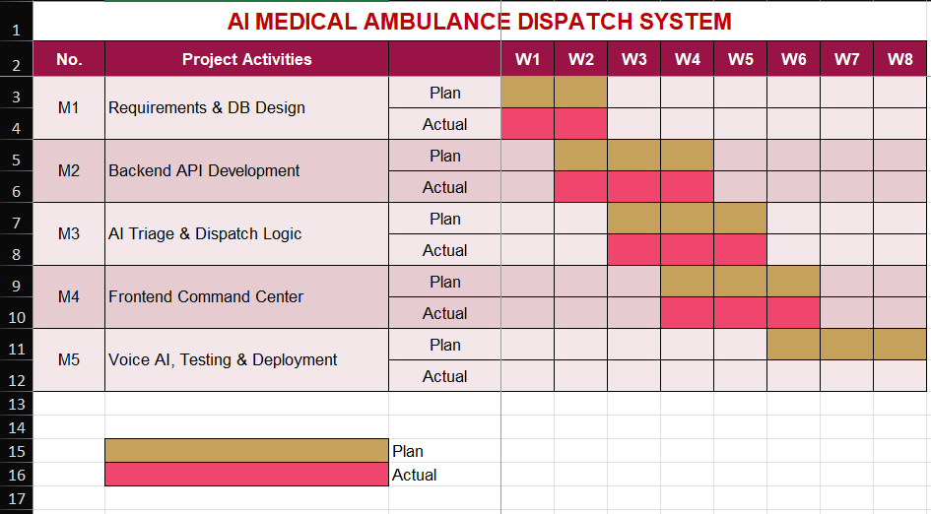
Gantt Chart
Literature Review
Literature Survey
Problem Identification
Problem Statement
Significance of the Project
Objectives
Scope
Methodology
Technologies Used
Gantt Chart
References

Slide 21
References
Literature Review
Literature Survey
Problem Identification
Problem Statement
Significance of the Project
Objectives
Scope
Methodology
Technologies Used
Gantt Chart
References
1. Shekhar et al., “Use of a Large Language Model (LLM) for Ambulance Dispatch and Triage,” American Journal of Emergency Medicine, 2025.
2. Wang et al., “Building a Machine Learning-based Ambulance Dispatch Triage Model for EMS,” Health Data Science, 2023.
3. Ferri et al., “An End-to-End Solution for Out-of-Hospital Emergency Medical Dispatch Triage,” Artificial Intelligence in Medicine, 2025.
4. Selvan et al., “Ambulance Route Optimization in a Mobile Ambulance Dispatch System Using DNN,” Scientific Reports, 2025.
5. Alrawashdeh et al., “Applications and Performance of Machine Learning Algorithms in EMS: A Scoping Review,” Prehospital and Disaster Medicine, 2024.
6. Essus et al., “Real-Time Optimization for Relocation and Dispatching of EMS,” Computers & Industrial Engineering, 2024.
7. Nadar et al., “Adaptive Variable Neighbourhood Search for Joint Ambulance Location and Dispatching,” Computers & Operations Research, 2023.
8. Alruwaili et al., “LSTM and ResNet18 for Optimized Ambulance Routing and Traffic Signal Control,” Scientific Reports, 2025.
9. Gago-Carro et al., “Stochastic Programming Model for Ambulance (Re)location-Allocation,” Expert Systems with Applications, 2024.
10. Shiri et al., “Online Algorithms for Ambulance Routing in Disaster Response,” OR Spectrum, 2024.

Slide 22
References
Literature Review
Literature Survey
Problem Identification
Problem Statement
Significance of the Project
Objectives
Scope
Methodology
Technologies Used
Gantt Chart
References
11. Shahidian et al., “Short-Term Forecasting of EMS Demand Exploring Machine Learning,” Computers & Industrial Engineering, 2025.
12. Bozorgmanesh & Rydén, “Optimal Placement of Ambulance Stations Using Data-Driven Search Methods,” International Journal of Medical Informatics, 2025.
13. Shiri et al., “Online Optimisation for Ambulance Routing with Partial or No Victim Information,” Computers & Operations Research, 2023.
14. Khoshgehbari & Mirzapour Al-e-Hashem, “Ambulance Location Routing Problem Considering All Sources of Uncertainty,” Computers & Operations Research, 2023.
15. Hemici et al., “Multiobjective Evolutionary Algorithm for Ambulance Dispatching and Relocation During COVID-19,” Applied Soft Computing, 2023.
16. Luan & Jiang, “Emergency Vehicle Routing Optimization Considering Complex Traffic Conditions,” PLOS ONE, 2024.
17. Monks et al., “Forecasting Daily Demand for Emergency Medical Ambulances in England and Wales,” BMC Medical Informatics and Decision Making, 2023.
18. Porto, “Improving Triage Performance in EDs Using ML and NLP: Systematic Review,” BMC Emergency Medicine, 2024.
19. Tahernejad et al., “Application of Artificial Intelligence in Triage in Emergencies and Disasters,” BMC Public Health, 2024.
20. Yi et al., “Effects of Applying Artificial Intelligence to Triage in the Emergency Department,” Journal of Nursing Scholarship, 2025.

Slide 23

Thank You

