Slide 1

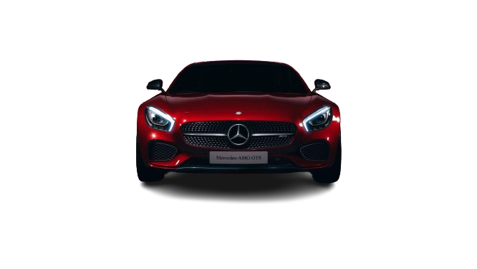
Car Price Prediction
Jamia Hamdard University
( Deemed-to-be university, New Delhi )
Under the supervision of:
Mr. Aqeel Khalique
Mohd Badar Ansari
MCA
2022-501-036

Slide 2
We Will Discuss About
Introduction about the project
Architecture of the Project
What are the Requirement for the project
Models Used in Project
Entities are required
How to built the project step by step (Methodology)
Result of the project

Slide 3
Introduction
This Project is Used to predict the old car price .
It is used to Customers guidance, Negotiation, Research phase about car etc.

Slide 4
Architecture of the model
1
Download Data Set Of Car { Quikr.com }
2
Import and Checking the Data
3
Cleaning the Dataset
Import Models { Linear Regression, Decision Tree, Random Forest Regression and Support Vector Machines (SVM) }
4
5
6
Accuracy
Data Visualization { Matplotlib}

Slide 5
Requirement for the project
Python
Pandas
SciKit Learn
Numpy
Matplotlib
Jupyter Notebook
Dataset

Slide 6
Models
I used Four Different Types of Classifiers:
Linear Regression : Linear regression is a fundamental statistical method used in machine learning for predicting a continuous target variable based on one or more input features
Decision Tree : A decision tree is a popular machine learning algorithm used for both classification and regression tasks.
Random Forest Regression : Random Forest Regression is an ensemble learning method that improves the accuracy and robustness of predictions by combining multiple decision trees.
Support Vector Machine (SVM) : SVM are particularly effective in high-dimensional spaces and are versatile due to their use of different kernel functions

Slide 7
Entities Requirement
Some entities are to be required:
Model name
Company
Year
Price (Market Price)
Kilometer driven

Slide 8
Methodology
Import previous years Dataset of cars : Dataset is import by using pandas library to .ipynb file
Clean the dataset : Some data having missing or incorrect values, using python functions i.e. unique(), is numeric() etc.
Use the Models : Classifiers Models are used by sklearn library. Testing & Training using pipeline is mandatory .
Check the accuracy percentage of the model : Accuracy of percentage must be defined by numpy.
Visualize the model per percentage : Model can be visualized by matplotlib in the form or bar.
Select the model which one having the best percentage : Model can be selected by max(). Which one is having highest percentage of it select that model

Slide 9
Conclusion
When everything is ready in the project, place the required entities and click the 'run' button..
This project's code will provide the predicted price of a car with accurate percentage to the user.

Slide 10
Thank You

