Slide 1

Crowd Flow Prediction in Public Spaces
Smart Visits | Safer Cities

Slide 2

Problem Statement
Managing crowd flow in public spaces like malls, parks, and temples is challenging due to unpredictable human behavior, weather changes, and special events. Without accurate forecasting, this can lead to overcrowding, safety concerns, and poor visitor experiences. There is a need for a data-driven solution that predicts crowd density using historical footfall data, weather conditions, and event schedules to help plan safer and smarter visits.

Slide 3

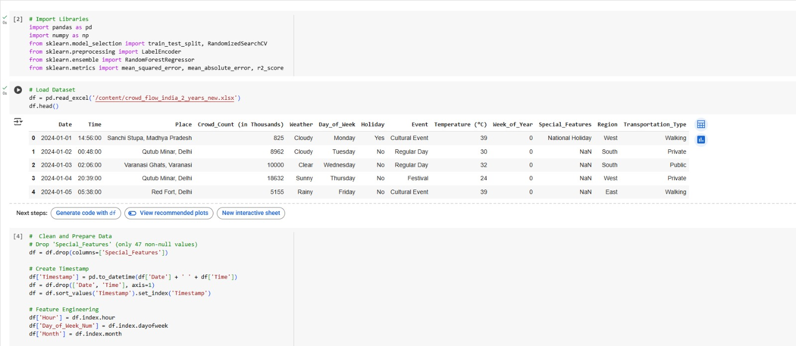
DATA DESCRIPTION

Slide 4
How Are Features Connected?
The correlation matrix reveals strong relationships between crowd count and key features such as weather conditions, day of the week, and special events, helping us understand which factors significantly impact public space traffic.

Slide 5
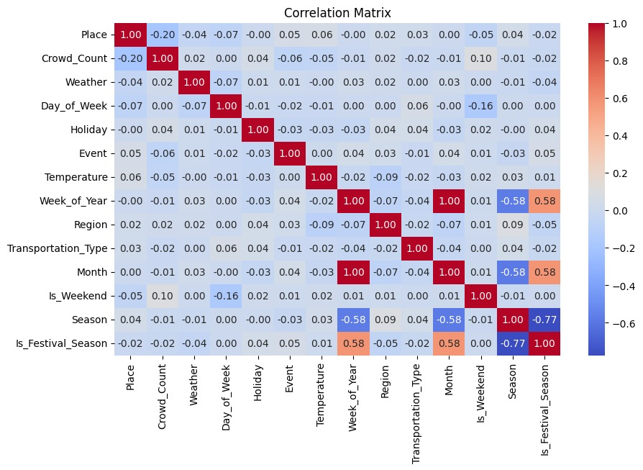
CORRELATION MATRIX

Slide 6
How Crowds Vary Over Time
The distribution shows that crowd counts generally fall within a moderate range, reflecting normal public activity patterns. Rare extremes—either unusually high or low—often correspond to special events, holidays, or unexpected weather conditions.

Slide 7
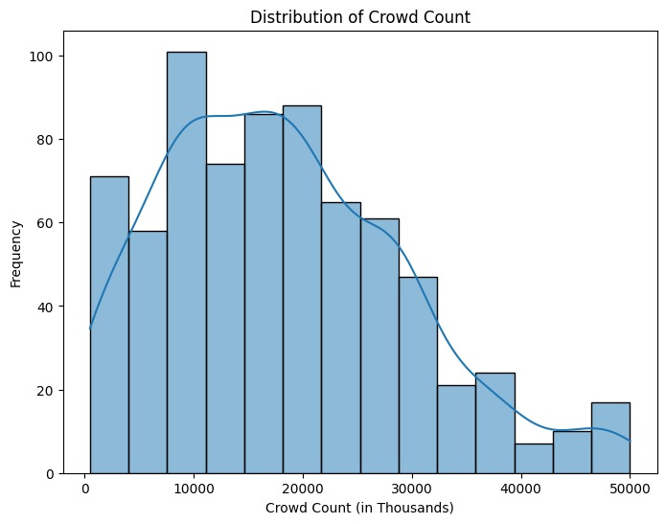
DISTRIBUTION OF CROWD COUNT

Slide 8
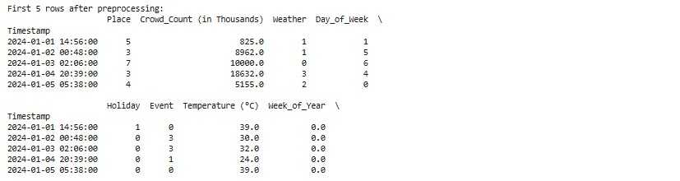
Initial Dataset Insights
The dataset is well-structured, containing key attributes like place, crowd count, weather, day of the week, and event tags—providing a strong foundation for efficient preprocessing, feature engineering, and insightful analysis.

Slide 9
Weather’s Role in Crowding
Analysis shows that extreme heat tends to deter outdoor activity, leading to lower crowd counts, whereas pleasant and moderate weather encourages higher footfall in public spaces

Slide 10
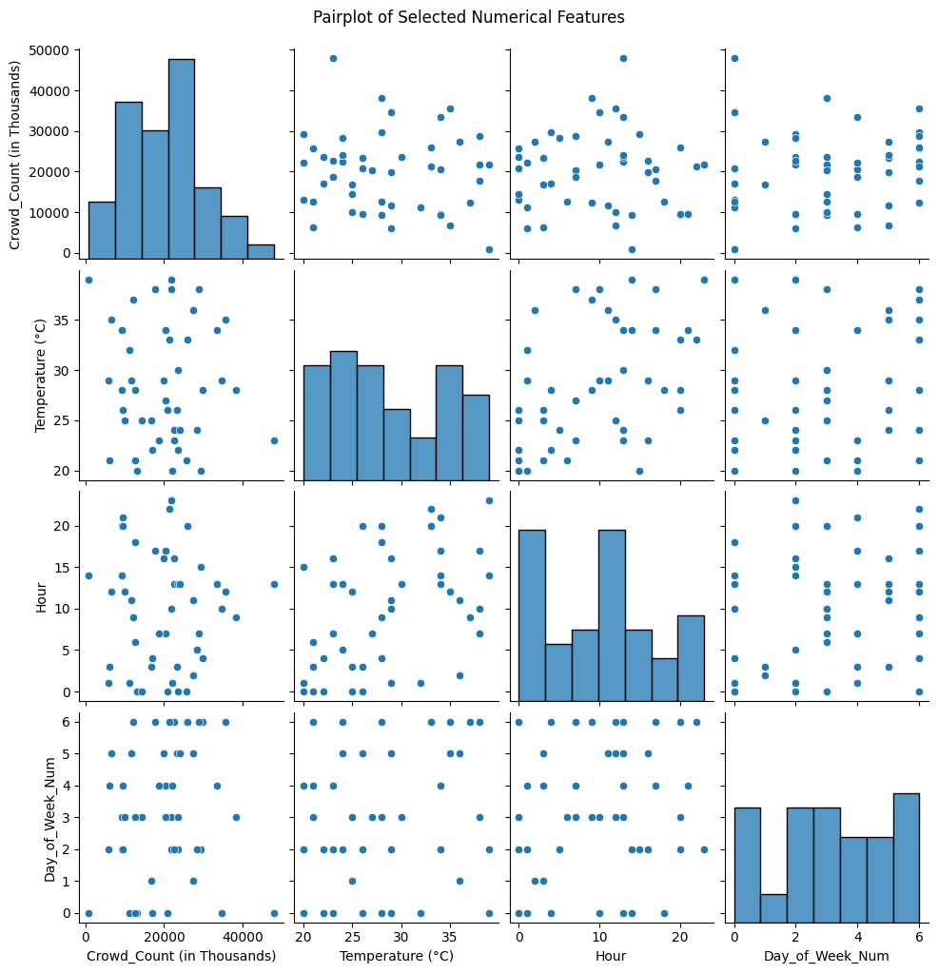
PAIRPLOT WITH NUMERICAL FEATURES

Slide 11
Relationships Between Variables
Building on the pairplot analysis, we observe that weekends consistently show higher crowd levels, while an inverse relationship between temperature and crowd count indicates people avoid going out during extreme weather. These patterns guide predictive feature selection.

Slide 12
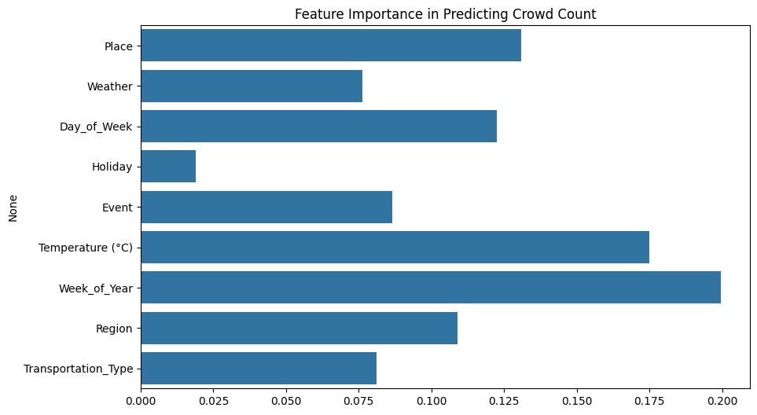
Impact of Time, Events & Holidays

Slide 13
What Drives Crowd Prediction?

Slide 14
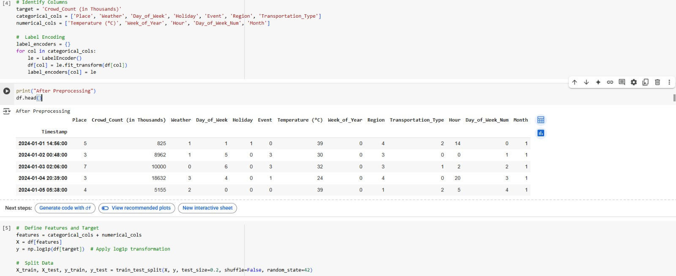
AFTER PREPROCESSING

Slide 15
Feature Engineering in Action
To enhance model performance, categorical features were encoded and numerical values were normalized—ensuring consistent data formatting and improved learning for prediction models.

Slide 16
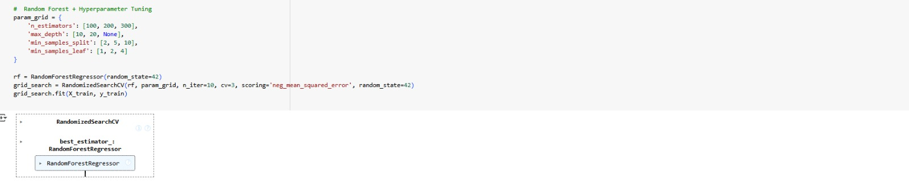
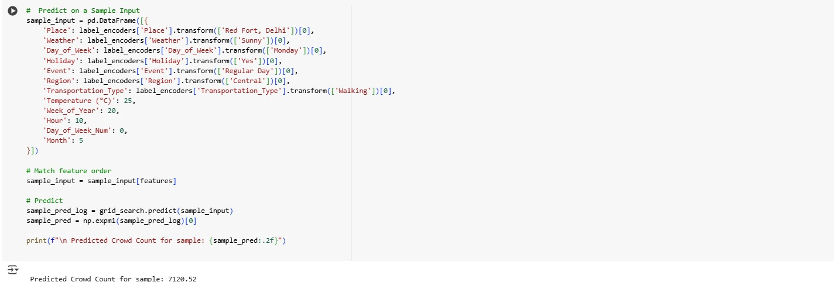
Predictive Model: Random Forest Regressor

Slide 17
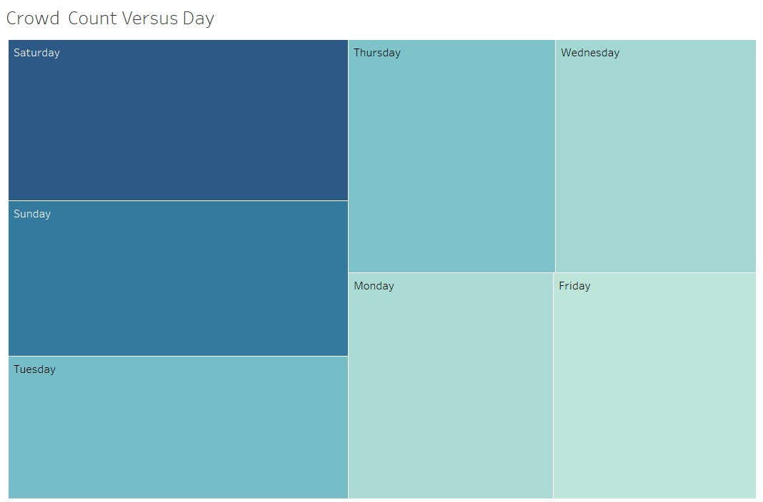
CROWD COUNT/DAY

Slide 18
When Do Crowds Peak?
Crowd trends peak during weekends, largely driven by leisure outings, shopping habits, and cultural or religious gatherings—highlighting predictable surges in public space usage.

Slide 19
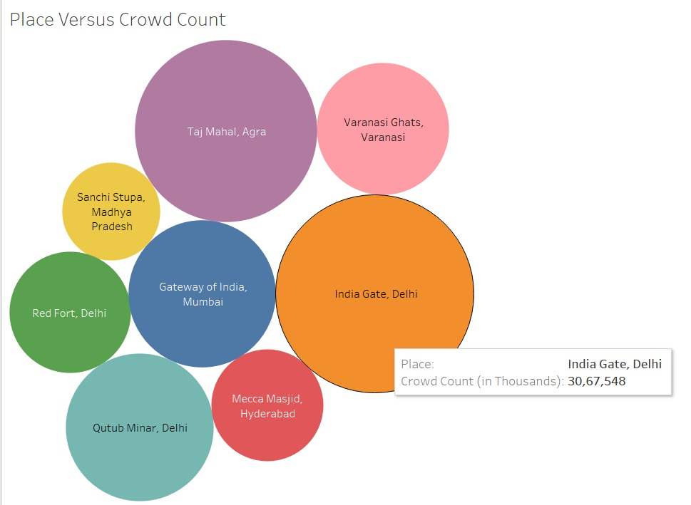
Places VS Crowd Count

Slide 20
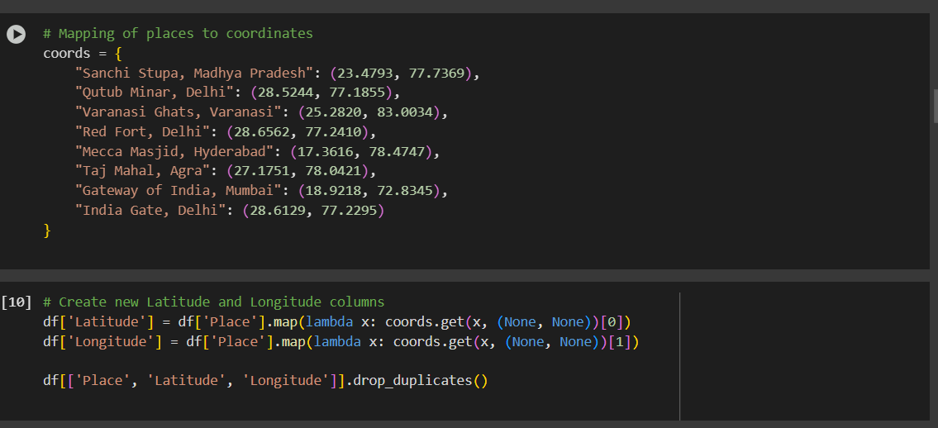
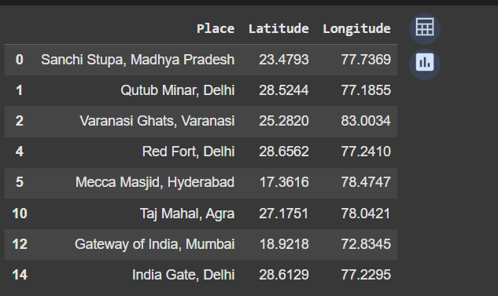
ADDING LATITUDE AND LONGITUDE IN THE DATASET FOR VISUALIZING

Slide 21
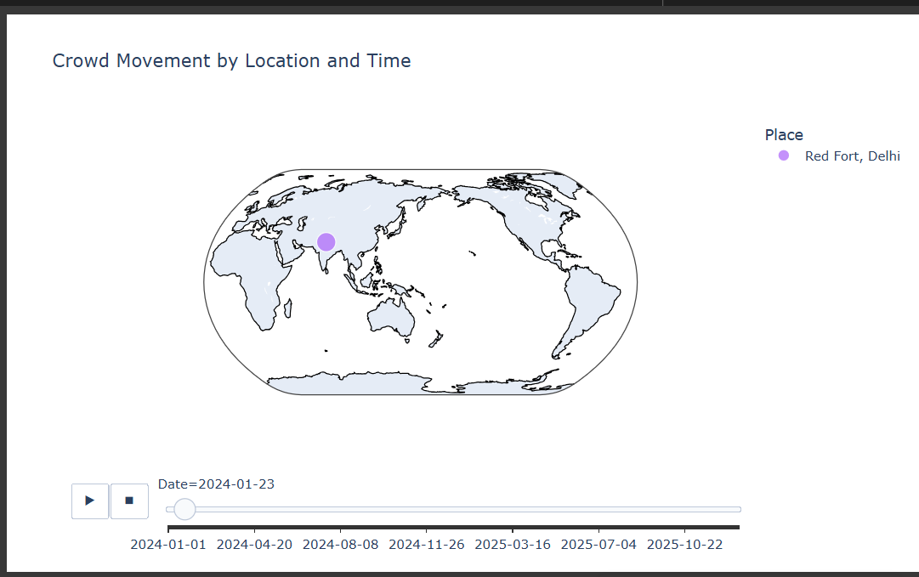
Map Scatter Plot: Geographical Distribution of Crowds

Slide 22
Geographical Crowd Flow Across India
This scatter plot uses latitude and longitude coordinates to map crowd flow across famous Indian landmarks. The size of each marker represents the number of people present (in thousands). It effectively visualizes geospatial crowd patterns and hotspots across different regions of the country.

Slide 23
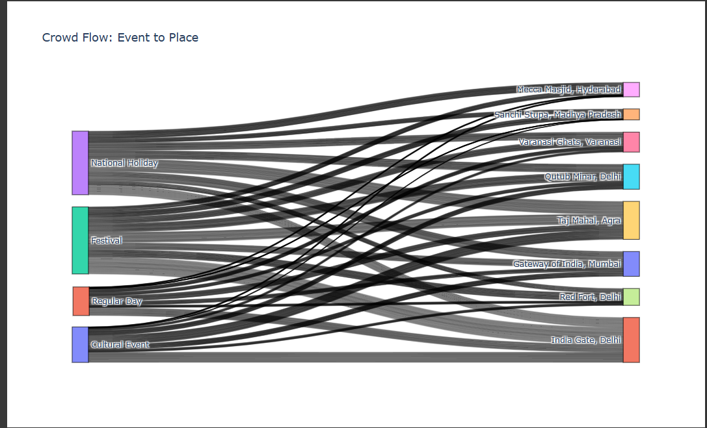
Sankey Diagram: Crowd Flow from Events to Places

Slide 24
Sankey Diagram of Event-Based Crowd Movement
The Sankey Diagram illustrates how crowds are distributed from various event types (like Festivals, Cultural Events, National Holidays, and Regular Days) to popular public places across India.
Thicker flow lines represent higher crowd volumes, providing a visual sense of the intensity and direction of human movement. This chart is useful to identify which events attract the most visitors to specific landmarks, helping in event planning, security deployment, and resource management.

Slide 25
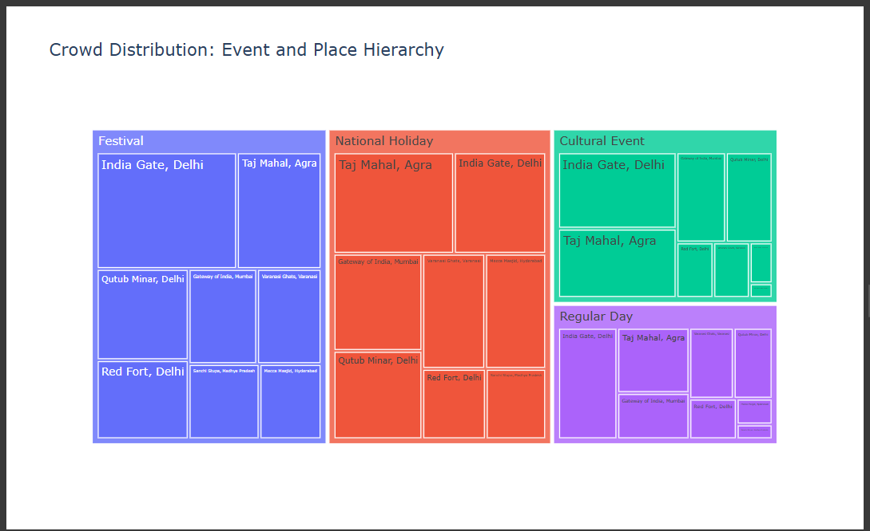
Tree Map: Hierarchical Distribution of Crowd by Event and Place

Slide 26
Tree map of Crowd Distribution by Event and Location
The tree map provides a hierarchical visualization of how crowd sizes are distributed across different event types (festival, national holiday, cultural event, and regular day), and within each event, across various locations.
The size of each rectangle represents the crowd count, helping quickly identify the most visited places under each event category.
For instance, India Gate, Delhi and the Taj Mahal, Agra dominate across multiple event types, showing their popularity. This chart helps in visualizing comparative crowd density in a compact format, ideal for space-efficient insights.

Slide 27
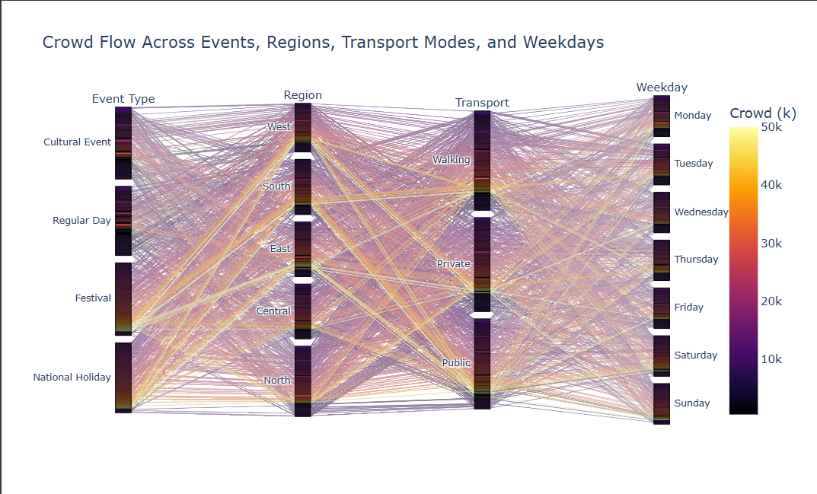
Parallel Categories Plot: Crowd Flow Across Event Type, Region, Transport, and Weekday

Slide 28
Parallel Categories Plot of Crowd Flow by Event, Region, Transport, and Weekday
The Parallel Categories Plot provides a multi-dimensional view of how crowd movement is distributed across several categorical variables — event types, geographic regions, transport modes, and weekdays.
Each line in the plot represents a flow of people, and the color intensity reflects the crowd volume. This visualization helps in identifying patterns such as high crowd density during festivals and national holidays, especially in the North and South regions. Public and private transport modes are prominently used, and weekends tend to witness more activity. This plot effectively conveys complex relationships and patterns in crowd behavior across different categories.

Slide 29
CHALLENGES
📅 Unpredictable Crowd Behavior: Daily and seasonal variations make it hard to forecast accurately.
🌦️ Weather Dependency: Sudden weather changes significantly affect footfall.
🎉 Event Impact: Public holidays and local events cause irregular spikes in crowd density.
📍 Location Variation: Different places (malls, temples, parks) show unique crowd patterns.
🔢 Data Complexity: Handling time-series data with mixed types (numerical, categorical) requires careful preprocessing.
🧠 Model Accuracy: Choosing the right features and models is crucial for reliable predictions.
📊 Visualization: Effectively communicating insights to non-technical stakeholders can be challenging.

Slide 30
FUTURE SCOPE
🌍 Scalability: Extend the model to predict crowd flow in diverse urban locations and tourist destinations globally.
📱 Real-Time Predictions: Integrate real-time weather and event data to provide dynamic crowd predictions for live updates.
🛠️ Advanced Models: Incorporate deep learning techniques, such as LSTM, for more accurate time-series forecasting.
🏙️ Smart City Integration: Use predictions for urban planning, traffic management, and safety measures.
🔄 User Feedback Loop: Implement a feedback mechanism where crowd data is continuously refined based on real-time observations.
🌐 Mobile App: Develop a user-friendly mobile app to deliver personalized crowd predictions to visitors in public spaces.

Slide 31
Conclusion
Insightful Patterns: Crowd trends align with weather, events, and time. 🧠 Accurate Prediction: ML models, especially Random Forest, forecast crowd flow well. 🌦️ Weather Effect: Pleasant days attract crowds; extremes reduce turnout. 🛍️ Peak Times: Weekends and events show consistent crowd surges. 🧭 Practical Use: Supports smart tourism, safety, and congestion control.

