Slide 1
SCRAPY OLX
<p> Faiz Dzakirullail - 2008107010063</p>

Slide 2
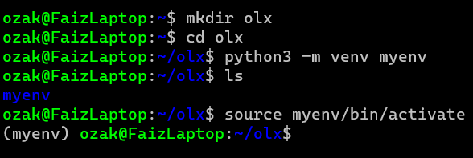
Preperation
First of all, we will create a directory and create a virtual environment for our project.

Slide 3
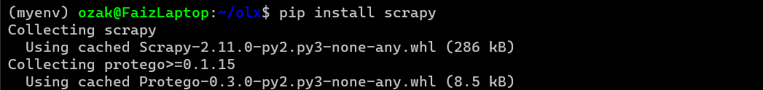
Install SCRAPY
The next step is to install scrapy in that directory

Slide 4
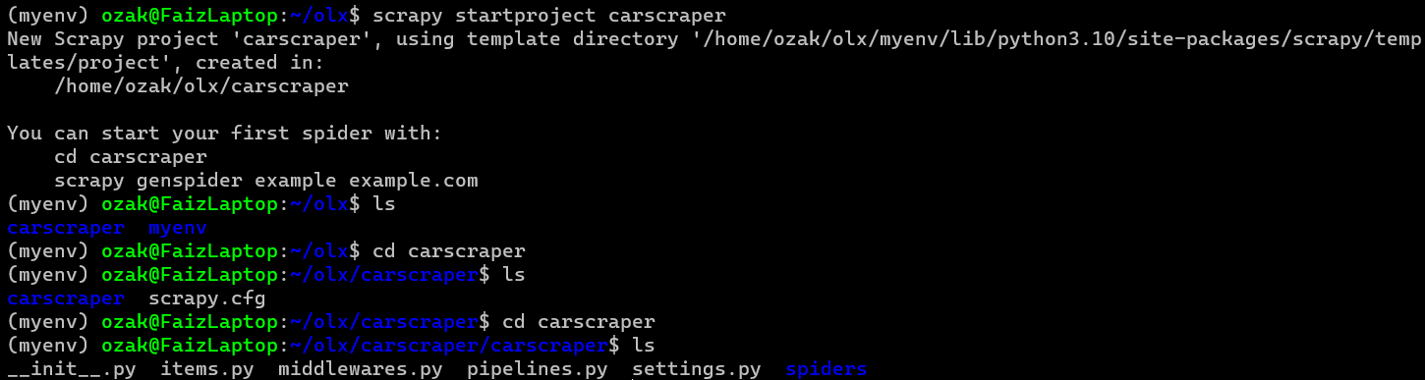
Create Project
using command:
scrapy startproject [name your project]

Slide 5
Create Spider
If you want, your can create spider manually or using a basic template by running this command:
scrapy genspider [name] [link]

Slide 6
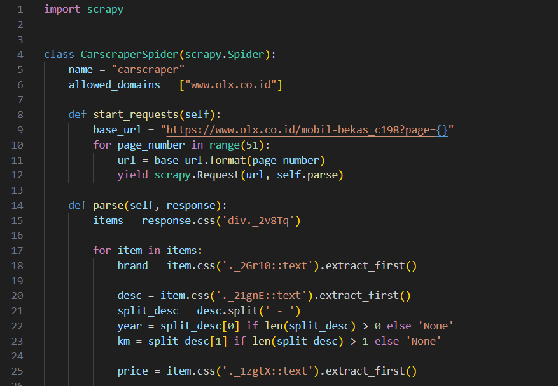
Customize Spider
In this stage we will code the spider according to the needs of this project

Slide 7
Save The Output
save the output that has been crawled using this command :
Scrapy crawl [spider name] –o output.json

